Slide 1
LABTRACK
Laboratory inventory &
equipment borrowing
Project pitch and system walkthrough
Faculty presentation
9 October 2026
01
Notes:
Opening: Good morning. LABTRACK is a laboratory inventory and equipment borrowing platform. It connects the people who borrow equipment with the assistants who issue it and the administrators who manage inventory. The central idea is simple: every physical unit should have an identity, and every loan should have a traceable record.
Project sources:
D:/PROJECTS/LABTRACK/README.md

Slide 2
The laboratory management problem
Availability
A stock count does not explain which physical units are ready to borrow.
Responsibility
A loan needs a named borrower, issuing lab and due date.
Coordination
Requests, approvals and counter handover need a shared record.
Planning
Administrators need usage and shortage information before buying stock.
02
Notes:
Frame these as the problems the project addresses, not findings from a measured campus survey. When inventory and borrowing records are separate, an assistant has to answer several questions manually. Is this unit available? Who took it? When is it due? A count of equipment alone cannot answer those questions.
Project sources:
D:/PROJECTS/LABTRACK/README.md
D:/PROJECTS/LABTRACK/labtrack_implementation_plan.md

Slide 3
The LABTRACK solution
One equipment record.
A complete borrowing history.
Unit identity
Unique asset IDs and QR labels identify each physical item.
Controlled handover
Approval and counter issue connect a request to the actual unit.
Visibility
Status, notifications and reports show what happens after issue.
03
Notes:
Pitch the value without promising measured savings. LABTRACK brings inventory and the borrowing lifecycle into one application. Students and faculty can see equipment and request it. Assistants manage handover and returns. Administrators manage labs, users and reports. The intended benefit is less repeated record keeping and clearer responsibility.
Project sources:
D:/PROJECTS/LABTRACK/README.md
D:/PROJECTS/LABTRACK/src/App.jsx

Slide 4
Four roles, distinct responsibilities
Administrator
Faculty
Manages departments, labs, inventory, accounts and reports.
Borrows equipment and coordinates event or club requests.
Lab assistant
Student
Reviews assigned-lab requests and handles equipment issue and return.
Browses equipment, submits requests and tracks personal loans.
04
Notes:
Explain why four portals matter. Each role has different work to do, so the application shows different pages and the backend also checks permissions. Assistants work within assigned labs. Student and faculty history is scoped to their own activity. Faculty and assistant self-registration requires approval.
Project sources:
D:/PROJECTS/LABTRACK/src/App.jsx
D:/PROJECTS/LABTRACK/backend/app/api/deps.py
D:/PROJECTS/LABTRACK/backend/app/db/models.py

Slide 5
Equipment models and individual units
Equipment model
Illustrative example
Describes a type of equipment, its category and associated lab.
Arduino Uno model
Unit 1, Unit 2 and Unit 3 each carry a distinct asset tag.
Physical unit
Operational result
Stores its asset ID, serial number, current lab, condition and status.
A loan records the exact unit. Other available units can still circulate.
05
Notes:
Use an example: Arduino Uno is an equipment model. Three Arduino Uno boards are three units, each with its own asset ID, condition, status and current lab. The example is illustrative and is not a claim about actual stock. This distinction lets the system record which board a person borrowed rather than just reducing a generic count.
Project sources:
D:/PROJECTS/LABTRACK/backend/app/db/models.py
D:/PROJECTS/LABTRACK/backend/app/services/asset_ids.py

Slide 6
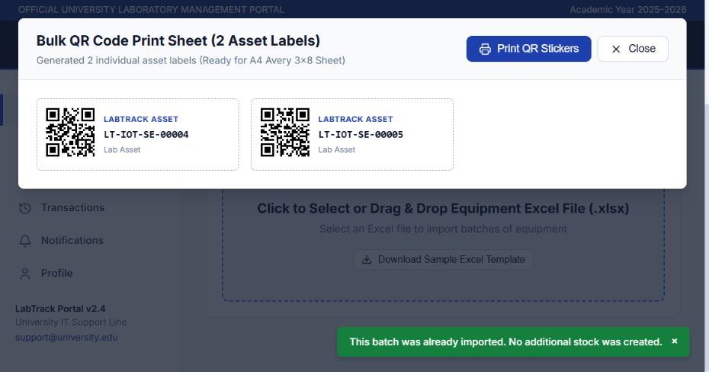
Inventory import and QR labels
Unique identity
Asset IDs link labels to database units.
Batch import
Spreadsheet uploads add inventory in bulk.
Replay protection
A repeated batch returns its existing result.
Project verification screenshot: QR labels and duplicate-upload protection
06
Notes:
The application supports adding inventory and importing equipment spreadsheets. Every unit receives a unique asset ID and a QR label. The import batch records a content hash per lab so replaying a completed upload does not add the same stock again. The screenshot is existing browser verification evidence with synthetic data, not live inventory.
Project sources:
D:/PROJECTS/LABTRACK/backend/app/services/asset_ids.py
D:/PROJECTS/LABTRACK/backend/app/db/models.py
D:/PROJECTS/LABTRACK/audit-artifacts/verified-upload-replay.png

Slide 7
Standard borrowing workflow
01 Request
Borrower selects equipment, quantity, purpose and required dates.
02 Review
Authorized staff approve or reject the request.
03 Counter issue
Assistant identifies the borrower and assigns an available physical unit.
04 Return
Assistant records the return and condition, then closes the loan.
07
Notes:
Walk through the normal student or faculty reservation. First the borrower chooses a model, quantity and dates. The request enters pending review. An authorized assistant or administrator reviews it for that lab. Approval does not itself mean the item has been physically handed over. At checkout, the assistant identifies the borrower and specific asset. The system creates an active loan. On return, the loan closes and the unit status changes.
Project sources:
D:/PROJECTS/LABTRACK/backend/app/api/endpoints/borrowing.py
D:/PROJECTS/LABTRACK/src/pages/requests/RequestEquipmentPage.jsx

Slide 8
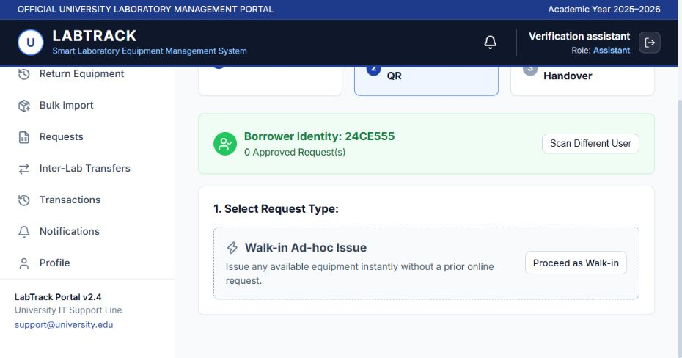
Counter issue and borrower identification
Borrower identity
Enter or scan the registered institutional ID.
Asset identity
Scan or enter the unit asset tag.
Backend checks
Validate the model, owning lab and available status.
Project verification screenshot: institutional ID resolves a borrower
08
Notes:
The assistant can scan or enter an institutional ID. Exact lookup resolves the registered borrower, including IDs such as 24CE555. The assistant then uses an approved request or the walk-in issue flow. Manual entry provides a fallback if camera scanning is unavailable. QR scanning helps identify an asset, but the backend still checks that it matches the requested model, lab and availability. Physical camera scanning still needs device validation.
Project sources:
D:/PROJECTS/LABTRACK/src/pages/operations/IssueEquipmentPage.jsx
D:/PROJECTS/LABTRACK/backend/app/api/endpoints/borrowing.py
D:/PROJECTS/LABTRACK/audit-artifacts/student-id-only-lookup.png

Slide 9
Returns and equipment condition
Return record
Maintenance
Stores return date and condition remarks against the active loan.
Damage-related remarks move the unit to maintenance.
Ready for another borrower
Overdue tracking
A normal return makes the equipment unit available.
An active loan becomes overdue when its due date has passed.
09
Notes:
Returns preserve accountability. The assistant finds the active loan using the asset ID and records remarks. A normal return makes the unit available. In the current implementation, remarks containing damage-related words send the unit to maintenance. This is a simple keyword rule, not automated inspection. A multi-unit request reaches returned status when no active loans remain. Overdue is calculated from an active loan whose due date is in the past.
Project sources:
D:/PROJECTS/LABTRACK/backend/app/api/endpoints/borrowing.py
D:/PROJECTS/LABTRACK/backend/app/db/models.py

Slide 10
Faculty event and club requests
Faculty submission
Choose a lab, equipment types, quantities and event details.
Assistant allocation
Select the exact units that match the requested quantities.
Approval and issue
Recheck availability and create the event loans together.
Decision visibility
Faculty can track approval or the recorded rejection reason.
10
Notes:
Describe the current source implementation, which now accepts equipment types and quantities. Faculty select a lab, event details, return date and the required equipment quantities. The assigned active assistant reviews the request and chooses exact asset units. Allocation must match the requested models and quantities. Approval locks the request and units, rechecks stock and issues the batch in one transaction. A pending event request does not reserve stock. Rejection records a reason and leaves units available.
Project sources:
D:/PROJECTS/LABTRACK/backend/app/api/endpoints/events.py
D:/PROJECTS/LABTRACK/backend/app/api/endpoints/borrowing.py
D:/PROJECTS/LABTRACK/src/pages/operations/EventIssuePage.jsx

Slide 11
Other equipment circulation flows
Walk-in issue
Assistant records a direct counter loan without a prior reservation.
Faculty quick borrow
A short counter loan supports same-day equipment use.
Inter-lab transfer
Admin approval marks units in transit. Receiving staff complete the move.
11
Notes:
These workflows address different situations. Walk-in issue lets an assistant issue available equipment without a prior online reservation. Quick borrow serves short faculty loans with a due time at the end of the day. Inter-lab transfers use a pending and approved workflow, marking units in transit until the receiving assistant completes the transfer. The backend supports transfers, but the current frontend ownership/status display still needs reconciliation.
Project sources:
D:/PROJECTS/LABTRACK/backend/app/api/endpoints/borrowing.py
D:/PROJECTS/LABTRACK/backend/app/api/endpoints/transfers.py
D:/PROJECTS/LABTRACK/audit-artifacts/GMAIL_STARTUP_UPDATES.md

Slide 12
System architecture
Browser interface
React 19, Vite, React Router and Axios
Application API
FastAPI validates requests and applies role and workflow rules.
Data layer
SQLAlchemy and PostgreSQL persist equipment, requests and loans.
Supporting services
Alembic migrations, portal notifications and an optional email outbox
12
Notes:
Describe the request path in plain terms. A user interacts with React pages. The shared Axios client calls FastAPI endpoints. FastAPI validates the request, checks the current user and runs workflow rules. SQLAlchemy queries PostgreSQL and commits changes. The API returns data to update the interface. Alembic manages schema changes. Email uses an optional persistent outbox rather than being required for a loan to succeed.
Project sources:
D:/PROJECTS/LABTRACK/package.json
D:/PROJECTS/LABTRACK/src/api/client.js
D:/PROJECTS/LABTRACK/backend/app/api/api_router.py
D:/PROJECTS/LABTRACK/backend/app/db/database.py
D:/PROJECTS/LABTRACK/backend/app/services/email_notifications.py

Slide 13
Core database relationships
Inventory hierarchy
Event relationship
Department contains labs.
Equipment model contains individual units.
Event request captures faculty demand.
Event issue links the approved batch loans.
Borrowing relationship
Supporting records
User submits a request.
Transaction connects it to a physical unit.
Lab assignments, transfers, notifications and import batches preserve context.
13
Notes:
Explain the relational design. A department contains labs. An equipment model has many units. A request links a borrower to a model and quantity. A transaction links that borrower and request to one physical unit. Event requests and event issues connect batch loans to their faculty coordinator. Foreign keys maintain those relationships. Supporting records hold transfers, lab assignments, policies and notifications.
Project sources:
D:/PROJECTS/LABTRACK/backend/app/db/models.py

Slide 14
Permissions and data integrity
Account access
Password hashing, expiring JWT sessions and active-account checks
Operation scope
Backend role permissions and assigned-lab checks
Asset consistency
Unique asset tags and one active loan per physical unit
Event allocation
Row locks and a single commit protect batch approval and issue.
14
Notes:
Avoid calling the entire application production-secure. Describe concrete controls: passwords are hashed with bcrypt, JWT tokens carry identity and expiry, and the backend resolves the current active user. Endpoint permissions and assigned-lab checks limit operations. Asset counters allocate unique ranges. A database partial unique index prevents multiple active loans for one asset. Event approval uses row locks and a single database transaction. These controls reduce specific risks, while remaining bugs and deployment checks still need work.
Project sources:
D:/PROJECTS/LABTRACK/backend/app/core/security.py
D:/PROJECTS/LABTRACK/backend/app/api/deps.py
D:/PROJECTS/LABTRACK/backend/app/db/models.py
D:/PROJECTS/LABTRACK/backend/app/services/asset_ids.py
D:/PROJECTS/LABTRACK/backend/app/api/endpoints/events.py

Slide 15
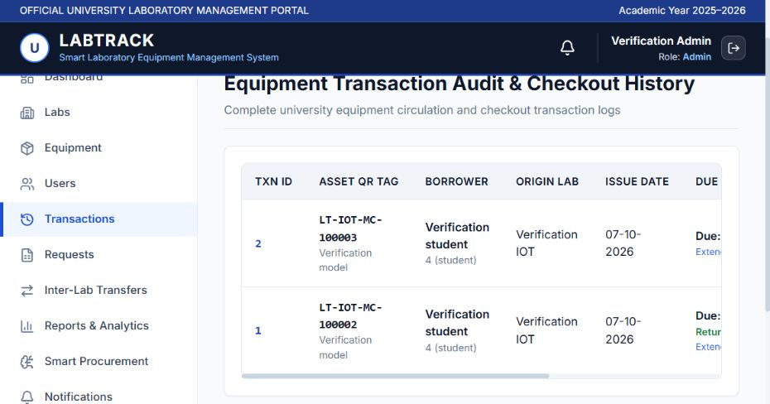
Transaction history and notifications
Traceable loans
Asset, borrower, lab and loan dates stay linked.
Portal updates
Workflow notifications explain status changes.
Optional email
Queued delivery needs provider setup and authorization.
Project verification screenshot: equipment checkout history
15
Notes:
The transaction history is the traceability layer. A loan records the physical asset, borrower, lab and relevant dates. Portal notifications communicate workflow outcomes. Optional Gmail API or SMTP delivery uses a database queue with retries. Live email remains disabled until authorization and provider configuration are completed. The screenshot is test evidence and uses synthetic accounts.
Project sources:
D:/PROJECTS/LABTRACK/backend/app/db/models.py
D:/PROJECTS/LABTRACK/backend/app/services/email_notifications.py
D:/PROJECTS/LABTRACK/backend/MAIL_SETUP.md
D:/PROJECTS/LABTRACK/audit-artifacts/date-only-transactions.png

Slide 16
Reports and procurement suggestions
Operational reports
Purchase prompts
Available, issued and maintenance stock
Active loans and overdue loans
Empty stock, high utilization or pending demand trigger suggestions.
Usage reports
Current method
Monthly borrowing trends
Lab utilization and most-used equipment
Rules use stored counts.
Administrators still make purchasing decisions.
16
Notes:
The reporting endpoints derive counts and trends from stored records. They report stock status, active and overdue loans, monthly borrowing and lab utilization. Procurement suggestions are rule-based. The current code suggests initial stock for an empty model, more units when utilization exceeds 80 percent, or additional stock when the count of pending requests exceeds available units. The pending metric counts requests, not total requested quantity. These are planning prompts, not machine-learning forecasts or automatic purchases.
Project sources:
D:/PROJECTS/LABTRACK/backend/app/api/endpoints/analytics.py
D:/PROJECTS/LABTRACK/src/pages/analytics/ReportsAnalyticsPage.jsx
D:/PROJECTS/LABTRACK/src/pages/analytics/SmartProcurementPage.jsx

Slide 17
Current progress and remaining work
Implemented in source
Workflow completion
Inventory and QR labels, borrowing, event approvals, reports and notifications
Extension review and transfer display need further work. Some actions remain placeholders.
Recorded verification
Deployment validation
API regressions, database migration checks, frontend build and selected browser flows
Live email, physical camera scanning and full container deployment need verification.
17
Notes:
Be candid in the faculty evaluation. The current source contains inventory, borrowing, event approvals, reports and portal notifications. Repository verification reports document regression checks on disposable databases and successful builds. Those reports do not prove the latest working tree, every user journey or public deployment is complete. Known remaining work includes extension review integration, transfer display consistency, placeholder account/procurement actions and automatic overdue scheduling. Real email and physical camera scanning require external validation.
Project sources:
D:/PROJECTS/LABTRACK/audit-artifacts/EVENT_ID_UPDATES.md
D:/PROJECTS/LABTRACK/audit-artifacts/GMAIL_STARTUP_UPDATES.md
D:/PROJECTS/LABTRACK/README.md

Slide 18
Demonstration sequence
01 Browse and request
Show available equipment, then submit a borrowing request.
02 Approve and issue
Use the assistant portal and assign the specific asset.
03 Return and inspect history
Close the loan and show the equipment status and transaction record.
04 Show an event request
Explain faculty quantities and assistant selection of physical units.
18
Notes:
Use a prepared development database and accounts, not real users. First show inventory and an available unit. Switch to a student or faculty account and submit a standard request. Switch to the assigned assistant to approve and issue the unit. Show that the loan is active. Return the item and show its available status and transaction history. If time allows, show the faculty event request and assistant allocation. If a live screen fails, the verification screenshots in this deck provide a fallback. This is a proposed presentation sequence, not a claim that a fresh end-to-end rehearsal has run.
Project sources:
D:/PROJECTS/LABTRACK/README.md
D:/PROJECTS/LABTRACK/src/App.jsx

Slide 19
The project’s contribution
Every unit has an identity.
Every loan has a responsible borrower.
Next step: complete remaining workflows
and validate a pilot in one laboratory.
Questions & discussion
19
Notes:
Closing: LABTRACK demonstrates how a laboratory can connect inventory to the people and processes that use it. Its main contribution is traceability at the physical-unit level, with responsibilities separated across roles. The next step is to complete the remaining workflows and validate a small pilot with one lab. Do not claim that the pilot has already happened. Thank the faculty and invite questions.
Project sources:
D:/PROJECTS/LABTRACK/README.md
D:/PROJECTS/LABTRACK/backend/app/db/models.py

