Slide 1

Chapter 6
Bandwidth Utilization:
Multiplexing and Spreading
6.<number>
Copyright © The McGraw-Hill Companies, Inc. Permission required for reproduction or display.

Slide 2

Note
Bandwidth utilization is the wise use of
available bandwidth to achieve
specific goals.
Efficiency can be achieved by multiplexing; i.e., sharing of the bandwidth between multiple users.
6.<number>

Slide 3
6-1 MULTIPLEXING
Whenever the bandwidth of a medium linking two devices is greater than the bandwidth needs of the devices, the link can be shared. Multiplexing is the set of techniques that allows the (simultaneous) transmission of multiple signals across a single data link. As data and telecommunications use increases, so does traffic.
Topics discussed in this section:
Frequency-Division Multiplexing
Wavelength-Division Multiplexing
Synchronous Time-Division Multiplexing
Statistical Time-Division Multiplexing
6.<number>

Slide 4

Figure 6.1 Dividing a link into channels
6.<number>

Slide 5

Figure 6.2 Categories of multiplexing
6.<number>

Slide 6

Figure 6.3 Frequency-division multiplexing (FDM)
6.<number>

Slide 7
Note
FDM is an analog multiplexing technique that combines analog signals.
It uses the concept of modulation discussed in Ch 5.
6.<number>

Slide 8

Figure 6.4 FDM process
6.<number>

Slide 9

FM
6.<number>

Slide 10

Figure 6.5 FDM demultiplexing example
6.<number>

Slide 11
Note
WDM is an analog multiplexing technique to combine optical signals.
6.<number>

Slide 12

Figure 6.11 Prisms in wavelength-division multiplexing and demultiplexing
6.<number>

Slide 13

Figure 6.12 Time Division Multiplexing (TDM)
6.<number>

Slide 14
Note
TDM is a digital multiplexing technique for combining several low-rate digital
channels into one high-rate one.
6.<number>

Slide 15

Figure 6.13 Synchronous time-division multiplexing
6.<number>

Slide 16
Note
In synchronous TDM, the data rate
of the link is n times faster, and the unit duration is n times shorter.
6.<number>

Slide 17

Figure 6.14 Example 6.6
6.<number>

Slide 18
Interleaving
The process of taking a group of bits from each input line for multiplexing is called interleaving.
We interleave bits (1 - n) from each input onto one output.
6.<number>

Slide 19

Figure 6.15 Interleaving
6.<number>

Slide 20
Data Rate Management
Not all input links maybe have the same data rate.
Some links maybe slower. There maybe several different input link speeds
There are three strategies that can be used to overcome the data rate mismatch: multilevel, multislot and pulse stuffing
6.<number>

Slide 21
Data rate matching
Multilevel: used when the data rate of the input links are multiples of each other.
Multislot: used when there is a GCD between the data rates. The higher bit rate channels are allocated more slots per frame, and the output frame rate is a multiple of each input link.
Pulse Stuffing: used when there is no GCD between the links. The slowest speed link will be brought up to the speed of the other links by bit insertion, this is called pulse stuffing.
6.<number>

Slide 22

Figure 6.19 Multilevel multiplexing
6.<number>

Slide 23

Figure 6.20 Multiple-slot multiplexing
6.<number>

Slide 24

Figure 6.21 Pulse stuffing
6.<number>

Slide 25
Synchronization
To ensure that the receiver correctly reads the incoming bits, i.e., knows the incoming bit boundaries to interpret a “1” and a “0”, a known bit pattern is used between the frames.
The receiver looks for the anticipated bit and starts counting bits till the end of the frame.
Then it starts over again with the reception of another known bit.
These bits (or bit patterns) are called synchronization bit(s).
They are part of the overhead of transmission.
6.<number>

Slide 26

Figure 6.22 Framing bits
6.<number>

Slide 27

Figure 6.23 Digital hierarchy
6.<number>

Slide 28

Table 6.1 DS and T line rates
6.<number>

Slide 29

Figure 6.24 T-1 line for multiplexing telephone lines
6.<number>

Slide 30

Figure 6.25 T-1 frame structure
6.<number>

Slide 31

Table 6.2 E line rates
6.<number>

Slide 32
Inefficient use of Bandwidth
Sometimes an input link may have no data to transmit.
When that happens, one or more slots on the output link will go unused.
That is wasteful of bandwidth.
6.<number>

Slide 33

Figure 6.18 Empty slots
6.<number>

Slide 34

Figure 6.26 TDM slot comparison
6.<number>

Slide 35
6-1 SPREAD SPECTRUM
In spread spectrum (SS), we combine signals from different sources to fit into a larger bandwidth, but our goals are to prevent eavesdropping and jamming. To achieve these goals, spread spectrum techniques add redundancy.
Topics discussed in this section:
Frequency Hopping Spread Spectrum (FHSS)
Direct Sequence Spread Spectrum (DSSS)
6.<number>

Slide 36
Spread Spectrum
A signal that occupies a bandwidth of B, is spread out to occupy a bandwidth of B_{ss}
All signals are spread to occupy the same bandwidth B_{ss}
Signals are spread with different codes so that they can be separated at the receivers.
Signals can be spread in the frequency domain or in the time domain.
6.<number>

Slide 37

Figure 6.27 Spread spectrum
6.<number>

Slide 38

Figure 6.28 Frequency hopping spread spectrum (FHSS)
6.<number>

Slide 39

Figure 6.29 Frequency selection in FHSS
6.<number>

Slide 40

Figure 6.30 FHSS cycles
6.<number>

Slide 41

Figure 6.31 Bandwidth sharing
6.<number>

Slide 42

Figure 6.32 DSSS
6.<number>

Slide 43

Figure 6.33 DSSS example
6.<number>

Slide 44
Note
SONET was developed by ANSI; SDH was developed by ITU-T.
17.<number>

Slide 45
17-1 ARCHITECTURE
Let us first introduce the architecture of a SONET system: signals, devices, and connections.
Topics discussed in this section:
Signals
SONET Devices Connections
17.<number>

Slide 46
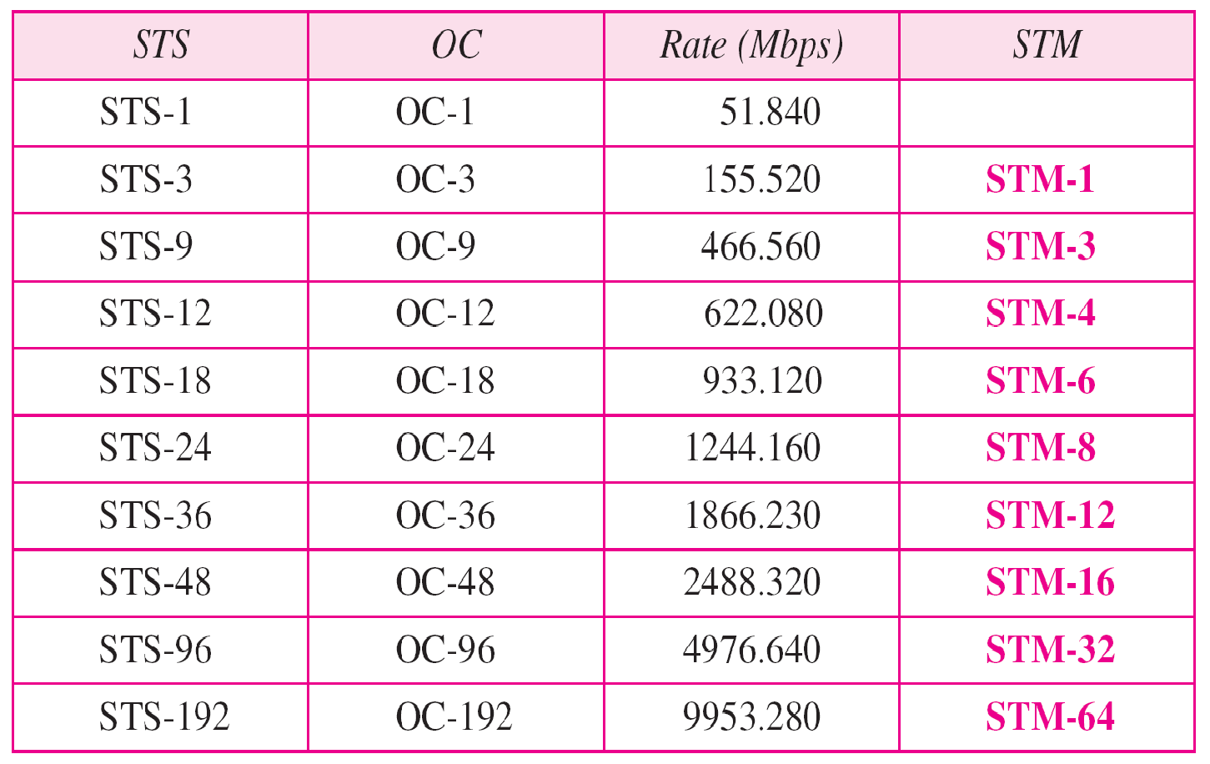
Table 17.1 SONET/SDH rates
17.<number>

Slide 47
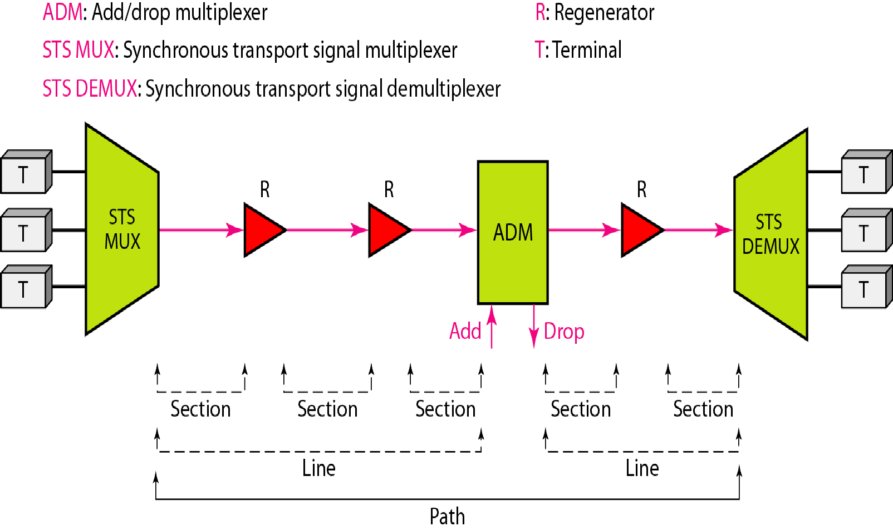
Figure 17.1 A simple network using SONET equipment
17.<number>

Slide 48
17-2 SONET LAYERS
The SONET standard includes four functional layers: the photonic,, the section,, the line,, and the path layer. They correspond to both the physical and the data link layers.
Topics discussed in this section:
Path Layer Line Layer Section Layer Photonic Layer
Device–Layer Relationships
17.<number>

Slide 49

Note
SONET defines four layers: path, line, section, and photonic.
17.<number>

Slide 50
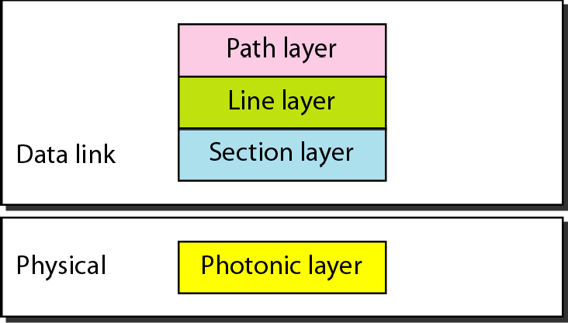
Figure 17.2 SONET layers compared with OSI or the Internet layers
17.<number>

Slide 51
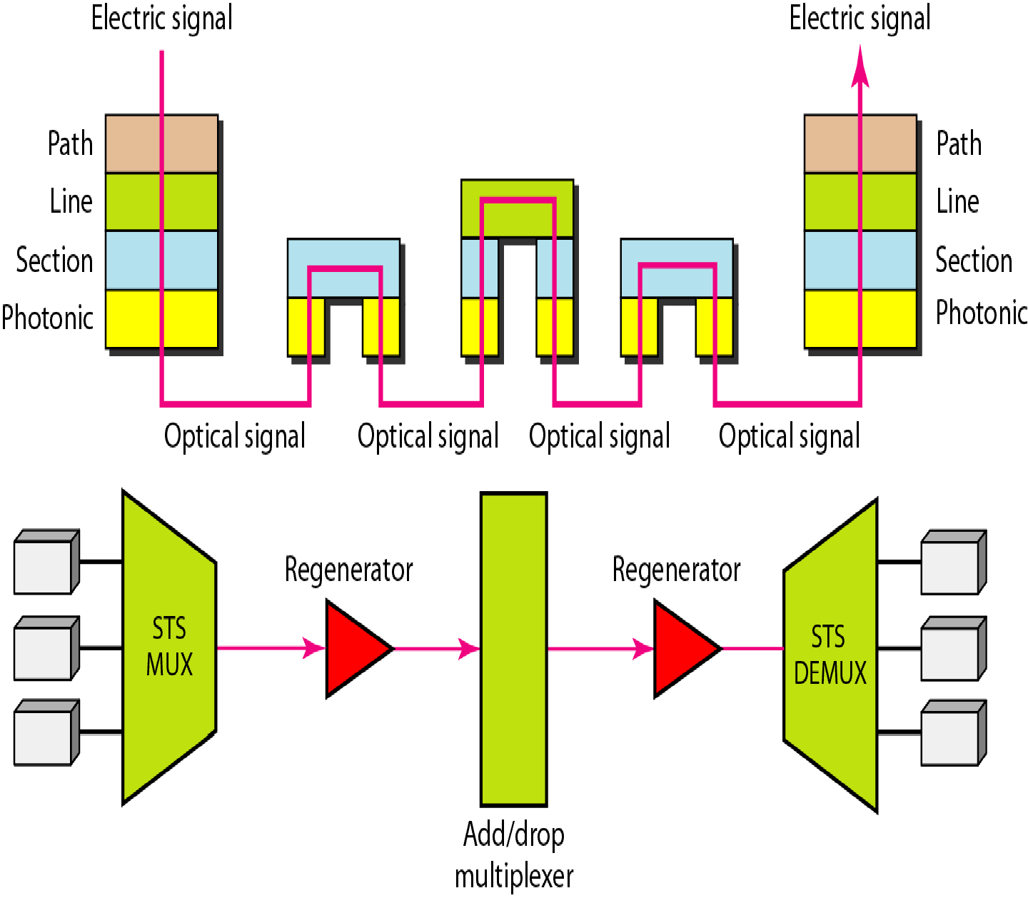
Figure 17.3 Device–layer relationship in SONET
17.<number>

Slide 52
17-3 SONET FRAMES
Each synchronous transfer signal STS-n is composed of 8000 frames. Each frame is a two-dimensional matrix of bytes with 9 rows by 90 × n columns..
Topics discussed in this section: Frame, Byte, and Bit Transmission STS-1 Frame Format Encapsulation

Slide 53
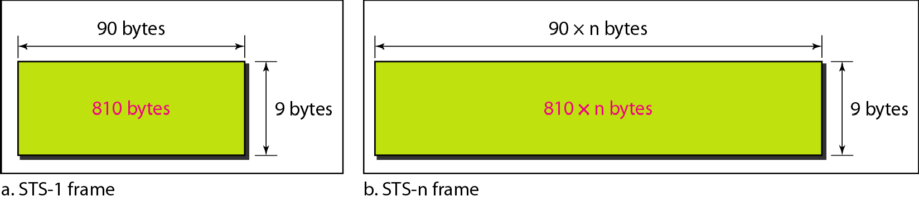
Figure 17.4 An STS-1 and an STS-n frame

Slide 54
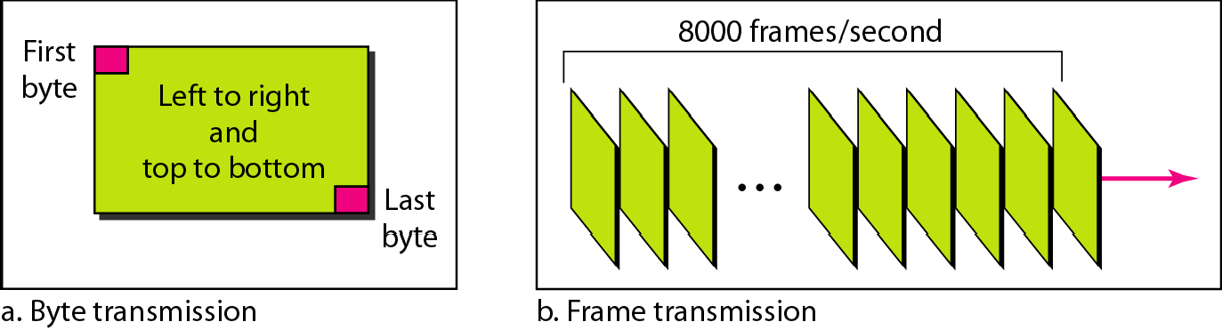
Figure 17.5 STS-1 frames in transmission

Slide 55
Note
A SONET STS-n
signal is transmitted at 8000 frames per second.

Slide 56
Note
Each byte in a SONET frame can carry a digitized voice channel.

Slide 57
Note
In SONET, the data rate of an STS-n signal is n times the data rate
of an STS-1 signal.

Slide 58
Note
In SONET,
the duration of any frame is 125 μs.

Slide 59
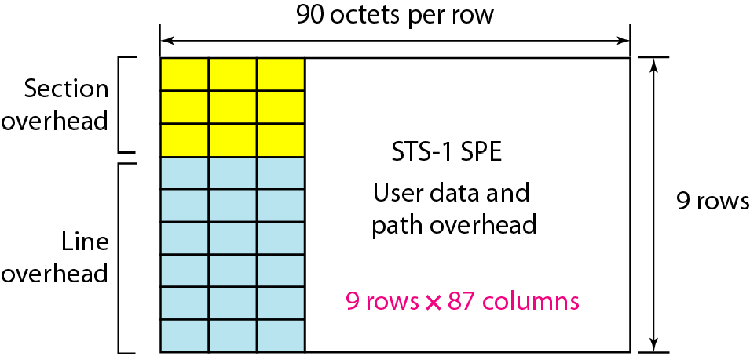
Figure 17.6 STS-1 frame overheads

Slide 60
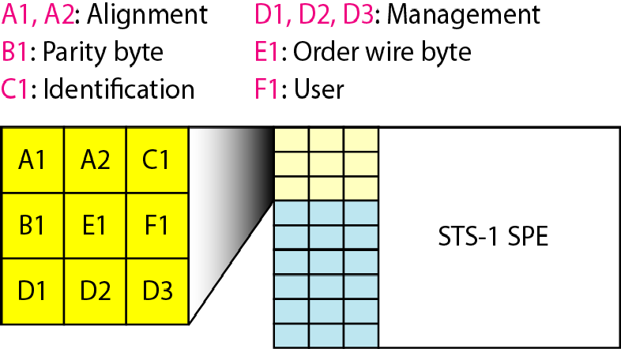
Figure 17.7 STS-1 frame: section overhead

Slide 61
Note
Section overhead is recalculated for each SONET device
(regenerators and multiplexers).

Slide 62
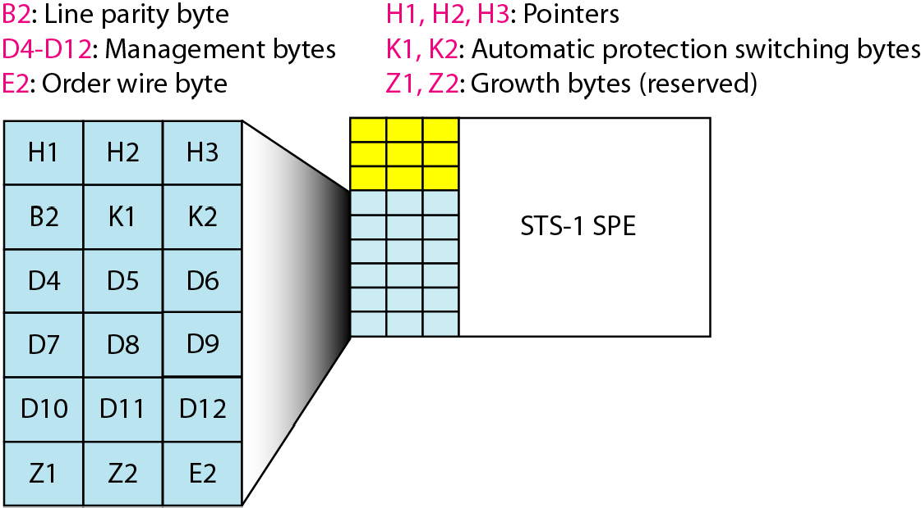
Figure 17.8 STS-1 frame: line overhead

Slide 63
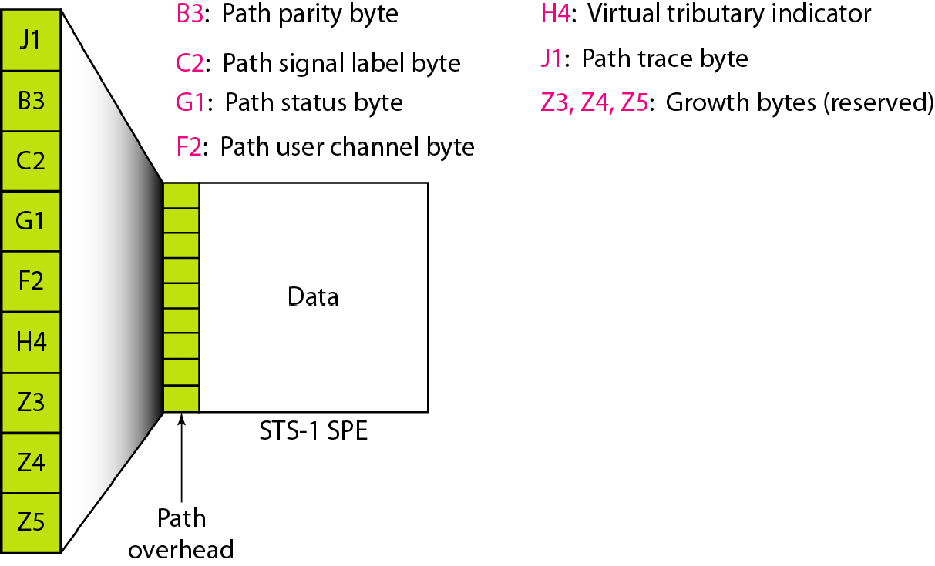
Figure 17.9 STS-1 frame: path overhead

Slide 64
Note
Path overhead is only calculated for end-to-end (at STS multiplexers).

Slide 65
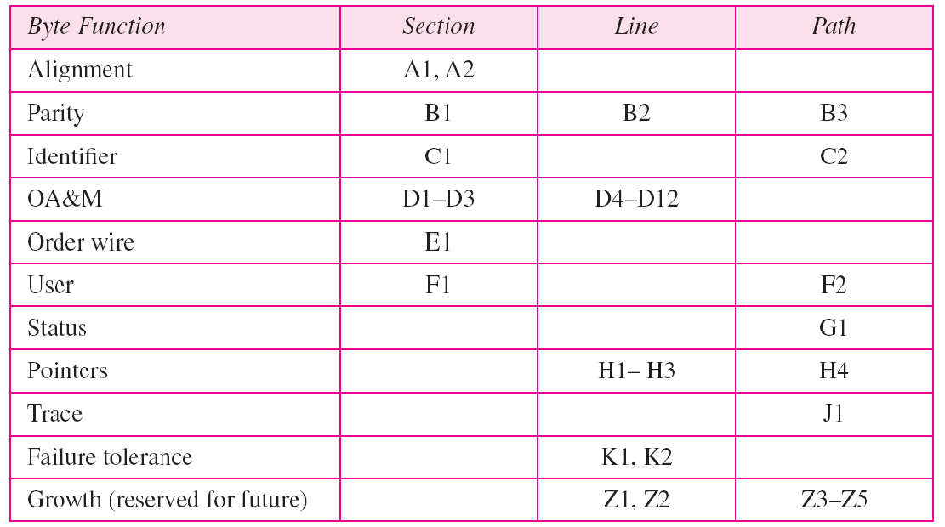
Table 17.2 Overhead bytes

Slide 66
17-5 SONET NETWORKS
Using SONET equipment, we can create a SONET network that can be used as a high-speed backbone carrying loads from other networks.. We can roughly divide SONET networks into three categories: linear,, ring,, and mesh networks..
Topics discussed in this section:
Linear Networks Ring Networks Mesh Networks

Slide 67
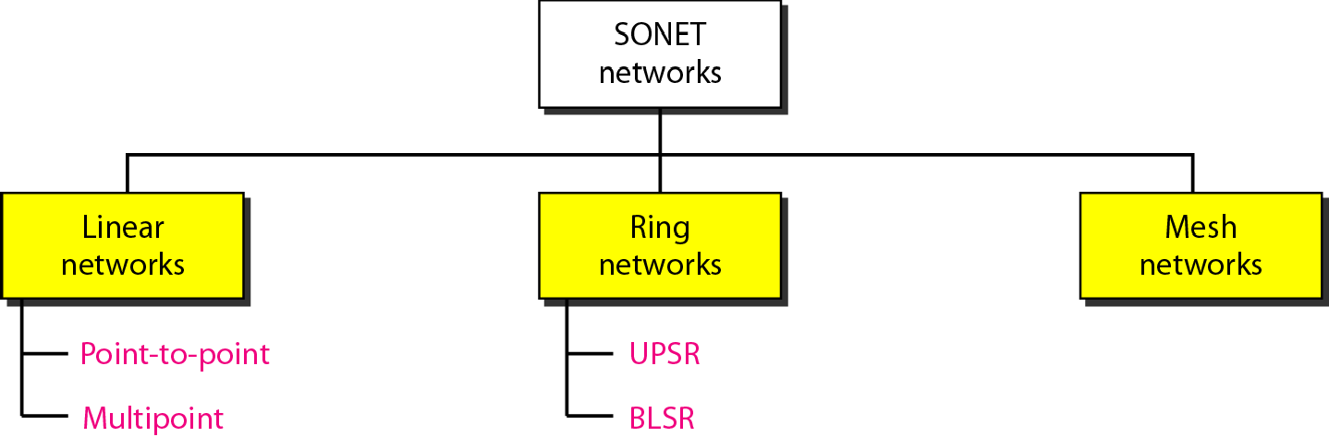
Figure 17.17 Taxonomy of SONET networks

Slide 68
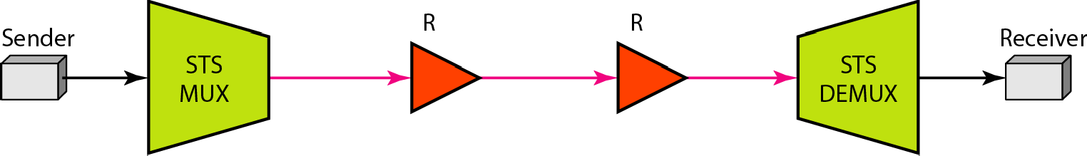
Figure 17.18 A point-to-point SONET network

Slide 69
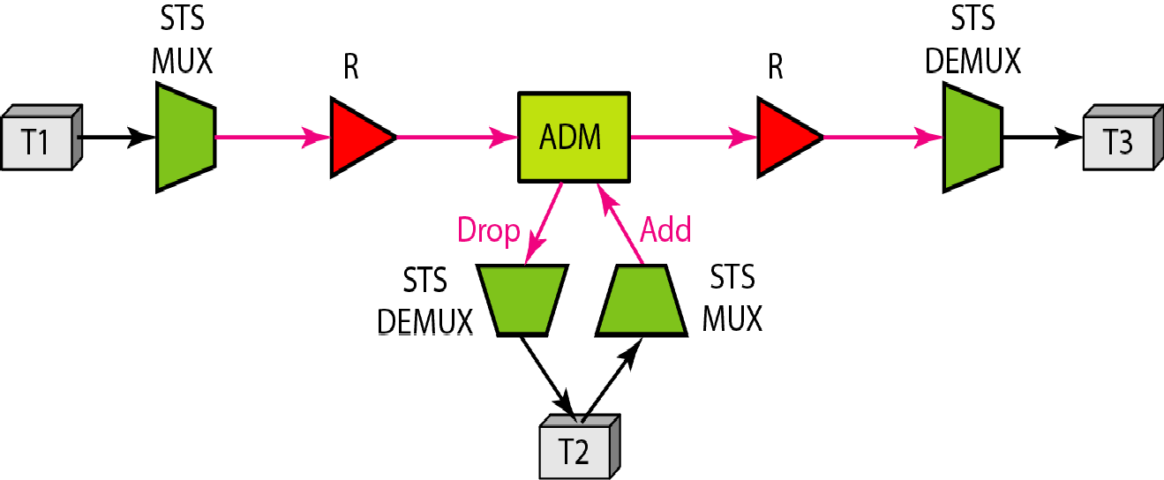
Figure 17.19 A multipoint SONET network

Slide 70
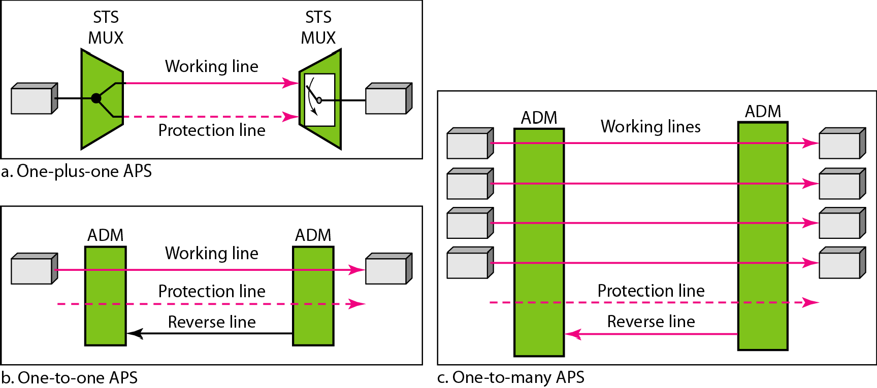
Figure 17.20 Automatic protection switching in linear networks

Slide 71
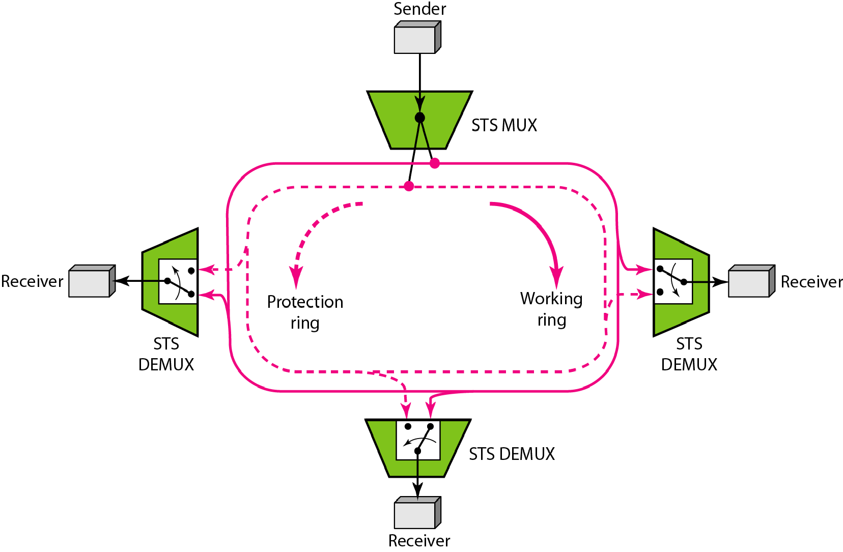
Figure 17.21 A unidirectional path switching ring

Slide 72
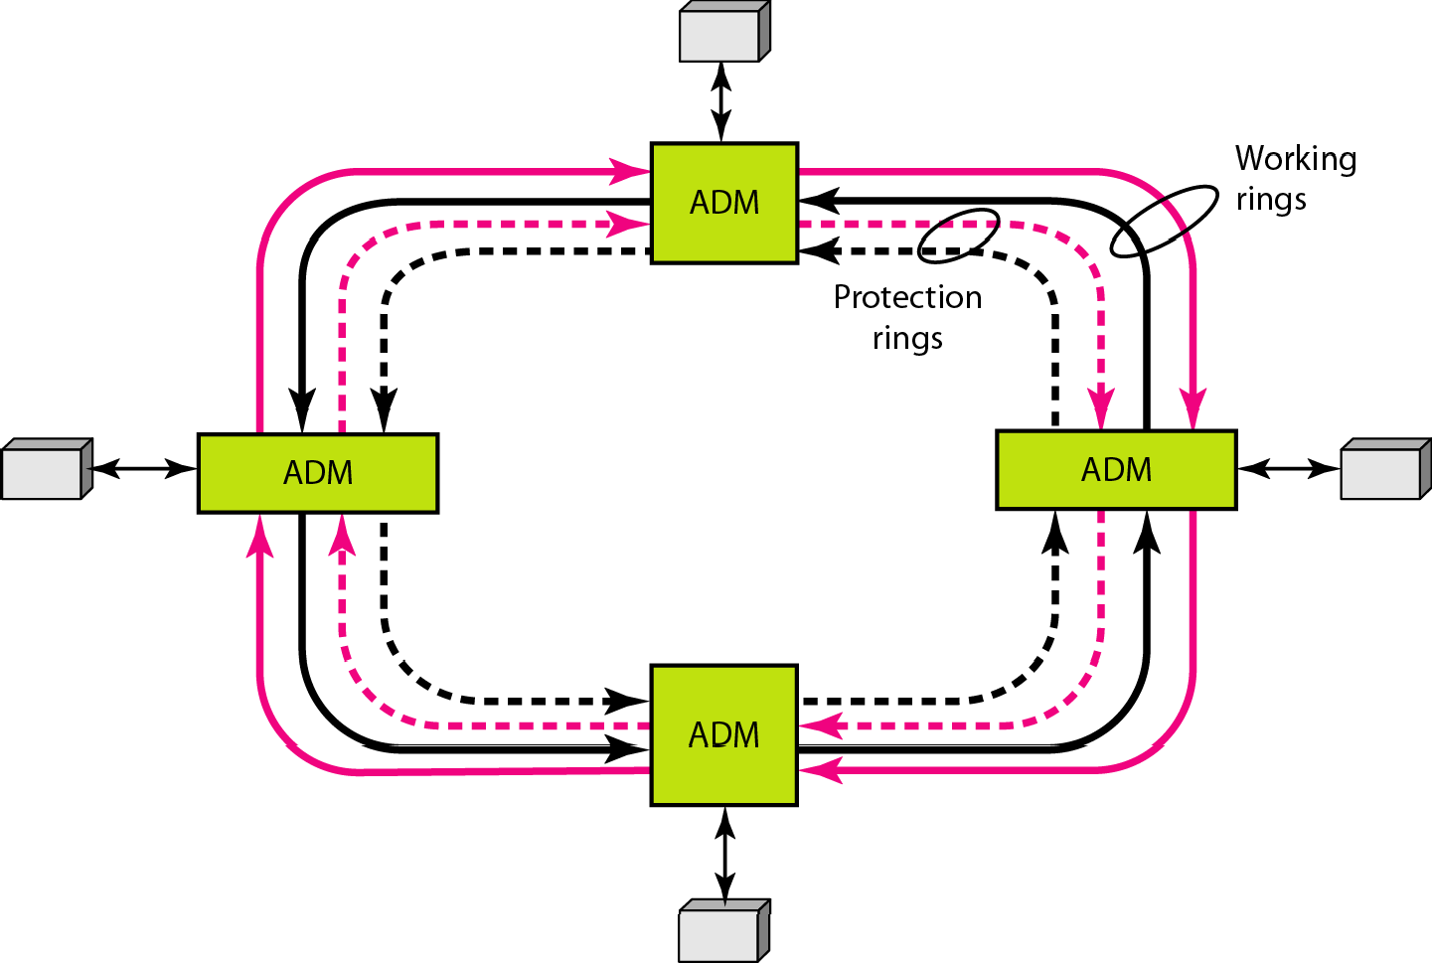
Figure 17.22 A bidirectional line switching ring

Slide 73
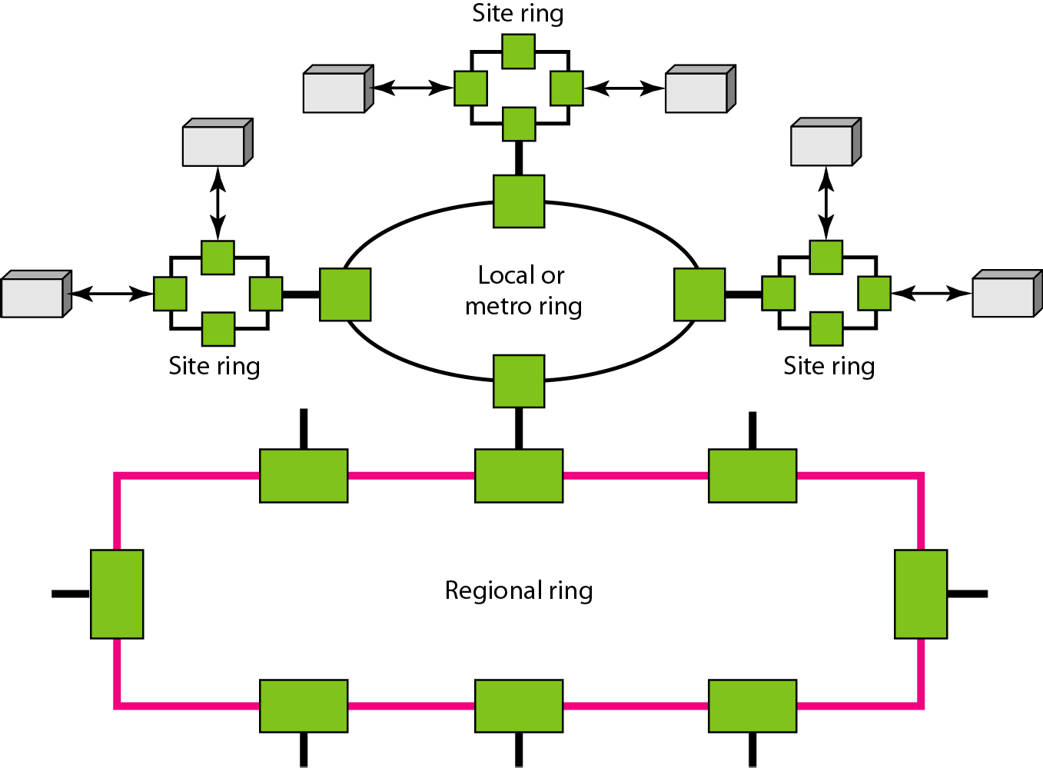
Figure 17.23 A combination of rings in a SONET network

Slide 74
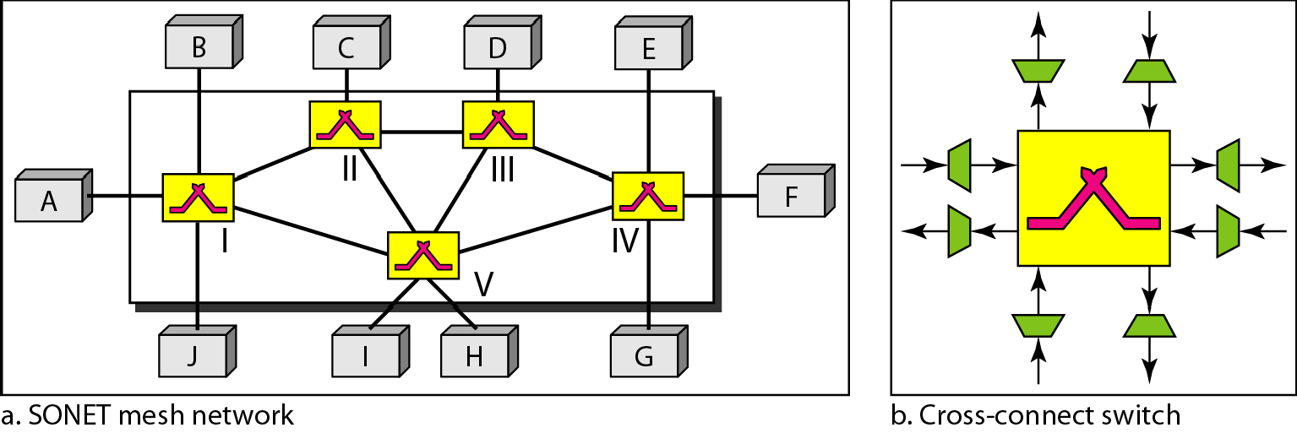
Figure 17.24 A mesh SONET network

