Slide 1

Chapter 9
Using Telephone
and Cable Networks
for Data Transmission
9.<number>
Copyright © The McGraw-Hill Companies, Inc. Permission required for reproduction or display.

Slide 2
9-1 TELEPHONE NETWORK
Telephone networks use circuit switching. The telephone network had its beginnings in the late 1800s. The entire network, which is referred to as the plain old telephone system (POTS), was originally an analog system using analog signals to transmit voice.
Topics discussed in this section:
Major Components
LATAs
Signaling
Services Provided by Telephone Networks
9.<number>

Slide 3
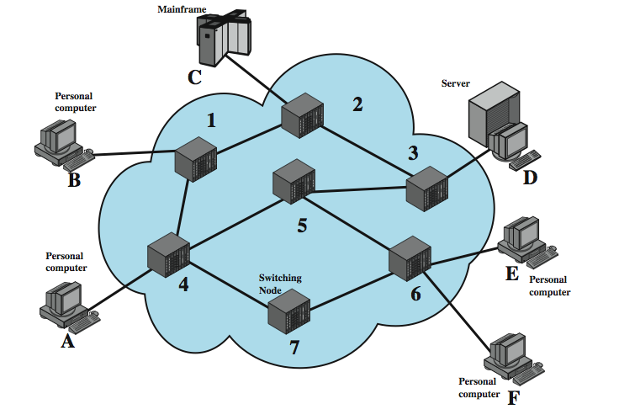
Switched Network
9.<number>
Notes:
For transmission of data beyond a local area, communication is typically achieved by transmitting data from source to destination through a network of intermediate switching nodes; this switched network design is typically used to implement LANs as well. The switching nodes are not concerned with the content of the data; rather, their purpose is to provide a switching facility that will move the data from node to node until they reach their destination. Stallings DCC8e Figure 10.1 illustrates a simple network. The devices attached to the network may be referred to as stations. The stations may be computers, terminals, telephones, or other communicating devices. We refer to the switching devices whose purpose is to provide communication as nodes. Nodes are connected to one another in some topology by transmission links. Node-station links are generally dedicated point-to-point links. Node-node links are usually multiplexed, using either frequency division multiplexing (FDM) or time division multiplexing (TDM). In a switched communication network, data entering the network from a station are routed to the destination by being switched from node to node. For example, in Figure 10.1, data from station A intended for station F are sent to node 4. They may then be routed via nodes 5 and 6 or nodes 7 and 6 to the destination.

Slide 4
Circuit Switching
uses a dedicated path between two stations
has three phases
  establish
  transfer
  disconnect
inefficient
  channel capacity dedicated for duration of connection
  if no data, capacity wasted
set up (connection) takes time
once connected, transfer is transparent
9.<number>
Notes:
Communication via circuit switching implies that there is a dedicated communication path between two stations. That path is a connected sequence of links between network nodes. On each physical link, a logical channel is dedicated to the connection. Communication via circuit switching involves three phases:
Circuit establishment - Before any signals can be transmitted, an end-to-end (station-to-station) circuit must be established.
Data transfer - Data can now be transmitted through the network between these two stations. The transmission may be analog or digital, depending on the nature of the network. As the carriers evolve to fully integrated digital networks, the use of digital (binary) transmission for both voice and data is becoming the dominant method. Generally, the connection is full duplex.
Circuit disconnect - After some period of data transfer, the connection is terminated, usually by the action of one of the two stations. Signals must be propagated to the intermediate nodes to deallocate the dedicated resources.
Circuit switching can be rather inefficient. Channel capacity is dedicated for the duration of a connection, even if no data are being transferred. For a voice connection, utilization may be rather high, but it still does not approach 100%. For a client/server or terminal-to-computer connection, the capacity may be idle during most of the time of the connection. In terms of performance, there is a delay prior to signal transfer for call establishment. However, once the circuit is established, the network is effectively transparent to the users.

Slide 5
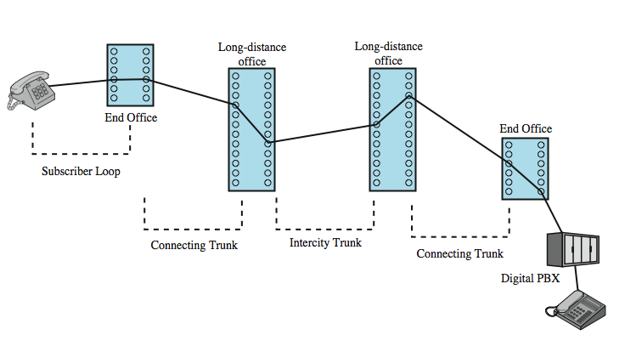
Public Circuit Switched Network
9.<number>
Notes:
Circuit switching was developed to handle voice traffic but is now also used for data traffic. The best-known example of a circuit-switching network is the public telephone network (see Stallings DCC8e Figure 10.2 above). This is actually a collection of national networks interconnected to form the international service. A public telecommunications network can be described using four generic architectural components:
• Subscribers: The devices that attach to the network, typically telephones, but the percentage of data traffic increases year by year.
• Subscriber line: The link between the subscriber and the network, also referred to as the subscriber loop or local loop, mostly using twisted-pair wire.
• Exchanges: The switching centers in the network. A switching center that directly supports subscribers is known as an end office.
Trunks: The branches between exchanges. Trunks carry multiple voice-frequency circuits using either FDM or synchronous TDM

Slide 6
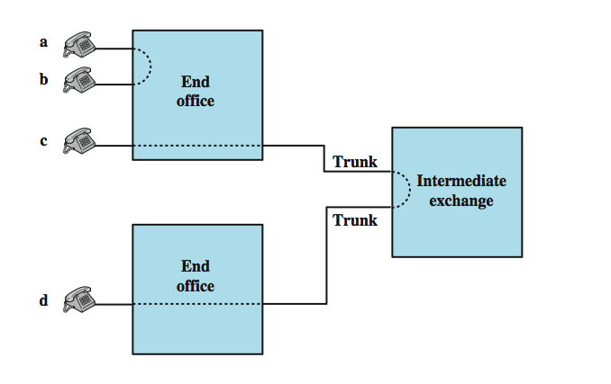
Circuit Establishment
9.<number>
Notes:
Subscribers connect directly to an end office, which switches traffic between subscribers and between a subscriber and other exchanges. The other exchanges are responsible for routing and switching traffic between end offices. This distinction is shown here in Stallings DCC8e Figure 10.3. To connect two subscribers attached to the same end office, a circuit is set up between them. If two subscribers connect to different end offices, a circuit between them consists of a chain of circuits through one or more intermediate offices. In the figure, a connection is established between lines a and b by simply setting up the connection through the end office. The connection between c and d is more complex. In c's end office, a connection is established between line c and one channel on a TDM trunk to the intermediate switch. In the intermediate switch, that channel is connected to a channel on a TDM trunk to d's end office. In that end office, the channel is connected to line d.
Circuit-switching technology has been driven by those applications that handle voice traffic. One of the key requirements for voice traffic is that there must be virtually no transmission delay and certainly no variation in delay. A constant signal transmission rate must be maintained, because transmission and reception occur at the same signal rate. These requirements are necessary to allow normal human conversation. Further, the quality of the received signal must be sufficiently high to provide, at a minimum, intelligibility. Circuit switching achieved its widespread, dominant position because it is well suited to the analog transmission of voice signals. In today's digital world, its inefficiencies are more apparent. However, despite the inefficiency, circuit switching will remain an attractive choice for both local area and wide area networking.

Slide 7
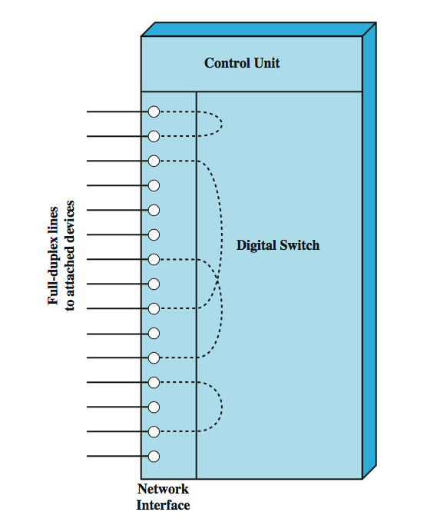
Circuit Switch Elements
9.<number>
Notes:
The technology of circuit switching is best approached by examining the operation of a single circuit-switching node. A network built around a single circuit-switching node consists of a collection of stations attached to a central switching unit. The central switch establishes a dedicated path between any two devices that wish to communicate. Stallings DCC8e Figure 10.4 depicts the major elements of such a one-node network. The dotted lines inside the switch symbolize the connections that are currently active.
The heart of a modern system is a digital switch. The function of the digital switch is to provide a transparent signal path between any pair of attached devices. The path is transparent in that it appears to the attached pair of devices that there is a direct connection between them. Typically, the connection must allow full-duplex transmission.
The network interface element represents the functions and hardware needed to connect digital devices, such as data processing devices and digital telephones, to the network. Analog telephones can also be attached if the network interface contains the logic for converting to digital signals. Trunks to other digital switches carry TDM signals and provide the links for constructing multiple-node networks.
The control unit performs three general tasks. First, it establishes connections. This is generally done on demand, that is, at the request of an attached device. Second, the control unit must maintain the connection. Because the digital switch uses time division principles, this may require ongoing manipulation of the switching elements. Third, the control unit must tear down the connection, either in response to a request from one of the parties or for its own reasons.

Slide 8
Blocking or Non-blocking
blocking network
  may be unable to connect stations because all paths are in use
  used on voice systems
non-blocking network
  permits all stations to connect at once
  used for some data connections
9.<number>
Notes:
An important characteristic of a circuit-switching device is whether it is blocking or nonblocking. Blocking occurs when the network is unable to connect two stations because all possible paths between them are already in use. A blocking network is one in which such blocking is possible. Hence a nonblocking network permits all stations to be connected (in pairs) at once and grants all possible connection requests as long as the called party is free. When a network is supporting only voice traffic, a blocking configuration is generally acceptable, because it is expected that most phone calls are of short duration and that therefore only a fraction of the telephones will be engaged at any time. However, when data processing devices are involved, these assumptions may be invalid. For example, for a data entry application, a terminal may be continuously connected to a computer for hours at a time. Hence, for data applications, there is a requirement for a nonblocking or "nearly nonblocking" (very low probability of blocking) configuration.

Slide 9
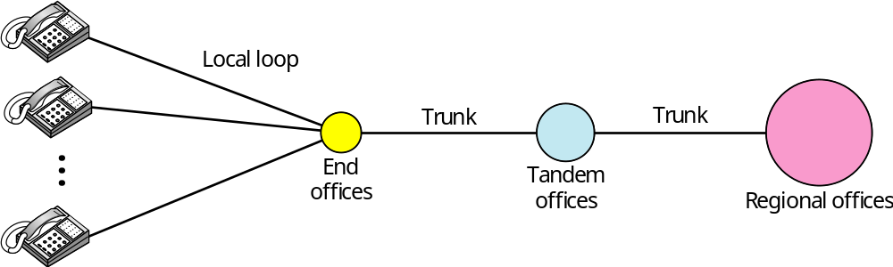
Figure 9.1 A telephone system
9.<number>

Slide 10
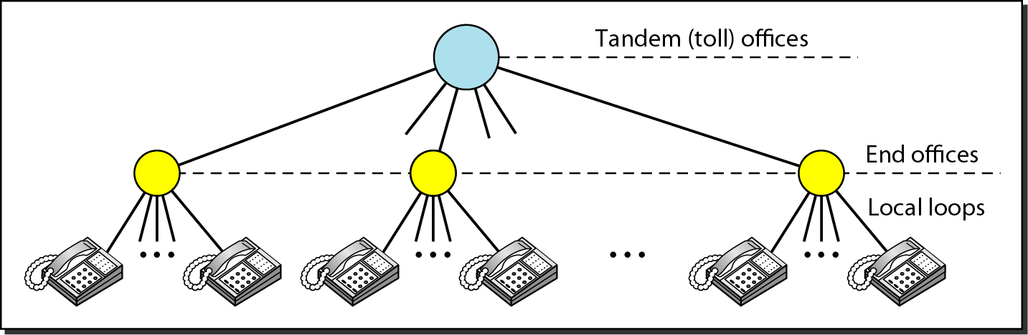
Figure 9.2 Switching offices in a LATA
9.<number>

Slide 11

Note
Intra-LATA (local access transport area) services are provided by local exchange carriers (LECs).
Since 1996, there are two
types of LECs: incumbent local exchange carriers and competitive
local exchange carriers.
IXC (Interexchange carrier, long distance company)
9.<number>

Slide 12
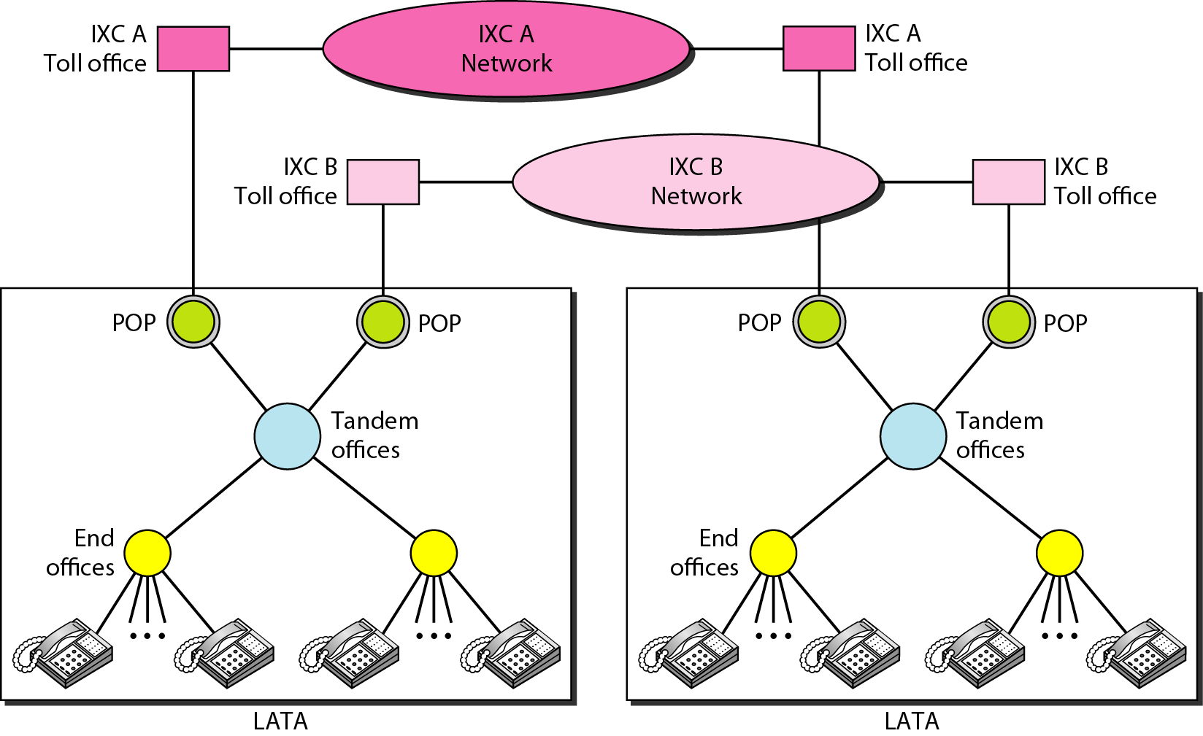
Figure 9.3 Point of presences (POPs)
Normally digitized data
9.<number>

Slide 13
Note
The tasks of data transfer and signaling are separated in modern telephone networks: data transfer is done by one network, signaling by another.
9.<number>

Slide 14
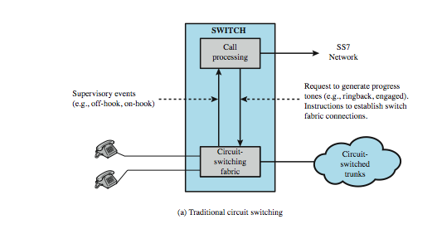
Traditional Circuit Switching
9.<number>
Notes:
Stallings DCC8e Figure 10.7a contrasts the the softswitch architecture with that of a traditional telephone network circuit switch.

Slide 15
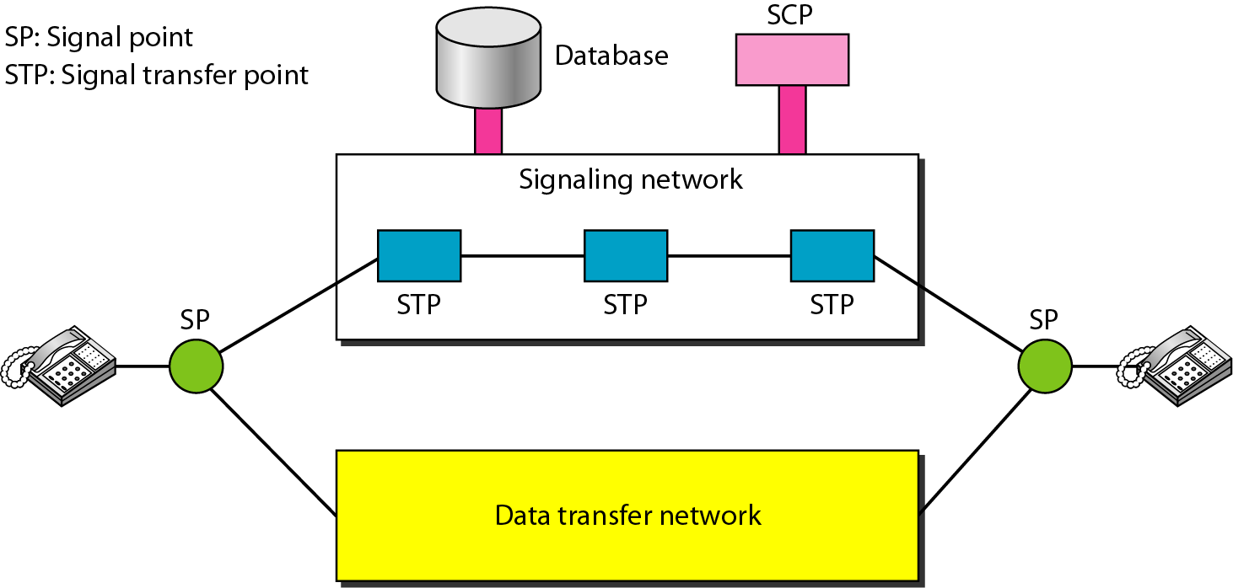
Figure 9.4 Data transfer and signaling networks
Packet-switch
Packet-switch or circuit-switch
9.<number>

Slide 16
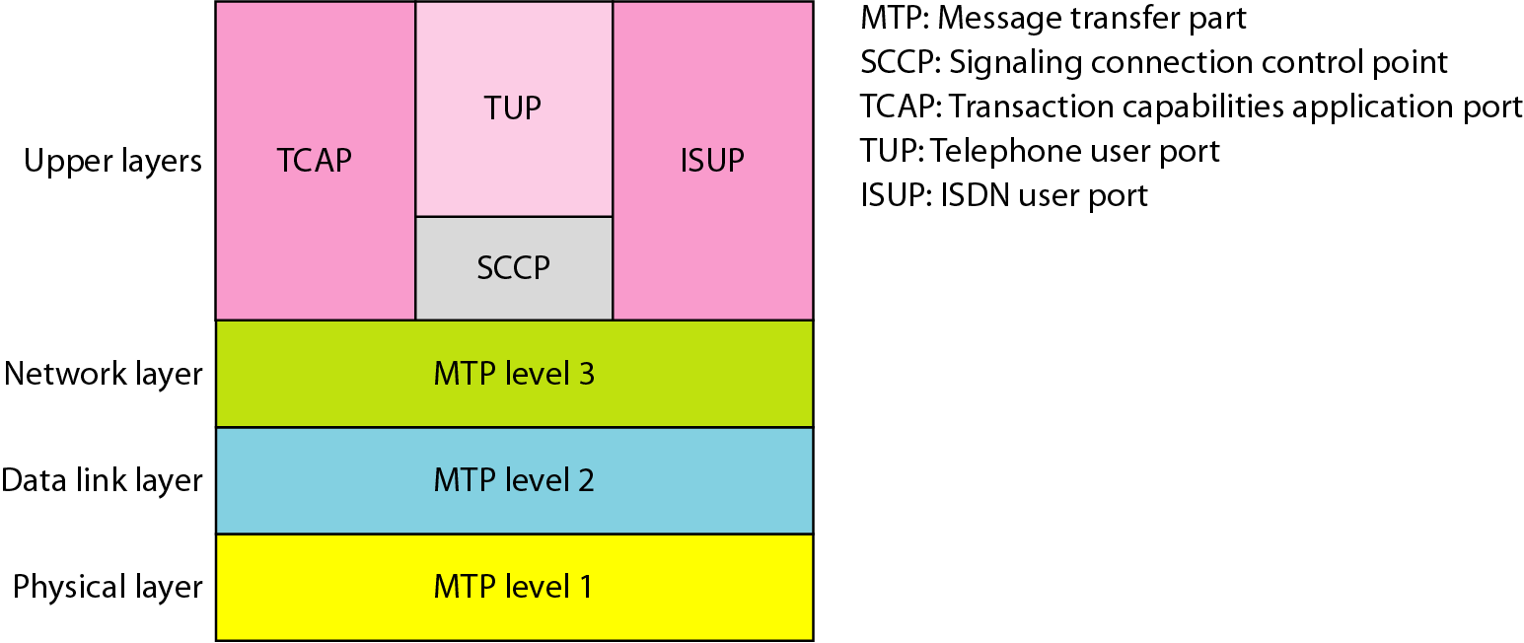
Figure 9.5 Layers in SS7 (signaling system seven)
9.<number>

