Slide 1

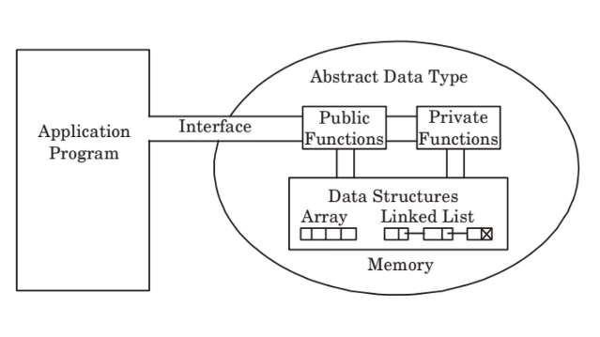
Classification of Data Structures
Data structures are fundamental building blocks in computer science. They can be classified in various ways to better understand their characteristics and applications. By Prof. Ayush Gour

Slide 2

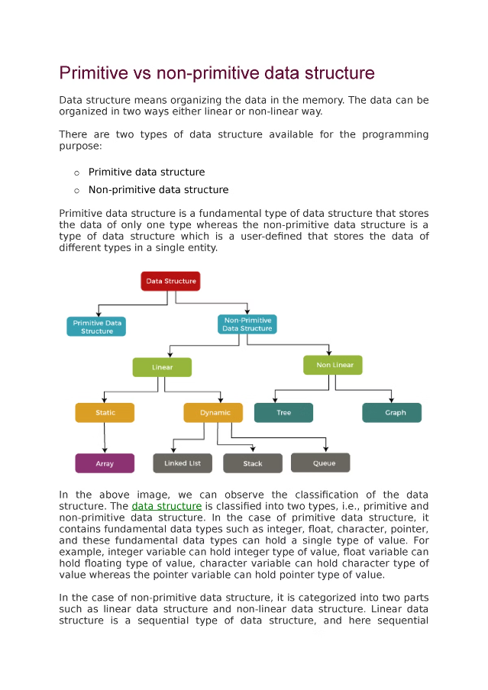
Primitive and Non-Primitive Data Structures
1
Primitive
Basic data types like integers, floats, characters, and booleans.
2
Non-Primitive
Composite data structures like arrays, linked lists, stacks, queues, trees, and graphs.

Slide 3
Linear and Non-Linear Data Structures
Linear
Non-Linear
Data elements are stored in a sequential manner, like arrays and linked lists.
Data elements are not stored in a sequential manner, like trees and graphs.

Slide 4

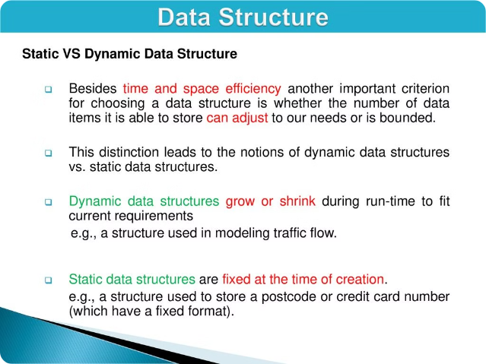
Static and Dynamic Data Structures
1
Static
Fixed size, allocated in contiguous memory locations.
2
Dynamic
Variable size, allocated and deallocated at runtime.

Slide 5

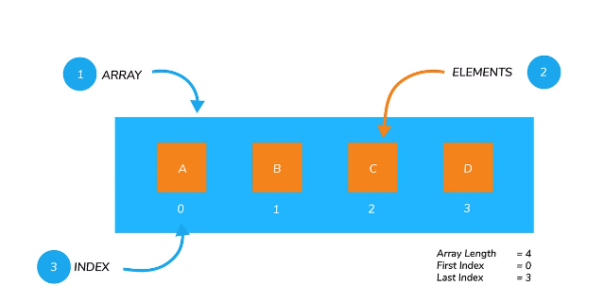
Arrays
Homogeneous
All elements are of the same data type.
Indexed
Elements are accessed using an index number.
Fixed Size
The size is determined at declaration and cannot be changed.

Slide 6


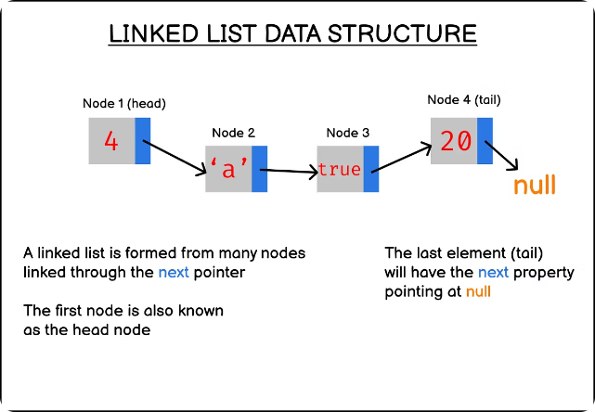

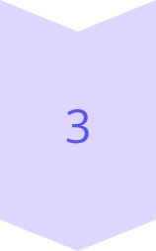
Linked Lists
Nodes
Consist of data and a pointer to the next node.
Dynamic Size
Size can be changed at runtime by adding or removing nodes.
Traversal
Sequential access, starting from the head node.

Slide 7




Stacks
Push
Pop
Peek
Add an element to the top of the stack.
Remove an element from the top of the stack.
View the top element without removing it.

Slide 8

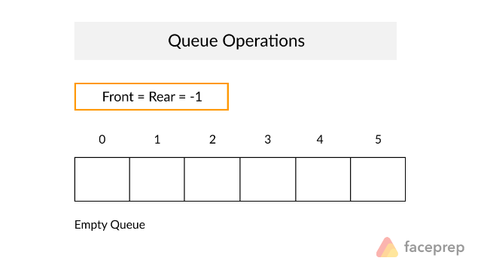
Queues
Enqueue
Add an element to the rear of the queue.
Dequeue
Remove an element from the front of the queue.
Front
Access the element at the front of the queue.
Rear
Access the element at the rear of the queue.

Slide 9
Trees
Nodes
Hierarchy
Traversal
Each node has a value and pointers to child nodes.
Data is organized in a hierarchical, non-linear structure.
Can be done in various orders: preorder, inorder, postorder.

Slide 10

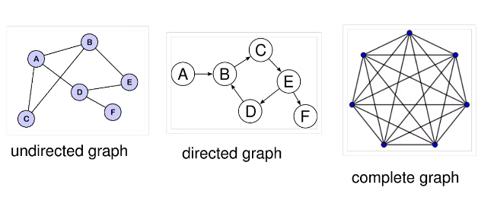
Graphs
Vertices
Represent the objects or entities.
Edges
Represent the relationships between vertices.
Connectivity
Can be directed or undirected, weighted or unweighted.
Traversal
Can be done using DFS (Depth-First Search) or BFS (Breadth-First Search).

Slide 11

Thank You!
Thank you for taking the time to explore our presentation on data structures. We hope you found it informative and engaging. If you have any questions or would like to learn more, please feel free to reach out to us. We appreciate your interest and look forward to hearing from you!

