Slide 1

By Prof. Ayush Gour

Slide 2
Syllabus
Introduction: Introduction to data type and data structure. Types of data structure: primitive & non-primitive, linear & non-linear. Operations on data structures: traversing, searching, inserting, deleting. Algorithms, Complexity analysis – worst case, best case, average case.

Slide 3

Classification of Data Structures
Data Structures
Primitive
Data Structures
Non-Primitive
Data Structures
Integer
Real
Character
Boolean
Linear
Data Structures
Non-Linear
Data Structures
Array
Stack
Queue
Linked List
Tree
Graph
Notes:
목차
자바의 생성배경
자바를 사용하는 이유
과거, 현재, 미래의 자바
자바의 발전과정
버전별 JDK에 대한 설명
자바와 C++의 차이점
자바의 성능
자바 관련 산업(?)의 경향

Slide 4
Basic Concepts and Notations
Algorithm: Outline, the essence of a computational procedure, step-by-step instructions
Program: an implementation of an algorithm in some programming language
Data Structure: Organization of data needed to solve the problem

Slide 5
Data Structure Operations
Data Structures are processed by using certain operations.
Traversing: Accessing each record exactly once so that certain items in the record may be processed.
Searching: Finding the location of the record with a given key value, or finding the location of all the records that satisfy one or more conditions.
Inserting: Adding a new record to the structure.
Deleting: Removing a record from the structure.
Notes:
목차
자바의 생성배경
자바를 사용하는 이유
과거, 현재, 미래의 자바
자바의 발전과정
버전별 JDK에 대한 설명
자바와 C++의 차이점
자바의 성능
자바 관련 산업(?)의 경향

Slide 6
Special Data Structure-Operations
Sorting: Arranging the records in some logical order (Alphabetical or numerical order).
Merging: Combining the records in two different sorted files into a single sorted file.
Notes:
목차
자바의 생성배경
자바를 사용하는 이유
과거, 현재, 미래의 자바
자바의 발전과정
버전별 JDK에 대한 설명
자바와 C++의 차이점
자바의 성능
자바 관련 산업(?)의 경향

Slide 7
What is a Good Algorithm?
Efficient:
  Running time
  Space used

Slide 8
Complexity Analysis
Why we should analyze algorithms?
  Predict the resources that the algorithm requires
    Computational time (CPU consumption)
    Memory space (RAM consumption)
    Communication bandwidth consumption
  The running time of an algorithm is:
    The total number of primitive operations executed (machine independent steps)
    Also known as algorithm complexity

Slide 9
Time Complexity
Generally calculate:
  Amount of time taken by algorithm.
  Length of the input.
  WHY??
  For making better programs.
  Comparisons of algorithms.

Slide 10
Time Complexity
Worst-case
  An upper bound on the running time for any input of given size
Average-case
  Assume all inputs of a given size are equally likely
Best-case
  The lower bound on the running time

Slide 11
Time Complexity
  Worst-case:
    n comparisons
  Best-case:
    1 comparison
  Average-case:
    n/2 comparisons

Slide 12
Asymptotic Analysis
Asymptotic Analysis: Evaluate the performance of an algorithm in term of input size.
You will learn what asymptotic notations are.
Also, you will learn about
    Big-O notation
    Theta notation
    Omega notation

Slide 13
The efficiency of an algorithm depends on the amount of time, storage and other resources required to execute the algorithm.
The efficiency is measured with the help of asymptotic notations.

Slide 14
An algorithm may not have the same performance for different types of inputs. With the increase in the input size, the performance will change.
The study of change in performance of the algorithm with the change in the order of the input size is defined as asymptotic analysis.

Slide 15
Asymptotic Notations
Asymptotic Notation: For describing the running time and space complexity of algorithm based on input time.
Asymptotic notations are the mathematical notations used to describe the running time of an algorithm when the input tends towards a particular value or a limiting value.
For example: In binary search , when the input array is already sorted, the time taken by the algorithm
i.e. the best case.

Slide 16
Asymptotic notations
Algorithm complexity is rough estimation of the number of steps performed by given computation depending on the size of the input data
  Examples:
    Linear complexity O(n) – all elements are processed once (or constant number of times)
    Quadratic complexity O(n²) – each of the elements is processed n times

Slide 17
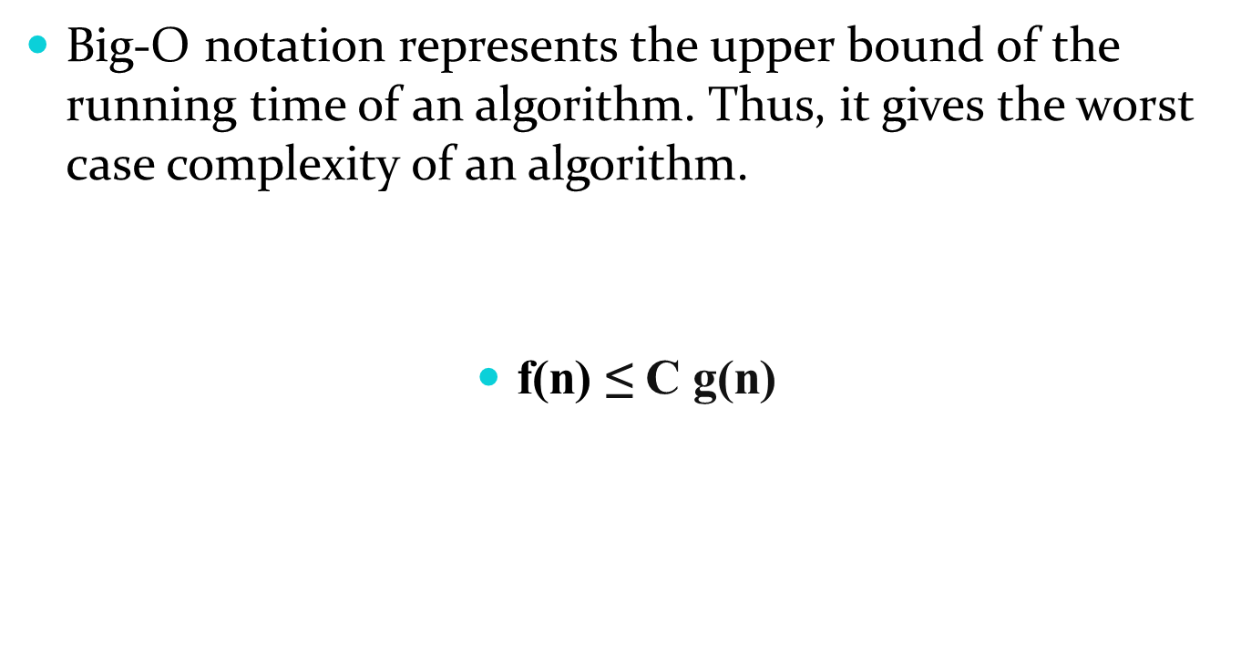
Big-O Notation (O-notation)

Slide 18
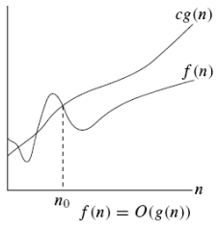

O-notation
Asymptotic upper bound

Slide 19
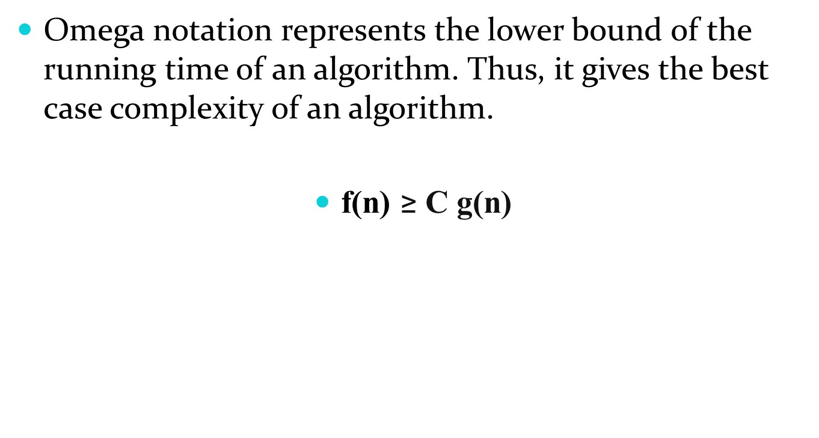
Ω Notation

Slide 20
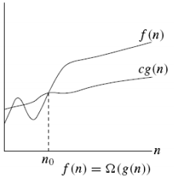

Ω notation
Asymptotic lower bound

Slide 21
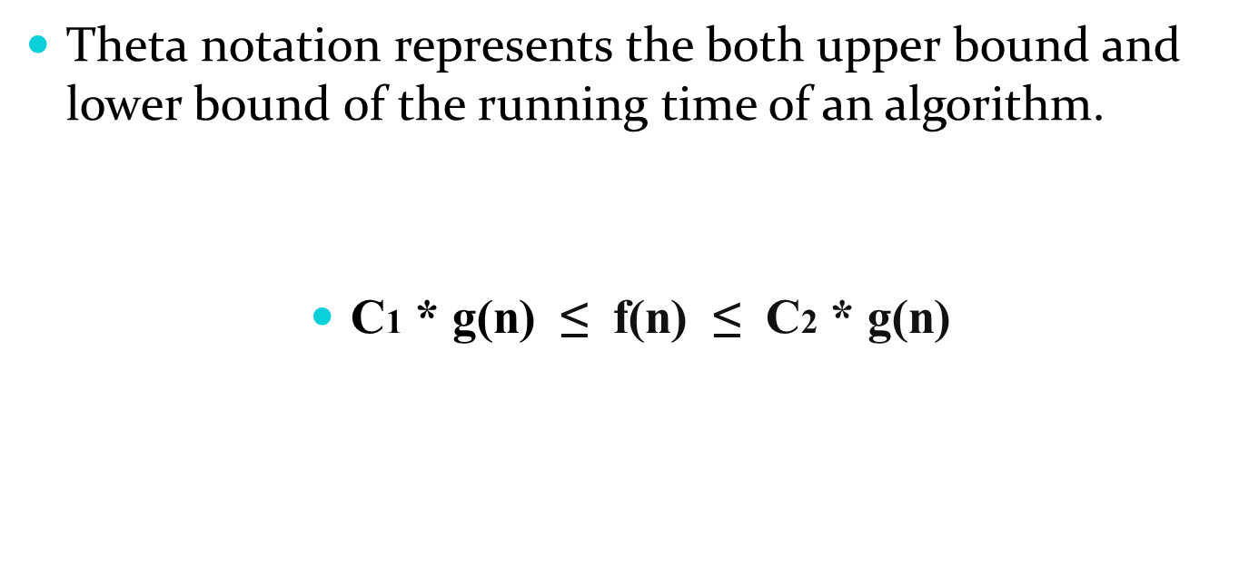
Θ Notation

Slide 22
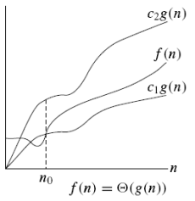

Θ notation
g(n) is an asymptotically tight bound of f(n)

Slide 23





Slide 24
Basic Rules
1. Nested loops are multiplied together.
2. Sequential loops are added.
3. Only the largest term is kept, all others are dropped.
4. Constants are dropped.

Slide 25
Types of Complexities
Constant Time – O(1)
Linear Time – O(n)
Logarithmic Time – O(log n)
Quadratic Time – O(n²)
Cubic Time – O(n³)

Slide 26
Order of Complexities
O(1) < O(log n) < O(n) < O(n log n) < O(n²) < O(n³) < O(2*n) < O(N!)

Slide 27
Practice Questions
f(n) = 2n² +3n
f(n) = n² + log n
f(n) = 12001
f(n) = 3n³ + 2n² + 5
f(n) = n³/300
f(n) = 5n² + log n
f(n) = n/4
f(n) = n + 4 / 4

Slide 28
Example 1
//linear
for(int i = 0; i < n; i++) {
cout << i << endl;
}

Slide 29
Ans: O(n)

Slide 30
Example 2
//quadratic
for(int i = 0; i < n; i++) {
for(int j = 0; j < n; j++){
//do swap stuff, constant time
}
}

Slide 31
Ans O(n²)

Slide 32
Example 3
for(int i = 0; i < 2*n; i++) {
cout << i << endl;
}

Slide 33
At first you might say that the upper bound is O(2n); however, we drop constants so it becomes O(n)

Slide 34
Example 4
//linear
for(int i = 0; i < n; i++) {
cout << i << endl;
}
//quadratic
for(int i = 0; i < n; i++) {
for(int j = 0; j < n; j++){
//do constant time stuff
}
}

Slide 35
Ans : In this case we add each loop's Big O, in this case n+n². O(n²+n) is not an acceptable answer since we must drop the lowest term. The upper bound is O(n²). Why? Because it has the largest growth rate

Slide 36
Example 5
for(int i = 0; i < n; i++) {
for(int j = 0; j < 2; j++){
//do stuff
}
}

Slide 37
Ans: Outer loop is 'n', inner loop is 2, this we have 2n, dropped constant gives up O(n)

Slide 38
Example 6
for(int i = 1; i < n; i *= 2) {
cout << i << endl;
}

Slide 39
There are n iterations, however, instead of simply incrementing, 'i' is increased by 2*itself each run. Thus the loop is log(n).

Slide 40
Example 7
for(int i = 0; i < n; i++) { //linear
for(int j = 1; j < n; j *= 2){ // log (n)
//do constant time stuff
}
}

Slide 41
Ans: n*log(n)

Slide 42
Example 8
for(int i = 0; i < n; i++) {
for(int j = 0; j < m; j ++){
//do constant time stuff
}
}

Slide 43
O(n*m) nested loop is present in this given question that’s why we are multiplying each other.

Slide 44
Example 9
for(int i = 0; i < n; i++) {
cout << i << endl;
}
for(int j = 0; j < m; j++){
//do constant time stuff
}

Slide 45
O(n+m) separate loop in the given problem that’s why we are adding the both.

Slide 46
Thank You

