Slide 1
Arrays in Data Structure and Algorithm
By
Prof. Ayush Gour
1

Slide 2
Unit - 2
Arrays: Introduction to Arrays, Array Representation: Row major order & Column major order, One dimensional and 2D array, Storage structure of arrays, operations on arrays, Sparse Matrix

Slide 3
Introduction
Data Structure can be classified as:
  Linear
  Non-linear
Linear (elements arranged in sequential in memory location) i.e. array & linear link-list
Non-linear such as a tree and graph.
Operations:
  Traversing, Searching, Inserting, Deleting, Sorting, Merging

Slide 4
Array is used to store a fix size for data and a Link-List the data can be varies in size.
Arrays are fundamental data structures in computer programming.
It allow you to store and organize multiple elements of the same data type in a single variable.
Provide a structured way to manage and access data, making them essential for a wide range of applications.

Slide 5
Introduction
Advantages of an Array:
  Simplicity and Flexibility
  Fast Element Access
  Economy – if full use of memory
  Random accessed at the same time

Slide 6
Introduction
Disadvantage of an Array:
  Fixed Size
  Inefficient Insertion and Deletion
  Wasting memory if not fully used
  Potential for Wastage(in sparse matrices)
  Limited Flexibility in datatypes.

Slide 7
Linear Array
Homogeneous data:
a) Elements are represented through indexes.
b) Elements are saved in sequential in memory locations.
Number of elements (N) –> length or size of an array.
If:
UB : upper bound ( the largest index)
LB : lower bound (the smallest index)
Then: N = (UB – LB) + 1
Length :- N = UB ; when LB = 1

Slide 8
Linear Array
All elements in A are written symbolically as (1....n) is the subscript.
A1, A2, A3, .... , An
In FORTRAN and BASIC → A(1), A(2), ..., A(N)
In Pascal, C/C++ and Java → A[0], A[1], ..., A[N-1] subscript starts from 0
LB = 0
UB = N–1

Slide 9
Representation of Array in a Memory
In general, index function:
Address of a[k] = b + w * k;
where b is base address, w is size of variable and k is index number of finding element in array .
For real number: 4 byte, integer: 4 byte, character: 1 byte, float: 4 byte and double: 8 byte.
Example:
If LB = 0, Base Address = 2560, and w = 4, find (a[12]) ?

Slide 10
Operations on Array
Searching: Searching for an element in an array can be done using linear search or binary search, depending on the array's organization.
Insertion: Inserting an element into an array can be a challenging operation, as it may require shifting existing elements to make room for the new one, depending on the array's size and the desired position of the new element.
Deletion: Deleting an element from an array can also be a complex operation, as it may require shifting the remaining elements to fill the gap left by the deleted element.
Traversing: Access each and every element in an array and performing an operations on it.
Sorting: Sorting an array is a common operation that can be performed using various algorithms, such as bubble sort, insertion sort, merge sort, quicksort and radix sort.

Slide 11
Traversing Algorithm
Traversing operation means visit every element once.
Or access each element exactly once.
[Assign counter]
Set K=LB // LB = 0
2. Repeat step 2.1 and 2.2 while K <= UB // If LB = 0
2.1 [visit element]
do PROCESS on A[K]
  2.2 [add counter]
  K=K+1
3. End of loop and step 2
4. Exit

Slide 12
Insertion Algorithm
INSERT(LA, N, K, ITEM)
//A is a linear array with N element
//K is location where we want to insert an item and J is variable
//Insert an element, ITEM in index K
1. [Assign counter]
Set J = N; // LB = 1
2. Repeat step 2.1 and 2.2 while J >= K
2.1 [shift to the right all elements from J]
A[J+1] = A[J]
2.2 [decrement counter] J = J – 1
3. [Stop repeat step 2]
4. [Insert element] A[K] = ITEM
5. [Reset N] N = N + 1
6. Exit

Slide 13
Deletion Algorithm
// K is the location where we want to delete
// ITEM is the value which we delete from an array
//
DELETE(A, N, K, ITEM)
1. Set ITEM = A[K]
2. Repeat (for J = K to N–1) // If LB = 1
2.1 [Shift element, forward]
A[J] = A[J+1]
3. [End of for loop]
4. [Reset N in A]
Set N = N – 1
5. Exit

Slide 14
MULTIDIMENSIONAL or 2-D ARRAY

Slide 15
Two Dimensional Array
1. Rectangular Structure: Two-dimensional arrays are organized in a rectangular grid, with rows and columns. They are useful for representing and manipulating tabular data, such as spreadsheets or matrices.
2. Memory Representation: In memory, two-dimensional arrays are typically stored in either row-major order or column-major order, depending on the application requirements.

Slide 16
Two Dimensional Array
3. Accessing Element: Elements in a two-dimensional array are accessed using two indices: one for the row and one for the column. This allows for efficient manipulation of data organized in a grid-like structure.
4. Common Operations: Common operations on two-dimensional arrays include accessing, inserting, deleting, and searching for elements, as well as performing matrix operations, such as addition, multiplication, and transposition.

Slide 17
2-D ARRAY
A 2-D array, A with m X n elements.
In math application it is called matrix.
In business application – table.
Example:
Assume 25 students had taken 4 tests.
The marks are stored in 25 X 4 array locations:
 |  | U0 | U1 | U2 | U3
Stud 0 |  | 88 | 78 | 66 | 89
Stud 1 |  | 60 | 70 | 88 | 90
Stud 2 |  | 62 | 45 | 78 | 88
.. |  | .. | .. | .. | ..
.. |  | .. | .. | .. | ..
Stud 24 |  | 78 | 88 | 98 | 67
m
n

Slide 18
2-D ARRAY
Multidimensional array declaration in C++
int StudentMarks [25][4];
StudentMarks[0][0] = 88;
StudentMarks[0][1] = 78;

Slide 19
Row Major Order
In row-major order, elements of a two-dimensional array are stored in memory by rows. This means that the first row of the array is stored consecutively in memory, followed by the second row, and so on. This representation is widely used in programming languages like C and C++.

Slide 20
Row Major order
Row Major order:
a[i][j] = B + W[n(i-LBR) + (j-LBC)]
Where:
  B = Base Address
  W = Size of element
  n = Number of Columns
  LBR = Lower bound of row index
  LBC = Lower bound of column index
  i, j = indices
  Question: Suppose the size of an array is a[7][7] and the base address is 500. Find the address of a[3][4] for integer data types ?

Slide 21
Row Major Order
Advantages:
Efficient for accessing elements by row
Simplifies the calculation of memory addresses
Aligned with the way many algorithms operate on data
Disadvantages:
Accessing elements by column can be less efficient
Requires more memory for storing row information

Slide 22
Column Major Order
In column-major order, the elements of a two-dimensional array are stored in memory by columns. This means that the first column of the array is stored consecutively in memory, followed by the second column, and so on. This representation is commonly used in programming languages like FORTRAN, where column-oriented operations are more common.

Slide 23
Column Major order
Column Major order:
a[i][j] = B + W[(i-LBR) + n(j-LBC)]
Where:
  B = Base Address
  W = Size of element
  n = Number of rows
  LBR = Lower bound of row index
  LBC = Lower bound of column index
  i, j = indices
  Question: Suppose the size of an array is a[8][8] and the base address is 1000. Find the address of a[5][6] for integer data types?

Slide 24
Column Major Order
Advantages:
Efficient for accessing elements by column
Simplifies the calculation of memory addresses for column-oriented operations
Useful for certain scientific and mathematical applications
Disadvantages:
Accessing elements by row can be less efficient
Requires more memory for storing column information

Slide 25
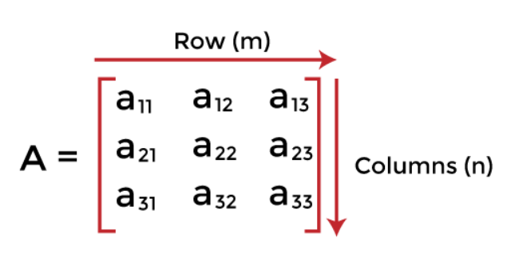
What is a matrix?
A matrix can be defined as a two-dimensional array having 'm' rows and 'n' columns.
A matrix with m rows and n columns is called m × n matrix. It is a set of numbers that are arranged in the horizontal or vertical lines of entries.

Slide 26
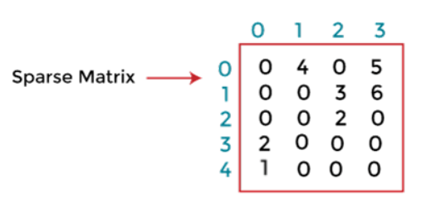
Sparse matrix
Sparse matrices are those matrices that have the majority of their elements equal to zero.
In other words, the sparse matrix can be defined as the matrix that has a greater number of zero elements than the non-zero elements.

Slide 27

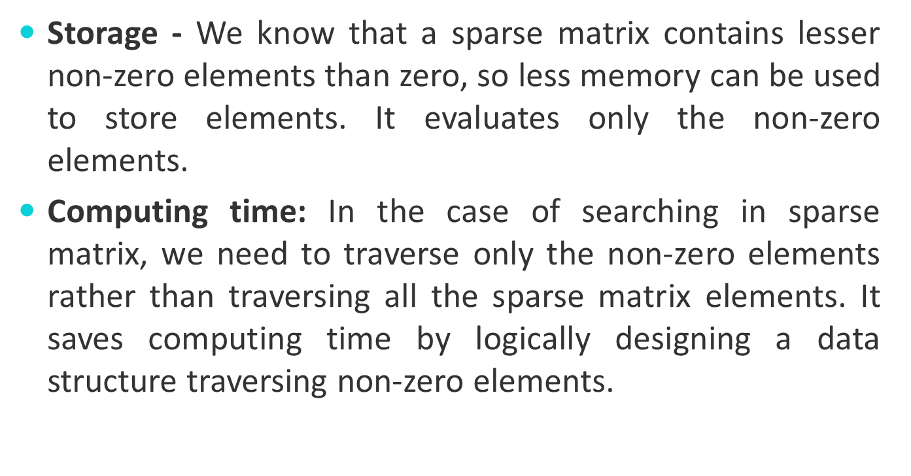

Slide 28

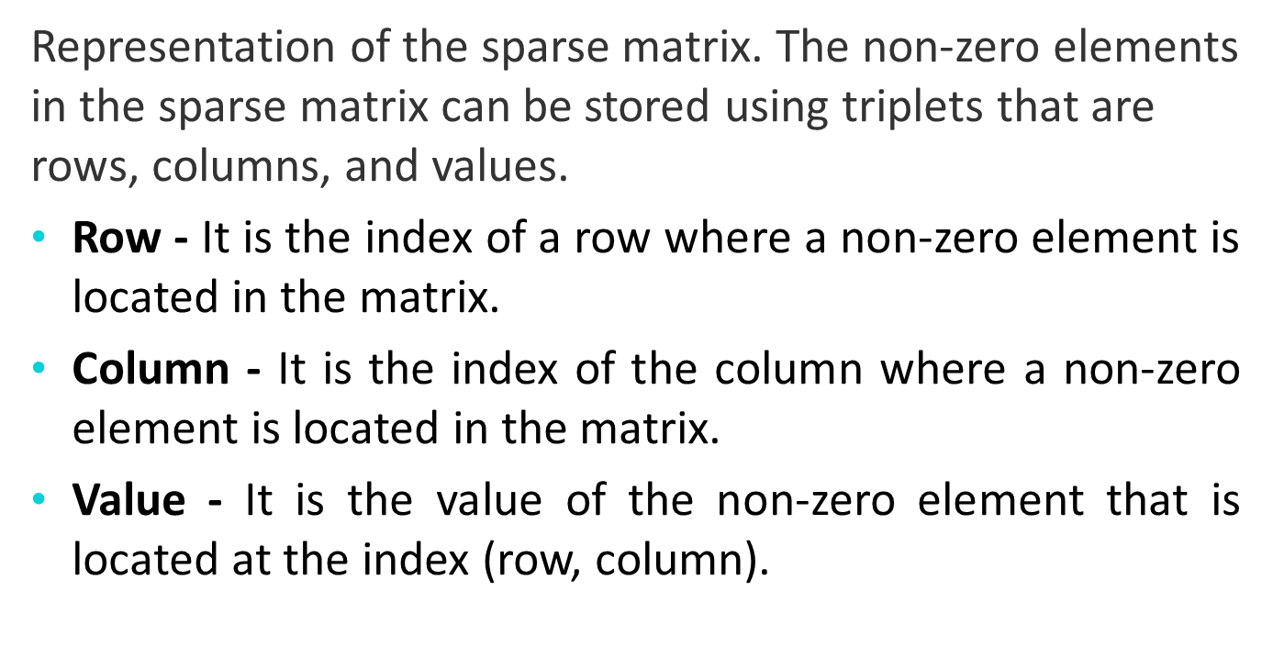

Slide 29
Thank You

