Slide 1
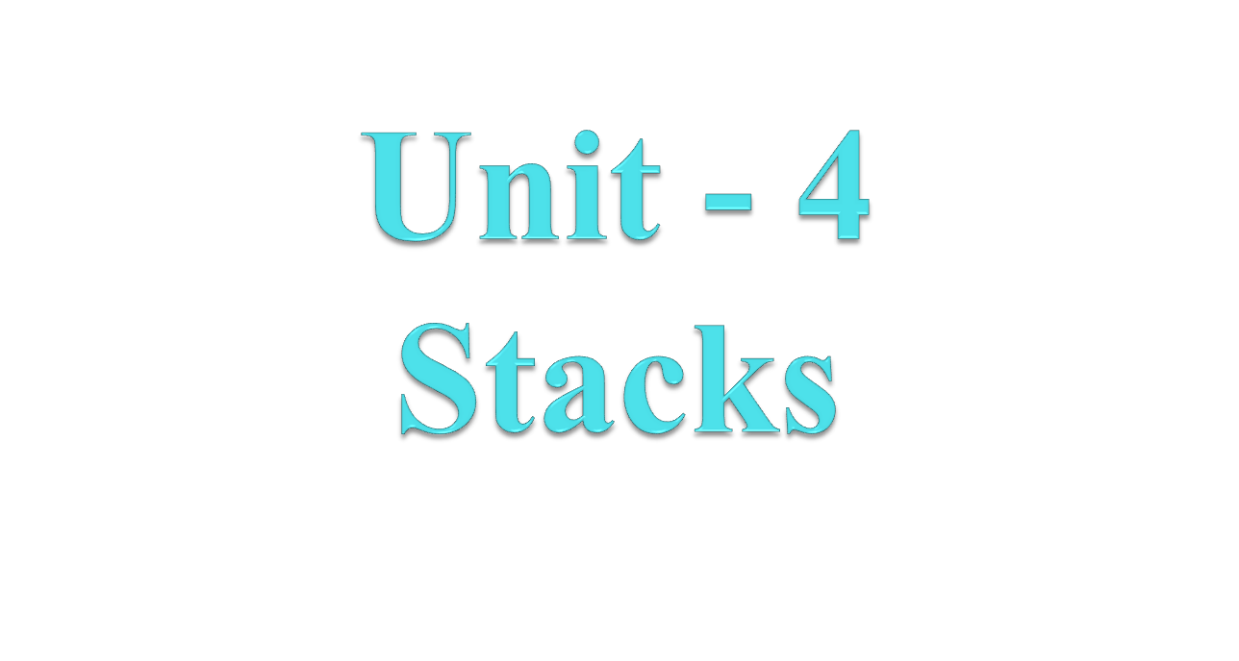

Slide 2
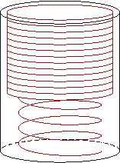
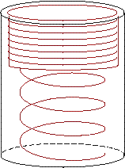
Introduction to Stacks
Stack is linear Data Structure, in which insertion and deletion of the elements can takes place only at one end that is called TOP.
A stack is a last-in-first-out (LIFO) data structure.
Adding an item
  Referred to as PUSH it onto the stack
Removing an item
  Referred to as
  POP it from
  the stack

Slide 3
Introduction to Stack
A Stack is a linear data structure that follows the LIFO (Last-In-First-Out) principle. Stack has one end.
It contains only one pointer top pointer pointing to the topmost element of the stack.
Whenever an element is added in the stack, it is added on the top of the stack, and the element can be deleted only from the stack.
In other words, a stack can be defined as a container in which insertion and deletion can be done from the one end known as the top of the stack.

Slide 4
Introduction to Stacks
Definition:
  An ordered collection of data items
  Can be accessed at only one end (the top)
Stack is used for Smart Memory Management.
Empty Stack = TOP – 1

Slide 5
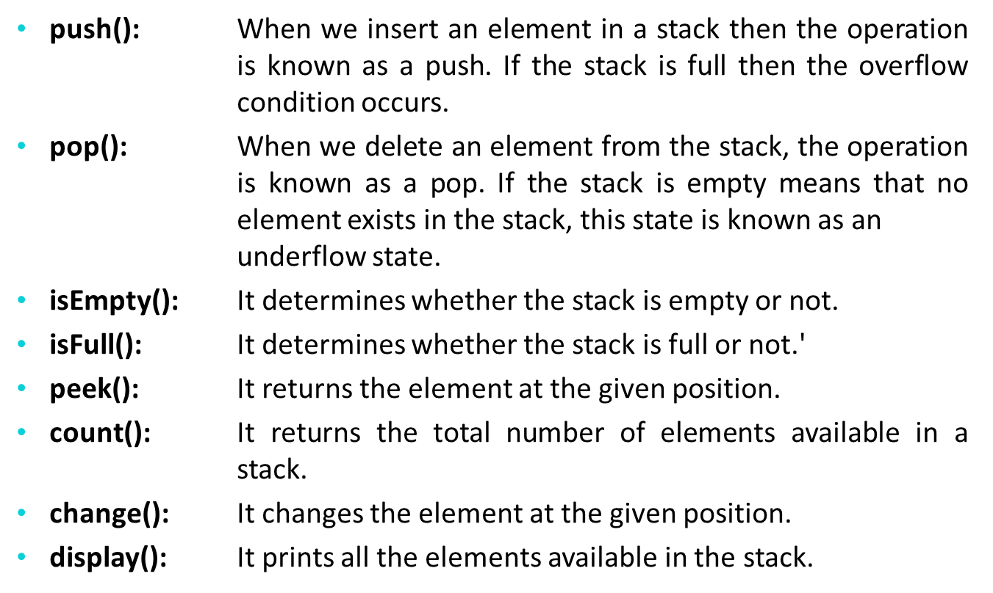
Operations of Stack

Slide 6
Application of Stack
String reversal: Stack is also used for reversing a string. For example, we want to reverse a “ABCDE" string, so we can achieve this with the help of a stack.
UNDO/REDO: It can also be used for performing Undo/Redo operations.
DFS(Depth First Search): This search is implemented on a Graph, and Graph uses the stack data structure.
Expression conversion: Stack can also be used for expression conversion. This is one of the most important applications of stack.

Slide 7
Stack
items[MAX-1]
. | .
. | .
. | .
items[2] | C
items[1] | B
items[0] | A
Top=2

Slide 8
Insert an item A
A new item (A) is inserted at the Top of the stack
items[MAX-1]
. | .
. | .
items[3]
items[2]
items[1]
items[0] | A | Top=0

Slide 9
Insert an item B
A new item (B) is inserted at the Top of the stack
items[MAX-1]
. | .
. | .
items[3]
items[2]
items[1] | B | Top=1
items[0] | A

Slide 10
Insert an item C
A new item (C) is inserted at the Top of the stack
items[MAX-1]
. | .
. | .
items[3]
items[2] | C | Top=2
items[1] | B
items[0] | A

Slide 11
Insert an item D
A new item (D) is inserted at the Top of the stack
items[MAX-1]
. | .
. | .
items[3] | D | Top=3
items[2] | C
items[1] | B
items[0] | A

Slide 12
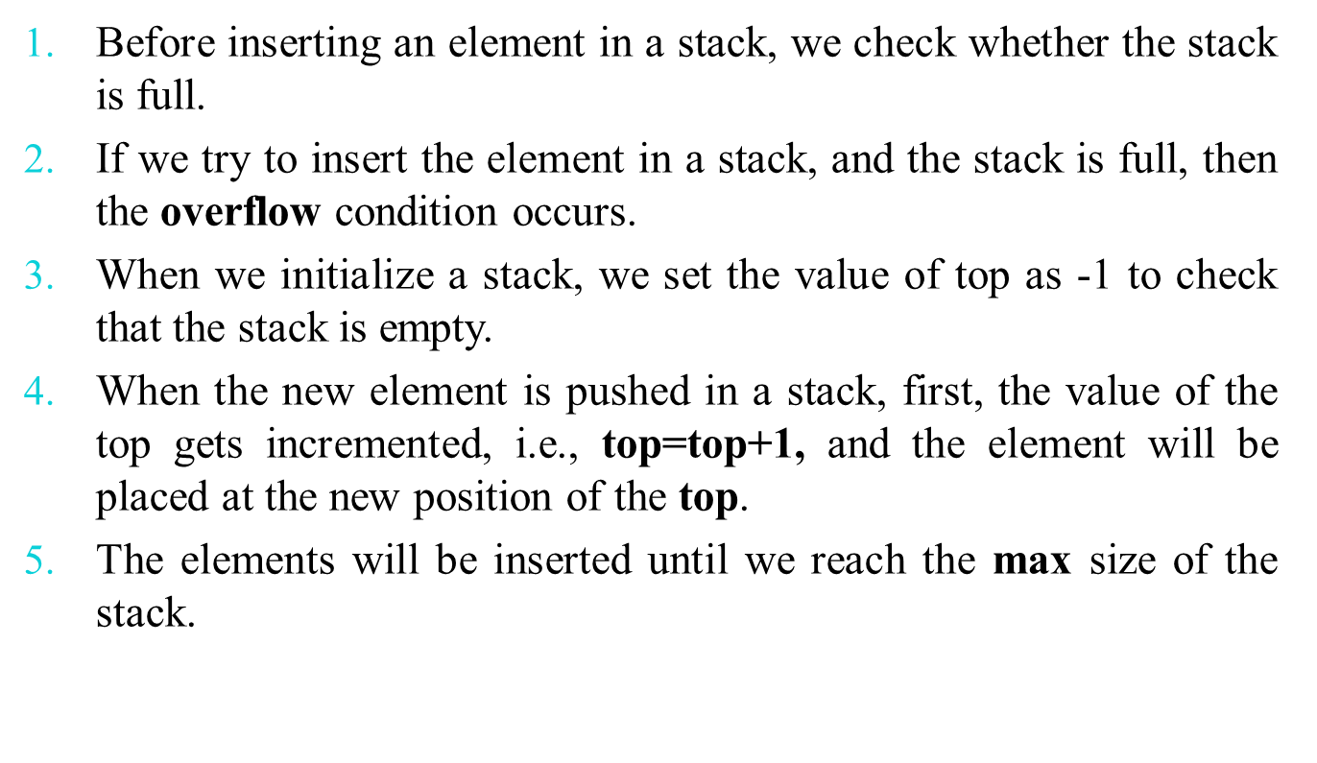
PUSH/Insert Operation

Slide 13
Insert Operation(Array)
PUSH(STACK, N, TOP, ITEM)
1. If TOP = N-1:
write “OVERFLOW”, and Return.
2. Set TOP = TOP + 1.
3. Set STACK[TOP] = ITEM.
4. Return.

Slide 14
Delete D
an item (D) is deleted from the Top of the stack
items[MAX-1]
. | .
. | .
items[3] | D
items[2] | C | Top=2
items[1] | B
items[0] | A

Slide 15
Delete C
an item (C) is deleted from the Top of the stack.
items[MAX-1]
. | .
. | .
items[3] | D
items[2] | C
items[1] | B | Top=1
items[0] | A

Slide 16
Delete B
an item (B) is deleted from the Top of the stack
items[MAX-1]
. | .
. | .
items[3] | D
items[2] | C
items[1] | B
items[0] | A | Top=0

Slide 17
Delete A
an item (A) is deleted from the Top of the stack.
items[MAX-1]
. | .
items[4]
items[3] | D
items[2] | C
items[1] | B
items[0] | A | Top=-1

Slide 18
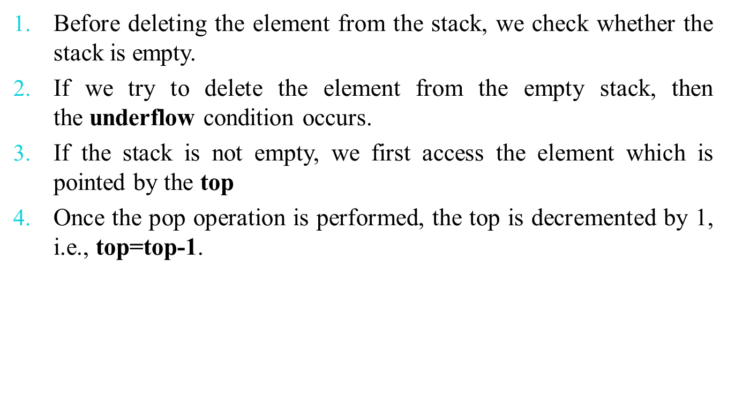
POP/Delete Operation

Slide 19
Delete Operation(Array)
POP(STACK, N, TOP, ITEM)
If TOP = NULL then :
write “UNDERFLOW”, and Return.
2. Set ITEM = STACK [TOP].
3. Set TOP = TOP - 1.
4. Return

Slide 20
Order of Precedence
The order of precedence of different operators is as follows:
Exponents have precedence one.
Multiplication and Division has precedence two.
Addition and subtraction have precedence three.

Slide 21
Postfix Notation(RPN)
Polish notation, also known as prefix notation.
It is a symbolic logic invented by Polish mathematician Jan Lukasiewicz in the 1920's.
Most compilers convert an expression in infix notation to postfix
  the operators are written after the operands
So a * b + c becomes a b * c +
Advantage:
  expressions can be written without parentheses

Slide 22

Reverse Polish Notation:
1. Scan the expression from left to right to find an operator.
2. Locate ("underline") the last two preceding operands
and combine them using this operator.
3. Repeat until the end of the expression is reached.
Example:
2 3 4 + 5 6 - - *
→ 2 3 4 + 5 6 - - *
→ 2 7 5 6 - - *
→ 2 7 5 6 - - *
→ 2 7 -1 - *
→ 2 7 -1 - * →
2 8 * →
16
2 8 * →

Slide 23

By hand: "Fully parenthesize-move-erase" method:
1. Fully parenthesize the expression.
2. Replace each right parenthesis by the corresponding operator.
3. Erase all left parentheses.
Examples:
A * B + C →
((A * B) + C)
A * (B + C) →
(A * (B + C) )
→ ((A B * C +
→ A B * C +
→ (A (B C + *
→ A B C + *

Slide 24

By hand: "Fully parenthesize-move-erase" method:
1. Fully parenthesize the expression.
2. Replace each left parenthesis by the corresponding operator.
3. Erase all right parentheses.
Examples:
A * B + C →
((A * B) + C)
A * (B + C) →
(A * (B + C))
→ + * A B) C)
→ + * A B C
→ * A + B C ))
→ * A + B C

Slide 25
Postfix and Prefix Examples
INFIX POSTFIX PREFIX
A + B
A * B + C
A * (B + C)
A - (B - (C - D))
A - B - C - D
A B +
+ A B
A B * C +
+ * A B C
A B C + *
* A + B C
A B C D---
-A-B-C D
A B-C-D-
---A B C D
Prefix : Operators come before the operands

Slide 26
Thank You

