Slide 1
GRAPHS

Slide 2
INTRODUCTION
A data structure that establishes a relationship from many parents to many children is graph.
In real life its used in number of situations like modelling the inter connection between various cities, airmap modelling the interconnection between various countries, routing messages over a computer network from one node to another, flow chart of a program.

Slide 3
Definition: Graphs
A graph is a non-linear data structure that consists of a collection of nodes(or vertices) and a collection of edges, with each edge joining one node to another. Edges are sometimes referred to as arcs. Formally a graph G=(V,E) consist of two sets
V called set of vertices or nodes.
E called set of all edges or arcs. This set E is the set of pair of elements from V.
In graph,
Vertices are represented by circles or points,
Edges are represented by line segments or arcs connecting the vertices.

Slide 4
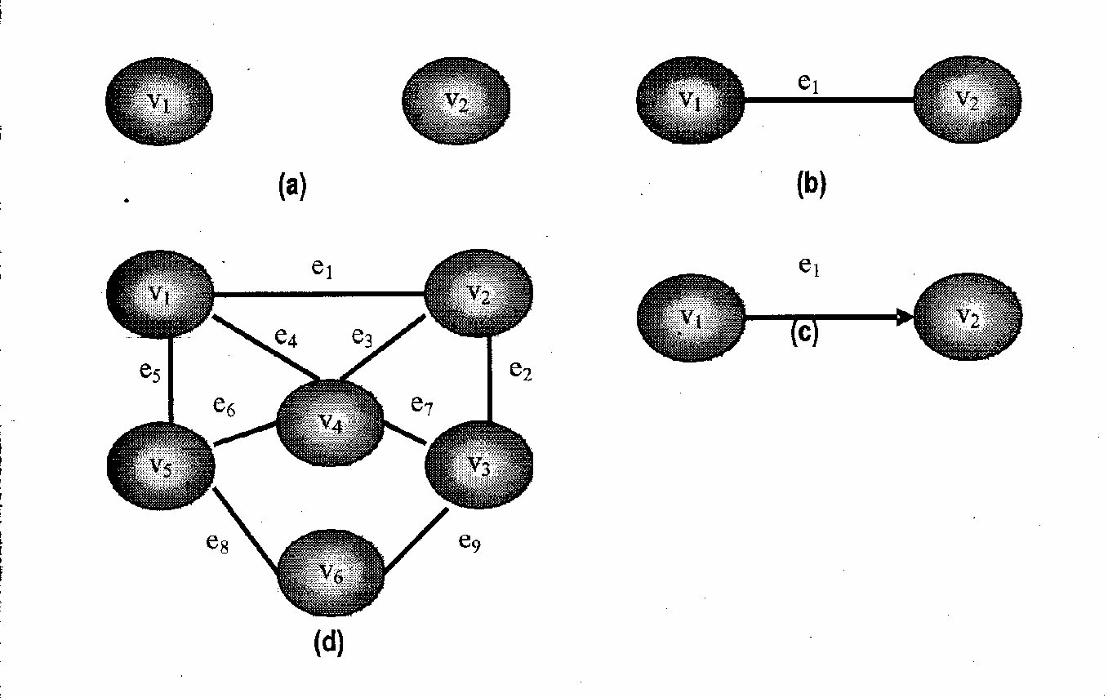

Slide 5
Types of Graphs
  Directed Graphs
  Undirected Graphs
  Weighted Graphs
  Unweighted Graphs
  Simple Graph
  Multigraph
  Complete Graph
  Connected Graph
  Disconnected Graph

Slide 6
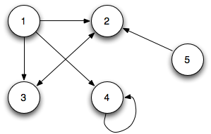
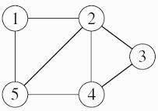
Directed and Undirected Graph
The edge in a graph can be directed or undirected depending on whether the direction of the edge is specified or not.
When the edges in a graph have no direction, the graph is called undirected
When the edges in a graph have a direction, the graph is called directed (or digraph)
DIRECTED GRAPH
UNDIRECTED GRAPH

Slide 7
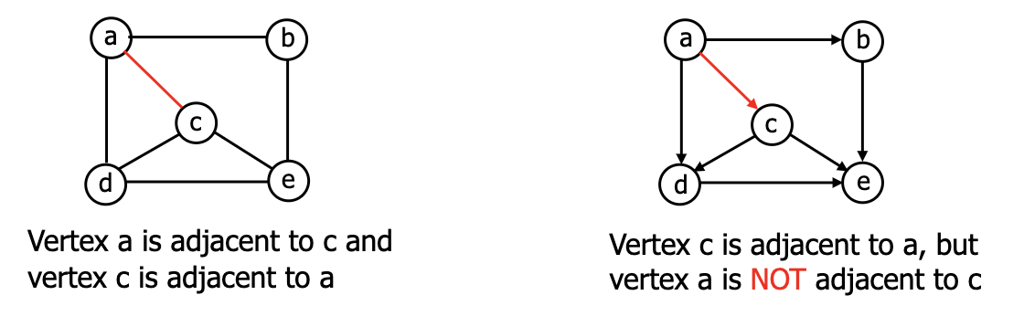
GRAPH TERMINOLOGY
1.ADJACENT VERTEX:
Two vertices in a graph are said to be adjacent if there exsists an edge between them. If a graph contains an edge(v1,v2) then vertex v2 is said to be adjancent to vertex v1.

Slide 8
2.PATH:
A path is a sequence of vertices traversed by following the edges between them. A path is simple if it has no repeating vertices. Ex: A→B→C
One special type of simple path is called cycle. A cycle is a simple path consisting of sequence of vertices such that the starting and ending vertex are same. Ex: A→B→C→A
A loop is special case of cycle in which an edge begins and ends with the same vertex. Ex: A→A
If a graph doesn’t contain any cycle, then it is called an acyclic graph.

Slide 9
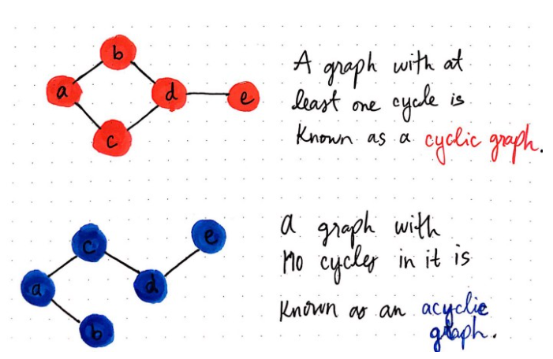

Slide 10
3.DEGREE OF VERTEX:
In an undirected graph ,the degree of vertex is the number of edges originating from it.
In other words, the number of edges connected with vertex v_{i} is called the degree of vertex v_{i.} It is denoted by degree (v_{i})
For directed graph this term is used as:
Indegree : is the number of edges entering the vertex. The indegree of vertex is denoted by indegree(v_{i} )
Outdegree : is the number of edges leaving the vertex. And represented by outdegree (v_{i} )
A vertex is pendent if its indegree is 1 and its outdegree is 0

Slide 11
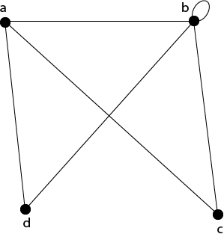
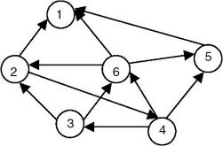
d(a)=3; d(b)=5; d(c) = 2; d(d)=2.

Slide 12
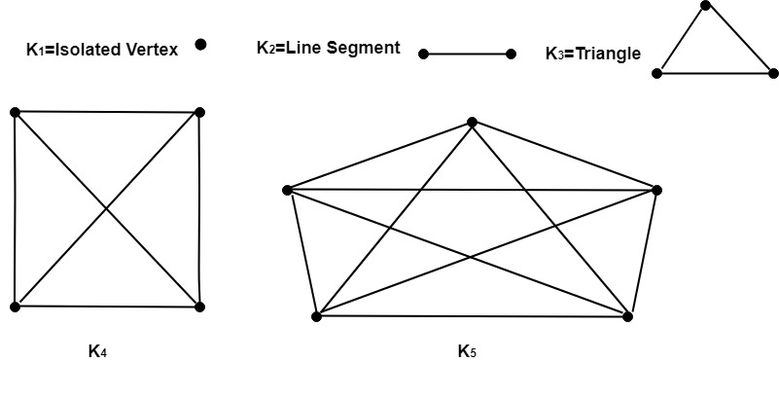
4.COMPLETE GRAPH:
A graph is said to be complete if there are edges from any vertex to all other vertices.
In such type of graph ,each vertex is adjacent to every other vertex.

Slide 13
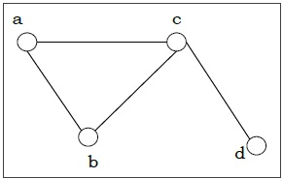
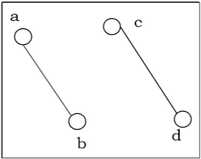
5.CONNECTED and DISCONNECTED GRAPH:
Connected Graph: A graph is called connected if there is a path from any vertex a to d or vice-versa.
Disconnected Graph: A graph is called disconnected if there is no path between any two of its vertices.

Slide 14
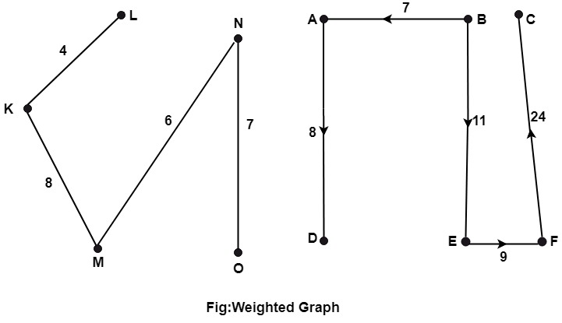
6.WEIGHTED GRAPH:
A graph is termed as weighted graph if all the edges in it are labelled with some weights.
A weight is the measure of the cost of using an edge to go from one vertex to another.
In an unweighted graph where the weight is not mentioned explicitly ,the cost of traversing an edge is same for all the edges.

Slide 15
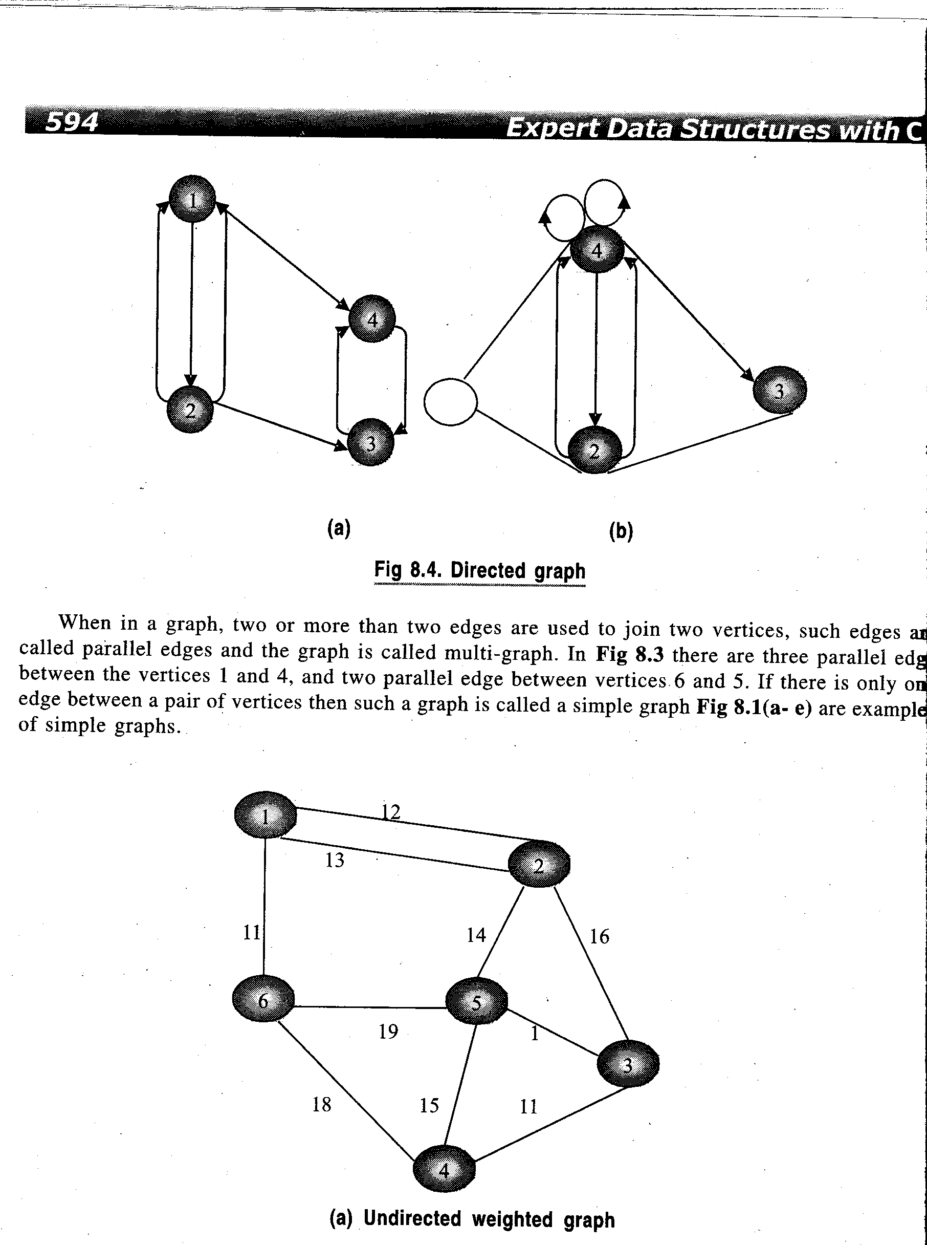
7.MULTIGRAPH:
It may be possible that there are two or more edges connecting the same vertices of graph. Such a graph is called multigraph.
In other words, it is a graph having at least one loop or multiple edges.

Slide 16
REPRESENTATION OF GRAPHS

Slide 17
Representation of a graph
There are two main ways of representing a graph in memory. These are:
1)Sequential Representation: Adjacency Matrix
2)Linked List Representation: Adjacency List

Slide 18
1. SEQUENTIAL/MATRIX REPRESENTATION
This representation can be used for both directed and undirected graph.
The graphs can be represented as matrices in sequential representation.
In this representation a square matrix of order NxN is used where N is number of vertices in graph.
There are two most common matrices. These are:
Adjacency Matrix
Incidence Matrix

Slide 19
1 if v_{i} is adjacent to v_{j} (if there is an edge between v_{i} and v_{j})
a_{ij} =
0 if there is no edge between v_{i} and v_{j}
Such a matrix that contains entries of only 0 or 1 is called a bit matrix or Boolean matrix.
The adjacency matrix of the graph G does depend on the ordering of the nodes in G that is different ordering of the nodes may result in a different adjacency matrix.

Slide 20
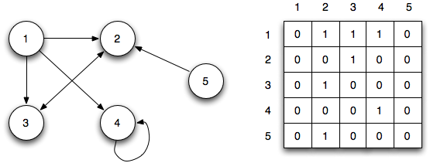
Matrix representation of a graph

Slide 21
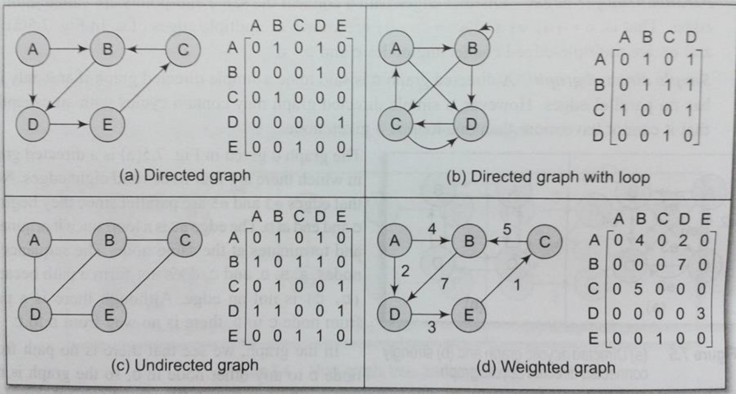
Adjacency Matrix

Slide 22
2. LINKED REPRESENTATION OF GRAPH
The sequential representation of the graph in memory i.e the representation of graph by adjacency matrix has a number of major drawbacks
It may be difficult to insert and delete nodes in Graph. This is because the size of array may need to be changed and the nodes may need to reordered which can lead to many changes in the matrix.
Also, if the number of edges are very less, then, the matrix will be sparse and there will be wastage of memory.

Slide 23
LINKED REPRESENTATION OF GRAPH
In linked representation of a graph ,two linked lists a vertex list and adjacency list are maintained.
The vertex list is a singly linked list maintaining all the vertices in the list irrespective of any order.
From each node of this vertex list another linked list known as adjacency list eminates that maintains all the vertices adjacent to the vertex stores in source node irrespective of any order

Slide 24
Each node of the vertex list contain of three parts:
The first part VERT_INFO that stores the vertex name.
The second part NEXTLINK that points to the next node in the vertex list.
The third part ADJ_LINK that points to the first node of its adjaceny list.
A node of the adjacency list consists of two parts:
The first part LINK_VERT that points to the node of the vertex list which is adjancent to it.
The second part LINK that points to the next node in the same adjacency list.

Slide 25
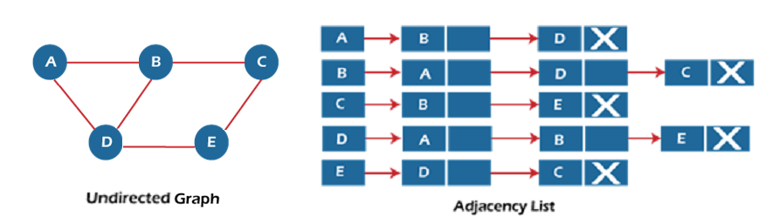
Adjacency List
This consists of a list of nodes.
Every node is linked to its own list that contains the names of all other nodes that are adjacent to it.
It provides ease to follow and clearly show adjacent nodes of a particular node.

Slide 26
A D
E
B C
Node | Adjacency List
A B C D E | B,C,D C C,E C

Slide 27
Graph Traversal Techniques
By traversing a graph, means the method of examining the nodes and edges of the graph.
There are 2 standard methods of graph traversal. These two methods are:
  1. Breadth-first search
  2. Depth-first search

Slide 28
Traversing a Graph
  Two methods:
  Breadth First Search (BFS)
  Depth First Search (DFS)
  BFS will use Queue and DFS will use Stack as auxiliary storage
  The algorithm will process only those nodes which are reachable from the starting node
  During the execution of the algorithm, each node N of G will be in one of the three states, called status of N
  STATUS = 1 : Ready State , i.e. initial state of node N
  STATUS = 2 : Waiting State , i.e. node N is in Queue or stack waiting to be processed
  STATUS = 3 : Processed State , i.e. node N has been processed

Slide 29
BFS
Breadth-first search is a graph traversal algorithm that starts traversing the graph from the root node and explores all the neighboring nodes. Then, it selects the nearest node and explores all the unexplored nodes. While using BFS for traversal, any node in the graph can be considered as the root node.
There are many ways to traverse the graph, but among them, BFS is the most commonly used approach. It is a recursive algorithm to search all the vertices of a tree or graph data structure.
BFS puts every vertex of the graph into two categories - visited and non-visited. It selects a single node in a graph and, after that, visits all the nodes adjacent to the selected node.

Slide 30
Applications of BFS algorithm
BFS can be used to find the neighboring locations from a given source location.
In a peer-to-peer network, BFS algorithm can be used as a traversal method to find all the neighboring nodes. Most torrent clients, such as BitTorrent, uTorrent, etc. employ this process to find "seeds" and "peers" in the network.
BFS is used to determine the shortest path and minimum spanning tree.

Slide 31
Example of breadth-first search
a
f
h
d
b
g
e
i
c
Q:

Slide 32
Example of breadth-first search
0
a
f
h
d
b
g
e
i
c
0
Q: a

Slide 33
Example of breadth-first search
0
a
f
h
1
d
1
b
g
e
i
c
1 1
Q: a b d

Slide 34
Example of breadth-first search
0
a
f
h
1
d
1
b
g
e
i
2
c
2
1 2 2
Q: a b d c e

Slide 35
Example of breadth-first search
0
a
f
h
1
d
1
b
g
e
i
2
c
2
2 2
Q: a b d c e

Slide 36
Example of breadth-first search
0
a
f
h
1
d
1
b
g
e
i
2
c
2
2
Q: a b d c e

Slide 37
Example of breadth-first search
0
a
f
h
1
d
3
1
b
g
e
i
2
c
2
3
3 3
Q: a b d c e g i

Slide 38
Example of breadth-first search
4
0
a
f
h
1
d
3
1
b
g
e
i
2
c
2
3
3 4
Q: a b d c e g i f

Slide 39
Example of breadth-first search
4
4
0
a
f
h
1
d
3
1
b
g
e
i
2
c
2
3
4 4
Q: a b d c e g i f h

Slide 40
Example of breadth-first search
4
4
0
a
f
h
1
d
3
1
b
g
e
i
2
c
2
3
4
Q: a b d c e g i f h

Slide 41
Example of breadth-first search
4
4
0
a
f
h
1
d
3
1
b
g
e
i
2
c
2
3
Q: a b d c e g i f h

Slide 42
BFS Algorithm
Step 1: SET STATUS = 1 (ready state) for each node in G
Step 2: Enqueue the starting node A and set its STATUS = 2 (waiting state)
Step 3: Repeat Steps 4 and 5 until QUEUE is empty
Step 4: Dequeue a node N. Process it and set its STATUS = 3 (processed state).
Step 5: Enqueue all the neighbours of N that are in the ready state (whose STATUS = 1) and set their STATUS = 2 (waiting state)
[END OF LOOP]
Step 6: EXIT

Slide 43
DFS (Depth First Search)
It is a recursive algorithm to search all the vertices of a tree data structure or a graph. The depth-first search (DFS) algorithm starts with the initial node of graph G and goes deeper until we find the goal node or the node with no children.
Because of the recursive nature, stack data structure can be used to implement the DFS algorithm. The process of implementing the DFS is similar to the BFS algorithm.

Slide 44
DFS (Depth First Search)
The step-by-step process to implement the DFS traversal is given as follows –
First, create a stack with the total number of vertices in the graph.
Now, choose any vertex as the starting point of traversal, and push that vertex into the stack.
After that, push a non-visited vertex (adjacent to the vertex on the top of the stack) to the top of the stack.
Now, repeat steps 3 and 4 until no vertices are left to visit from the vertex on the stack's top.
If no vertex is left, go back and pop a vertex from the stack.
Repeat steps 2, 3, and 4 until the stack is empty.

Slide 45
Applications of DFS algorithm
DFS algorithm can be used to implement the topological sorting.
It can be used to find the paths between two vertices.
It can also be used to detect cycles in the graph.
DFS algorithm is also used for one solution puzzles.
DFS is used to determine if a graph is bipartite or not.

Slide 46
Algorithm
Step 1: SET STATUS = 1 (ready state) for each node in G
Step 2: Push the starting node A on the stack and set its STATUS = 2 (waiting state)
Step 3: Repeat Steps 4 and 5 until STACK is empty
Step 4: Pop the top node N. Process it and set its STATUS = 3 (processed state)
Step 5: Push on the stack all the neighbors of N that are in the ready state (whose STATUS = 1) and set their STATUS = 2 (waiting state)
[END OF LOOP]
Step 6: EXIT

Slide 47
BFS vs DFS
.Sr No | Stands for | BFS stands for Breadth First Search. | DFS stands for Depth First Search.
2. | Data Structure | BFS(Breadth First Search) uses Queue data structure for finding the shortest path. | DFS(Depth First Search) uses Stack data structure.
3. | Definition | BFS is a traversal approach in which we first walk through all nodes on the same level before moving on to the next level. | DFS is also a traversal approach in which the traverse begins at the root node and proceeds through the nodes as far as possible until we reach the node with no unvisited nearby nodes.
4. | Technique | BFS can be used to find a single source shortest path in an unweighted graph because, in BFS, we reach a vertex with a minimum number of edges from a source vertex. | In DFS, we might traverse through more edges to reach a destination vertex from a source.
5. | Conceptual Difference | BFS builds the tree level by level. | DFS builds the tree sub-tree by sub-tree.

Slide 48
6. | Backtracking | In BFS there is no concept of backtracking. | DFS algorithm is a recursive algorithm that uses the idea of backtracking
7. | Suitable for | BFS is more suitable for searching vertices closer to the given source. | DFS is more suitable when there are solutions away from source.
8. | Time Complexity | The Time complexity of BFS is O(V + E) when Adjacency List is used and O(V^2) when Adjacency Matrix is used, where V stands for vertices and E stands for edges. | The Time complexity of DFS is also O(V + E) when Adjacency List is used and O(V^2) when Adjacency Matrix is used, where V stands for vertices and E stands for edges.
9. | Visiting of Siblings/ Children | Here, siblings are visited before the children. | Here, children are visited before the siblings.
10. | Applications | BFS is used in various applications such as bipartite graphs, shortest paths, etc. | DFS is used in various applications such as acyclic graphs and topological order etc.

Slide 49
11. | Memory | BFS requires more memory. | DFS requires less memory.
12. | Optimality | BFS is optimal for finding the shortest path. | DFS is not optimal for finding the shortest path.
13. | Space complexity | In BFS, the space complexity is more critical as compared to time complexity. | DFS has lesser space complexity because at a time it needs to store only a single path from the root to the leaf node.
14. | Speed | BFS is slow as compared to DFS. | DFS is fast as compared to BFS.
15. | When to use? | When the target is close to the source, BFS performs better. | When the target is far from the source, DFS is preferable.

Slide 50
THANK YOU

