Slide 1
Trees

Slide 2
Non-Linear data structure
Non-Linear data structure is that when one element can be connected to more than 2 adjacent element.
Every data item is attached to several other data items in a way that is specific for reflecting relationships.
The data items are not arranged in a sequential structure.
Example: Trees and Graphs.

Slide 3
Non-Linear data structure
Not stored in sequential order
Branches to more than one node
Can’t be traversed in a single run
Data members are not processed one after another

Slide 4
Tree
A tree is a multi-level data structure that represent a hierarchical relationship between the set of individual elements called nodes.
It is a set of one or more nodes where one node is designated as the root of the tree.
All the remaining nodes can be partitioned into non-empty sets each of which is a sub-tree of the root.
Collection of nodes or Finite set of nodes This collection can be empty Nodes and Edges.

Slide 5
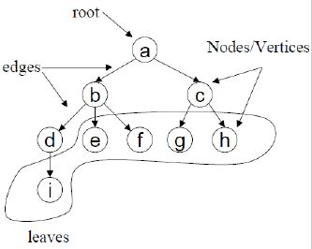
Tree
A vertex(or node) is a simple object that can have a name and can carry other associated information. Eg: Left pointer, Right pointer and a data element.
The first or top node in a tree is called the root node.
An edge is a connection between two vertices.
A path in a tree is a list of distinct vertices in which successive vertices are connected by edges in the tree.
Eg: {a,b,d,i} is path.

Slide 6
TREE TERMINOLOGY
NODE:A node is the key component of the tree data structure that stores the data element and may contain zero, one or more link to other successor node for connectivity. A tree consist of finite set of nodes.
EDGE or LINK: A directed line from one node to the other successor node is called edge of the tree.
  It is also known as link or arc or branch of a tree.
PARENT: The immediate predecessor of a node is called its parent. All the nodes except the root node have exactly one parent.
CHILD: All the immediate successors of a node are known as its child. If a node has two child then one on the left is called left child and other on the right is called right child.
SIBLING: Two or more nodes with same parents are called siblings.

Slide 7
ROOT: The topmost node of the tree is called the root of the trees. One can reach any node of the tree from the root node by following the edges.
DEGREE: The maximum number of children that are possible for a node is known as degree ,like in binary tree max 2 children can be there so degree is 2,
LEAF: The node that does not have any child node is called leaf node.
PATH: A path is a result in sequence of nodes when we traverse from a node to a node along the edges that connect them. There is always a unique path from the root to any other node in a tree.
LEVEL: The level of the node is an integer value that measures the distance of a node from the root. As the root is at zero distance from itself so it is at level 0.
DEPTH: The depth of a node is the length(number of edges) of the path from the root to the node of the tree.
Depth of the node is sometimes also referred to the level of a node.
HEIGHT: The height of a tree is the length (number of edges) of the path from the node to its furthest leaf.

Slide 8
Height and Depth of Tree
Depth of a node is the number of edges from the root to that node.
Depth of A (the root) = 0 (no edges).
Depth of B = 1 (one edge: A → B).
Depth of D = 2 (two edges: A → B → D).
Depth of G = 3 (three edges: A → B → E → G).
Height of a node is the number of edges on the longest path from that node to a leaf.
Height of D, G, H, F (all leaves) = 0 (no edges going downward).
Height of E = 1 (one edge downward: E → G or E → H).
Height of B = 2 (two edges downward: B → E → G or B → E → H).
Height of A (the root) = 3 (three edges downward: A → B → E → G or A → B → E → H).
A <- Root (Level 0)
/ \
B C <- Level 1
/ \ \
D E F <- Level 2
/ \
G H <- Level 3

Slide 9
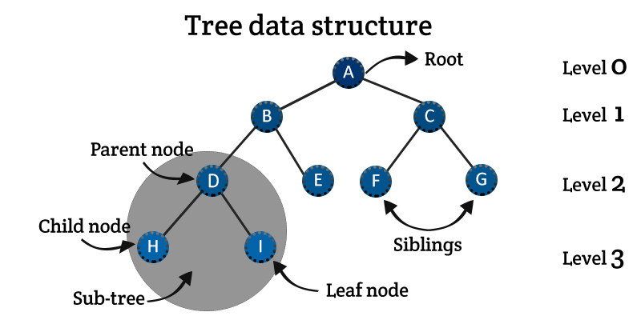
Level Number
Level number: Every node in the tree is assigned a level number in such a way that the root node is at level 0, children of the root node are at level number 1.
Thus, every node is at one level higher than its parent.
So, all child nodes have a level number given by parent’s level number + 1.

Slide 10
Degree of Node
Degree of a node is equal to the number of children it has.
Degree of leaf node is always zero.
Degree of F = 0
Degree of C = 2
Degree of B = 3

Slide 11
Binary Tree

Slide 12
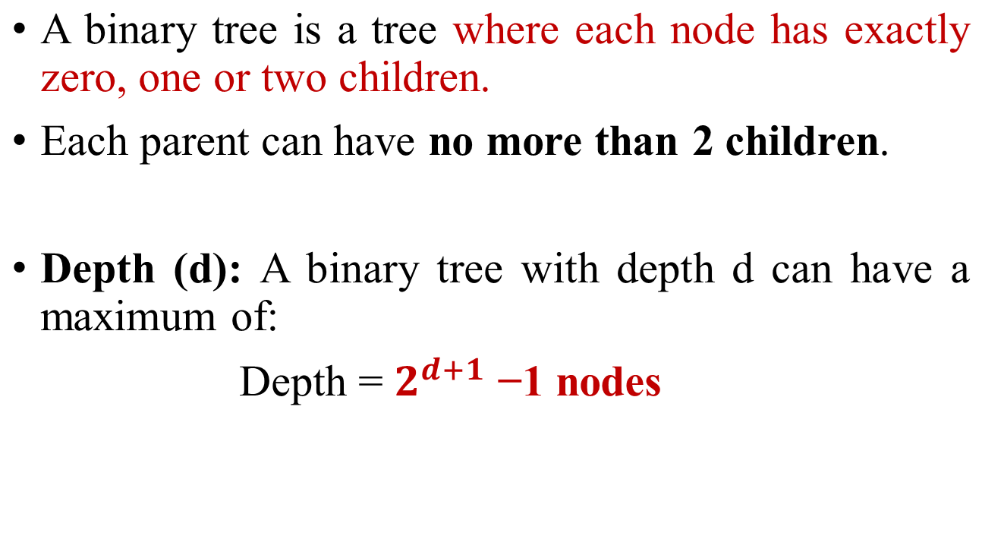
Binary Tree

Slide 13
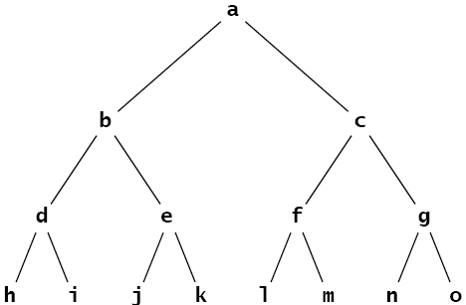
Full Binary Tree
A binary tree is said to be full binary tree if each node has exactly zero or two children.
Also known as proper binary tree

Slide 14
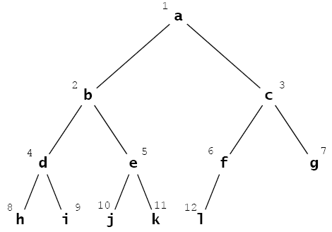
Complete Binary Tree
A complete binary tree is a binary tree where:
All levels are completely filled except possibly for the last level.
In the last level, all nodes are as far left as possible.
This means that a complete binary tree is filled level by level from left to right.
The last level may not be full, but all nodes on that level are packed to the left.

Slide 15
Binary Tree
Full binary tree
Complete binary tree

Slide 16
Representation of Binary Trees
In the linked representation of a binary tree, every node will have 3 parts:
  the data element,
  a pointer to the left node,
  a pointer to the right node.
So, in C, the binary tree is built with a node type given below.
    struct node {
    struct node *left;
    int data;
    struct node *right;
    };

Slide 17
Representation of Binary Trees
Every binary tree has a pointer ROOT, which points to the root element (topmost element) of the tree.
If ROOT = NULL, then the tree is empty

Slide 18
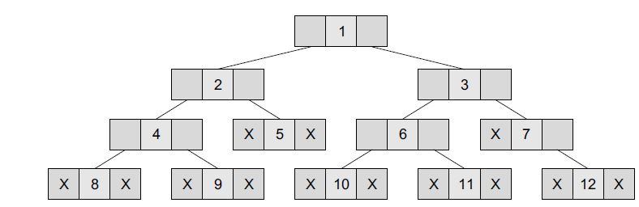
Representation of Binary Trees
The left position is used to point to the left child of the node or to store the address of the left child of the node.
The middle position is used to store the data.
Finally, the right position is used to point to the right child of the node or to store the address of the right child of the node.

Slide 19
Tree Traversal Technique
Visiting each of the nodes in a tree and examine the value there, a process called Traversal.
There are several common orders in which the nodes can be visited.
  1.Pre-Order: Root, Left child, Right child
  2.In-Order: Left child, Root, Right child.
  3.Post-Order: Left Child, Right child, Root

Slide 20
Pre-Order
1.Pre-Order: Root, Left child, Right child
  To traverse a non-empty binary tree in pre-order, the following operations are performed recursively at each node.
  The algorithm works by:
    1. Visiting the root node.
    2. Traversing the left sub-tree.
    3. Traversing the right sub-tree.

Slide 21
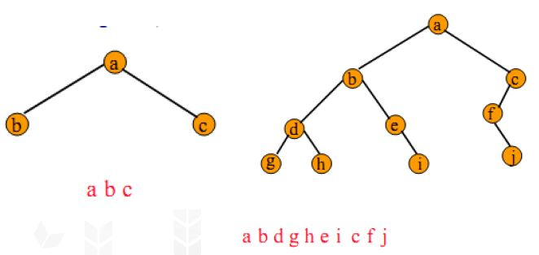
Pre-Order
Pre-Order: Root, Left child, Right child
  Step 1: Repeat step 2 to 4 while TREE != NULL
    Step 2: Write “TREE->DATA”
    Step 3: PREORDER(TREE->LEFT)
    Step 4: PREORDER(TREE->RIGHT)
  [END OF WHILE]
  Step 5: END

Slide 22
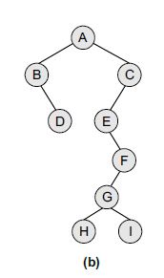
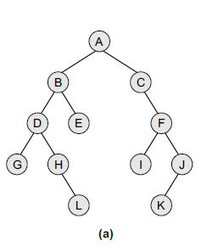
TRAVERSAL ORDER:
A, B, D, G, H, L, E, C, F, I, J,K
TRAVERSAL ORDER:
A, B, D, C, E, F, G, H,I

Slide 23
IN-ORDER
2. In-Order: Left child, Root, Right child
For in-order traversal of a binary tree, the following operations are performed recursively at each node:
1. Traverse the left sub-tree.
2. Visit the root node.
3. Traverse the right sub-tree.
In-order traversal typically visits nodes in a sorted order for binary search trees.

Slide 24
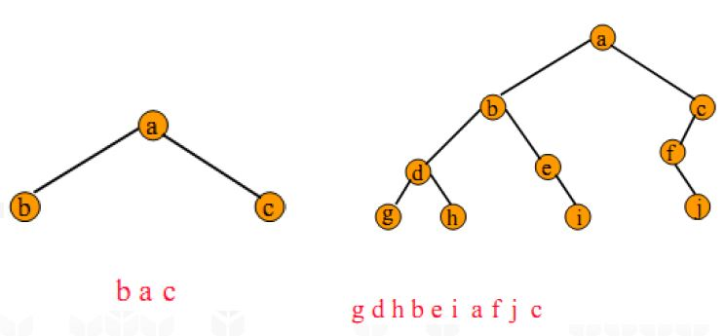
IN-ORDER
In-Order: Left child, Root, Right child.
Step 1: Repeat step 2 to 4 while TREE != NULL
  Step 2: INORDER(TREE->LEFT)
  Step 3: Write “TREE->DATA”
  Step 4: INORDER(TREE->RIGHT)
[END OF WHILE]
Step 5: END

Slide 25
Post-Order
3. Post-Order: Left Child, Right child, Root
To traverse a non-empty binary tree in post-order, the following operations are performed recursively at each node.
The algorithm works by:
  1. Traversing the left sub-tree.
  2. Traversing the right sub-tree.
  3. Visiting the root node.

Slide 26
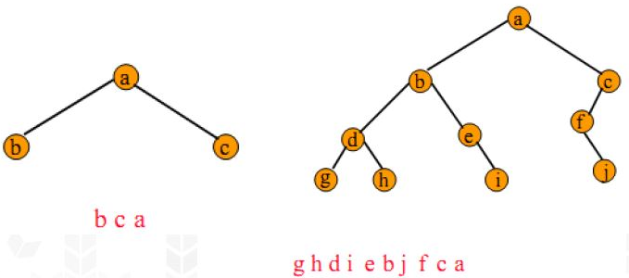
Post-Order
Post-Order: Left Child, Right child, Root
Step 1: Repeat step 2 to 4 while TREE != NULL
  Step 2: POSTORDER(TREE->LEFT)
  Step 3: POSTORDER(TREE->RIGHT)
  Step 4: Write “TREE->DATA”
[END OF WHILE]
Step 5: END

Slide 27
Preoder, Inorder, Postorder
In Preorder, the root
is visited before (pre)
the subtrees traversals
In Inorder, the root is
visited in-between left
and right subtree traversal
In Preorder, the root
is visited after (pre)
the subtrees traversals
Preorder Traversal:
Visit the root
Traverse left subtree
Traverse right subtree
Inorder Traversal:
Traverse left subtree
Visit the root
Traverse right subtree
Postorder Traversal:
Traverse left subtree
Traverse right subtree
Visit the root

Slide 28
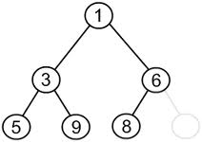
Tree Traversals
Pre-Order(NLR)
1, 3, 5, 9, 6, 8

Slide 29
Tree Traversals
In-Order(LNR)
5, 3, 9, 1, 8, 6

Slide 30
Tree Traversals
Post-Order(LRN)
5, 9, 3, 8, 6, 1

Slide 31
Illustrations for Traversals
1
3
7
5
8
9
10
4
6
11
12

Slide 32
Illustrations for Traversals
Assume: visiting a node
is printing its label
Pre order: 1 3 5 4 6 7 8 9 10 11 12
In order: 4 5 6 3 1 8 7 9 11 10 12
Post order: 4 6 5 3 8 11 12 10 9 7 1
1
3
7
5
8
9
10
4
6
11
12

Slide 33
Illustrations for Traversals
15
8
20
2
11
27
6
10
12
22
30
3
7
14

Slide 34
Illustrations for Traversals
Assume: visiting a node
is printing its data
Pre order: 15 8 2 6 3 7
11 10 12 14 20 27 22 30
In order: 2 3 6 7 8 10 11
12 14 15 20 22 27 30
Post order: 3 7 6 2 10 14
12 11 8 22 30 27 20 15
15
8
20
2
11
27
6
10
12
22
30
3
7
14

Slide 35
Construct Tree using Inorder and Preorder Traversal
Question 1:
Pre Order: F, A, E, K, C, D, H, G, B (NLR)
In Order: E, A, C, K, F, H, D, B, G (LNR)

Slide 36
Construct Tree using Inorder and Preorder Traversal
Question 2:
Pre Order: 1, 2, 4, 8, 9, 10, 11, 5, 3, 6, 7 (NLR)
In Order: 8, 4, 10, 9, 11, 2, 5, 1, 6, 3, 7 (LNR)

Slide 37
Construct Tree using Inorder and Postorder Traversal
Question 1:
Post Order: E, C, K, A, H, B, G, D, F (LRN)
In Order: E, A, C, K, F, H, D, B, G (LNR)

Slide 38
Construct Tree using Inorder and Postorder Traversal
Question 2:
Post Order: 9, 1, 2, 12, 7, 5, 3, 11, 4, 8 (LRN)
In Order: 9, 5, 1, 7, 2, 12, 8, 4, 3, 11 (LNR)

Slide 39
Binary Search Tree

Slide 40
BINARY TREE
A binary tree is a special form of tree in which a node can have atmost two children
A node in a binary tree may not necessarily have the maximum of two children i.e either 1,2 or 0 child.
A tree which does not contain any node is called empty binary node.

Slide 41
Binary Search Tree
Binary Search Tree abbreviated as BST is a special form of binary tree whose nodes are arranged in such a way that for every node N, the values contained in all nodes in its left sub tree are less the value contained in N and values contained in the right sub tree are larger than the node N.

Slide 42
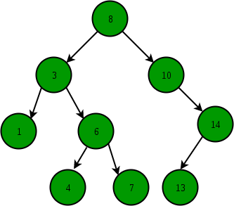
Binary Search Tree
Binary Search Tree is a node-based binary tree data structure which has the following properties:
The left subtree of a node contains only nodes with keys lesser than the node’s key.
The right subtree of a node contains only nodes with keys greater than the node’s key.
The left and right subtree each must also be a binary search tree.

Slide 43
Binary Search Tree
Question 1: Construct BST for the below elements
45, 98, 76, 14, 12, 30, 18, 90, 72, 50, 20
Question 2: Construct BST for the below elements
45, 32, 90, 32, 45, 65, 25, 90, 74
Question 3: Construct BST for the below elements
S, Y, R, B, K, T, M, O, Q, Z, A, D, P, H

Slide 44
Operations on BST includes:
  Search Operation
  Insert Operation
  Delete Operation

Slide 45
SEARCHING
Searching an item is the key operation performed on a BST. When we want to search given item(ITEM) in BST ,we begin by first comparing the ITEM with the value in root.
If they are equal then the location of the root node is returned.
If the ITEM is less than the value of the root then we need to search the left sub tree of the root. The right sub tree is eliminated .
If the ITEM is greater than the value of the root then we need to search the right sub tree of the root.

Slide 46
Algorithm to search an element in Binary search tree
Search (root, item)
Step 1 - if (item = root → data) or (root = NULL)
return root
else if (item < root → data)
return Search(root → left, item)
else
return Search(root → right, item)
END if
Step 2 - END

Slide 47
INSERTION IN BST
Insertion of new node into binary search tree is very simple operation based on the search operation.
In order to insert a node with given item into BST ,we begin searching at the root and descend level by level moving left or right subtree as appropriate comparing the value of the current node and node being inserted.
When we reach a node with empty subtree (i.e leaf) then we insert the new node as its left or right child depending on ITEM.

Slide 48
INSERTION IN BST
While searching if the ITEM to be inserted is already in the tree then do nothing as we know binary tree cannot hold the duplicate values.
Also note that as insertion take place only at leaf node so we only need ITEM to be inserted and not the location of the insertion

Slide 49
Inserting a Node in BST
Step 1: IF TREE = NULL, then
Allocate memory for TREE
SET TREE -> DATA = VAL
SET TREE -> LEFT = TREE -> RIGHT = NULL
ELSE
IF VAL < TREE -> DATA
Insert(TREE->LEFT, VAL)
ELSE
Insert(TREE->RIGHT, VAL)
[END OF IF]
[END OF IF]
Step 2: Exit

Slide 50
Deleting a node in BST
Case 1: Delete a node that has no children
Case 2 : Delete a node that has one child
Case 3 : Delete a node that has two children

Slide 51
Deleting a node in BST
Case 1: Delete a node that has no children
If we are trying to delete a leaf, there is no problem. We just delete it and the rest of the tree is exactly as it was, so it is still a BST.

Slide 52
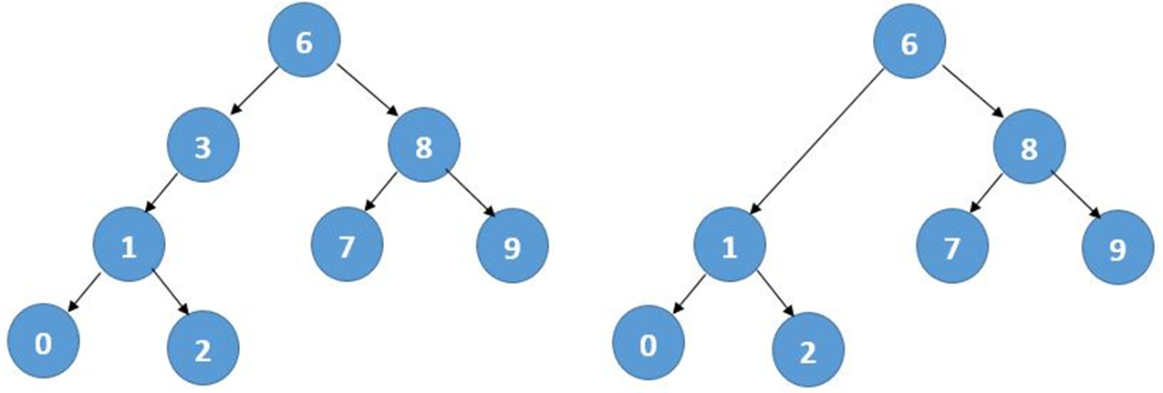
Deleting a node in BST
Case 2 : Delete a node that has one child
There is another simple situation: suppose the node we're deleting has only 1 subtree.
In the following example, ‘3’ has only 1 subtree.
To delete a node with 1 subtree, we just ‘link past’ the node, i.e. connect the parent of the node directly to the node's only subtree.
This always works, whether the one subtree is on the left or on the right. Deleting ‘3’ gives us:

Slide 53
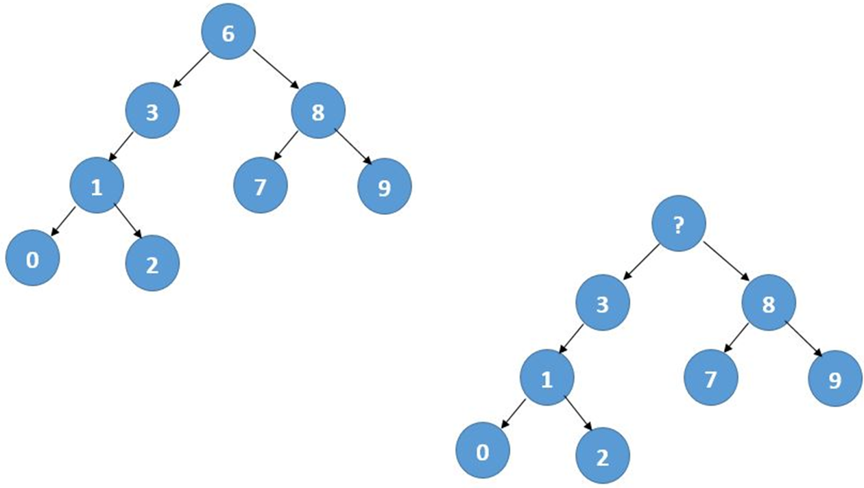
Deleting a node in BST
Case 3 : Delete a node that has two children
We leave the node containing ‘6’ exactly where it is, but we get rid of the value 6 and find another value to store in the ‘6’ node.
This value is taken from a node below the ‘6’s node, and it is that node that is actually removed from the tree.

Slide 54
Deleting a node in BST
Now, what value can we move into the vacated node and have a binary search tree?
If we choose value X, then:
Everything in the left subtree must be smaller than X.
Everything in the right subtree must be bigger than X.

Slide 55
Deleting a node in BST
Let's suppose we're going to get X from the left subtree.
We must choose X such that it is the largest value in the left subtree.
X = 3 is guaranteed because everything in the left subtree is smaller than everything in the right subtree.

Slide 56
AVL Tree / Height Balanced Tree

Slide 57
AVL Tree
AVL Tree is invented by GM Adelson - Velsky and EM Landis in 1962
An AVL tree is a self-balancing binary search tree.
In an AVL tree, the heights of the 2 child subtrees of any node differ by at most one.
If at any time they differ by more than one, rebalancing is done to restore this property.
Insertions and deletions may require the tree to be rebalanced by one or more tree rotations.

Slide 58
AVL Tree
A balanced binary tree, also referred to as a height-balanced binary tree, is defined as, a binary tree in which the height of the left and right subtree of any node differ by not more than 1.
Following are the conditions for a height-balanced binary tree:
Difference between the left and the right subtree for any node is not more than one.
The left subtree is balanced.
The right subtree is balanced.

Slide 59
AVL Tree
The balance factor of a binary tree is the difference in heights of its two subtrees (h_{L}-h_{R}).
The balance factor (bf) of a height balanced binary tree may take on one of the values -1, 0, +1.
An AVL Tree is a height-balanced binary search tree.
An AVL node is:
"left-heavy" when bf = -1.
"equal-height" when bf = 0.
"right-heavy" when bf = +1.

Slide 60
AVL Tree
AVL trees are height-balanced binary search trees
Balance factor of a node
height(left subtree) - height(right subtree)
An AVL tree has balance factor calculated at every node
For every node, heights of left and right subtree can differ by no more than 1

Slide 61
AVL TREE ROTATIONS
We perform rotation in AVL tree only in case if Balance Factor is other than -1, 0, and 1. There are basically four types of rotations which are as follows:
L L rotation: Inserted node is in the left subtree of left subtree of A
R R rotation : Inserted node is in the right subtree of right subtree of A
L R rotation : Inserted node is in the right subtree of left subtree of A
R L rotation : Inserted node is in the left subtree of right subtree of A

Slide 62
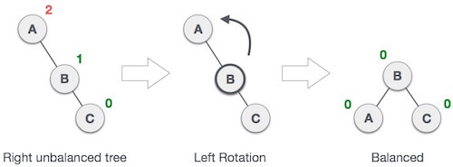
RR ROTATION

Slide 63
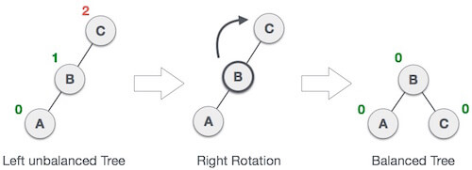
LL ROTATION

Slide 64

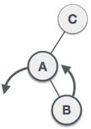
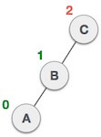
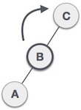
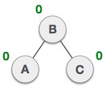
LR ROTATION
First RR rotation is performed on subtree and then LL rotation is performed on full tree
LR rotation = LL rotation + RR rotation

Slide 65

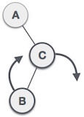
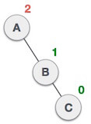
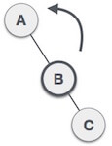
RL ROTATION
First LL rotation is performed on subtree and then RR rotation is performed on full tree.
R L rotation = RR rotation + LL rotation

Slide 66
AVL Tree
Question 1: Construct AVL Tree from given elements
35, 50, 40, 25, 30, 60, 78, 20, 28
Question 2: Construct AVL Tree from given elements
45, 70, 19, 72, 14, 90, 66, 68, 12, 10, 5

Slide 67
Deletion in an AVL Tree
Deletion in an AVL tree is similar to that in a BST.
Deletion of a node tends to disturb the balance factor. Thus to balance the tree, we again use the Rotation mechanism.
Deletion in AVL tree consists of two steps:
Removal of the node: The given node is removed from the tree structure. The node to be removed can either be a leaf or an internal node.
Re-balancing of the tree: The elimination of a node from the tree can cause disturbance to the balance factor of certain nodes. Thus it is important to re- balance theb_fact of the nodes; since the balance factor is the primary aspect that ensures the tree is an AVL Tree.

Slide 68
Deletion in an AVL Tree
Note: There are certain points that must be kept in mind during a deletion process.
If the node to be deleted is a leaf node, it is simply removed from the tree.
If the node to be deleted has one child node, the child node is replaced with the node to be deleted simply.
If the node to be deleted has two child nodes then,
  Either replace the node with it’s inorder predecessor , i.e, the largest element of the left sub tree.
  Or replace the node with it’s inorder successor , i.e, the smallest element of the right sub tree.

Slide 69
B Tree

Slide 70
B Tree
It is a special type of search tree called B Tree in which a node contains more than one value (key) and more than two children.
B Tree was developed in the year 1972 by Bayer and McCreight with the name Height Balanced m-way Search Tree. Later it was named as B Tree.
B Tree is a specialized m-way tree that can be widely used for disk access.
A B Tree of order m can have at most m-1 keys and m children.
One of the main reason of using B tree is its capability to store large number of keys in a single node and large key values by keeping the height of the tree relatively small.

Slide 71
B Tree
B tree of order m contains all the properties of an M way tree. In addition, it contains the following properties.
Every node in a B-Tree contains at most m children.
Every node in a B-Tree except the root node and the leaf node contain at least m/2 children.
The root nodes must have at least 2 nodes.
All leaf nodes must be at the same level.
It is not necessary that, all the nodes contain the same number of children but, each node must have m/2 number of nodes.

Slide 72
B Tree
B tree of order m:
Max keys = m-1
Min keys = [m/2] – 1

Slide 73
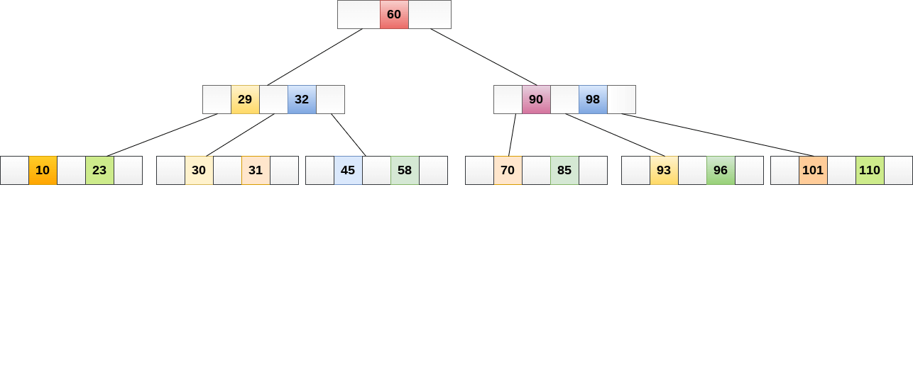
B Tree
While performing some operations on B Tree, any property of B Tree may violate such as number of minimum children a node can have. To maintain the properties of B Tree, the tree may split or join

Slide 74
B Tree
Question 1: Create a B-Tree of order 3 and inserting values from 1 to 10 ?
Question 2: Create a B-Tree of order 4 and insert the following values 5, 3, 21, 9, 1, 13, 2, 7, 10, 12, 4, 8

Slide 75
B Tree Searching
Searching in B Trees is similar to that in Binary search tree. For example, if we search for an item 49 in the following B Tree. The process will something like following:
Compare item 49 with root node 78. since 49 < 78 hence, move to its left sub-tree.
Since, 40<49<56, traverse right sub-tree of 40.
49>45, move to right. Compare 49.
match found, return.

Slide 76
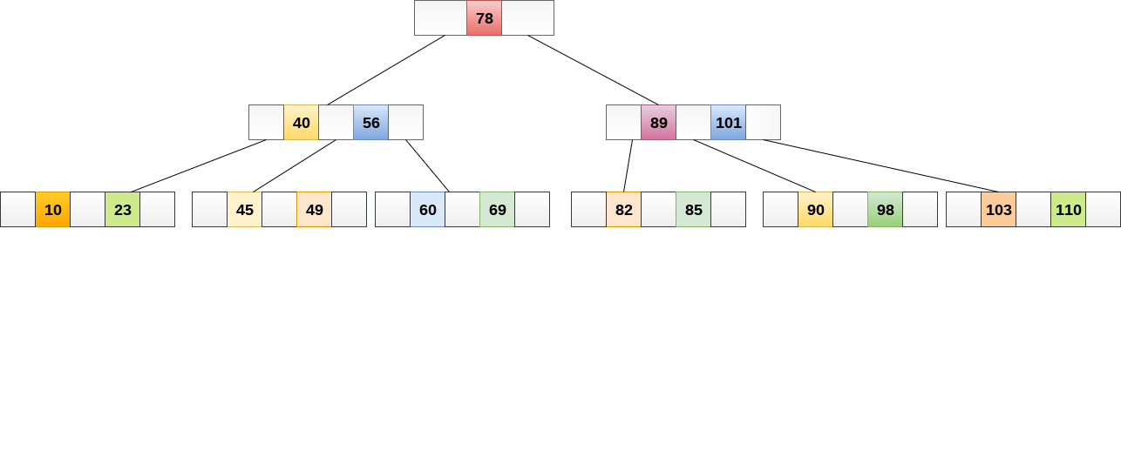
B Tree Searching
Searching in a B tree depends upon the height of the tree. The search algorithm takes O(log n) time to search any element in a B tree.

Slide 77
B Tree Insertion
Insertions are done at the leaf node level. The following algorithm needs to be followed in order to insert an item into B Tree.
Traverse the B Tree in order to find the appropriate leaf node at which the node can be inserted.
If the leaf node contain less than m-1 keys then insert the element in the increasing order.
Else, if the leaf node contains m-1 keys, then follow the following steps.
  Insert the new element in the increasing order of elements.
  Split the node into the two nodes at the median.
  Push the median element upto its parent node.
  If the parent node also contain m-1 number of keys, then split it too by following the same steps.

Slide 78
B Tree Deletion
Deletion is also performed at the leaf nodes. The node which is to be deleted can either be a leaf node or an internal node. Following algorithm needs to be followed in order to delete a node from a B tree.
Locate the leaf node.
If there are more than m/2 keys in the leaf node then delete the desired key from the node.
If the leaf node doesn't contain m/2 keys then complete the keys by taking the element from eight or left sibling.
  If the left sibling contains more than m/2 elements then push its largest element up to its parent and move the intervening element down to the node where the key is deleted.
  If the right sibling contains more than m/2 elements then push its smallest element up to the parent and move intervening element down to the node where the key is deleted.
If neither of the sibling contain more than m/2 elements then create a new leaf node by joining two leaf nodes and the intervening element of the parent node.
If parent is left with less than m/2 nodes then, apply the above process on the parent too.
If the the node which is to be deleted is an internal node, then replace the node with its in-order successor or predecessor. Since, successor or predecessor will always be on the leaf node hence, the process will be similar as the node is being deleted from the leaf node.

Slide 79
Application of B-Tree
B tree is used to index the data and provides fast access to the actual data stored on the disks since, the access to value stored in a large database that is stored on a disk is a very time consuming process.
Searching an un-indexed and unsorted database containing n key values needs O(n) running time in worst case. However, if we use B Tree to index this database, it will be searched in O(log n) time in worst case.

Slide 80
B+ Tree

Slide 81
B+ Tree
B+ Tree is an extension of B Tree which allows efficient insertion, deletion and search operations.
In B Tree, Keys and records both can be stored in the internal as well as leaf nodes.
Whereas, in B+ tree, records (data) can only be stored on the leaf nodes while internal nodes can only store the key values.
The leaf nodes of a B+ tree are linked together in the form of a singly linked lists to make the search queries more efficient.
B+ Tree are used to store the large amount of data which can not be stored in the main memory.
Due to the fact that, size of main memory is always limited, the internal nodes of the B+ tree are stored in the main memory whereas, leaf nodes are stored in the secondary memory.

Slide 82
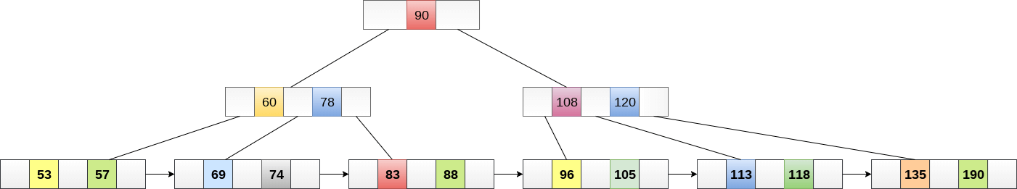
B+ Tree
The internal nodes of B+ tree are often called index nodes. B+ tree of order 3 is shown in the following figure.

Slide 83
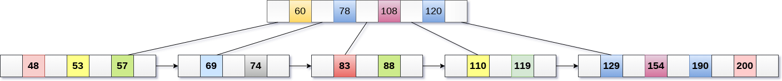
B+ Tree Insertion
Insert the value 195 into the B+ tree of order 5 shown in the following figure.

Slide 84
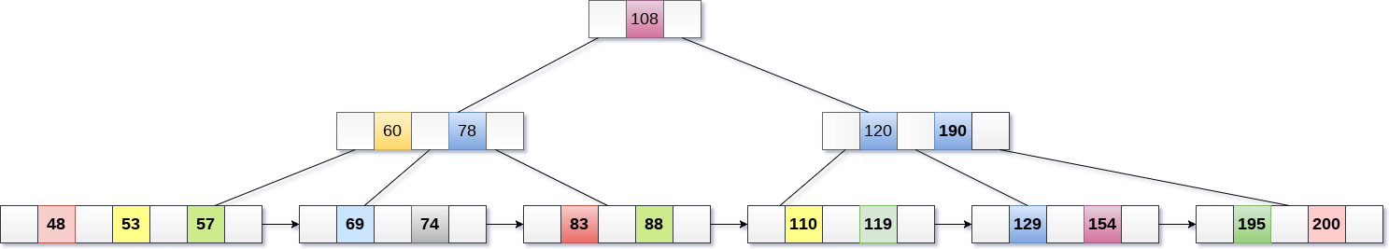
B+ Tree Insertion

Slide 85
B+ Tree Deletion
Step 1: Delete the key and data from the leaves.
Step 2: if the leaf node contains less than minimum number of elements, merge down the node with its sibling and delete the key in between them.
Step 3: if the index node contains less than minimum number of elements, merge the node with the sibling and move down the key in between them.

Slide 86
B+ Tree
Question 1: Create a B+ Tree of order 4 and insert the following values 1, 3, 5, 7, 9, 2, 4, 6, 8, 10 ?
Question 2: Create a B+ Tree of order 3 and insert the following values 10, 20, 30, 40, 50 ?
Question 3: Create a B+ Tree of order 4 and insert the following values 3, 18, 14, 30, 32, 36, 15, 16, 12, 40, 38, 45 ?

Slide 87
Advantages of B+ Tree
Records can be fetched in equal number of disk accesses.
Height of the tree remains balanced and less as compare to B tree.
We can access the data stored in a B+ tree sequentially as well as directly.
Keys are used for indexing.
Faster search queries as the data is stored only on the leaf nodes.

Slide 88
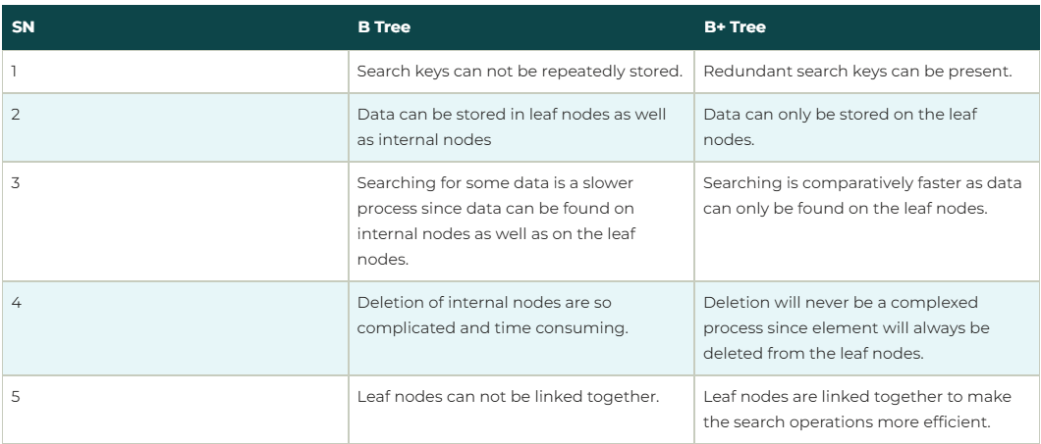
B Tree vs B+ Tree

Slide 89
THANK YOU

