Slide 1
Data Structures
LINKED LIST

Slide 2
Introduction
A linked list is a linear data structure, in which the elements are not stored at contiguous memory locations.
OR
Linked List can be defined as collection of objects called nodes that are randomly stored in the memory.
Each node is divided into two parts.
First part contains the information of the element.
Second part contains the address of the next node in the list.
The last node of the list contains pointer to the null.

Slide 3
Key Points
Linked list
Linear collection of nodes.
Connected by pointer links.
Accessed via a pointer to the first node of the list.
Link pointer in the last node is set to null to mark the list’s end.
Use a linked list instead of an array when
You have an unpredictable number of data elements
You want to insert and delete quickly.

Slide 4
Advantages
Data structure can shrink and grow at the runtime by deallocating or allocating memory, so there is no need for an initial size in linked list.
Data structures like queues and stacks can be easily implemented using a Linked List.
No Memory Wastage.
Insertion and Deletion are easy.
Disadvantages:
More memory usage.
Accessing particular element takes more time.
In a singly linked list, reverse traversal is not possible, as every node stores only the address of the next node

Slide 5
Why use linked list over array?
Array contains following limitations:
The size of array must be known in advance before using it in the program.
Increasing size of the array is a time taking process. It is almost impossible to expand the size of the array at run time.
All the elements in the array need to be contiguously stored in the memory. Inserting any element in the array needs shifting of all its predecessors.

Slide 6
Why use linked list over array?
Linked list is the data structure which can overcome all the limitations of an array. Using linked list is useful because,
It allocates the memory dynamically. All the nodes of linked list are non-contiguously stored in the memory and linked together with the help of pointers.
Sizing is no longer a problem since we do not need to define its size at the time of declaration. List grows as per the program's demand and limited to the available memory space.

Slide 7
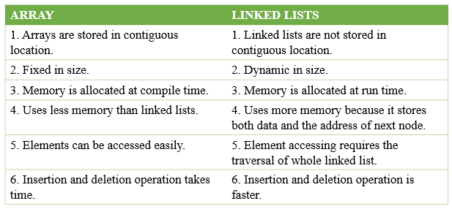
Differences between Array and Linked List

Slide 8
Applications
Implementation of stacks and queues
Implementation of graphs
Maintaining a directory of names
Performing arithmetic operations on long integers
Manipulation of polynomials by storing constants in the node of the linked list
Representing sparse matrices

Slide 9
Types of Linked List
Singly linked list
Circular linked list
Doubly linked list
Circular Doubly linked list

Slide 10
Types of Linked Lists
1. Singly linked list
Begins with a pointer to the first node
Terminates with a null pointer
Only traversed in one direction
2. Circular, singly linked
Pointer in the last node points
back to the first node
3. Doubly linked list
Two “start pointers” – first element and last element
Each node has a forward pointer and a backward pointer
Allows traversals both forwards and backwards
4. Circular, doubly linked list
Forward pointer of the last node points to the first node and backward pointer of the first node points to the last node

Slide 11
Singly Linked List

Slide 12
Singly Linked List
Singly linked list can be defined as the collection of ordered set of elements. The number of elements may vary according to need of the program.
A node in the singly linked list consist of two parts: data part and link part. Data part of the node stores actual information that is to be represented by the node while the link part of the node stores the address of its immediate successor.
One way chain or singly linked list can be traversed only in one direction. In other words, we can say that each node contains only next pointer, therefore we can not traverse the list in the reverse direction.

Slide 13
Consider an example where the marks obtained by the student in three subjects are stored in a linked list as shown in the figure.
In the above figure, the arrow represents the links. The data part of every node contains the marks obtained by the student in the different subject. The last node in the list is identified by the null pointer which is present in the address part of the last node. We can have as many elements we require, in the data part of the list.

Slide 14
Singly Linked List
A singly linked list is a concrete data structure consisting of a sequence of nodes
Each node stores
element
link to the next node
next
element
node
∅
A
B
C
D

Slide 15
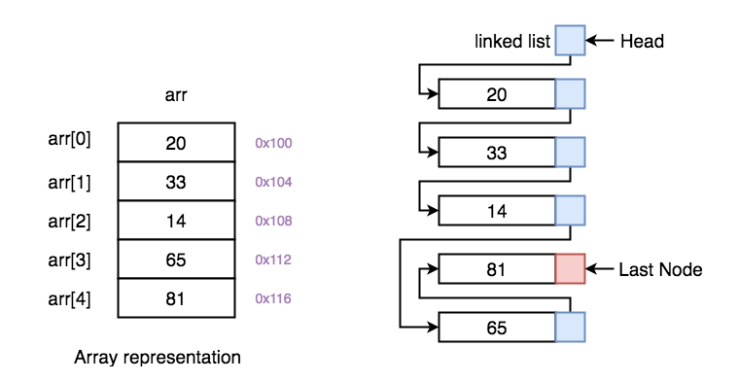

Slide 16
Insertion in singly linked list at beginning
Step 1: IF PTR = NULL
Write OVERFLOW Go to Step 7 [END OF IF]
Step 2: SET PTR = NEW_NODE //create memory loc for new node insertion
Step 3: SET PTR = PTR → NEXT //next available free node in memory
Step 4: SET NEW_NODE → DATA = VAL // update value
Step 5: SET NEW_NODE → NEXT = HEAD
Step 6: SET HEAD = NEW_NODE //now HEAD pointing new node
Step 7: EXIT

Slide 17
Inserting at the end
Step 1: IF PTR = NULL
Write OVERFLOW [END OF IF]
Step 2: SET NEW_NODE = PTR //points to the free block of memory
Step 3: SET PTR = PTR - > NEXT //next available free node
Step 4: SET NEW_NODE - > DATA = VAL
Step 5: SET NEW_NODE - > NEXT = NULL
Step 6: SET PTR = HEAD //point to the HEAD for traversal of list
Step 7: Repeat Step 8 while PTR - > NEXT != NULL
Step 8: SET PTR = PTR - > NEXT //move PTR to the next node [END OF LOOP]
Step 9: SET PTR - > NEXT = NEW_NODE //link next PTR of last node
Step 10: EXIT

Slide 18
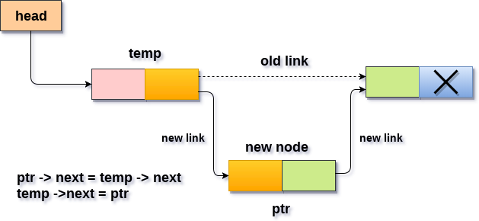
Inserting element at Specific Position

Slide 19
Inserting element at Specific Position
STEP 1: IF PTR = NULL
WRITE OVERFLOW GOTO STEP 12
STEP 2: SET NEW_NODE = PTR // //points to the free block of memory
STEP 3: NEW_NODE → DATA = VAL
STEP 4: SET TEMP = HEAD // Temporary points to head for list traversal
STEP 5: SET I = 0
STEP 6: REPEAT STEP 7 AND 6 UNTIL I
STEP 7: TEMP = TEMP → NEXT //Traverse the list by setting this and increment the I until reach the position
STEP 8: IF TEMP = NULL
WRITE "DESIRED NODE NOT PRESENT" GOTO STEP 12 STEP 9: PTR → NEXT = TEMP → NEXT //Link new node to temp node
STEP 10: TEMP → NEXT = PTR // insert the new node into the list
STEP 11: SET PTR = NEW_NODE //created node for future operations.
STEP 12: EXIT

Slide 20
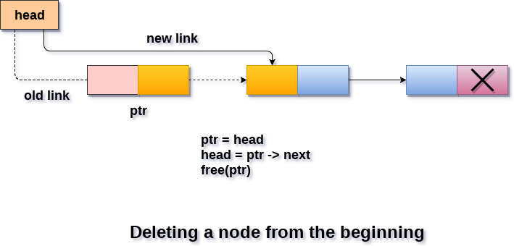
Deletion of node from Beginning

Slide 21
Deletion of node from Beginning
Step 1: IF HEAD = NULL
Write UNDERFLOW Go to Step 5 [END OF IF]
Step 2: SET PTR = HEAD
Step 3: SET HEAD = PTR -> NEXT
Step 4: FREE (PTR)
Step 5: EXIT

Slide 22
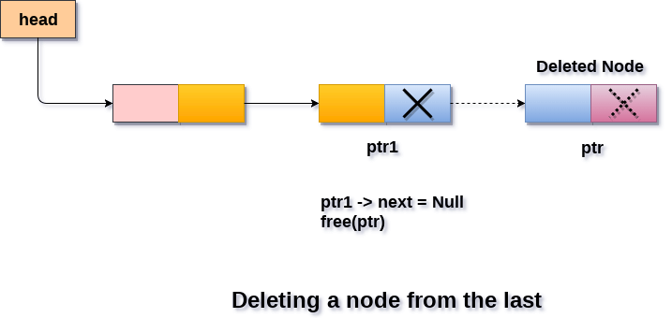
Deletion from the end

Slide 23
Deletion from the end
Step 1: IF HEAD = NULL
Write UNDERFLOW Go to Step 8 [END OF IF]
Step 2: SET PTR = HEAD //traverse the list and find last node
Step 3: Repeat Steps 4 and 5 while PTR -> NEXT!= NULL
Step 4: SET PREPTR = PTR //track second last node
Step 5: SET PTR = PTR -> NEXT //move PTR to next node in list
[END OF LOOP]
Step 6: SET PREPTR -> NEXT = NULL
Step 7: FREE (PTR)
Step 8: EXIT

Slide 24
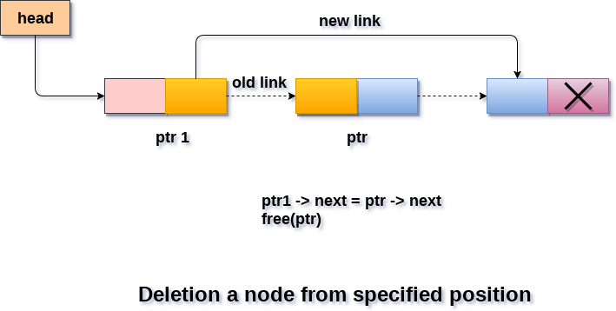
Deleting element at particular position

Slide 25
Deleting element at particular position
STEP 1: IF HEAD = NULL
WRITE UNDERFLOW GOTO STEP 11 STEP 2: SET TEMP = HEAD
STEP 3: SET I = 0
STEP 4: REPEAT STEP 5 TO 8 UNTIL I
STEP 5: TEMP1 = TEMP //store current node before moving to next node
STEP 6: TEMP = TEMP → NEXT //move next node in the list
STEP 7: IF TEMP == NULL
WRITE "DESIRED NODE NOT PRESENT" GOTO STEP 11
STEP 8: I = I+1
END OF LOOP
STEP 9: TEMP1 → NEXT = TEMP → NEXT //link node after being deleted
STEP 10: FREE TEMP
STEP 11: EXIT

Slide 26
Traversing a Linked List
PTR is a pointer variable which points to the node currently being processed.
PTR -> NEXT points to the next node to be processed.
Algorithm (Traversing a linked list)
Set PTR = HEAD.
Repeat step 3 and 4 while PTR ≠ NULL.
Apply PROCESS to PTR->DATA
Set PTR=PTR -> NEXT //PTR points to next node
EXIT

Slide 27
Circular Singly Linked List

Slide 28
Circular Singly Linked List
In a Circular Singly Linked list, the last node of the list contains a pointer to the first node of the list. We can have circular singly linked list as well as circular doubly linked list.
We traverse a circular singly linked list until we reach the same node where we started.
The circular singly liked list has no beginning and no ending. There is no null value present in the next part of any of the nodes.

Slide 29
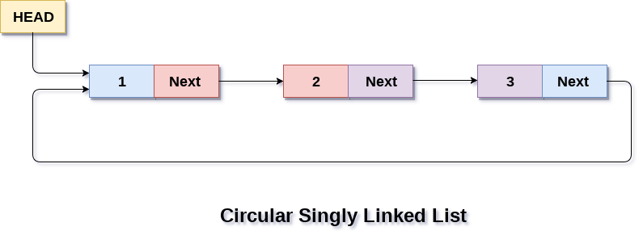
Circular Singly Linked List
Circular linked list are mostly used in task maintenance in operating systems. There are many examples where circular linked list are being used in computer science including browser surfing where a record of pages visited in the past by the user, is maintained in the form of circular linked lists and can be accessed again on clicking the previous button.

Slide 30
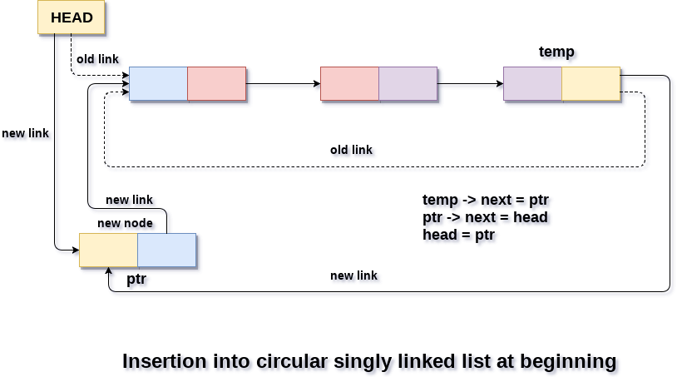
Insertion into circular singly linked list at beginning

Slide 31
Insertion into circular singly linked list at beginning
Step 1: IF PTR = NULL
Write OVERFLOW Go to Step 11 Step 2: SET NEW_NODE = PTR // Allocate space for new node
Step 3: SET PTR = PTR -> NEXT //Next Available memory location
Step 4: SET NEW_NODE -> DATA = VAL
Step 5: SET TEMP = HEAD //Traversing list to find last node
Step 6: Repeat Step 8 while TEMP -> NEXT != HEAD
Step 7: SET TEMP = TEMP -> NEXT
[END OF LOOP]
Step 8: SET NEW_NODE -> NEXT = HEAD
Step 9: SET TEMP → NEXT = NEW_NODE
Step 10: SET HEAD = NEW_NODE
Step 11: EXIT

Slide 32
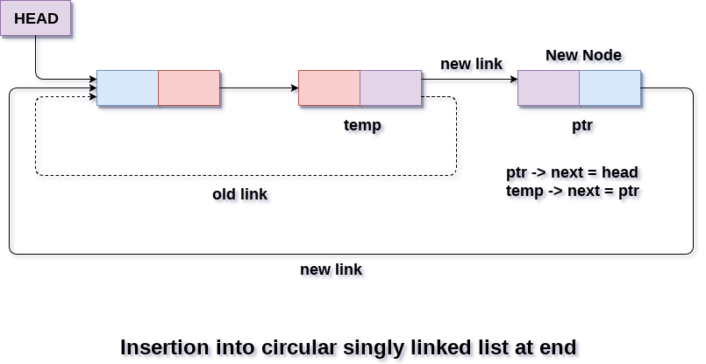
Insertion into circular singly linked list at the end

Slide 33
Insertion into circular singly linked list at the end
Step 1: IF PTR = NULL
Write OVERFLOW Go to Step 1 Step 2: SET NEW_NODE = PTR //Allocate space for new node
Step 3: SET PTR = PTR -> NEXT //Next Available memory location
Step 4: SET NEW_NODE -> DATA = VAL
Step 5: SET NEW_NODE -> NEXT = HEAD //For Circular nature
Step 6: SET TEMP = HEAD //Traversing the list
Step 7: Repeat Step 8 while TEMP -> NEXT != HEAD
Step 8: SET TEMP = TEMP -> NEXT
[END OF LOOP]
Step 9: SET TEMP -> NEXT = NEW_NODE
Step 10: EXIT

Slide 34
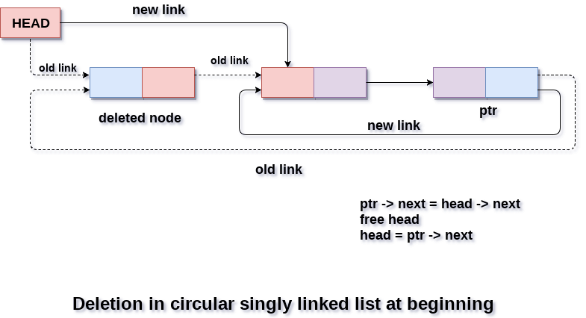
Deletion in circular singly linked list at beginning

Slide 35
Deletion in circular singly linked list at beginning
Step 1: IF HEAD = NULL
Write UNDERFLOW Go to Step 8 Step 2: SET PTR = HEAD //Traversing the list
Step 3: Repeat Step 4 while PTR → NEXT != HEAD
Step 4: SET PTR = PTR → next
[END OF LOOP]
Step 5: SET PTR → NEXT = HEAD → NEXT
Step 6: FREE HEAD
Step 7: SET HEAD = PTR → NEXT
Step 8: EXIT

Slide 36
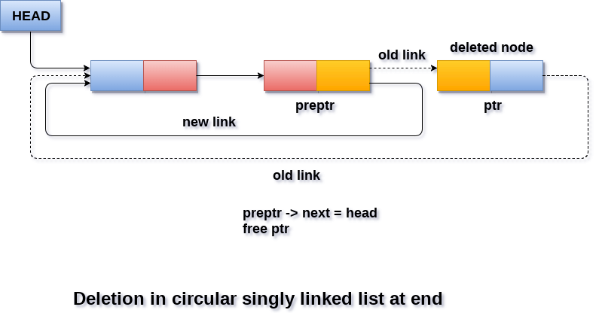
Deletion in circular singly linked list at end

Slide 37
Deletion in circular singly linked list at end
Step 1: IF HEAD = NULL
Write UNDERFLOW Go to Step 8 Step 2: SET PTR = HEAD //Traversing the list
Step 3: Repeat Steps 4 and 5 while PTR -> NEXT != HEAD
Step 4: SET PREPTR = PTR
Step 5: SET PTR = PTR -> NEXT
[END OF LOOP]
Step 6: SET PREPTR -> NEXT = HEAD
Step 7: FREE PTR
Step 8: EXIT

Slide 38
Key Points of Singly linked list
If a list can be traversed in only one direction, it is called One-way List.
List Pointer variable START points to the first node or header node.
Next-pointer field LINK is used to point to the next node in the list.
Only next node can be accessed.
Don’t have access to the preceding node.

Slide 39
Doubly linked list

Slide 40
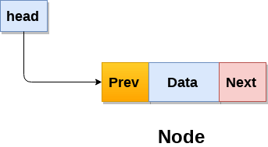
Doubly linked list
Doubly linked list is a complex type of linked list in which a node contains a pointer to the previous as well as the next node in the sequence.
In a doubly linked list, a node consists of three parts: node data, pointer to the next node in sequence (next pointer) , pointer to the previous node (previous pointer). A sample node in a doubly linked list is shown in the figure.

Slide 41
Doubly linked list
A Two-Way list is a linear collection of data elements, called nodes, where each node N is divided into three parts:
An information field INFO which contains the data of Node.
A pointer field FORWARD which contains the location of the next node in the list.
A pointer field BACKWARD which contains the location of the previous node in the list.

Slide 42
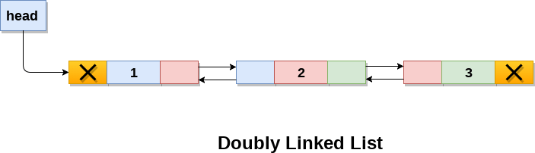
Doubly linked list
A doubly linked list containing three nodes having numbers from 1 to 3 in their data part, is shown in the following image.
In a singly linked list, we could traverse only in one direction, because each node contains address of the next node and it doesn't have any record of its previous nodes. However, doubly linked list overcome this limitation of singly linked list.
Due to the fact that, each node of the list contains the address of its previous node, we can find all the details about the previous node as well by using the previous address stored inside the previous part of each node.

Slide 43
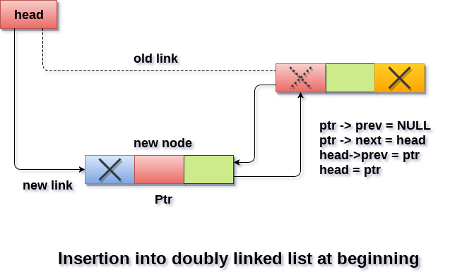
Insertion in doubly linked list at beginning

Slide 44
Insertion in doubly linked list at beginning
Step 1: IF ptr = NULL
Write OVERFLOW Go to Step 9 [END OF IF]
Step 2: SET NEW_NODE = ptr //create new node
Step 3: SET ptr = ptr -> NEXT //Next available memory location
Step 4: SET NEW_NODE -> DATA = VAL
Step 5: SET NEW_NODE -> PREV = NULL
Step 6: SET NEW_NODE -> NEXT = HEAD
Step 7: SET head -> PREV = NEW_NODE //connect original head to newnode
Step 8: SET head = NEW_NODE
Step 9: EXIT

Slide 45
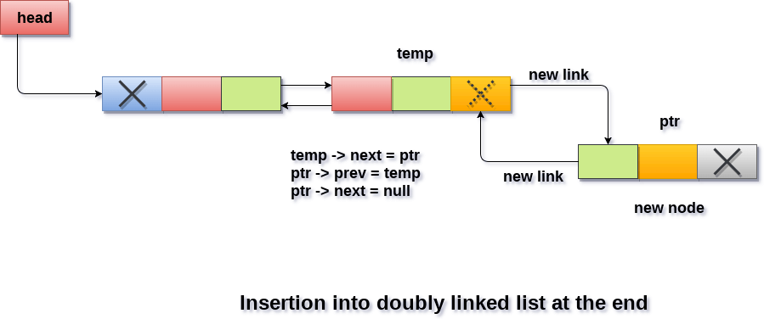
Insertion in doubly linked list at the end

Slide 46
Insertion in doubly linked list at the end
Step 1: IF PTR = NULL
Write OVERFLOW Go to Step 11 [END OF IF]
Step 2: SET NEW_NODE = PTR //create new node
Step 3: SET PTR = PTR -> NEXT //Next available space
Step 4: SET NEW_NODE -> DATA = VAL
Step 5: SET NEW_NODE -> NEXT = NULL
Step 6: SET TEMP = HEAD //Traversing the list
Step 7: Repeat Step 8 while TEMP -> NEXT != NULL
Step 8: SET TEMP = TEMP -> NEXT
[END OF LOOP]
Step 9: SET TEMP -> NEXT = NEW_NODE
Step 10: SET NEW_NODE -> PREV = TEMP
Step 11: EXIT

Slide 47
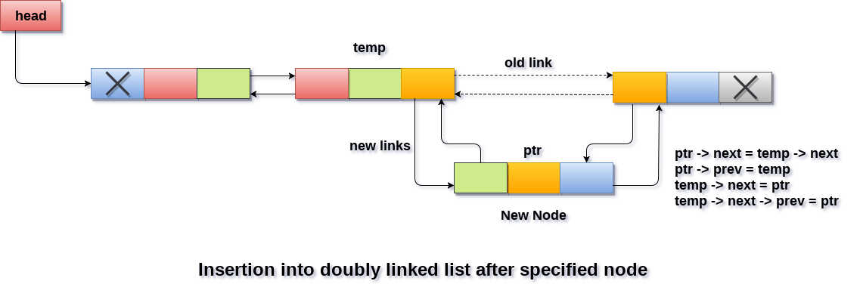
Insertion in doubly linked list after Specified node

Slide 48
Insertion in doubly linked list after Specified node
Step 1: IF PTR = NULL
Write OVERFLOW Go to Step 15 Step 2: SET NEW_NODE = PTR //create new node
Step 3: SET PTR = PTR -> NEXT //Next available space
Step 4: SET NEW_NODE -> DATA = VAL
Step 5: SET TEMP = HEAD //Traversing the list
Step 6: SET I = 0
Step 7: REPEAT 8 to 10 until I
Step 8: SET TEMP = TEMP -> NEXT
STEP 9: IF TEMP = NULL
STEP 10: WRITE "LESS THAN DESIRED NO. OF ELEMENTS"
GOTO STEP 15 [END OF LOOP]
Step 11: SET NEW_NODE -> NEXT = TEMP -> NEXT
Step 12: SET NEW_NODE -> PREV = TEMP
Step 13 : SET TEMP -> NEXT = NEW_NODE
Step 14: SET TEMP -> NEXT -> PREV = NEW_NODE
Step 15: EXIT

Slide 49
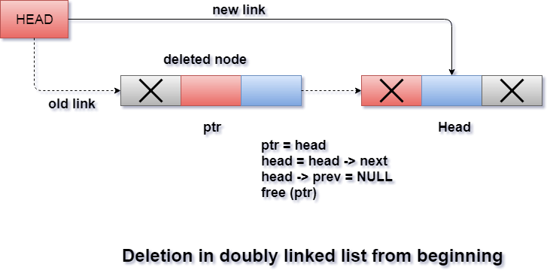
Deletion in doubly linked list at beginning

Slide 50
Deletion in doubly linked list at beginning
STEP 1: IF HEAD = NULL
WRITE UNDERFLOW GOTO STEP 6
STEP 2: SET PTR = HEAD
STEP 3: SET HEAD = HEAD → NEXT
STEP 4: SET HEAD → PREV = NULL
STEP 5: FREE PTR
STEP 6: EXIT

Slide 51
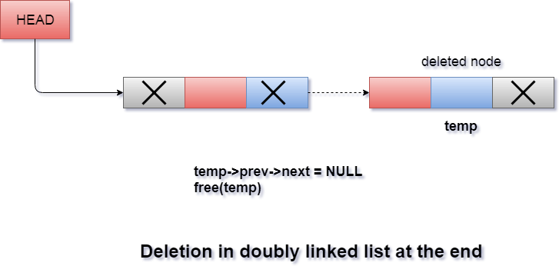
Deletion in doubly linked list at End

Slide 52
Deletion in doubly linked list at End
Step 1: IF HEAD = NULL
Write UNDERFLOW Go to Step 7 Step 2: SET TEMP = HEAD //Traversing the list
Step 3: REPEAT STEP 4 WHILE (TEMP->NEXT != NULL)
Step 4: SET TEMP = TEMP->NEXT
[END OF LOOP]
Step 5: SET TEMP ->PREV-> NEXT = NULL
Step 6: FREE TEMP
Step 7: EXIT

Slide 53
Circular Doubly Linked List

Slide 54
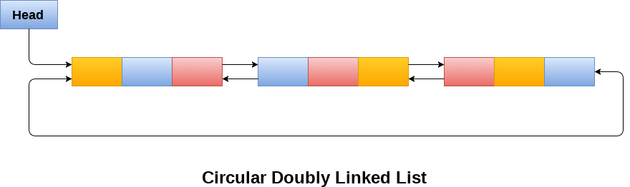
Circular Doubly Linked List
Circular doubly linked list is a more complexed type of data structure in which a node contain pointers to its previous node as well as the next node.
Circular doubly linked list doesn't contain NULL in any of the node. The last node of the list contains the address of the first node of the list. The first node of the list also contain address of the last node in its previous pointer.

Slide 55
Circular Doubly Linked List
Due to the fact that a circular doubly linked list contains three parts in its structure therefore, it demands more space per node and more expensive basic operations.
However, a circular doubly linked list provides easy manipulation of the pointers and the searching becomes twice as efficient.

Slide 56
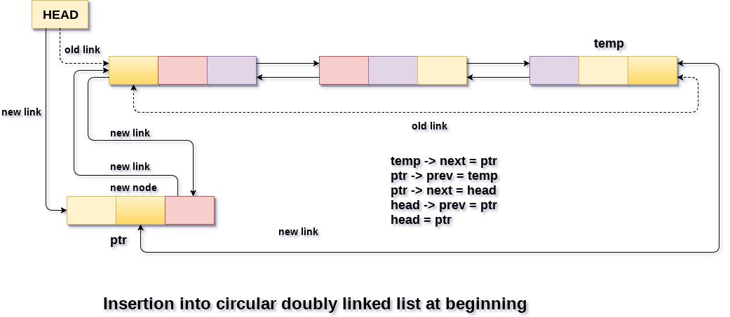
Insertion in circular doubly linked list at beginning

Slide 57
Insertion in circular doubly linked list at beginning
Step 1: IF PTR = NULL
Write OVERFLOW Go to Step 13 Step 2: SET NEW_NODE = PTR //create new node
Step 3: SET PTR = PTR -> NEXT //Next available space
Step 4: SET NEW_NODE -> DATA = VAL
Step 5: SET TEMP = HEAD //Traversing the list
Step 6: Repeat Step 7 while TEMP -> NEXT != HEAD
Step 7: SET TEMP = TEMP -> NEXT
[END OF LOOP]
Step 8: SET TEMP -> NEXT = NEW_NODE
Step 9: SET NEW_NODE -> PREV = TEMP
Step 1 : SET NEW_NODE -> NEXT = HEAD
Step 11: SET HEAD -> PREV = NEW_NODE
Step 12: SET HEAD = NEW_NODE
Step 13: EXIT

Slide 58
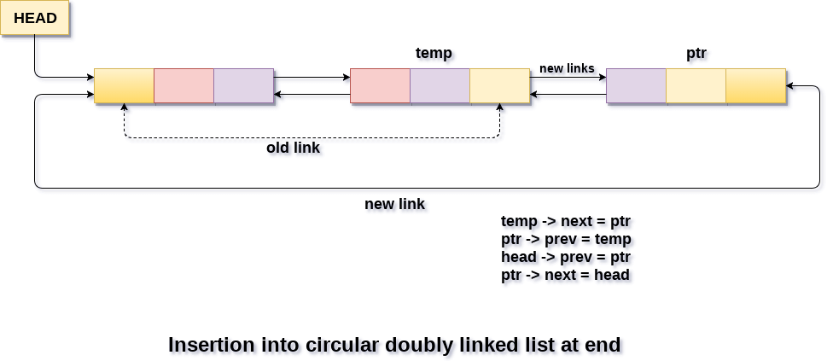
Insertion in circular doubly linked list at End

Slide 59
Insertion in circular doubly linked list at End
Step 1: IF PTR = NULL
Write OVERFLOW Go to Step 12
Step 2: SET NEW_NODE = PTR //create new node
Step 3: SET PTR = PTR -> NEXT //Next available space
Step 4: SET NEW_NODE -> DATA = VAL
Step 5: SET NEW_NODE -> NEXT = HEAD
Step 6: SET TEMP = HEAD //Traversing the List
Step 7: Repeat Step 8 while TEMP -> NEXT != HEAD
Step 8: SET TEMP = TEMP -> NEXT
[END OF LOOP]
Step 9: SET TEMP -> NEXT = NEW_NODE
Step 10: SET NEW_NODE -> PREV = TEMP
Step 11: SET HEAD -> PREV = NEW_NODE
Step 12: EXIT

Slide 60
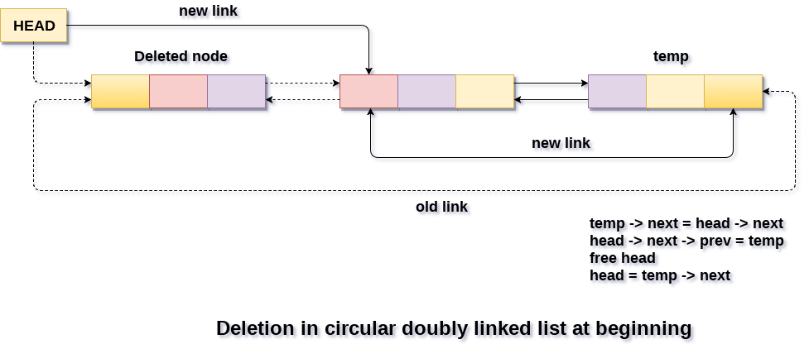
Deletion in Circular doubly linked list at beginning

Slide 61
Deletion in Circular doubly linked list at beginning
Step 1: IF HEAD = NULL
Write UNDERFLOW Go to Step 9 Step 2: SET TEMP = HEAD //Traversing the List
Step 3: Repeat Step 4 while TEMP -> NEXT != HEAD
Step 4: SET TEMP = TEMP -> NEXT
[END OF LOOP]
Step 5: SET TEMP -> NEXT = HEAD -> NEXT
Step 6: SET HEAD -> NEXT -> PREV = TEMP
Step 7: FREE HEAD
Step 8: SET HEAD = TEMP -> NEXT
Step 9: EXIT

Slide 62
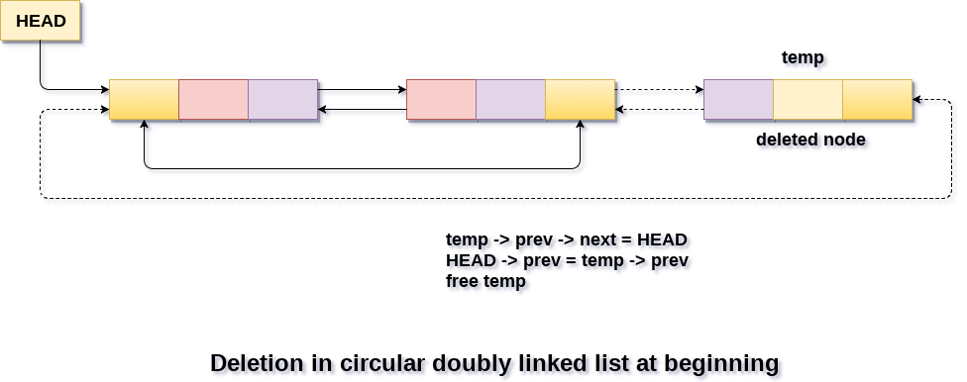
Deletion in Circular doubly linked list at End

Slide 63
Deletion in Circular doubly linked list at End
Step 1: IF HEAD = NULL
Write UNDERFLOW Go to Step 8 Step 2: SET TEMP = HEAD //Traversing the list
Step 3: Repeat Step 4 while TEMP -> NEXT != HEAD
Step 4: SET TEMP = TEMP -> NEXT
[END OF LOOP]
Step 5: SET TEMP -> PREV -> NEXT = HEAD
Step 6: SET HEAD -> PREV = TEMP -> PREV
Step 7: FREE TEMP
Step 8: EXIT

Slide 64
THANK YOU

