Slide 1
Unit – 4 Introduction to Queue

Slide 2
Queue
Queue is the data structure that is similar to the queue in the real world. A queue is a data structure in which whatever comes first will go out first.
It follows the FIFO (First-In-First-Out) policy.
Queue can also be defined as the list or collection in which,
Insertion is done from one end known as the rear end or the tail of the queue,
Deletion is done from another end known as the front end or the head of the queue.
For example: The real-world example of a queue is the ticket queue outside a cinema hall, where the person who enters first in the queue gets the ticket first, and the last person enters in the queue gets the ticket at last. Similar approach is followed in the queue in data structure.

Slide 3
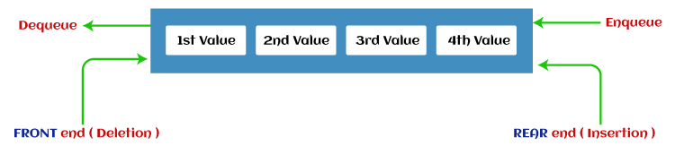
Queue

Slide 4
Applications of Queue
Queues are widely used as waiting lists for a single shared resource like printer, disk, CPU.
Queues are used in asynchronous transfer of data. For e.g., pipes, file IO.
Queues are used as buffers in most of the applications like MP3 media player, CD player, etc.
Queue are used to maintain the play list in media players in order to add and remove the songs from the play-list.

Slide 5
Types of Queue
1 2 3 4
Simple Queue or Linear Queue
Circular Queue
Priority Queue
Double Ended Queue (or Deque)

Slide 6
Operations performed on queue
Enqueue: The Enqueue operation is used to insert the element at the rear end of the queue. It returns void.
Dequeue: It performs the deletion from the front-end of the queue. It also returns the element which has been removed from the front-end. It returns an integer value.
Peek: This is the third operation that returns the element, which is pointed by the front pointer in the queue but does not delete it.
Queue overflow (isfull): It shows the overflow condition when the queue is completely full.
Queue underflow (isempty): It shows the underflow condition when the Queue is empty, i.e., no elements are in the Queue

Slide 7
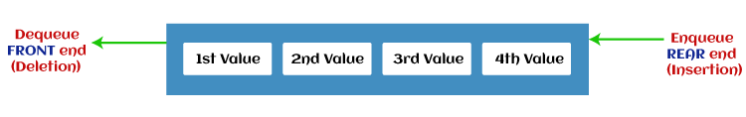
Simple Queue or Linear Queue
In Linear Queue, an insertion takes place from one end while the deletion occurs from another end. The end at which the insertion takes place is known as the rear end, and the end at which the deletion takes place is known as front end. It strictly follows the FIFO rule.

Slide 8
Algorithm to insert any element in a queue or Enqueue operation
The following steps should be taken to enqueue (insert) data into a queue:
Step 1: Check if the queue is full.
Step 2: If the queue is full, return “overflow” error and exit.
Step 3: If the queue is not full, increment the rear pointer to point to the next empty space.
Step 4: Add the data element to the queue location, where the rear is pointing.
Step 5: return success.

Slide 9
Algorithm to insert any element in a queue or Enqueue operation
Step 1: IF (REAR = MAX – 1) // queue is full Write “OVERFLOW” Go to step 4.
Step 2: IF (FRONT = -1 and REAR = -1) //queue is empty SET (FRONT = REAR = 0) ELSE SET (REAR = REAR + 1)
Step 3: Set QUEUE[REAR] = ITEM
Step 4: EXIT

Slide 10
Algorithm to delete an element from the queue or Dequeue Operation
The following steps are taken to perform the dequeue operation:
Step 1: Check if the queue is empty.
Step 2: If the queue is empty, return the “underflow" error and exit.
Step 3: If the queue is not empty, access the data where the front is pointing.
Step 4: Increment the front pointer to point to the next available data element.
Step 5: The Return success.

Slide 11
Algorithm to delete an element from the queue or Dequeue Operation
Step 1: IF FRONT = -1 or FRONT > REAR // checking queue is empty
Write "UNDERFLOW"
Go to Step 3
ELSE
SET VAL = QUEUE[FRONT]
IF FRONT = REAR //the queue will become empty after the dequeue
SET FRONT = -1 and REAR = -1
ELSE
SET FRONT = FRONT + 1 // front is increment by 1 for pointing next element
Step 2: EXIT

Slide 12
Simple Queue or Linear Queue
The major drawback of using a linear Queue is that insertion is done only from the rear end.
If the first three elements are deleted from the Queue, we cannot insert more elements even though the space is available in a Linear Queue. In this case, the linear Queue shows the overflow condition as the rear is pointing to the last element of the Queue.

Slide 13
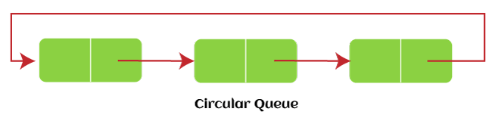
Circular Queue
In Circular Queue, all the nodes are represented as circular. It is similar to the linear Queue except that the last element of the queue is connected to the first element.
It is also known as Ring Buffer, as all the ends are connected to another end. The representation of circular queue is shown in the below image.

Slide 14
Circular Queue
The drawback that occurs in a linear queue is overcome by using the circular queue. If the empty space is available in a circular queue, the new element can be added in an empty space by simply incrementing the value of rear. The main advantage of using the circular queue is better memory utilization.
A circular queue is similar to a linear queue as it is also based on the FIFO (First In First Out) principle except that the last position is connected to the first position in a circular queue that forms a circle. It is also known as a Ring Buffer.
There was one limitation in the array implementation of Queue. If the rear reaches to the end position of the Queue, then there might be possibility that some vacant spaces are left in the beginning which cannot be utilized. So, to overcome such limitations, the concept of the circular queue was introduced.

Slide 15
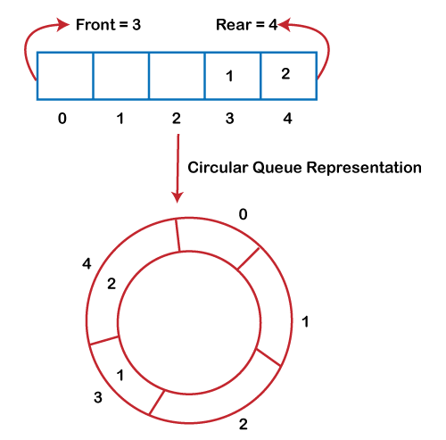
Circular Queue
As we can see in the above image, the rear is at the last position of the Queue and front is pointing somewhere rather than the 0th position.
In array, there are only two elements and other three positions are empty. The rear is at the last position of the Queue; if we try to insert the element then it will show that there are no empty spaces in the Queue.
There is one solution to avoid such wastage of memory space by shifting both the elements at the left and adjust the front and rear end accordingly.
The efficient approach to avoid the wastage of the memory is to use the circular queue data structure.

Slide 16
Operations on Circular Queue
Front: It is used to get the front element from the Queue.
Rear: It is used to get the rear element from the Queue.
enQueue(value): This function is used to insert the new value in the Queue. The new element is always inserted from the rear end.
deQueue(): This function deletes an element from the Queue. The deletion in a Queue always takes place from the front end.

Slide 17
Applications of Circular Queue
Memory management: The circular queue provides memory management. As we have already seen that in linear queue, the memory is not managed very efficiently. But in case of a circular queue, the memory is managed efficiently by placing the elements in a location which is unused.
CPU Scheduling: The operating system also uses the circular queue to insert the processes and then execute them.
Traffic system: In a computer-control traffic system, traffic light is one of the best examples of the circular queue. Each light of traffic light gets ON one by one after every interval of time. Like red light gets ON for one minute then yellow light for one minute and then green light. After green light, the red light gets ON.

Slide 18
Enqueue operation
The steps of enqueue operation are given below:
First, we will check whether the Queue is full or not.
Initially the front and rear are set to -1. When we insert the first element in a Queue, front and rear both are set to 0.
When we insert a new element, the rear gets incremented,
rear=rear+1.

Slide 19
Algorithm to insert an element in a circular queue
INSERT ITEM(QUEUE, FRONT, REAR, MAX, N, ITEM)
1. If (N = MAX) then
a. Display “Queue overflow”;
go to step 3.
2. Else
a. If (REAR = MAX - 1) then
i. REAR = 0; //wrapping around
b. Else
i. REAR = REAR + 1;
c. If (N = 0) then
i. FRONT = REAR; // when empty
d. QUEUE[REAR] = ITEM;
e. N = N + 1;
3. Exit.

Slide 20
Algorithm to delete an element from the circular queue
The steps of dequeue operation are given below:
First, we check whether the Queue is empty or not. If the queue is empty, we cannot perform the dequeue operation.
When the element is deleted, the value of front gets decremented by 1.
If there is only one element left which is to be deleted, then the front and rear are reset to -1.

Slide 21
Algorithm to delete an element from the circular queue
DELETE ITEM(QUEUE, FRONT, REAR, MAX, N, ITEM)
1. If (N = 0) then
a. Display “Queue underflow”;
go to step 3.
2. Else
a. ITEM = QUEUE[FRONT];
b. If (FRONT = MAX - 1) then // wrap around to the beginning of the array
i. FRONT = 0;
c. Else
i. FRONT = FRONT + 1;
d. N = N - 1;
3. Exit.

Slide 22
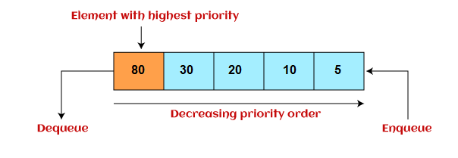
Priority Queue
It is a special type of queue in which the elements are arranged based on the priority. It is a special type of queue data structure in which every element has a priority associated with it.
Suppose some elements occur with the same priority, they will be arranged according to the FIFO principle. The representation of priority queue is shown in the below image –

Slide 23
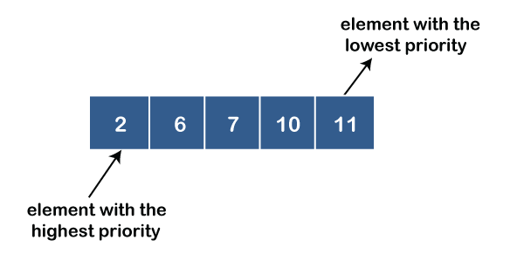
Types of priority queue
Ascending order priority queue: In ascending order priority queue, a lower priority number is given as a higher priority in a priority.
For example, we take the numbers from 1 to 5 arranged in an ascending order like 1,2,3,4,5; therefore, the smallest number, i.e., 1 is given as the highest priority in a priority queue.

Slide 24
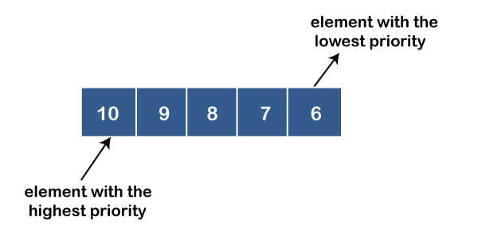
Types of priority queue
2. Descending order priority queue: In descending order priority queue, a higher priority number is given as a higher priority in a priority.
For example, we take the numbers from 1 to 5 arranged in descending order like 5, 4, 3, 2, 1; therefore, the largest number, i.e., 5 is given as the highest priority in a priority queue.

Slide 25
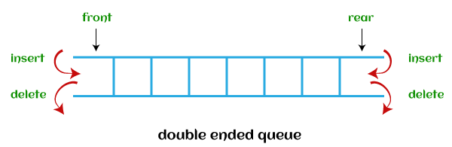
Double Ended Queue
In Double Ended Queue, insertion and deletion can be done from both ends of the queue either from the front or rear. It means that we can insert and delete elements from both front and rear ends of the queue. Deque can be used as a palindrome checker means that if we read the string from both ends, then the string would be the same.
Deque can be used both as stack and queue as it allows the insertion and deletion operations on both ends. Deque can be considered as stack because stack follows the LIFO (Last In First Out) principle in which insertion and deletion both can be performed only from one end. And in deque, it is possible to perform both insertion and deletion from one end, and Deque does not follow the FIFO principle.

Slide 26
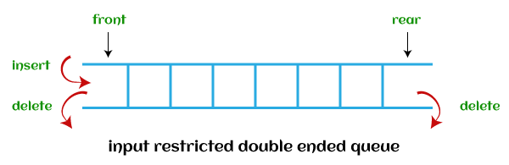
Types of deque
There are two types of deque that are discussed as follows -
Input restricted deque - As the name implies, in input restricted queue, insertion operation can be performed at only one end, while deletion can be performed from both ends.

Slide 27
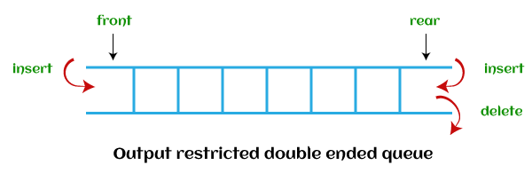
Types of deque
2. Output restricted deque - As the name implies, in output restricted queue, deletion operation can be performed at only one end, while insertion can be performed from both ends.

Slide 28

Thank You

