Slide 1


Subject Code: 01AI0302
Subject Name: Programming with Python Unit – 3: Python Functions and Data Structures

Slide 2
Organizing python codes using functions and Modules
When your Python code grows in size, most probably it becomes unorganised over time. Keeping your code in the same file as it grows makes your code difficult to maintain. At this point, Python modules and packages help you to organize and group your content by using files and folders.
Modules are files with “.py” extension containing Python code. They help to organise related
functions, classes or any code block in the same file.
It is considered as a best practice to split the large Python code blocks into modules containing up to 300– 400 lines of code.
Packages group similar modules in a separate directory. They are folders containing related
modules and an __init__.py file which is used for optional package-level initialization.
Depending on your Python application, you can consider to group your modules in sub-packages
such as doc, core, utils, data, examples, test.

Slide 3
Python module import
Import in python is similar to #include header_file in C/C++. Python modules can get access to code from another module by importing the file/function using import. The import statement is the most common way of invoking the import machinery, but it is not the only way.
import module_name
When the import is used, it searches for the module initially in the local scope by calling
import () function. The value returned by the function is then reflected in the output of the
initial code.
Example:
import math
pie = math.pi
print("The value of pi is : ",pie)
Output:
The value of pi is : 3.141592653589793

Slide 4
Python Modules
Like many other programming languages, Python supports modularity. That is, you can break large code into smaller and more manageable pieces. And through modularity, Python supports code reuse. You can import modules in Python into your programs and reuse the code therein as many times as you want.
What are Python Modules?
Modules provide us with a way to share reusable functions. A module is simply a “Python file” which contains code we can reuse in multiple Python programs. A module may contain functions, classes, lists, etc.
Modules in Python can be of two types:
Built-in Modules.
User-defined Modules.

Slide 5
Python Built-in Modules.
One of the many superpowers of Python is that it comes with a “rich standard library”. This rich standard
library contains lots of built-in modules. Hence, it provides a lot of reusable code.
To name a few, Python contains modules like “os”, “sys”, “datetime”, “random”.
You can import and use any of the built-in modules whenever you like in your program.
Example: To call the randint function of random, we simply need to use the dot notation import random
print(random.randint(20, 100))
Output:
65 # any integer randomly will be generated
Using import…as statement (Renaming a module)
import random as r
print(r.randint(20, 100))

Slide 6
Python Built-in Modules.
Using from…import statement
You can import a specific function, class, or attribute from a module rather than importing the entire
module. Follow the syntax below,
from <modulename> import <function>
Example
from random import randint
randint(20, 100)
Output
69
Example
from math import pi, sqrt print(3 * pi) print(sqrt(100))
Output
9.42477796076938
10.0
Note that while importing from a module in this way, we don’t need to use the dot operator while calling
the function or using the attribute.

Slide 7
Python Built-in Modules
Importing everything from Python module
If we need to import everything from a module and we don’t want to use the dot
operator, do this:
Example
from math import * print(3 * pi) print(sqrt(100))
Output
9.42477796076938
10.0

Slide 8
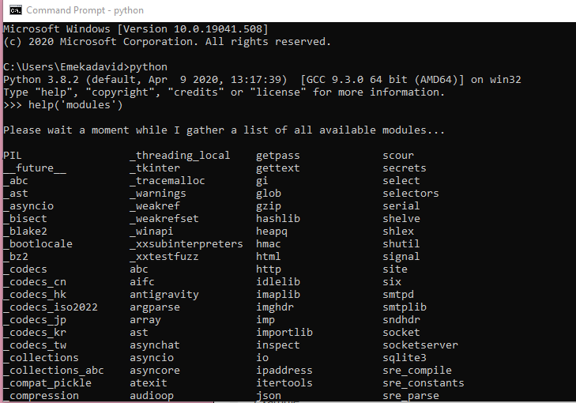
Python Built-in Modules

Slide 9
Python Built-in Functions
The Python built-in functions are defined as the functions whose functionality is pre-defined in Python. The python interpreter has several functions that are always present for use. These functions are known as Built-in Functions.
Function is a block of code written to carry out a specified task. Functions provide better modularity and a high degree of code reusing.
You can Pass Data(input) known as parameter to a function
A Function may or may not return any value(Output)

Slide 10
Python Built-in Functions
There are three types of functions in Python:
Built-in functions The Python interpreter has a number of functions built into it that are always
available. They are listed here in alphabetical order.
User-Defined Functions (UDFs): The Functions defined by User is known as User Defined Functions. These are defined with the keyword def
Anonymous functions, which are also called lambda functions because they are not declared with the
standard def keyword.
Functions vs Methods : A method refers to a function which is part of a class. You access it with an instance or object of the class. A function doesn’t have this restriction: it just refers to a standalone function. This means that all methods are functions, but not all functions are methods.

Slide 11
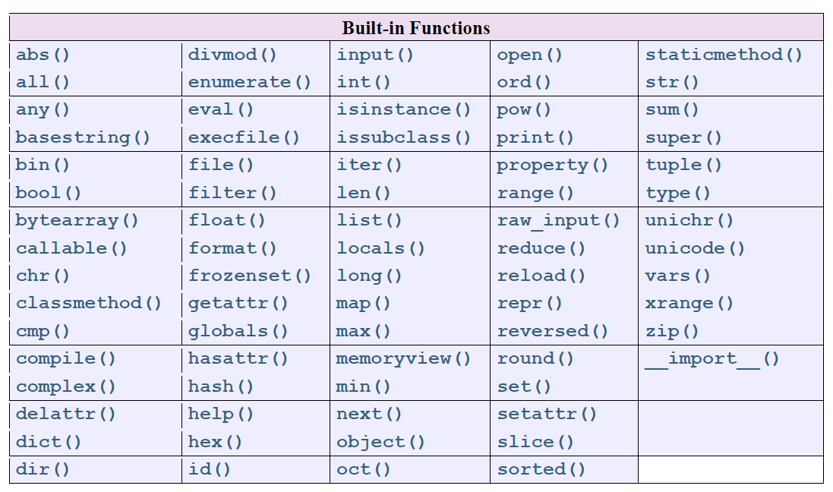
Python Built-in Functions

Slide 12
User Defined Functions
Following are the rules to define a User Define Function in Python.
Function begin with the keyword def followed by the function name and parentheses ( ) .
Any list of parameter(s) or argument(s) should be placed within these parentheses.
The first statement within a function is the documentation string of the function or docstring is an optional statement
The function block within every function starts with a colon (:) and is indented.
The statement return [expression] exits a function, optionally passing back an expression to the caller. A
return statement with no arguments is the same as return None.
Syntax
def functionName( list of parameters ):
"_docstring" function_block return [expression]
By default, parameters have a positional behavior and you need to inform them in the same order that they
were defined.

Slide 13
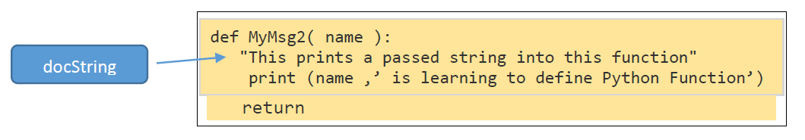
User Defined Functions
Example for Creating a Function without parameter
In Python a function is defined using the def keyword:
>>> def MyMsg1():
print("Learning to create function")
Example for Creating a Function parameter
The following function takes a string as parameter and prints it on screen.

Slide 14

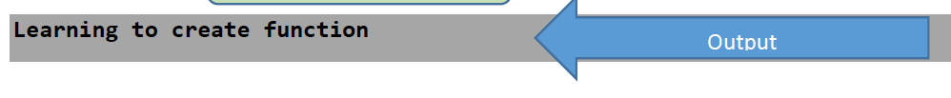
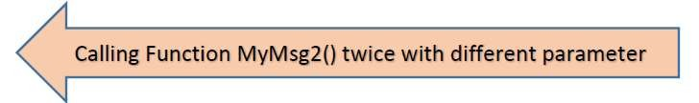
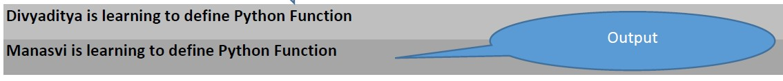
User Defined Functions
Calling a Function To call a function, use the function name followed by parenthesis:
>>> MyMsg1()
>>> MyMsg2(‘Divyaditya’)
>>> MyMsg2(‘Manasvi’)

Slide 15
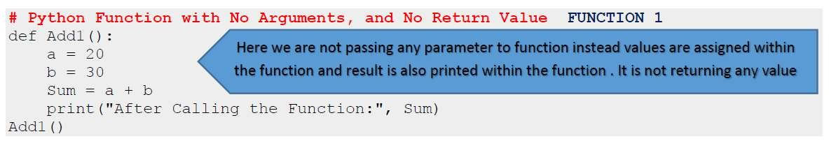
User Defined Functions
Parameter (argument) Passing
We can define UDFs in one of the following ways in Python
Function with no argument and no Return value [ like MyMsg1(),Add() ]
Function with no argument and with Return value
Python Function with argument and No Return value [like MyMsg2() ]
Function with argument and Return value

Slide 16
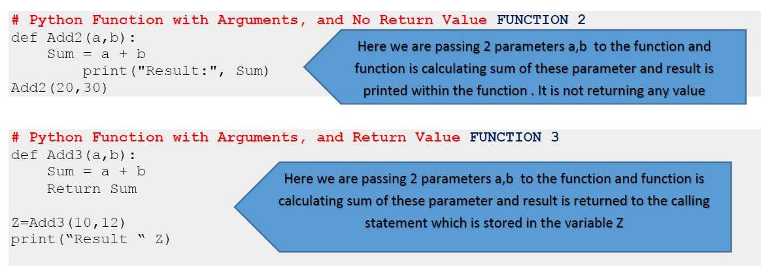
User Defined Functions

Slide 17
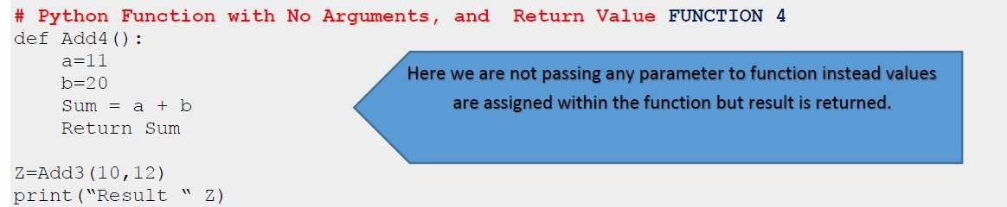
User Defined Functions

Slide 18
User Defined Functions
In-class Exercise1:
Write a python program having an User Defined Function names as area which takes radius as an
argument of function and returns calculated area of a circle. Use constant pi from math module.
In-class Exercise2:
Write a python program having an User Defined Function operation which takes 3 arguments: number1 as integer value, number2 as integer value and operator as single character value of mathematical operator. The function should return mathematical calculation answer based on operation sign provided in third argument.
In-class Exercise3:
Write a python program that is having an UDF named as series which display odd numbers between
entered range by the user.

Slide 19
User Defined Functions
In-class Exercise4:
Write a python program that is having an UDF named as table which display table of given number.
In-class Exercise5:
Write a python UDF that accept a string from user and returns length of the string.
In-class Exercise6:
Write a python UDF that accept a string from user and returns upper case version of the string.

Slide 20
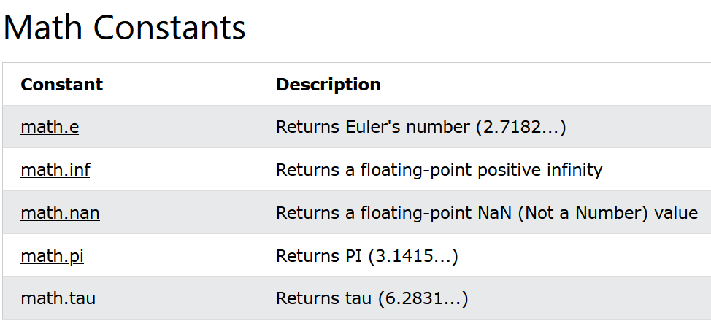
User Defined Functions math
Python has a built-in module that you can use for mathematical tasks. The math module has a set of methods and constants.

Slide 21
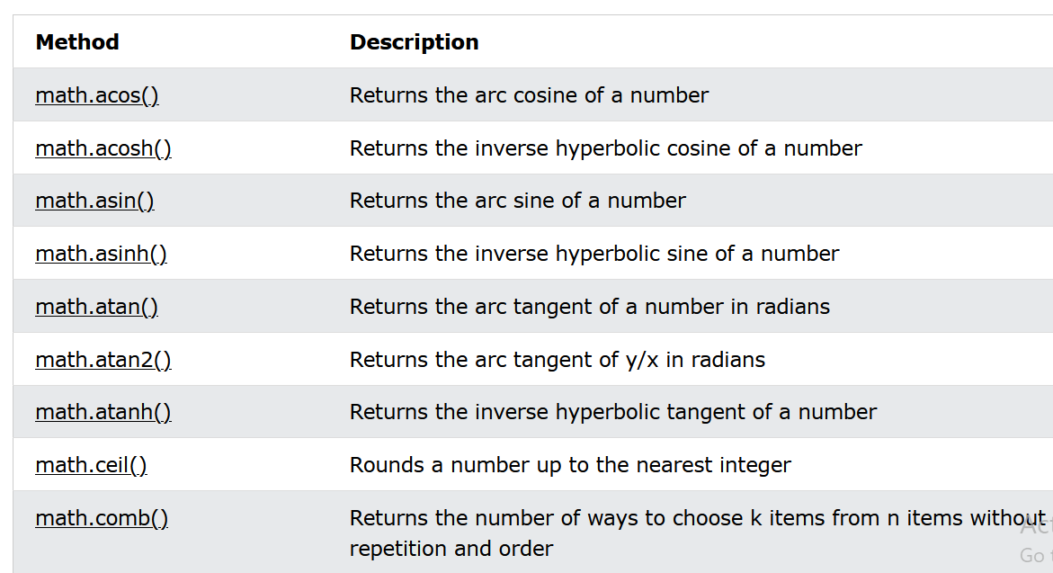
Python Math Module
Python Built-in Functions

Slide 22
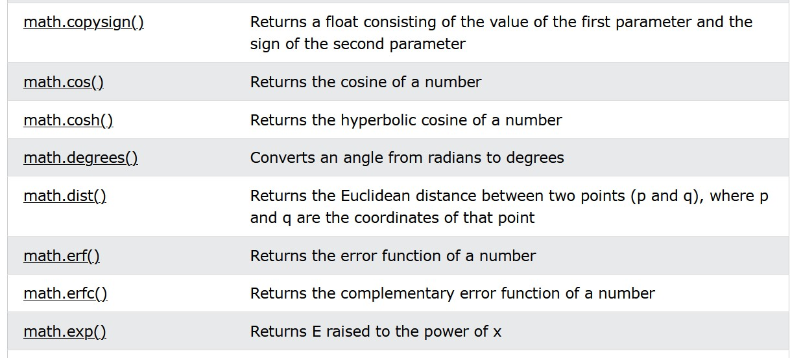
Python Math Module

Slide 23
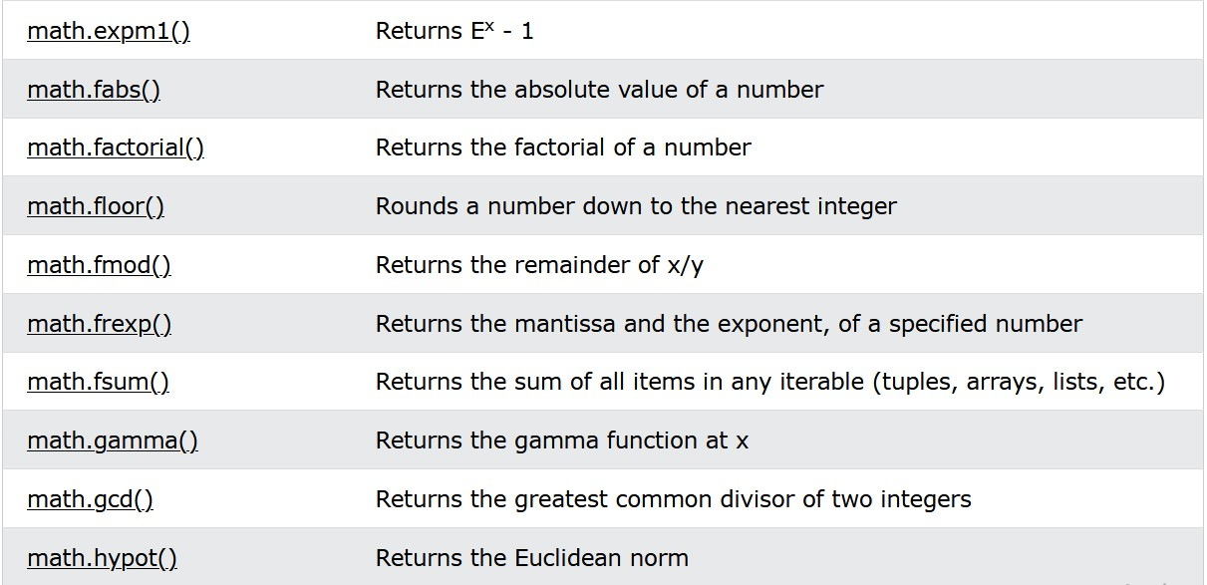
Python Math Module
Python Built-in Functions

Slide 24
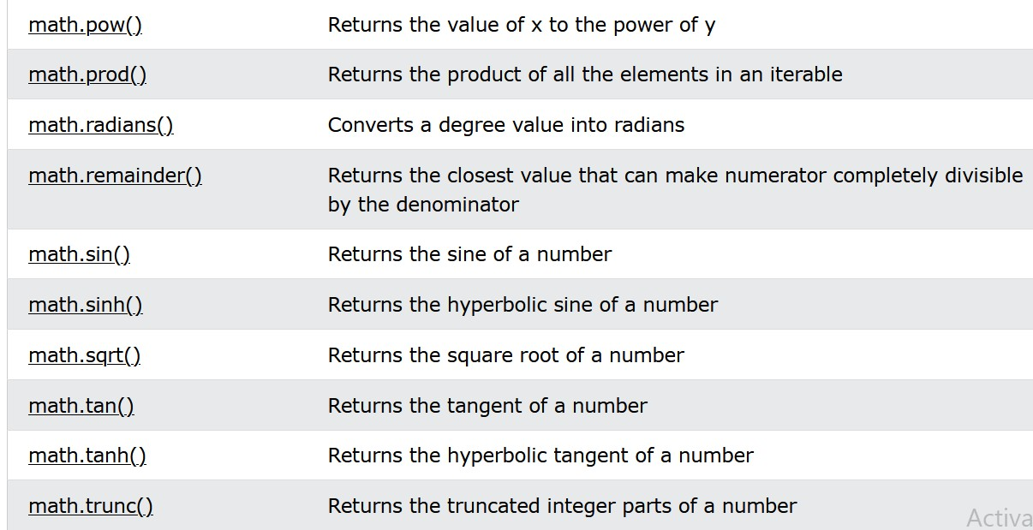
Python Math Module
Python Built-in Functions

Slide 25
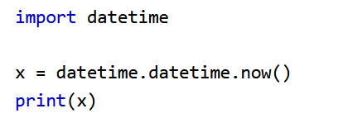

Python Date Module
A date in Python is not a data type of its own, but we can import a module named datetime to work with dates as date objects. The date contains year, month, day, hour, minute, second, and microsecond. The datetime module has many methods to return information about the date object.
Example
Import the datetime module and display the current date:
Output

Slide 26
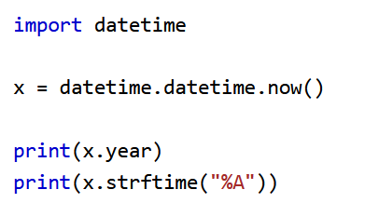
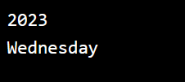
Python datetime Module
Example
Return the year and name of weekday:
Example

Slide 27
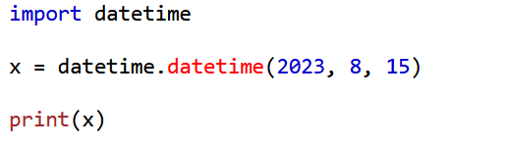

Python datetime Module
Creating Date Objects
To create a date, we can use the datetime() class (constructor) of the datetime module.
The datetime() class requires three parameters to create a date: year, month, day.
Example
Create a date object:
Output

Slide 28
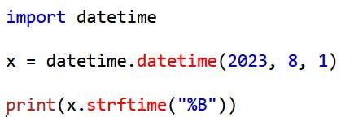

Python datetime Module
The datetime() class also takes parameters for time and timezone (hour, minute, second, microsecond, tzone), but they are optional, and has a default value of 0, (None for timezone).
The strftime() Method
The datetime object has a method for formatting date objects into readable strings.
C
The method is called strftime(), and takes one parameter, format, to specify the format of the
returned string:
Example
Display the name of the month:
Output

Slide 29
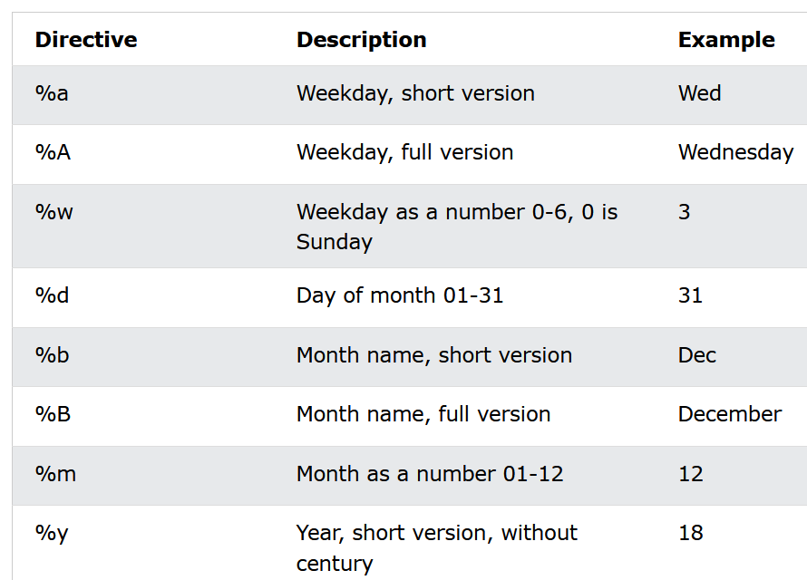
Python datetime Module
A reference of all the legal format codes:

Slide 30
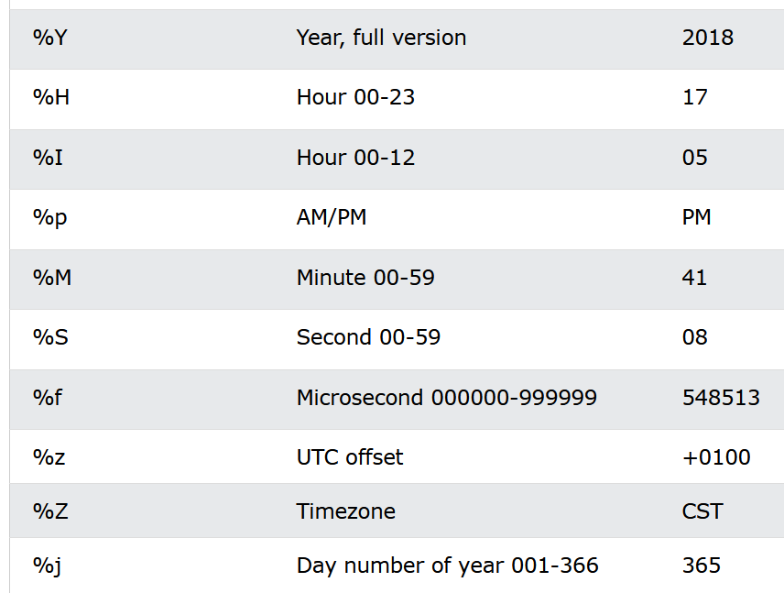
Python datetime Module

Slide 31
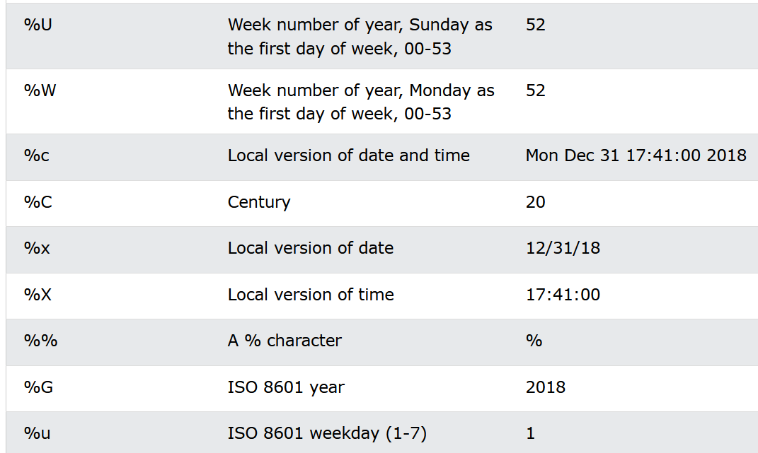
Python datetime Module

Slide 32
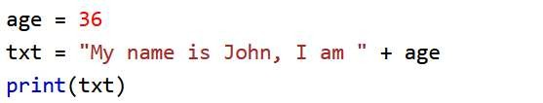
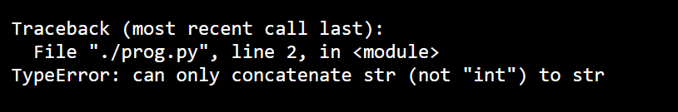
Python String
String Format: As we learned in the Python Variables chapter, we cannot combine strings and numbers like this:
Example
Output

Slide 33
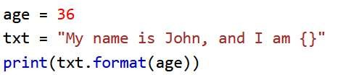

Python String
But we can combine strings and numbers by using the format() method!
The format() method takes the passed arguments, formats them, and places them in the string where the placeholders {} are:
Use the format() method to insert numbers into strings:
Example
Output

Slide 34
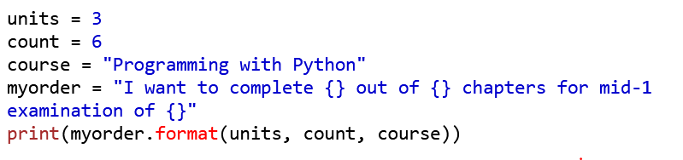
Python Strings
Python string format
Example:
Output

Slide 35


Python Strings
Strings are Arrays
Like many other popular programming languages, strings in Python are arrays of bytes representing
unicode characters.
However, Python does not have a character data type, a single character is simply a string with a length of 1.
Square brackets can be used to access elements of the string.
Example
Get the character at position 1 (remember that the first character has the position 0):
Output

Slide 36


Python Strings
Looping Through a String
Since strings are arrays, we can loop through the characters in a string, with a for loop.
Example
Loop through the letters in the word “marwadi":
Output

Slide 37


Python Strings
String Length
To get the length of a string, use the len() function.
Example
Output

Slide 38


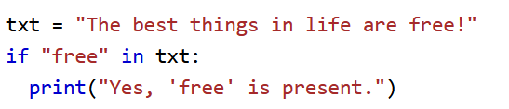

Python Strings
Check String
To check if a certain phrase or character is present in a string, we can use the keyword in.
Example Output
Use it in an if statement:
Example
Output

Slide 39

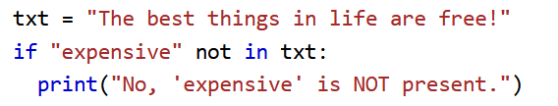

Python Strings
Check if NOT
To check if a certain phrase or character is NOT present in a string, we can use the keyword not in.
Example
Output
Use it in an if statement:
Example
Output

Slide 40




String Built-in functions
Python has a set of built-in methods that you can use on strings.
Upper Case: The upper() method returns the string in upper case
Example
Output
Lower Case: The lower() method returns the string in lower case.
Output

Slide 41
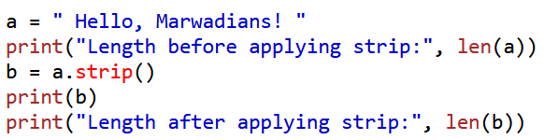

String Built-in functions
Remove Whitespace: Whitespace is the space before and/or after the actual text, and very
often you want to remove this space.
The strip() method removes any whitespace from the beginning or the end.
Example
Output

Slide 42
List

Slide 43
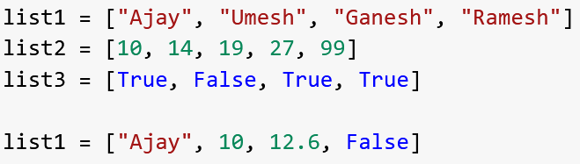
List
Lists are used to store multiple items in a single variable.
Lists are one of 4 built-in data types in Python used to store collections of data, the other 3 are Tuple, Set, and Dictionary, all with different qualities and usage.
List items can be of any data type:
Example

Slide 44
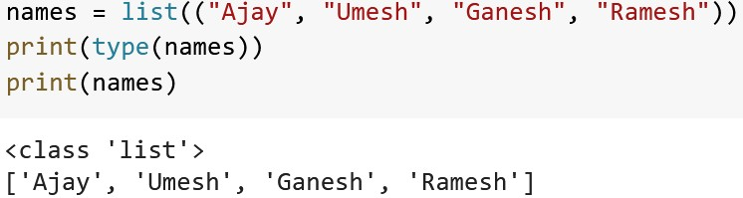
List
It is also possible to use the list() constructor when creating a new list.
Example
Output

Slide 45
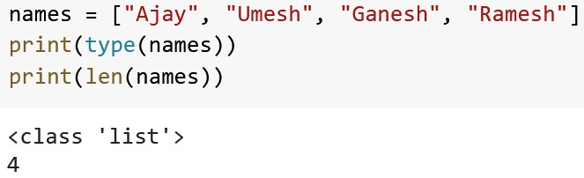
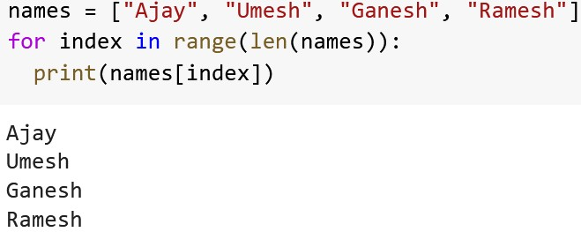
List
To determine how many items a list has, use the len() function.
Example1
Output
Example2
Output

Slide 46
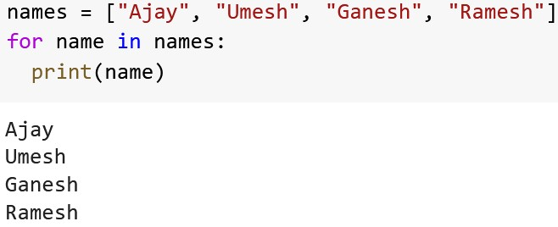
List
List: Access List Items
Example
Output

Slide 47
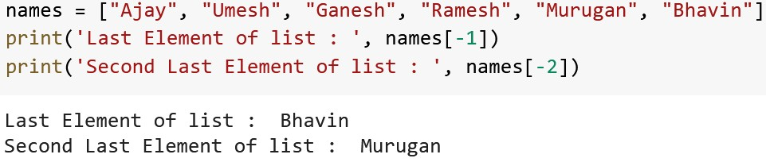
List
List: Access List Items
Example
Output

Slide 48
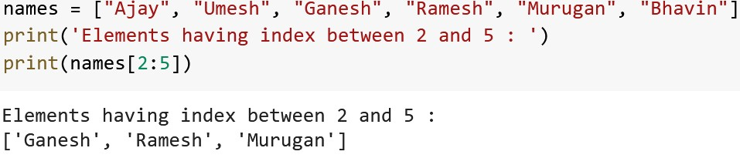
List
List: Access List Items
Example
Output

Slide 49
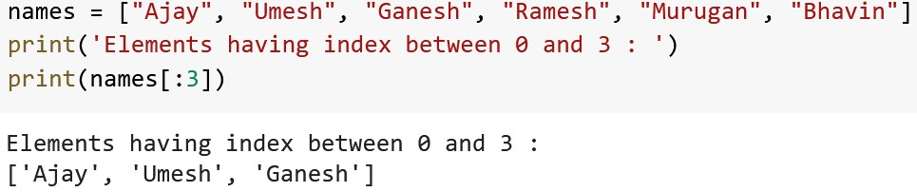
List: Access List Items
By leaving out the start value, the range will start at the first item
Example
Output

Slide 50
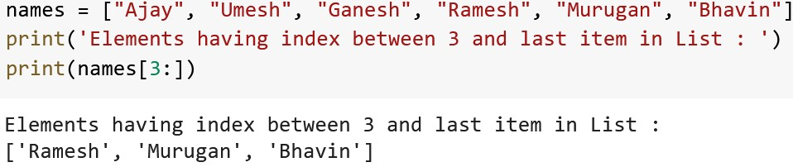
List: Access List Items
By leaving out the end value, the range will go on to the end of the list
Example
Output

Slide 51
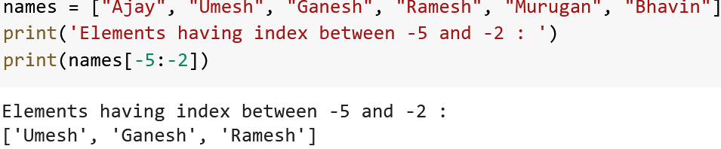
List: Access List Items
Specify negative indexes if you want to start the search from the end of the list
Example
Output

Slide 52
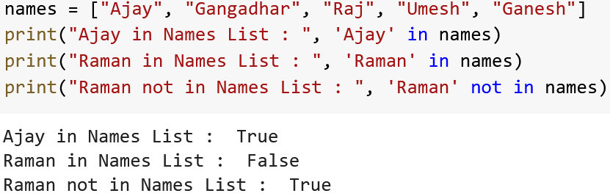
List: Membership Operator
To determine if a specified item is present in a list use the in keyword
To determine if a specified item is not present in a list use the not in keyword
Example
Output

Slide 53
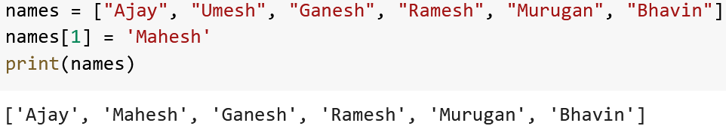
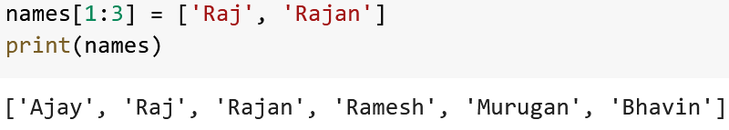
Update List Items
Example
Output
Example
Output

Slide 54
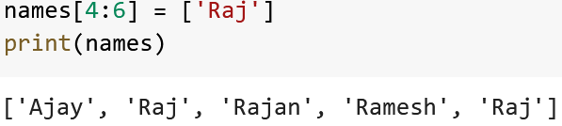
Update List Items
Example
Output

Slide 55

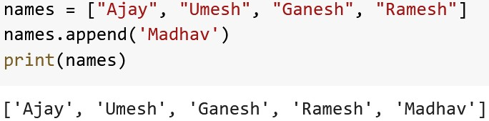
List
The append() method appends an element to the end of the list
Syntax:
Example
Output

Slide 56

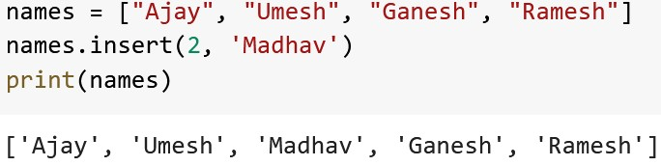
List
To insert a new list item, without replacing any of the existing values, we can use
the insert() method.
The insert() method inserts an item at the specified index
Syntax:
Example
Output

Slide 57

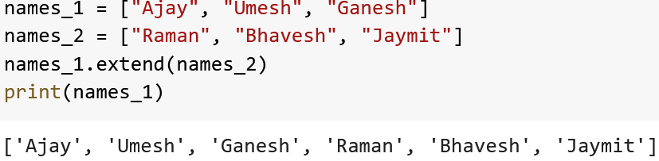
List
The extend() method adds the specified list elements (or any iterable) to the end
of the current list
Syntax:
Example
Output

Slide 58
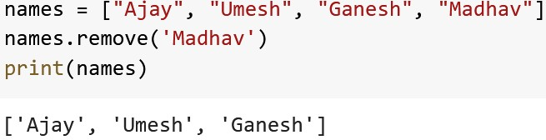
List
The remove() method removes the first occurrence of the element with the
specified value
Syntax:
Example
Output

Slide 59
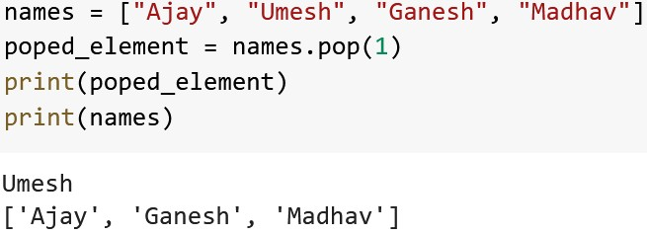
List
The pop() method removes the element at the specified position.
Syntax:
pos Optional parameter, a number specifying the position of the element you
want to remove, default value is -1, which returns the last item
Example
Output

Slide 60
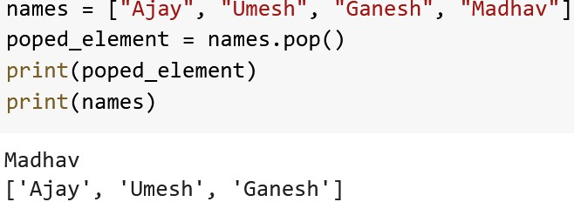
List
Example
Output

Slide 61
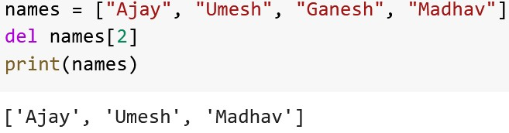
List
The keyword also removes the specified index
del
Example
Output

Slide 62

List
The del keyword can also delete the list completely
Example
Output

Slide 63

The clear() method removes all the elements from a list
List
Syntax:
Example
Output

Slide 64
List
The sort() method sorts the list ascending by default.
You can also make a function to decide the sorting criteria(s)
Syntax:
reverse | Optional. reverse=True will sort the list descending. Default is reverse=False
key | Optional. A function to specify the sorting criteria(s)

Slide 65

List
Example
Output

Slide 66

List
Example
Output

Slide 67

List
The copy() method returns a copy of the specified list
Example
Output

Slide 68

List
You cannot copy a list simply by typing list2 = list1, because: list2 will only be a reference to list1, and changes made in list1 will automatically also be made in list2
Example
Output

Slide 69

List
Merge two list
Example
Output

Slide 70

List
The count() method returns the number of elements with the specified value
Syntax
Example
Output

Slide 71

List
The index() method returns the position at the first occurrence of the specified
value
Syntax
Example
Output

Slide 72

List
The reverse() method reverses the order of the elements
Syntax
Example
Output

Slide 73
Tuple

Slide 74

Tuple
Tuples are used to store multiple items in a single variable.
Tuple is one of 4 built-in data types in Python used to store collections of data,
the other 3 are List, Set, and Dictionary, all with different qualities and usage.
A tuple is a collection which is ordered and unchangeable.
Tuples are written with round brackets.
Example
Output

Slide 75

Tuple
Tuple is immutable. Member item can not change value.
Example
Output

Slide 76


Tuple
Tuple with Single Element
Wrong Approach:
Correct Approach:

Slide 77

Tuple: Access Tuple Elements
It is similar to list.

Slide 78

Tuple
To determine if a specified item is present in a tuple or not

Slide 79

Tuple
When we create a tuple, we normally assign values to it. This is called “Packing”
a tuple
In Python, we are also allowed to extract the values back into variables. This is
called “Unpacking”

Slide 80

Tuple

Slide 81

Tuple
If the asterisk is added to another variable name than the last, Python will assign values to the variable until the number of values left matches the number of variables left

Slide 82



Tuple: Loop Through a Tuple
Example 1
Example 2
Example 3

Slide 83

Tuple
Joining two tuples using ‘+’ operator

Slide 84

Tuple
Effect of ‘*’ operator on tuple

Slide 85

Tuple
Delete tuple using
del
keyword

Slide 86

Tuple
The index() method finds the first occurrence of the specified value.
The index() method raises an exception if the value is not found.
Syntax:

Slide 87

Tuple
The count() method returns the number of times a specified value appears in the
tuple
Syntax:

Slide 88
Tuple
Advantages of Tuple over List
Since tuples are immutable, iterating through a tuple is faster than with list. So
there is a slight performance boost.
Tuples that contain immutable elements can be used as a key for a dictionary.
With lists, this is not possible.
If you have data that doesn't change, implementing it as tuple will guarantee that
it remains write-protected.

Slide 89
Dictionary

Slide 90
Dictionary
Python Dictionary is used to store the data in a key-value pair format.
The dictionary is the data type in Python, which can simulate the real-life data
arrangement where some specific value exists for some particular key.
It is the mutable data-structure.
The dictionary is defined into element Keys and values.
Keys must be a single element
Value can be any type such as list, tuple, integer, etc.
In other words, we can say that a dictionary is the collection of key-value pairs where the value can be any Python object. In contrast, the keys are the immutable Python object, i.e., Numbers, string

Slide 91

Dictionary
The dictionary can be created by using multiple key-value pairs enclosed with
the curly brackets {}, and each key is separated from its value by the colon (:)
To determine how many items a dictionary has, use the len() function

Slide 92

Dictionary
Dictionary items are unordered, changeable, and does not allow duplicates
Dictionary items can be referred to by using the key name

Slide 93

Dictionary
The get() method returns the value of the item with the specified key
Syntax:
keyname | Required. The keyname of the item you want to return the value from
value | Optional. A value to return if the specified key does not exist. Default value None

Slide 94

Dictionary
The keys() method returns a view object.
The view object contains the keys of the dictionary, as a list.
The view object will reflect any changes done to the dictionary
Syntax:

Slide 95

Dictionary
The values() method returns a view object.
The view object contains the values of the dictionary, as a list.
The view object will reflect any changes done to the dictionary
Syntax:

Slide 96

Dictionary
The items() method returns a view object. The view object contains the key-
value pairs of the dictionary, as tuples in a list.
Syntax:

Slide 97

Dictionary
To determine if a specified key is present in a dictionary use the in keyword

Slide 98

Dictionary
The update() method inserts the specified items to the dictionary
The specified items can be a dictionary, or an iterable object with key value
pairs
Syntax:

Slide 99
Dictionary
The pop() method removes the specified item from the dictionary
The value of the removed item is the return value of the pop() method
Syntax:
keyname | Required. The keyname of the item you want to remove
Defaultvalue | Optional. A value to return if the specified key do not exist. If this parameter is not specified, and the no item with the specified key is found, an error is raised

Slide 100
A set is an unordered collection of items. Every set element is unique (no duplicates) and must be immutable (cannot be changed).
Set
However, a set itself is mutable. We can add or remove items from it.
Sets can also be used to perform mathematical set operations like union, intersection, symmetric difference, etc

Slide 101


Creating Python Sets
A set is created by placing all the items
(elements) inside curly braces {}, separated by comma, or by using the built- in set() function.
It can have any number of items and they may be of different types (integer, float, tuple, string etc.). But a set cannot have mutable elements like lists, sets or dictionaries as its elements.

Slide 102


Creating Empty Sets is bit tricky
Empty curly braces {} will make an
empty dictionary in Python. To make a set without any elements, we use the set() function without any argument.

Slide 103


Modifying a set in Python
Sets are mutable. However, since they are unordered, indexing has no meaning.We cannot access or change an element of a set using indexing or slicing. Set data type does not support it.
We can add a single element using the add() method, and multiple elements using the update() method. The update() method can take tuples, lists, strings or other sets as its argument. In all cases, duplicates are avoided

Slide 104


Removing elements from a set
discard( ) and remove( )
A particular item can be removed from a set using the
methods discard() and remove().
The only difference between the two is that the discard() function leaves a set unchanged if the element is not present in the set. On the other hand, the remove() function will raise an error in such a condition (if element is not present in the set).

Slide 105


Removing elements from a set – pop( ) and
clear( )
Similarly, we can remove and return an item using the pop() method.
Since set is an unordered data type, there is no way of determining which item will be popped. It is completely arbitrary.
We can also remove all the items from a set using
the clear() method.

Slide 106




Python Set Operations – union( )
Sets can be used to carry out mathematical set operations like union, intersection, difference and
symmetric difference. We can do this with operators or methods.
Union of A and B is a set of all elements from both sets.
Union is performed using | operator.
Same can be accomplished using the union() method.

Slide 107




Python Set Operations – intersection( )
Intersection of A and B is a set of elements that are common in both the sets. Intersection is
performed using & operator. Same can be accomplished using the intersection() method.

Slide 108


Python Set Operations – intersection_update( )
The intersection_update() finds the intersection of different sets and updates it to the set that
calls the method.

Slide 109




Python Set Operations – difference( )
Difference of the set B from set A(A - B) is a set of elements that are only in A but not in B. Similarly, B - A is a set of elements in B but not in A.
Difference is performed using - operator. Same can be
accomplished using the difference() method.

Slide 110


Python Set Operations – difference_update( )
The difference_update() method computes the difference between two sets (A - B) and updates set A
with the resulting set.

Slide 111




Python Set Operations – symmetric_difference( )
Symmetric Difference of A and B is a set of elements in A and B but not in both (excluding the intersection).
Symmetric difference is performed using ^ operator. Same can be accomplished using the method symmetric_difference().

Slide 112



Python Set Operations – isdisjoint()
The isdisjoint() method returns True if two sets don't have any common items between them, i.e. they
are disjoint. Else the returns False.

Slide 113



Python Set Operations – issubset()
The issubset() method returns True if set A is the subset of B, i.e. if all the elements of set A are present
in set B . Else, it returns False.

