Slide 1

Department of CE-AI
B. Tech. Sem : III (CE-AI)
Subject Name: Probability and
Statistics
Unit no:- 4 & 5
Unit title:
Hypothesis Testing
Subject name : PS(01AI1301)
Instructor:
Prof. Ladva Vipul

Slide 2
UN
IT
OUTLINE
Large Sample
Single proportion
Single mean
Small sample t-Test
Single mean
Difference of means
F-Test
Ratio of Variances
χ² – Test
Difference between two proportion
Difference between two means
Difference of standard deviations
Correlation Coefficients
Goodness of Fit
Independence of Attributes
Test of hypothesis
OR
Test of significance

Slide 3
REMAINING
UNIT
Small sample t-Test
Single mean
Difference of means
F-Test
Ratio of Variances
χ² – Test
Correlation Coefficients
Goodness of Fit
Independence of Attributes
Test of hypothesis
OR
Test of significance

Slide 4
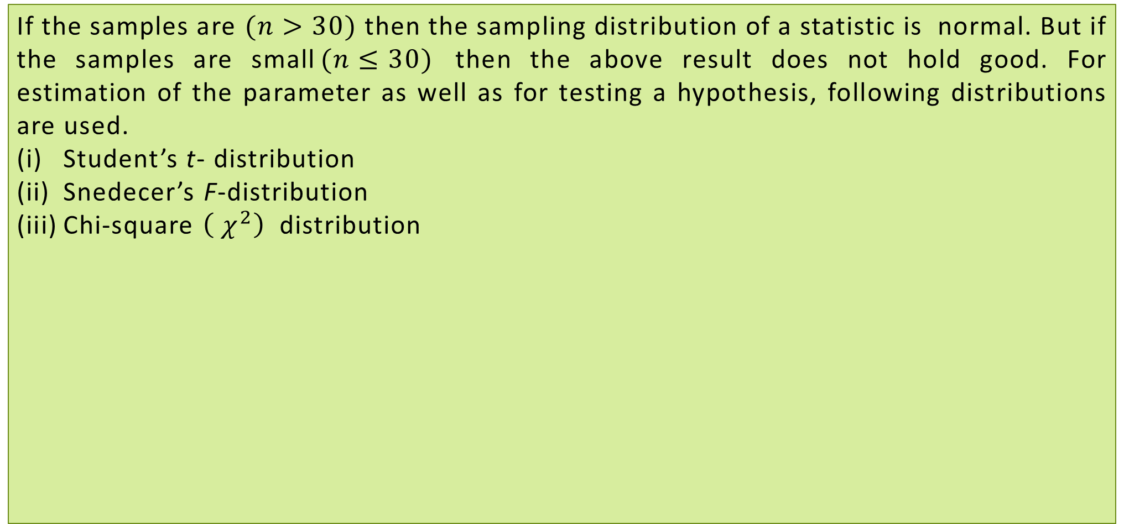
SMALL SAMPLE TESTS
If the samples are $(n>30)$ then the sampling distribution of a statistic is normal. But if the samples are small$(n≤30)$ then the above result does not hold good. For estimation of the parameter as well as for testing a hypothesis, following distributions are used.
Student’s t- distribution
Snedecer’s F-distribution
Chi-square $\left({ χ}^{2}\right)$ distribution

Slide 5
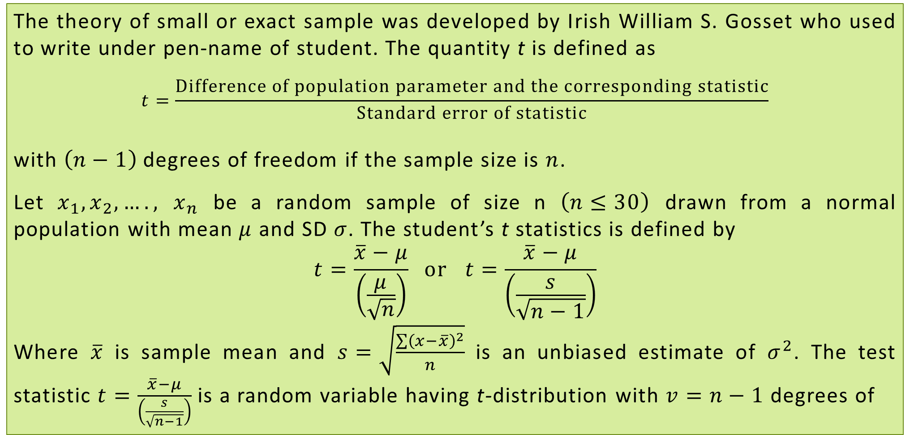
STUDENT’S t-DISTRIBUTION
The theory of small or exact sample was developed by Irish William S. Gosset who used to write under pen-name of student. The quantity t is defined as
$$t=\frac{Difference of population parameter and the corresponding statistic}{Standard error of statistic}$$
with $\left(n−1\right)$ degrees of freedom if the sample size is $n$.
Let $x_{1},x_{2},….,$ $x_{n}$ be a random sample of size n $\left(n≤30\right)$ drawn from a normal population with mean $μ$ and SD $σ$. The student’s t statistics is defined by
$$t=\frac{\overline{x}−μ}{\left(\frac{μ}{\sqrt{n}}\right)} or t=\frac{\overline{x}−μ}{\left(\frac{s}{\sqrt{n−1}}\right)}$$
Where $\overline{x}$ is sample mean and $s=\sqrt{\frac{\sum{{\left(x−\overline{x}\right)}^{2}}}{n}}$ is an unbiased estimate of $σ^{2}$. The test statistic $t=\frac{\overline{x}−μ}{\left(\frac{s}{\sqrt{n−1}}\right)}$ is a random variable having t-distribution with $v=n−1$ degrees of

Slide 6
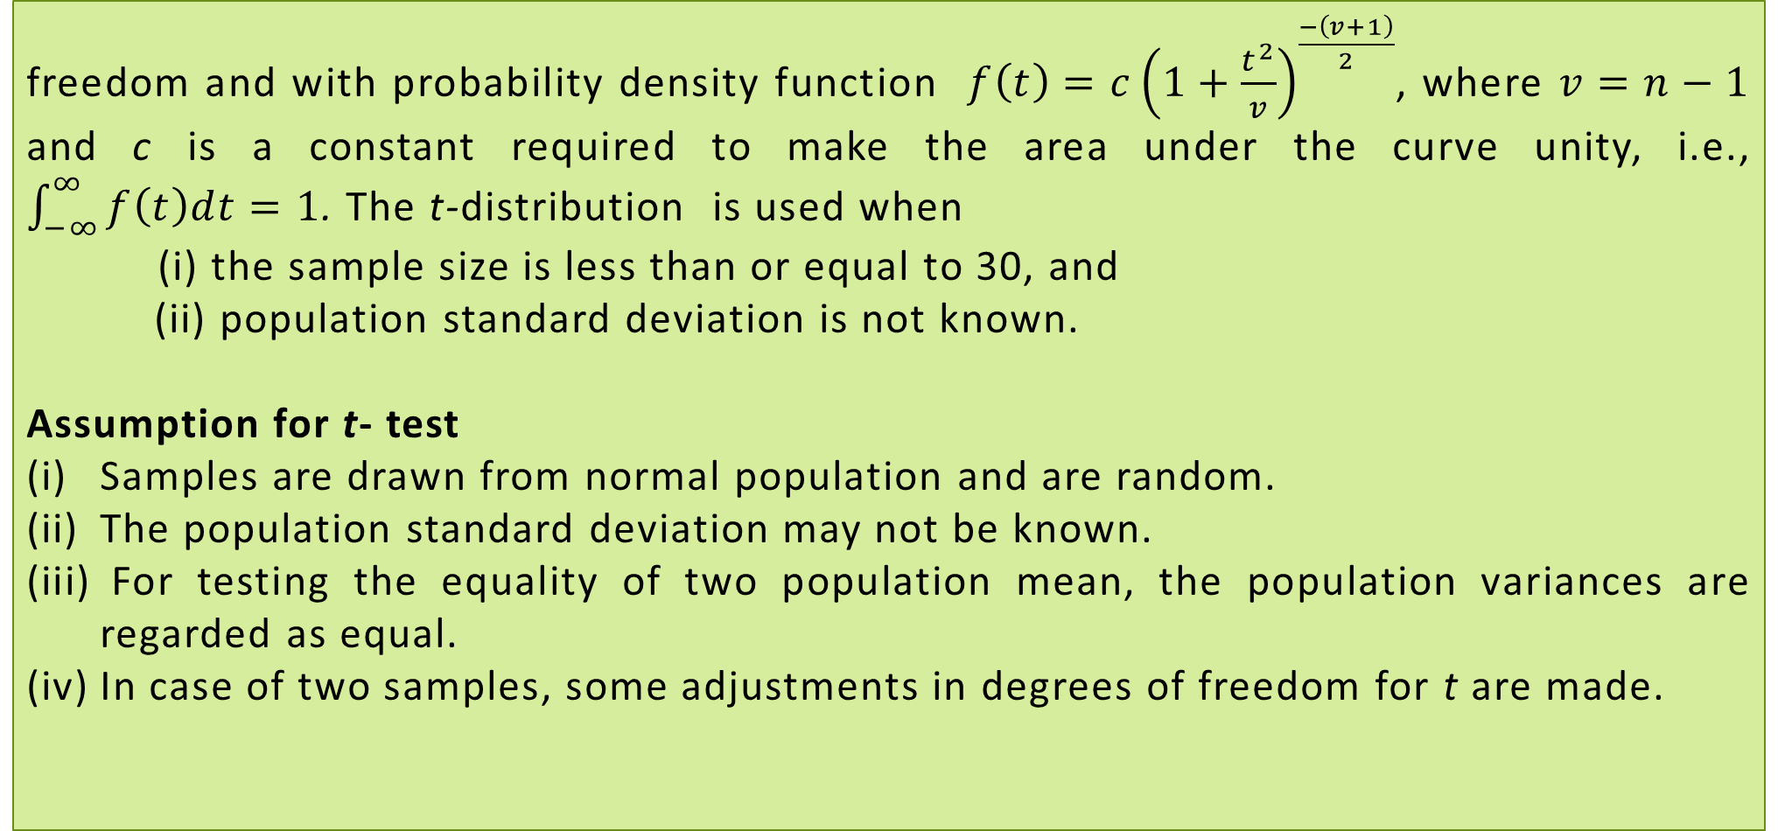
STUDENT’S t-DISTRIBUTION
freedom and with probability density function $f\left(t\right)=c{\left(1+\frac{t^{2}}{v}\right)}^{\frac{−\left(v+1\right)}{2}}$, where $v=n−1$ and c is a constant required to make the area under the curve unity, i.e., $\int_{−∞}^{∞}{f\left(t\right)dt=1}$. The t-distribution is used when
(i) the sample size is less than or equal to 30, and
(ii) population standard deviation is not known.
Assumption for t- test
Samples are drawn from normal population and are random.
The population standard deviation may not be known.
For testing the equality of two population mean, the population variances are regarded as equal.
In case of two samples, some adjustments in degrees of freedom for t are made.

Slide 7
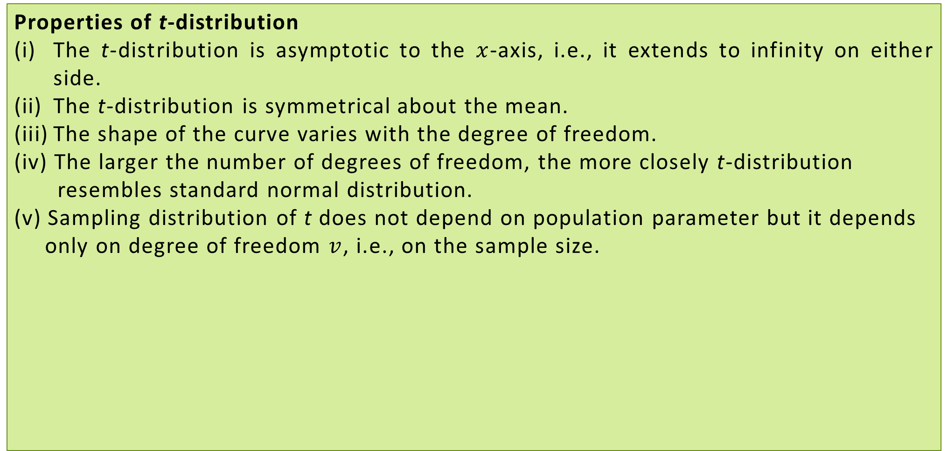
STUDENT’S t-DISTRIBUTION
Properties of t-distribution
The t-distribution is asymptotic to the $x$-axis, i.e., it extends to infinity on either side.
The t-distribution is symmetrical about the mean.
The shape of the curve varies with the degree of freedom.
(iv) The larger the number of degrees of freedom, the more closely t-distribution
resembles standard normal distribution.
(v) Sampling distribution of t does not depend on population parameter but it depends
only on degree of freedom $v$, i.e., on the sample size.
f(t)
t

Slide 8
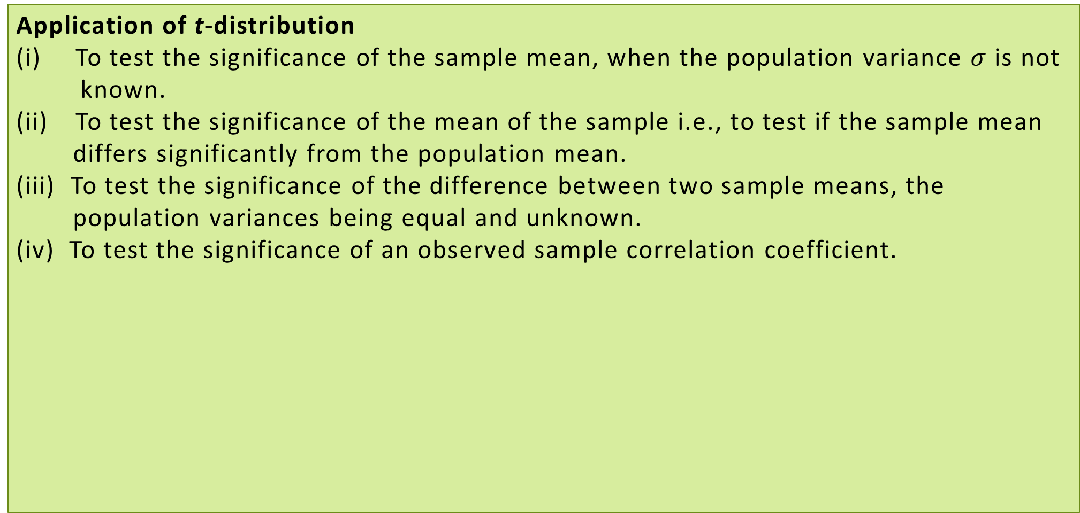
STUDENT’S t-DISTRIBUTION
Application of t-distribution
To test the significance of the sample mean, when the population variance $σ$ is not
known.
To test the significance of the mean of the sample i.e., to test if the sample mean
differs significantly from the population mean.
(iii) To test the significance of the difference between two sample means, the
population variances being equal and unknown.
(iv) To test the significance of an observed sample correlation coefficient.

Slide 9
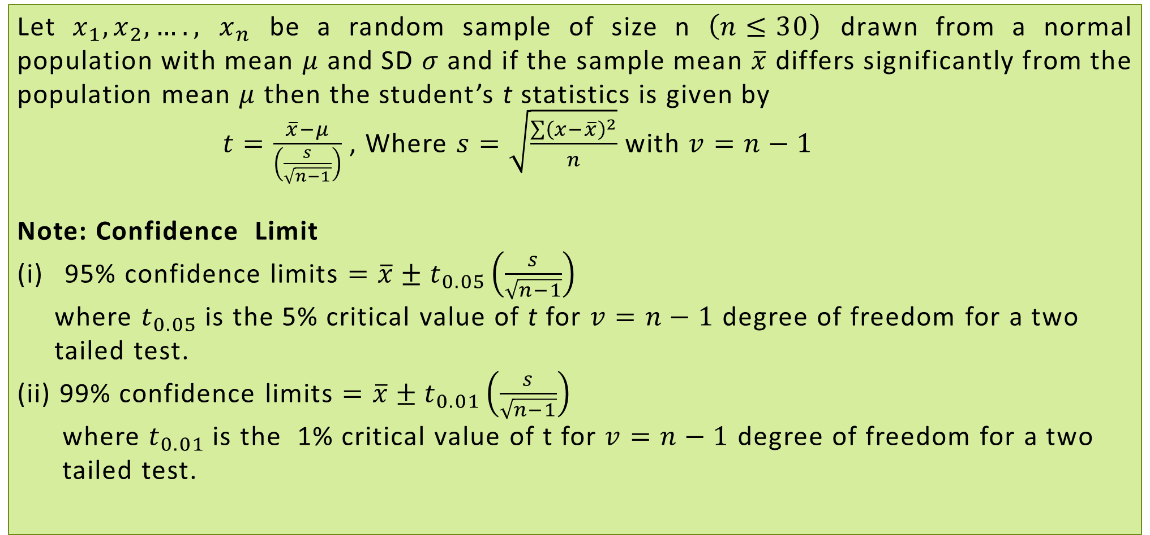
t-TEST: TEST OF SIGNIFICANCE FOR SINGLE MEAN
Let $x_{1},x_{2},….,$ $x_{n}$ be a random sample of size n $\left(n≤30\right)$ drawn from a normal population with mean $μ$ and SD $σ$ and if the sample mean $\overline{x}$ differs significantly from the population mean $μ t$hen the student’s t statistics is given by
$t=\frac{\overline{x}−μ}{\left(\frac{s}{\sqrt{n−1}}\right)}$ , Where $s=\sqrt{\frac{\sum{{\left(x−\overline{x}\right)}^{2}}}{n}}$ with $v=n−1$
Note: Confidence Limit
95% confidence limits $=\overline{x}±t_{0.05}\left(\frac{s}{\sqrt{n−1}}\right)$
where $t_{0.05}$ is the 5% critical value of t for $v=n−1$ degree of freedom for a two
tailed test.
(ii) 99% confidence limits $=\overline{x}±t_{0.01}\left(\frac{s}{\sqrt{n−1}}\right)$
where $t_{0.01}$ is the 1% critical value of t for $v=n−1$ degree of freedom for a two
tailed test.

Slide 10
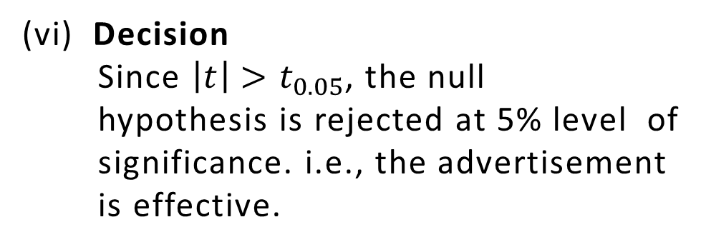
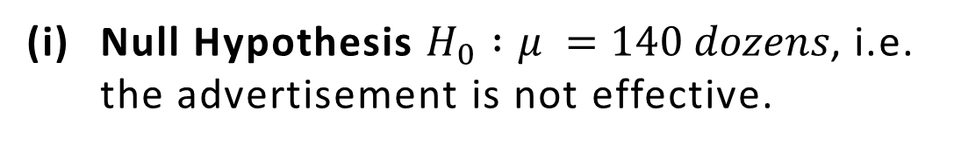
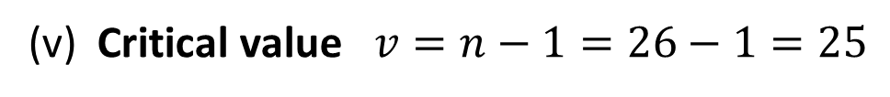



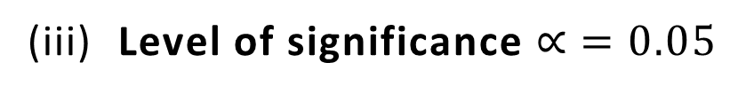
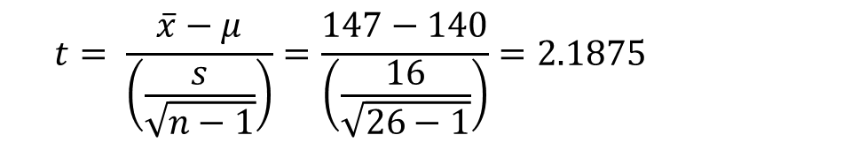
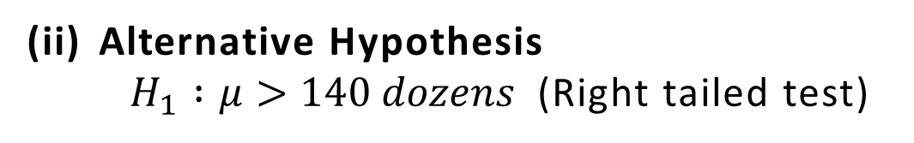
Example 21
A soap manufacturing company was distributing a particular brand of soap through a large number of retail shops. Before a heavy advertisement campaign, the mean sales per week per shop was 140 dozens. After the campaign, a sample of 26 shops was taken and the mean sales was found to be 147 dozens with standard deviation 16. Can you consider the advertisement effective?
Solution
$$\left|t\right|=2.1875$$
$$n =26,\overline{x}=147 dozens$$
(v) Critical value $v=n−1=26−1=25$
$$s=16 dozens, μ=140 dozens$$
Null Hypothesis $H_{0} :μ =140 dozens$, i.e. the advertisement is not effective.
$$t_{0.05}\left(v=25\right)=1.708$$
(vi) Decision
Since $\left|t\right|>t_{0.05}$, the null
hypothesis is rejected at 5% level of
significance. i.e., the advertisement
is effective.
Alternative Hypothesis
$H_{1} :μ>140 dozens$ (Right tailed test)
(iii) Level of significance $∝ =0.05$
(iv) Test statistics
$$t= \frac{\overline{x}−μ}{\left(\frac{s}{\sqrt{n−1}}\right)}=\frac{147−140}{\left(\frac{16}{\sqrt{26−1}}\right)}=2.1875$$

Slide 11
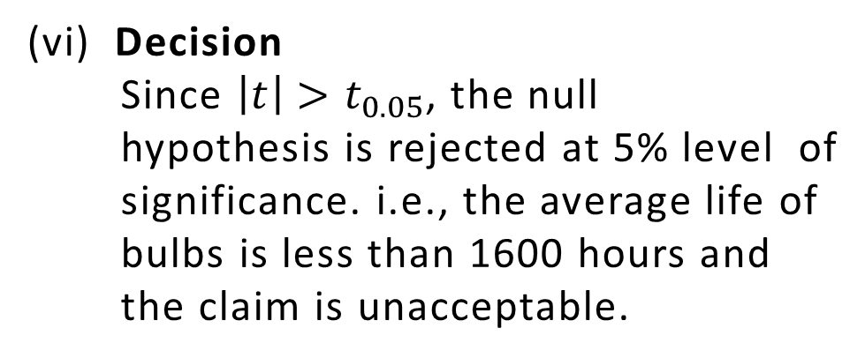
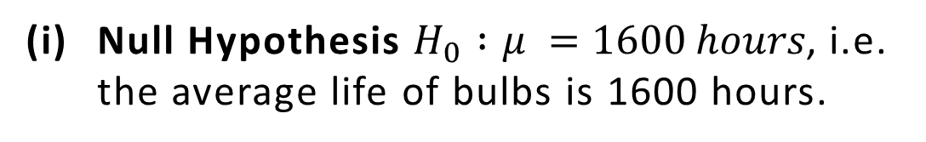
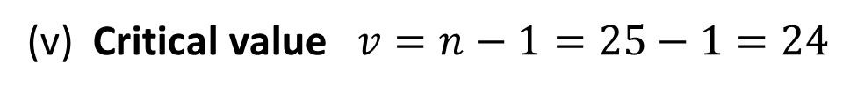



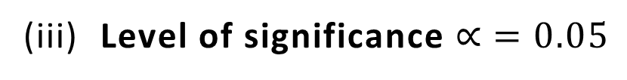
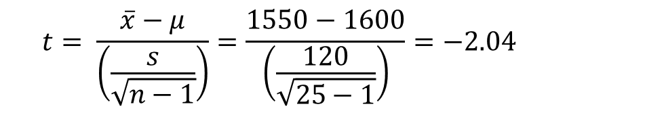
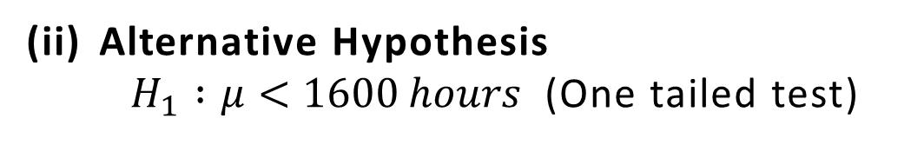
Example 22
The mean lifetime of a sample of 25 bulbs is found as 1550 hours with a SD of 120 hours. The company manufacturing the bulbs claims that the average life of their bulbs is 1600 hours. Is the claim acceptance at 5% level of significance?
Solution
$$n =25,\overline{x}=1550 hours$$
$$\left|t\right|=2.04$$
$$s=120 hours, μ=1600 hours$$
(v) Critical value $v=n−1=25−1=24$
Null Hypothesis $H_{0} :μ =1600 hours$, i.e. the average life of bulbs is 1600 hours.
$$t_{0.05}\left(v=24\right)=1.711$$
Alternative Hypothesis
$H_{1} :μ<1600 hours$ (One tailed test)
(vi) Decision
Since $\left|t\right|>t_{0.05}$, the null
hypothesis is rejected at 5% level of
significance. i.e., the average life of
bulbs is less than 1600 hours and
the claim is unacceptable.
(iii) Level of significance $∝ =0.05$
(iv) Test statistics
$$t= \frac{\overline{x}−μ}{\left(\frac{s}{\sqrt{n−1}}\right)}=\frac{1550−1600}{\left(\frac{120}{\sqrt{25−1}}\right)}=−2.04$$

Slide 12
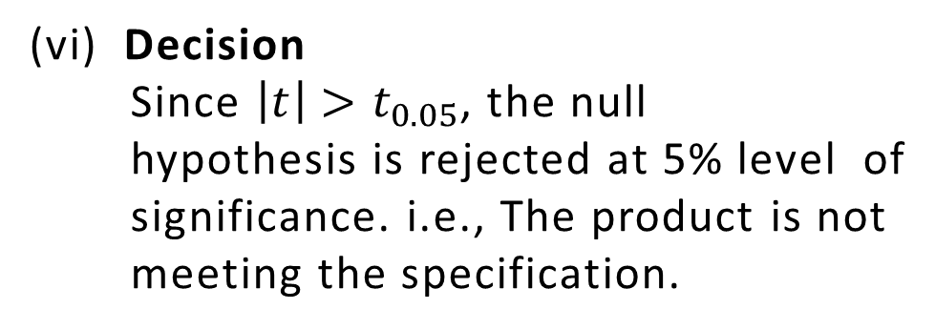
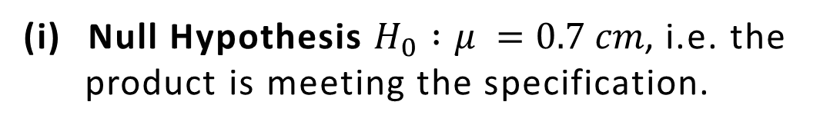
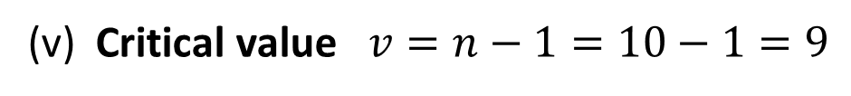



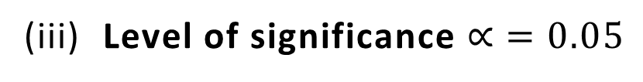
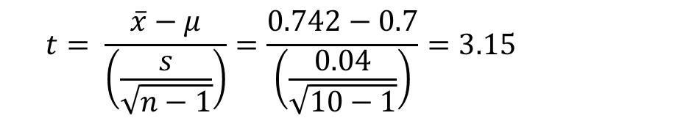
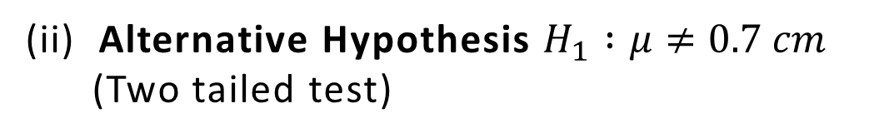
Example 23
A machinist is making engine parts with axle diameter of 0.7 cm. A random sample of 10 parts shows a mean diameter of 0.742 cm with a standard deviation of 0.04 cm. Compute the statistic you would use to test whether work is meeting the specification at 0.05% level of significance.
Solution
$$\left|t\right|=3.15$$
$$n =10,\overline{x}=0.742 cm$$
$$s =0.04 cm, μ=0.7 cm$$
(v) Critical value $v=n−1=10−1=9$
Null Hypothesis $H_{0} :μ =0.7 cm$, i.e. the
product is meeting the specification.
$$t_{0.05}\left(v=9\right)=2.262$$
(ii) Alternative Hypothesis $H_{1} :μ≠0.7 cm$
(Two tailed test)
(vi) Decision
Since $\left|t\right|>t_{0.05}$, the null
hypothesis is rejected at 5% level of
significance. i.e., The product is not
meeting the specification.
(iii) Level of significance $∝ =0.05$
(iv) Test statistics
$$t= \frac{\overline{x}−μ}{\left(\frac{s}{\sqrt{n−1}}\right)}=\frac{0.742−0.7}{\left(\frac{0.04}{\sqrt{10−1}}\right)}=3.15$$

Slide 13
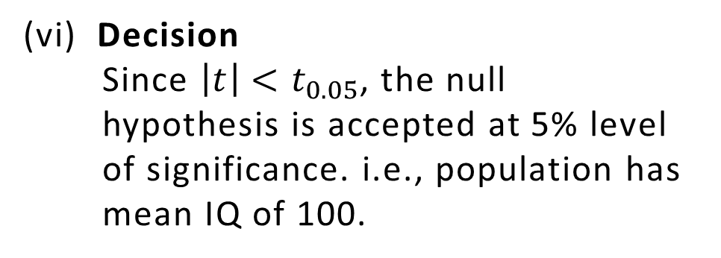
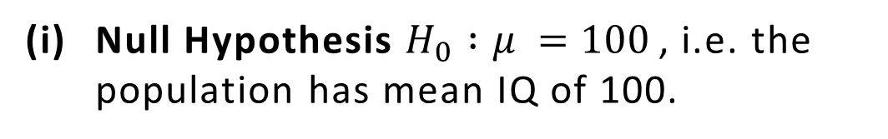
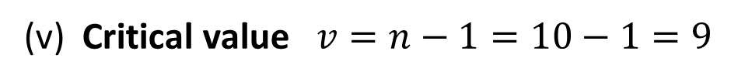


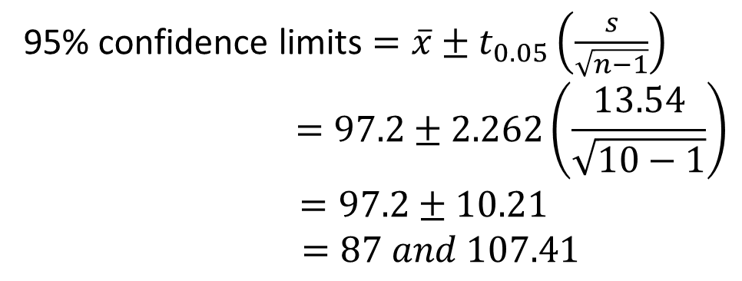
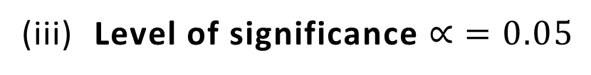


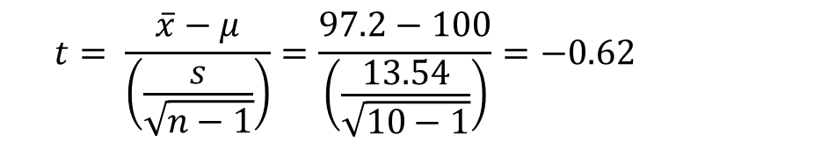
Example 24
A random sample of 10 boys had the following IQs:
70,120,110,101,88,83,95,98,107 and100.
Do these data support the assumption of a population mean IQ of 100?
Find 95% confidence limits for the mean IQ.
Solution
$$n =10,$$
$$\overline{x}=97.2,s=13.54$$
(v) Critical value $v=n−1=10−1=9$
$$t_{0.05}\left(v=9\right)=2.262$$
Null Hypothesis $H_{0} :μ =100$, i.e. the population has mean IQ of 100.
(vi) Decision
Since $\left|t\right|<t_{0.05}$, the null
hypothesis is accepted at 5% level
of significance. i.e., population has
mean IQ of 100.
Alternative Hypothesis
$H_{1} :μ≠100$ (Two tailed test)
(iii) Level of significance $∝ =0.05$
95% confidence limits $=\overline{x}±t_{0.05}\left(\frac{s}{\sqrt{n−1}}\right)$
$$=97.2±2.262\left(\frac{13.54}{\sqrt{10−1}}\right)$$
$$=97.2±10.21$$
$$=87 and 107.41$$
(iv) Test statistics
$$t= \frac{\overline{x}−μ}{\left(\frac{s}{\sqrt{n−1}}\right)}=\frac{97.2−100}{\left(\frac{13.54}{\sqrt{10−1}}\right)}=−0.62$$
$$\left|t\right|=0.62$$

Slide 14


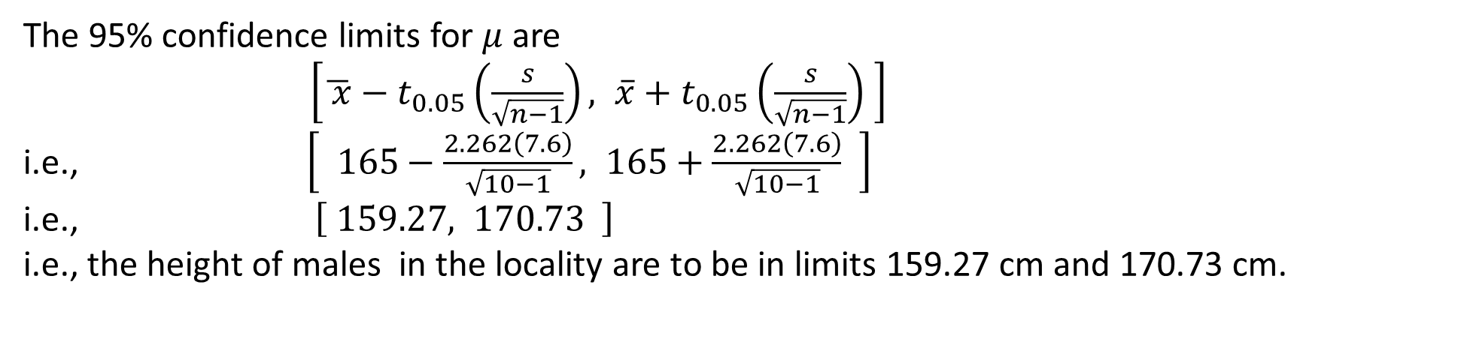
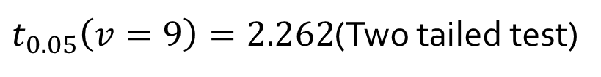
Example 25
The heights of 10 males of a given locality are found to be 175,168,155,170,152,170,175,160,160 and 165 cm. Based on this sample, find the 95% confidence limits for the heights of males in that locality.
Solution
$$n =10,$$
$$\overline{x}=165,s=7.6$$
$v=n−1=10−1=9$
From t- table
$t_{0.05}\left(v=9\right)=2.262$(Two tailed test)
The 95% confidence limits for $μ$ are
$\left[\overline{ x}−t_{0.05}\left(\frac{s}{\sqrt{n−1}}\right), \overline{x}+t_{0.05}\left(\frac{s}{\sqrt{n−1}}\right) \right]$
i.e., $\left[ 165−\frac{2.262\left(7.6\right)}{\sqrt{10−1}}, 165+\frac{2.262\left(7.6\right)}{\sqrt{10−1}} \right]$
i.e., $\left[ 159.27, 170.73 \right]$
i.e., the height of males in the locality are to be in limits 159.27 cm and 170.73 cm.

Slide 15
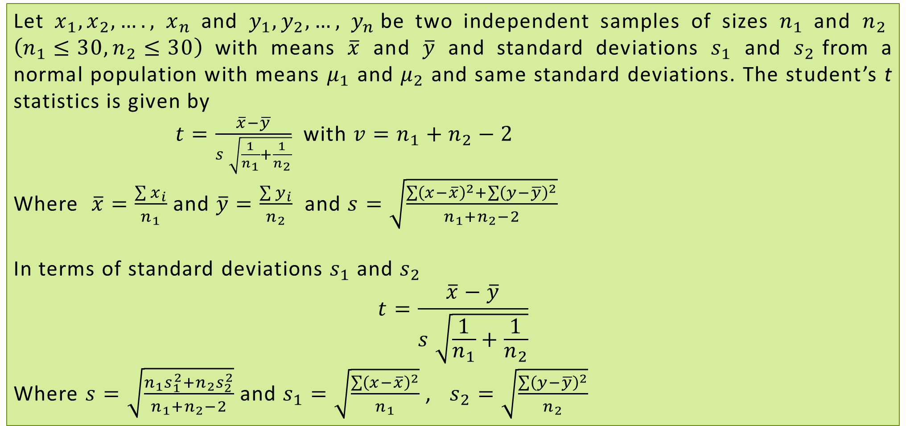
t-TEST: TEST OF SIGNIFICANCE FOR DIFFERENCE OF MEANS
Let $x_{1},x_{2},….,$ $x_{n}$ and $y_{1},y_{2},…,$ $y_{n}$be two independent samples of sizes $n_{1}$ and $n_{2}$ $\left(n_{1}≤30,n_{2}≤30\right)$ with means $\overline{x}$ and $\overline{y}$ and standard deviations $s_{1}$ and $s_{2}$from a normal population with means $μ_{1}$ and $μ_{2}$ and same standard deviations. The student’s t statistics is given by
$t=\frac{\overline{x}−\overline{y}}{s \sqrt{\frac{1}{n_{1}}+\frac{1}{n_{2}}}}$ with $v=n_{1}+n_{2}−2$
Where $\overline{x}=\frac{\sum{x_{i}}}{n_{1}}$ and $\overline{y}=\frac{\sum{y_{i}}}{n_{2}}$ and $s=\sqrt{\frac{\sum{{\left(x−\overline{x}\right)}^{2}}+\sum{{\left(y−\overline{y}\right)}^{2}}}{n_{1}+n_{2}−2}}$
In terms of standard deviations $s_{1}$ and $s_{2}$
$$t=\frac{\overline{x}−\overline{y}}{s \sqrt{\frac{1}{n_{1}}+\frac{1}{n_{2}}}}$$
Where $s=\sqrt{\frac{n_{1}s_{1}^{2}+n_{2}s_{2}^{2}}{n_{1}+n_{2}−2}}$ and $s_{1}=\sqrt{\frac{\sum{{\left(x−\overline{x}\right)}^{2}}}{n_{1}}}$ , $s_{2}=\sqrt{\frac{\sum{{\left(y−\overline{y}\right)}^{2}}}{n_{2}}}$

Slide 16
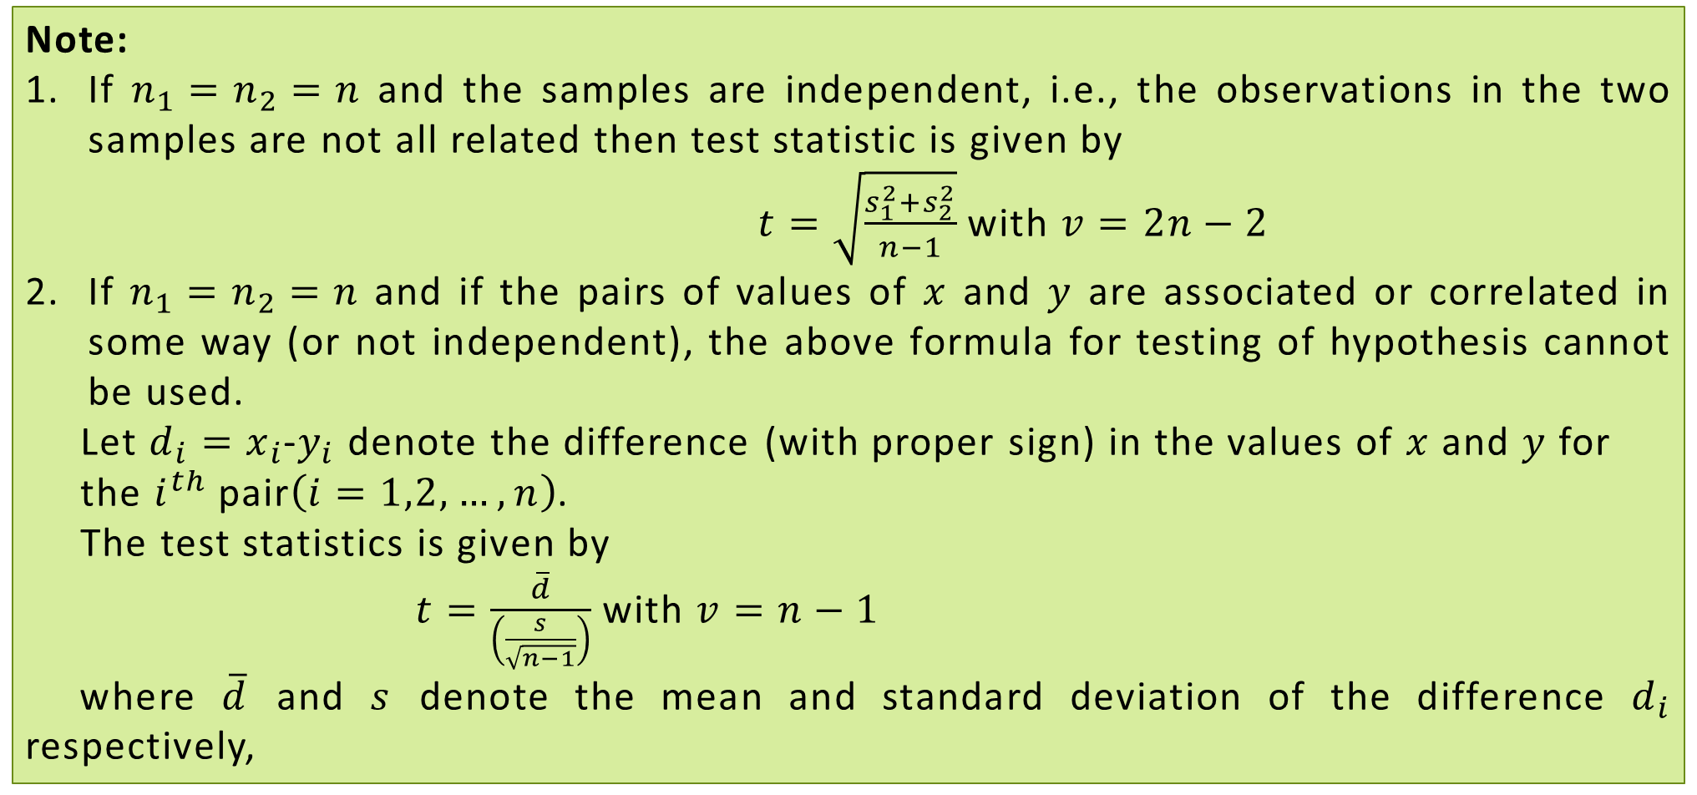
t-TEST: TEST OF SIGNIFICANCE FOR DIFFERENCE OF MEANS
Note:
If $n_{1}=n_{2}=n$ and the samples are independent, i.e., the observations in the two samples are not all related then test statistic is given by
$t=\sqrt{\frac{s_{1}^{2}+s_{2}^{2}}{n−1}}$ with $v=2n−2$
If $n_{1}=n_{2}=n$ and if the pairs of values of $x$ and $y$ are associated or correlated in some way (or not independent), the above formula for testing of hypothesis cannot be used.
Let $d_{i}=x_{i}$-$y_{i}$ denote the difference (with proper sign) in the values of $x$ and $y$ for
the $i^{th}$ pair$\left(i=1,2,…,n\right)$.
The test statistics is given by
$t=\frac{\overline{d}}{\left(\frac{s}{\sqrt{n−1}}\right)}$ with $v=n−1$
where $\overline{d}$ and $s$ denote the mean and standard deviation of the difference $d_{i}$ respectively,

Slide 17
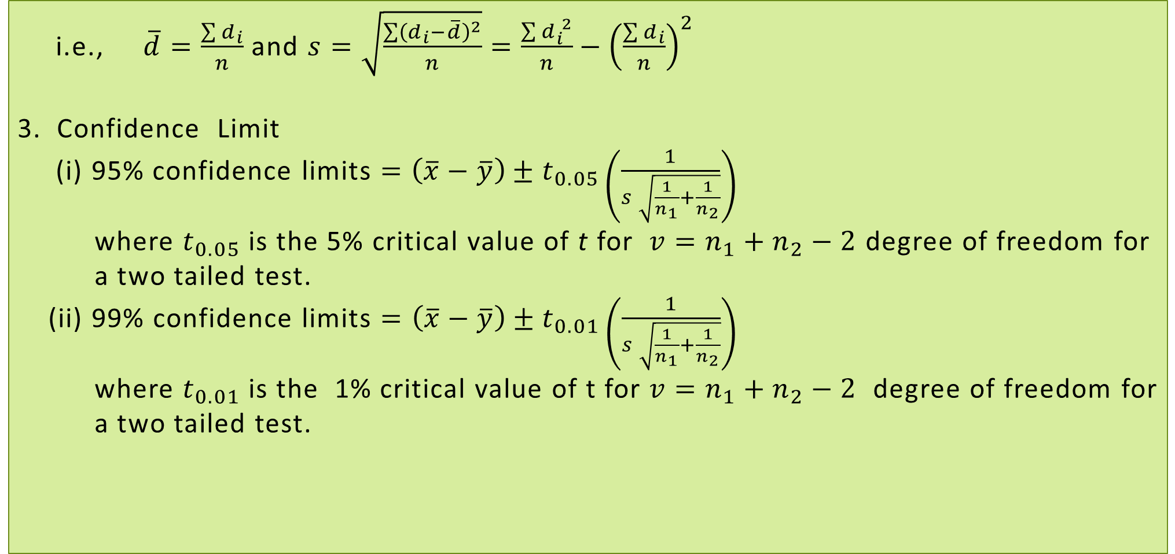
t-TEST: TEST OF SIGNIFICANCE FOR DIFFERENCE OF MEANS
i.e., $\overline{d}=\frac{\sum{d_{i}}}{n}$ and $s=\sqrt{\frac{\sum{{\left(d_{i}−\overline{d}\right)}^{2}}}{n}}=\frac{\sum{d_{i}^{ 2}}}{n}−{\left(\frac{\sum{d_{i}}}{n}\right)}^{2}$
3. Confidence Limit
(i) 95% confidence limits $=\left(\overline{x}−\overline{y}\right)±t_{0.05}\left(\frac{1}{s \sqrt{\frac{1}{n_{1}}+\frac{1}{n_{2}}}}\right)$
where $t_{0.05}$ is the 5% critical value of t for $v=n_{1}+n_{2}−2$ degree of freedom for
a two tailed test.
(ii) 99% confidence limits $=\left(\overline{x}−\overline{y}\right)±t_{0.01}\left(\frac{1}{s \sqrt{\frac{1}{n_{1}}+\frac{1}{n_{2}}}}\right)$
where $t_{0.01}$ is the 1% critical value of t for $v=n_{1}+n_{2}−2$ degree of freedom for
a two tailed test.

Slide 18
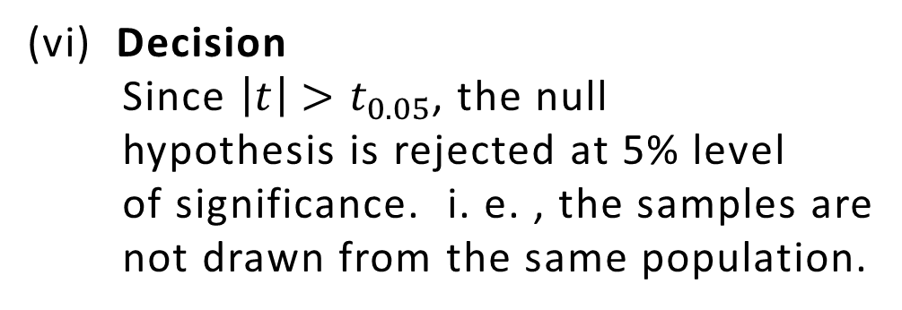
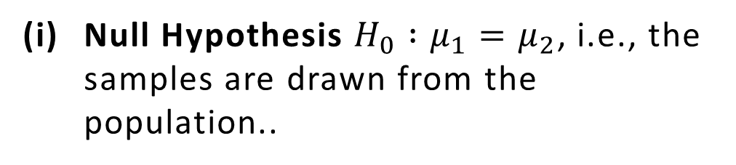
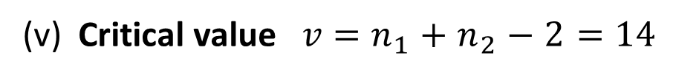
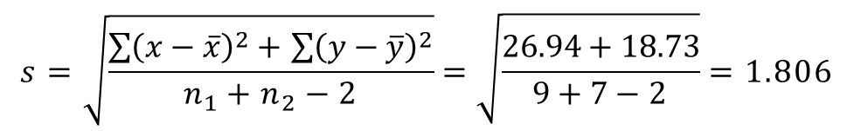
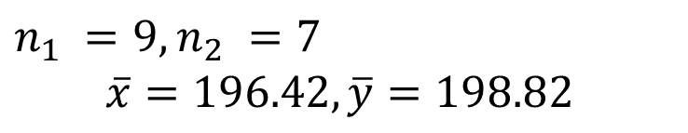

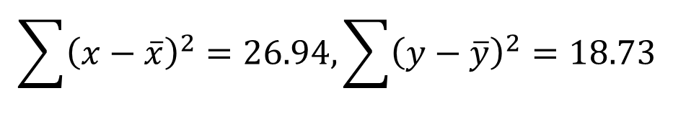
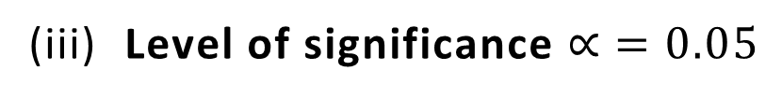


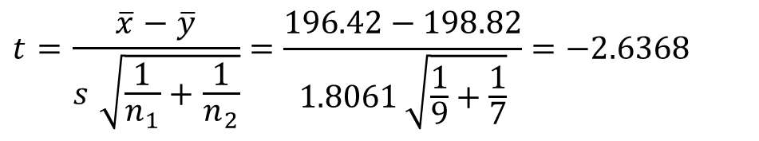
Example 26
The means of two random samples of size 9 and 7 are 196.42 and 198.82 respectively. The sum of squares of the deviation from the mean are 26.94 and 18.73 respectively. Can the sample be considered to have been drawn from the same population?
Solution
$n_{1} =9,$ $n_{2} =7$
$$\overline{x}=196.42,\overline{y}=198.82$$
(iv) Test statistics
$$\sum{{\left(x−\overline{x}\right)}^{2}}=26.94,\sum{{\left(y−\overline{y}\right)}^{2}}=18.73$$
$$t=\frac{\overline{x}−\overline{y}}{s \sqrt{\frac{1}{n_{1}}+\frac{1}{n_{2}}}}=\frac{196.42−198.82}{1.8061 \sqrt{\frac{1}{9}+\frac{1}{7}}}=−2.6368$$
$$s=\sqrt{\frac{\sum{{\left(x−\overline{x}\right)}^{2}}+\sum{{\left(y−\overline{y}\right)}^{2}}}{n_{1}+n_{2}−2}}=\sqrt{\frac{26.94+18.73}{9+7−2}}=1.806$$
$$\left|t\right|=2.6368$$
(v) Critical value $v=n_{1}+n_{2}−2=14$
Null Hypothesis $H_{0} :μ_{1}=μ_{2}$, i.e., the samples are drawn from the population..
$$t_{0.05}\left(v=14\right)=2.145$$
(vi) Decision
Since $\left|t\right|>t_{0.05}$, the null
hypothesis is rejected at 5% level
of significance. i. e. , the samples are
not drawn from the same population.
Alternative Hypothesis
$H_{1} :μ_{1}≠μ_{2}$(Two tailed test)
(iii) Level of significance $∝ =0.05$

Slide 19
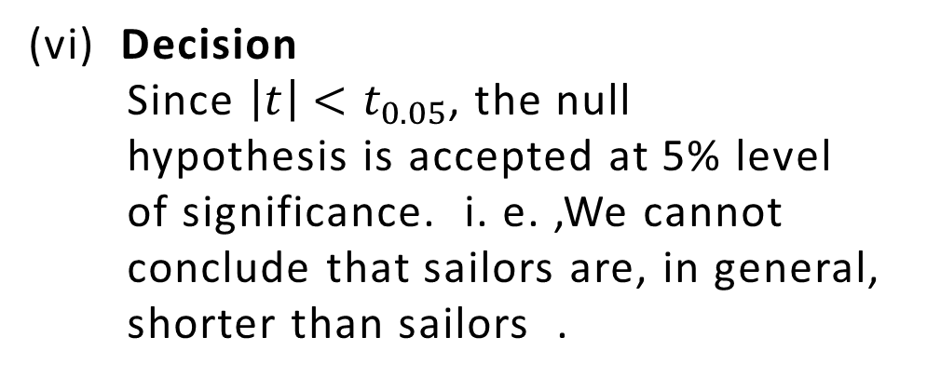
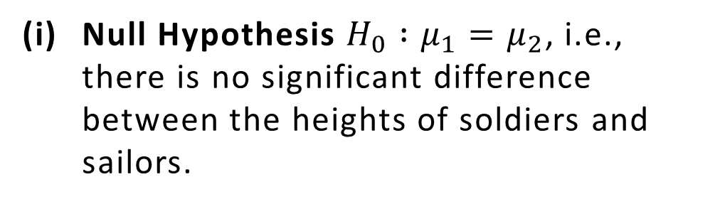
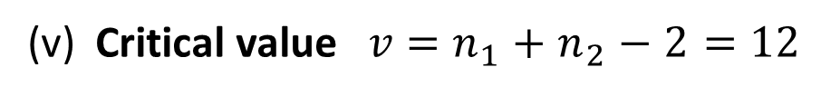
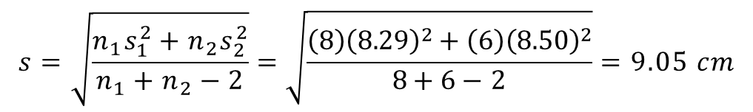
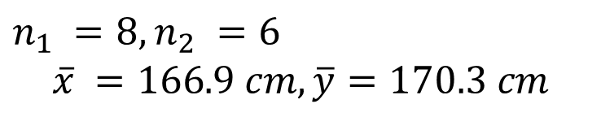




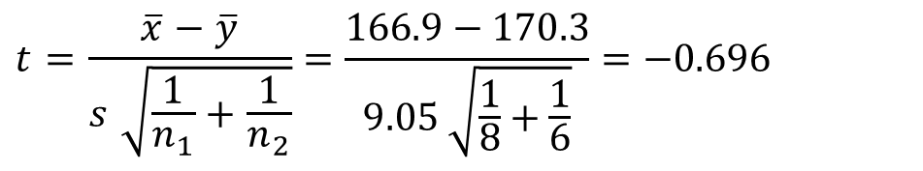
Example 27
The mean height and SD height of 8 randomly chosen soldiers are 166.9 cm and 8.29 cm respectively. The corresponding values of 6 randomly chosen sailors are 170.3 cm and 8.50 cm respectively. Based on this data, can we conclude that soldiers are, in general, shorter than sailors ?
Solution
(iv) Test statistics
$n_{1} =8,$ $n_{2} =6$
$$\overline{x} =166.9 cm,\overline{y}=170.3 cm$$
$$t=\frac{\overline{x}−\overline{y}}{s \sqrt{\frac{1}{n_{1}}+\frac{1}{n_{2}}}}=\frac{166.9−170.3}{9.05 \sqrt{\frac{1}{8}+\frac{1}{6}}}=−0.696$$
$$s_{1}=8.29 cm, s_{2}=8.50 cm$$
$$\left|t\right|=0.696$$
$$s=\sqrt{\frac{n_{1}s_{1}^{2}+n_{2}s_{2}^{2}}{n_{1}+n_{2}−2}}=\sqrt{\frac{\left(8\right){\left(8.29\right)}^{2}+\left(6\right){\left(8.50\right)}^{2}}{8+6−2}}=9.05 cm$$
(v) Critical value $v=n_{1}+n_{2}−2=12$
Null Hypothesis $H_{0} :μ_{1}=μ_{2}$, i.e., there is no significant difference between the heights of soldiers and sailors.
$$t_{0.05}\left(v=12\right)=1.782$$
(vi) Decision
Since $\left|t\right|<t_{0.05}$, the null
hypothesis is accepted at 5% level
of significance. i. e. ,We cannot
conclude that sailors are, in general,
shorter than sailors .
Alternative Hypothesis
$H_{1} :μ_{1}<μ_{2}$(One tailed test)
(iii) Level of significance $∝ =0.05$

Slide 20
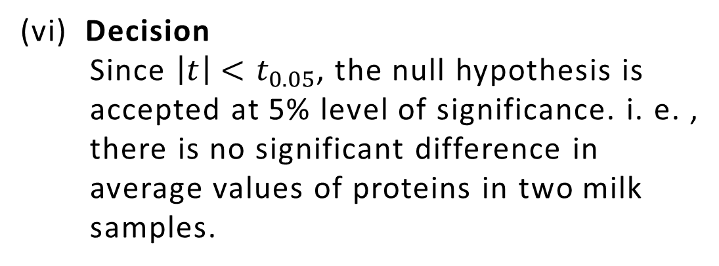








Example 28
The following data represent the biological values of protein from cow’s milk and buffalo’s milk at a certain level.
Examine if the average values of protein in the two samples significantly differ.
Solution
Cow’s milk | 1.82 | 2.02 | 1.88 | 1.61 | 1.81 | 1.54
Buffalo’s milk | 2.00 | 1.83 | 1.86 | 2.03 | 2.19 | 1.88
$$t=\frac{\overline{x}−\overline{y}}{\sqrt{\frac{s_{1}^{2}+s_{2}^{2}}{n−1}}}=\frac{1.78−1.965}{ \sqrt{\frac{{\left(0.16\right)}^{2}+{\left(0.124\right)}^{2}}{6−1}}}=−2.043$$
n$=6,{\overline{x}}_{1}=1.78,{\overline{x}}_{2}=1.965, s_{1}=0.16,s_{2}=0.124$
$$\left|t\right|=2.043$$
Null Hypothesis $H_{0} :μ_{1}=μ_{2}$, i.e., there is no significant difference in average values of proteins in two milk samples
(v) Critical value $v=2n−2=10$
$$t_{0.05}\left(v=10\right)=2.228$$
(vi) Decision
Since $\left|t\right|<t_{0.05}$, the null hypothesis is
accepted at 5% level of significance. i. e. ,
there is no significant difference in
average values of proteins in two milk
samples.
Alternative Hypothesis
$H_{1} :μ_{1}≠μ_{2}$(Two tailed test)
(iii) Level of significance $∝ =0.05$
(iv) Test statistics

Slide 21

t-TEST: TEST OF SIGNIFICANCE FOR CORRELATION COEFFICIENTS
Let $\left(x_{1} ,y_{1}\right),\left(x_{2} ,y_{2}\right)$,…, $\left(x_{n} ,y_{n}\right)$ be $n$ pairs of observations of a random sample from a bivariate normal population and let $r$ be the observed correlation coefficient in the sample. It is required to test if this sample correlation coefficient is significant of any correlation in the population, i.e., whether the value of the population correlation coefficient $ρ$ is zero and the observed value of $r$ has arisen due to fluctuation of sampling. The student’s t statistics is given by
$t=\frac{r\sqrt{n−2}}{ \sqrt{1−r^{2}}}$ with $v=n−2$

Slide 22









Example 30
A random sample of 18 pairs of observations from a bivariate normal population gives a correlation coefficient of 0.3. Is it likely that variables are uncorrelated in the population?
Solution
$$n=18, r=0.3$$
$$\left|t\right|=1.26$$
Null Hypothesis $H_{0} : ρ=0$, i.e., the variables are uncorrelated.
(v) Critical value $v=n−2=18−2=16$
$$t_{0.05}\left(v=16\right)=2.12$$
Alternative Hypothesis
$H_{1} :ρ≠0$(Two tailed test)
(vi) Decision
Since $\left|t\right|<t_{0.05}$, the null
hypothesis is accepted at 5% level
of significance. i. e. , the variables
are uncorrelated in the population..
(iii) Level of significance $∝ =0.05$
(iv) Test statistics
$$t=\frac{r\sqrt{n−2}}{\sqrt{1−r^{2}}}=\frac{0.3\sqrt{18−2}}{ \sqrt{1−{\left(0.3\right)}^{2}}}=1.26$$

Slide 23









Example 31
The correlation coefficient between income and food expenditure for sample of 7 household from a low income group is 0.9. Using 1% level of significance, test whether the correlation coefficient between incomes and food expenditure is positive. Assume that the population of both variables are normally distributed.
Solution
$$n=7, r=0.9$$
$$\left|t\right|=4.61$$
Null Hypothesis $H_{0} : ρ=0$, i.e., there is no correlation between incomes and food expenditure.
(v) Critical value $v=7−2=7−2=5$
$$t_{0.01}\left(v=7\right)=4.032$$
Alternative Hypothesis
$H_{1} :ρ≠0$(Two tailed test)
(vi) Decision
Since $\left|t\right|>t_{0.01}$, the null
hypothesis is accepted at 1% level
of significance. i. e. , there is a
correlation between incomes and
food expenditure.
(iii) Level of significance $∝ =0.01$
(iv) Test statistics
$$t=\frac{r\sqrt{n−2}}{\sqrt{1−r^{2}}}=\frac{0.9\sqrt{7−2}}{ \sqrt{1−{\left(0.9\right)}^{2}}}=4.61$$

Slide 24











Example 32
Find the least value of $r$ in samples of 18 pairs of observations from a bivariate normal population, which is significant at 5% level.
Solution
The value of $r$ for $n=18$ will be significant at 5% level if
$16r^{2}≥4.5−4.5r^{2}$
$\left|\frac{r\sqrt{n−2}}{\sqrt{1−r^{2}}}\right|≥t_{0.05}\left(v=16\right)$
$20.5r^{2}≥4.5$
$\left|\frac{r\sqrt{n−2}}{\sqrt{1−r^{2}}}\right|≥2.12$
$r^{2}≥0.22$
Squaring both the sides and putting $n=18$ ,
$$\left|r\right|≥0.47$$
$$\frac{r^{2}\left(18−2\right)}{1−r^{2}} ≥4.5$$
Hence, the least value of $r$ is 0.47 (numerically).

Slide 25

SNEDECOR’S F-TEST FOR RATIO OF VARIANCES
Let $x_{1},x_{2},….,$ $x_{n}$ and $y_{1},y_{2},…,$ $y_{n}$be two independent samples of sizes $n_{1}$ and $n_{2}$ $\left(n_{1}≤30,n_{2}≤30\right)$ with means $\overline{x}$ and $\overline{y}$ drawn from the normal population with $μ$ and standard deviation $σ$. The test statistics of Snedecor’s F-test in terms of unbiased estimates of standard deviations $S_{1}$ and $S_{2}$ of population is given by
$F=\frac{S_{1}^{2}}{S_{2}^{2}}$
Where $S_{1}^{2}{>S}_{2}^{2}$ and $S_{1}^{2}=\frac{\sum{{\left(x−\overline{x}\right)}^{2}}}{n_{1}−1}$, $S_{2}^{2}=\frac{\sum{{\left(y−\overline{y}\right)}^{2}}}{n_{2}−1}$with numerator degree of freedom $v_{1}=n_{1}−1$ and denominator degree of freedom $v_{2}=n_{2}−1$.
If $s_{1}$ and $s_{2}$ are standard deviations of samples then $s_{1}^{2}=\frac{\sum{{\left(x−\overline{x}\right)}^{2}}}{n_{1}}$ and $s_{2}^{2}=\frac{\sum{{\left(y−\overline{y}\right)}^{2}}}{n_{2}}$
$∴$ $\sum{{\left(x−\overline{x}\right)}^{2}}=n_{1}s_{1}^{2}$
$\sum{{\left(y−\overline{y}\right)}^{2}}=n_{2}s_{2}^{2}$
Substituting in $s_{1}^{2}$ and $s_{2}^{2}$,
$S_{1}^{2}=\frac{n_{1}s_{1}^{2}}{n_{1}−1}$ and $S_{2}^{2}=\frac{n_{2}s_{2}^{2}}{n_{2}−1}$

Slide 26

SNEDECOR’S F-TEST FOR RATIO OF VARIANCES
The Snedecor’s F-distribution is defined by
$$P\left(F\right)=cF^{\left(\frac{v_{1}−2}{2}\right)} {\left(1+\frac{v_{1}}{v_{2}}F\right)}^{−\left(\frac{v_{1}+v_{2}}{2}\right)}$$
Where the constant c depends on $v_{1}$ and $v_{2}$. It is so chosen that the area under the curve is unity.
Properties of F-distribution
(i) F-distribution curve lies entirely in the first quadrant and is unimodal.
(ii) F-distribution is independent of the population variance $σ^{2}$ and depends on $v_{1}$ and
$v_{2}$ only.
(iii) The mode of F-distribution is less than unity.
$F_{1−∝}\left(v_{1},v_{2}\right)=\frac{1}{F_{∝}\left(v_{2},v_{1}\right)}$
where $F_{∝}\left(v_{2},v_{1}\right)$ is the value of F with $v_{2}$ and $v_{1}$ degrees of freedom such that the
area under the F-distribution curve right of $F_{∝}$ is $∝$.

Slide 27

SNEDECOR’S F-TEST FOR RATIO OF VARIANCES
(v) F-test is one tailed test(right tailed test).
$P\left(F\right)$
$F$
$O$
$F−distribution curve$

Slide 28

TEST OF SIGNIFICANCE FOR RATIO OF VARIANCES
Significant test is performed by means of Snedecer’s F-table which provides 5% and 1% of points of significance for F. 5% points of F means that the area under the F-curve, to the right of the ordinate at a value of F, is 0.05. Further, F-table gives only single tail test. F-distribution is very useful for testing the equality of population means by comparing sample variances.
Working Rule
Null Hypothesis $H_{0}: σ_{1}^{2}=σ_{2}^{2}$
Alternative Hypothesis $H_{1}: σ_{1}^{2}>σ_{2}^{2}$
Level of significance: Select the level of significance
Test statistics : $F=\frac{S_{1}^{2}}{S_{2}^{2}}$ where $S_{1}^{2}{>S}_{2}^{2}$
Critical value: Find the critical value(tabulated value) $F_{∝}$ at the given level of significance at degree of freedoms $v_{1}=n_{1}−1$ and $v_{2}=n_{2}−1$.
Decision: If $F>F_{∝}$ at the level of significance $∝$, the null hypothesis is rejected.
If $F<F_{∝}$ at the level of significance $∝$, the null hypothesis is accepted.

Slide 29










Example 35
In a test given to two groups of students drawn from two normal populations, the marks obtained were as follows:
Examine at 5% level, whether the two populations have the same variances.
Solution
Group I | 18 | 20 | 36 | 50 | 49 | 36 | 34 | 49 | 41
Group II | 29 | 28 | 26 | 35 | 30 | 44 | 46
$n_{1} =9,$ $n_{2} =7,\overline{x}=37,\overline{y}=34,$
$$s_{1}=11.225,s_{2}=7.426$$
$$F=\frac{S_{1}^{2}}{S_{2}^{2}}=\frac{141.75}{64.33}=2.203$$
(iv) Test statistics
$$S_{1}^{2}=\frac{n_{1}s_{1}^{2}}{n_{1}−1}=\frac{9{\left(11.2225\right)}^{2}}{9−1}=141.75$$
$$S_{2}^{2}=\frac{n_{2}s_{2}^{2}}{n_{2}−1} =\frac{7{\left(7.426\right)}^{2}}{7−1}=64.3$$
(v) Critical value $v_{1}=n_{1}−1=9−1=8$
$$v_{2}=n_{2}−1=7−1=6$$
$$F_{0.05}\left(v_{1}=8,v_{2}=6\right)=4.15$$
Null Hypothesis $H_{0} :σ_{1}^{2}=σ_{2}^{2}$, i.e., the two populations have same variances.
(vi) Decision
Since $F<F_{0.05}$ , the null
hypothesis is accepted at 5% level
of significance. i. e., the two
populations have same variances.
Alternative Hypothesis
$H_{1} :σ_{1}^{2}>σ_{2}^{2}$
(iii) Level of significance $∝ =0.05$

Slide 30










Example 36
Two nicotine contents in two random samples of tobacco are given below:
Can we say that two samples came from the same population?.
Solution
Sample I | 21 | 24 | 25 | 26 | 27
Sample II | 22 | 27 | 28 | 30 | 31 | 36
F-test :
(iii) Level of significance $∝ =0.05$
$n_{1} =5,$ $n_{2} =6,\overline{x}=24.6,\overline{y}=29,$
$$s_{1}=2.06,s_{2}=4.24$$
$$F=\frac{S_{2}^{2}}{S_{1}^{2}}=\frac{21.57}{5.30}=4.07$$
(iv) Test statistics
$$S_{1}^{2}=\frac{n_{1}s_{1}^{2}}{n_{1}−1}=\frac{5{\left(2.06\right)}^{2}}{5−1}=5.30$$
$$S_{2}^{2}=\frac{n_{2}s_{2}^{2}}{n_{2}−1} =\frac{6{\left(4.24\right)}^{2}}{6−1}=21.57$$
(v) Critical value $v_{1}=n_{1}−1=5−1=4$
$$v_{2}=n_{2}−1=6−1=5$$
$$F_{0.05}\left(v_{2}=5,v_{1}=4\right)=6.26$$
(vi) Decision
Since $F<F_{0.05}$ , the null
hypothesis is accepted at 5% level
of significance. i. e., the two
populations have same variances.
Null Hypothesis $H_{0} :σ_{1}^{2}=σ_{2}^{2}$, i.e., the two populations have same variances.
Alternative Hypothesis
$H_{1} :σ_{1}^{2}>σ_{2}^{2}$

Slide 31










Example 33
In two independent samples of sizes 8 and 10, the sum of squares of deviations of the sample values from the respective means were 84.4 and 102.6. Test whether the difference of variances of the population is significant or not. Use a 0.05 level of significance.
Solution
(iv) Test statistics
$n_{1} =8,$ $n_{2} =10$
$$\sum{{\left(x−\overline{x}\right)}^{2}}=84.4, \sum{{\left(y−\overline{y}\right)}^{2}}=102.6$$
$$F=\frac{S_{1}^{2}}{S_{2}^{2}}=\frac{12.057}{11.4}=1.057$$
(v) Critical value $v_{1}=n_{1}−1=8−1=7$
$S_{1}^{2}=\frac{\sum{{\left(x−\overline{x}\right)}^{2}}}{n_{1}−1}=\frac{84.4}{8−1}=12.057$,
$S_{2}^{2}=\frac{\sum{{\left(y−\overline{y}\right)}^{2}}}{n_{2}−1}=\frac{102.6}{10−1}=11.4$
$$v_{2}=n_{2}−1=10−1=9$$
$$F_{0.05}\left(v_{1}=7,v_{2}=9\right)=3.29$$
(vi) Decision
Since $F<F_{0.05}$ , the null
hypothesis is accepted at 5% level
of significance. i. e. , there is no
significant difference in variances of
the population.
Null Hypothesis $H_{0} :σ_{1}^{2}=σ_{2}^{2}$, i.e., the variances of two populations are equal.
Alternative Hypothesis
$H_{1} :σ_{1}^{2}>σ_{2}^{2}$
(iii) Level of significance $∝ =0.05$

Slide 32









Example 34
The standard deviations calculated from two random samples of sizes 9 and 13 are 2.1 and 1.8 respectively. Can the samples be regarded as drawn from normal populations with the same SD?
Solution
(iv) Test statistics
$n_{1} =9,$ $n_{2} =13,s_{1}=2.1,s_{2}=1.8$
$$F=\frac{S_{1}^{2}}{S_{2}^{2}}=\frac{4.96}{3.51}=1.41$$
$$S_{1}^{2}=\frac{n_{1}s_{1}^{2}}{n_{1}−1}=\frac{9{\left(2.1\right)}^{2}}{9−1}=4.96$$
$$S_{2}^{2}=\frac{n_{2}s_{2}^{2}}{n_{2}−1} =\frac{13{\left(1.8\right)}^{2}}{13−1}=3.51$$
(v) Critical value $v_{1}=n_{1}−1=9−1=8$
$$v_{2}=n_{2}−1=13−1=12$$
$$F_{0.05}\left(v_{1}=8,v_{2}=12\right)=2.85$$
Null Hypothesis $H_{0} :σ_{1}^{2}=σ_{2}^{2}$, i.e., the variances of two populations are equal.
(vi) Decision
Since $F<F_{0.05}$ , the null
hypothesis is accepted at 5% level
of significance. i. e. , the samples can
be regarded as drawn from normal
population with same SD.
Alternative Hypothesis
$H_{1} :σ_{1}^{2}>σ_{2}^{2}$
(iii) Level of significance $∝ =0.05$

Slide 33

CHI-SQUARE $\left( χ^{2}\right)$ TEST
The chi-square $\left( χ^{2}\right)$ test is a useful measure of comparing experimentally obtained results with those expected theoretically and based on hypothesis. It is used as a test statistics in testing a hypothesis that provides a set of theoretical frequencies with which observed frequencies are compared. The magnitude of discrepancy between observed and theoretical frequencies is given by the quantity $χ^{2}$ (pronounced as chi-square). If $χ^{2}=0$, the observed and expected frequencies completely coincide. As the value if $χ^{2}$ increases, the discrepancy between the observed and theoretical frequency decreases. If $f_{o_{1}},f_{o_{2}},…,f_{o_{n}}$ be a set of observed frequencies and $f_{e_{1}},f_{e_{2}},…,f_{e_{n}}$ be the corresponding set of expected (or theoretical ) frequencies then $χ^{2}$ is defined by
$χ^{2}=\frac{{\left(f_{o_{1}−}f_{e_{1}}\right)}^{2}}{f_{e_{1}}}+\frac{{\left(f_{o_{2}−}f_{e_{2}}\right)}^{2}}{f_{e_{2}}}+…+\frac{{\left(f_{o_{n}−}f_{e_{n}}\right)}^{2}}{f_{e_{n}}}=\sum{\frac{{\left(f_{o}−f_{e}\right)}^{2}}{f_{e}}}$
With $n−1$ degree of freedom.

Slide 34

CHI-SQUARE $\left( χ^{2}\right)$ TEST
Note
If the data is given in a series of $n$ numbers then degrees of freedom $v=n−1$
In case of binomial distribution, $v=n−1$
In case of Poisson distribution, $v=n−2$
In case of normal distribution, $v=n−3$
Chi-Square Distribution
If $x_{1}$, $x_{2},…,x_{n}$ are $n$ independent normal variates with mean zero and standard deviation unity then $x_{1}^{2}+x_{2}^{2}+…+x_{n}^{2}$ is a random variates having $χ^{2}$ distribution with probability density function given by
$$P\left(χ^{2}\right)=y_{0}{\left(χ^{2}\right)}^{\frac{v−1}{2}}e^{−\frac{x^{2}}{2}}$$
Where $v=$degrees of freedom$=n−1$ and$y_{0}=$ constant depending on the degrees of freedom.

Slide 35





CHI-SQUARE $\left( χ^{2}\right)$ TEST
$$P\left(χ^{2}\right)$$
$$v=3$$
$$v=5$$
$$χ^{2}$$
O
$$v=1$$
Chi-square distribution curve

Slide 36

CHI-SQUARE $\left( χ^{2}\right)$ TEST
Properties of $χ^{2}$- Distribution
Chi-Square test is always positively skewed.
The mean of chi-square distribution is the number of degree of freedom.
The standard deviation of chi-square distribution$=\sqrt{2v}$.
Chi-square values increases with the increase in degrees of freedom.
The value of $χ^{2}$ lies between zero and infinity.
For different values of degrees of freedom, the shape of the curve will be different.

Slide 37

CHI-SQUARE $\left( χ^{2}\right)$ TEST : GOODNESS OF FIT
The values of $χ^{2}$ is used to test whether the deviations of the observed frequencies from the expected frequencies are significant or not. It is also used to fit a set of observations to a given distribution. Hence, chi-square test provides a test of goodness of fit and may be used to examine the validity of some hypothesis about an observed frequency distribution.
Test of significance
Let $f_{o_{1}},f_{o_{2}},…,f_{o_{n}}$ be a set of observed frequencies and $f_{e_{1}},f_{e_{2}},…,f_{e_{n}}$ be the corresponding set of expected (or theoretical ) frequencies then $χ^{2}$ is given by
$$χ^{2}=\sum{\frac{{\left(f_{o}−f_{e}\right)}^{2}}{f_{e}}}$$

Slide 38

CHI-SQUARE $\left( χ^{2}\right)$ TEST : GOODNESS OF FIT
Working Rule
Set up a null hypothesis.
Set up an alternative hypothesis.
Set a level of significance $∝$.
Calculate $χ^{2}$.
Find the degree of freedom and find the corresponding value of $χ^{2}$ at given level of
significance $∝$.
If the calculated values of $χ^{2}$ is less than tabulated value of $χ^{2}$ at given level of significance $∝$, the null hypothesis is accepted. If the calculated values of $χ^{2}$ is more than tabulated value of $χ^{2}$ at given level of significance $∝$, the null hypothesis is rejected.

Slide 39






Example 37
A dice was thrown 132 times and the following frequencies were observed:
Test the hypothesis that the dice is unbiased.
Solution
No. obtained | 1 | 2 | 3 | 4 | 5 | 6 | Total
Frequency | 15 | 20 | 25 | 15 | 29 | 28 | 132
$$n=6$$
No. obtained | Observed frequency $f_{o}$ | Expected frequency $f_{e}$ | $$\frac{{\left(f_{o}−f_{e}\right)}^{2}}{f_{e}}$$
1 | 15 | 22 | 2.23
2 | 20 | 22 | 0.18
3 | 25 | 22 | 0.41
4 | 15 | 22 | 2.23
5 | 29 | 22 | 2.23
6 | 28 | 22 | 1.64
$χ^{2}=\sum{\frac{{\left(f_{o}−f_{e}\right)}^{2}}{f_{e}}=8.92}$
Null Hypothesis $H_{0} :$ The dice is unbiased.
Alternative Hypothesis
$H_{1} :$ The dice is biased.
(iii) Level of significance $∝ =0.05$
(iv) Test statistics
Expected frequency of each
number $f_{e}=\frac{132}{6}=22$

Slide 40



Example 37
A dice was thrown 132 times and the following frequencies were observed:
Test the hypothesis that the dice is unbiased.
Solution
No. obtained | 1 | 2 | 3 | 4 | 5 | 6 | Total
Frequency | 15 | 20 | 25 | 15 | 29 | 28 | 132
(v) Critical value$v=n−1=6−1=5$
$$χ_{0.05}^{2} \left(v=5 \right)=11.07$$
(vi) Decision
Since , $χ^{2}<χ_{0.05}^{2}$, the null hypothesis is accepted at 5% level of significance.
i. e., the dice is unbiased.

Slide 41







Example 38
The number of car accidents in a metropolitan city was found to be 20, 17,6,7,15,8,5,16 and 14 per month respectively. Use $χ^{2}$ test to check whether these frequencies are in agreement with the belief that the occurrence of accidents was the same during 10 months period. Test at 5% level of significance.
Solution
$$n=10$$
Observed frequency $f_{o}$ | Expected frequency $f_{e}$ | $$\frac{{\left(f_{o}−f_{e}\right)}^{2}}{f_{e}}$$
20 | 12 | 5.53
17 | 12 | 2.08
12 | 12 | 0
6 | 12 | 3
7 | 12 | 2.08
15 | 12 | 0.75
8 | 12 | 1.33
Null Hypothesis $H_{0} :$ Occurrence of accident was same during 10 months period.
Alternative Hypothesis
$H_{1} :$ Occurrence of accident was
not same during 10 months period.
(iii) Level of significance $∝ =0.05$
(iv) Test statistics
Expected frequency of the accidents
per month number $f_{e}=\frac{120}{10}=22$

Slide 42




Example 38
The number of car accidents in a metropolitan city was found to be 20, 17,6,7,15,8,5,16 and 14 per month respectively. Use $χ^{2}$ test to check whether these frequencies are in agreement with the belief that the occurrence of accidents was the same during 10 months period. Test at 5% level of significance.
Solution
$$χ_{0.05}^{2} \left(v=9\right)=16.92$$
Observed frequency $f_{o}$ | Expected frequency $f_{e}$ | $$\frac{{\left(f_{o}−f_{e}\right)}^{2}}{f_{e}}$$
5 | 12 | 4.08
16 | 12 | 1.33
14 | 12 | 0.33
$χ^{2}=\sum{\frac{{\left(f_{o}−f_{e}\right)}^{2}}{f_{e}}=20.31}$
(vi) Decision
Since , $χ^{2}>χ_{0.05}^{2}$, the null
hypothesis is rejected at 5% level
of significance. i.e., occurrence of
accidents was not same during 10
months period.
(v) Critical value$v=n−1=6−1=5$

Slide 43





Example 39
Theory predicts that the proportion of beans groups A,B,C,D should be 9:3:3:1. In an experiment 1600 beans, the numbers in the four groups were 882,313,287 and 118. Does the experimental results support the theory?
Solution
Group | Observed frequency $f_{o}$ | Expected frequency $f_{e}$ | $$\frac{{\left(f_{o}−f_{e}\right)}^{2}}{f_{e}}$$
A | 882 | $$\frac{9}{16}×1600=900$$ | 0.36
B | 313 | $$\frac{3}{16}×1600=300$$ | 0.56
C | 287 | $$\frac{3}{16}×1600=300$$ | 0.56
D | 118 | $$\frac{1}{16}×1600=100$$ | 3.24
$χ^{2}=\sum{\frac{{\left(f_{o}−f_{e}\right)}^{2}}{f_{e}}=4.72}$
$$n=4$$
Null Hypothesis $H_{0} :$ The proportion of the beans in the four groups A,B,C,D is 9:3:3:1.
Alternative Hypothesis
$H_{1} :$ The proportion of the beans
in the four groups A,B,C,D is not
9:3:3:1.
(iii) Level of significance $∝ =0.05$
(iv) Test statistics

Slide 44



Example 39
Theory predicts that the proportion of beans groups A,B,C,D should be 9:3:3:1. In an experiment 1600 beans, the numbers in the four groups were 882,313,287 and 118. Does the experimental results support the theory?
Solution
(v) Critical value$v=n−1=4−1=3$
$$χ_{0.05}^{2} \left(v=3\right)=7.81$$
(vi) Decision
Since , $χ^{2}<χ_{0.05}^{2}$, the null hypothesis is accepted at 5% level of significance. i.e.,
experimental results support the theory and the proportion of the beans is 9:3:3:1.

Slide 45





Example 40
The following mistakes per page were observed in a book:
Fit a Poisson distribution and test the goodness of fit.
Solution
No. of mistakes per page | 0 | 1 | 2 | 3 | 4
No. of pages | 211 | 90 | 19 | 5 | 0
(iv) Test statistics
Null Hypothesis $H_{0} :$ The mistakes follow Poisson distribution and Poisson distribution can be fitted to the data.
Expected frequency by Poisson distribution
are given by
$f_{e}=N_{p}=N\left(\frac{e^{−λ}λ^{x}}{x!}\right),x=0,1,2,3,4$
$$λ=\frac{\sum{fx}}{N}=\frac{211\left(0\right)+90\left(1\right)+19\left(2\right)+5\left(3\right)+0\left(4\right)}{211+90+19+5+0}=0.44$$
Alternative Hypothesis
$H_{1} :$ The mistakes do not follow
Poisson distribution.
.
$$f_{e}=N_{p}=325\left(\frac{e^{−0.44}{0.44}^{x}}{x!}\right), x=0,1,2,3,4$$
(iii) Level of significance $∝ =0.05$

Slide 46



Example 40
The following mistakes per page were observed in a book:
Fit a Poisson distribution and test the goodness of fit.
Solution
No. of mistakes per page | 0 | 1 | 2 | 3 | 4
No. of pages | 211 | 90 | 19 | 5 | 0
No. of mistakes | Observed frequency $f_{o}$ | Expected frequency $f_{e}$ | $$\frac{{\left(f_{o}−f_{e}\right)}^{2}}{f_{e}}$$
0 | 211 | 209.31 | 0.014
1 | 90 | 92.10 | 0.048
2 | 19
3 | 5 |  | 0.008
4 | 0
$χ^{2}=\sum{\frac{{\left(f_{o}−f_{e}\right)}^{2}}{f_{e}}=0.07}$
Expected or Theoretical frequency
$$x$$ | 0 | 1 | 2 | 3 | 4
$$f_{e}$$ | 209.31 | 92.1 | 20.26 | 2.97 | 0.33
$$\left.\begin{matrix}20.26 \\ 2.97 \\ 0.33\end{matrix} \right\}$$
When expected frequencies are less than 10, classes are grouped together.

Slide 47



Example 40
The following mistakes per page were observed in a book:
Fit a Poisson distribution and test the goodness of fit.
Solution
No. of mistakes per page | 0 | 1 | 2 | 3 | 4
No. of pages | 211 | 90 | 19 | 5 | 0
Critical value : The number of degrees of freedom is 1 for each class. There are 5 classes originally. Hence, the degrees of freedom originally is 5. Since the classes are reduced by 2, the degrees of freedom is reduced by 2. Further, while calculating the parameter $λ$, two sums $\sum{fx}$ and $\sum{f}$ are used. Hence, the degrees of freedom is again reduced by 2.
Hence, the number of degrees of freedom $v=5−\left(2+2\right)=1$
$$χ_{0.05}^{2} \left(v=1\right)=3.84$$
(vi) Decision
Since , $χ^{2}<χ_{0.05}^{2}$, the null hypothesis is accepted at 5% level of significance. i.e.,
the mistakes follow Poisson’s distribution.

