Slide 1
Project on analyzing Sentiments of Students’ reviews on Online Courses
By Dhruv Gupta
Uni Roll No: 2021188
Under the mentorship of
Asst. Prof. Dr. Amit Kumar

Slide 2

Contents
Introduction and Problem Statement
Methodology
Result and Discussion
Future Work and Conclusion

Slide 3
Introduction and Problem Statement
This mini-project analyzes sentiments in student reviews of online courses to extract valuable insights. It trains models using Random Forest and Support Vector Machine (SVM) algorithms on preprocessed data, involving removing stop words and tokenizing words.
As online education grows, understanding student feedback is crucial for maintaining high educational standards. Analyzing sentiments helps educators improve course content and teaching strategies, enhancing satisfaction and retention rates. For e-learning platforms, sentiment analysis identifies strengths and weaknesses, offering a competitive edge and personalizing learning experiences.
By comparing SVM and Random Forest classifiers, the project aims to find the most effective method for sentiment classification, contributing to educational data mining and learning analytics.

Slide 4

Methodology:
Collection of Data
Split the Data Into Train and Test set
Build The Model
Train the Model
Results
Deploy The Model
Calculate accuracy for the model

Slide 5
1.)Required and important libraries are imported
2.)Data is loaded and explored
3.)Data is pre-processed
4.)The data is split into features
5.)Modelling, which includes several Machine Learning algorithms

Slide 6
Data Pre-processing:
Text is cleaned by removing punctuation and converting to lowercase.
Tokenization splits text into individual words.
Stop words are removed to retain only meaningful words.
TF-IDF Vectorization:
Converts the preprocessed text into numerical feature vectors with a maximum of 1000 features.
Model Training:
The SVM classifier is trained on the TF-IDF vectors.
The Random Forest classifier is also trained for comparison.
Evaluation:
Both classifiers are evaluated on the test set, and their accuracy and classification reports are printed.
The trained SVM model and TF-IDF vectorizer are saved (pickled) for future use.
By using both SVM and Random Forest classifiers, the code aims to determine which model performs better in classifying the sentiment of student reviews.

Slide 7
Random Forest Classifier (RF):
In this code, the Random Forest Classifier is used to classify the sentiments of student reviews. It operates by constructing multiple decision trees during training and outputting the class that is the mode of the classes of the individual trees. This ensemble method is known for its robustness and accuracy, especially in handling overfitting and improving predictive performance.
TF-IDF Vectorizer
The TF-IDF (Term Frequency-Inverse Document Frequency) Vectorizer is used to convert the text data into numerical feature vectors. In this code, it:
Calculates Term Frequency (TF): Measures how frequently a word appears in a document.
Calculates Inverse Document Frequency (IDF): Measures how important a word is by considering the frequency of that word across all documents in the dataset.
Combines TF and IDF: The final score highlights words that are important in a document but not too common across all documents, making it useful for text classification tasks.
Support Vector Machine (SVM):
The SVM classifier in this code is used with a linear kernel to classify the sentiment of student reviews. SVM works by finding the hyperplane that best separates the data into different classes. A linear kernel implies that the classifier is looking for a straight line (or hyperplane in higher dimensions) that best divides the sentiment classes. SVM is known for its effectiveness in high-dimensional spaces and is often used for text classification due to its robustness and accuracy.

Slide 8
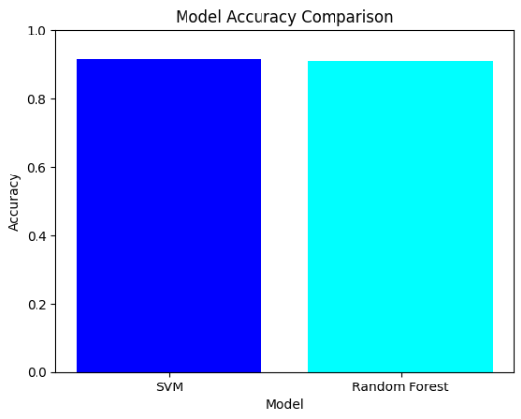
As we can see from the Graph the Accuracy of the Linear SVM is the most and will give the best output when used for text classification purposes

Slide 9
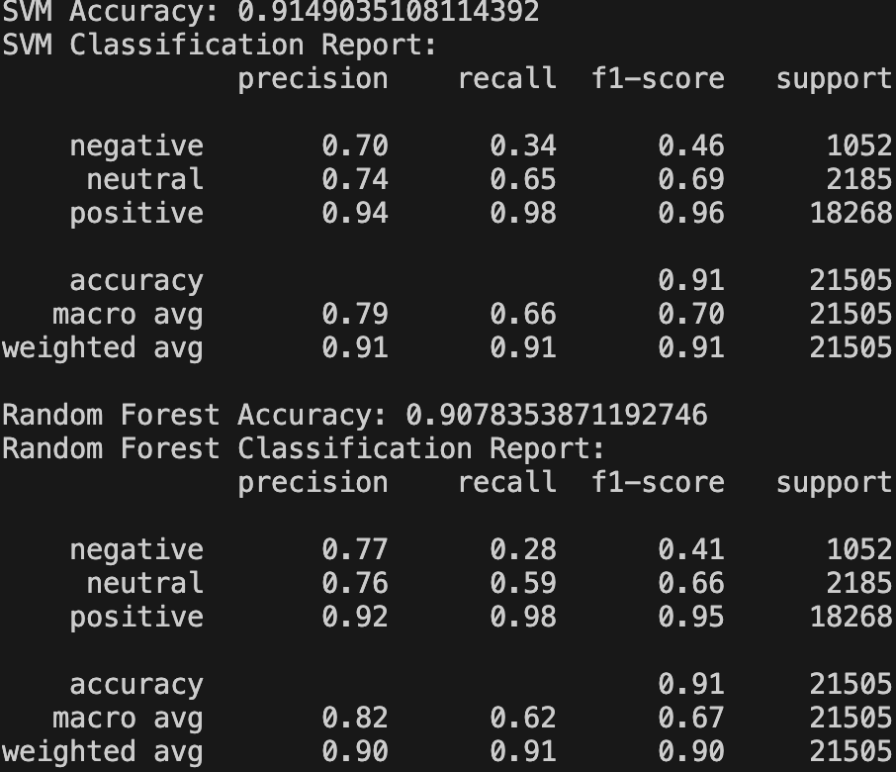
Model Selection: Based on these metrics, SVM appears to be slightly more effective than Random Forest for sentiment analysis of student reviews in online courses, particularly due to its better performance in handling minority classes (negative and neutral sentiments).
Application: These models can be used to automatically analyze and categorize large volumes of student feedback, providing valuable insights for educators and e-learning platforms to improve course offerings and overall student satisfaction.

Slide 10
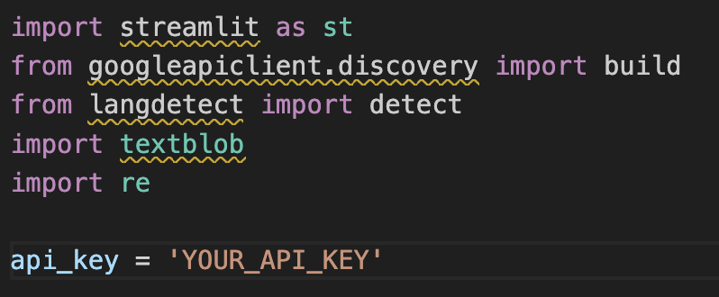
streamlit: A library for creating web applications in Python.
googleapiclient.discovery.build: Used to create a service object for interacting with the Google API.
langdetect.detect: Used to detect the language of a given text.
textblob: A library for processing textual data, providing simple API for diving into common natural language processing (NLP) tasks.
re: Python's regular expression library for matching patterns in strings.
api_key: Your Google API key. This key is required to access Google's services such as the YouTube Data API.

Slide 11
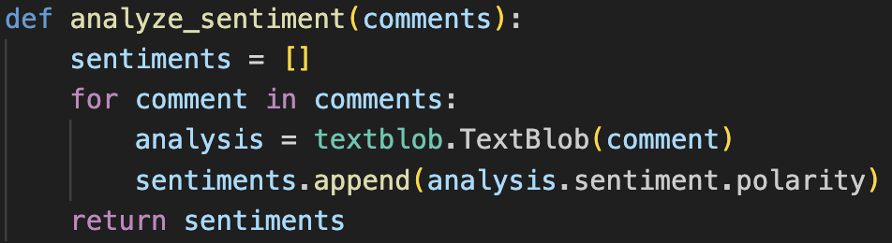
analyze_sentiment(comments): This function takes a list of comments and returns their sentiment scores.
analysis.sentiment.polarity: Calculates the sentiment polarity of the comment. Polarity is a float within the range [-1.0, 1.0], where negative values indicate negative sentiment, and positive values indicate positive sentiment.

Slide 12
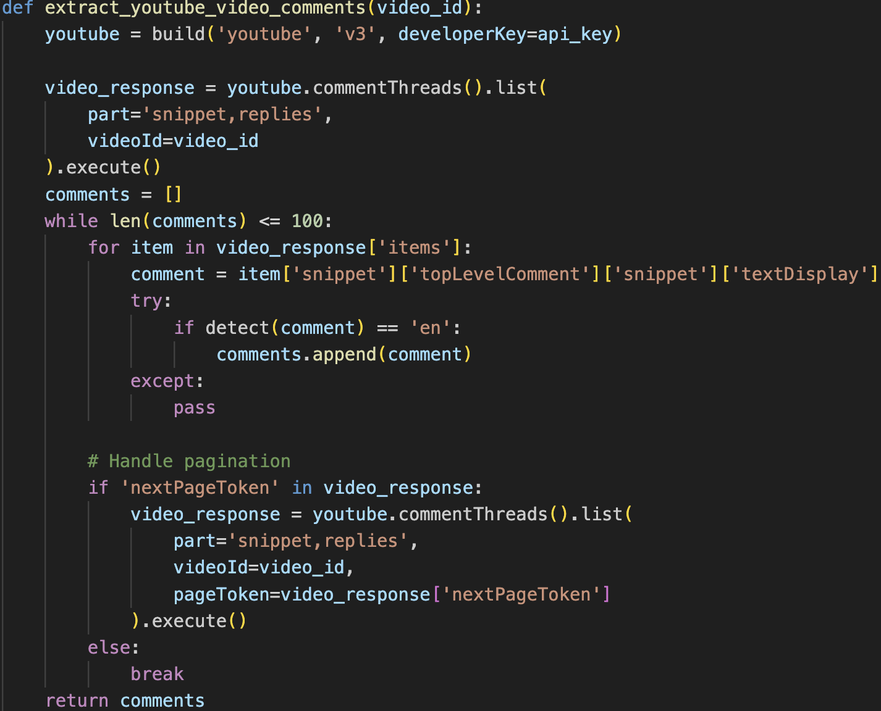
extract_youtube_video_comments(video_id): This function retrieves comments from a YouTube video given its ID.
youtube = build('youtube', 'v3', developerKey=api_key): Initializes the YouTube API client.
video_response = youtube.commentThreads().list(...).execute(): Fetches the comments for the specified video.
comment = item['snippet']['topLevelComment']['snippet']['textDisplay']: Extracts the comment text.
if detect(comment) == 'en': Checks if the comment is in English.
if 'nextPageToken' in video_response: Handles pagination to get more comments if available.

Slide 13
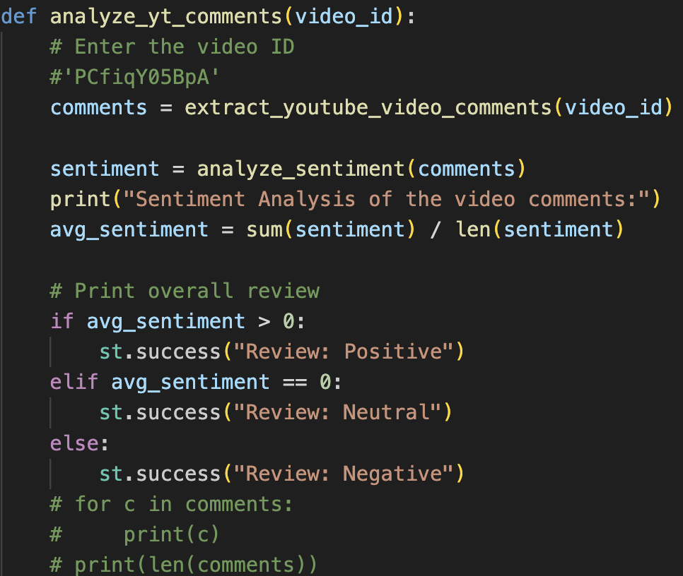
analyze_yt_comments(video_id): This function analyzes the sentiment of comments for a given YouTube video ID.
comments = extract_youtube_video_comments(video_id): Retrieves the comments for the video.
sentiment = analyze_sentiment(comments): Analyzes the sentiment of the comments.

Slide 14
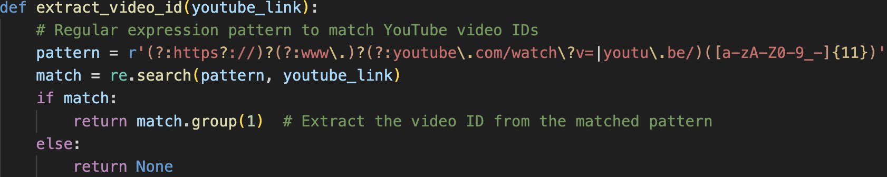
extract_video_id(youtube_link): This function extracts the YouTube video ID from a given URL.
match = re.search(pattern, youtube_link): Searches the URL for a match.

Slide 15
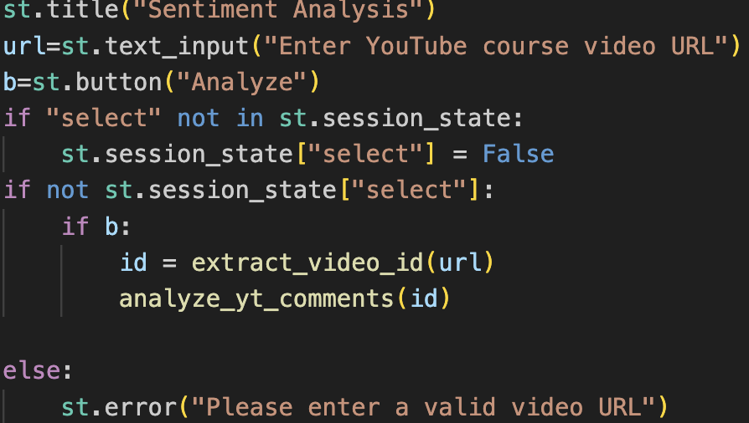
url = st.text_input("Enter YouTube course video URL"): Creates a text input box for the user to enter a YouTube URL.
if "select" not in st.session_state: st.session_state["select"] = False: Initializes a session state variable "select" to False if it doesn't exist.
if not st.session_state["select"]:: Checks if the session state variable "select" is False.
if b:: Checks if the "Analyze" button was clicked.
id = extract_video_id(url): Extracts the video ID from the entered URL.

Slide 16
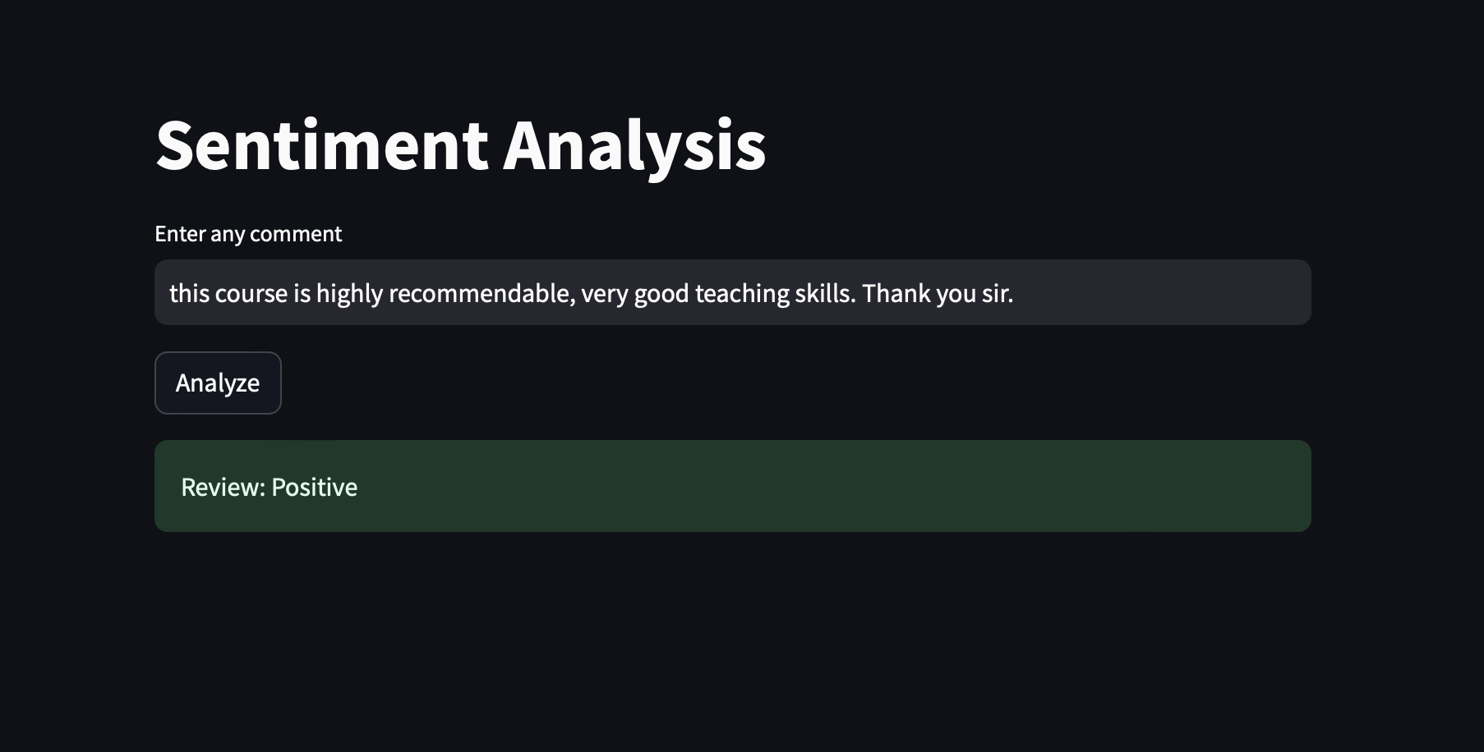
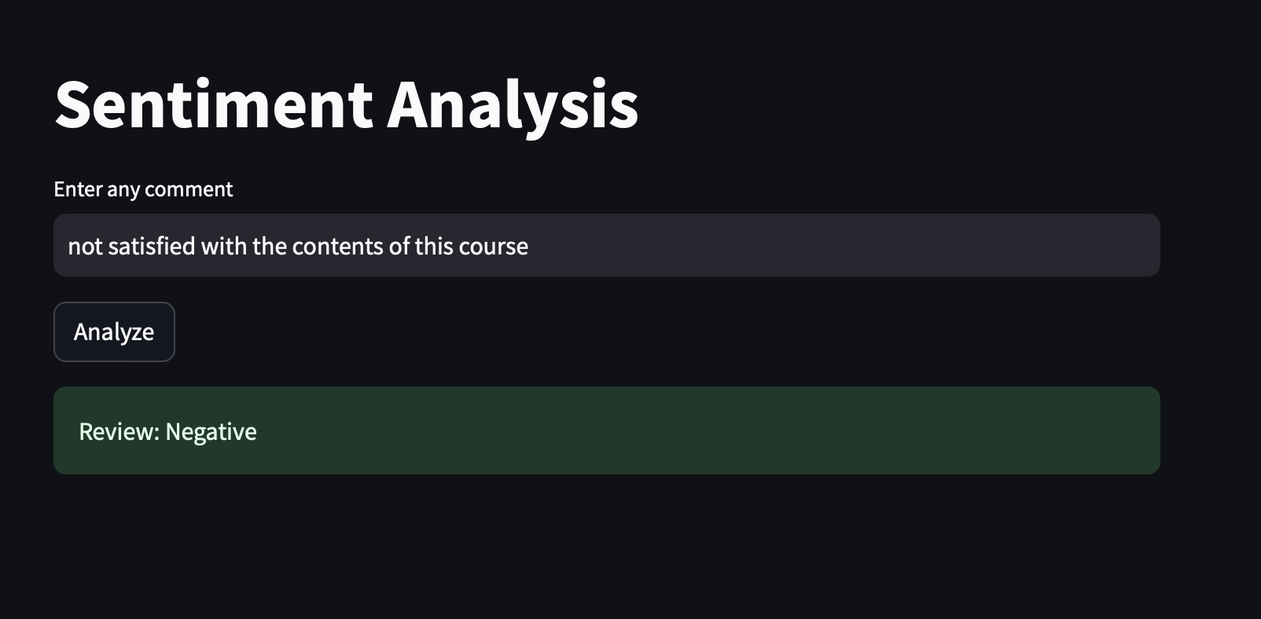
Result and Discussion
The implementation utilizes Streamlit to create a graphical user interface (GUI) for the "Student Reviews Sentiment Analysis" tool. Streamlit's functions like st.sidebar.title, st.title, st.checkbox, st.text_area, st.button, st.success, and st.warning are employed to build an interactive and user-friendly interface.

Slide 17
Future Work and Conclusion
The current implementation provides a solid foundation for sentiment analysis of YouTube video comments using Streamlit and Google's YouTube Data API. It allows users to input a YouTube video URL, fetch comments, analyze sentiments, and display overall sentiment feedback through a simple and intuitive interface.
Key Contributions:
Usability: Streamlit facilitates the creation of a user-friendly interface for interacting with the sentiment analysis tool.
Functionality: The integration with YouTube API enables real-time fetching and analysis of comments, providing immediate insights into viewer sentiments.
Scalability: With further development, the application can scale to handle larger datasets and incorporate more advanced features like trend analysis and multi-video processing.
In conclusion, this project lays the groundwork for leveraging sentiment analysis in educational settings (like online courses), helping educators and platforms better understand student feedback and improve learning experiences. Future enhancements can build upon this foundation to enhance functionality, usability, and analytical depth.

