Slide 1

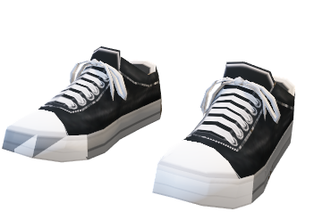
Clickmart

Slide 2
Agenda
Introduction
Technologies
Features
Data Flow Diagram
Advantage & Disadvantages
Future Plans
Questions

Slide 3
Introduction
Clickmart has changed how we buy and sell goods. It's about purchasing products or services online, making shopping convenient and accessible anytime, anywhere. With personalized experiences and secure transactions, it's revolutionized retail for businesses big and small, leveling the playing field and offering a global marketplace.

Slide 4
Technologies
React Js
Node Js
MongoDB
Postman
PayPal Integration

Slide 5
Features
Modules
Homepage
Register /Login
Admin
User
Filter
Category
Cart

Slide 6
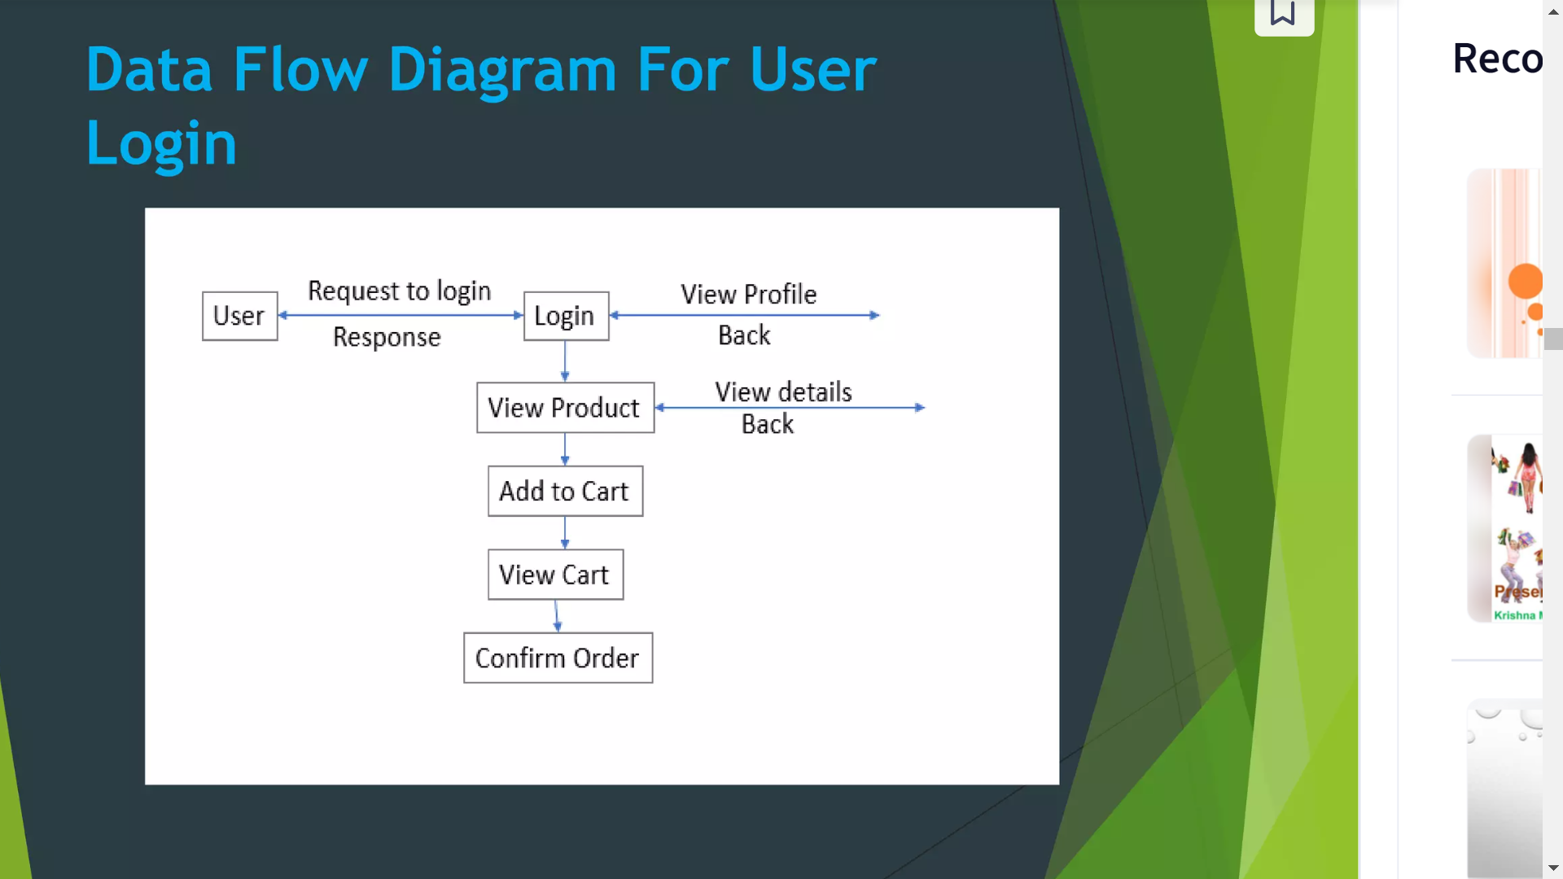
Data Flow Chart (User)

Slide 7
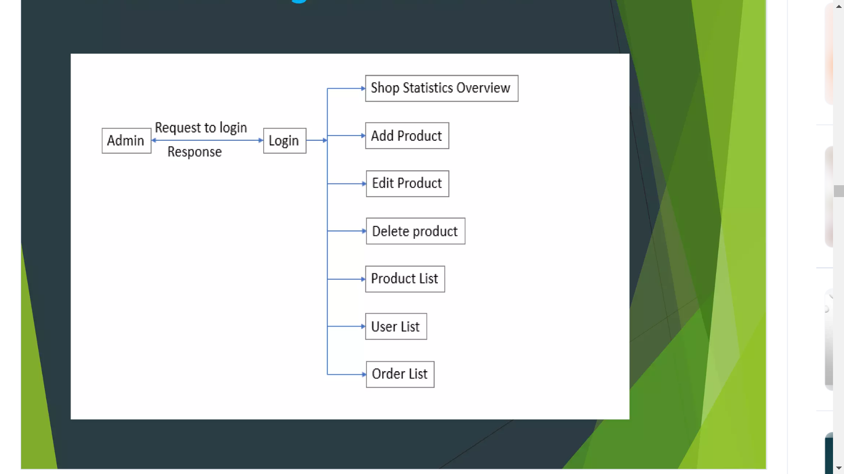
Data Flow Chart (Admin)

Slide 8
Advantages
Faster Buying and selling procedure , as well as easy to find Products
Low operational costs and better quality of services
More reach to customer ,there is no theoretical geographic limitations
Easy to start and manage access

Slide 9
Disadvantages
Required internet connection .
Customers Cannot Experience Products Before Purchasing
Shipping Delay , Delivery not on time
There is possibility of credit card number theft

Slide 10
Future Plans
GUI Modifications ( More Use Friendly )
User can sell their products
User can Login with their google with authentication
Update more Filters for easy Getting Products
User can track their Orders

Slide 11
Any Questions ?

Slide 12
Thank You

