Slide 1
Unveiling Spotify Song Popularity
An in-depth analysis of audio features, genre trends,
and predictive modeling to understand song success

Slide 2
Data Preparation & Cleaning
• Multiple datasets combined
• Verified data shape & consistency
• Removed irrelevant columns
• Ensured high data quality

Slide 3
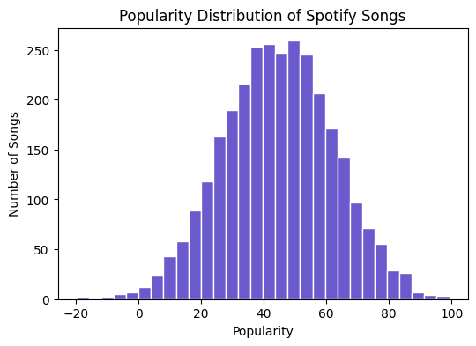
Popularity Distribution
• Right-skewed distribution
• Few songs achieve very high popularity
• Competitive music landscape

Slide 4
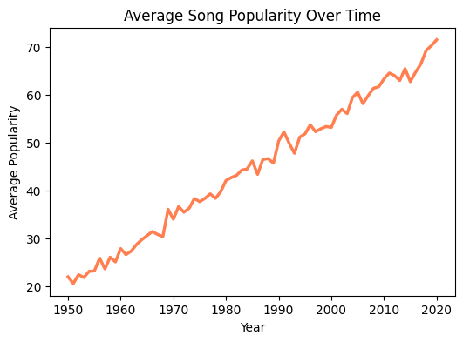
Popularity Trend Over Time
• Upward trend in popularity
• Digital streaming influence
• Changing listener behavior

Slide 5
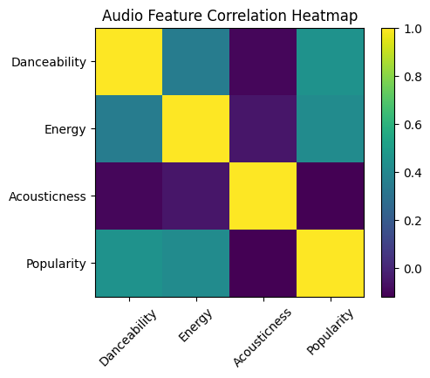
Audio Feature Relationships
• Energy & danceability positively correlated
• No single dominant feature
• Multiple factors drive popularity

Slide 6
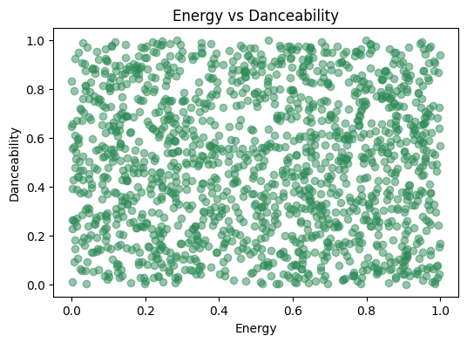
Energy vs Danceability
• Strong positive relationship
• Energetic tracks are more danceable
• Aligns with modern music trends

Slide 7
Predictive Modeling
• Linear Regression & Tree models
• Random Forest performed best
• Popularity partially predictable

Slide 8
Key Insights & Impact
• Danceability & energy drive success
• Useful for artists & platforms
• Data-driven music strategy

Slide 9
Conclusion
• Popularity influenced by multiple factors
• ML provides strong insights
• Scope for advanced analytics

