Slide 1
SYMMETRIC KEY CRYPTOGRAPHY
PREPARED BY :
02 - Nidhi Adroja
71 - Dhanvi Vasoya
40 - Asti Paladiya
72 - Priyanka Vastarpara
73 - Dhruvi Vavadiya

Slide 2
CRYPTOGRAPHY
Definition :
Cryptography is the practice and study of techniques for securing communication and information by transforming data into a format that can only be read or understood by those who have the proper key to decrypt it.
It involves methods such as encryption, decryption, and the use of algorithms to protect the confidentiality, integrity, and authenticity of information from unauthorized access or tampering.
Importance:
Ensures confidentiality, integrity, and authenticity of data.

Slide 3
SYMMETRIC KEY CRYPTOGRAPHY
Definition:
Symmetric Key Cryptography is a type of encryption where the same key is used for both encrypting and decrypting the data. This means that both the sender and the receiver must have access to the same secret key in order to communicate securely.
Here are five types of ciphers:
1. Caesar Cipher
2. Monoalphabetic Cipher
3. Playfair Cipher
4. Hill Cipher
5. Polyalphabetic Cipher (Vigenère Cipher)

Slide 4
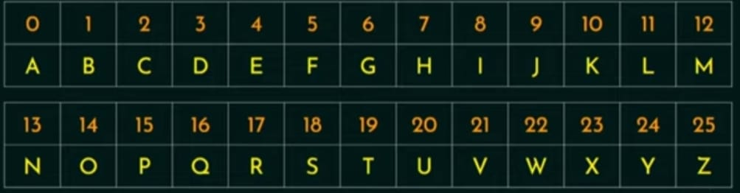
1. CAESAR CIPHER
A Caesar Cipher is also known as Shift Cipher, Caesar’s Code or Caesar shift, is one of the simplest and most widely known encryption techniques.
It is a type of substitution cipher in which each letter in the plaintext is replaced by a letter some fixed number of positions down the alphabet.

Slide 5
1. CAESAR CIPHER
Here you will be converting Plaintext into Ciphertext by using the formula C = E(3,P) = (P+3)
P = D(3,C) = (C-3)
Example:
Plaintext: HELLO
Ciphertext (with a shift of 3): KHOOR
Pros of Caesar Cipher:
Simplicity
Fast and Efficient
Low Complexity for Quick Communication
Cons of Caesar Cipher:
Limited Key Space
Not Suitable for Sensitive Information

Slide 6
2. MONOALPHABETIC CIPHER
A Monoalphabetic cipher also known as Simple Substitution cipher.
Monoalphabetic cipher is a substitution cipher where each letter of the plain text is replaced with another letter of the alphabet.
It uses a fixed key which consist of the 26 letter of a “Shuffled alphabet”.

Slide 7
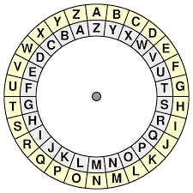
2.MONOALPHABETIC CIPHER
Example:
Plain text : C R Y P T O G R A P H Y
Cipher text : X I B K G L T I Z K S B

Slide 8
2. MONOALPHABETIC CIPHER
Pros:
1. Better Security than Caesar cipher.
2. Provides Encryption and Decryption to data.
3. Maintains a frequency of letters.
Cons:
1. Less secure than a polyalphabetic cipher.
2. The English Language is used so the nature of plain text is known.

Slide 9
3. PLAYFAIR CIPHER
A Playfair cipher also known as A Digraph Substitution cipher that
encrypts pairs of letters instead of single letters.
Invented in 1854 by Charles Wheatstone.
Encryption Rules:
1. Create The Grid(Key Square)
2. Prepare The Plaintext
3. Encrypt The Pairs
Example:
Key : Secret Plain Text : Message Pair of Plain Text : Me sx sa ge | Grid Matrix(5 * 5): s e c r t a b d f g h i k l m n o p q u v w x y z | Encrypted Text : itcvahbt

Slide 10
4. PLAYFAIR CIPHER
Pros:
More Secure
Efficient and Practical
Cons:
1. Key Management
2. Inconvenience of Handling
3. Not Perfectly Secure
4. Plaintext Modification

Slide 11
4. HILL CIPHER
In classical cryptography, the Hill cipher is a polygraphic substitution cipher based on linear algebra. Invented by Lester S. Hill in 1929.
it uses matrix multiplication, modulo calculation, and the inverse calculation of matrices.
Security :
security of the cipher depends on the choice of an invertible matrix as the key.
Hill Cipher can work seamlessly with digraphs (two-letter blocks), trigraphs (three-letter blocks), or any larger blocks.

Slide 12
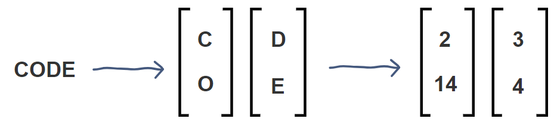
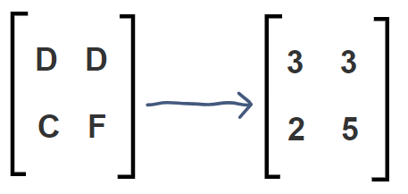
4.HILL CIPHER
To encrypt : E(K, P) = (K * P) mod 26
Example :
Plaintext : CODE
Vector matrix : CO DE
Key : DDCF
Key matrix :

Slide 13
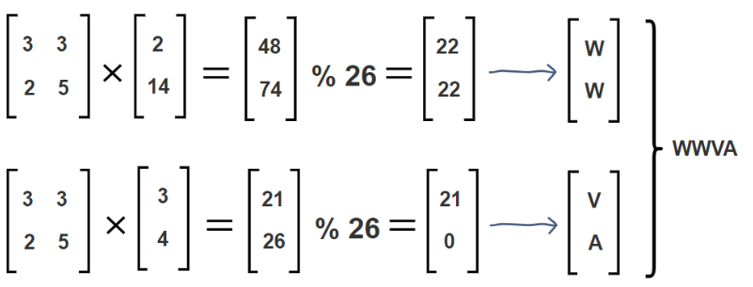
4.HILL CIPHER
Decryption :
D(K, C) = (K-1 *C) mod 26
Decryption requires the inverse of matrix(K-1)

Slide 14
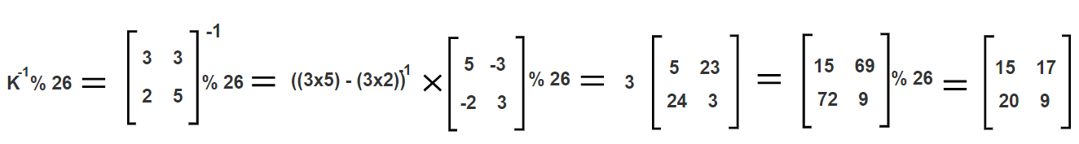
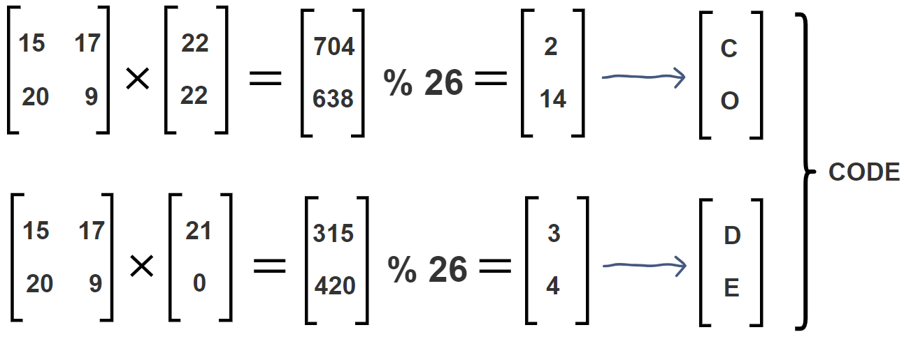
4.HILL CIPHER
To Find Inverse of matrix (K-1):
then,
th

Slide 15
5. VIGENERE CIPHER
The Vigenère cipher is a method of encrypting alphabetic text where each letter of the plaintext is encoded with a different Caesar cipher, whose increment is determined by the corresponding letter of another text, the key.
The Vigenère cipher is more secure than the Caesar cipher because it uses multiple shifts (one for each letter of the keyword) rather than a single shift.

Slide 16
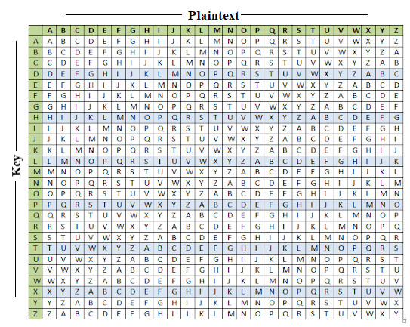
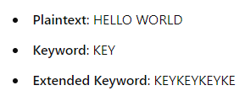
5. VIGENERE CIPHER
Method 1 :
It uses a Vigenere table or Vigenere square for encryption and decryption of the text. The vigenere table is also called the tabula recta.
Ex.

Slide 17
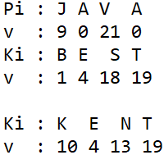

5. VIGENERE CIPHER
Method 2:
When the vigenere table is not given, the encryption and decryption are done by Vinegener algebraically formula in this method (convert the letters (A - Z) into the numbers (0-25)).
Encr ex,
Formula of encryption is,
Ei = (Pi + Ki)
Formula of decryption is,
Di = (Ei - Ki)

Slide 18
Thank You

