Slide 1

Natural Gas Prices Forecasting
Dhruvi Patel

Slide 2
Problem Statement
The natural gas market is considered seasonal with dual seasonal peaks where annual seasonality is observed in winter, and secondary seasonal peak is observed in summer. There is also an economic element in the natural gas market especially with renewable energy adoption and geopolitical shifts.
Why accurate natural gas price forecasting matters:
Budget and Cost Planning: power plants, manufacturing and commercial facilities, utilities companies
Risk Management and Hedging: set hedging strategies, reduce exposure to price swings, time buying selling and storage decisions
Electricity Market Planning
Policy, Regulation, & Energy Security: plan long-term energy supply, set tariffs and public utility rates, evaluate affordability for households, assess impact of climate or emissions policies
Investment Decisions: pipeline expansions, LNG terminals, drilling/exploration projects, storage facilities, renewable alternatives
Environment & Transition Planning: economy moving towards renewable energy or hydrogen

Slide 3
Data
Total monthly Natural Gas prices in United States ($) from January 1997 to August 2020.
Source: Kaggle
Actual Data Source: US Energy Information Administration (EIA)
Background
Natural Gas prices are hard to forecast because:
Although it has predictable demand, but prices are driven by unpredictable external factors that result in low signal and high noise
Storage levels, pipeline outages, export/import constraints cause massive market shocks
Nonlinear relationships in terms of supply, demand, and production
Heavily traded commodity so it is extremely unstable

Slide 4
Methodology
Accuracy Measure Used for the Model Analysis: MAPE
Easy to interpret
Scale-Independent
Uses absolute mean error – equal weight to positive and negative values avoids over- and under- forecasting
Time Series Model Used
Naïve Model
Moving Average model as the orders go up became equivalent to Naïve Model
Random Walk, Simple Exponential Smoothing, ARIMA produced similar MAPE

Slide 5
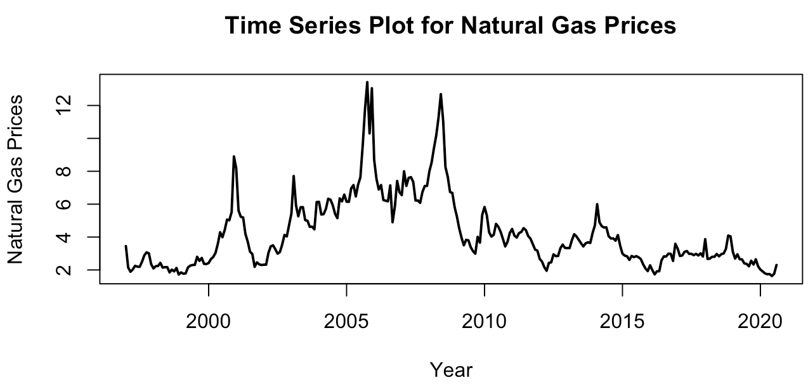
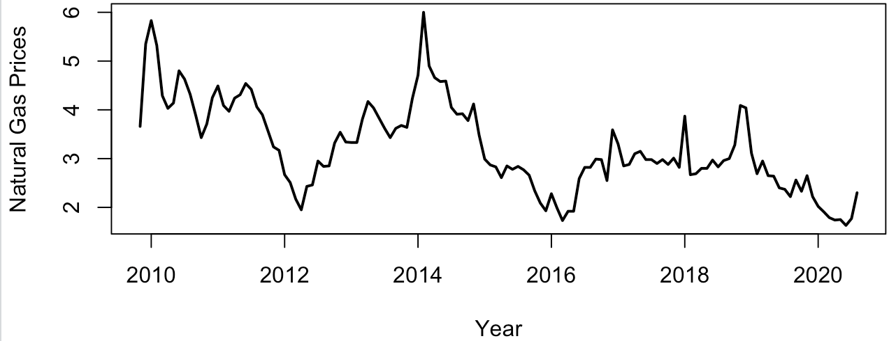
Exploration of Time series Data window
Higher spikes are observed around 2001, 2005, and early 2009 due to frigid winters, hurricanes, and combination of economic and financial instability, respectively.
For more accurate forecast, data was truncated around November 2009.

Slide 6
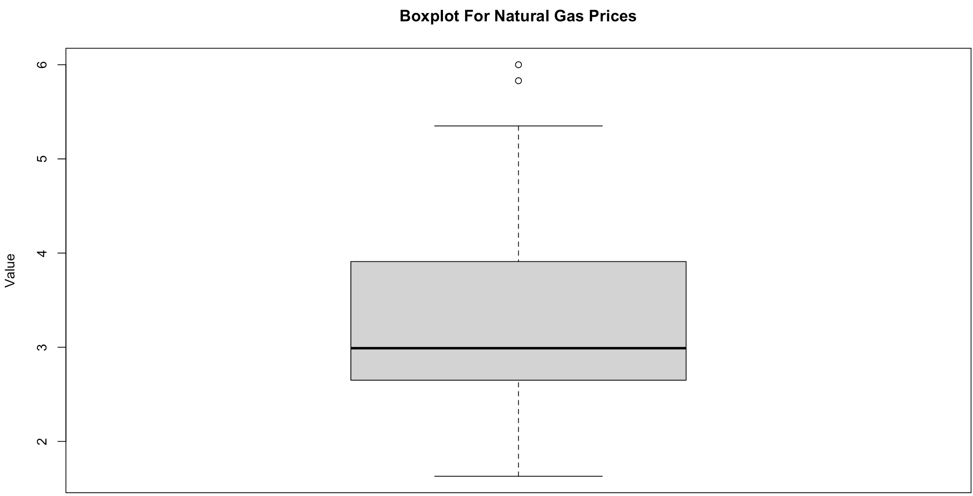
Exploration – Data Check
Only 2 outliers are observed, the rest of the data is summarized in the boxplot
Median is shown around $2.99
Min. | 1st Qu. | Median | Mean | 3rd Qu. | Max.
1.630 | 2.652 | 2.990 | 3.241 | 3.908 | 6.000

Slide 7
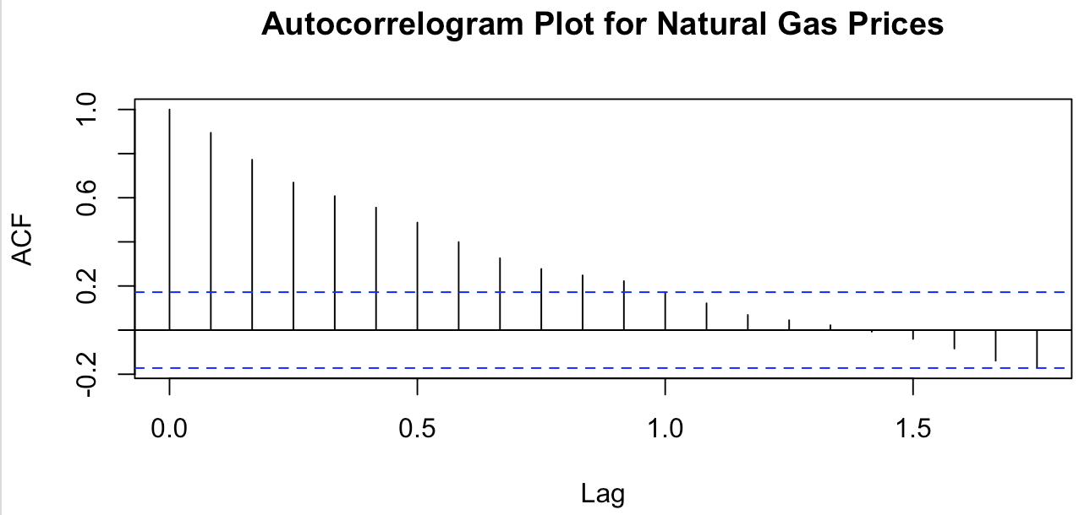
Exploration – ACF & Seasonality
Trend
Declines prior to falling below the significant line.
Seasonality
No significant seasonality
Nearly stationary time series
Suggests Random Walk
Series is trend-driven and not seasonal

Slide 8
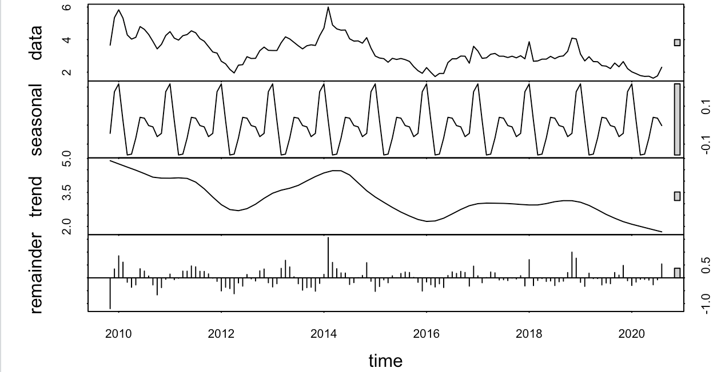
Decomposition
Seasonality is observed
Extremely regular repeats every 12 months
Has smaller amplitude (highs/lows)
Exists but weak relative to the level and trend of the series
Trend is observed
Increasing and decreasing pattern over specific time intervals with an overall decreasing trend
Additive time series
Monthly Index Peaks
High: February = 0.129913966
Low: May = - 0.133535108

Slide 9
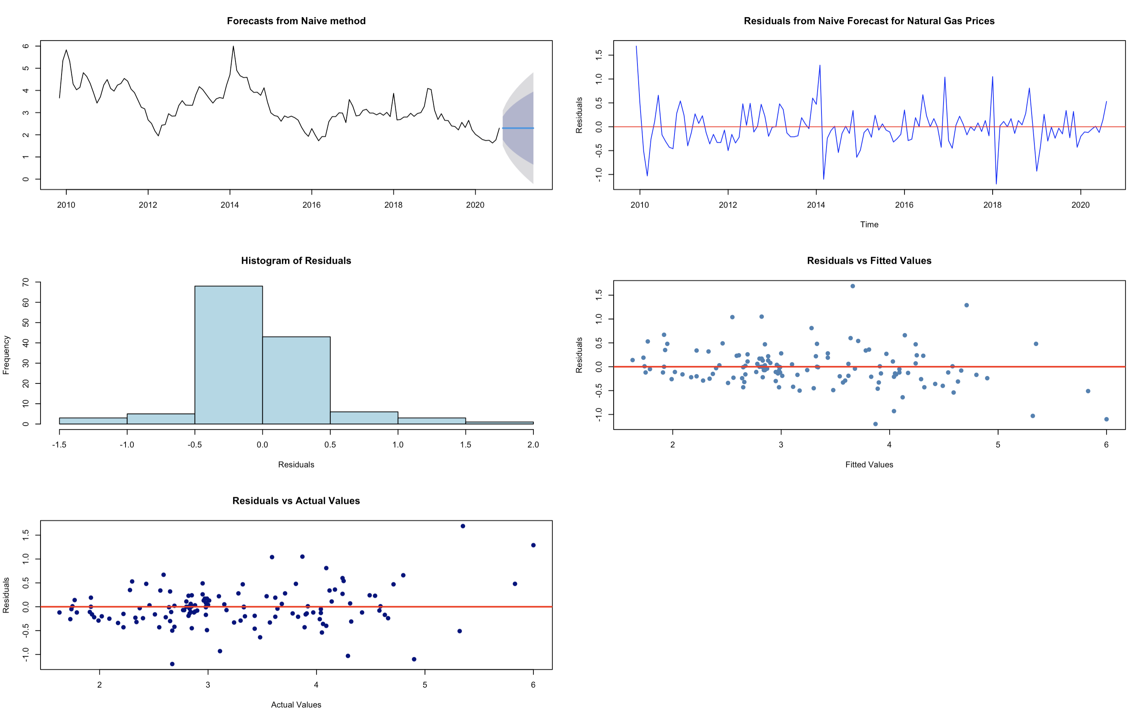
Judgement: Model and Accuracy Analysis
Model | RMSE | MAPE
Naive | 0.407 | 8.706
ETS | 0.404 | 8.742
Random Walk | 0.406 | 8.656
SES | 0.405 | 8.639
ARIMA | 0.381 | 8.633

Slide 10
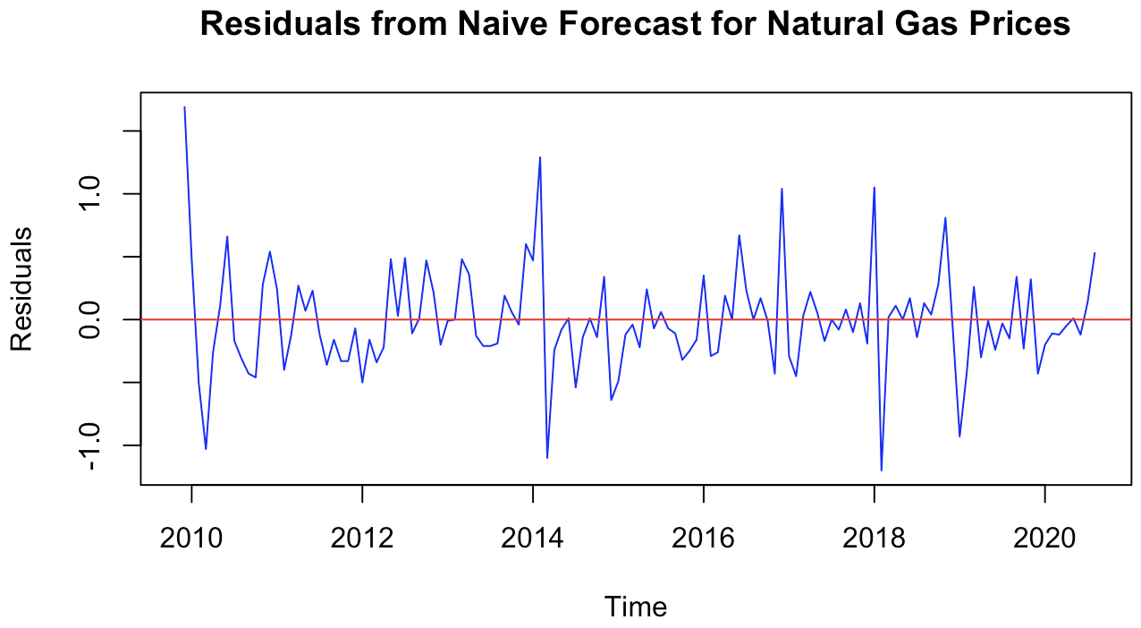
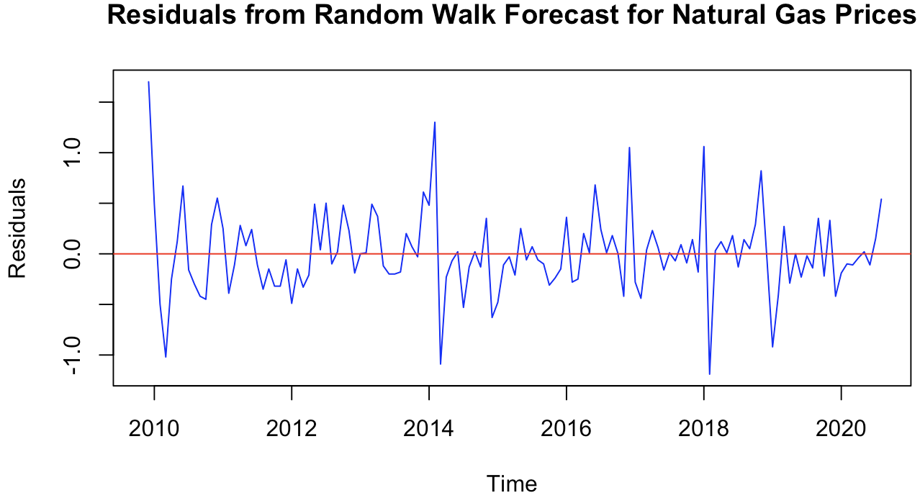
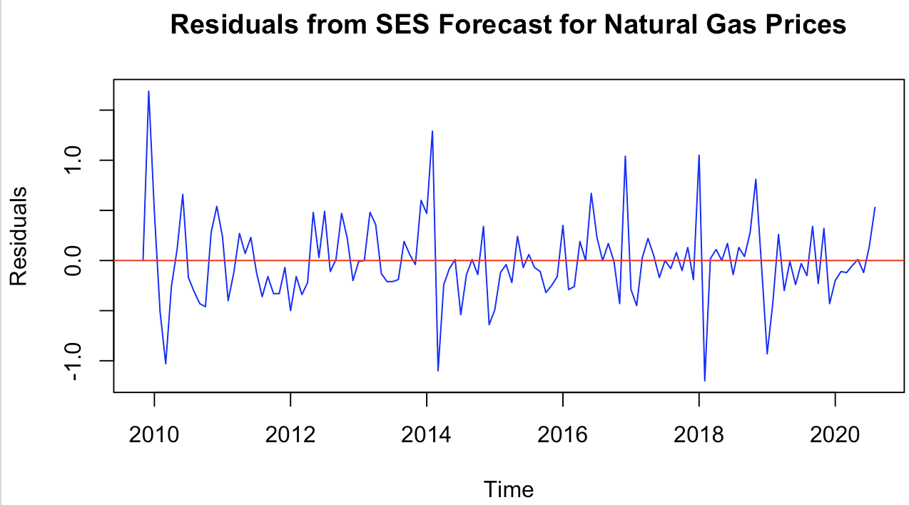
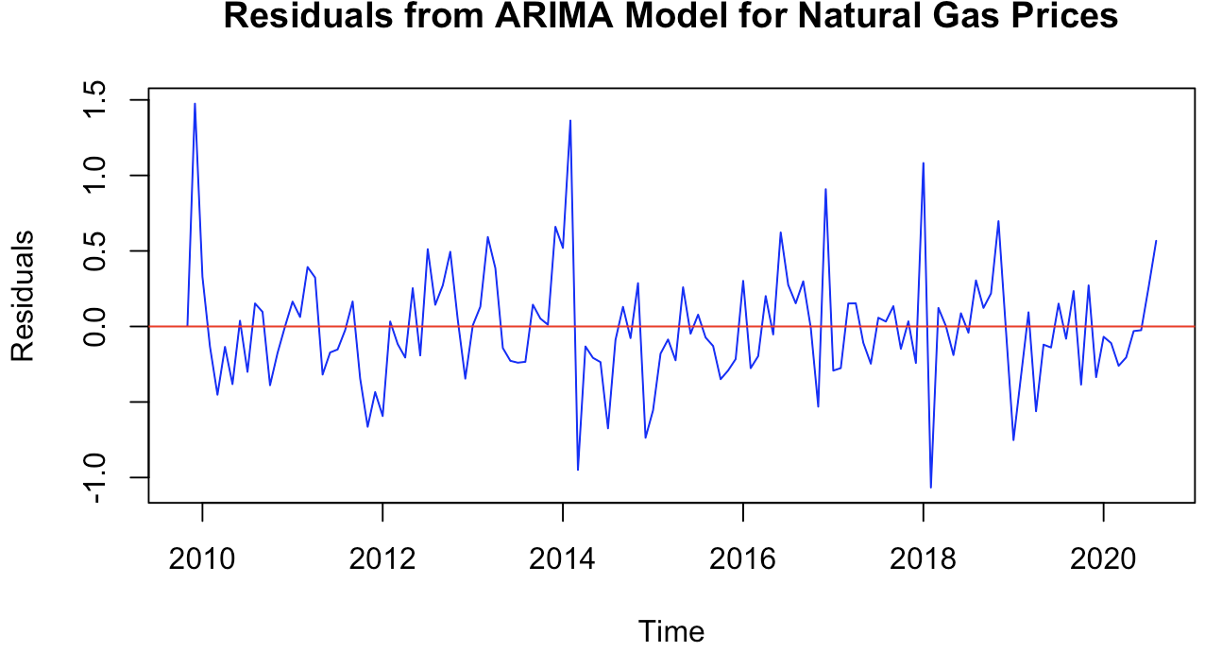
Forecasting Model Residuals
Notes:
Similar to Naïve forecast -> Random Walk, SES, and ARIMA residual plots have random fluctuate around 0, therefore it can be concluded that all of these models captured the overall pattern of this dataset. There are high/low spikes observed that indicate variable seasonality with smaller amplitudes for all of the models.

Slide 11
Recommendation, Forecast & Conclusion
Recommendation: Naïve Model
MAPE: 8.706%
Cost efficient
Easy to understand
Faster to compute
Reduced risk of overfitting
Easy to maintain with incoming data
Forecast for August 2021 (1 year): $2.30
2 year ahead: trend is expected to decrease, and seasonality is expected to be variable yet weak
Conclusion: Natural Gas Prices are unstable and hard to predict
Trend: This dataset has a relatively stable trend with no variability, and it is expected to decrease yet stay stable
Seasonality: it is unstable/variable, peaking in February due to the high demands, and lower in May. Overall, the seasonality is weak due to smaller amplitude high/low spikes and variable year to year.
Distribution & Skewness: series is right-skewed
Autocorrelation: residuals are uncorrelated indicating adequate model fit for all the models.

Slide 12
How to improve the forecast
Machine Learning Regression Models + External Variables
Add meaningful features like weather, demand levels, storage levels, geopolitical issues/policies
Models: XGBoost/LightGBM, Random Forest Regression, Gradient Boosting, ARIMAX (ARIMA with external features), Vector Autoregression with external features (VARX) or neural networks
Fixes: nonlinear relationships, add external features and interactions
Model the changes (differences/returns)
Transform data: forecast difference in price or log-returns and then reconstruct the level
Fixes: stabilizes variance, handles the random behavior
Hybrid strategies
Simple average, weighted average, stacking, forecast reconciliation for hierarchical forecasts
Fixes: reduces model risk and is robust to new incoming data
Probabilistic forecast: quantile regression

Slide 13
Questions?

