Slide 1



THERACIS The Healthcare Appointment Portal For Physiotherapy

Slide 2

PREPARED BY :-
NAME : GOHEL DHRUVI HIRENBHAI
ROLL NO : 25
ENROLLMENT NO : 23002170110044
BATCH : A1
BRANCH : CE

Slide 3

PROJECT OUTLINE
Introduction
Functionalities
Procedures
Merits & Demerits
Tools Used & References
Future Scope

Slide 4
INTRODUCTION
What is Theracis?
Theracis is a dedicated healthcare appointment system designed specifically for physiotherapy services.
It serves as a bridge between patients and physiotherapists, allowing users to book appointments seamlessly through an online platform.
The system aims to enhance accessibility, efficiency, and patient convenience in scheduling physiotherapy sessions.

Slide 5
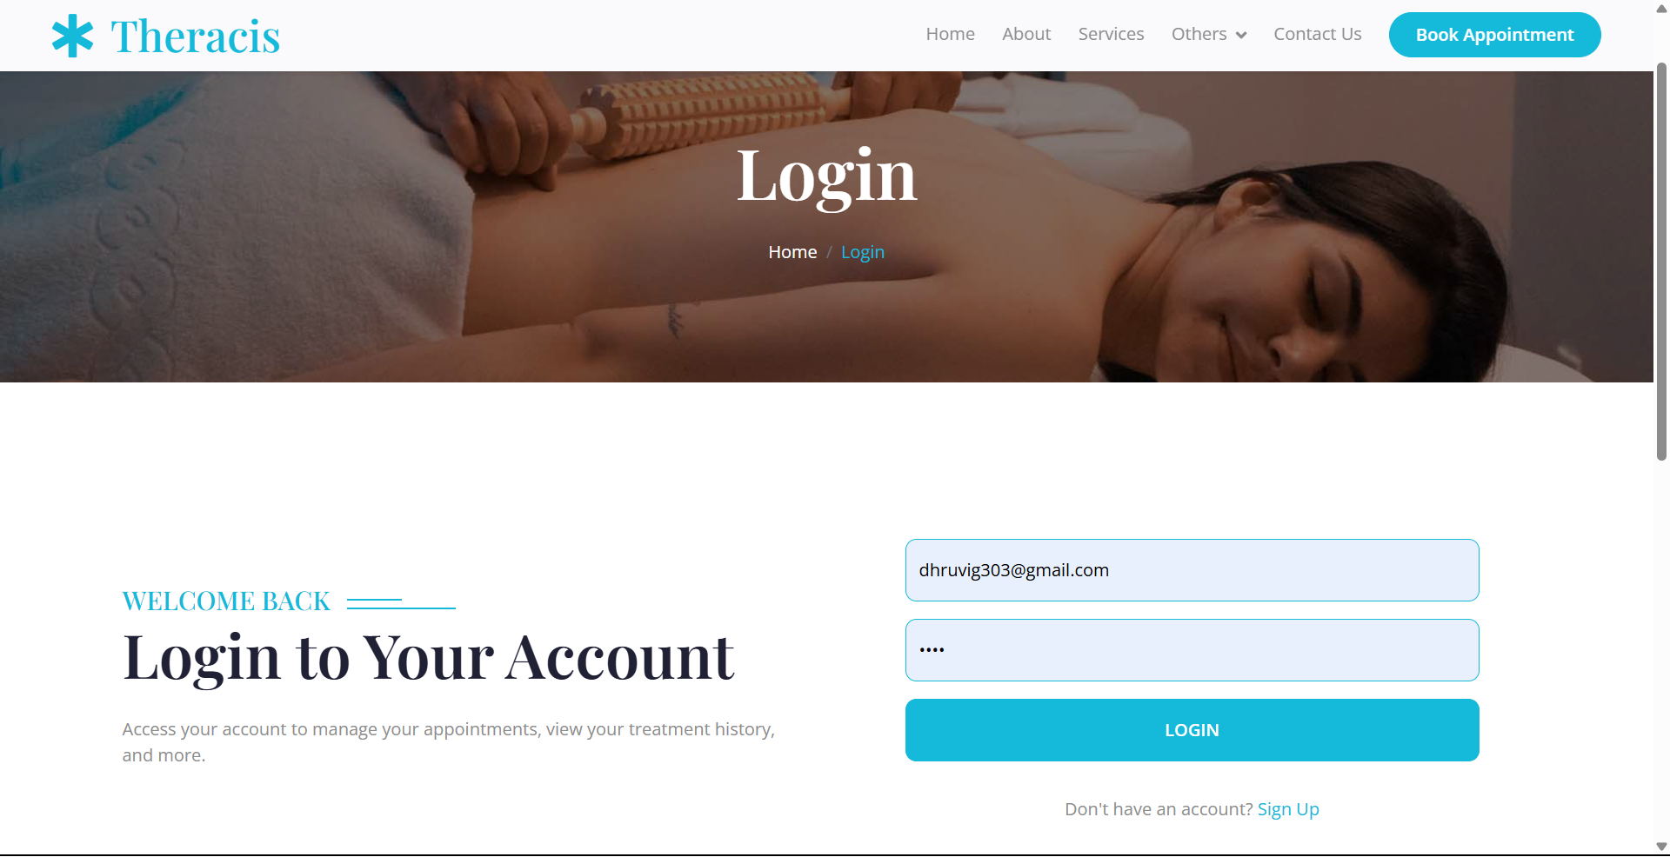
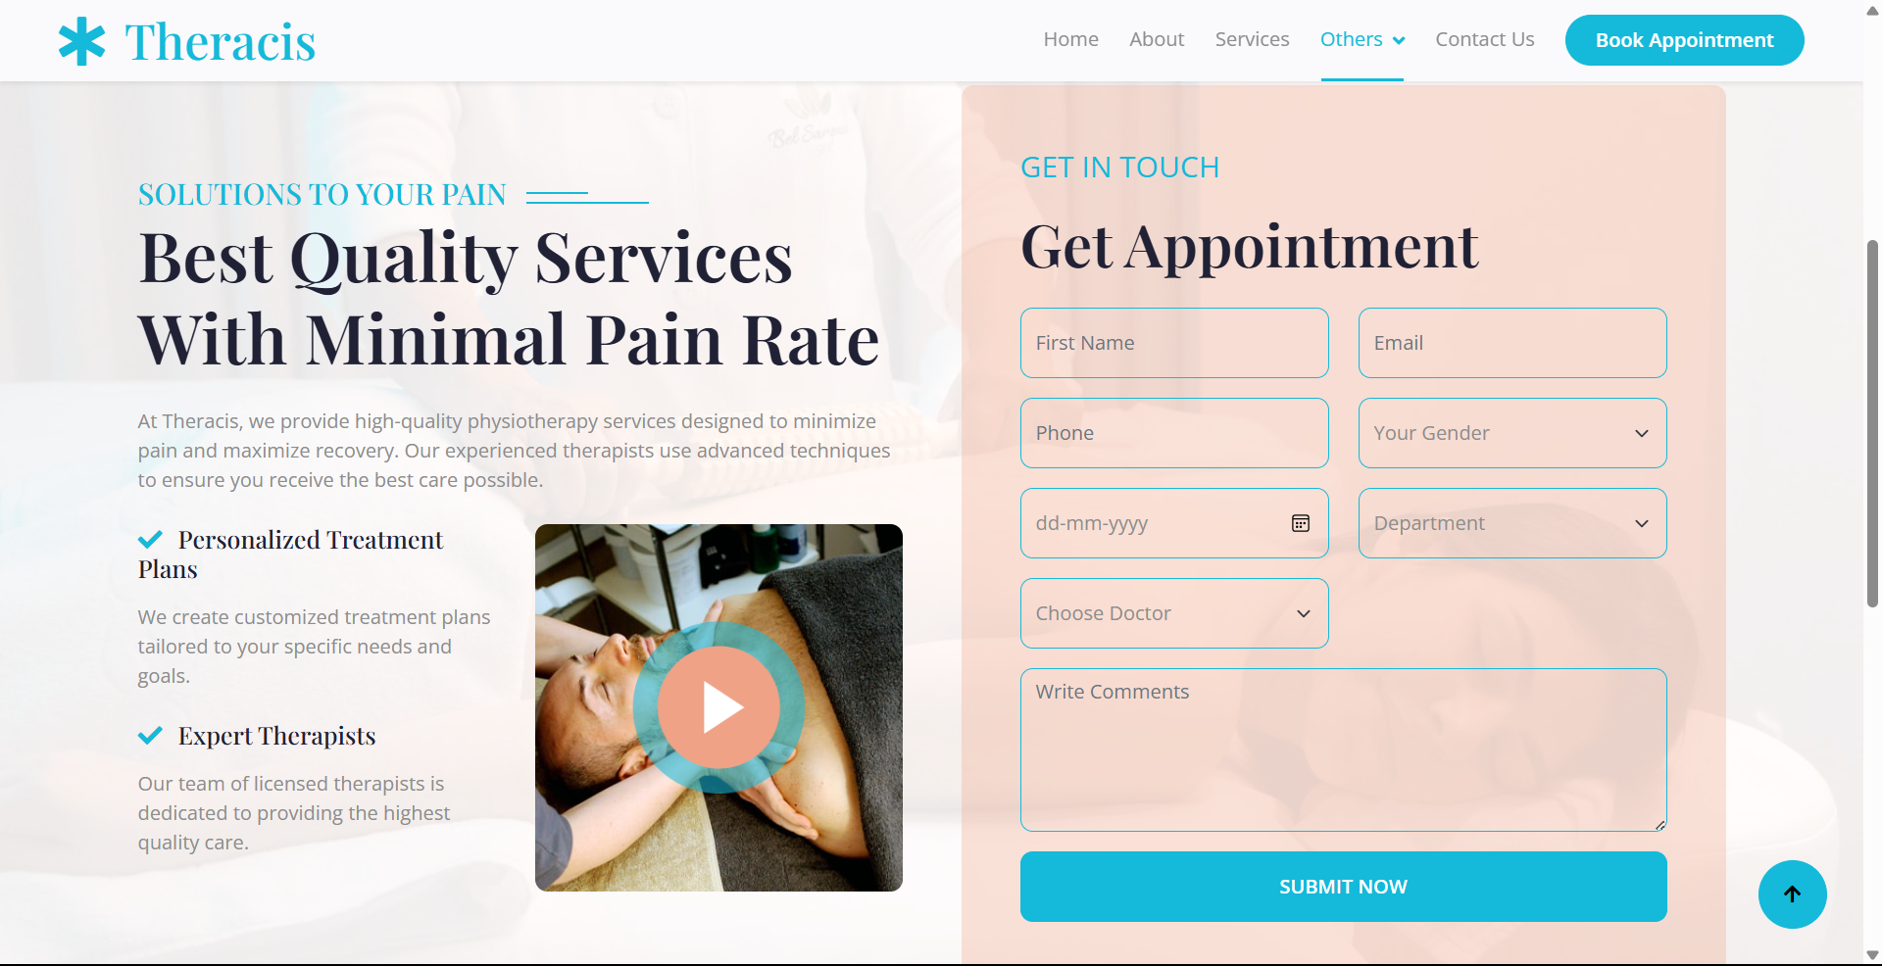
FUNCTIONALITIES
🔹 User Authentication & Security
✅ Register & Login System – Users must sign up before accessing services. ✅ Access Control – Only logged-in users can book appointments. ✅ Secure Database Storage – Credentials & appointments stored using Node.js & MySQL.
🔹 Appointment Booking System
✅ Book Physiotherapy Sessions – Users can schedule appointments easily. ✅ Data Management – Appointment details are securely stored in the database.

Slide 6
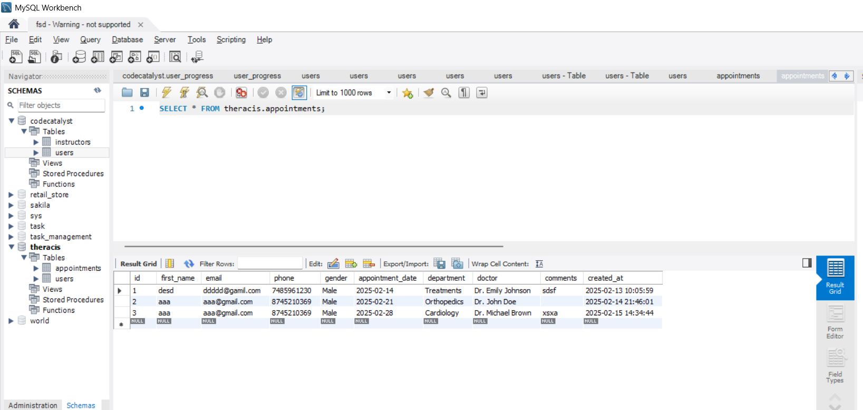
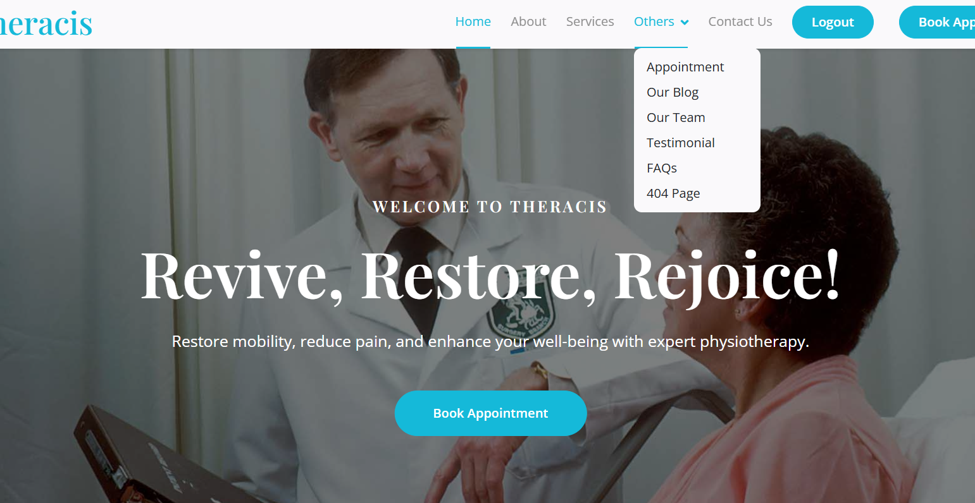
FUNCTIONALITIES
🔹 Backend & Database Integration
✅ Node.js (Express.js) – Manages user requests & appointment handling. ✅ MySQL Database – Stores user credentials & appointment records.
🔹 Accessing Website Information
✅Users can explore pages like FAQs, Testimonials, Services, About Us, Team and Contact Us for information. ✅ Contact forms allow users to reach out for support or inquiries.

Slide 7
PROCEDURES
🔹 1. User Registration & Login
✅ New users sign up with their details. ✅ Existing users log in to access appointment booking. ✅ Credentials are securely stored in the MySQL database.
🔹 2. Appointment Booking
✅ Only logged-in users can book an appointment. ✅ Users select a date, time, and preferred physiotherapist. ✅ Appointment details are stored in the database for reference.
🔹 3. Data Management & Security
✅ User details & bookings are managed using Node.js & MySQL. ✅ Ensures secure storage and quick retrieval of information.

Slide 8
✔️ Easy Appointment Booking – Users can schedule physiotherapy sessions anytime, anywhere. ✔️ Secure Authentication – Only registered users can access booking features. ✔️ Automated System – Reduces manual workload for clinic staff. ✔️ Centralized Data Management – All user and booking data are securely stored using Node.js & MySQL. ✔️ User-Friendly Interface – Simple navigation with access to FAQs, Testimonials, Services, etc. ✔️ Scalability – Can be expanded to include more features like teleconsultations & notifications.
Merits (Advantages)

Slide 9
❌ Internet Dependency – Requires an active internet connection to function. ❌ Limited to Physiotherapy – Currently focuses only on physiotherapy services. ❌ Initial Setup Complexity – Requires technical knowledge to configure the backend and database.
❌ Demerits (Limitations)

Slide 10
TOOLS USED
🔹 Frontend Development
✅ HTML, CSS, JavaScript – For designing the user interface.
🔹 Backend Development
✅ Node.js (Express.js) – Handles user authentication, requests, and appointment processing.
🔹 Database Management
✅ MySQL – Stores user details, login credentials, and appointment records.
🔹 Additional Technologies
✅ CSS Frameworks (Bootstrap) – For responsive and modern UI design.
✅ Google Maps API: Integrated for location-based services, such as displaying maps and routes.

Slide 11
FUTURE SCOPE
🚀 Expansion to Other Healthcare Services – Extend the platform to support general healthcare, telemedicine, and multiple specialties.
📲 Mobile App Development – Create an Android/iOS app for easier access and on-the-go appointment booking.
🔔 Appointment Reminders & Notifications – Implement SMS/Email alerts for upcoming appointments.
🤖 AI-Based Consultation & Chatbots – Introduce AI-powered chatbots for quick consultations and FAQs.
📊 Data Analytics & Reports – Provide insights on patient bookings, trends, and therapist availability.
🔗 Integration with Wearable Devices – Connect with health trackers for personalized physiotherapy recommendations.

Slide 12
THANK YOU

