Slide 1



Application Of Stack
LJ INSTITUTE OF ENGINEERING AND TECHNOLOGY
Prepared By:
Name : Gohel Dhruvi HirenBhai
Roll No. : 17
Enrollment No. : 23002170110044
Batch : D1
Branch : CE
Presenter Name

Slide 2
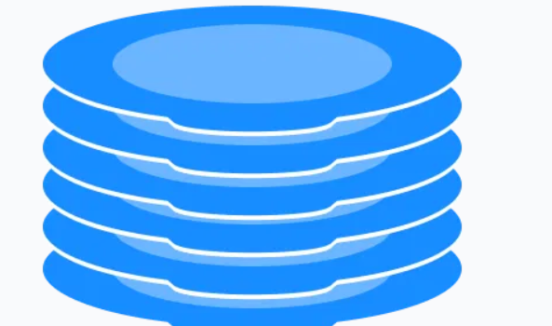
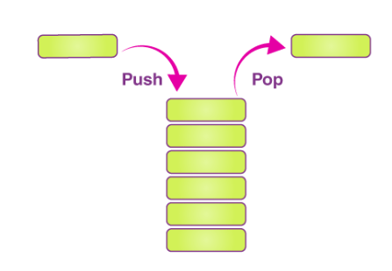
Agenda
Introduction
Purpose Of the project
Flow – Chart
ER Diagram
Use Case Diagram
Functionalities
Used Data Structure and class
Merits & Demerits
Tools Used & References
Future scope

Slide 3
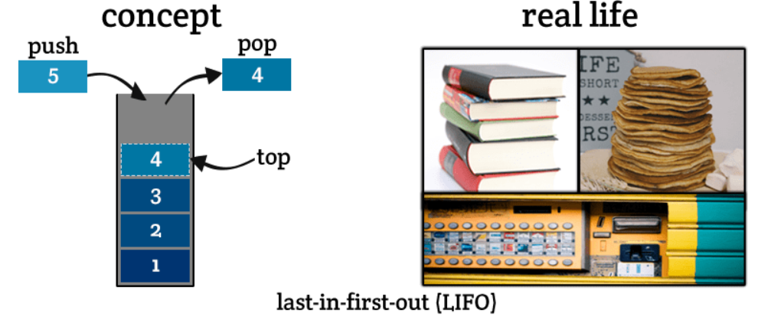
Introduction
A stack is a fundamental data structure that operates on a Last In, First Out (LIFO) principle, meaning the last element added is the first one to be removed. Our Stack Operating System is designed to help users understand and utilize this powerful concept in various computational tasks. The app provides an intuitive interface to perform standard stack operations such as pushing, popping, and peeking elements.

Slide 4
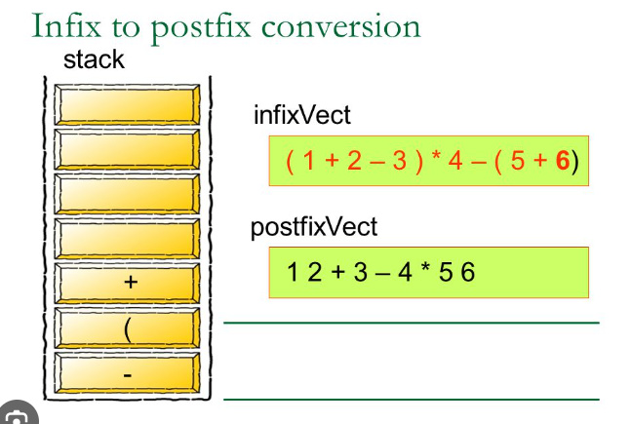
Purpose
The primary purpose of a stack operating system is to efficiently manage and manipulate data in a way that supports quick access. This LIFO approach is crucial in several computational processes, such as:
Function Call Management
Expression Evaluation
Memory Management
Backtracking Algorithms
Undo Mechanisms
Data Reversal

Slide 5
Flow - Chart
Start
Take User Choice
Register
Login
Exit
Take User details
Take User details
Yes
If exists?
No
Yes
Valid?
No
Print message
Register details
Display Menu
Display error

Slide 6
Display Menu
Take User Choice
Push
Peek
Size
Infix to Postfix
Postfix to Infix
Postfix to Prefix
Return
Infix to Prefix
Prefix to Infix
Prefix to Postfix
Pop
isEmpty
Clear
Take user choice

Slide 7
ER Diagram
Id
User_id
Id
operation
Username
Users
1
operates
m
Stack_operations
value
password
time

Slide 8
Use Case Diagram
Application Of Stack
Register
Push
<extend>
pop
<extend>
Login
peek
<extend>
<extend>
Is empty
<extend>
<extend>
size
<extend>
<extend>
clear
User
Infix to postfix
Infix to prefix

Slide 9
Use Case Diagram
Application Of Stack
Postfix to Infix
<extend>
Prefix to Infix
<extend>
Login
Postfix to prefix
<extend>
<extend>
Prefix to postfix
Exit
User

Slide 10
Functionalities
Stack Functions
Push
Add an element to the top of the stack.
Pop
Remove the top element from the stack.
Peek
Retrieve the top element without removing it.
IsEmpty
Check if the stack is empty.
Size
Get the number of elements currently in the stack.
Clear
To clear the stack

Slide 11
Expressions Conversions
Infix to Postfix
Converts infix expressions to postfix notation for efficient evaluation.
Infix to Prefix
Transforms infix expressions to prefix notation for easier parsing.
Postfix to Infix
Translates postfix expressions back to infix notation for readability.
Prefix to Infix
Converts prefix expressions to infix notation for better understanding.
Postfix to Prefix
Changes postfix expressions to prefix notation for alternative representation.
Prefix to Postfix
Switches prefix expressions to postfix notation for different parsing approaches.

Slide 12
Data Structure
Stack
User Class
StackOperation Class
A Last-In-First-Out (LIFO) data structure implemented using Java's built-in Stack class, used to store and manipulate elements.
A custom class representing user information, with attributes like ID, username, and password, and corresponding getter and setter methods.
A custom class representing stack operations, with attributes like ID, user ID, operation type, value, and timestamp, and corresponding getter and setter methods.
These data structures work together to enable user registration, login, stack operations, and operation recording and retrieval in the system.

Slide 13
Data Base
User Data Storage
Data Persistence:
Querying and Retrieval
The database stores user information, such as username and password, in the "Users" table, allowing for secure authentication and authorization.
The database provides data persistence, ensuring that user data and operation history are retained even after the application is closed or restarted.
The database allows for querying and retrieval of specific data, such as retrieving a user's operation history or all operations of a specific type.
The database is used to store and retrieve data, enabling the application to provide features like user registration, login, stack operations, and operation history.

Slide 14
Java
Java Collections Framework:
Java Exceptions Handling
Java Object-Oriented Programming (OOP) Concepts
Java's built-in collections framework is used to implement the stack data structure, specifically the Stack class, which provides methods for pushing, popping, and peeking elements.
Java's built-in exception handling mechanism is used to handle errors and exceptions that may occur during database operations, user input, and stack operations.
Java's built-in OOP concepts, such as design and implementing the application's classes and objects, including the User, StackOperation, and UserStack classes.

Slide 15
Merits & Demerits
Merits
Demerits
User Authentication
Stack Operations
Expression Conversions
Error Handling
Object-Oriented Design
Complexity.
Database Dependency
Limited Scalability
Lack of Code Optimization
No Data Encryption

Slide 16
Tools Used
Visual Studio Code
Xampp
MySQl
References
https://www.slideshare.net/slideshow/stack-and-its-operations/245899338Xampp
ChatGPT

Slide 17

Future scope
Expanding data structures and algorithm implementations
Introducing multi-user support and real-time collaboration
Enhancing security measures and customization options
Developing mobile and web interfaces for broader accessibility
Integrating with other tools and systems for increased utility

Slide 18

Thank You

