Slide 1

National Research Conference on Next-Gen Intelligence: AI, Analytics, and Data Science Across Global Domains (NRC-2026) organized by Department of IT, SD, MSc. BDA Jai Hind College, Churchgate Mumbai
Kisan Sahayak: An AI powered Framework for Subsidy Recommendation for Farmers in India
Paper ID: (NRC_11)
07-02-2026 Next-Gen Intelligence: AI, Analytics, and Data Science Across Global Domains

Slide 2
INTRODUCTION: The Scale of Indian Agriculture
Agriculture supports ~58% of India’s population contributing to ~20% of GDP.
Government provides large agricultural subsidies (~₹4 trillion in 2024-25) ranging from fertilizers to insurance to income support and much more.
85% are small/marginal farmers (<2 hectares) with limited resources.
However, the existence of subsidies does not automatically translate into access or utilization due to poor targeting and administrative leakages.
The central challenge is not policy absence, but information access failure.

Slide 3
PROBLEM STATEMENT
Rural smartphone ownership has surged to ~74.8%, yet digital proficiency remains low.
Farmers use WhatsApp/YouTube, but struggle with complex, text-heavy government forms or websites.
Schemes are scattered across different ministries, portals, rules and timelines with no unified view.
Current portals (like myscheme.gov.in) function as “directories” rather than advisors. They assume the user knows exactly what to search for.
A fundamental mismatch between system design (Bureaucratic, Text-Heavy, English) and user capability (Voice-First, Vernacular, Intuitive).
This leads to dependence on intermediaries for information and leakage of benefits.

Slide 4
System overview
A voice-first, conversational AI assistant deployed on Telegram.
Why Telegram?
Leverages an interface farmers already trust and use and works on low-bandwidth networks (unlike heavy web portals).
Allowed for quick deployment and testing.
Core Technology:
Retrieval-Augmented Generation (RAG): Retrieves facts from official government PDFs instead of guessing.
Multilingual Support: Accepts voice input in local dialects (Hindi/Gujarati) and responds in audio.
Two Mode Architecture:
Information Mode (Implemented): Strictly extracts facts from government guidelines.
Decision Mode (Future): A separate logic layer for personalized eligibility (not just AI guessing).
High-level flow:
Farmer asks a question (voice or text)
System retrieves relevant documents
Response is delivered (voice/text).

Slide 5
Architecture Choice: RAG vs Fine-Tuned LLMs
Large Language Models (LLMs) are probabilistic deep learning models that produce fluent text based on massive internal training data.
Retrieval-Augmented Generation (RAG) is an AI architecture that enhances language models by combining text generation with external knowledge retrieval.
Feature | Fine-Tuned LLM (Risk) | RAG (Solution)
Accuracy | Prone to Hallucination | Grounded in official PDFs
Traceability | Black Box (No sources) | Explainable (Cites sources)
Updates | Static (Requires retraining) | Dynamic (Real-time updates)
Cost | High (Expensive compute) | Low (Efficient storage)
RAG prioritizes Faithfulness over Fluency, essential for high-stakes financial subsidies.

Slide 6
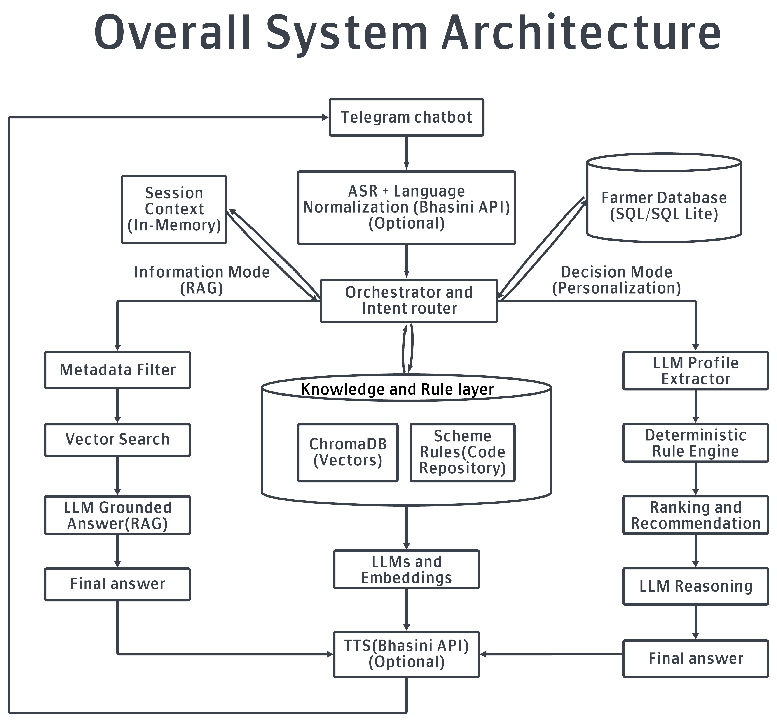
System Architecture
The system follows a layered, modular architecture:
User Layer: Telegram-based interaction (low bandwidth, familiar)
Language Layer: ASR, translation, TTS for multilingual access
Intelligence Layer: RAG pipeline (retrieval → augmentation → generation)
Knowledge Layer: Official PDFs + curated summaries
Application Layer: Bot orchestration and session handling
The implemented system is constrained to information-only behavior.

Slide 7
METHODOLOGY: data & tech stack
The Data Source:
Official government operational guidelines for major agricultural schemes such as PM-KISAN, PMFBY, PM-KSY, PM-KMY, KCC, and RWBCIS, obtained in PDF format from official portals.
Curated summary documents created to simplify and consolidate information distributed across lengthy and complex guideline documents.
Tech stack:
Backend: Python, LangChain
Vector Database: ChromaDB (for semantic search; Open-source & lightweight).
Embeddings: BAAI/bge-m3 (for similarity search; multilingual retrieval).
LLM Engine: LLaMA-based model hosted on Groq (for fast inference).
Interface: Telegram Bot API + Google Speech-to-Text for voice interaction.

Slide 8
Methodology: Data Processing & ingestion
Dual-Format Ingestion:
PDFs (Official Guidelines): Processed with structure-aware extraction to preserve headings.
DOCX (Curated Summaries): Extracted paragraph-wise for clean, linear text.
Smart Chunking Strategy:
Two-Stage Process: Initial recursive splitting followed by Chunk Consolidation (merging small adjacent chunks).
Goal: Prevents context loss and reduces fragmentation of complex policy clauses.
Header-Aware Metadata: Extracts section headers to tag chunks with context (e.g., Eligibility, Exclusions). Enables the system to find relevant answers even if the user doesn't use exact keywords.

Slide 9
Methodology: Retrieval & Generation
Vector Search & Storage:
Embeddings stored in ChromaDB using sentence transformers (BAAI/bge-m3) optimized for semantic similarity.
Retrieval Logic:
Prioritization: Summary documents are ranked higher; PDFs serve as authoritative verification.
Search Logic: Section-aware retrieval using metadata context.
Controlled Generation:
Strict Constraints: System prompt prohibits inference or assumptions.
Safety Fallback: Explicitly returns “Information not found” if data is absent or has low similarity scores, preventing hallucinations.

Slide 10
RESULTS AND Evaluation
Evaluation Objective: Assessed faithfulness, coverage, and robustness in accessing official scheme information, rather than just conversational fluency.
Dual Evaluation Strategy:
Offline Structured Testing: 30 predefined queries (eligibility, exclusions, ambiguous phrasing, etc.) executed directly against the backend.
Interactive Real-World Testing: Live Telegram bot trials using Text & Voice in English, Hindi, and Gujarati.
Observed Successes:
High faithfulness on clear queries (e.g., “What is PMFBY?”).
Successfully triggered “Information Not Found” fallbacks, eliminating hallucinations.
Challenges:
PDF Dominance: Raw PDF chunks sometimes overpowered clean summaries due to semantic similarity.
Language Barrier: ASR (Speech-to-Text) errors in Hindi/Gujarati occasionally caused “Intent Drift”.

Slide 11
Limitations and FUTURE enhancement
Current Limitations:
Covers only Central Government schemes (State schemes excluded).
System is stateless (no conversational memory).
Processes one scheme at a time.
Does not support cross-scheme comparisons.
Not for landless farmers.
Future Enhancement:
Personalization: Moving from "Information Mode" to "Decision Mode" (e.g., checking specific eligibility based on land size).
Bhashini Integration: For superior native-language intent detection.
OCR Pipelines: To ingest scanned/image-based government circulars.
Implementing session memory to allow users to ask follow-up questions.

Slide 12
CONCLUSION
Feasibility Proven: Demonstrated that RAG is a viable architecture for providing accurate, verifiable, and non-advisory access to agricultural schemes.
Safety & Trust: Prioritizes Faithfulness over Fluency. The system eliminates hallucinations by strictly grounding answers in official docs or triggering “Information Not Found”.
Impact: Reduces Information Asymmetry by converting complex, static policy documents into accessible, multilingual voice interactions for farmers.
This work establishes a solid foundation for a trustworthy assistant that bridges the gap between static government policy and actionable farmer support.

Slide 13
REFERENCES
[1] ForumIAS, “Farm subsidies in India,” 2024.
[2] Drishti IAS, “Rationalizing subsidies in India,” 2024.
[3] BioThink, BioThink Journal, vol. 16, 2025.
[4] Rest Publisher, “The role of subsidies in shaping Indian agriculture: An economic perspective,” 2025.
[5] Government of India, Agriculture Census 2015–16, Department of Agriculture, Cooperation and Farmers Welfare, New Delhi, India, 2019.
[6] Drishti IAS, “Reforming agricultural subsidies,” 2024.
[7] IJCRT, “Impact of agricultural subsidies on Indian agriculture,” International Journal of Creative Research Thoughts, 2025.
[8] Rang De, “Understanding farm subsidies,” 2024.
[9] Government of India, Agriculture Infrastructure Fund: Scheme Guidelines, Ministry of Agriculture and Farmers Welfare, New Delhi, India, 2023.
[10] International Institute for Sustainable Development, “Agricultural subsidies in India,” 2023.

