Slide 1


Mini Project - PP
(CS441)
Typing speed test
Prepared by:
Dhruvil Chauhan(D18DCS073)
Meetkumar Patel(D18DCS077)

Slide 2
Content
Introduction
Objective
Software Requirement
Software Requirements
Implementation
Snapshots

Slide 3
Introduction
In this Python project, we are going to build project through which you can check and even improve your typing speed. For a graphical user interface, we are going to use the pygame library which is used for working with graphics. We will draw the images and text to be displayed on the screen.

Slide 4
Objective
The purpose of the typing test is to not only test speed, but to test accuracy as well. The program behind the exam has been built to afford immediate real-time grading, so once a word is typed, it measures the speed and grades the word immediately after the applicant advances beyond it.

Slide 5
Software Requirements
Programming language – Python
Operating System - Window/ Linux

Slide 6
Implementation
At the start, we are utilizing the pygame library. So we have to import the library alongside some inherent modules of Python like time and irregular libraries.
We make the game class which will include numerous functions responsible for beginning the game, reset the game and few helper functions to perform calculations that are required for our project.
We also used some functions like draw_text(), get_sentence(), show_results(), run(), reset_game().

Slide 7
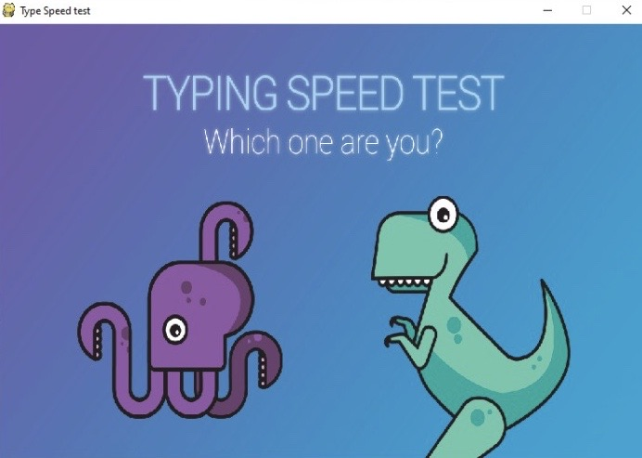
Snapshot

Slide 8
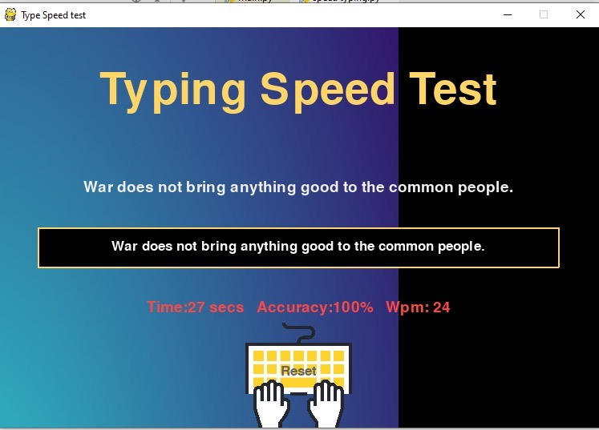
Snapshot

Slide 9
Thank you

