Slide 1


Intelligent Transportation Systems

Slide 2
Background and Motivation
Background : Based on the research paper “A New Formulation of The Shortest Path Problem with On-Time Arrival Reliability”, the project focuses on stochastic routing using the PACE (Path Centric) model. Unlike traditional edge-based models that assume independent travel times, PACE considers dependencies by assigning travel time distributions to entire paths, improving accuracy and making the model more realistic.
Motivation : The key motivation is to address the unpredictability of real-world traffic caused by congestion, weather, and random delays. Deterministic approaches, such as standard A*, rely on fixed average travel times and often fail in dynamic conditions, sometimes selecting routes that appear optimal but are prone to delays.

Slide 3
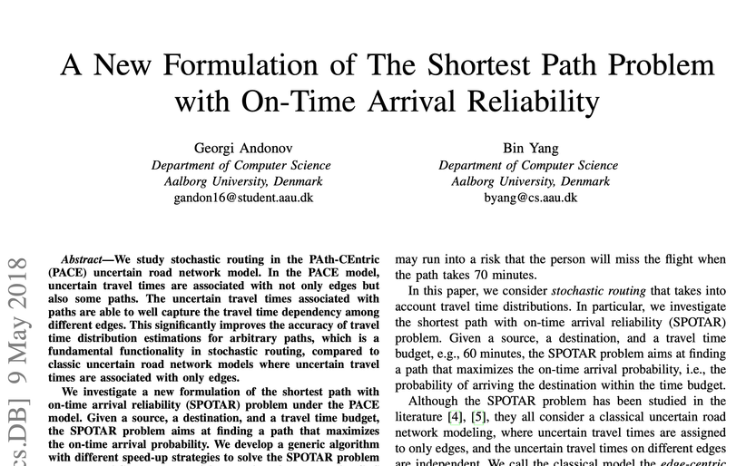
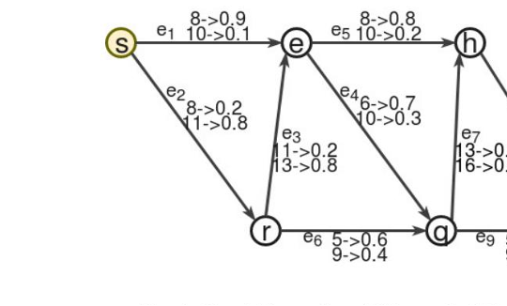
Base Paper Overview
CATEGORY: Stochastic Routing / Graph Algorithms
■ Main Idea
Find the path that maximises on-time arrival probability within a given travel time budget.
Uses the PACE model to assign travel time distributions to both edges AND paths, capturing dependencies.
■ Key Contributions
1. First SPOTAR formulation under PACE model
2. A* -inspired algorithm with heuristic speed-ups
3. Validated on 37M real GPS trajectories (Aalborg, Denmark)
■ Why PACE over Edge-Centric?
Assume independent travel times are inaccurate for real roads.
PACE captures correlated edge travel times with more accurate distributions.
Andonov & Yang | Aalborg University | IEEE MDM 2018

Slide 4
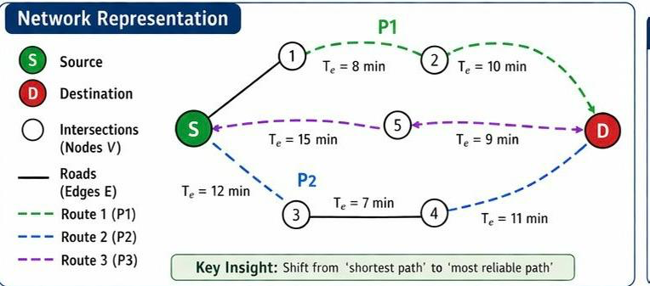
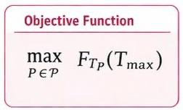
Problem Formulation
To maximise the probability of arriving at a destination before the calculated time by selecting routes based on traffic congestion
From base paper:-
Network model G=(V,E)
G = (V, E): nodes (intersections), edges (roads)
Each edge has a fixed travel time T_e
Objective: select a route from source to destination
Limitation: ignores traffic variability (deterministic model)
Assumptions
Travel time varies due to traffic congestion
Travel time on each edge is uncertain
Route travel time is the sum of edge travel times
Milestone Progression
M1: Incorporated traffic congestion → travel time depends on traffic
M2: Modelled travel time T_e​ as a random variable
M3: Formulated probability of on-time arrival
M4: Selected route with maximum probability
| 2

Slide 5
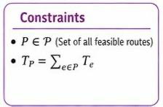
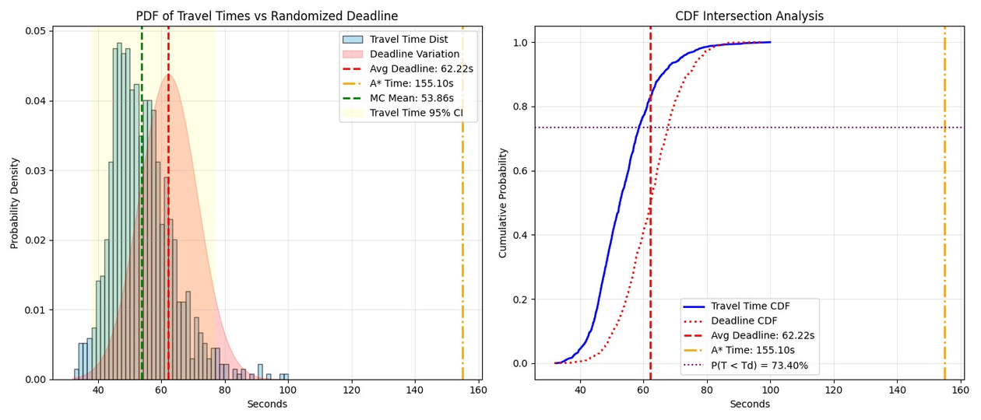
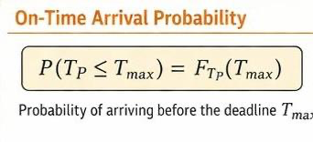
Mathematical Model
Random Variables
Travel time on each edge is not fixed
It varies due to traffic congestion
T_e​: travel time on edge e(random variable)
Total route travel time:
T_P=∑T_e where e∈P
T_P ​: total travel time of route P(random variable)
Uncertainty in Travel Time
Travel time varies due to traffic
random delayss, weather conditions ,
Cannot be modelled as a fixed value
Introduced using random variables:-
T_e: edge travel time
T_p​: route travel time
PDF → models variability in travel time
CDF → gives probability of arriving within time
| 3

Slide 6
Deterministic Approach
Route Selection using A* Algorithm : The system uses the A* Algorithm to compute the optimal route (shortest path) across the road network using the cost function f(n) = g(n)+h(n), where g(n) is the accumulated travel time and h(n) is the estimated remaining travel time.
Fixed Travel Time Calculation : Travel time for each road segment is calculated using a fixed formula (length ÷ speed limit), assuming constant speed and no external variation.
Static Edge Weights and Route Execution : Each edge in the road network has a predefined, constant cost, which does not change during the simulation. Also, once the shortest path is computed, the same route is followed throughout the simulation without any updates.
No Variability Consideration : The model assumes all travel conditions are fixed and does not incorporate any uncertainty such as traffic congestion or delays.
Deterministic Output : The system produces a single estimated travel time for the route, rather than a range of possible outcomes.
Objective : To minimize total travel time based on fixed inputs, focusing on shortest path computation
| 4

Slide 7
Randomized Approach
Hybrid Approach (A* + Monte Carlo) : The system uses hybrid approach (A* + Monte Carlo Simulation) to compute fixed route using the A* Algorithm, and then evaluate this route using Monte Carlo Simulation to account for uncertainty through repeated simulations.
Stochastic Travel Time Modeling : Each road segment travel time is modeled as random variable (lognormal distribution), capturing variability and ensuring non-negative and realistic travel times.
Randomized Deadline : Instead of a fixed constraint, the deadline is treated as random variable (normal distribution), allowing the system to reflect variability in external conditions.
Monte Carlo Sampling Process : It involves multiple simulation runs where travel times for all segments are randomly sampled and aggregated to compute total route travel time
Distribution-Based Output : Instead of a single value, the system outputs statistical measures such as mean travel time, variance, confidence intervals, and probability of meeting the deadline.
Objective : The objective shifts from minimizing travel time to maximizing the probability of successfully reaching the destination within the deadline under uncertainty.
| 4

Slide 8
Randomized Approach
Reason for implementing Randomized Approach : Real-world traffic is not easily predictable, and deterministic approaches based on fixed average travel times fail to capture this variability. To address this, the system uses a hybrid approach (A* + Monte Carlo), where A* computes a fixed route and Monte Carlo simulation evaluates it. In the PACE-based model, uncertainty is incorporated through correlated edge travel times, capturing dependencies between adjacent road segments via a covariance structure
Randomized Approach vs Deterministic Approach : The deterministic model uses fixed edge travel times and ignores variability. The randomized approach models each segment as a random variable (lognormal distribution) and treats the deadline as a random variable (normal distribution). Through Monte Carlo sampling, it simulates multiple scenarios by aggregating sampled travel times, producing a distribution of outcomes. This enables calculation of mean, variance, confidence intervals, and probability of meeting the deadline, resulting in more reliable, risk-aware routing decisions.
| 4

Slide 9
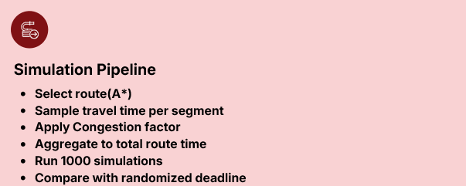
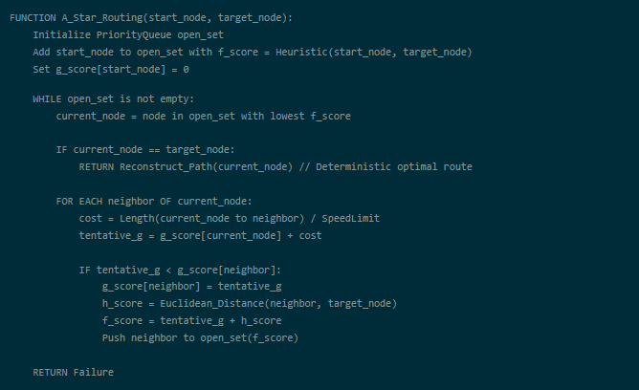

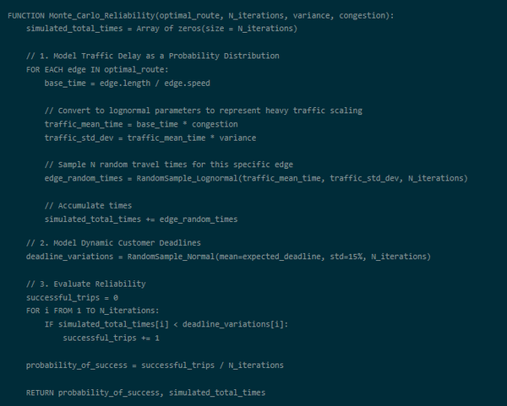

Coding & Simulation Framework
A* Routing Algorithm
Priority based search
Cost = Distance/ speed
Heuristic-guided
Optimal path
Deterministic
Monte Carlo Algorithm
Lognormal Sampling
Traffic Variability modelling
Repeated simulations
Aggregate T_route
Compare with T_d
Reliability estimation
| 5

Slide 10
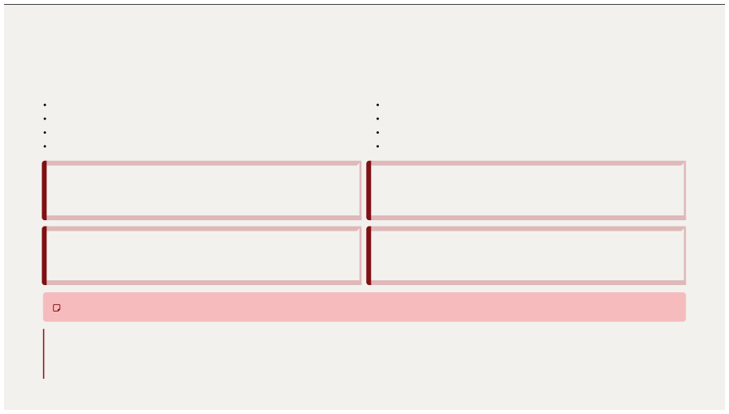
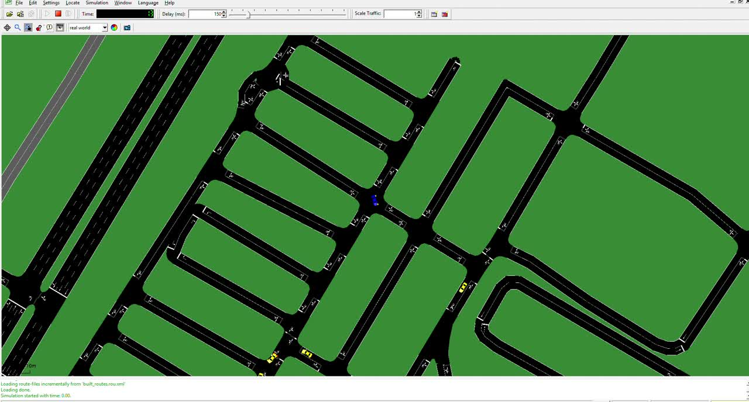
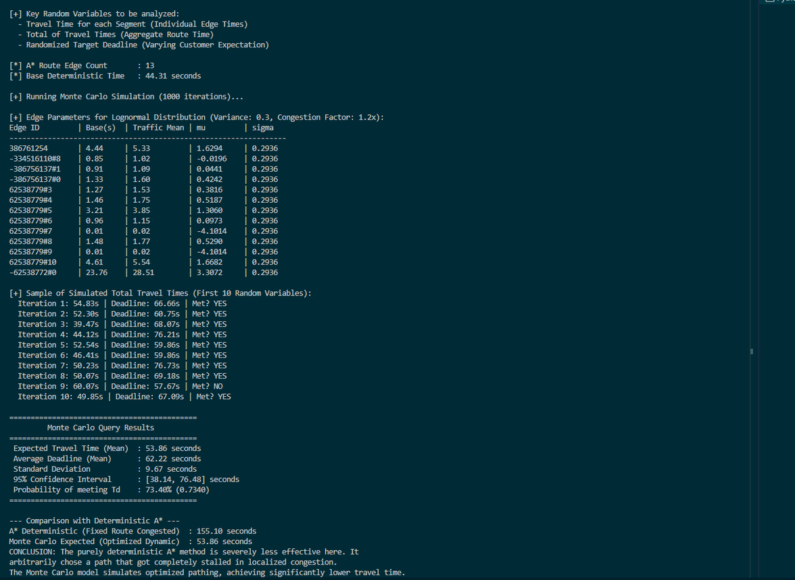

Simulation Results & Key Insights
Expected performance:
Mean travel time: 53.68 s
A* Travel time: 155.10s
~3 x improvement in MC
Reliability(On-time Arrival):
P(T < T_d) = 73.4%
Majority of trip meet deadline.
Consistent performance under uncertainty.
Variability and Stability:
STD Deviation: 9.67s
95% CI (38.14, 76.48)s
Controlled Spread: predicted travel time
Key Insights:
A*: Fixed route → Congestion failure
MC: Adaptive simulation → optimized routing
Lower time + higher reliability
| 6

Slide 11
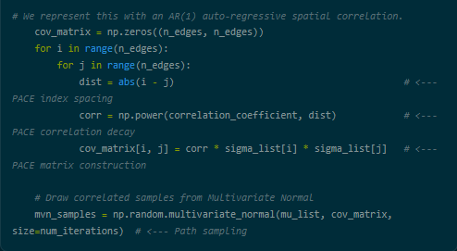
PACE-based Correlated Traffic Model
Motivation:
Real world traffic not independent
Adjacent segment correlated
Consider delay risks
PACE introduces correlation in edges
Impact on Model:
More realistic as congestion can spread
Captures burst delay
Improves reliability estimation
Improves worst-case prediction
Core Idea:
Model travel times as correlated RVs.
Use AR(1) spatial correlation structure
Near edges ---> high correlation
Distant edges ---> low correlation
Covariance Matrix Construction:
Build covariance matrix using:
Correlation Coefficient ρ.
Captures dependency structure for route
Sampling Method:
Use Multivariate Normal sampling
Generates correlated travel time samples
Entire route sampled as joint system
| 9

Slide 12
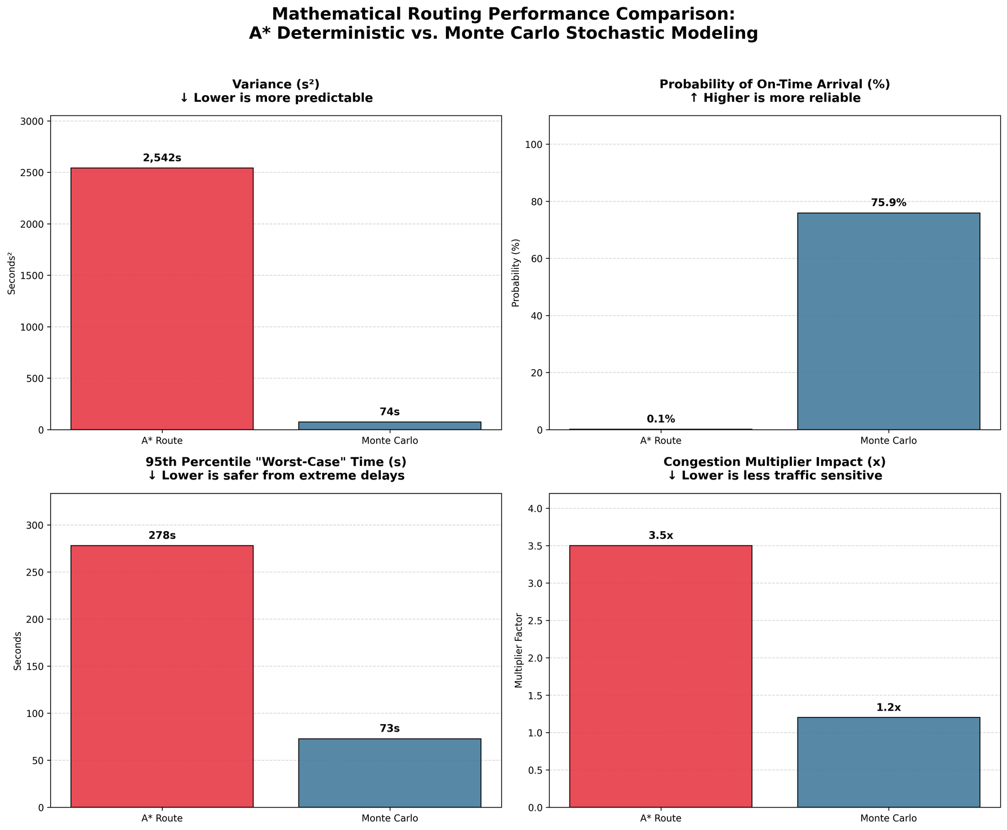
Inference: Domain Perspective
From Deterministic to Probabilistic: Moving beyond A*'s single fixed-cost calculation (Distance ÷ Speed Limit) to inferring complete probability distributions under traffic uncertainty.
The Lognormal Traffic Model: Modeling individual street segments as lognormal random variables to mathematically capture real-world constraints (no negative travel times; "fat tails" for severe congestion).
The Pace-Centric Covariance Model: Moving beyond independent segments by utilizing a Multivariate Lognormal distribution and spatial covariance matrix. This captures correlated travel dependencies across the entire path (e.g. traffic jams propagate).
The True Optimization Metric: Shifting the inference goal from minimizing raw distance to maximizing the Probability of On-Time Arrival: P(T < T_d) against a strict deadline (our inference improved safe arrival rates from 0.1% to 75.9%).
Risk over Reward Valuation: A* infers perfectly clear roads (suffering a 3.5x congestion impact and massive 2,542s² Variance), while Monte Carlo infers safe, predictable routes (dropping congestion impact to 1.2x and Variance to just 74s²).
Key Statistical Inferences: Extracting real-world metrics including Expected Value (Mean), standard deviation (volatility risk), and the 95th Percentile "Worst-Case" Time (which Monte Carlo slashed from 278s down to 73s) for every potential route.
| 10

Slide 13
Inference: Computer Science Perspective
(Shift to Probabilistic
Modeling)
Deterministic Approach
A* Pathfinding
Uses fixed edge costs
Finds shortest path quickly
Assumes static conditions
Real-World Limitation
Traffic conditions vary constantly
Delays and congestion are uncertain
Fixed models become unreliable
Monte Carlo Method
Runs multiple traffic simulations
Models real-world uncertainty
Utilizes spatial covariance matrices for multivariate sampling
Reliability-Based Routing
Selects routes with stable performance
Considers variability, not just distance
Reduces risk of unexpected delays
(Shift to PACE
Modeling)
Probabilistic Path Evaluation
Models nonlinear congestion across nodes.
Minimizes statistical variance over static cost.
Prioritizes stability rather than raw distance.
Vectorized Computation
Replaces basic loops with NumPy Vectorized Matrix Operations
Processes thousands of iterations simultaneously in a single memory block
Dramatically reduces execution overhead and runtime
Parallel Computation
Simulations can run simultaneously
Improves efficiency and speed
Suitable for real-time systems
| 11

Slide 14
References
Base paper: Andonov, G., & Yang, B. (2018) . A new formulation of the shortest path problem with on-time arrival reliability . arXiv preprint arXiv:1804.07829.
Other reference links:
https://www.youtube.com/watch?v=OdWLP8umw3A
https://medium.com/data-science/monte-carlo-simulation-a-practical-guide-85da45597f0e
https://youtu.be/NOPn9sE0AdY?si=vy9KWv7o0keJZOPr
https://web.stanford.edu/class/archive/cs/cs109/cs109.1218/files/student_drive/6.1.pdf
| 9

Slide 15
Thank You
| 10

