Slide 1
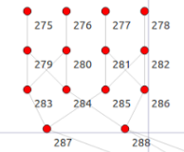
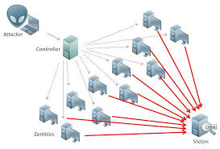
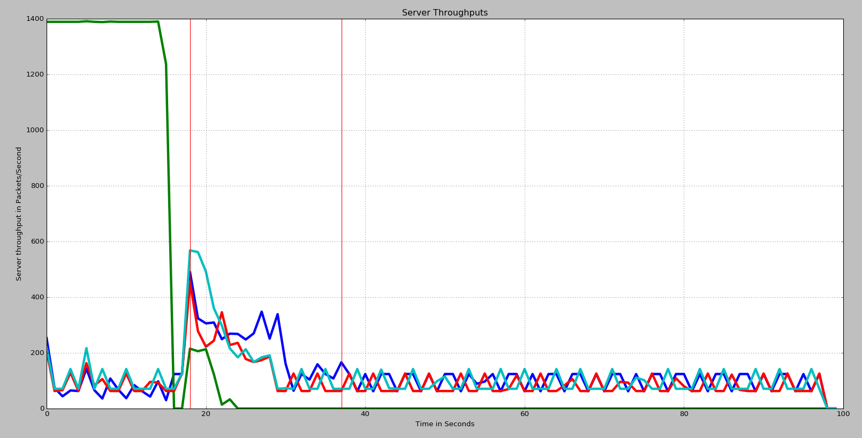
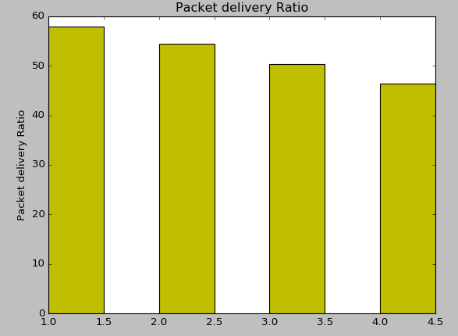
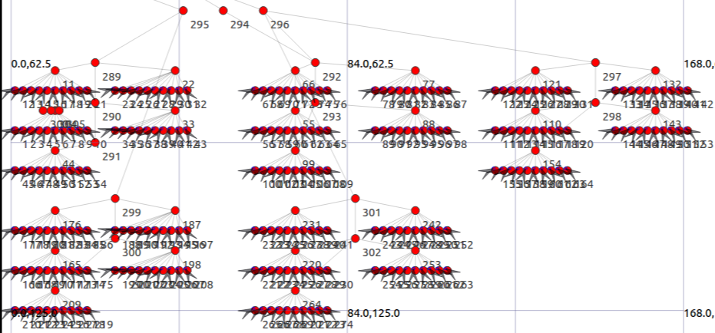
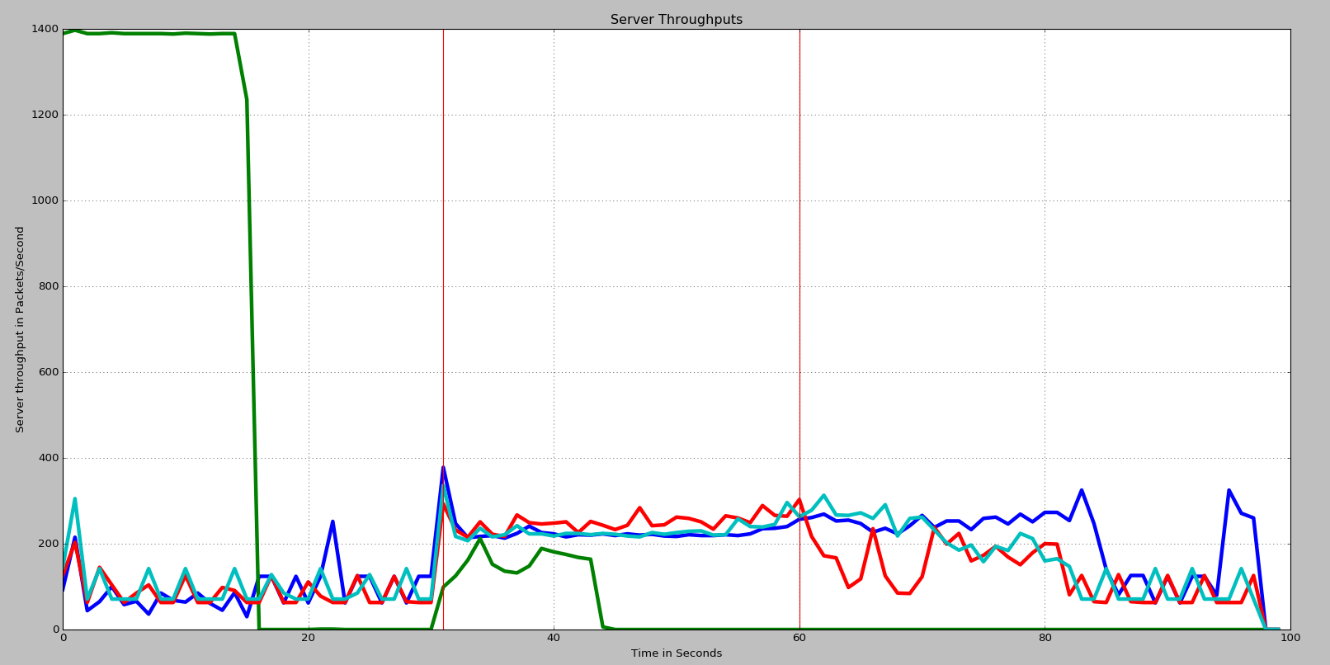
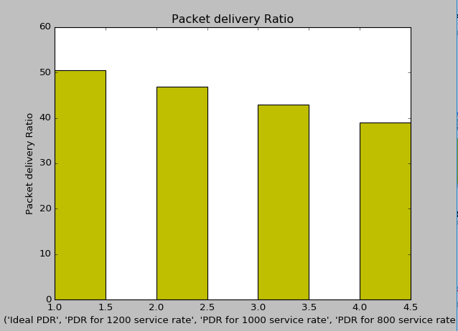
Network Design and DDoS Attack on Cloud Network
Dhruvin Shah & Gulmeen Kaur Purewal
Project Advisor: Prof. Morris Jones Electrical Engineering Department, San José State University, San Jose, California 95192
Introduction
Methodology
Results
Proposed Mitigation Technique
DDoS attacks are an immediate concern for organizations and small to large sized businesses. Criminal enterprises, hackers and cyber terrorists play with and launch DDoS attacks to gain profit as well as to include fun element in their lives. DDoS attack can be launched by flooding the target machine with malicious traffic to exhaust existing resources, thus making the system go offline. DDoS attack is a cyber-attack that focus on depleting the existing network resources temporarily or indefinitely thus making them unavailable to the legitimate users. DDoS mainly introduce the concept of flooding the victim with incoming traffic from hundreds or thousands of users, potentially cutting the legitimate user access to resources. The idea behind DDoS is use of multiple unique IP addresses making them difficult to trace back to the attacker. DDoS attacks have scaled largely over time with the attacks in 2016 exceeding almost a terabit per second.
The symptoms of a network infected by DDoS attack include unusually slow network performance, dramatic increase of spam emails, unavailability of a standard website/ inability to access a website, inability to access a wired/wireless internet connection. The scalability of these attacks may result in the inaccessibility of entire geographical region to the internet connection or inaccessibility to a website.
For the cloud network, there were basically three options. 1. Fat tree topology, 2. Three tier topology and 3. Dcell.
The reason for selecting Fat tree topology is that it resolves oversubscription and cross section bandwidth problem caused by Three tier topology. However, this causes the number of switches used much higher. It is used because it also facilitates full bandwidth option throughout the network.
After successfully generating the random traffic and DDoS traffic, it was time to simulate the attack. Two criteria were decided to measure the effect of DDoS attack on the network.
1.Throughput and 2. Packet Delivery Ratio. To trace the packets for throughput and Packet delivery ratio, PCAP trace files were used. The things that were considered to achieve the goals are mentioned below.
Packets coming from Network to cloud
Packets successfully reaching the data server
Packets responded by server based on service rate r
Packet successfully received from cloud to Network
Based on the above result, it is clear that DDoS caused large packet loss which could further be dangerous for real world finite service rate servers as evident from the packet delivery ratio bar graph. We think the effect would be much lesser if the server would use credit score of users to priorities the packets in its queue. This credit score is similar to the one used in credit card i.e. the user who has longer credit history can receive higher credit. When a legitimate regular user asks queries to a particular server over a longer period of time, lets say one year, his credit score will increase. As he gets more and more connection sessions with server over longer period with some authentic regularity, his credit score will be more. The server can then serve the packets in its queue based on users credit score, which is saved in it’s database.
This proposal is particularly important and useful for large companies like Google and Amazon which has large base of regular users.
Here, it is a valid assumption that regular long time users of internet are aware of Network security and outside threats, thus less vulnerable to Malware used for DDoS attack.
Server
Server
Server
Server
Data from cloud
Reply from server
Congested cloud Network
Data from Nodes
Reply back to client
Network with infected Zombies
Summary
First phase of the project involved building a network topology of 300+ nodes with a complex arrangement of star and p2p topology with CSMA nodes based on Network Simulator 3.
Second phase of the project was to generate randomized traffic from outside network to the cloud network with a challenge of generating traffic similar to the real world traffic.
Final phase focused on launching the DDoS attack on cloud network that was achieved by installing the on off application in network nodes randomly with the server acting as the remote packet sink.
After the network creation, the next goal was to create a randomized traffic from outside network to cloud network. The challenge was that the traffic must be similar to real world traffic and the effect of DDoS must be observed when the cloud network is under DDoS. For that reason, a UDP echo client server application with uniformly random inter arrival time and exponentially random packet size was selected, similar to real world traffic. The UDP clients were installed in all the Network nodes and UDP server was installed in four top of the rack servers.
The final step of the project was to install the application in network nodes that can generate maximum number of packets in limited time similar for DDoS attack. Considering the goal, on off application was selected for the purpose. The on off application is unique for the purpose because it provides many options like bandwidth, ON time, OFF time, packet size and interval. So on off application was installed randomly in selected nodes and the remote packet sink was the server. Here, it was assumed that server can serve both TCP and UDP traffic on particular port.
It is important to know some network statistics before considering the results.
It is quite difficult to trace the packet from client to server, and then back to client. So for simplicity, the packets to and from network to cloud and packets to and from server to cloud are considered. Based on this assumption, python script is developed to observe the result of DDoS attack.
Scenario 1: The effect of 15 seconds of DDoS attack in 100 second of simulation with three different service rates
Methodology
Key References
Network simulator tool was used to simulate the network with large number of Nodes. The initial step was to get familiar with the environment while simulating already given examples. The initial goal was to build a small network similar to the real world networks. After some research, the team found out that star and dedicated Ethernet lines are few of the most used topologies in small network consisting of routers and switches for routing. So in the proposed network, the team decided to use Star topology, p2p topology and few CSMA nodes to make the network more realistic.
[1] F.N.Ugwoke, K.C.Okafor, V.C.Chijindu Security QOS profiling against Cyber Terrorism in Airport Network Systems, International Conference on Cyber-Space Governance, p. 241-251
[2] Mohammed Khundhur Hussein, Ir. Dr. Nasharuddin Bin Zainal, Aws Naser Jaber, Data Security Analysis for DDoS Defense of Cloud Based Networks. IEEE Student Conference on Research and Development, 2015, p. 305-310
[3] Rana Khattak, ZAhid Anwar, D3TAC: Utilizing Distributed Computing for DDoS Attack Traffic Analysis on the Cloud, 2016 p.
[4] Omkar P. Badve, B.B.Gupta, Shingo Yamaguchi, Zhaolong Gou, “DDoS Detection and Filtering Technique in Cloud Environment using GARCH Model, IEEE 4th Global Conference on Consumer Electronics (GCCE), 2015, p. 584-586
Scenario 2: The effect of 30 seconds of intense DDoS attack in 100 second of simulation with three different service rates
Entity | Amount | Entity | Amount
Server count | 4 | P2P link bandwidth | 10 Mbps
Number of nodes | >300 | Cloud link bandwidth | 1 Mbps
Star link bandwidth | 10 Mbps | OnOff bandwith | 5 Mbpa
Acknowledgements
The Authors Dhruvin Shah and Gulmeen Kaur Purewal would like to thank Professor Morris Jones for his continuous guidance and allowing us to use laboratory resources for this Project. The Authors would also like to thank their parents for their immense support and without whom, they would not be able to complete the project.

