Slide 1
Result Management System
Mini project for Foundations of Programming (2025–26). Batch/Group: [E2-4]. Team:
Parth Kale
Dhruvin Solanki
1262251718
1262251026
Guided by: Mr. Shirish Paygude
Notes:
1

Slide 2




Introduction & Motivation
We built a C-based application to digitize student academic records and automate grading workflows. Manual systems suffer human error, inconsistent calculations, and redundant file handling. This project improves speed, accuracy, and provides persistent, auditable records.
Performance
Persistence
Reliability
Fast grade computations using efficient algorithms (qsort).
CSV-based storage for easy import/export and backup.
Duplicate-roll protection and input validation to preserve integrity.
Notes:
2

Slide 3

Problem Statement & Objectives
Problem: Need a reliable tool to manage large student mark datasets while ensuring integrity and enabling analytics.
CRUD Operations
CSV Persistence
Automated Analytics
Create, Read, Update, Delete student records via menu-driven interface.
Robust file I/O using formatted parsing (sscanf/fprintf) for durable storage.
Grade calculation, distribution, and class-level performance metrics.
Notes:
3

Slide 4
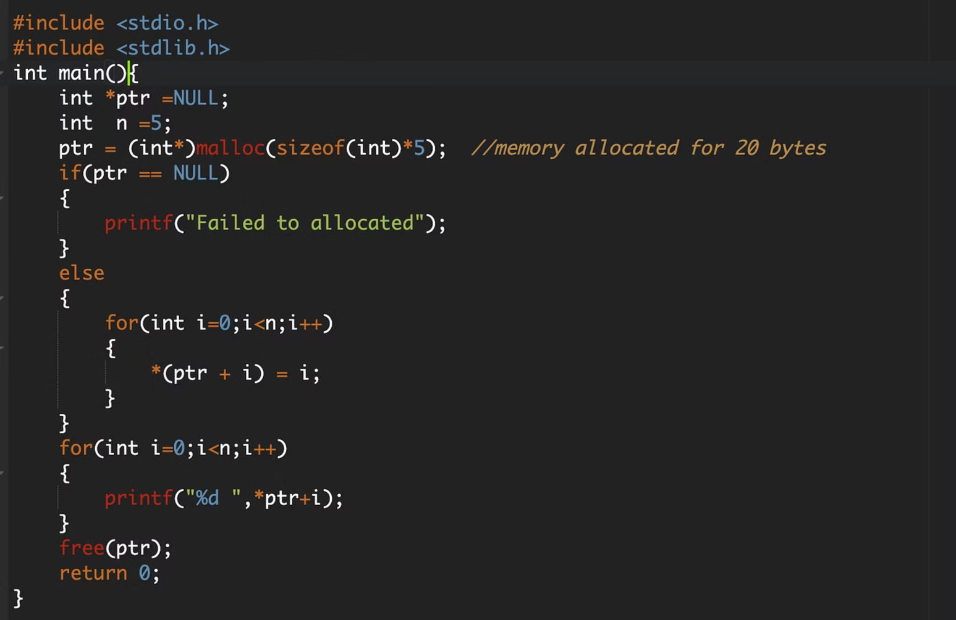
Individual Contribution — Implementation & Algorithms
Name: [Your Name] — Responsible for core system design and implementation.
Key Tasks
Design and implement Student struct with dynamic memory for names.
qsort-based sorting for rank and performance reports.
malloc/free usage with careful bounds checking.
roll_exists() to prevent duplicate entries.
Notes:
4

Slide 5
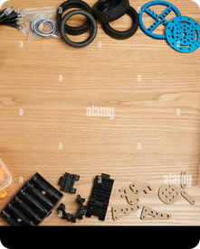
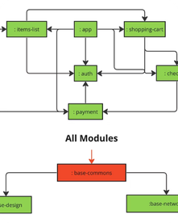
Literature Survey — Sources & Takeaways
Ref [1]: Standard C Documentation
Ref [2]: Modular Programming
Provided authoritative examples for file I/O and formatted parsing (sscanf), enabling reliable CSV handling.
Guided function decomposition and menu-driven architecture for maintainability and testability.
Notes:
5

Slide 6
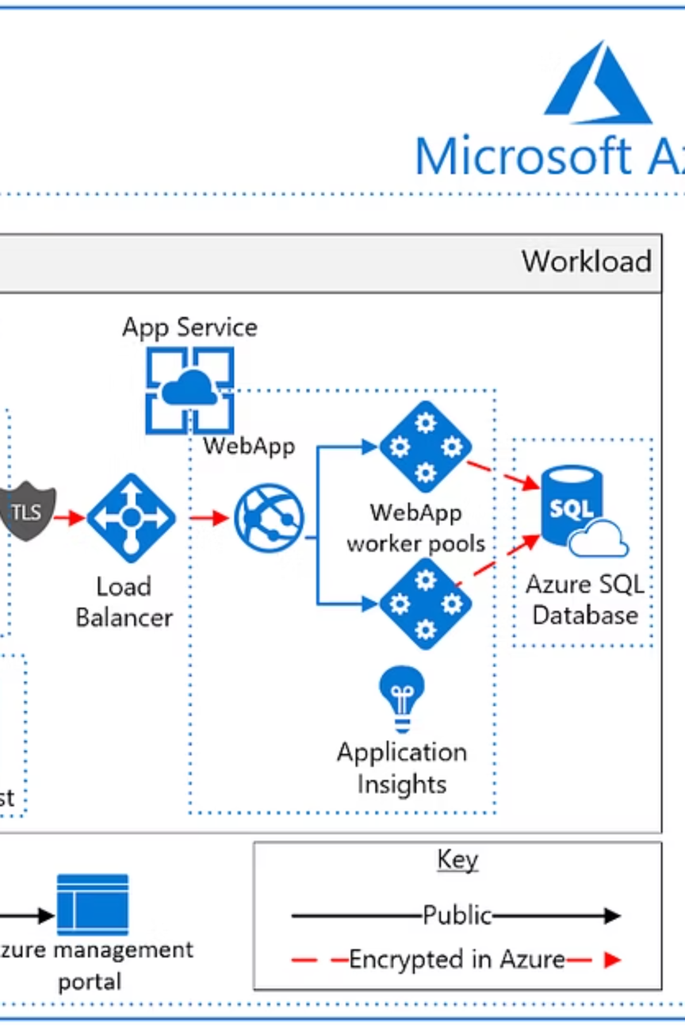
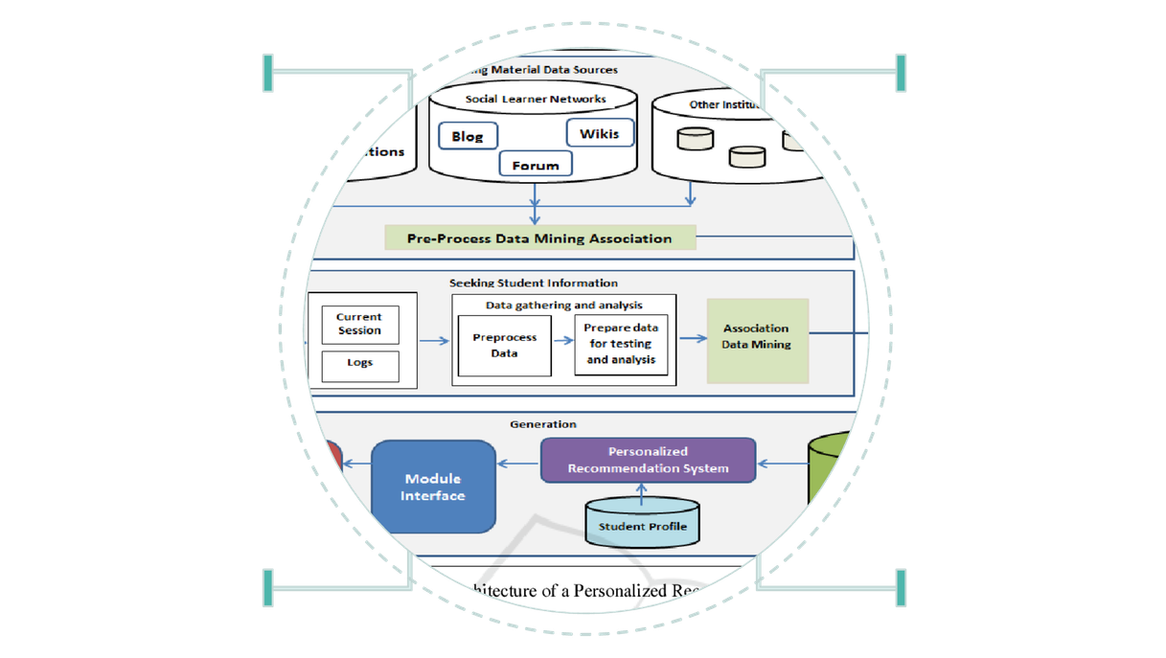
Proposed System — Design & Data Model
Multi-module CLI application. Central Student struct encapsulates roll (int), name (char[] up to 32), and marks[5] (float). Modular separation: I/O, validation, analytics, and reporting.
Data Model
File I/O
Student struct: roll, name, marks
Persistent read/write of student files
CRUD
Analytics
Create, read, update, delete records
Compute averages, trends, validations
Diagram: Shows modules and directional flow from CSV storage to analytics and report generation.
Notes:
6

Slide 7
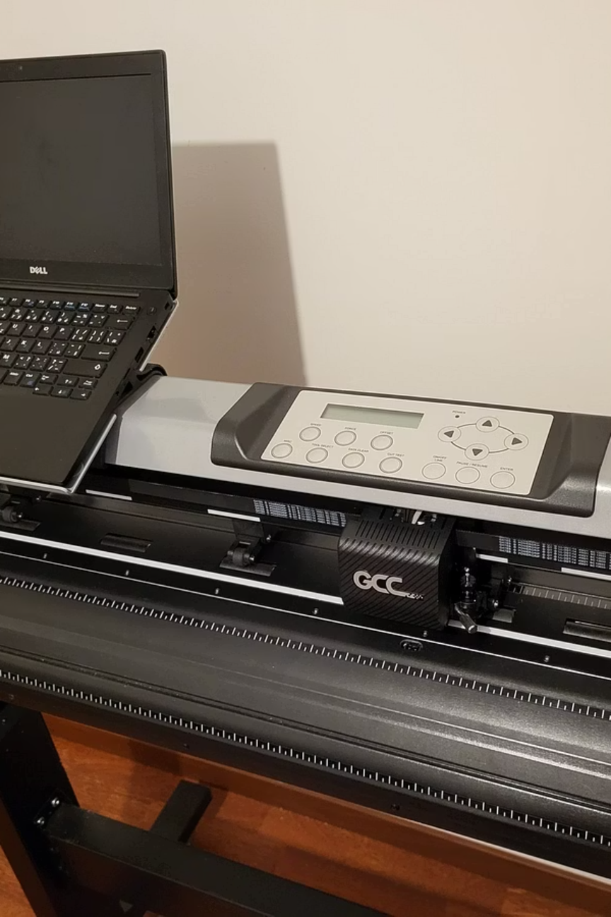
Hardware & Software Requirements
Hardware
Software
Standard PC/Laptop — Intel i3/i5 or equivalent
4GB+ RAM; minimal CPU needs for student-scale datasets
Reason: Efficient local compilation and testing
VS Code (editor) — for development and debugging
GCC (MinGW on Windows) — standard C compiler
CSV text files — portable storage for records
Notes:
7

Slide 8
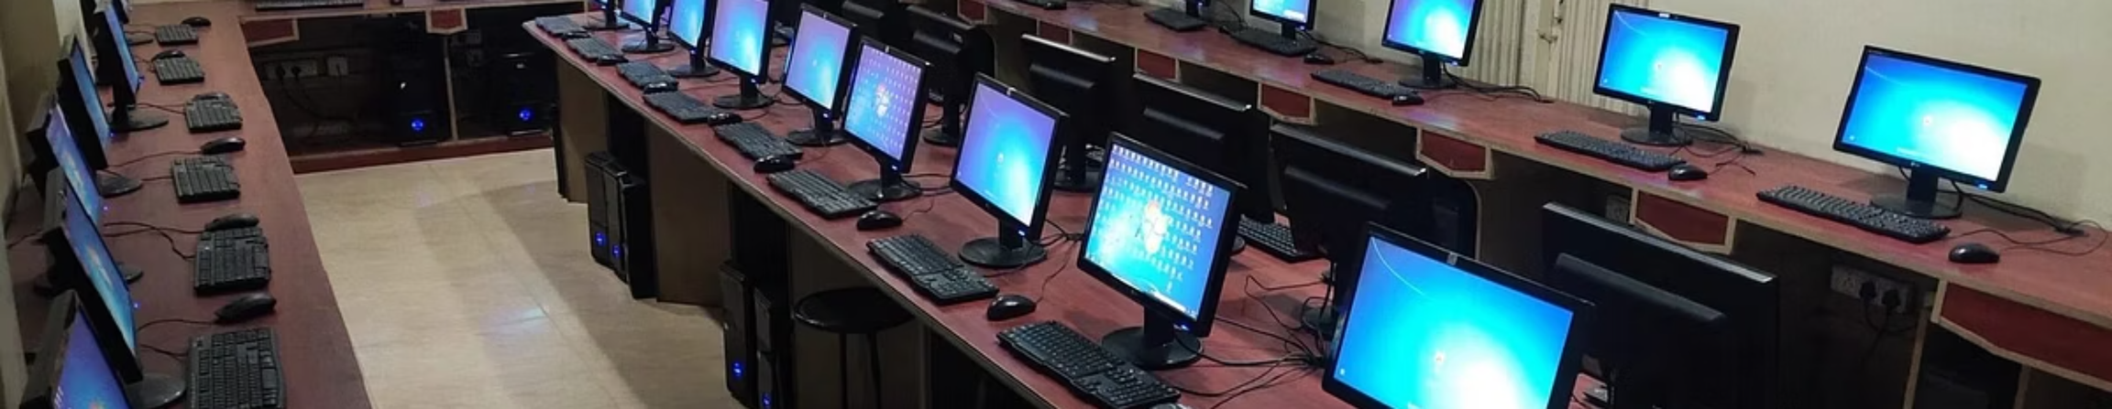



Implementation & Experimental Setup
Implementation supports names up to 32 characters and five subjects: C, Java, Python, DSA, AI & ML. The system validates roll uniqueness, parses CSV lines robustly, and sorts records for reporting.
Data Input
Storage
Processing
CSV import and menu-driven entry with input sanitization.
Persistent CSV writes with atomic updates to avoid corruption.
qsort for ranking, aggregate functions for class analytics.
Notes:
8

Slide 9
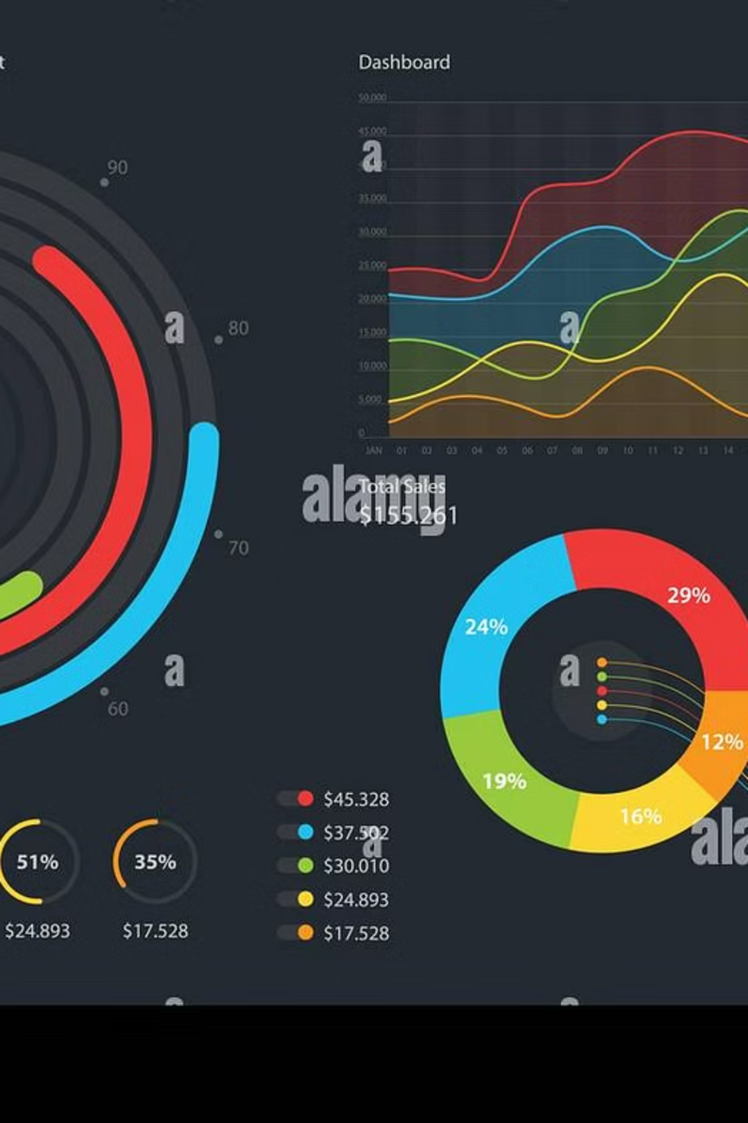
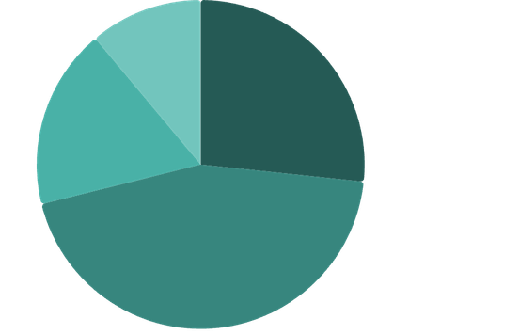
Results & Conclusions
Results: The program generates individual Performance Reports and a Class Analytics Dashboard (grade distribution, averages, highest/lowest). Tests show correct grade assignment and stable CSV persistence under concurrent edits (manual sequential testing).
A·26.67%
·26.67%
·
B·44.44%
·44.44%
·
C·17.78%
·17.78%
·
F·11.11%
·11.11%
·
Conclusion: Modular C programming with careful memory and file management is sufficient to manage course-scale datasets reliably and produce actionable analytics.
Notes:
9

Slide 10
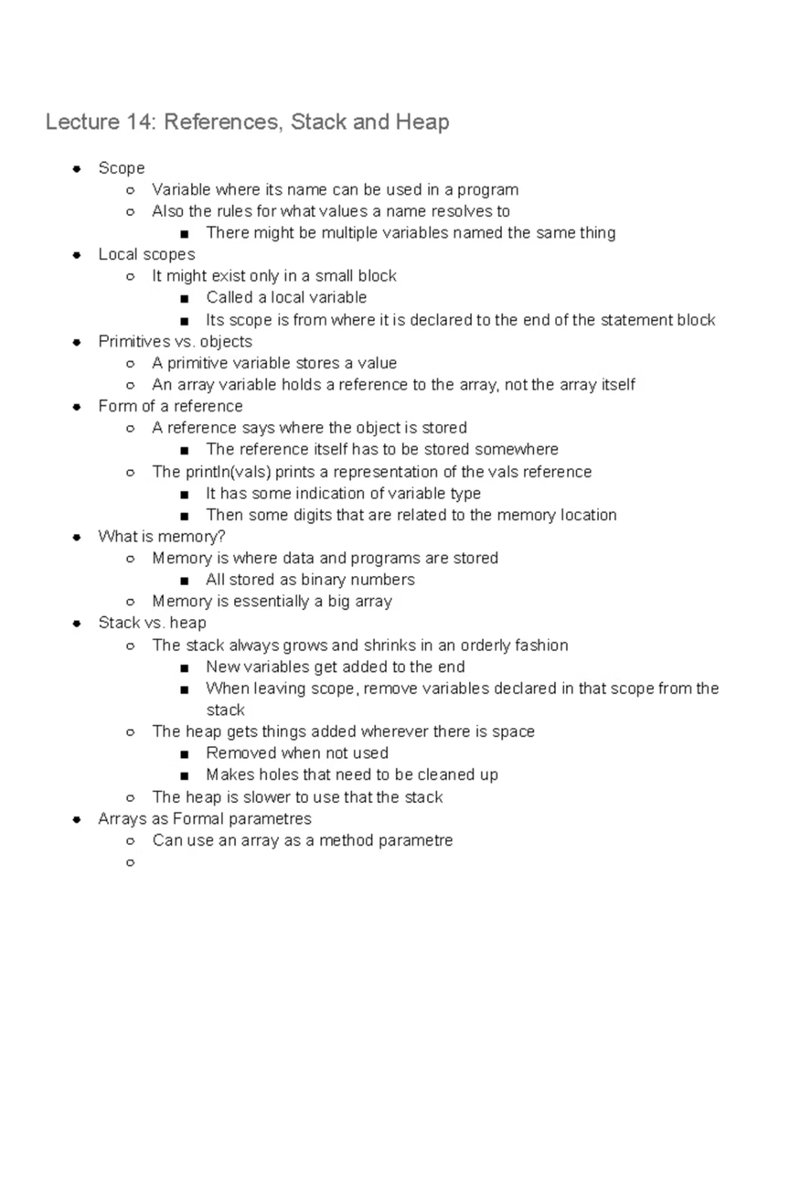

References
Ref [1]: Foundations of Programming Course Material — MIT-WPU
Ref [2]: K. N. King, C Programming: A Modern Approach
ISO C Standard and GNU GCC Documentation — for file I/O and memory management best practices
Acknowledgments: Faculty guide and peer reviewers who validated test cases and file-handling edge cases.
Notes:
10

