Slide 1
Advanced Digital System Design
Design Elevator on FSM
Using Verilog
Submitted by- Dhruvit Tripathi
Submitted to- Dr. Vijay Savani

Slide 3
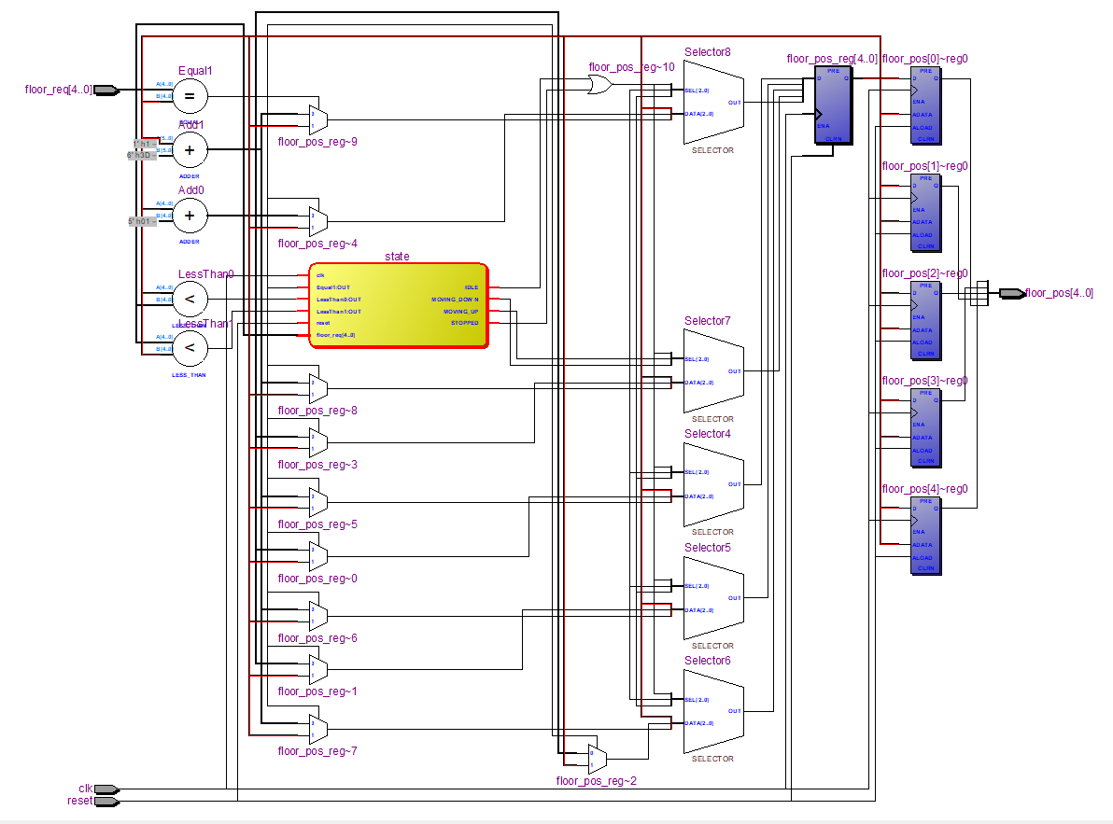

Slide 4
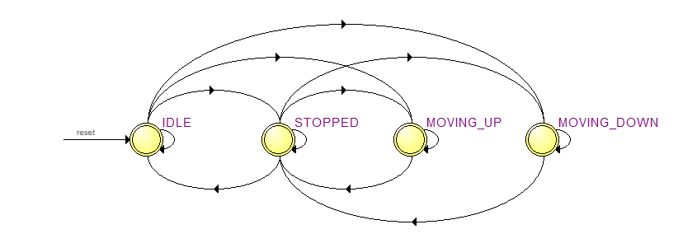
State Diagram

