Slide 1





Employee Attrition Analysis & HR Decision Support
Identifying key drivers of employee attrition and delivering actionable HR recommendations through data-driven analysis.
Python & Pandas
Data cleaning, transformation & statistical analysis
SQL
Querying & aggregating workforce datasets
Power BI
Interactive dashboards & visual storytelling
1,470 Employees
38 features across HR, finance & performance

Slide 2
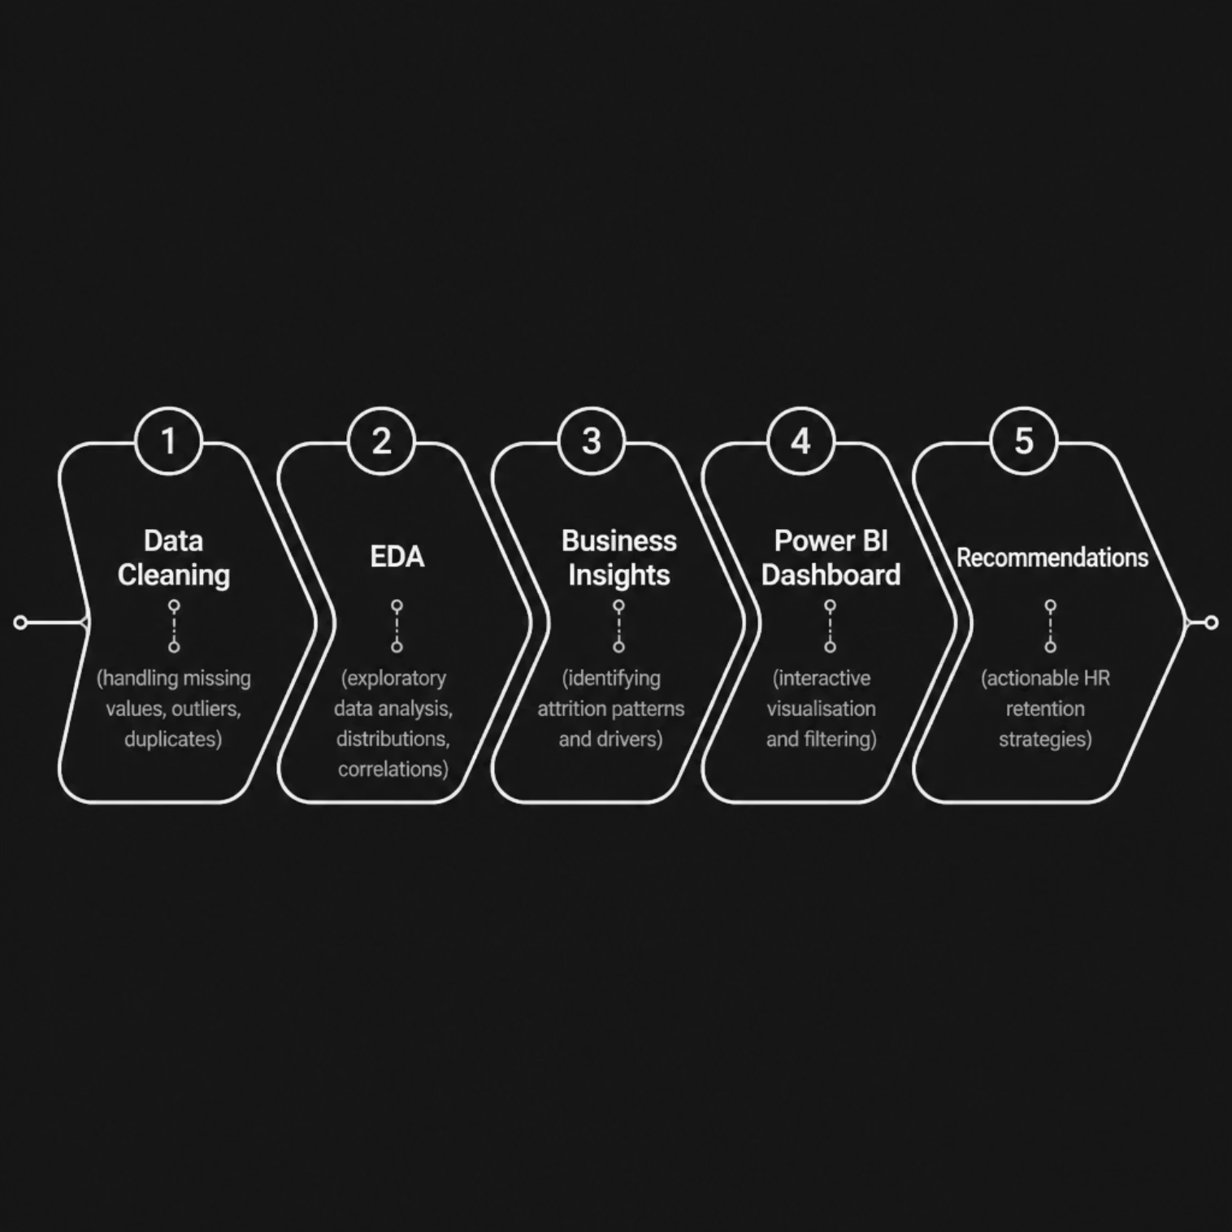

METHODOLOGY
Business Problem & Analytical Approach
The Challenge
High employee attrition increases hiring costs, reduces productivity, and destabilises workforce planning. Organisations need to understand who is leaving, why, and when — before it becomes a systemic risk.
This analysis transforms raw HR data into a strategic retention framework.

Slide 3
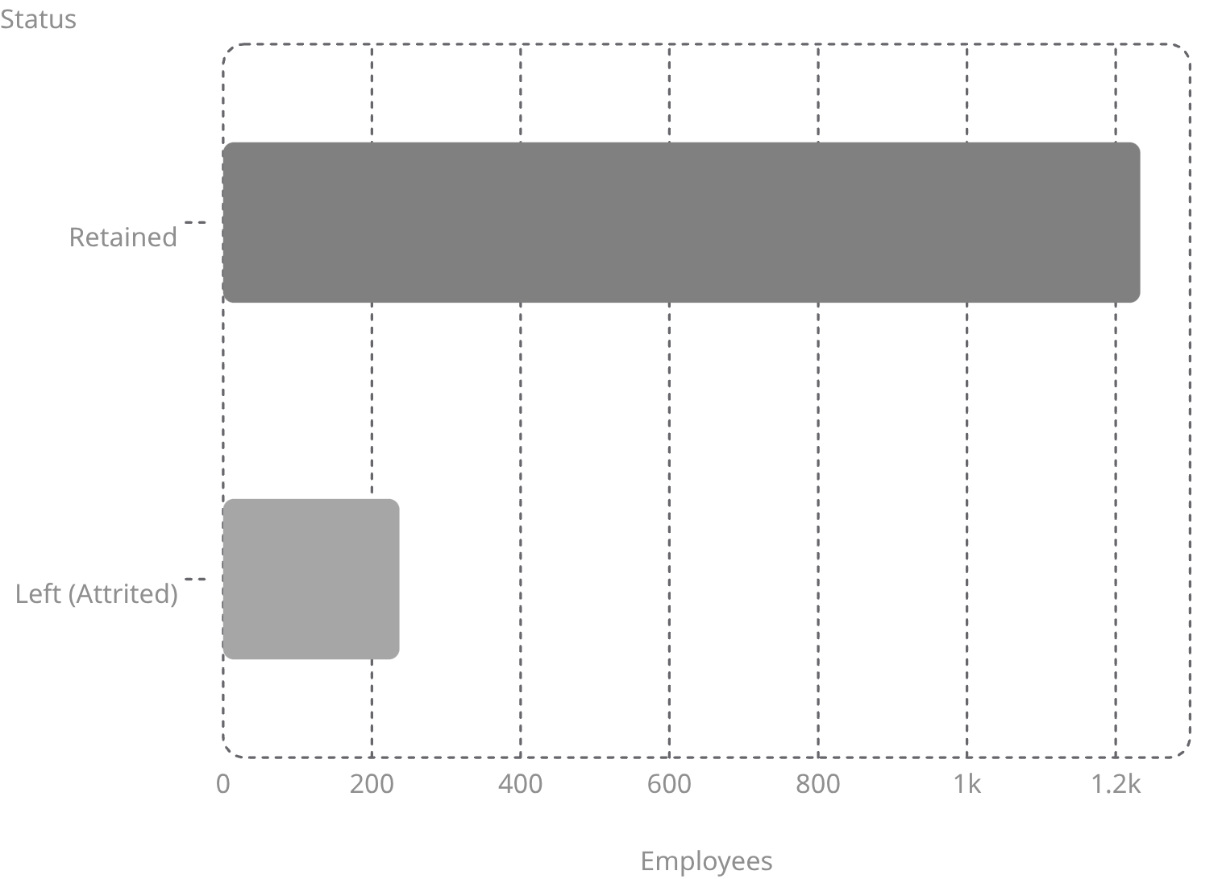
ATTRITION OVERVIEW
The Scale of the Problem
1,470
237
16.1%
Total Employees
Employees Left
Attrition Rate
In the analysed workforce dataset
Recorded attritions in the period
Approximately 1 in 6 employees exits
Key Insight
At a 16.12% attrition rate, the organisation is losing a significant portion of its workforce each cycle. Replacing these employees carries direct costs — recruitment, onboarding, and lost productivity — making retention a clear business priority.

Slide 4
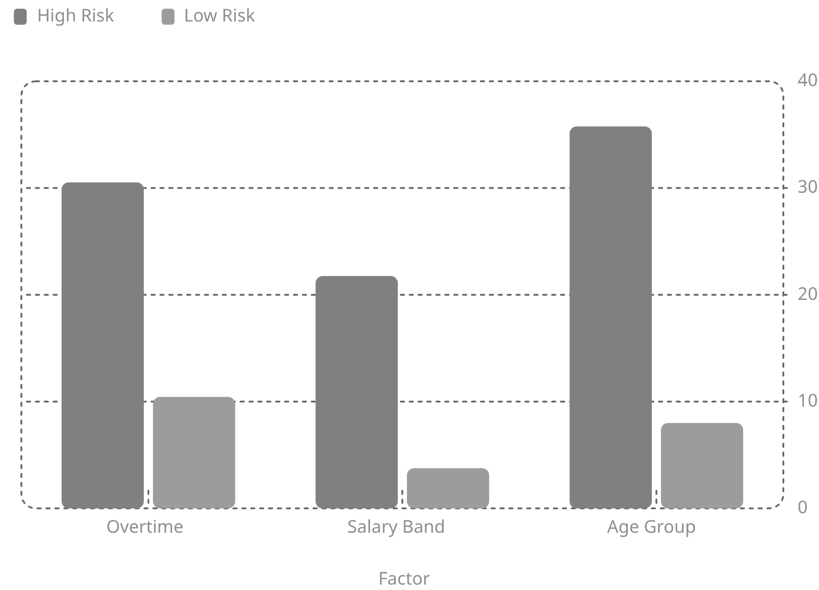

ATTRITION DRIVERS
The Three Strongest Predictors of Attrition
What the Data Reveals
⏱ Overtime
Employees working overtime have 3× higher attrition (30.53% vs 10.44%).
💰 Salary
Employees earning below $5K face 21.76% attrition vs just 3.76% for those above $15K.
🎂 Age 18–25
Younger employees show the highest exit rate at 35.77% — nearly 1 in 3.

Slide 5

RISK SEGMENTATION
High-Risk Employee Profiles
Combining multiple risk factors reveals critical segments where attrition is most concentrated.
⚠️ Highest Risk
🔴 Very High Risk
📋 Composite Profile
Sales Rep + Overtime
Attrition: 66.67%
2 in 3 employees in this segment leave.
Overtime + Salary <$5K
Attrition: 42.93%
Nearly half of this group exits.
Age 18–25 · Sales Rep · Overtime · Salary <$5K · Single
The convergence of all five factors defines the most vulnerable employee.
Priority Action: Sales Representatives working overtime on lower salaries represent the single highest-risk cohort and should be the first target for retention intervention.

Slide 6
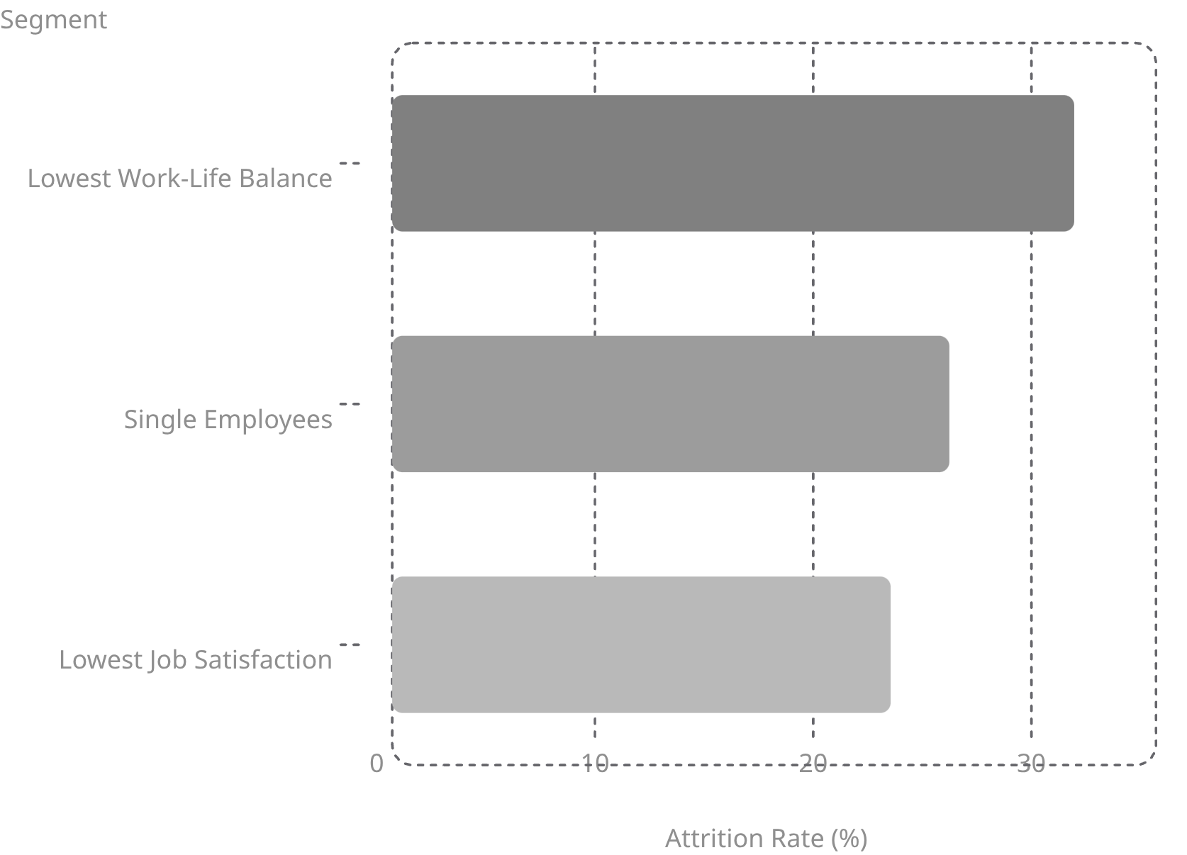

EMPLOYEE EXPERIENCE
Work-Life Balance & Satisfaction Drive Attrition
Beyond Pay & Hours
Employee experience factors are significant independent predictors of attrition. Employees who rate work-life balance poorly are nearly 3× more likely to leave than satisfied counterparts.
Work-Life Balance: Lowest-rated employees show 31.25% attrition
Job Satisfaction: Dissatisfied employees exit at 22.84%
Marital Status: Single employees show 25.53% attrition

Slide 7
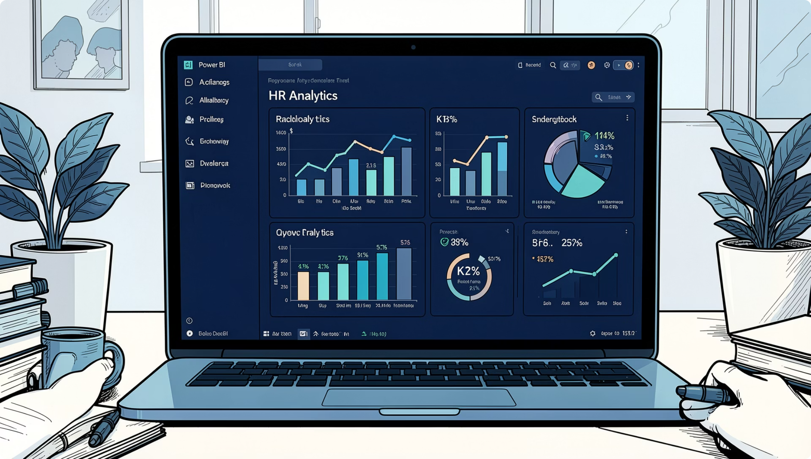




DELIVERABLE
Power BI Dashboard Showcase
Dashboard Capabilities
Executive Overview
High-level KPIs and attrition trends for leadership review.
Interactive Filtering
Drill down by department, role, age, salary, and tenure.
Risk Identification
Highlights high-risk segments for proactive HR intervention.
Attrition Drivers
Visual breakdown of the strongest predictors of employee exit.

Slide 8

CONCLUSION
Recommendations & Strategic Next Steps
01
02
03
Reduce Excessive Overtime
Review Lower Salary Bands
Target Retention at Ages 18–25
Redistribute workload and enforce capacity planning to lower the 30.53% attrition rate among overtime employees.
Conduct a pay equity review — employees below $5K are 5× more likely to leave.
Introduce career development pathways and mentorship programmes for younger employees.
04
05
Improve Work-Life Balance
Monitor High-Risk Roles
Implement flexible working policies and monitor wellbeing scores proactively.
Sales Representatives on overtime with lower salaries require immediate HR attention.
Bottom Line: Overtime, salary, age, and job role are the primary drivers of attrition. Targeted retention strategies can significantly improve workforce stability and reduce turnover costs.

