Slide 1
MACHINE LEARNING · HEALTHCARE ANALYTICS
Disease Prediction
from Symptoms
A supervised machine-learning system that predicts the most likely disease from a patient's reported symptoms — comparing Naive Bayes, Decision Tree, Random Forest, and Gradient Boosting.
PRESENTED BY
Dhruv Patel
Himanshu Kumar
2505112070040
2505112070042
MCA · Division H · Faculty of IT & Computer Science, Parul University

Slide 2
OVERVIEW
What this presentation covers
01
Problem & Objectives
02
Dataset & Preprocessing
Why symptom-based prediction matters, and project goals
4,920 records across 132 symptoms and 41 diseases
03
System Architecture
04
Models & Training
End-to-end pipeline from input to prediction
Four algorithms, configuration, and evaluation method
05
Results & Demo
06
Applications & Roadmap
Accuracy comparison and a live inference walkthrough
Use cases, limitations, and what's next
DISEASE PREDICTION FROM SYMPTOMS
02

Slide 3
THE PROBLEM
Turning symptoms into an early signal
Patients often struggle to know which condition their symptoms point to, and early self-triage information is scarce, generic, or requires a clinician visit just to get a first opinion.
132
symptom features
A machine-learning classifier trained on documented symptom–disease relationships can offer a fast, data-driven starting point — flagging the most probable disease so users know when and where to seek care.
41
possible diseases
4,920
labeled patient records
For demonstration purposes only — always consult a doctor for diagnosis.
DISEASE PREDICTION FROM SYMPTOMS
03

Slide 4
GOALS
Project objectives
✓
Model the relationship
↻
Compare algorithms fairly
Learn statistical patterns linking 132 symptoms to 41 diagnosable diseases.
Train Naive Bayes, Decision Tree, Random Forest, and Gradient Boosting under one evaluation protocol.
≡
Quantify performance
◎
Enable real inference
Score each model on held-out validation and test splits using accuracy and classification reports.
Ship a reusable, saved-model pipeline that predicts on a fresh symptom vector in real time.
DISEASE PREDICTION FROM SYMPTOMS
04

Slide 5
DATASET
Two complementary data sources
SOURCE 1 · main.py
SOURCE 2 · notebook
Kaggle Symptom–Disease Set
Columbia DBMI Symptom KB
4,920 train + 42 test rows
Disease · Occurrence · Symptom
133 columns — 132 binary symptom flags (0/1) plus a prognosis label. Used to train and save the four production models.
A curated knowledge base scraped from Columbia University's Disease-Symptom database, explored in the companion Jupyter notebook.
DISEASE PREDICTION FROM SYMPTOMS
05

Slide 6
DATASET
What a training row looks like
Each row is one patient case: 132 symptom columns hold 1 (present) or 0 (absent); the final column names the confirmed disease.
itching | skin_rash | high_fever | cough | fatigue | … | prognosis
1 | 1 | 0 | 0 | 0 | … | Fungal infection
0 | 0 | 1 | 1 | 1 | … | Bronchial Asthma
0 | 1 | 0 | 0 | 0 | … | Allergy
1 | 0 | 1 | 0 | 1 | … | Malaria
132
1
4,920
symptom columns
prognosis label column
total training rows
DISEASE PREDICTION FROM SYMPTOMS
06

Slide 7
ARCHITECTURE
End-to-end prediction pipeline
1
2
3
4
5
6
Load Config
Load Data
Split
Train Model
Evaluate
Persist
›
›
›
›
›
config.yaml sets paths, split ratio, model hyperparameters
Train / test CSVs parsed with pandas; sanity-checked to 132 features
train_test_split carves a 33% validation set (random_state = 101)
Selected classifier fit on the training partition
Accuracy, confusion matrix & classification report on validation + test
Trained model serialized to saved_model/*.joblib via joblib
Implemented in main.py as the DiseasePrediction class, driven end-to-end by a single config.yaml.
DISEASE PREDICTION FROM SYMPTOMS
07

Slide 8
PREPROCESSING
Preparing data for training
Column trim
Drop trailing unnamed / duplicate index columns from the raw CSV before feature extraction.
Feature / label split
First 132 columns become X (symptoms); the prognosis column becomes y (disease).
Sanity assertions
Code asserts exactly 132 features per row and matching feature/label row counts.
Train / validation split
scikit-learn's train_test_split reserves 33% of training data for validation, with a fixed random_state for reproducibility.
Correlation check
A full feature-correlation heatmap is generated to inspect symptom co-occurrence before modelling.
DISEASE PREDICTION FROM SYMPTOMS
08

Slide 9
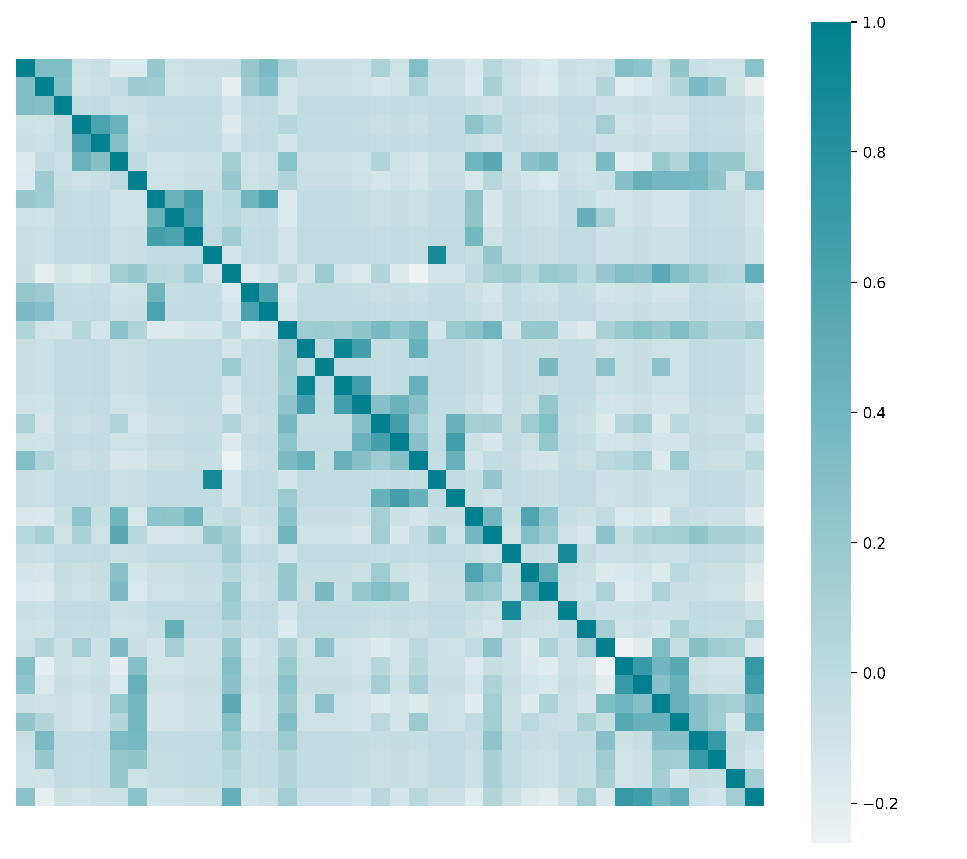
EXPLORATORY ANALYSIS
Feature correlation heatmap
Before training, main.py computes pairwise correlation across all symptom columns and renders it as a heatmap (feature_correlation.png) — surfacing symptoms that tend to co-occur within the same diagnosis.
Darker cells → stronger co-occurrence between two symptoms
Helps spot redundant or highly-related features
Purely exploratory — all 132 features are still used for training
DISEASE PREDICTION FROM SYMPTOMS
09

Slide 10
MODELLING
Four algorithms, one benchmark
N
D
R
G
Naive Bayes
Decision Tree
Random Forest
Gradient Boosting
MultinomialNB
criterion = entropy
n_estimators = 10
n_estimators = 150
Probabilistic baseline assuming conditional independence between symptoms.
A single interpretable tree that splits on the most informative symptoms first.
An ensemble of decision trees that votes to reduce overfitting.
Sequentially boosted trees (friedman_mse) that correct prior errors.
DISEASE PREDICTION FROM SYMPTOMS
10

Slide 11
CONFIGURATION
Training setup — config.yaml
Parameter | Value | Purpose
random_state | 101 | Reproducible splits and model initialization
validation_size | 0.33 | Share of training data held out for validation
decision_tree.criterion | entropy | Information-gain based splitting rule
random_forest.n_estimators | 10 | Number of trees in the forest ensemble
gradient_boost.n_estimators | 150 | Number of sequential boosting stages
gradient_boost.criterion | friedman_mse | Split quality measure for boosted trees
model_save_path | ./saved_model/ | Destination for the trained .joblib artifacts
DISEASE PREDICTION FROM SYMPTOMS
11

Slide 12
RESULTS
Model accuracy — validation vs. test
DISEASE PREDICTION FROM SYMPTOMS
12

Slide 13
RESULTS
Head-to-head scorecard
Model | Validation acc. | Test acc. | Notes
Naive Bayes | 100.0% | 100.0% | Strong baseline given largely independent symptom flags
Decision Tree | 100.0% | 100.0% | Perfectly separates classes; entropy-based splits
Random Forest | 100.0% | 97.6% | Slight variance from bootstrap sampling across 10 trees
Gradient Boosting | 100.0% | 97.6% | 150 boosting stages; marginal test-set misclassifications
Evaluated on the 42-row held-out test set (dataset/test_data.csv), covering all 41 disease classes; measured via accuracy_score after main.py's train_test_split (random_state = 101).
DISEASE PREDICTION FROM SYMPTOMS
13

Slide 14
LIVE INFERENCE
From symptoms to a prediction — infer.py
INPUT — symptom vector
OUTPUT — predicted disease
itching
= 1
⚕
Impetigo
skin_rash
= 1
Predicted by: Random Forest classifier
red_sore_around_nose
= 1
… 129 other symptoms set to 0
Matches the symptom combination in infer.py's sample input — skin_rash and red_sore_around_nose are hallmark signs of impetigo.
clf = load('saved_model/random_forest.joblib')
result = clf.predict(df_test)
Any of the four saved .joblib models can be swapped in for inference without retraining.
DISEASE PREDICTION FROM SYMPTOMS
14

Slide 15
TECHNOLOGY
Tech stack
Py
sk
pd
jb
Python 3
scikit-learn
pandas
joblib
Core language
Models, split & metrics
Data loading & wrangling
Model persistence (.joblib)
sn
jn
ym
cv
seaborn / matplotlib
Jupyter Notebook
PyYAML
conda
Correlation heatmap
Interactive demo.ipynb
config.yaml parsing
environment.yml reproducibility
DISEASE PREDICTION FROM SYMPTOMS
15

Slide 16
PROJECT LAYOUT
Repository structure
Disease-Prediction-from-Symptoms/
├─ dataset/
│ ├─ training_data.csv
│ └─ test_data.csv
├─ saved_model/
│ └─ *.joblib (4 trained models)
├─ notebook/
│ ├─ dataset/raw_data.xlsx
│ └─ ...checkpoint.ipynb
├─ main.py ─ train & save models
├─ infer.py ─ standalone inference
├─ demo.ipynb ─ interactive demo
├─ config.yaml ─ all parameters
└─ requirements.txt
•
main.py
Defines the DiseasePrediction class: loads data, trains, evaluates, and saves a chosen model.
•
infer.py
Loads a saved .joblib model and predicts on a hand-built symptom dictionary.
•
demo.ipynb
Jupyter-based interactive walkthrough for sharing or presenting the model.
•
config.yaml
Single source of truth for paths, split size, and every model's hyperparameters.
DISEASE PREDICTION FROM SYMPTOMS
16

Slide 17
USE CASES
Where this fits in practice
⌘
Self-triage assistant
⚖
Telemedicine intake
A quick first signal for patients deciding whether and where to seek care.
Pre-consultation symptom screening to route patients to the right specialist.
⚙
Clinical decision support
▦
Public-health monitoring
A secondary signal alongside a clinician's own assessment, not a replacement for it.
Aggregated symptom-trend signals across a population or region.
DISEASE PREDICTION FROM SYMPTOMS
17

Slide 18
HONEST ASSESSMENT
Limitations & risks
!
Small, synthetic-leaning dataset
132 curated symptom flags and only 42 test rows understate real-world symptom variability and noisiness.
!
Perfect scores are a caution sign
100% validation/test accuracy usually signals a clean, separable dataset rather than clinical-grade robustness.
!
Binary symptom encoding only
No severity, duration, or combination effects — real symptoms are rarely simple on/off flags.
!
Not a diagnostic device
Explicitly a demo; outputs must never substitute for professional medical evaluation.
DISEASE PREDICTION FROM SYMPTOMS
18

Slide 19
ROADMAP
Future enhancements
Larger, real-world datasets
Incorporate broader clinical data with symptom severity and demographics.
Confidence-scored predictions
Surface class probabilities, not just a single top prediction.
Deployable API / app
Wrap the saved models behind a REST API or mobile front end for real use.
Model explainability
Add SHAP / feature-importance views so predictions are interpretable.
Continuous evaluation
Track drift and retrain as new symptom-disease data becomes available.
DISEASE PREDICTION FROM SYMPTOMS
19

Slide 20
CONCLUSION
A solid foundation for symptom-based screening
Across four algorithms trained on 4,920 labeled cases spanning 41 diseases, all four topped 97% test accuracy, with Naive Bayes and Decision Tree scoring a clean 100% — showing that a well-structured symptom dataset can power fast, high-accuracy disease screening. The next step is scaling to messier, real-world data.
Thank you
Dhruv Patel (2505112070040) & Himanshu Kumar (2505112070042) · MCA, Division H, Parul University
20

