Slide 1

FutureScope : college prediction engine
Internet and Web Programming (BCSE404L)
Member 1 name – Dhruv pandey (21bce5560)
MEMBER 2 NAME – PRANSHU SHARMA (21BCE5003)
MEMBER 3 NAME – BAKLIWAL MANAV RUPESH (21BCE5375)

Slide 2
Software Technologies Used
Back-end:
Flask: Flask, renowned as Python's lightweight and versatile web framework, empowers developers with its simplicity and extensibility, facilitating the creation of robust and scalable web applications with ease.
Machine Learning Model : A machine learning model trained with knn (K Neigbors Classifier) making it a preferred choice for classification and regression tasks in data science. This Model uses dataset from Kaggle.
Front-end:
Html: HTML, the standard markup language for web pages, utilizes elements and tags to define structure and content, facilitating the creation of visually appealing and interactive online experiences.
CSS: CSS (Cascading Style Sheets) is the language used to style the presentation of HTML elements on web pages, allowing developers to control aspects such as layout, color, typography, and spacing, enhancing the visual appeal and usability of websites. Here we have used Bootstrap Framework for CSS,HTML.
JavaScript: JavaScript is a versatile programming language primarily used for adding interactivity and dynamic behavior to web pages. It enables developers to create interactive elements, manipulate the DOM (Document Object Model), handle events, and communicate with servers, enhancing the user experience and functionality of web applications. Here we have used JavaScript for Input Form Validation.

Slide 3
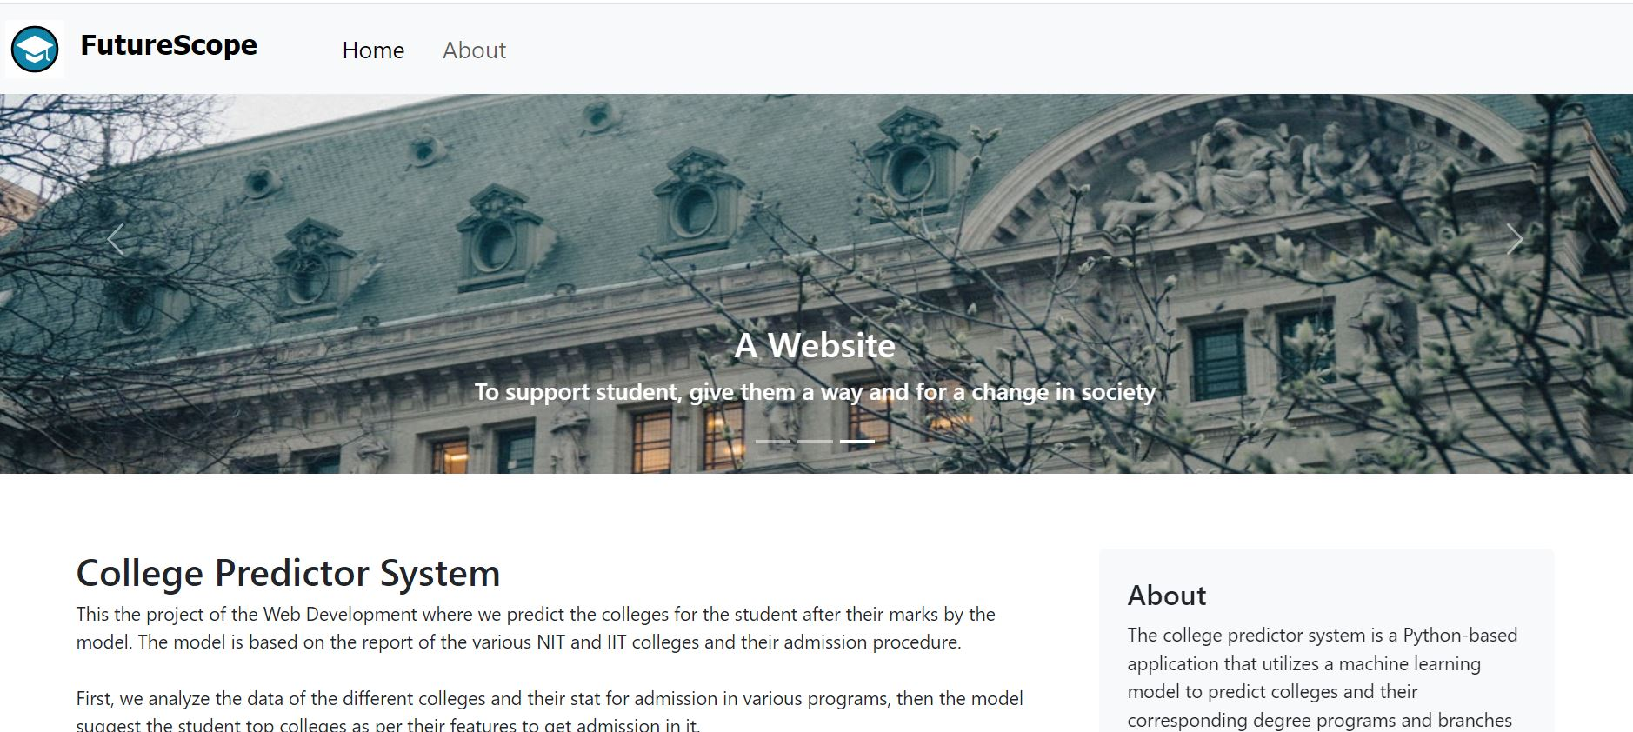
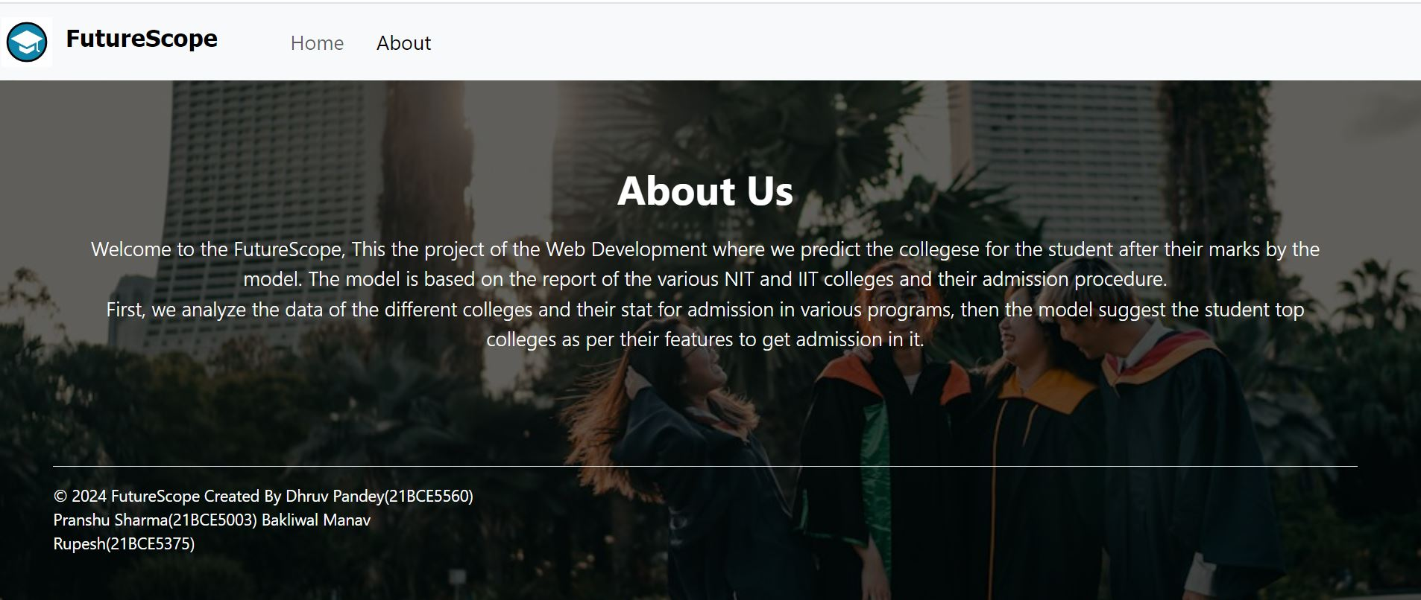
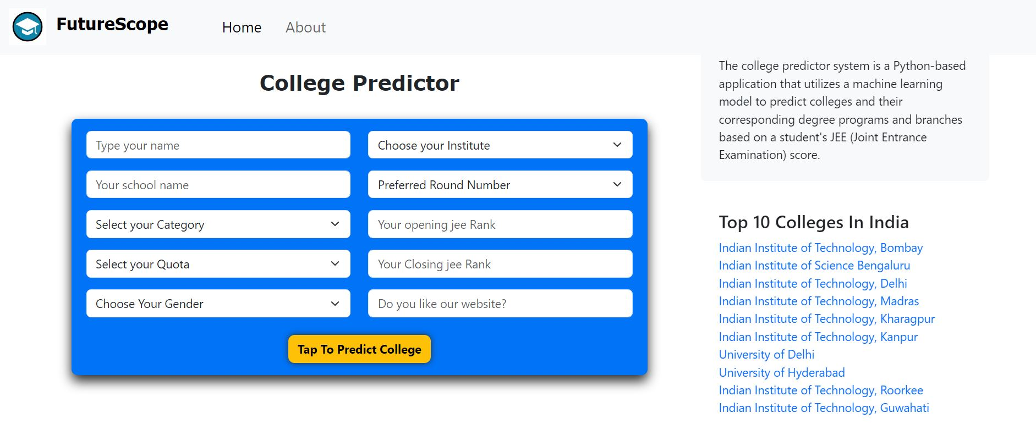
Overall Design

Slide 4
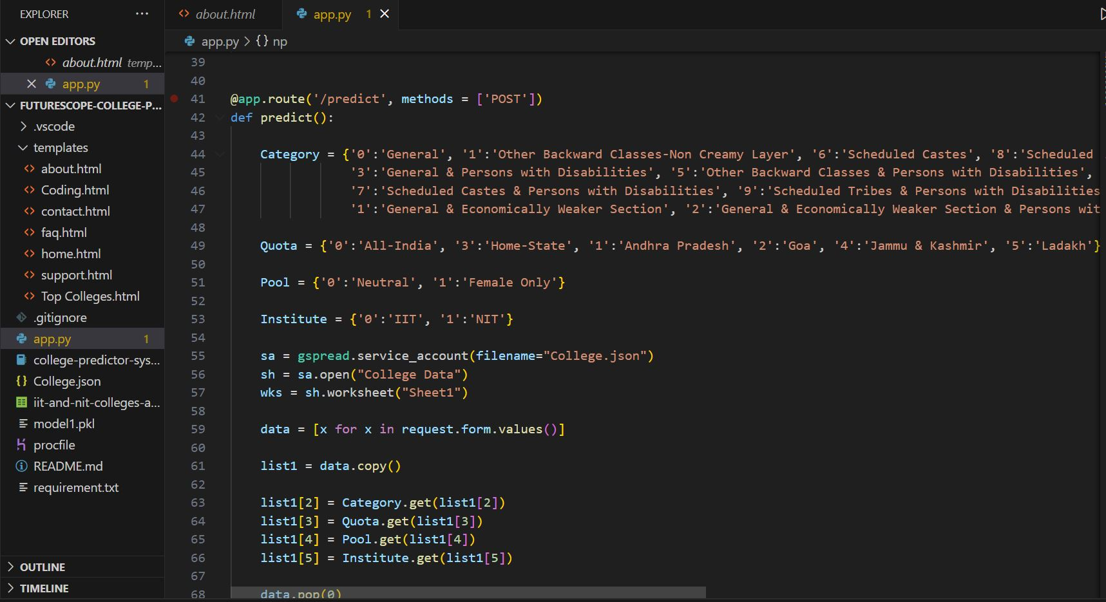
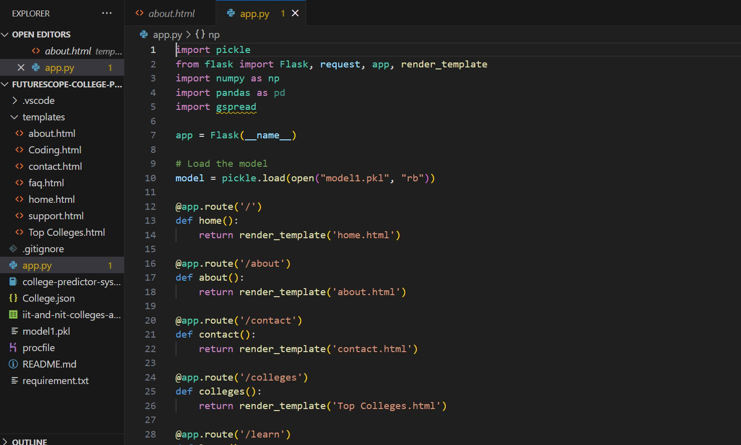
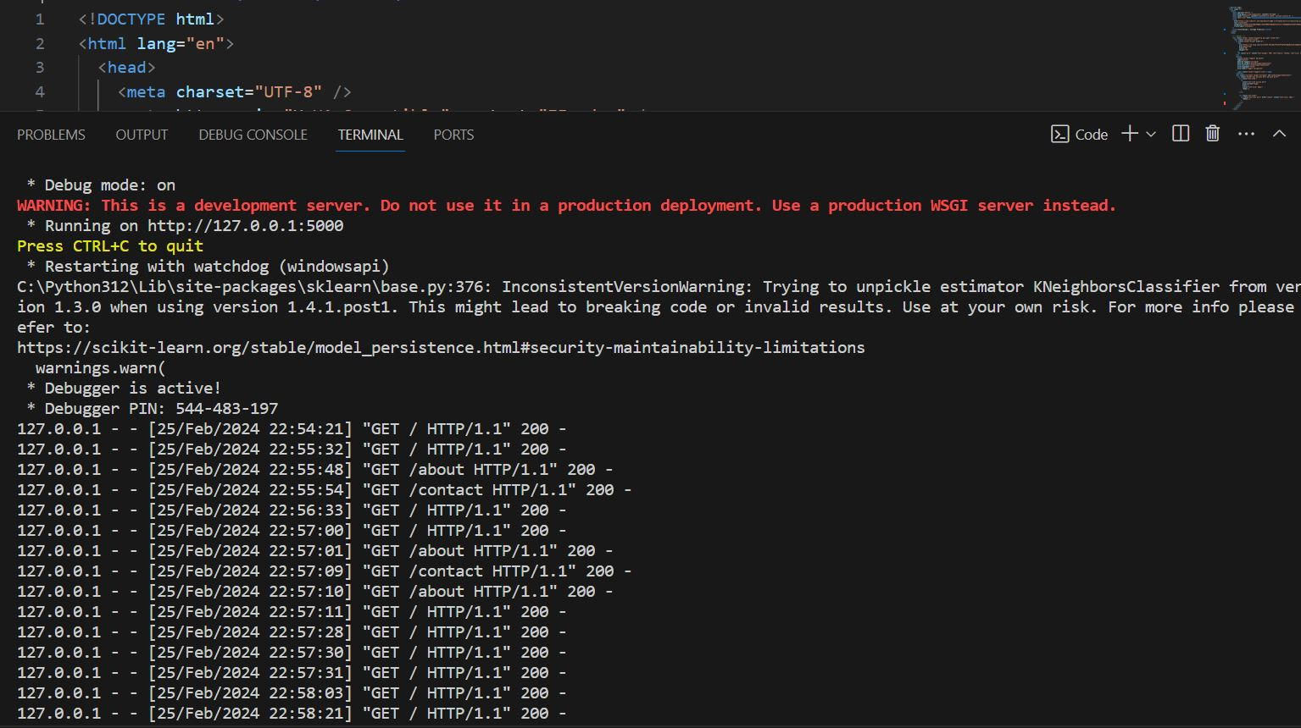
Overall Design (Code)

Slide 5
TEAM Contribution
Team leader & UI Developer: Dhruv Pandey: The frontend is built with basic HTML and CSS, where HTML defines content structure and CSS handles styling. Together, they create the visual representation of web pages. User input is sent to a trained ML model deployed on Flask, a lightweight web framework in Python.
Logic & Program Developer : Bakliwal Manav Rupesh : Data preprocessing involves identifying null values, selecting relevant features, and encoding labels in the dataset. Handling missing values often entails replacing them with the mean of the column values. Next, the dataset is split into training and testing sets to train machine learning models, which learn correlations in the training set and are evaluated for accuracy on the test set.
Tester & Document Writer : Pranshu Sharma : Contributed In Development and training of the ML model , Tested the project Evaluation entails testing the Frontend interface and the Flask-deployed ML model with diverse user-input parameters. This process assesses Frontend responsiveness and layout, ensuring a smooth user experience, while also scrutinizing the ML model's predictive accuracy and effectiveness in processing inputs and delivering meaningful outcomes.

Slide 6
Future Work
Dynamic Visualization: Incorporate dynamic data visualization tools to present predictions and insights in a more interactive and engaging manner, such as interactive charts, graphs, and dashboards.
Real-time Data Integration: Implement real-time data integration capabilities to continuously update the model with the latest placement data and student profiles, ensuring predictions remain accurate and relevant over time.
Integration with Career Resources: Integrate the web app with career resources such as job boards, resume builders, interview preparation tools, and networking platforms to offer a comprehensive suite of services to students aiming for placements.
Mobile Optimization: Ensure the web app is optimized for mobile devices to cater to the growing trend of mobile usage among students, enabling them to access placement predictions conveniently from their smartphones or tablets.

