Slide 1
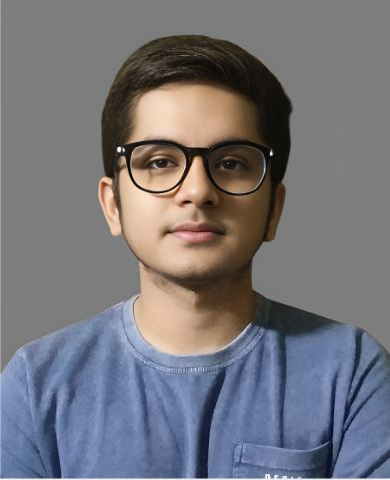
AICTE PROJECT SUBMISSION (IBM SkillsBuild) Front End Development : Clone Website/Application
Student Details
Name – Dhruv Pandey
SkillsBuild Email – dhruvpandey928@gmail.com
SkillsBuild Organization – DGT
College Name – Vellore Institute of Technology, Chennai
College State – Tamil Nadu
Internship Domain – Front End Development
Internship Start Date – 12/06/2023
Internship End Date – 24/07/2023

Slide 2

Netflix Clone Website
Netflix is an American subscription video on-demand over-the-top streaming service owned and operated by Netflix, Inc. The service primarily distributes films and television series produced by the media company of the same name from various genres, and it is available internationally in multiple languages

Slide 3
Project Agenda
Project Scope: The Netflix Clone project focuses on developing the Responsive front-end of the application, using HTML, CSS, and JavaScript frameworks.

Slide 4
Solution & Presentation
Development Approach: The Netflix Clone was developed using a combination of modern front-end technologies such as Front-end: React.js, HTML, CSS, JavaScript
User Interface Design: The application's user interface was designed to provide an intuitive and visually appealing experience, with a focus on easy navigation and seamless streaming.

Slide 5
Target Audience
End Users: The target audience for the Netflix Clone includes individuals who enjoy streaming movies and TV shows online. The application caters to various age groups and interests, making it suitable for a wide range of viewers.

Slide 6
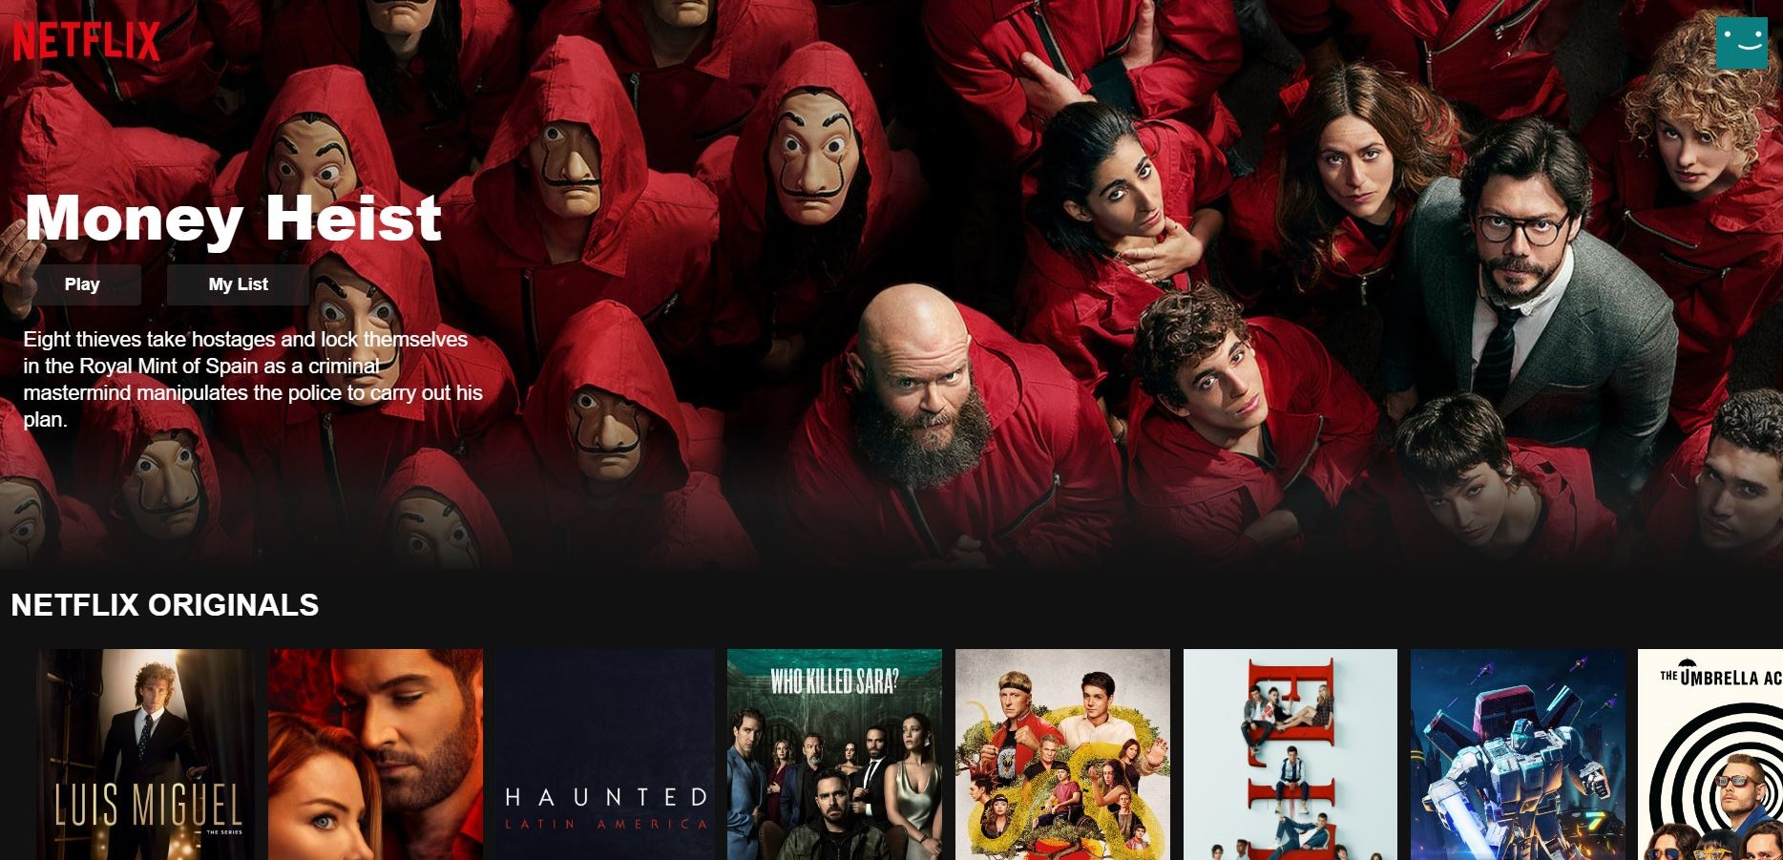
Demonstration

Slide 7
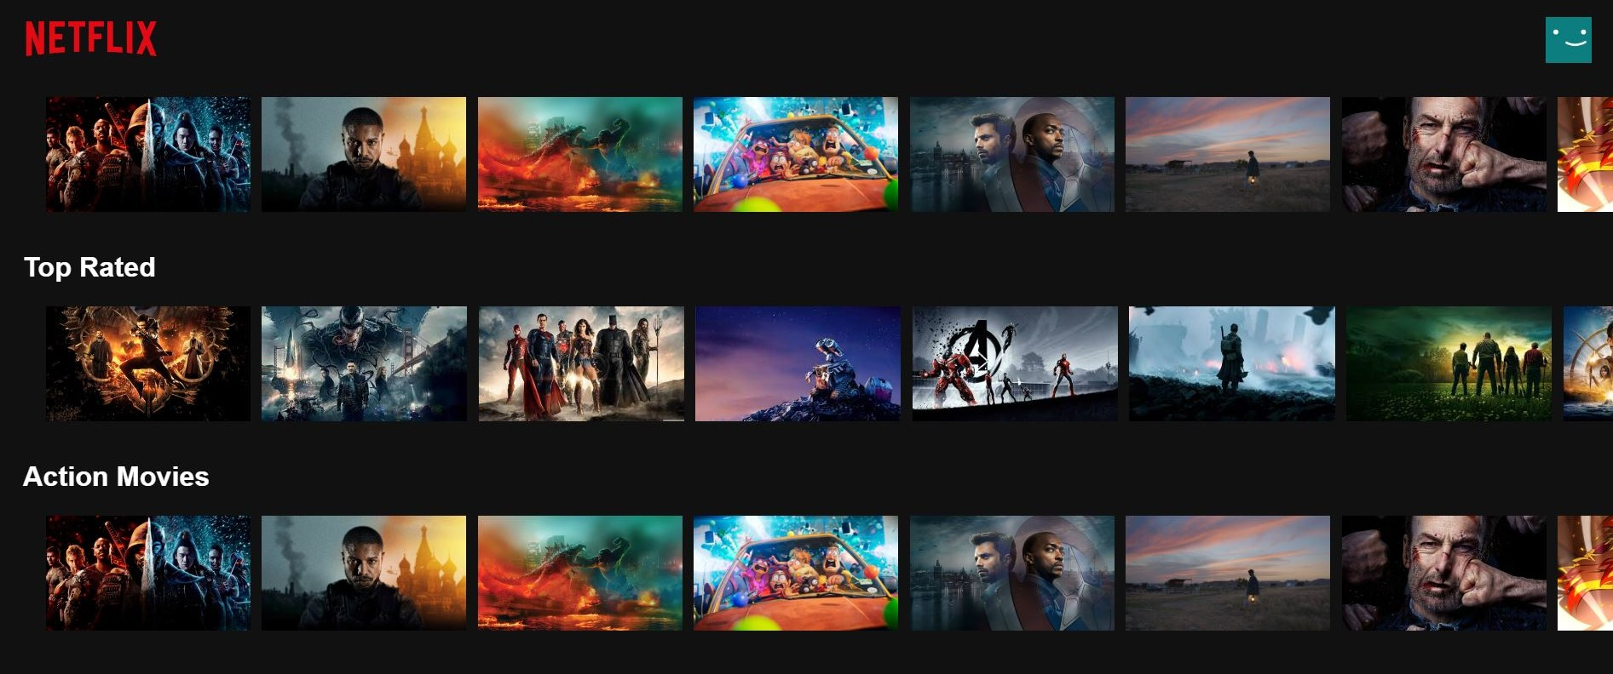
Demonstration

Slide 8
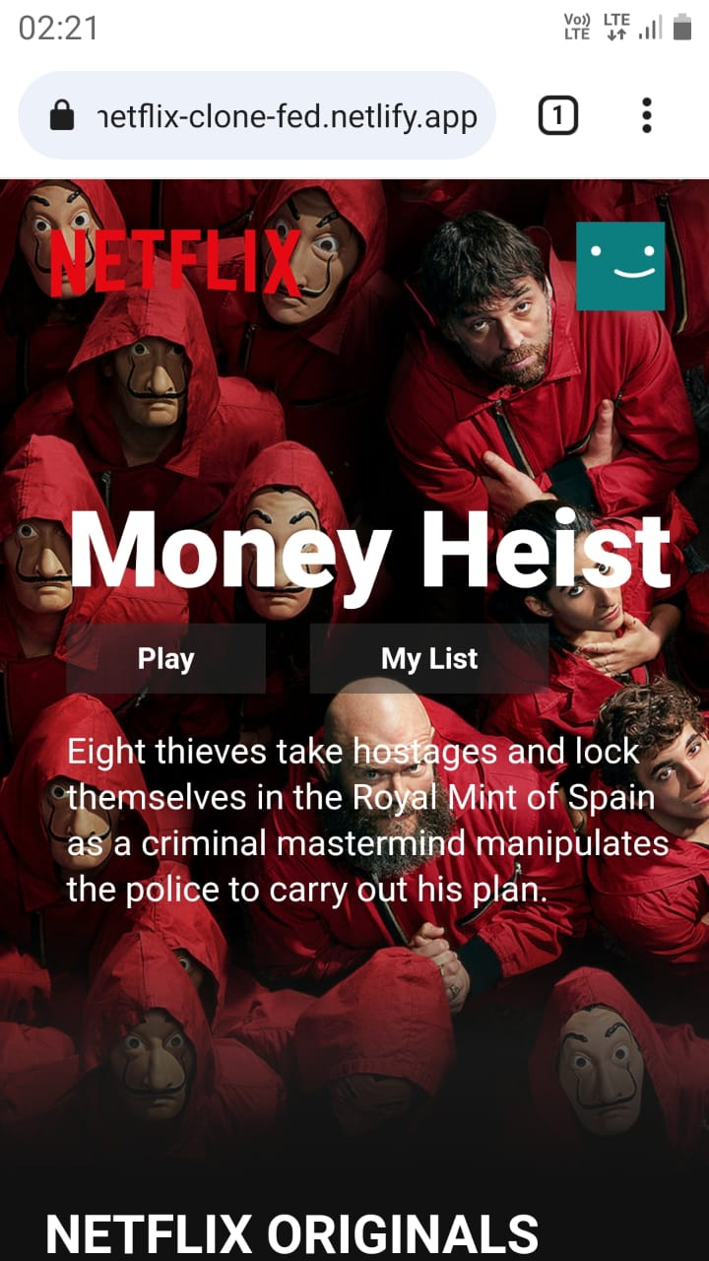
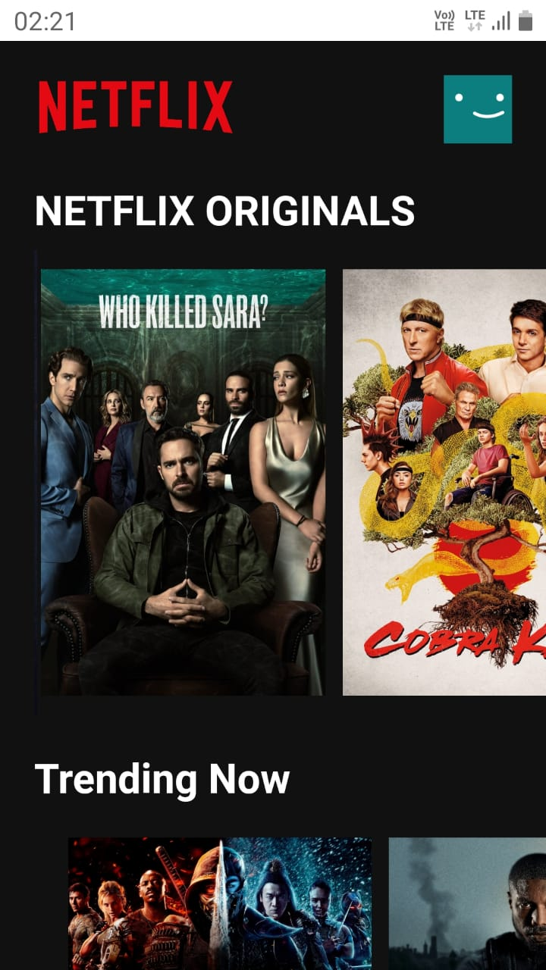
Demonstration – Mobile View

Slide 9
Result
This is my Front End Development project of Netflix Clone Website for IBM SkillsBuild Internship.You can Check out How it Works.
The Netflix Clone project successfully replicated the Front End design of Netflix, browsing, and streaming of movies and TV shows options and Thumbnails are present.
Learnings: During the development process, valuable insights were gained into front-end technologies, UI/UX design principles, and the challenges of working with Responsive Design for all types of Devices.
Future Plans: Future enhancements may include integrating a back-end server, implementing personalized recommendations, and expanding the database of available content.

Slide 10
Links
GitHub Link : https://github.com/Dhruvpandey08/Netflix-Clone
Live Link : https://netflix-clone-fed.netlify.app/

Slide 11
THANK YOU

