Slide 1
Loops
LOOP = block of code that is repeated a number of times
While value entered is > 0, add it to the sum.
Compute the sum of the first N positive integer numbers.
While loops
For loops

Slide 2
While loop
Update statement
while boolean condition:
instruction 1
instruction 2
…
update statement
// change boolean condition
instruction after loop
Instruction 1
Instruction 2
….
Boolean condition
True
False
Instruction after loop
….

Slide 3
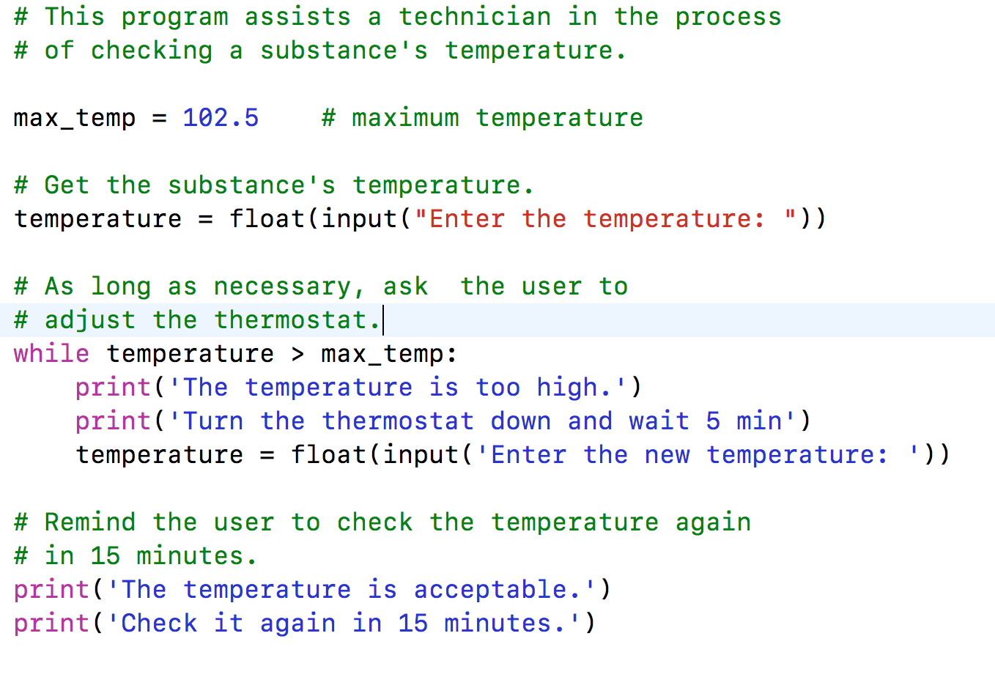
Example While loop
Update statement
temperature = input(…)
print(…)
print (….)
temperature > max_temp
True
False
Instruction after loop
….

Slide 4
Continue AND Break
continue inside of a loop ➔ jumps to the beginning of the loop (condition)
Skip remaining lines in the loop
break inside of a loop ➔ jumps to the first line after the loop
The program exits the loop immediately and continues first line after the loop
Use break and continue only if it improves the readability of your code

Slide 5
Break Example
Write a program that prints false if a string contains non-digit numbers and true otherwise.
User cases:
User enters: ‘1234’ -> Print True
User enters: ‘123ab’ -> Print False
Index 0 | 1 | 2 | 3 |
inp_str = | ‘1’ |’2’ | ‘3’ | ‘4’ |
inp_str = input(“Enter a number”) # read as a string

Slide 6
ConTINUE Example
Write a program that extracts the non-alpha characters from a string and prints the resulting string:
Use cases:
User enters: ‘john85’ program displays: ‘john’
User enters: ‘45 apples’ program displays ‘apples’
inp_str = input(“Enter a number”) # read as a string

Slide 7
Examples
Write a while loop that reads an integer value v_int from the keyboard until the value entered is 0.
User enters: 0 -> body while loop does not run condition is false the first time is evaluated
User enters: 1,2,3,0 -> while loop body runs three times, for values 1,2, and 3, then stops
# code
# before while loop
v_int = int(input(“Enter an int value, 0 to stop”))
while v_int == 0: #condition
# body - empty
# update statement
v_int = int(input(“Enter an int value, 0 to stop”))

Slide 8
Examples
Write a loop that reads an integer value v_int from the keyboard until the value is greater than 0. (execute the loop while v_int is less than 0)
User enters: 0 -> exits the loop
User enters: -1,0 -> run the loop once
User enters 2,3,0 -> exits the loop at 2.

Slide 9
Examples
Write a while loop that reads an integer value v_int from the keyboard until the value entered is between 0 and 10. (negate until to while the value entered is less than 0 or greater than 10)
Use cases:
User enters: 9 -> while stops
User enters: -1, 10 -> while stops
User enters: 20, 15, -1, 5 -> while stops
v_int = int(input(“Enter a value between 0 and 10”))
num_tries = 0
while v_int < 0 or v_int > 10: #condition
print(’Incorrect’)
if num_tries >= 3:
print(’Sorry no more tries’)
break
num_tries += 1
# update statement
v_int = int(input(“Enter a value between 0 and 10”))

Slide 10
Examples
Write a while loop that reads an integer value v_int from the keyboard until the value entered is even or it is 1.

Slide 11
Examples
Write a while loop that computes the sum of positive even numbers up to and including a max value entered by the user.

Slide 12
Examples
Write a while loop that computes the average of a series of integer values (vInt) entered by the user. The loop stops when user enters 0 or a negative number.
// Enter your code here
!!!Avoid dividing by 0
!!!Average is a real number, don’t cut the decimal part.

Slide 13
Examples
Write a loop that reads a character ch from the keyboard until that character is either 'q' or 'Q'.
// Enter your code here
Use De Morgan’s rule to write
the boolean condition:

Slide 14
For loop
Start statement
for var in [val1, val2, …]:
instruction 1
instruction 2
…
Instruction after loop
Instruction 1
Instruction 2
….
var in [ val1, val2, …]
True
False
Instruction after loop

Slide 15
For loop
Start statement
LIST data type
for var in [val1, val2, …]:
{
instruction 1
instruction 2
…
}
Instruction after loop
Instruction 1
Instruction 2
….
var in [ val1, val2, …]
True
What is different between for and while loops?
False
Instruction after loop

Slide 16
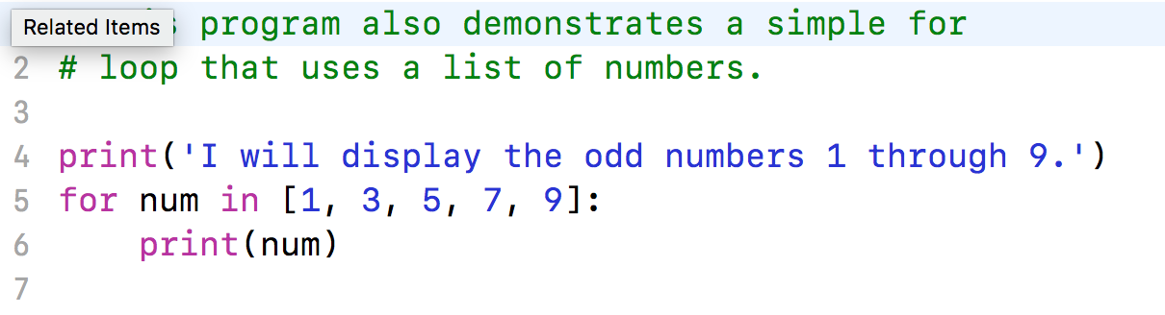
For loop – 1st iteration (repetition)
Start statement
num = 1
print (1)
1 in [1,3,5, 7,9]
True
False
Instruction after loop

Slide 17
For loop – 2nd iteration (repetition)
Start statement
num = 3
print (3)
3 in [1,3,5,7,9]
True
False
Instruction after loop

Slide 18
For loop – 3rd iteration (repetition)
Start statement
num = 5
print (5)
5 in [1,3,5,7,9]
True
False
Instruction after loop

Slide 19
For loop – 4th iteration (repetition)
Start statement
num = 7
print (7)
7 in [1,3,5,7,9]
True
False
Instruction after loop

Slide 20
For loop – 4th iteration (repetition)
Start statement
num = 9
print (9)
9 in [1,3,5,7,9]
True
False
Instruction after loop

Slide 21
For loop – end iteration
Start statement
end list of values
print (num)
num in [1,3,5,7,9]
True
False
Instruction after loop

Slide 22
Range function
How to generate a longer list of values without enumerating all values?
Examples:
List of all positive integers from 1 to the value stored variable last.
List of all positive integers from values in first and last.
List of all odd numbers from 1 to a value stored in last.

Slide 23
Range function
Optional
Default value = 1
range(starting_value, ending_value, [step] )
= generates a range of values from starting_value to (just less than) ending_value with an increment = step
Examples:
list(range(1,5)) → [1,2,3,4]
list(range(1,5,2)) → [1,3]
list(range(0,-5,-1) -> [0, -1, -2, -3, -4]
list(range(0, -5)) ?
list() = generates a list type [ …]

Slide 24
Range function
range(starting_value, ending_value, [step] )
Examples:
List of all positive integers from 1 to the value stored variable last.
range( , )
List of all positive integers from values in first and last.
range( , )
List of all odd numbers from 1 to a value stored in last.
range( , )

Slide 25
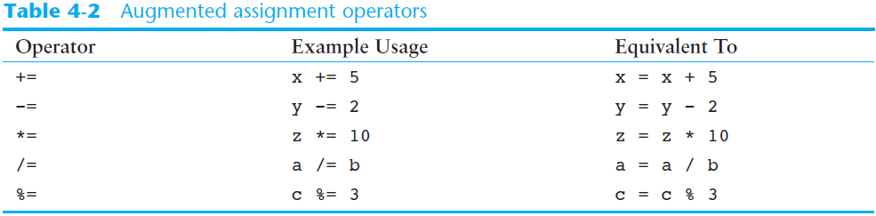
Augmented assignment operators

Slide 26
Observations
Use while loop when you don’t know how many times the loop will repeat.
If you know the number of times a loop will repeat, use for loop.

Slide 27
Examples
Write a for loop that adds all odd numbers from 1 to 51.
// Enter your code here
v += expr is equivalent with
v = v + expr
Write the loop without an if inside

Slide 28
Examples
Write a for loop that adds odd numbers and subtracts even ones (1 - 2+ 3- 4 +5 - ...), up to 100
// Enter your code here
Try not to use an if inside the loop

Slide 29
review
Know when to use while or for loops
continue inside of a loop ➔ jump to the beginning of the loop (condition)
break inside of a loop ➔ jumps to the first line after the loop
Use break and continue only if it improves the readability of your code
Avoid nesting of loops when possible
Use clear, positive (if possible) boolean conditions (no more than 2 connected with logical operator and or not)

