Slide 1
Week 3: While Loops

Slide 2
Outline
What are loops?
What are while loops?
When do we use while loops?

Slide 3
Loops
LOOP = block of code that repeats
While value entered is > 0, add it to the sum.
Compute the sum of the first N positive integer numbers.
While loops
For loops

Slide 4
Example Loops
Check if at least one character in a string is upper case letter:
For each character
If it is an upper-case letter exit the loop
Else go to the next character in the string
Ask repeatedly the user to enter an integer number between 1 and 6 until the user enters such a number.
Ask user to enter a value
While the value is not between 1 and 6
Ask the user to enter a new value

Slide 5
Example 1
Ask the user repeatedly to enter an integer value v_int from the keyboard until the value entered is 0.
User enters: 0
User enters: 1,2,3,0

Slide 6
Example 2
Ask the user repeatedly to enter an integer value v_int from the keyboard until the value entered is between 0 and 10.
Use cases:
User enters: 9
User enters: -1, 10
User enters: 20, 15, -1, 5

Slide 7
Example 3
Write a while loop that computes the sum of positive even numbers up to and including a max value entered by the user.
Max value = 10, Values entered 1,3,4, 5,6, -2, 7

Slide 8
Example 4
Write a while loop that computes the average of a series of integer values (vInt) entered by the user. The loop stops when user enters 0 or a negative number.
Use cases:
2, 3, 4,5 -1
4,7,0

Slide 9
Example 5
Write a loop that reads a character ch from the keyboard until that character is either 'q' or 'Q'.

Slide 10
While loop
Initialize vars in bool condition
Initialize vars in bool condition
while bool condition:
instruction 1
instruction 2
…
update statement
// change boolean condition
instruction after loop
Update statement
Instruction 1
Instruction 2
….
Boolean condition
True
False
Instruction after loop
….

Slide 11
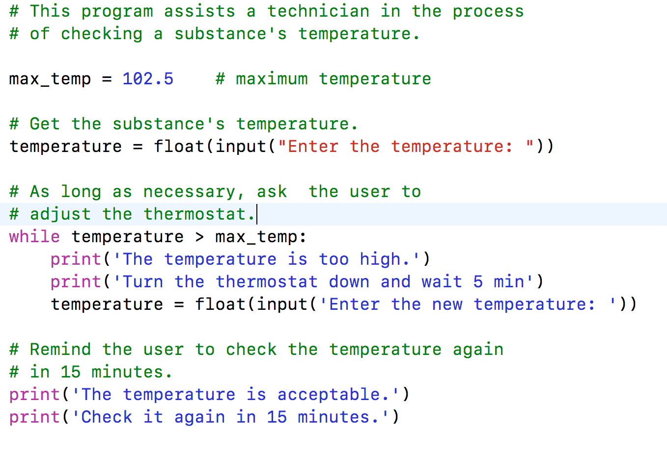
Example While loop
temp = 102.5
Update statement
temperature = input(…)
print(…)
print (….)
temperature > max_temp
True
False
Instruction after loop
….

Slide 12
Continue AND Break
continue inside of a loop ➔ jumps to the beginning of the loop (condition)
Skip remaining lines in the loop
break inside of a loop ➔ jumps to the first line after the loop
The program exits the loop immediately and continues first line after the loop
Use break and continue only if it improves the readability of your code

Slide 13
Break Example
Write a program that prints false if a string contains non-digit numbers and true otherwise.
User cases:
User enters: ‘1234’ -> Print True
User enters: ‘123ab’ -> Print False
Index 0 | 1 | 2 | 3 |
inp_str = | ‘1’ |’2’ | ‘3’ | ‘4’ |
inp_str = input(“Enter a number”) # read as a string

Slide 14
ConTINUE Example
Write a program that extracts the non-alpha characters from a string and prints the resulting string:
Use cases:
User enters: ‘john85’ program displays: ‘john’
User enters: ‘45 apples’ program displays ‘apples’
inp_str = input(“Enter a number”) # read as a string

Slide 15
Example 1
Write a while loop that reads an integer value v_int from the keyboard until the value entered is 0.
User enters: 0 -> body while loop does not run condition is false the first time is evaluated
User enters: 1,2,3,0 -> while loop body runs three times, for values 1,2, and 3, then stops
# code
# before while loop
v_int = int(input(“Enter an int value, 0 to stop”))
while v_int == 0: #condition
# body - empty
# update statement
v_int = int(input(“Enter an int value, 0 to stop”))

Slide 16
Example 2
Write a while loop that reads an integer value v_int from the keyboard until the value entered is between 0 and 10. (negate until to while the value entered is less than 0 or greater than 10)
Use cases:
User enters: 9 -> while stops
User enters: -1, 10 -> while stops
User enters: 20, 15, -1, 5 -> while stops
v_int = int(input(“Enter a value between 0 and 10”))
num_tries = 0
while v_int < 0 or v_int > 10: #condition
print(’Incorrect’)
if num_tries >= 3:
print(’Sorry no more tries’)
break
num_tries += 1
# update statement
v_int = int(input(“Enter a value between 0 and 10”))

Slide 17
Example 3
Write a while loop that computes the sum of positive even numbers up to and including a max value entered by the user.
Max value = 10, Values entered 1,3,4, 5,6, -2, 7

Slide 18
Example 4
Write a while loop that computes the average of a series of integer values (vInt) entered by the user. The loop stops when user enters 0 or a negative number.
Use cases:
2, 3, 4,5 -1
4,7,0
!!!Avoid dividing by 0
!!!Average is a real number, don’t cut the decimal part.
// Enter your code here

Slide 19
Example 5
Write a loop that reads a character ch from the keyboard until that character is either 'q' or 'Q'.
// Enter your code here
Use De Morgan’s rule to write
the boolean condition:

Slide 20
Outline
What are loops?
What are while loops?
When do we use while loops?

