Slide 1
Week 3: While Loops

Slide 2
Outline
What are loops?
What are while loops?
When do we use while loops?

Slide 3
Loops
LOOP = block of code that repeats
While value entered is > 0, add it to the sum.
Compute the sum of the first N positive integer numbers.
While loops
For loops

Slide 4
Example Loops
Check if at least one character in a string is upper case letter:
For each character
If it is an upper-case letter exit the loop
Else go to the next character in the string
Ask repeatedly the user to enter an integer number between 1 and 6 until the user enters such a number.
Ask user to enter a value
While the value is not between 1 and 6
Ask the user to enter a new value

Slide 5
Example 1
Ask the user repeatedly to enter an integer value v_int from the keyboard until the value entered is 0.
User enters: 0
User enters: 1,2,3,-2, 0
Read user value
While user value is different than 0
read user value
user_val = int(input())
while user_val != 0:
user_val = int(input())

Slide 6
Example 2
Ask the user repeatedly to enter an integer value v_int from the keyboard until the value entered is between 0 and 10.
Use cases:
User enters: 9
User enters: -1, 10
User enters: 20, 15, -1, 5
While user value is less than 0 and greater than 10
While user value is greater than or equal to 0 and less than or equal10
Ask user to enter user value
While user value is less than 0 or greater than 10
Ask user to enter a new value
user_val = int(input())
while user_val < 0 or user_val > 10:
user_val = int(input())

Slide 7
Example 3
Write a while loop that asks the user to enter a max value and then computes the sum of positive even numbers the user enters while the sum is less than the max value.
Max value = 10, Values entered 1,3,4, 5,6, STOP
1. 3 4 5
Sum = 0, Sum = 0, 0 4 4 12 STOP
Enter Max_value
Initialize sum_values to 0
While sum of user values less than max_value
Enter user_value
If user value is > 0 and even
Add it to sum user values
If sum values < max_value
Subtract user_value from sum_values
max_val = int(input())
sum_values = 0
while sum_values < max_val:
user_val = int(input())
if user_val > 0 and user_val % 2 == 0:
sum_values += user_val
if sum_values > max_val:
sum_values -= user_val

Slide 8
Example 4
Write a while loop that computes the average of a series of integer values (vInt) entered by the user. The loop stops when user enters 0 or a negative number.
Use cases:
2, 3, 4,5 -1
4,7,0

Slide 9
Example 5
Write a loop that reads a character ch from the keyboard until that character is either 'q' or 'Q'.

Slide 10
While loop
Initialize vars in bool condition
Initialize vars in bool condition
while bool condition:
instruction 1
instruction 2
…
update statement
// change boolean condition
instruction after loop
Update statement
Instruction 1
Instruction 2: break
Boolean condition
True
False
Instruction after loop
….

Slide 11
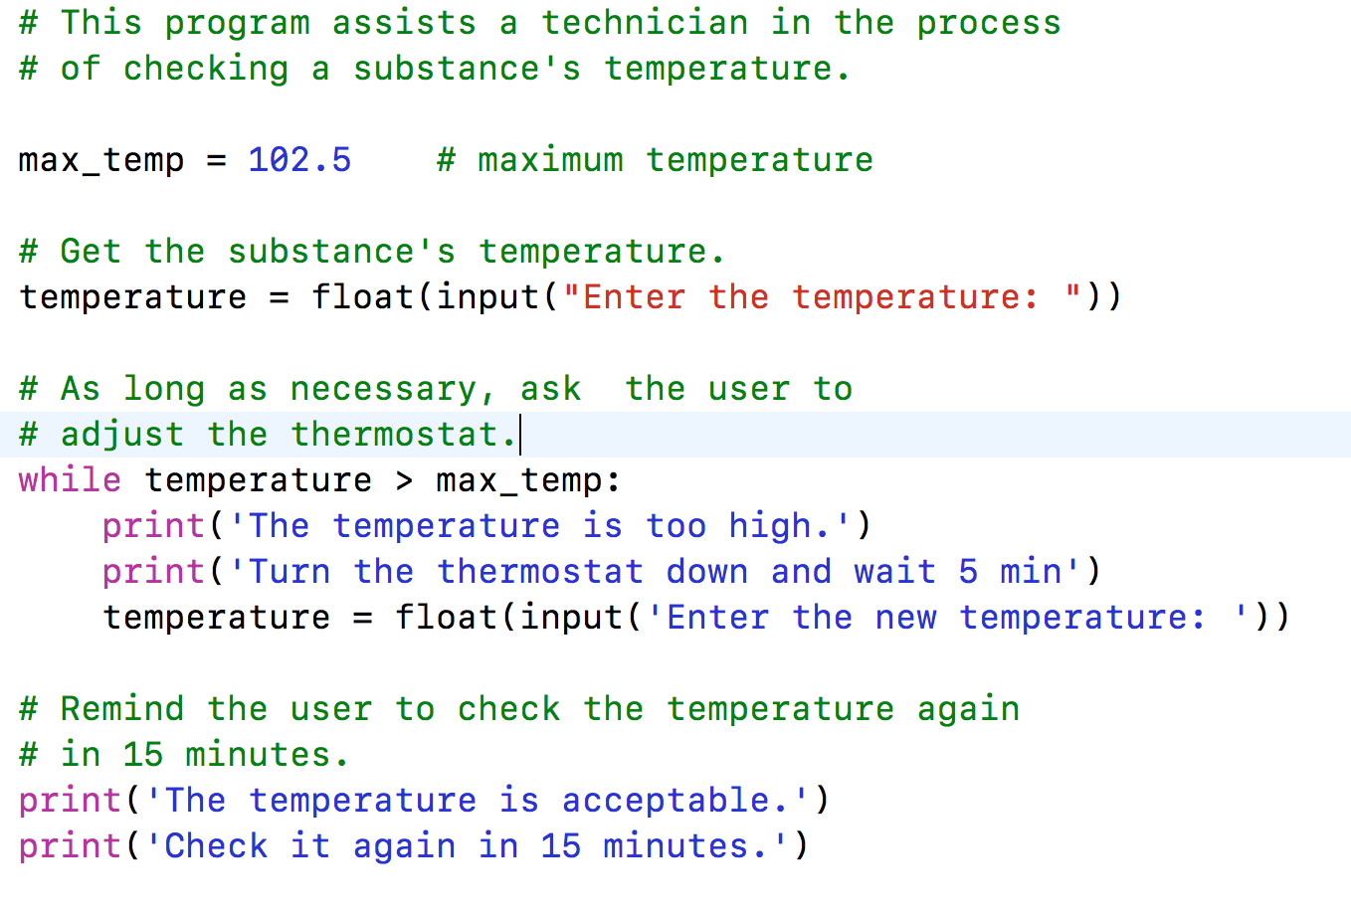
Example While loop
temp = 102.5
Update statement
temperature = input(…)
print(…)
print (….)
temperature > max_temp
True
False
Instruction after loop
….

Slide 12
Continue AND Break
continue inside of a loop ➔ jumps to the beginning of the loop (condition)
Skip remaining lines in the loop
break inside of a loop ➔ jumps to the first line after the loop
The program exits the loop immediately and continues first line after the loop
Use break and continue only if it improves the readability of your code

Slide 13
Break Example
Write a program that prints false if a string contains non-digit characters and true otherwise.
User cases:
User enters: ‘1234’ -> Print True
User enters: ‘123ab’ -> Print False
Index 0 | 1 | 2 | 3 |
inp_str = | ‘1’ |’2’ | ‘3’ | ‘4’ |
inp_str = input(“Enter a number”) # read as a string
is_valid = True # the string has only digits
Ind_ch = 0
while ind_ch < len(inp_str) and is_valid:
if inp_str[ind_ch] < ‘0’ or inp_str[ind_ch] > ’9’: # check if a character is not a digit
is_valid = False
break
ind_ch += 1
print(is_valid)

Slide 14
ConTINUE Example
Write a program that extracts (removes) the non-alpha characters from a string and prints the resulting string:
Use cases:
User enters: ‘john85’ program displays: ‘john’
User enters: ‘45 apples’ program displays ‘apples’
inp_str = input(“Enter a number”) # read as a string
filtered_str = “” # add all alpha characters
Ind_ch = 0
while ind_ch < len(str):
# if inp_str[ind_ch] is a lowercase or uppercase letter then add it to filtered_str
if ‘A’ <= inp_str[ind_ch] <= ‘Z’:
filtered_str += inp_str[ind_ch]
elif ‘a’ <= inp_str[ind_ch] <= ‘z’:
filtered_str += inp_str[ind_ch]
ind_ch += 1

Slide 15
Example 1
Write a while loop that reads an integer value v_int from the keyboard until the value entered is 0.
User enters: 0 -> body while loop does not run condition is false the first time is evaluated
User enters: 1,2,3,0 -> while loop body runs three times, for values 1,2, and 3, then stops
# code
# before while loop
v_int = int(input(“Enter an int value, 0 to stop”))
while v_int == 0: #condition
# body - empty
# update statement
v_int = int(input(“Enter an int value, 0 to stop”))

Slide 16
Example 2
Write a while loop that reads an integer value v_int from the keyboard until the value entered is between 0 and 10. (negate until to while the value entered is less than 0 or greater than 10)
Use cases:
User enters: 9 -> while stops
User enters: -1, 10 -> while stops
User enters: 20, 15, -1, 5 -> while stops
v_int = int(input(“Enter a value between 0 and 10”))
num_tries = 0
while v_int < 0 or v_int > 10: #condition
print(’Incorrect’)
if num_tries >= 3:
print(’Sorry no more tries’)
break
num_tries += 1
# update statement
v_int = int(input(“Enter a value between 0 and 10”))

Slide 17
Example 3
Write a while loop that computes the sum of positive even numbers up to and including a max value entered by the user.
Max value = 10, Values entered 1,3,4, 5,6, -2, 7

Slide 18
Example 4
Write a while loop that computes the average of a series of integer values (vInt) entered by the user. The loop stops when user enters 0 or a negative number.
Use cases:
2, 3, 4,5 -1
4,7,0
!!!Avoid dividing by 0
!!!Average is a real number, don’t cut the decimal part.
// Enter your code here

Slide 19
Example 5
Write a loop that reads a character ch from the keyboard until that character is either 'q' or 'Q'.
// Enter your code here
Use De Morgan’s rule to write
the boolean condition:

Slide 20
Outline
What are loops?
What are while loops?
When do we use while loops?

