Slide 1
Week 7 – Functions Part 1

Slide 2
Outline
What are function?
What is a function definition?
What is a function call?
What is the main function?
Functions without input parameters
Functions without return

Slide 3
What are Functions ?
What is a function:
A block of code with a name + input parameters + return value
Implements a clear task.
Called frequently with different inputs.

Slide 4
What is a Function definition ?
Function definition
The code that implements the task of the function.
Input parameters
def function_name(param1, param2, …):
# code of the function
return var1, var2, …
Name + Function code
Return value

Slide 5
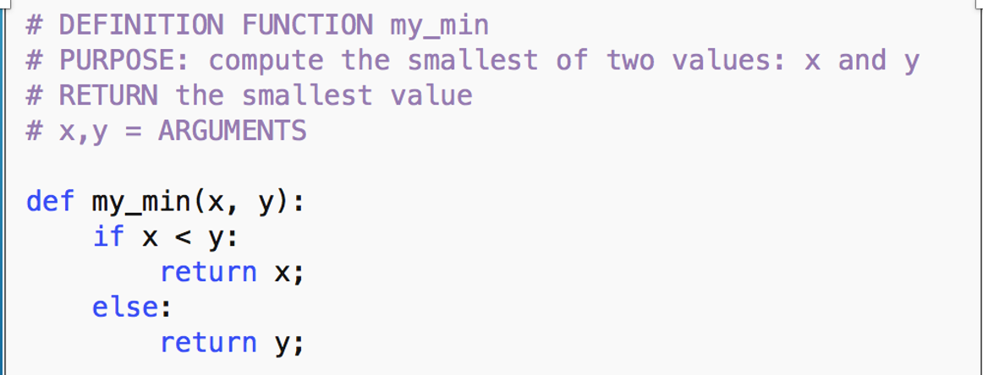
Example function definition

Slide 6
FUNCtion DEFINITION:
Specifies:
Function name
Input parameters
Function body (code)
Return value
NO CODE IS EXECUTED
x,y = input
parameters
Function name
def my_min( x, y):
// FUNCTION BODY
if (x < y)
return x;
else
return y; // return statement
Return value
if x < y
Return value
if x >= y

Slide 7
Examples of Function definitions
Find the max value in a list.
Find the number of vowels in a string of characters
def max_lst(lst): # input param = a list
max_val = lst[0]
for i in range(1,len(lst)):
if max_val < lst[i]:
max_val = lst[i]
return max_val
Input parameters
Name + Function code
Return value
def num_vowels(str):
count_vowels = 0
for c in str:
if is_vowel(c):
count_vowels += 1
return count_vowels
def is_vowel(ch):
# input param = character
# vowel ‘a’,’e’,‘i’,’o’,’u’,’y’
result = False
if ch.lower() in “aeiouy”:
result = True
return result

Slide 8
Examples of function Definitions
Is an integer number even?
Display a rectangle of a certain size and character filling.
Input parameters
def is_even(num):
if num % 2 == 0:
return True
else:
return False
Name + Function code
Return value
def draw_rectangle(size, char = ’*’):
for row in range(size):
for col in range(size):
print(char, end = ‘’)
print()
# no return needed for this function
Default value (use this value if none given

Slide 9
Examples of python functions you used
len(str) or len(lst)
print()
range()
random.randomint()
math.sqrt()
int(3.45)
input()
Did you write the function definition for these functions?
What did you do?
You called functions already defined in Python library

Slide 10
What is a function call?
A line of code:
var_return = function_name(value1, value2, …)
OR
function_name(value1, value2, …)
Examples:
str = “ABCDE”
len_str = len(str)
print(“the length is”, len_str)

Slide 11
Example function call
grade1 = float(input(”Enter the first grade”)
grade2 = float(input(“Enter the second grade”)
# Function call
min_grade = my_min(grade1,grade2)
print(“the smallest grade is”, min_grade)

Slide 12
WHAT is a FUNCtion Call?
Name of the function
Arguments => values for each input parameter
Store the return value in a variable.
x = grade1 val
y = grade2 val
Return value is stored in smaller var
arguments
#function definition
def my_min( x, y):
// FUNCTION BODY
if (x < y)
return x;
else
return y
smaller = my_min(grade1,grade2);
Return value is returned to the funct ion call

Slide 13
Examples of Function definitions
Find the max value in a list.
Find the number of vowels in a string of characters
#max_lst function call
my_lst = [1,5,8,3,2]
max_value = max_lst(my_lst)
print(max_value)
========================
8
def max_lst(lst):
max_val = lst[0]
return max_val
#num_vowels function call
s = input()
nr_vow = num_vowels(s)
print(nr_vow)
=========================
“Monday”
3
def num_vowels(str):
count_vowels = 0
return count_vowels

Slide 14
Examples of function Calls
#is_even function call
num = int(input())
if is_even(num):
print(‘Even’)
else:
print(‘Odd)
=========================
10
Even
Is an integer number even?
Display a rectangle of a certain size and character filling.
def is_even(num):
return
#draw_rectangle function call
draw_rectangle(3)
=========================
***
***
***
def draw_rectangle(size, char = ’*’):
# no return needed for this function
Default value

Slide 15
Review Questions
What is the purpose of a function definition?
What is the the purpose of a function call?
What is the relationship between a function call and a function definition?
What are input parameters?
What are arguments?
What is the difference between them?

Slide 16
Main = Special function
In other programming languages main function contains the executable code
In Python, the interpreter executes any line of code – outside a function.

Slide 17
Example using Main – the code inside main is executed
# function definition
def rectangle(rows, cols, char):
for r in range(cols):
for c in range(rows):
print(char, end = ‘’)
print()
if __name__ == ‘__main__’:
print(’this is the part that is executed’)
rectangle(5,3)

Slide 18
Functions without input parameters
A function that displays a message:
def welcome_message():
print(“Welcome to my game”)

Slide 19
Functions without return values
Called void functions
draw_rectangle function is a void function
welcome_message function is a void function

