Slide 1
Week 7 – Functions Part 2

Slide 2
Outline
What is the scope of a variable?
What are local variables?
What is a global variables?
When to use or not to use a global variable
Pass by value immutable parameters to a function.
Pass by reference mutable parameters to a function.

Slide 3
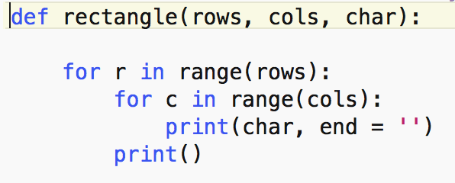
Local Variables
Variables inside a function:
Input parameters.
Variables defined inside a function.
Local variables:
Can be used only inside the function
Are only known inside the function.

Slide 4
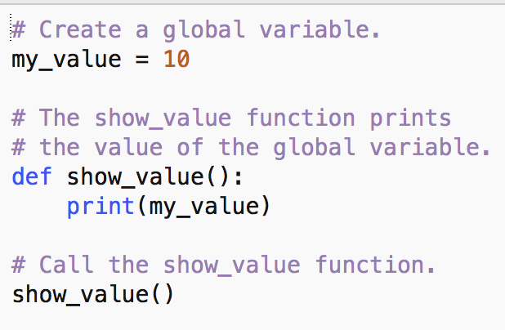
Global Variables
Variables defined outside any function.
Global variables:
Are known everywhere: inside and outside any function.
Can be accessed anywhere.

Slide 5
Global vs. Local Variables
More examples at https://www.geeksforgeeks.org/global-local-variables-python/
The word global inside a function – use it only if you want to change the value of a global variable.
my_value = 10
def fct():
global my_value
my_value = 20
print(my_value)
if __name__ == ‘main’:
print(my_value)
fct()
print(my_value)
my_value = 10
def fct():
my_value = 20
print(my_value)
if __name__ == ‘main’:
print(my_value)
fct()
print(my_value)

Slide 6
Global vs. Local Variables
my_value is the global variable
my_value is a local variable with same name as global variable
my_value = 10
def fct():
global my_value
my_value = 20
print(my_value)
if __name__ == ‘main’:
print(my_value)
fct()
print(my_value)
my_value = 10
def fct():
my_value = 20
print(my_value)
if __name__ == ‘main’:
print(my_value)
fct()
print(my_value)
10
20
20
Before function call
10
20
10
Inside function
After function call

Slide 7
When to use or not global variables
Use global variables only for data that does not change during the program’s execution
Ex: max_size_class, pi, etc.

Slide 8
Input pARAMETERS in PYTHOn
Immutable object types:
Int, float, bool, string, tuples
The function gets a copy of their value (passing by value)
Changes done inside a function remain local to the function
Mutable object types:
List, dictionaries, sets
Pass to the function a reference to the object (pass by reference)
Changes done inside a function change the ‘original’ objects.

Slide 9
ImMutable Parameters: Pass by value
def f(i_local,j_local):
temp = i_local
i_local = j_local
j_local = temp
print(i_local, j_local)
if __name__ == '__main__':
i_main = 5
j_main = 3
print('Before fct call', i_main, j_main)
f(i_main,j_main)
print('After fct call', i_main, j_main)

Slide 10
IMMutable Parameters: Pass by value
def f(i_local,j_local):
temp = i_local
i_local = j_local
j_local = temp
print(“Inside fct’, i_local, j_local)
if __name__ == '__main__':
i_main = 5
j_main = 3
print('Before fct call', i_main, j_main)
f(i_main,j_main)
print('After fct call', i_main, j_main)
Before fct call 5, 3
Inside fct 3,5
After fct call 5, 3

Slide 11
Mutable Parameters: pass by reference
def f(lst_local):
print("\t Inside f(): id(lst_local) = ", id(lst_local))
lst_local[0] = 2
print('\tInside fct:', lst_local)
if __name__ == '__main__':
lst_main = [1,2,3]
print('Before fct call',lst_main)
f(lst_main) # function call
print('After fct call', lst_main)
Before fct call [1,2,3]
Inside fct [2,2,3
After fct call [2,2,3]

Slide 12
Good functions to Know
locals() – shows all local variables in a block of code
globals() – shows all global variables in a block of code
id(var_name) = the id of an object with var_name

