Slide 1
Introduction to Python

Slide 2
Topics
What is Python?
What is a high-level language?
What is a program?
What is programming?
What is an algorithm?
What is pseudo-code?

Slide 3
What is Python?
A high-level programming language.
A programming language is a set of computer commands (instructions, statements) and rules.

Slide 4
High-Level Languages
Low-level language: close in nature to machine language
Example: assembly language
High-Level language: commands and syntax is closer to natural language
More intuitive to write programs and to understand
Examples of high-level programming languages: Ptyhon, Java, C++

Slide 5
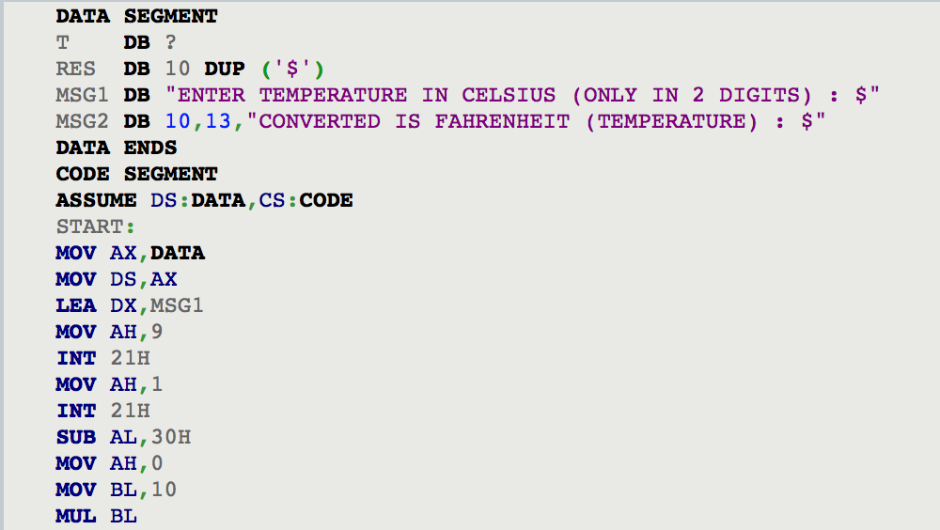
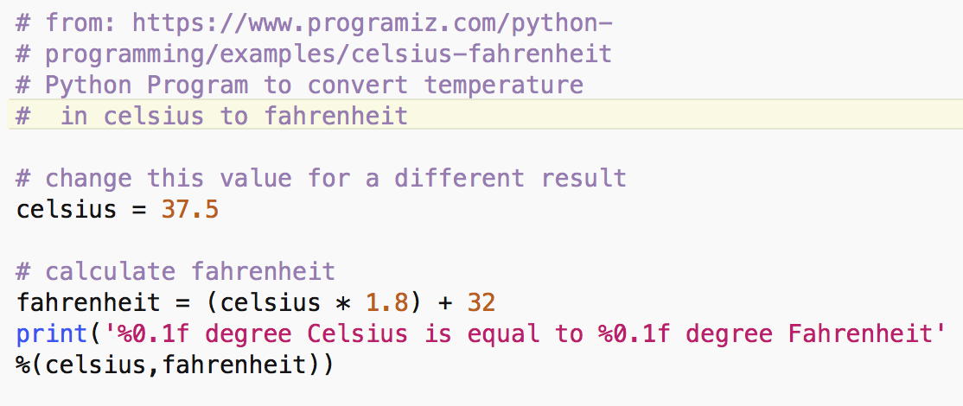
Assembly code- just a third of the whole program
Python language - same functionality

Slide 6
What is a program?
A sequence of computer commands
Add two numbers
Repeat 10 times s = s + 1
Repeat until a stop character is introduced
If stock prices today are higher than yesterday display ‘happy’
And data:
Integers: 10, -5,
Real: 3.46, 0.3,
Boolean: True, Falsse
Strings: ‘c’, ‘CSC15’

Slide 7
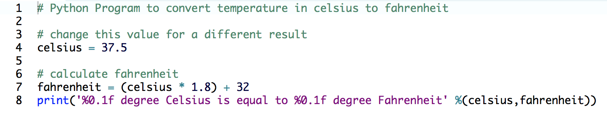
Sample Python program
From: https://www.programiz.com/python-programming/examples
Comment each line
Line 1,3, 6
Line 4
Line 7
Line 8

Slide 8
What is programming?
Step 1: Problem description
Identify inputs and outputs.
Use cases: Choose a few input values and identify the output values
Main processing steps.
Step 2: Design an algorithm that process any inputs and produces the correct output.
Step 3: Implement the algorithm in a programming language.

Slide 9
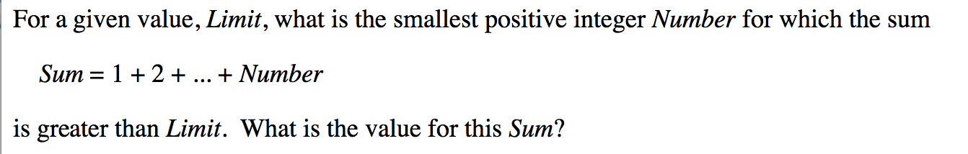
Example Problem

Slide 10
Step 1
What are the inputs to the program?
What are the outputs?
Use cases:
Main steps (how to get from inputs to outputs)

Slide 11
Step 2: Designing the algorithm
Determine the steps that must be taken to perform the task
Break down required task into a series of steps
Create an algorithm, listing logical steps that must be taken
Algorithm: set of well-defined logical steps that must be taken to perform a task

Slide 12
How to write an algorithm?
Pseudocode:
A sequence of steps that your program should do
Informal language that has no syntax rule
Can be translated easily into actual code in any programming language
Flowchart:
diagram that graphically depicts the steps in a program:

Slide 13
Pseudo-code
List of steps your program needs to do

Slide 14
Step 3: Python Program for the Sum problem
List of instructions

Slide 15
Topics
What is Python?
What is a high-level language?
What is a program?
What is programming?
What is an algorithm?
What is pseudo-code?

Slide 16
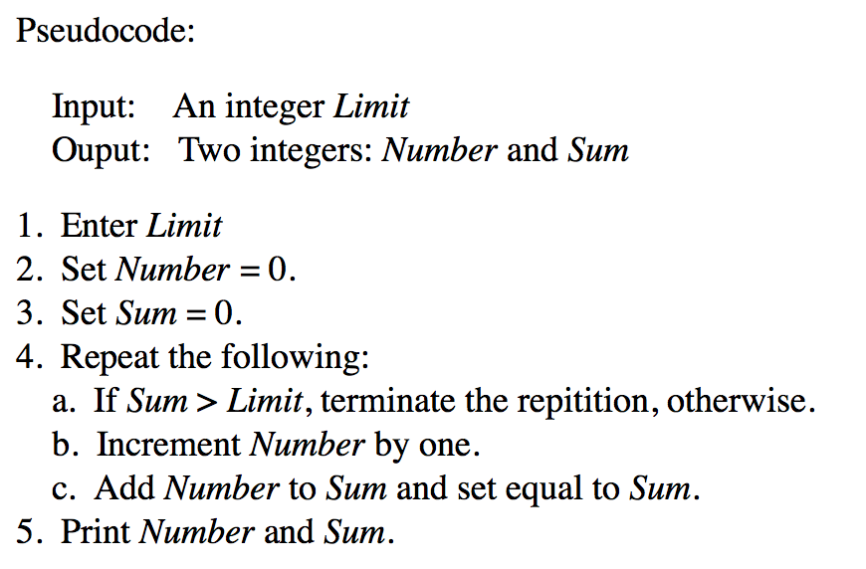
Pseudo-code

Slide 17
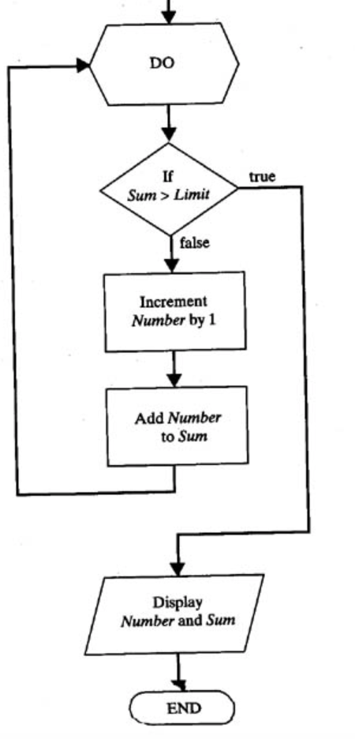
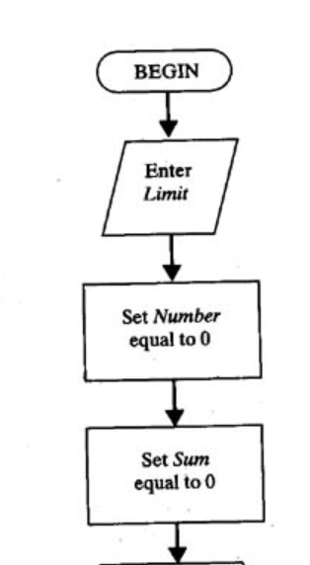
Flowchart for the sum example

