Slide 1
Supermarket Management System
Architecture, Data Design, and Flow

Slide 2
Project Overview
Full-stack supermarket management: products, sales, inventory, purchasing
Backend: FastAPI + PostgreSQL (SQLAlchemy engine)
Frontend: React (Vite) with dashboards and CRUD pages
Authentication, notifications, and analytic reports

Slide 3
Tech Stack
Backend: FastAPI, SQLAlchemy, Psycopg2, Uvicorn
Frontend: React, Vite, CSS
DB: PostgreSQL
Auth: bcrypt (password hashing)

Slide 4
Key Features
Product & Category management
Sales with line items and payment methods
Inventory updates and low-stock notifications
Purchase orders and receiving
Dashboards and analytical reports

Slide 5
Data Model Highlights
Products link to Categories and Suppliers via FKs
Sales header with child SaleItems; totals aggregated
Customers optional on Sales; Employees required
PurchaseOrders with items; receiving updates stock
Notifications reference Products for low-stock/events

Slide 6
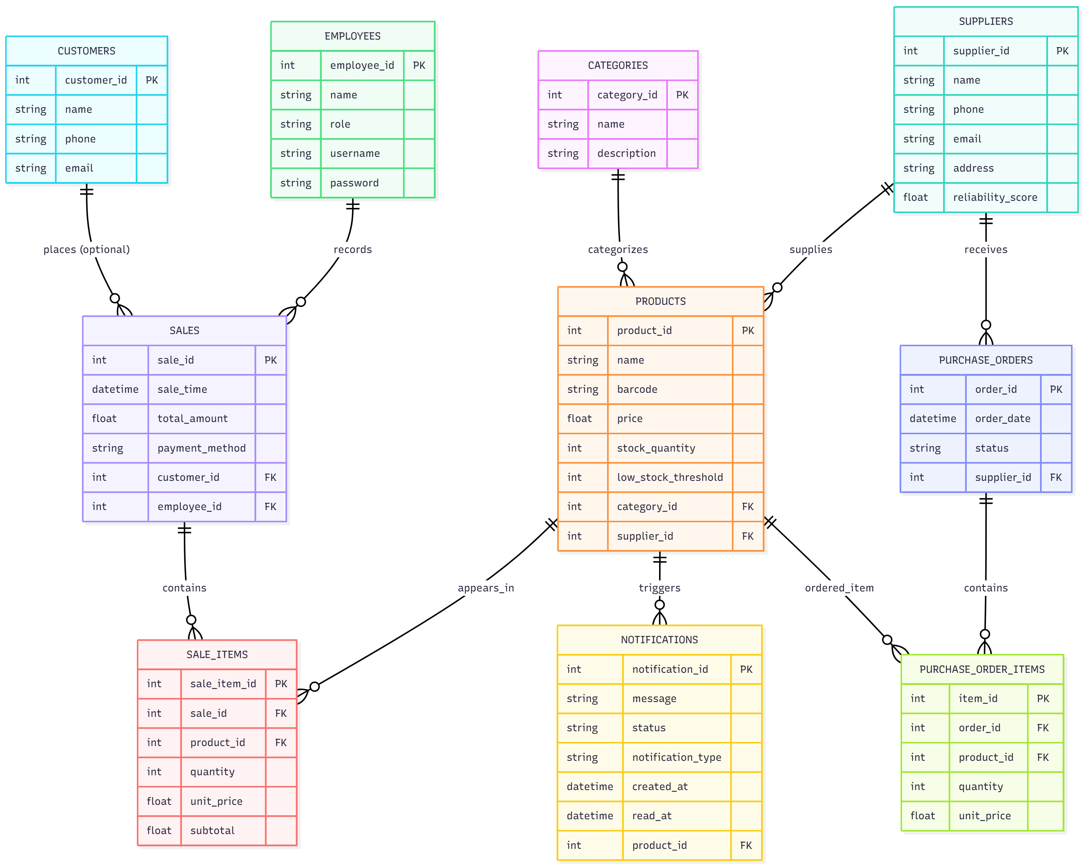
ER Diagram

Slide 7
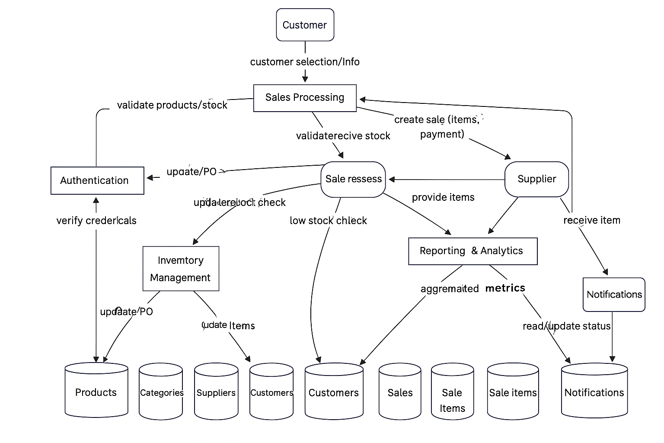
DFD 1

Slide 8
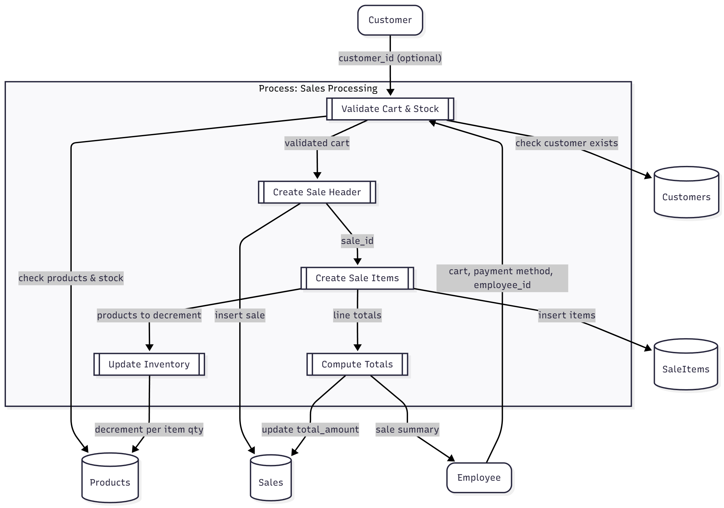
DFD 2

Slide 9
Core API Endpoints
/api/products, /api/categories, /api/suppliers
/api/sales (+ sale_items), /api/customers, /api/employees
/api/purchase-orders (+ items, receive)
/api/notifications (list/update)
/api/reports/* (sales-by-date, category-sales, top-products, all-time-analysis)

Slide 10
Run & Deploy
Backend: uvicorn api_server:app --reload
Frontend: cd frontend && npm run dev (Vite)
Production: Uvicorn behind reverse proxy; Vite build for static assets

