Slide 1

Adaptive On-Ramp Merging
Strategy under Imperfect Communication Performance
A Communication-Aware Approach to Autonomous Vehicle Control Experimental Implementation & Agent Comparison
Team Members
Dhruv Sandilya (231CS122) Dev Prajapati(231CS120)
Vrishank S Honnavalli (231CS165) Advaith Nair (231CS205)

Slide 2
The Merging Challenge
Chapter I: Setting the Scene
High-Risk Scenario
On-ramp merging zones represent critical traffic bottlenecks and are prone to accidents, demanding precise control and coordination.
V2V Communication Reliance
Current cooperative merging systems depend heavily on Vehicle-to-Vehicle (V2V) communication for sharing essential state data (position, speed, intention).
Real-World Imperfection
Communication channels are inherently unreliable, featuring realistic challenges such as signal delay and packet loss.

Slide 3



The Unaddressed Research Gap
Identifying the Problem
Existing autonomous merging models typically assume an ideal, flawless communication network, leading to potentially dangerous or inefficient control decisions when deployed in realistic settings.
Flawed Assumptions
Most existing control models operate under the assumption of perfect, real-time communication between vehicles.
Ignoring Reliability
There is a lack of strategies that explicitly quantify and adjust for varying communication quality during the manoeuvre.
Core Objective
The primary objective is to build an adaptive merging controller that dynamically accounts for communication performance metrics.

Slide 4








Key Contribution of the Paper
To test the paper's thesis, we are running a "tournament" at 4 junctions to see which control strategy wins.
Agent 1: E-AoI+DDPG
Agent 2: Vanilla DDPG
This agent is "channel-blind." It uses the same DDPG brain but cannot see the E-AoI. It trusts all data, even if it's old, creating a "blind spot."
This agent (at J16_J17) implements the paper's solution. It sees the E-AoI (communication quality) and is penalized for driving fast with stale data.
Agent 4: Baseline
This junction (J7_J8) is not controlled by AI. It uses a standard SUMO traffic flow (f_5_baseline_J4) to show how a non-learning, rule-based vehicle behaves.
Agent 3: DQN
This agent (at J1_J5) tests a different algorithm. It can only choose from 3 discrete actions (Accelerate, Hold, Decelerate) to see if a simpler model is more stable.
This experiment will prove whether the "channel-aware" agent is truly safer and more efficient than its "unaware" rivals

Slide 5

Architecture Overview
System Implementation
Vehicle Simulation
V2V Channel
RL Agent
Integration & E-Aol
The system is built around four primary components, allowing for the comprehensive testing of adaptive control strategies under synthetic, yet realistic, impaired communication conditions.

Slide 6
Chapter III: Our Execution Plan
Phase 2: Workflow Roadmap
Our implementation plan is divided into six logical steps, moving from theoretical understanding to full-scale simulation and analysis.
1
Paper Study & Metric
Deep-dive into E-AoI and DDPG methodology.
2
SUMO Network Built
Constructed the 4-junction Test2.net.xml environment.
3
V2V Channel Model
Implementing V2VChannel class with 30% packet loss, and E-AoI calculation.
4
Multi-Agent Integration
Linked the environment to the 3 agent brains (DDPG-EaOI, DDPG-Vanilla, DQN) via main_new_network.py.
5
Training & Evaluation
Currently running a 200-episode "fast-train" session to get initial models.
The evaluate() function is ready to compare models on key metrics.
6
Analysis & Reporting
We will analyze the final comparison table to select the two best-performing agents.

Slide 7





Our Implementation Stack
Technology & Resources
SUMO
Traffic Simulation: Used for high-fidelity, microscopic modelling of vehicle movements and highway geometry.
Python (TraCI API)
Interface & Control: Provides the necessary hooks for real-time control and data extraction from the SUMO environment.
PyTorch / RL Libraries
RL Implementation: Core framework for developing and training the
DDPG-based adaptive merging agent.
Pandas & Matplotlib
Evaluation & Reporting: Essential tools for rigorous metrics
calculation and clear data visualisation.
This integrated stack is optimised for both complex simulation and deep learning computation.

Slide 8
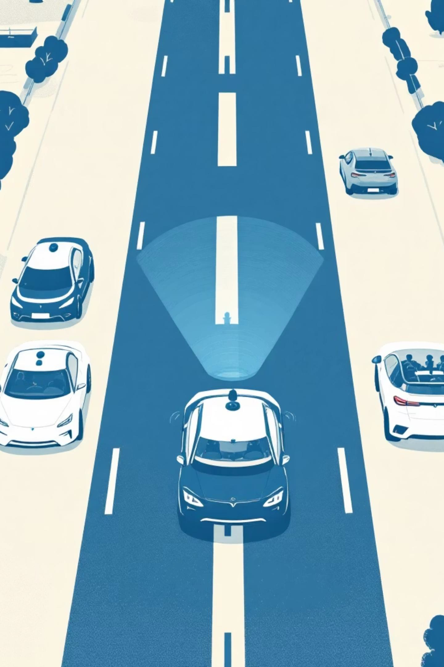
Performance Measurement
Expected Outcomes & Metrics
Our evaluation will focus on critical performance indicators that validate the effectiveness of the communication-aware controller.
Safety Collision Rate (Primary Metric) Minimum Safety Distance Maintained
Efficiency Average Merge Time Highway Throughput (Vehicles per hour)
Communication Awareness E-AoI Performance Impact on Decisions Robustness against High Packet Loss
Comfort Acceleration and Deceleration Smoothness Jerk Rate Analysis

Slide 9





Chapter IV: Outlook
Challenges Encountered & Mitigation
Anticipating potential roadblocks is crucial for maintaining project momentum and ensuring successful implementation.
SUMO & RL Integration Complexity
Challenge: The initial script was incompatible with the new Test2.net.xml file, as all road IDs had changed.
Mitigation: We re-mapped all road names (main_S_1 -> -E0, etc.) and agent routes inside the SumoEnvironment class.
Computation Time for Training
Challenge: The original 2000-episode training was "taking WAY too long" because training occurred on every step.
Mitigation: We implemented "fast-train" settings: reduced episodes to 200 and changed the training loop to update networks only once every 10 steps.

Slide 10


Implementation Complete
Summary
Implementation Complete
The 4-junction testbed, V2V channel, and all three agent scripts (DDPG-EaOI, DDPG-Vanilla, DQN) are built, integrated, and functional.
Training in Progress
We are running the 200-episode "fast-train" session to generate our first set of models.
Immediate Next Steps
Run the evaluate() script to analyse the performance of the fast-trained models
Visually inspect the baseline (J4) in the GUI to check for traffic jams.
Analyze the results: Is the "Channel-Aware" agent (J1) safer than the "Channel-Unaware" agent (J2)?
We are now open for questions regarding the Phase 1 review or our future implementation strategies.

