Slide 1

Addressing Class Imbalance in CICIoT2023-Based Intrusion Detection via SMOTE and Feature Selection
IoT MINI PROJECT · PHASE 2: RESULTS
Dhruv Sandilya · 231CS122 · NIT Karnataka
Base paper: E. C. P. Neto et al., “CICIoT2023: A Real-Time Dataset and Benchmark for Large-Scale Attacks in IoT Environment,” Sensors 23(13):5941, 2023
Notes:
Phase 2 presents the results: the reproduction of the CICIoT2023 benchmark, the improvement on rare attacks, and the feature-selection extension, all inside an IoT system designed with the 10-step methodology.

Slide 2



Three questions, three answers
RQ1 · Reproduce
RQ2 · Improve
RQ3 · Extend
0.995
+0.066
20 of 46
8-class accuracy (paper: 0.994). Same blind spot on web and brute-force attacks.
Macro-F1 of the Random Forest (0.785 → 0.851). Every method beats the baseline, p < 0.05.
features keep the full macro-F1 (0.856), 22% faster, 28% smaller.
Notes:
The short version. Reproduction matches the paper's accuracy. Handling the imbalance significantly improves detection of rare attacks. And twenty features are enough, which makes the model cheaper to run on a gateway.

Slide 3
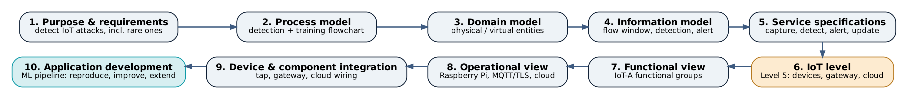
Designed with the 10-step IoT design methodology
Steps 1–5 · What and how
Steps 6–9 · Where it runs
Step 10 · Application
Purpose: catch attacks, incl. rare ones, at the gateway. Process flowchart, domain and information models, eight services.
Level 5: IoT devices as end nodes, the gateway as coordinator running detection, the cloud for storage, training and the dashboard.
The detection model and the ML pipeline that builds it: reproduce, improve, extend. The rest of this talk.
Notes:
The report follows the ten steps of Bahga and Madisetti. Steps one to nine design the IoT system around the detector; step ten, application development, is the machine-learning work.

Slide 4
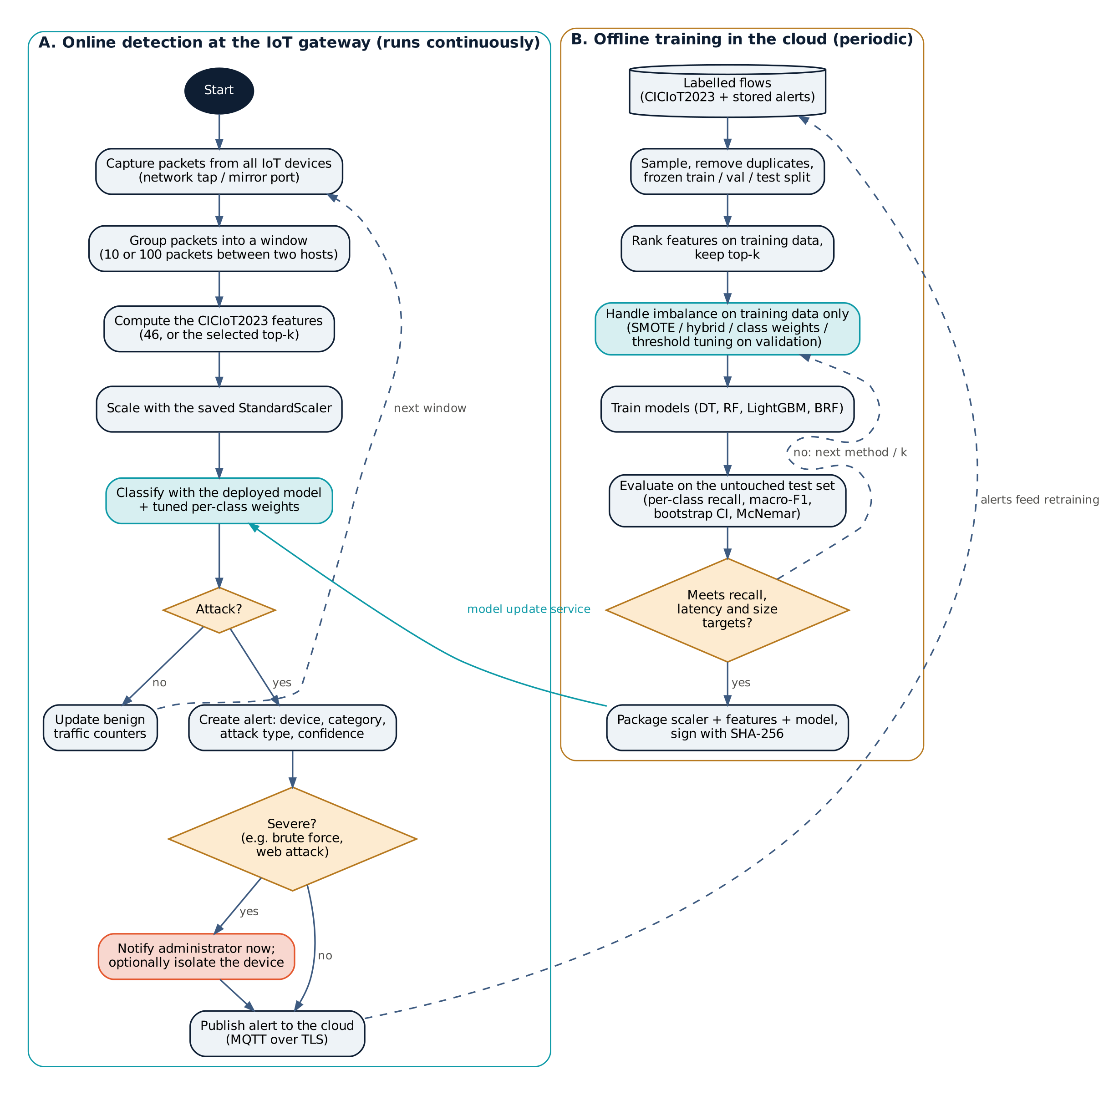
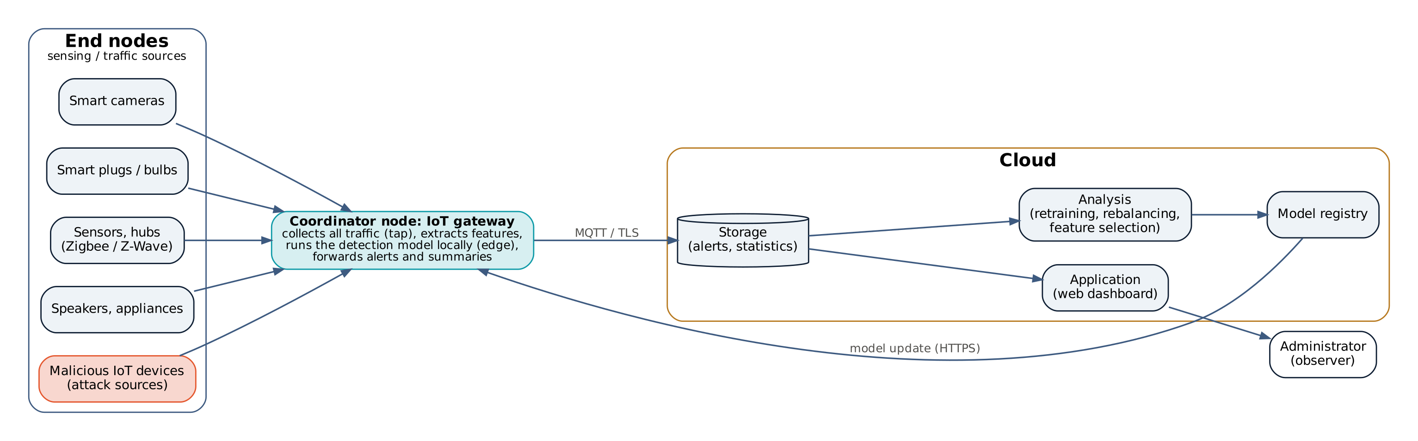
Process model and deployment level
Level 5, with detection at the coordinator: the gateway sees a copy of all traffic and classifies it in microseconds; only alerts go to the cloud, and models come back from it.
Notes:
Left: the process model. The online loop runs on the gateway for every traffic window; the offline loop in the cloud trains and evaluates models and publishes the best one. Right: a Level 5 deployment, except that detection runs at the coordinator rather than in the cloud. That is why model size and latency matter, which motivates the extension.

Slide 5
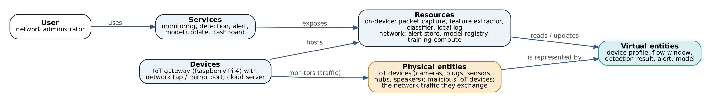
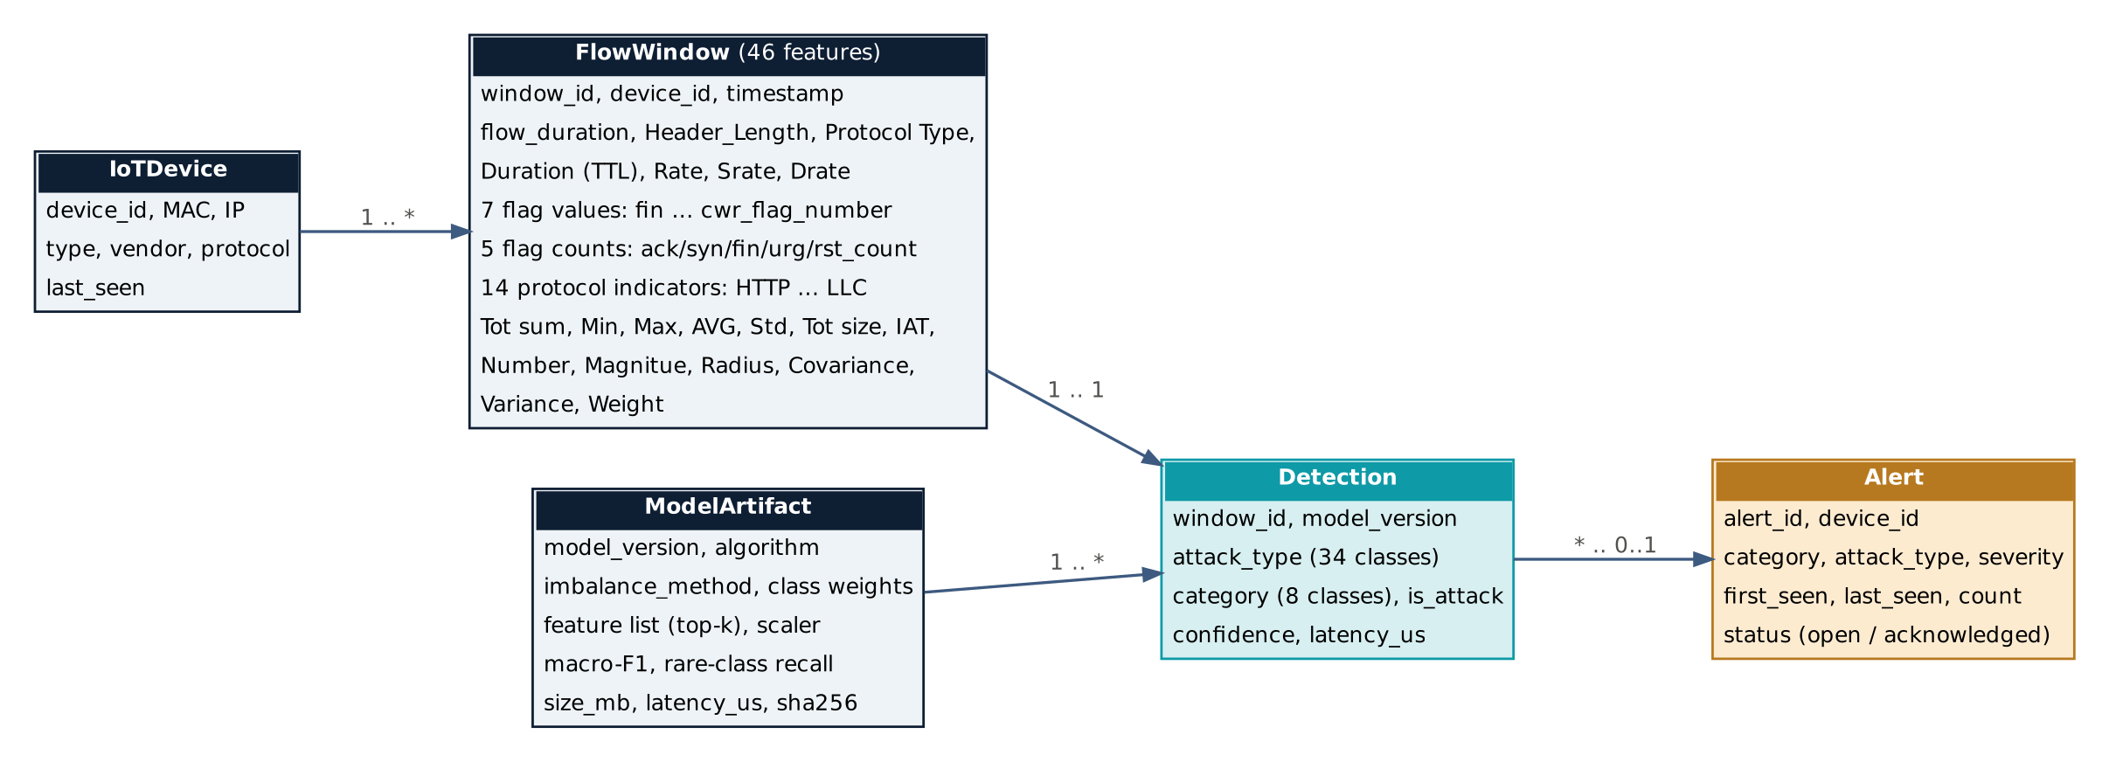
Domain and information models
46 features per window
Each FlowWindow summarises 10 or 100 packets between two hosts: rates, flags, protocol indicators and packet-size statistics, as in the CICIoT2023 CSV release.
Notes:
The domain model separates physical entities, the devices and their traffic, from the virtual entities that represent them. The information model defines the data structures; the central one is the 46-feature flow window that the model classifies.

Slide 6
The data: 1.4 million flows, 2,588 : 1 imbalance
1.40 M
flows from all 169 files (3.0% of 46.7 M), class ratios kept
166,898
exact duplicate rows removed before splitting
15.9%
of test rows would have an exact copy in training without de-duplication
Notes:
We sampled 3% of every file, which keeps the real imbalance. The test set has only 153 web and 79 brute-force flows. Removing duplicates matters: otherwise 16% of the test set is already in the training data.

Slide 7

Reproduction: the paper's accuracy, reproduced
Random Forest | Accuracy, paper | Accuracy, ours | Macro-F1, paper | Macro-F1, ours
2 classes | 0.997 | 0.997 | 0.965 | 0.970
8 classes | 0.994 | 0.995 | 0.719 | 0.785
34 classes | 0.992 | 0.993 | 0.714 | 0.751
The paper's precision and recall are swapped
From the paper's own RF confusion matrix (Table 8): recall 0.706, precision 0.917.
Table 6 prints them the other way round (0.910 / 0.705).
Cause: the example code calls recall_score(y_pred, y_test); scikit-learn expects (y_true, y_pred).
Accuracy agrees within 0.002 at every granularity. Our macro-F1 is higher, likely from the de-duplicated stratified split and a different training procedure.
Notes:
Accuracy matches closely. One surprise: the paper's precision and recall columns are swapped. Recomputing them from the paper's own confusion matrix gives recall 0.706 and precision 0.917, the reverse of Table 6. Its Logistic Regression row matches, digit for digit, a public example notebook that passes the arguments in the wrong order.

Slide 8
The blind spot, and how the fixes close it
6% → 65%
brute-force recall: the paper's RF vs our threshold-tuned RF
4% → 44%
web-attack recall: the paper's RF vs our SMOTE RF
Notes:
DDoS, DoS and Mirai are recalled almost perfectly by every model, so they are left out. The rare classes are where it matters: the paper's forest finds 6% of brute-force and 4% of web attacks. Our baseline is a bit better, and the imbalance methods raise both substantially.

Slide 9
Every method beats the baseline (Random Forest)
Method | Macro-F1 | Rare-class recall | Web recall | BruteForce recall | Model size | Bootstrap p
Baseline | 0.785 | 0.398 | 0.157 | 0.236 | 169 MB | –
SMOTE | 0.837 | 0.626 | 0.436 | 0.612 | 468 MB | < 0.001
SMOTE + undersampling | 0.837 | 0.626 | 0.429 | 0.612 | 449 MB | < 0.001
Class weights | 0.841 | 0.523 | 0.314 | 0.477 | 227 MB | < 0.001
Borderline-SMOTE | 0.811 | 0.481 | 0.355 | 0.262 | 487 MB | 0.013
Threshold tuning | 0.851 | 0.609 | 0.373 | 0.654 | 169 MB | < 0.001
Threshold tuning gives the best macro-F1 at no extra training data or size. SMOTE finds the most rare attacks but cuts web precision (0.901 → 0.443) and makes the forest 2.8× larger.
Notes:
Mean of three seeds on the same untouched test set. Every method improves macro-F1 and rare-class recall, and the bootstrap p-value is below 0.05 for every one. Threshold tuning is the best overall; SMOTE trades precision and model size for the highest rare-class recall.

Slide 10
Significant, not noise
+0.066
+0.228
5 of 5
macro-F1 with threshold tuning; 95% CI [+0.042, +0.090] across seeds
rare-class recall with SMOTE (Recon, Web, BruteForce averaged)
methods significant (bootstrap p < 0.05) for every seed
How it was tested: each method against the baseline trained with the same seed, on the same 246,892 test rows: 1,000 paired bootstrap resamples and McNemar's exact test.
Why McNemar can disagree for threshold tuning: it swaps a few majority-class errors for many rare-class hits, so the count of correct rows barely moves while the balance across classes improves.
Notes:
The gains are well outside the noise. Every confidence interval excludes zero. McNemar's test, which only counts correct rows, is not significant for one threshold-tuning seed because that method trades majority errors for rare hits.

Slide 11

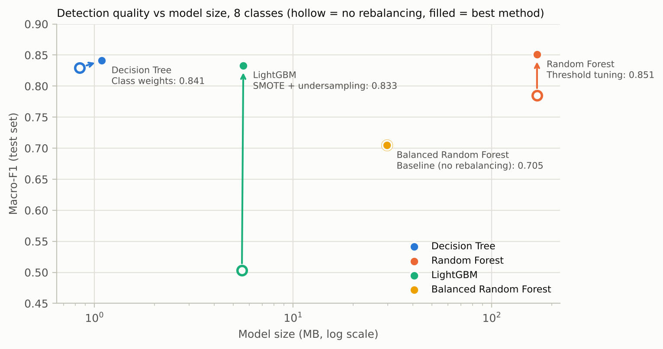

Four models: quality against size
Decision Tree
Class weights: macro-F1 0.841 in 1.1 MB, 0.11 µs per flow.
Balanced RF
Highest rare-class recall (0.771) but low precision: macro-F1 0.705.
LightGBM
Unstable without rebalancing (0.503 ± 0.13); rebalancing fixes it (0.833).
Notes:
Hollow points are baselines, filled points the best method for each model. The class-weighted Decision Tree is almost as good as the best forest at a fraction of the size. LightGBM with default settings is unstable on this imbalance; rebalancing repairs it, so its big jump is partly a repaired baseline.

Slide 12
34 classes: the hardest case
4
0.751 → 0.807
0.526 → 0.650
attack types the baseline forest never detects (Backdoor, SQL injection, ping sweep, uploading)
macro-F1 with SMOTE, the largest gain here (p < 0.001)
rare-class recall with SMOTE
With 34 classes the rarest attack types have only 8–33 test rows, so per-type recall is noisy; the 8-class task is the main result.
Notes:
At 34 classes the baseline forest misses four attack types entirely. SMOTE helps most here. The rarest types have very few test rows, so these per-type numbers are noisy.

Slide 13
Extension: 20 of 46 features is enough
−22%
prediction time per flow (4.02 → 3.12 µs)
−28%
model size (169 → 121 MB)
0.856
macro-F1 with 20 features (0.851 with all 46)
Notes:
Macro-F1 is flat from 46 down to 20 features and only drops slowly below that. Rare-class recall falls a little faster, so 20 is the operating point. The model is faster and smaller at no loss. This answers the future work the paper itself proposes: how features influence the models.

Slide 14


Which features matter
Rank | Mutual information | RF importance | RFE
1 | IAT | IAT | IAT
2 | Tot size | Min | Min
3 | Max | flow_duration | Magnitue
4 | Magnitue | Protocol Type | flow_duration
5 | AVG | Tot size | Tot size
6 | Tot sum | Magnitue | Max
7 | Min | Max | Tot sum
8 | Header_Length | AVG | rst_count
IAT ranks first in all three
Packet inter-arrival time separates the floods from everything else; packet-size statistics and flow duration follow.
Rankings agree
Filter (MI), embedded (RF) and wrapper (RFE) methods pick largely the same top features, so the selection is robust.
Notes:
Three ranking methods, computed on the training data only, agree on the important features. Inter-arrival time comes first in every ranking.

Slide 15
What to run on the gateway
Most accurate
Most deployable
Random Forest + threshold tuning, 20 features
Decision Tree + class weights
Macro-F1 0.856
3.1 µs per flow
121 MB
Macro-F1 0.841
0.11 µs per flow
1.1 MB (111× smaller)
Latency is batch prediction on a 4-core Kaggle CPU; on a Raspberry Pi, packet capture and feature extraction will dominate.
Notes:
Two sensible choices. If accuracy matters most, the tuned forest with 20 features. If the gateway is small, the class-weighted Decision Tree is nearly as good at about one megabyte.

Slide 16

Limitations and future work
Limitations
Future work
A 3% sample; the rarest 34-class types have few test rows
One dataset from one testbed; no replay attacks in CICIoT2023
Latency measured on a Kaggle CPU, without feature extraction
LightGBM run with default settings
Gateway, MQTT and dashboard designed, not deployed
Deploy the selected model on a Raspberry Pi with live capture
Test transfer to CIC IoT-DIAD 2024 and the Dalhousie IoT 2024 dataset
Tune LightGBM for imbalance
Two-stage detector: floods first, then a specialist for the rest
Notes:
The main limitations are the sample size for the rarest attack types, a single dataset, and that latency was measured offline. The natural next step is a live deployment on a Raspberry Pi and testing on the other datasets from the reading list.

Slide 17
Conclusion
A Level 5 gateway IDS, designed with the 10-step methodology, whose detector now finds the rare attacks the benchmark missed.
Reproduced
Improved
Extended
accuracy within 0.002 of the paper; its precision/recall swap found
macro-F1 0.785 → 0.851; rare recall up to 0.626; p < 0.05
20 features: same quality, 22% faster, 28% smaller
Thank you · Questions?
Notes:
To close: the benchmark reproduced, its blind spot fixed with statistically significant gains, and the model made light enough for a gateway. Code, results and the report are in the GitHub repository.

