Slide 1
Routing

Slide 2
In this Presentation
What for?
What information it provides?
Transaction routing phases
Prerouting
Routing
Post-routing
Configuring
Routing instructions
Unrouting

Slide 3
What Routing Does …
What is routing for?
We have a payment in. Decide, what to do with it.
What does it do?
Adds routing information to the payment
Uses BVA-defined rules to:
Determine payment’s Exchange Condition (EC)
Determine outgoing participants
Business participant
Settlement participant
Updates outgoing settlement day
Removes this information in specific situations

Slide 4
What Routing Does …
Determination of Routing Agent
Routing Agent will be set as intermediary Agent, if present in the payment transaction, else the Routing Agent will be the credit party agent (in Credit Transaction) .
Determination of Outgoing Settlement Day
The determination of outgoing settlement day for the payment transaction is done as a part of Routing Service
Determination of Outgoing Settlement Party/Account
Routing determines the outgoing settlement account for not on-us transactions based on the outgoing participant settlement details.

Slide 5
Phases of Routing I
Pre-Routing
Usually called in parsing
Routing Agent determination (aka Counterparty Identification)
Very Important Answer: who is the target of the payment?
Legacy account number redirection
Specific: update old account numbers
Core Routing
Exchange Condition determination (aka Exchange route determination)
By default: by rule matching using Exchange Criteria
Exchange Route Handler
Enrich the payment with Participant (Business, Settlement) and EC
For performance reasons approach may vary across projects
routing may be done in parsing, then need to unroute if want to re-route ☺

Slide 6
Phases of Routing II
Post Routing
Determine:
Each of these handled by a configurable handler
Settlement party
Exchange timing (settlement day, EAST, LAST)
„Latest submission in the past”
Since OPF 11.9.2: anther chance can be given
Dewarehousing timing (EDWART)
Prioritizing
Grouping into OPICs
Unrouting (optionally)

Slide 7
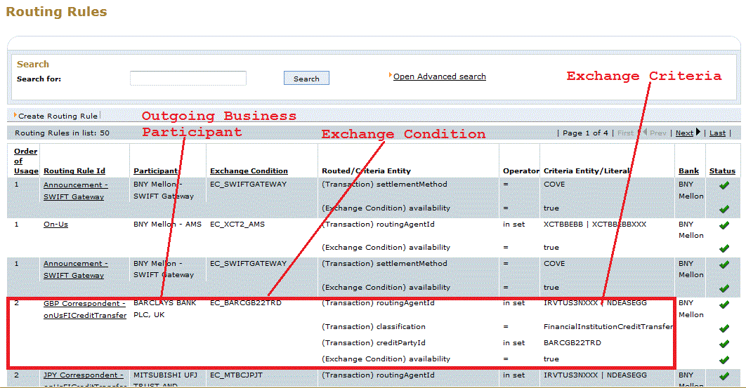
Core Routing

Slide 8
Core Routing
All the routing rules for the bank are retrieved.
Routing Rules are matched in ‘order of Usage’.
First matched routing rule is taken.
Each routing rule is linked to exactly one Exchange Condition.
Each exchange condition is linked to exactly one Participant. (Outgoing Business Participant)
Outgoing Business Participant is the one through which payment is routed to routing Agent.

Slide 9
Exchange Condition
Contains useful information during routing
Outgoing Business participant
Submission Calendar
Submission Timezone
Submission Start time
Submission CutOff time
Format of messages e.g MT103
EAST offset (not used)
LAST offset (not used)

Slide 10
Post Routing
Settlement party determination
Settlement Participant
Settlement Account (in settlement currency)
Exchange Timing (SettlementDay / EAST / LAST)
EAST stands for EArliest Submission Time
(Submission day + 1 sec + EC timezone)
LAST stands for LAtest Submission Time
(Submission day + cut off time of Exchange Condition + EC timezone)
SettlementDay changed if cutOff time passed or Holiday as per Business Calendar of Settlement participant
Now should be between EAST and LAST
If LAST < NOW , then settlement DAY is incremented so that LAST > NOW
Note: Submission Day = Settlement Day – offset (as specified in configuration, may be different for EAST/LAST)

Slide 11
Post Routing Continued …
Dewarehousing timing (EDWART)
EDWART stands for Expected DeWARehousing Time.
Prioritization (Urgent/High/Normal/Low)
According to prioritization criteria (not used in product)
trn.setDataDictionaryInteger(GProcTrnCnsts.PRIORITY_LEVEL, priorityLevel);
Grouping
Based on different format, priority, submission time, Business Participant, Settlement participant (and other configurable criteria. (An OPIC ID is created)

Slide 12
OPIC
OPIC stands for Outgoing Payment Instruction Chunk.
After succesful routing, status of txn is set to null and status of transaction is governed from status of OPIC.
Represents a group of transactions that have the same destination (Participant).
This is used during Submission process.
The reason for grouping transactions in an OPIC is that operations can be executed at the OPIC level instead of at the transaction level

Slide 13
Configuration : payment-routing.xml
<?xml version="1.0" encoding="ISO-8859-1" ?>
<configuration>
<resourcelist type="xml" debugMergedResource="false" inherit="true">
<resource name="config/payment-routing-opfpayment.xml" />
<resource name="config/payment-routing-xct.xml" />
</resourcelist>
</configuration>

Slide 14
Routing Configuration
<transaction-routing id="scheme-aware-transaction-routing">
<classname>com.clear2pay.bph.opfpayment.routing.util.SchemeAwareTransactionRouting
</classname>
<scheme-aware-transaction-routing id="config">
<!-- Pre routing -->
<counterparty-identification-handler
id="counterparty-identification-handler-impl">
<classname>
com.clear2pay.bph..routing.util.RoutingCounterpartyIdHandlerImpl
</classname>
</counterparty-identification-handler>
<!-- core routing -->
<exchange-route-handler id="exchange-route-handler-impl"> </exchange-route-handler>
. . .
</scheme-aware-transaction-routing>
</transaction-routing>

Slide 15
Core routing configuration
<!– CORE ROUTING -->
<exchange-route-handler id="exchange-route-handler-impl">
<classname>
com.clear2pay.bph.opfpayment.routing.util.ExchangeRouteHandlerImpl
</classname>
<exchangeroutehandler id="default">
<matchers id="default">
<matcher id="Criterion">
<ruleMatcherId>Criterion</ruleMatcherId>
<classname>
com.clear2pay.bph.routing.util.CriteriaBasedRoutingRuleMatcherImpl
</classname>
</matcher>
</matchers>
</exchangeroutehandler>
</exchange-route-handler>

Slide 16
Post routing configuration
<settlement-party-handlers id="settlement-party-handlers">
<settlement-party-handler id="ICT">
<classname>com...bph.xct..util.SettlementPartyAccountHandler</classname>
</settlement-party-handler>
</settlement-party-handlers>
<exchange-timing-handlers id="exchange-timing-handlers">
<exchange-timing-handler id="ICT">
<classname>com. xct..util.XCTExchangeTimingHandlerImpl</classname>
</exchange-timing-handler>
</exchange-timing-handlers>
<dewarehousing-timing-handlers id="dewarehousing-timing-handlers">
<dewarehousing-timing-handler id="ICT">
<classname>com..xct.routing.util.XCTDewarehousingTimingHandlerImpl
</classname>
</dewarehousing-timing-handler>
</dewarehousing-timing-handlers>

Slide 17
Routing Config continued …
<prioritization-handlers id="prioritization-handler-impl">
<classname>
com.clear2pay.bph.opfpayment.routing.util.TransactionPrioritizationHandlerImpl
</classname>
. . .
</prioritization-handlers>
<grouping-handler id="grouping-handler-impl">
<classname>
com.clear2pay.bph.opfpayment.routing.util.TransactionGroupingHandlerImpl
</classname>
. . .
</grouping-handler>

Slide 18
Instruction Routing
In some cases routing needs to be done on the instruction level directly:
The instruction does not contain any transactions (eg. PSR).
The incoming instruction needs to be routed directly on instruction level.
The application is not allowed to look inside and process transactions → the entire instruction is to be processed as a block.
Preparation - enrichment
Core routing
Finding out routing rule (exchange route determination)
Enrichment basing upon the rule
Setting the InstructedAgent, InstructingAgent
Post routing
Settlement Party determination
Exchange Timing determination (Only Last calculation)
outgoingInstruction.setDataDictionaryLong(GProcInstrCnsts.LATEST_SUBMISSION_TIME_MILLIS, Long.MAX_VALUE);

Slide 19
Instruction routing configuration
<instruction-routing id="instruction-routing">
<classname>com.clear2pay.bph.opfpayment.routing.util.StandardInstructionRouting</classname>
<standard-instruction-routing id="config">
<instruction-route-handler id="instruction-route-handler">
<classname>com.clear2pay.bph.opfpayment.routing.util.SchemeBasedInstructionRouteHandler
</classname>
</instruction-route-handler>
<instruction-settlement-party-handler id="instruction-settlement-party-handler">
<classname>com.clear2pay.bph.opfpayment.routing.util.DelegatedInstructionSettlementPartyHandler</classname>
<delegated-instruction-settlement-party-handler id="config">
<delegatesettlement id="delegatesettlement">
<maxnumber id="maxnumber">0</maxnumber>
</delegatesettlement>
</delegated-instruction-settlement-party-handler>
</instruction-settlement-party-handler>
<instruction-timing-handler id="instruction-timing-handler">
<classname>com.clear2pay.bph.opfpayment.routing.util.InfiniteInstructionTimingHandler</classname>
</instruction-timing-handler>
</standard-instruction-routing>
</instruction-routing>

Slide 20
Unroute Transaction
If Transaction needs to be repaired and the details of the transaction have changed.
Then any routing information that was previously added becomes invalid and is cleared.
public GenericIssueLog unrouteTransaction(PaymentTransaction txn)
public GenericIssueLog unrouteTransactions(PaymentTransaction txns[])
public GenericIssueLog unrouteTransaction(long txnKey)
public GenericIssueLog unrouteTransactions(long[] txnKeys)
public GenericIssueLog unrouteTransactions(long key, Class unitOfWork)

Slide 21
Routing

