Slide 1
Stop Payments, Go Payments

Slide 2
Stop them Payments!
Basically:
Check whether a transaction matches a Stop Payment Order
If so – stop it!
What for?
Direct Debit
Customer (debtor) notifies the bank that some types of DirectDebit txns for a given account should be blocked
Bank creates a StopOrder (a DB entry with parameters)
Don’t confuse with
SO = Standing Order
Go Payment
BlackList

Slide 3
Stop Payments – what happens?
StopPaymentService usually called from business flow
But could be any other service or BVA (facade!)
Params: entity type and key (txn, instr, OPIC)
Check given payment against StopOrders
Match is a relatively rare occurence → save performance! → two phases (SEPA implementation)
Phase 1: DB query for potential candidates (txn x StO % StO attributes)
Using only values available in DB tables
Implemented by *StopPayment (eg. DualPassStopPayment)
Phase 2: Code check
Check each txn against specific rules stored in StOs
Implemented by a StopHandler
ISSUE_STOPPAYMENTMATCHED generated on match
Issue Processor to handle it – reject, WLI (info, approval) etc.

Slide 4
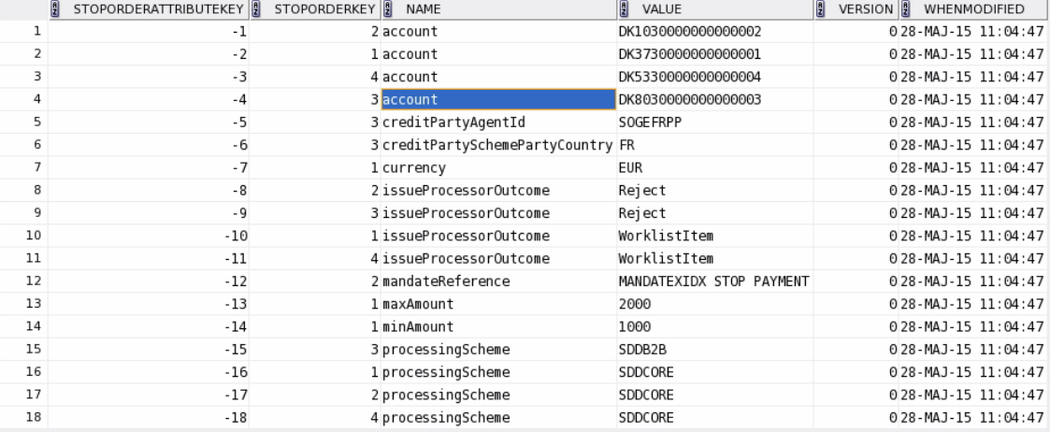
Stop Payments – building blocks
StopOrder:
StopOrderAttribute: name, value
Name = txn.field.name (mapped via XML)
Value: if txn.field.value matches it → stop!
Special attributes: maxAmount, minAmount
Special attribute: issueProcessorOutcome
Other special attributes possible

Slide 5
Stop Payments – building blocks
StopHandler:
Configured per StopOrder type (XML ~ DB stoporder.stopordertype)
Checks the above conditions (stopPayment(...))
Validates newly created stop payments and their attributes (BVA, other means of import)
StopPaymentService – functional
stopPayments() – check all entities against stop orders
get types, get attribute names, validate a StopOrder, import StopOrders
StopOrderService – maintenance
Suspend, enable
Create, delete, update
Fetch, find, ... StopOrders
Get types, attributes

Slide 6
Stop Payments – customizing
Regular:
StopPayment impl
StopHandler
+ obviously config for these
Additional attribute types on StopOrder
BVA StopOrder maintenance page
Advanced:
StopOrder table

Slide 7
Go Payments!
Basically:
Check whether a transaction matches a Go Payment Order
If not – but Go Payments for the given debtor exist – stop it!
What for?
Direct Debit
Customer (debtor) notifies the bank that only some types of DirectDebit txns for a given account should be allowed
Bank creates a GoPayment (a DB entry – single table this time)
Technically
SEPA-level (no OPF implementation; originally a Cedicam customization)
Friends or Enemies?
Stop Payment
BlackList

Slide 8
Go Payments – what happens?
GoPaymentService usually called from business flow
But could be any other service or BVA (facade!)
Params: entity type and key (txn, instr, OPIC)
Check given payment against GoPayments
Two phases again:
Find candidates
by matching accountId, proc scheme to existing non-suspended goPayments
Iterate through candidates, if no goPayment matched – stop!
ISSUE_GOPAYMENTNOTMATCHED generated on failure
Issue Processor to handle it – reject, WLI (info, approval) etc.

Slide 9
Go Payments – building blocks
GoPaymentService
checkGoPayment (...)
one has a parameter specifying UC variant to follow
Some logic, then lookup, then matching
Lookup (SPEXGoPaymentLookupBase)
First phase of matching
Parameters to match with values from GoPayment
list in COMMON_TX_GPO_LINK_FIELDS, default bank + bankgroup + scheme
Builds Criteria (payment x GoPayment)
Returns EntityIterator
Matcher (SPEXGoPaymentMatcherImpl)
Second phase: match specific rules with payments
Mandatory, optional
GoPaymentManagementService
Manipulate GoPayments:
Create, delete, update
Suspend, enable
Fetch, find

Slide 10
Go Payments – customizing
No attributes table
customize GOPAYMENTORDER to add more criteria
and extend the matcher to implement specific comparison rules
Code:
Service, lookup, matcher
BVA page to edit etc.

Slide 11
Stop Payments, Go Payments!

