Slide 1
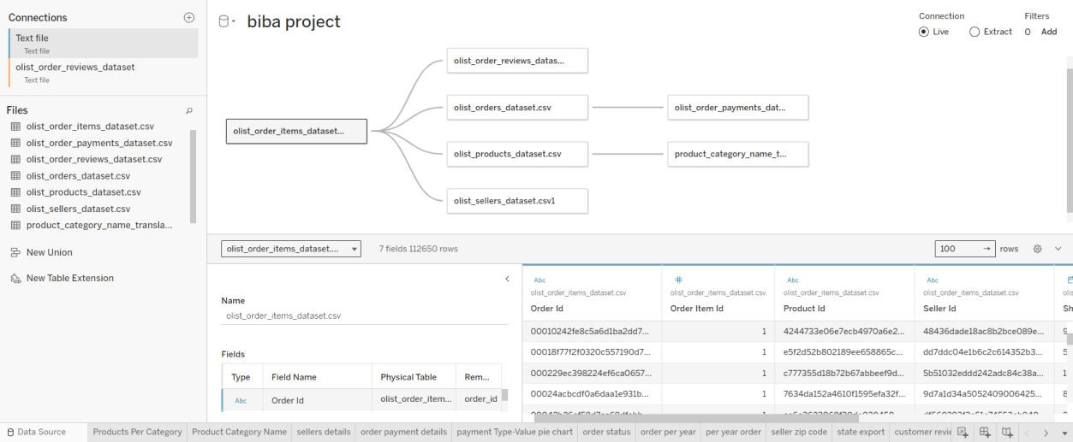
Business Intelligence and Business Analytics PPT
Data visualization: -
We have 7 datasets: -
Data visualization: -
We are working with 7 data sets which are linked through the following foreign keys: Order Id, Product Id and Seller Id.
Further, Tableau was used as the tool to plot the following plots to gain insights and identify potential details pertaining to the growth of the company: -
Line plot
Bar plot
Pie chart
Symbol map
Box whisker plot
Tree map
Four dashboards: -
Product Dashboard Inferences: -
  Product Dimensions : A bar plot of dimensions across different product categories was created considering the height, weight, width and weight of each product.
  Products per category: barplot of the amount invested by Olist to secure stock across different categories according to which gift watches, health beauty products and

Slide 2
furniture were the categories that emerged as the largest among all categories which makes sense as furniture is expensive and succumbing to its great made the organisation invest a great deal to secure stock in this category.
Also, the key departments that have significant contributions as per product value were identified to be housewares, furniture, decor, bed bath table and sports leisure.
Products value(inclusive of all taxes): Bar plot of tax inclusive value of products sold on the Olist platform across different categories which demonstrates automotive category as the greatest among each category and these values are higher than invested value to acquire products in these categories because of inclusion of taxes and various other charges viz. hosting charge, delivery charge, etc as expected.
Seller Dashboard Inferences: -
  Puerto Rico is the largest exporter of goods to be hosted on Olist platform for growing their business through Olist which took place based on screening of products for quality checks and if found satisfactory, helping expand these small organizations make their presence felt in ecommerce platform.
  Several states in the US such as Montana, South Carolina, Pennsylvania, Massachusetts, and Mississippi were identified as potential lead companies.
  Each seller was identified considering their state zip code.
Order Dashboard Inferences: -
order status: most of the goods were delivered on time regularly according to the order status bar plot. The number of orders which were cancelled were identified to be 625 and unavailable orders were 609.
order details: the freight value, prices and payment value of the goods were plotted on a line graph to show variability across products.
Order payment details: Credit card was identified as the most common method of payment amongst customers. This was done by plotting the method of payment against payment value. Customers also opted to use credit card as the payment method for payment through instalments.
Order per year: The count of order per year in the form of a line chart. The booming period of the company was identified from 2016 to 2017. The company continued to expand rapidly hereforth.
CEO Dashboard Inferences: -
  Customer review score
  Customer history
  Price per category
  Order status

Slide 3
Type value pie chart
Product details
Payment type
Sellers details
References:-
For dataset https://data.world/adas086/olistcustomersdataset
For Tableau – data visualization https://eu-west-
1a.online.tableau.com/#/site/dhruvsharma/workbooks/1113413/views
For Learning https://www.tableau.com/learn/training

