Slide 1

Hustlr
Real-Time Income Protection Engine for Gig Delivery Workers
"Because every minute you can't deliver is a minute your income disappears"
Hustlr is designed to help gig delivery workers protect the earnings that depend on constant mobility, fast decisions, and uninterrupted availability. By focusing on real-time support, it aims to reduce the financial impact of delays, downtime, and unexpected interruptions that can quickly affect daily income.
The platform concept centers on helping workers stay informed, respond faster to problems, and preserve earning potential during the most vulnerable moments of a delivery shift. It combines income protection thinking with the realities of on-demand work, where every completed order matters.
Inesh Agarwal (Team Leader)
V Dhruv
Prisha Agarwal
Daksh Gupta
T Anil Kumar

Slide 2


Meet Karthik:
Karthik,28 is a Swiggy delivery partner in Bengaluru,earning Rs 18000/month
Disruption:
On a stormy Tuesday, heavy rain stopped deliveries for 4 hours.
Loss:
₹0 earned that day ₹800 EMI + ₹200 fuel + ₹150 lunch = ₹1,150 unavoidable expense
Even one disrupted shift creates immediate financial stress because income stops, but expenses don’t.
7.7M
80+
Gig Workers in India
Disruption Days/Year
Millions of independent workers rely on daily earnings, often without paid leave or employer-backed benefits.
Rain, outages, strikes, bandh, vehicle issues, and app interruptions repeatedly break earning opportunities.
₹0
Insurance Coverage
The real risk is not injury alone, but loss of a day’s wage.
Expenses don’t pause when income does. Even a few hours of disruption can trigger unpaid bills, missed necessities, and long-term financial stress.

Slide 3

What happened to Karthik is not rare — it happens millions of times every day.
The Gap Hustlr Solves
TRADITIONAL INSURANCE
HUSTLR'S SOLUTION
Why Traditional Insurance misses this market
Built for Hyper-Local Income Risk
Q-commerce and delivery work are hyper-local. A worker can lose a full day’s income because one small zone is flooded, blocked, or offline. Traditional claims are too slow, too manual, and too broad to protect a shift-level income loss.
Hustlr is designed around the reality of gig work: small zones, sudden disruptions, and immediate income impact. Instead of waiting for a medical claim, it focuses on lost earning days and the specific local events that stop work in the first place.
No Income Disruption Coverage
Zone-Aware Protection
Instant Trigger Events
Health and accident plans pay for medical events, not the earnings lost when rain, outages, or shutdowns stop work.
Coverage is tied to the exact delivery area, so a disruption in one micro-market can be recognized as real income risk.
Rain, outages, curfews, or platform shutdowns can activate support when work stops — not days later after paperwork.
Claims are slow and paperwork-heavy
Traditional claims are manual and delayed, which defeats the purpose for paycheck-to-paycheck workers.
Income-First Payouts
The product is built to protect today’s paycheck, helping workers stay afloat when fixed expenses keep coming.
Zone-Blind Poricing misses local risk
National policies do not recognize micro-market disruptions like one flooded neighborhood or one offline restaurant cluster.
Hustlr matches the way gig income actually breaks — locally, suddenly, and repeatedly.

Slide 4
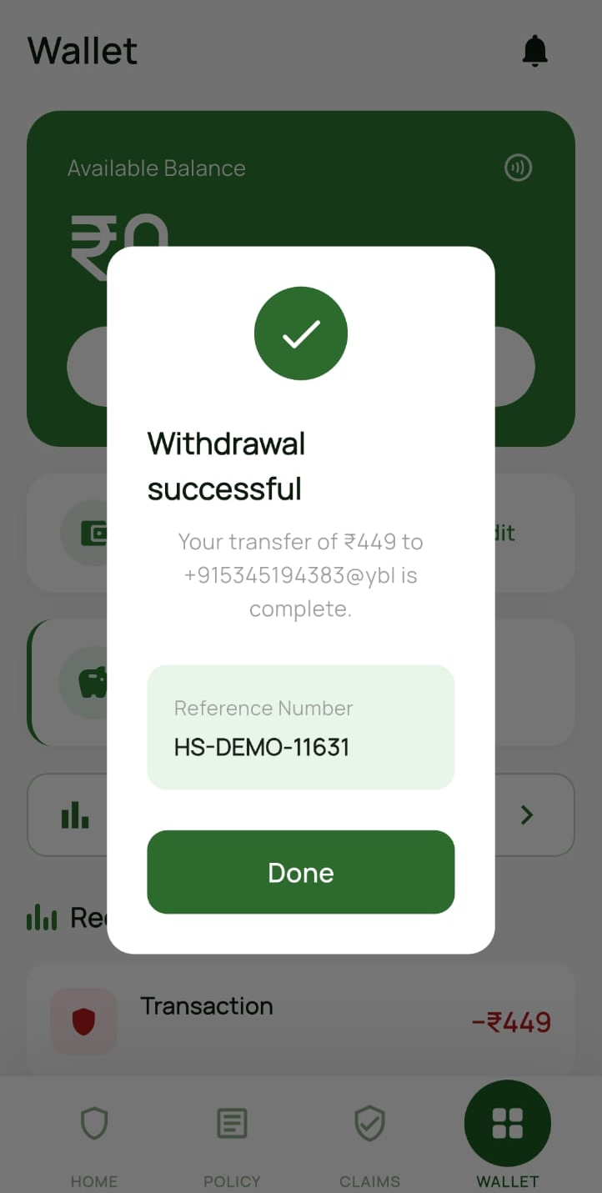
Introducing Hustlr
Parametric Income Protection Engine for Gig Delivery Workers— built from the ground up for India's gig delivery workforce, with automated protection designed to respond instantly when a shift in conditions threatens a worker's earnings.
Real-Time
Automatic
Disruption Monitoring
Trigger Validation
Continuous detection of disruption triggers across weather, traffic, and platform signals.
Payouts are triggered automatically — no forms, no paperwork, no waiting.
UPI payout
In Minutes
Verified payouts deposited directly to the worker's UPI wallet within 3 minutes.
Protection:
Relief:
Rain is detected automatically. ₹500 is credited instantly to Karthik’s UPI — no claim, no paperwork.
Karthik checks his phone. Payment received. He continues working the next day — his family stays financially stable.

Slide 5
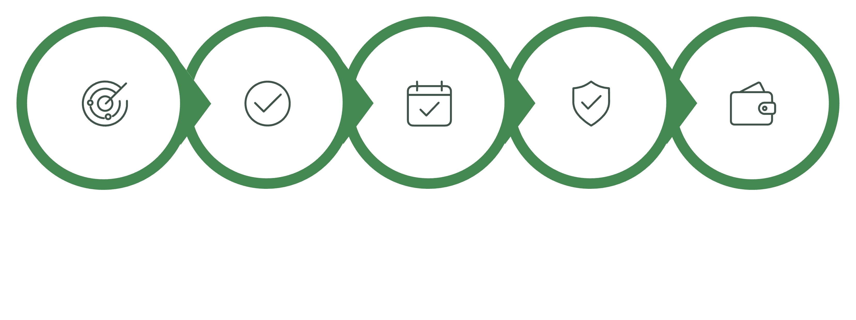
How It Works
Detect
Validate
Shift Check
Fraud Check
UPI Payout

Slide 6
Core Innovation - Hustlr is designed so situations like Karthik’s are automatically handled in real-time.
What Makes Hustlr Different
Every layer of Hustlr is intentionally built to address the core weaknesses of traditional insurance models in the gig economy, where speed, accuracy, and trust matter as much as protection itself.
Parametric First
70/30 Payout System
Zone Depth Scoring
Coverage is designed around real-world events that trigger payouts automatically, eliminating lengthy forms, claim disputes, and unnecessary delays for workers who need support quickly.
70% of the payout is delivered instantly, while the remaining 30% is released after verification to balance speed with accountability.
Risk is scored at street-level granularity, allowing the system to account for local conditions, delivery patterns, and neighborhood-specific volatility rather than relying on broad averages.
7-Layer Fraud Detection Engine
Data Trust Engine
A seven-layer validation system combines behavioral, geographic, temporal, velocity, and consistency checks to identify suspicious activity early and keep the payout process reliable.
An immutable audit trail captures every transaction, strengthening transparency, traceability, and confidence across the entire system.
Designed for speed
Built for precision
Built for trust
Automated payouts remove friction from the claims experience.
Hyper-local scoring makes risk evaluation more accurate and responsive.
Fraud detection and audit trails keep every payout verifiable.

Slide 7



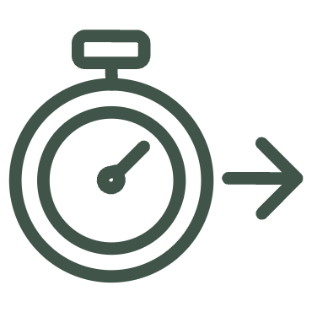

Key Features
Built to help delivery workers respond faster, get paid sooner, and stay protected with less manual effort.
Real-Time Detection
Automated Claims
AI Fraud Prevention
Continuously monitors live disruption signals across weather, traffic, platform uptime, and other operational indicators so risk is identified as early as possible.
Enables zero-touch claim processing by automatically verifying eligible events, calculating payout amounts, and routing approvals without manual review.
Uses a multi-layer machine learning engine to analyze patterns, behavior, and transaction signals in order to detect suspicious activity before payouts are released.
UPI Withdrawals
Predictive Alerts
Delivers instant transfers directly to each worker's preferred UPI ID, making funds easy to access any time of day without banking delays.
Provides proactive forecasting that warns workers ahead of likely disruption windows, helping them prepare routes, schedules, and expectations in advance.

Slide 8
Triggers We Cover
These are the exact events that stopped Karthik from earning — and now trigger protection.
Heavy Rain
Extreme Heat
IMD-verified rainfall threshold triggers that identify conditions where visibility, road safety, and delivery efficiency drop sharply enough to pause work and protect earnings.
Heat index alerts above safe delivery thresholds, helping workers avoid dangerous outdoor conditions that can increase fatigue, dehydration, and missed order capacity.
Poor AQI
Platform Outage
Air quality index spikes that make outdoor operations unsafe, especially during extended exposure windows when breathing conditions and worker health are at higher risk.
Verified app downtime on Swiggy, Zomato, Blinkit, and similar platforms when system failures stop workers from receiving orders or completing paid tasks.
Bandh / Strike
Internet Blackout
Civil disruptions confirmed via geo-tagged reports, covering road closures, local shutdowns, and protest-related interruptions that can make service routes inaccessible.
Network-level outage detection across zones, designed for moments when connectivity failures prevent app access, order updates, navigation, or payout workflows.
Traffic Blockage
Cyclone / Full Shield
Severe congestion that makes a zone undeliverable or too slow to service efficiently, reducing earning potential even when demand is still present.
Maximum payout activated for catastrophic events, providing the strongest level of protection when weather or regional disruption creates widespread shutdown conditions.

Slide 9
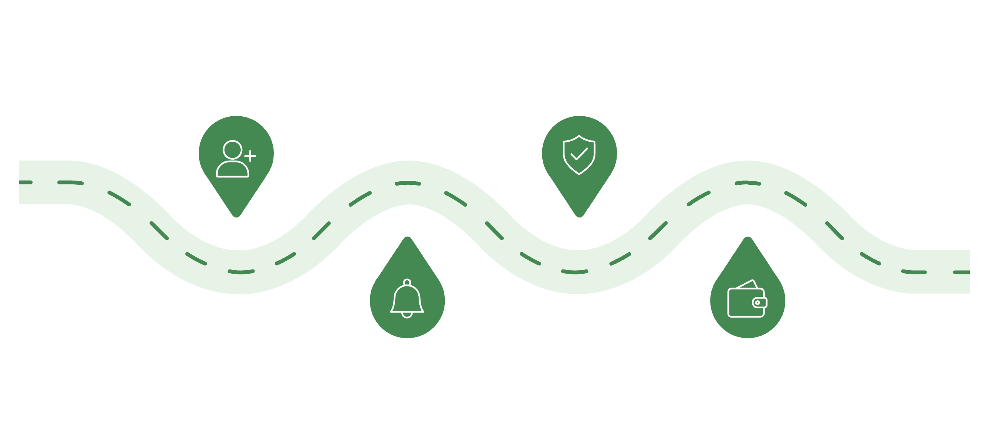
Demo Flow: 3-Minute Full Experience
Onboarding
Claim Processed
Karthik registers and links UPI in about 60 seconds so that he can become eligible for coverage without a lengthy setup process.
The claim is validated automatically using the trigger data, so Karthik avoids paperwork, follow-up calls, and any manual form-filling.
Trigger Detected
Wallet Credited in 3 minutes
Rain stops deliveries in his zone and the he is notified instantly with clear context about what happened and why the protection has been activated.
Once approved, ₹500 credited within minutes(70% of the payout) lands in his Hustlr wallet quickly, giving himimmediate financial support when income has been interrupted.
60 sec
<3 min
0 forms
Onboarding to active coverage, with zone setup and UPI linking completed in a fast, low-friction flow that gets the worker protected almost immediately.
Trigger to UPI payout, with automated detection, instant notification, validation, and crediting designed to keep response times extremely short.
Zero manual claims filed, because the entire experience is designed to remove paperwork, reduce effort, and minimize delays for the worker.

Slide 10
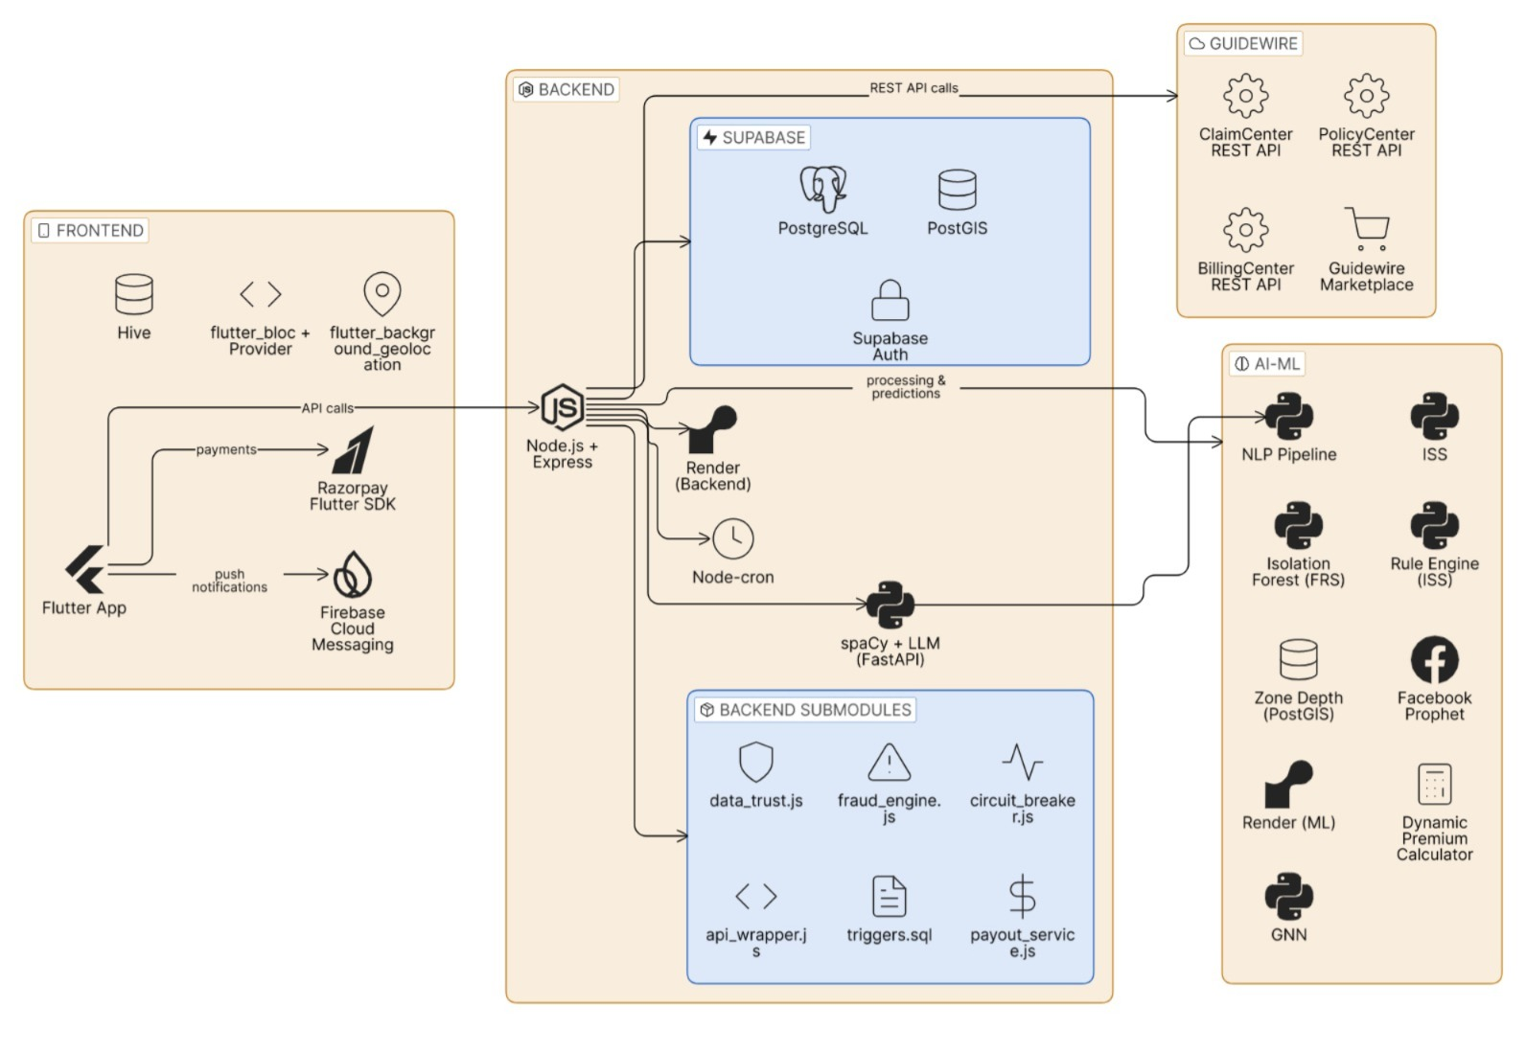
Tech Architecture

Slide 11
Guidewire Integration: Enterprise-Grade Insurance Stack
Built on Guidewire's market-leading platform to support end-to-end insurance operations, including policy administration, claims handling, and billing automation. This integration is designed to help insurers and platform partners operate at scale with greater speed, consistency, and control across the full customer lifecycle.
PolicyCenter
ClaimCenter
Automates policy creation, underwriting, renewals, and policy updates with flexible rules that can adapt to worker activity patterns, coverage tiers, and eligibility changes. For example, coverage can be adjusted as workers take on more shifts or move between partner platforms, helping ensure policies stay aligned with real-world usage.
Enables fast, consistent claims intake and adjudication with AI-assisted validation, reducing manual review and improving turnaround times. In practical terms, this supports instant auto-claims processing for common events, while more complex claims can be routed through structured review workflows with clear audit trails and real-time status tracking.
BillingCenter
Marketplace-Ready
Supports automated weekly payouts, premium collection, and subscription billing with flexible payment handling across different partner models. This helps simplify reconciliation, reduce payment delays, and improve cash flow visibility, whether the business is managing recurring premiums, micro-payments, or platform-funded coverage programs.
Offers a pre-built integration foundation for ecosystem partners such as Zepto, Swiggy, and Uber, making it easier to launch and scale embedded insurance offerings. This reduces implementation complexity, shortens deployment timelines, and creates a more seamless experience for both platform operators and end users.

Slide 12
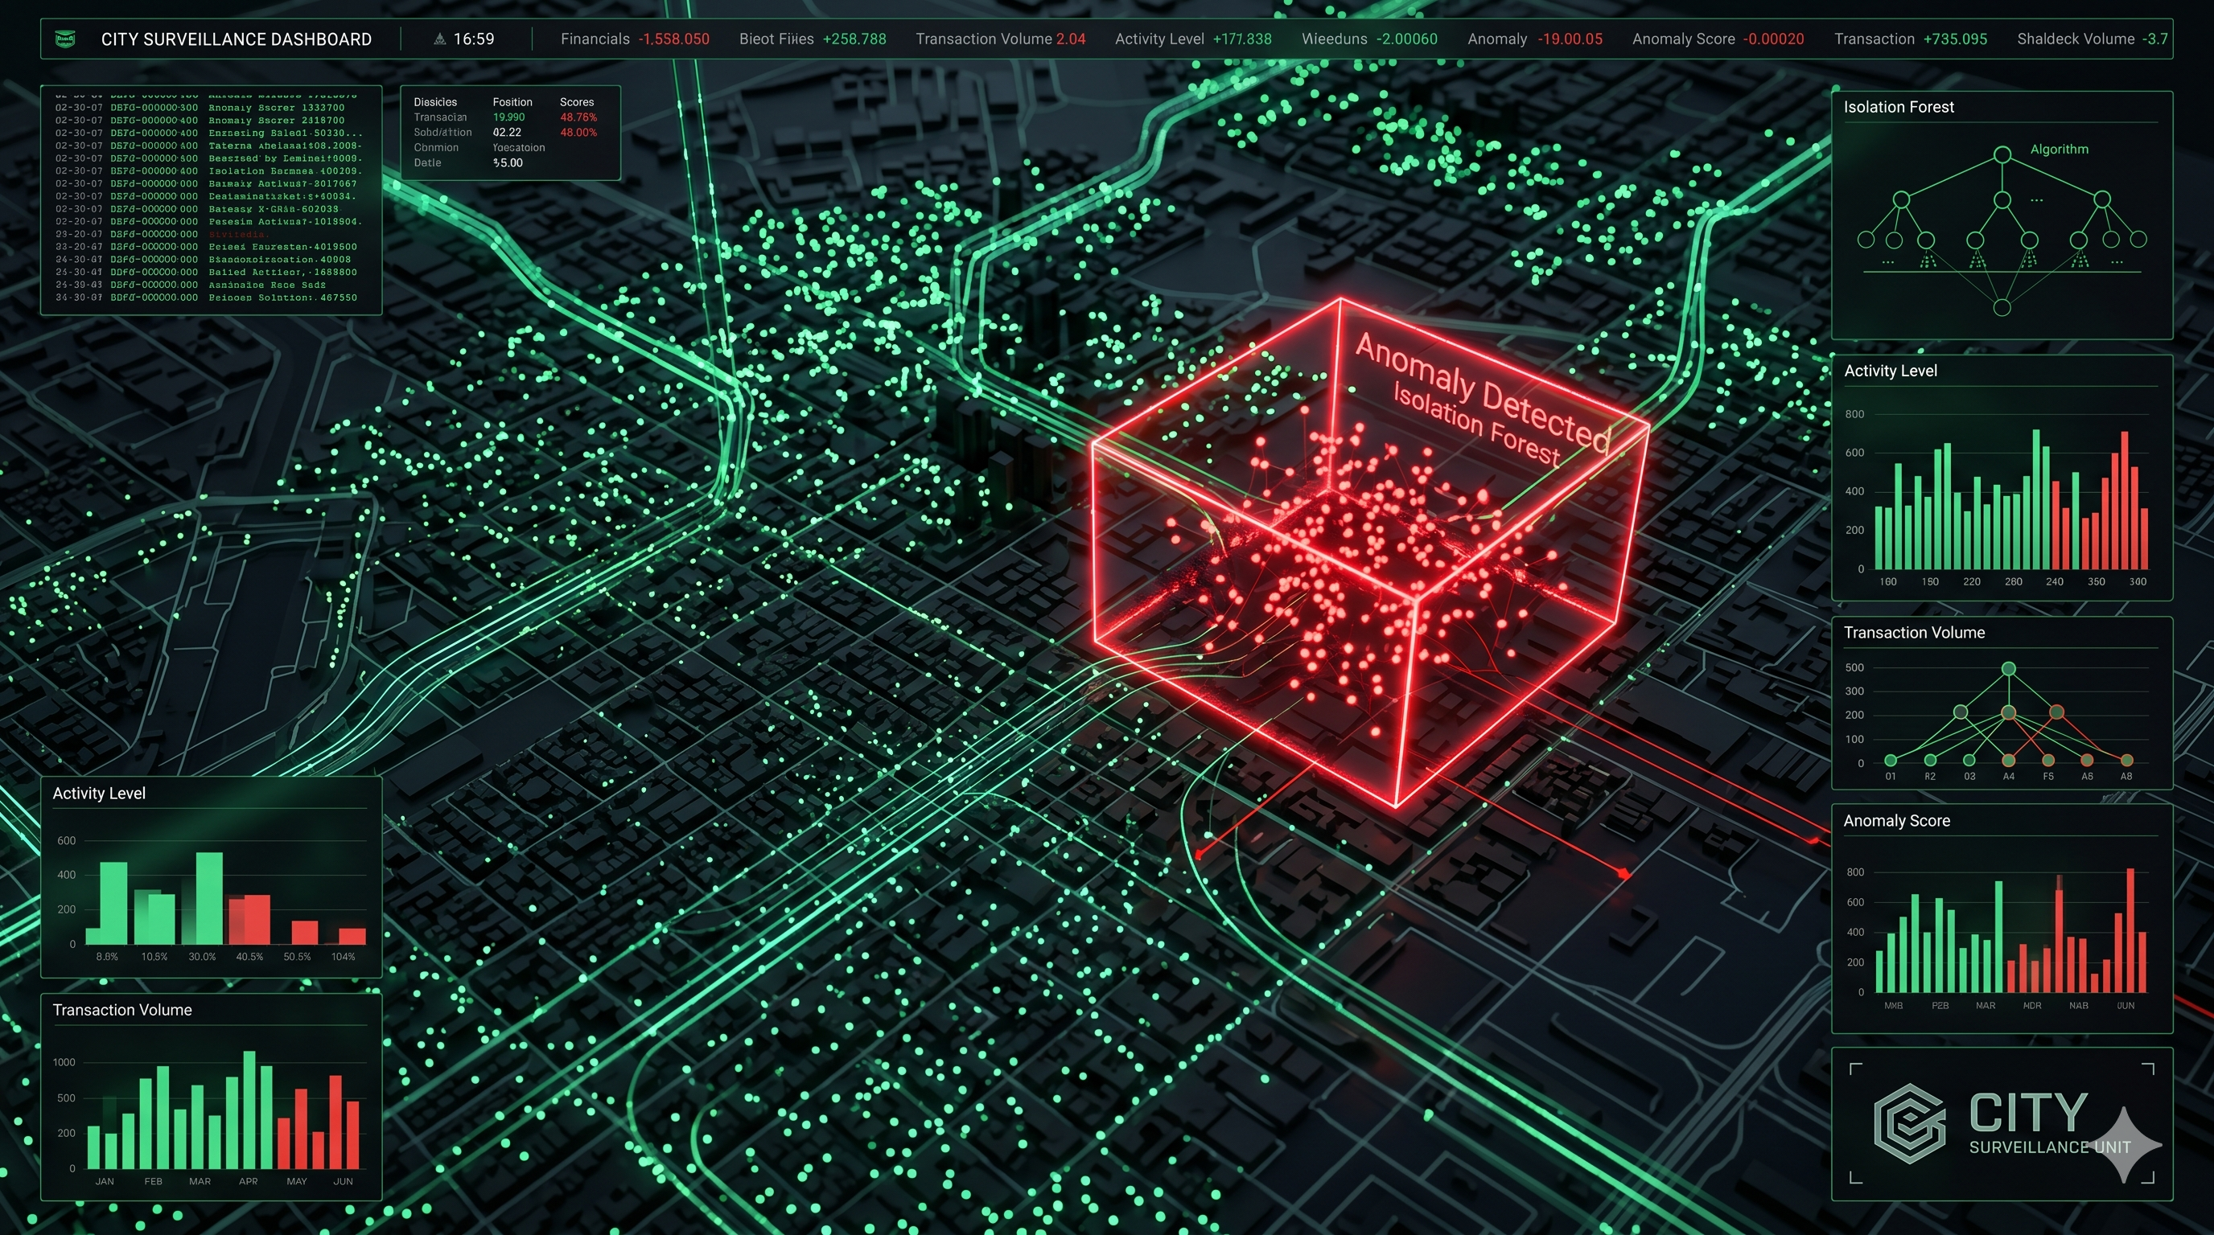
AI/ML Layer: Intelligent Risk Engine
7-Layer Fraud Detection
Multi-layered anomaly detection combines behavioral biometrics, device fingerprinting, claim timing, and transaction pattern analysis to identify suspicious activity early. By correlating signals across multiple checkpoints, the engine reduces false positives, improves investigation prioritization, and helps teams stop fraudulent claims before they progress through the workflow. For example, repeated changes in payout details, unusual login behavior, or inconsistent incident timing can trigger deeper review.
Natural Language Processing
Real-time NLP analyzes worker inputs, adjuster notes, call transcripts, and claim descriptions to detect disruption indicators and extract intent, sentiment, and scenario context. This helps surface claims that may require special handling, reveals hidden inconsistencies in narratives, and improves decision quality by giving teams a clearer understanding of the case in plain language. It is especially useful when claim details are unstructured or evolving over time.
Predictive Modeling
Prophet-based forecasting estimates income volatility, claim frequency, and seasonality so the platform can anticipate risk before it becomes visible in the numbers. Predictive models also support proactive routing, reserve planning, and capacity management by highlighting trends such as peak claim periods, location-specific spikes, or behavioral shifts across worker segments. This enables faster planning and more consistent operational decisions.
Zone Depth Scoring
Geospatial risk assessment uses historical claims data, traffic patterns, and regional incident trends to assign risk scores by zone and operating area. These scores help insurers and platform operators understand where exposure is concentrated, compare neighborhoods or corridors, and adapt underwriting or operational policies accordingly. For instance, areas with high claim density, congestion, or repeated incident patterns can be flagged for closer monitoring or adjusted thresholds.

Slide 13




Anti-Fraud System: Multi-Layer Security
Device Integrity
GPS + WiFi + IP
Play Integrity API validation confirms that each request is coming from a genuine, unmodified device and helps block spoofing, emulator abuse, and tampered app environments before they can interact with the system. This creates a trusted starting point for every session, reduces the risk of automated abuse, and improves confidence that the data being analyzed reflects real user activity rather than manipulated input.
Multi-factor location validation compares GPS coordinates, nearby WiFi signals, and IP-based network data to verify that a user is operating from a consistent and plausible location. By cross-checking several independent signals, the system can flag VPN usage, spoofed geolocation, and mismatches between claimed and observed whereabouts, which is especially useful for detecting claims filed from improbable locations or rapid location changes between sessions.
Behavioral Analysis
Cluster Detection
Pattern recognition tracks how users interact with the app over time, looking for deviations from normal behavior such as unusual navigation paths, repeated form changes, rapid submission attempts, or inconsistent session timing. These behavioral signals help distinguish legitimate users from suspicious activity, support early intervention before a claim progresses too far, and reduce false positives by comparing actions against each user’s own historical baseline as well as broader population trends.
Graph-based algorithms identify connected account networks that may indicate coordinated fraud rings, shared devices, reused identities, or other suspicious relationships across claims and transactions. This layer is valuable because fraudulent activity often appears normal when viewed in isolation, but becomes much more visible when accounts, devices, locations, and behaviors are analyzed together. It helps teams uncover organized abuse earlier, prioritize investigations, and stop repeat offenders from scaling their activity.

Slide 14

MARKET OPPORTUNITY
The Uninsured Gig Economy — A ₹2,500 Cr Opportunity
India's gig workforce is the fastest-growing uninsured labor segment in Asia — and it remains entirely unprotected by any parametric insurance product. With 12M workers in FY25 scaling to 23.5M by 2030, and ~95% lacking any form of income protection, the structural gap between workforce growth and financial safety nets has never been wider.
₹2,500Cr
Q-Commerce Market Dynamics
The $3.34B q-commerce market is dominated by two players whose combined daily volumes create a concentrated, addressable distribution channel for embedded insurance.
Total Addressable Market
Estimated insurance opportunity across India's gig workforce
25.6%
Blinkit·46%
Insurtech CAGR
Zepto·29%
India insurtech sector compound annual growth rate
Others·25%
95%
Uninsured Workers
Share of gig workers with zero income protection today
Blinkit alone processes 1.2M daily orders — each representing a worker exposed to income disruption with no safety net. No parametric insurance product exists in India to address this high-frequency income disruption problem. The window for category creation is now.

Slide 15

ACTUARIAL DESIGN
The Mathematics of Our Payout Caps
Payout caps are not product guardrails — they are mathematically engineered constraints that maintain a strict 6.0x–6.9x exposure multiplier across all premium tiers. This discipline is the foundation of our actuarial integrity and reinsurance viability.
Actuarial Consistency
Reinsurance Viability
Eliminating Moral Hazard
Locking the multiplier ensures higher premium tiers carry no disproportionate risk. The exposure ratio is identical whether a worker pays ₹35 or ₹79 — a rare property in micro-insurance design.
A hard 6.9x weekly cap strictly bounds Maximum Probable Loss (MPL) per worker. This predictability makes our risk pool structurally transferable to a catastrophe treaty without bespoke negotiation.
Caps cover 2–3 days of essential survival costs — meaningful relief without full income replacement. Workers remain incentivized to ride when conditions are safe, preserving behavioral integrity of the pool.
Plan
Weekly Premium
Payout Cap
Multiplier
Basic
₹35
₹210
6.0×
Standard
₹49
₹340
6.9×
Full Cover
₹79
₹500
6.3×
Multiplier discipline prevents nonlinear risk growth at scale. At 1M+ enrolled workers, the aggregate MPL remains fully bounded — a critical property for treaty-grade reinsurance placement.

Slide 16

MGA ECONOMICS
Revenue Architecture — Built for High-Volume Scaling
Hustlr operates a pure MGA model: we originate, underwrite (parametrically), and distribute — but carry zero balance sheet exposure. GWP of ~₹168/month per worker flows through a disciplined split, with the insurer retaining ~80% for claims and reserves while Hustlr earns a capital-light ~₹40/month platform fee.
₹168
Premium Pool at Scale
10,000 Workers
Monthly GWP
₹2.45 Cr annual premium pool — pilot validation threshold
Gross written premium per enrolled worker
₹40
1.5L Workers
₹36.75 Cr pool — metro deployment economics
Hustlr Revenue
MGA + platform fee per worker/month
10L Workers
₹245 Cr pool — multi-city, treaty-grade scale
37%
Loss Ratio
Structurally engineered, not cyclical
Revenue scales strictly with enrolled users — not with claims volatility or capital deployment. The asset-light MGA structure means each incremental worker adds ₹40/month of pure platform revenue with ₹0 claims cost via automated STP processing.

Slide 17
INFRASTRUCTURE ECONOMICS
Infrastructure Margin + Distribution Advantage
At ₹27.6 COGS per worker/month against ₹40 platform revenue, Hustlr operates at a ~31% platform margin today — expanding to 60–65%+ at 100K+ workers as fixed infrastructure costs amortize across a larger base. Critically, every rupee of tech spend doubles as a fraud prevention layer.
COGS Breakdown — ₹27.6/Worker/Month
The Zero-CAC Distribution Flywheel
40%
29%
B2B2C Onboarding
Cloud Compute
Maps / GPS
Enterprise agreements with Zepto, Blinkit, and Swiggy Instamart deliver instant worker enrollment. CAC = ₹0.
₹11 — core processing infrastructure
₹8 — trip telemetry + fraud detection
Infra = Fraud Engine
14%
12%
Tech spend at 18% of premium offsets ~20% fraud leakage. Net contribution to insurer economics is strongly positive.
Weather APIs
Payments
₹4 — parametric trigger validation
₹3.36 — UPI payout rails
Volume Margin Expansion
Fixed infra costs amortize rapidly. Margin scales from 31% today to 60–65%+ at 100K enrolled workers.
5%
Biometric Auth
₹1.25 — liveness verification

Slide 18



STRUCTURAL PROFITABILITY
Engineering Structural Profitability at Scale
A 37% Loss Ratio achieved through engineering — not underwriting luck. Traditional micro-insurance bleeds capital through operational overhead and syndicate abuse. Hustlr eliminates this entirely via parametric triggers, Isolation Forest ML fraud detection (recapturing 8.8% of gross premium from GPS spoofing), and 100% Straight-Through Processing via Guidewire ClaimCenter.
Risk Architecture
Guidewire Integration Stack
PolicyCenter
Catastrophic Events
API Failure
Full policy lifecycle — enrollment, renewals, modifications via API
Reinsurance treaty + dedicated reserves absorb tail risk
Fallback telemetry layer ensures zero claims processing downtime
ClaimCenter
100% STP automated adjudication — ₹0 claims cost per approved claim
BillingCenter
Fraud
Adverse Selection
Instant UPI payouts — sub-24hr settlement to worker wallets
ML + behavioral analytics + biometric liveness — three independent layers
Zone-based risk pools isolate exposure by delivery corridor density
Near-Term
Revenue Upside
ARR Target
Liveness API cost: ₹1.25 → ₹0.40 at volume contracts
Fraud API licensing: ₹10–15 L/month per platform partner
₹6–9 Cr ARR — MGA transitioning to national insurance infrastructure layer

Slide 19
Financial Model: Path to Profitability
B2C Revenue Stream
B2B Revenue Stream
Cost Efficiency
Direct worker subscriptions create a recurring consumer revenue base, with 75% gross margin after claims, servicing, and fraud-related costs. This model is designed to be affordable for individual gig workers while still producing attractive economics at scale.
Platform licensing fees from gig economy partners generate a high-margin enterprise revenue stream with 90%+ gross margin. This channel expands distribution efficiently by embedding insurance into partner platforms, marketplaces, and workforce applications.
Cloud-native architecture keeps fixed overhead minimal, with ₹0 infrastructure overhead and automated operations that reduce manual intervention. This makes it possible to scale coverage without building a heavy operating structure, improving unit economics as volume grows.
Weekly recurring revenue model that supports predictable cash flow and improves forecasting accuracy
Auto-renewal with seamless UPI payments to reduce churn and make coverage easy to maintain
Example: a delivery partner can stay continuously covered without needing to re-enroll after every payout cycle
Per-transaction infrastructure fees that scale with usage and align revenue to customer activity
White-label platform licensing for partners that want to offer insurance under their own brand
Example: a ride-hailing platform can bundle protection into driver onboarding or trip completion workflows
AI-powered claims processing to speed up approvals, reduce administrative load, and improve customer experience
Dynamic pricing via ML models to better match risk levels, segment customers, and protect margins
Example: fraud rules can automatically flag suspicious claims while legitimate claims move through quickly
Sustainable unit economics are driven by disciplined pricing, intelligent coverage caps, and fraud control systems that protect margins as the business scales. Together, these levers help the model grow profitably while maintaining affordability for workers and value for platform partners.

Slide 20
Innovation Differentiators
Shadow Policy
Predictive Nudges
Creates an invisible backup layer of coverage that automatically activates if the primary insurance path fails, helping workers stay protected without needing to take any extra action. This reduces gaps in coverage during onboarding delays, policy lapses, or processing errors, and it builds greater trust by making protection feel always on. For example, if a worker’s main policy is temporarily unavailable, the shadow policy can maintain continuity until the issue is resolved.
Uses real-time risk signals to alert workers before a shift begins, such as warnings about high-risk zones, severe weather, or unusually crowded conditions. These proactive reminders help workers make better decisions, avoid preventable incidents, and reduce the likelihood of claims. By intervening early, the system can lower risk exposure, improve safety awareness, and support more responsible work behavior. For example, a delivery worker might be notified to avoid a flooded route before heading out.
Cap Acceleration
Circuit Breaker System
Adjusts daily payout caps upward during verified high-risk periods such as monsoons, festivals, or sudden demand surges, allowing coverage to match the realities of the moment. This creates a more flexible protection model that responds to changing field conditions instead of relying on fixed limits that may be too low when workers need support most. It improves perceived fairness, strengthens adoption, and helps the platform stay relevant across seasonal and regional risk patterns. For example, payouts can expand temporarily when weather or event-related exposure spikes.
Automatically slows or pauses claims processing when the system detects a possible fraud wave, then routes suspicious activity into manual review before losses can escalate. This adds a strong protective layer around the claims engine, helping preserve capital, protect honest users, and maintain operational stability during unusual claim spikes. The result is better control over risk, fewer large-scale payout errors, and a more resilient claims workflow. For instance, a sudden cluster of similar claims from one location can be flagged for inspection before automatic approval.

Slide 21

Competitive Advantage
First Income-Based Engine
Real-Time Payouts
Zero Paperwork
Claims are processed and paid within 90 seconds, compared with 3–7 days for traditional insurers. This speed reduces stress during urgent situations, helps workers recover faster after an interruption, and creates a far better customer experience at the exact moment they need support. For example, a driver facing a sudden income loss can receive funds almost immediately instead of waiting through a lengthy manual review process.
The entire experience is fully digital, from onboarding to claim submission and approval, eliminating forms, physical documents, and unnecessary friction. With 100% automated approval for valid claims, the process is faster, more consistent, and easier to scale. This is especially valuable for users who may have limited time, limited documentation, or inconsistent access to administrative support.
The world’s first insurance product purpose-built for gig economy income patterns, rather than traditional salaried employment models. This means coverage can better reflect how workers actually earn, with benefits designed around irregular shifts, variable earnings, and short-term work cycles. The result is a more relevant product that improves affordability, adoption, and long-term usefulness for drivers, delivery partners, and other independent workers.
Built for India
The product is designed specifically for the Indian gig ecosystem, with UPI integration for seamless payments, regional language support for broader accessibility, and low-data mobile optimization for users on budget devices and variable network connections. These local-first features improve trust and usability while ensuring the platform works well in everyday conditions across diverse markets, cities, and worker segments.

Slide 22
Impact: Transforming Financial Stability
12.5M
90s
₹0
Workers Protected
Avg. Payout Time
Claim Friction
Scalable nationwide coverage across India's gig economy, designed to support delivery partners, drivers, and other independent workers who face irregular earnings and limited traditional safety nets.
From claim to payment in under 90 seconds, helping workers handle urgent expenses such as fuel, repairs, medical needs, or daily household commitments without waiting days for reimbursement.
Zero paperwork or manual intervention required, which reduces delays, removes administrative complexity, and makes the experience simple enough to use in fast-moving, real-world situations.
Reduced Income Volatility
Financial Security
Consistent protection against weather disruptions, vehicle breakdowns, platform cancellations, and other unpredictable events helps workers maintain more stable weekly earnings. For example, a rider who loses a day of income due to rain or an unexpected bike issue can still rely on coverage to soften the financial hit and avoid falling behind on essential expenses.
Workers gain confidence to accept high-risk shifts knowing income is protected, which can improve earning potential by 15-20% and encourage more flexible work decisions. This added security can also reduce stress, support better planning, and make it easier to manage savings, family obligations, and short-term cash flow needs.
Hustlr is not just insurance. It's income security.
Team Code Crafters | Thank You

