Slide 1

Presentation on Internship “Web Design and Development” Presented By Dhruv Kamlakar Wagh 305C071 TE-III Internal Guide Name Prof. Runal Pawar
Sinhgad Technical Education Society’s
SINHGAD COLLEGE OF ENGINEERING, Pune-41
Department of Computer Engineering

Slide 2


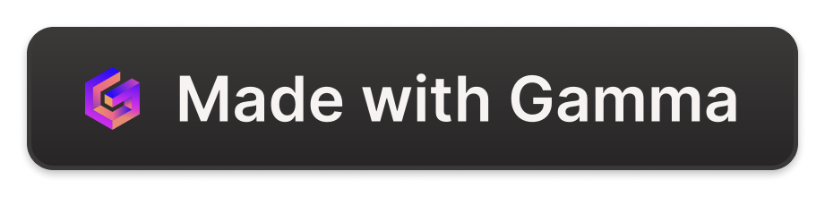
INTERNSHIP TOPIC DOMAIN/AREA :
Web development involves creating websites and web applications. It includes front-end development for the user interface and back-end development for server-side logic.
Key technologies include HTML, CSS, JavaScript, and popular frameworks like React and Angular. Continuous learning is essential due to the field's fast-paced evolution.

Slide 3

ABOUT THE COMPANY :
https://cit2.internshipstudio.com/istudio/
Workplace Culture :
Company Website :
Internship Studio is an online training and internship platform.
Industry :
Internship Studio emerges as a groundbreaking online platform, founded on the
principle of democratizing access to internship opportunities for students across
diverse fields. Their mission is to remove the barriers preventing students from pursuing
their passions by offering comprehensive internship programs that require no prior
experience.

Slide 4
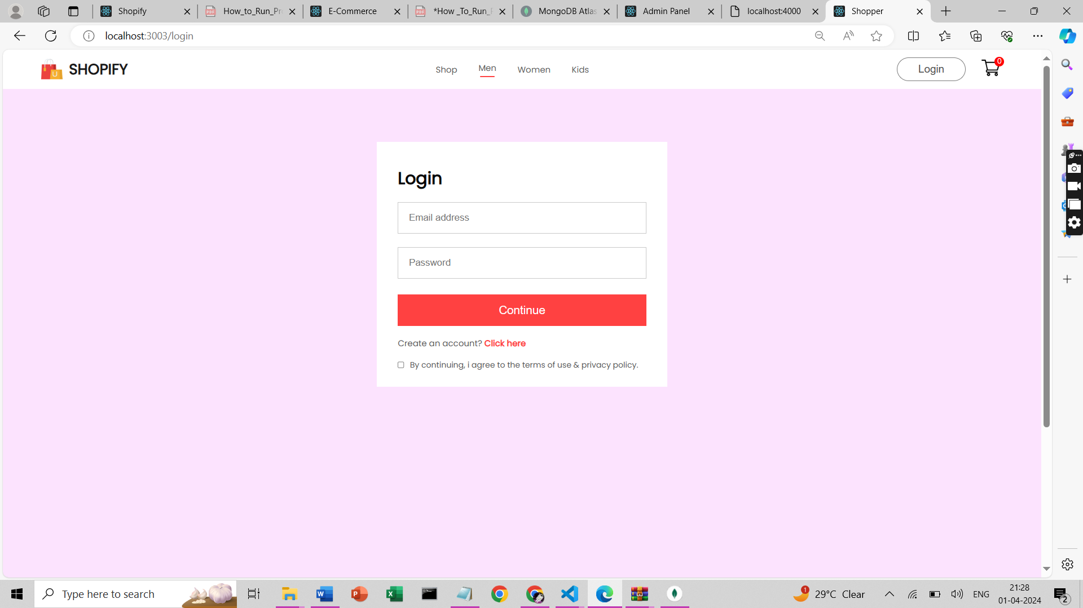
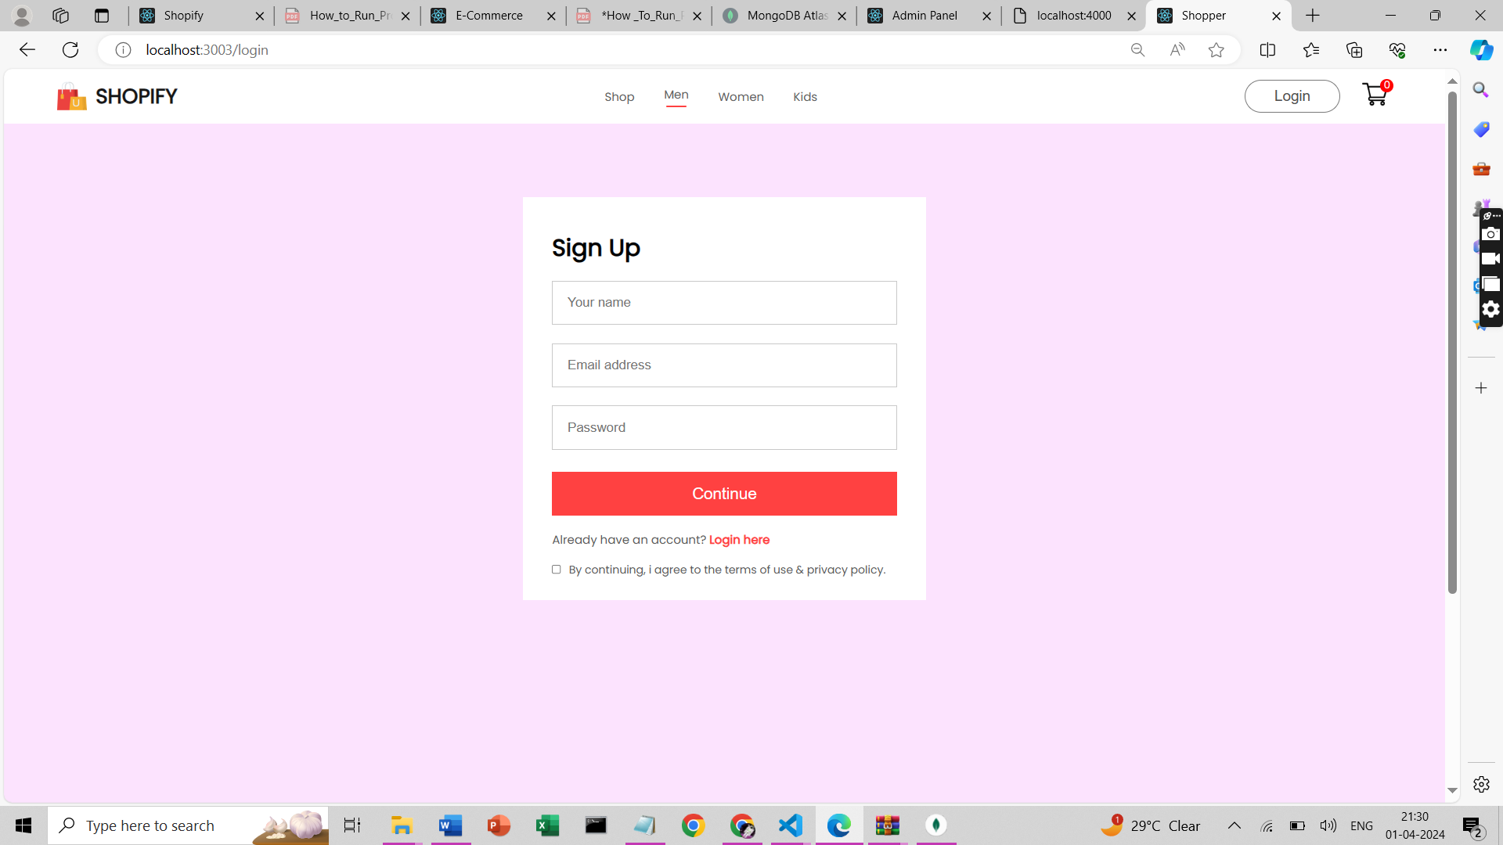
TASK PERFORMED:
ASSIGNED PROJECT :
Task 1 : Sign Up and Sign In page:
Build a E commerce website that allows users to sign up and sign in. Implement the functionality to store the details locally
using the browser’s local Storage API. Use HTML to structure the form, CSS to style the interface, and JavaScript to handle
task management and local storage operations.

Slide 5
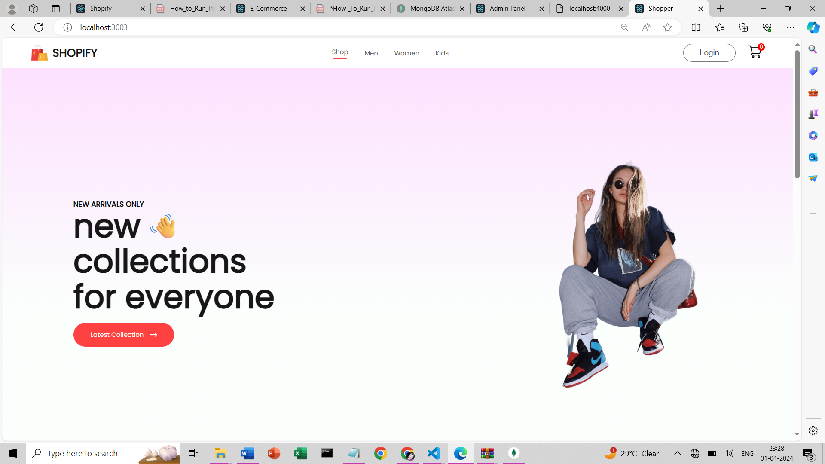
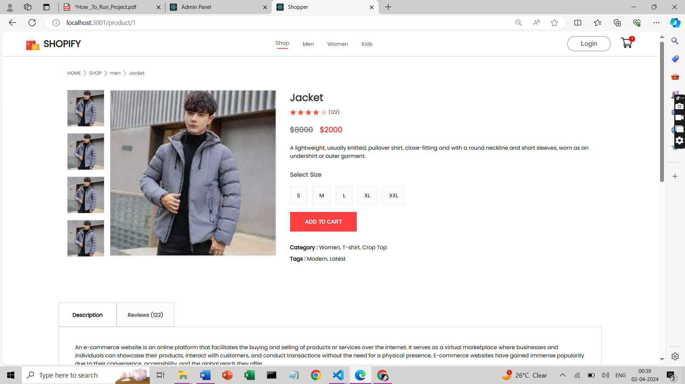
ASSIGNED PROJECT :
Task 2 : Home page and Shop Page:
Develop an home page with search options such as categories or price. Users can filter the products based on specific
criteria, such as top wear, bottom wear , or price ranges. Use HTML to structure the gallery, CSS to style the layout and
effects, and JavaScript to handle the filtering functionality.

Slide 6
Features Provided
1. user can view all products
2. user can view single product
3. user can search products and view products by category and price range
4. user can add to cart checkout products using credit card info
5. user can register & sign in
6. admin can create, edit, update & delete products
7. admin can create categories
8. admin can view ordered products

Slide 7
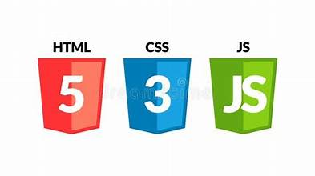
TASK OVERVIEW :
Language used :
HTML (Hypertext Markup Language) is the standard markup language for creating web pages. It provides the structure for content like text, images, and links using tags.
CSS (Cascading Style Sheets) is used to style the appearance of HTML elements on a web page. It allows you to set colors, fonts, spacing, and layout. CSS can be applied internally within an HTML document, externally using a separate CSS file, or inline directly within HTML elements.
JavaScript (JS) is a versatile programming language primarily used for adding interactivity to web pages. It allows you to manipulate the content and behavior of a webpage dynamically. JS can be used to validate forms, create animations, build interactive maps, and much more

Slide 8
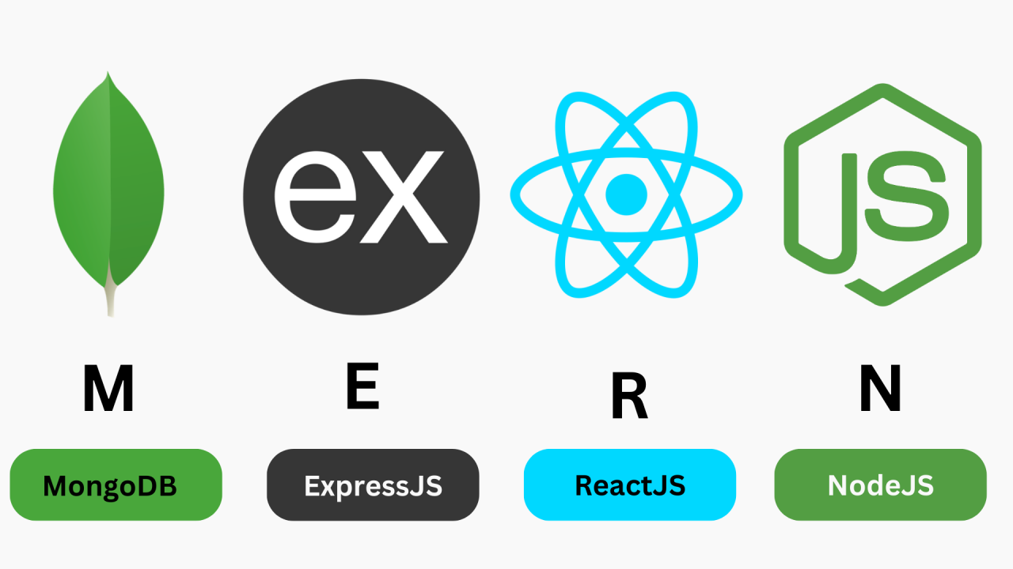
TASK OVERVIEW :
Technologies used :
MongoDB is a NoSQL database that stores data in JSON-like documents. To store and manipulate the data, such as the product catalog, the user information, the order history, etc.
Express is a web framework that handles routing, middleware, and server-side logic. To simplify the development process and handle the requests and responses between the frontend and the backend.
React is a front-end library that creates user interfaces using components and state management. To create dynamic and responsive user interfaces that showcase the products and services offered by the website.
Node.js is a runtime environment that executes JavaScript code outside the browser. To enable the development of scalable and efficient web applications.

Slide 9
LOG BOOK :
Week No. | Activity Planned | Activity Completed Status
Week 1 | Learn HTML, CSS, JavaScript. | Learned about the HTML Tags, there uses and different CSS properties for the styling.
Week 2 | Learn React, MongoDB. | Learned how To create dynamic and responsive user interfaces using react. And to store and manipulate data using MongoDB
Week 3 | Learn Express, Node.js | Learned the concept of Express and Node.js
Week 4 | Complete the project which is Ecommerce Website. | Create an ecommerce website using the MERN stack, which is a popular technology stack for web development

Slide 10

OBJECTIVES ACHIEVED :
1
Frontend Development Skills
Develop proficiency in creating visually appealing and responsive user interfaces using HTML for structure, CSS for styling, and JavaScript for interactivity.
2
Website Design and Layout
Learn to design and implement website layouts, navigation menus, and interactive components using CSS and JavaScript.
3
Web Page Responsiveness
Understand and implement responsive web design principles to ensure websites look and function well on various devices and screen sizes.

Slide 11
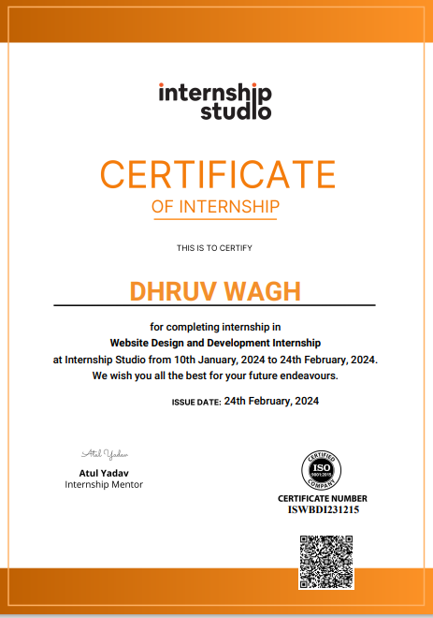
Certificate Of Internship :
Completion Recognition
Celebrating the successful completion of the
internship and the valuable insights gained.

