Slide 1
Cryptography &
Network Security
Department of C.S.E
CSIT, Durg
CNS_CSE_CSIT,Durg

Slide 2
Cryptography
It is a Greek word
It is secret writing.
Massege to be Encrypted is known as Plain Text
CNS_CSE_CSIT,Durg

Slide 3
Architecture and Services
Basic functions
Composition
Transfer
Reporting
Displaying
Disposition
CNS_CSE_CSIT,Durg

Slide 4
Security Attacks & Services
The OSI (Open Systems Interconnection ) security architecture provides a systematic framework for defining security attacks, mechanisms and services.
  Information Security
  Computer Security
  Network security/Internet Security
CNS_CSE_CSIT,Durg

Slide 5
PASSIVE ATTACKS:
Passive Attack services:-
  Release of message contents(Read contents of message from A to B)
  Traffic Analysis (Observe Patten of message from A to B)
CNS_CSE_CSIT,Durg

Slide 6
ACTIVE ATTACKS:
Active Attacks Services:-
  Masquerade(when one entity pretends to be different entity),
  Replay(involves the passive capture of a data unit & its subsequent retransmission),
  Modification of message(some portion of legitimate message is altered),
  Denial of service (prevents the normal use or management of communications facilities).
CNS_CSE_CSIT,Durg

Slide 7
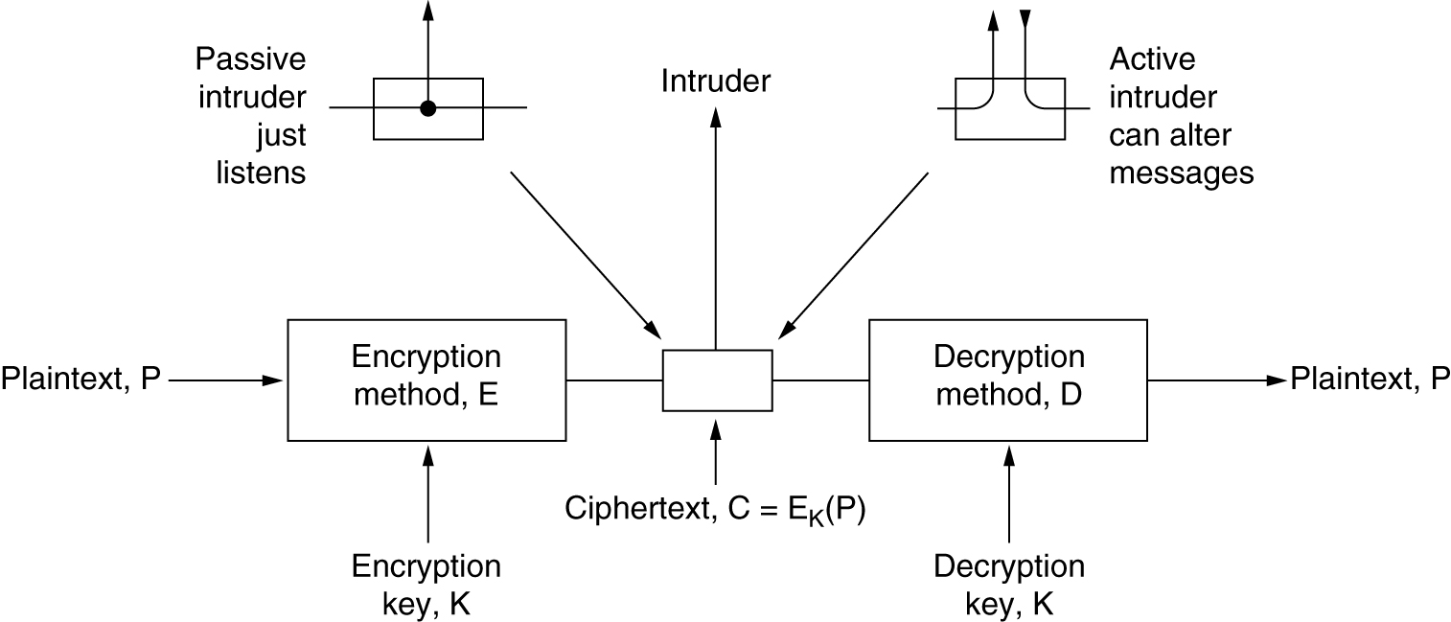
An Introduction to Cryptography
The encryption model (for a symmetric-key cipher).
CNS_CSE_CSIT,Durg

Slide 8
Plain text is transform in to cipher text
Cryptography is key to convert Text in to Cipher text.
The art of breaking the cipher is called Cryptanalysis.
CNS_CSE_CSIT,Durg

Slide 9
This process is called Cryptology.
Cipher means character to character or bit for bit.
C=E(P)
Means Encryption of text P using key K gives Cipher text ‘C’
CNS_CSE_CSIT,Durg

Slide 10
P=Dk(C)
Represents Decryption of C to get plain text
(Dk(Ek(P))=P
CNS_CSE_CSIT,Durg

Slide 11
Substitution & Permutation:-
Substitution Ciphers
  It is the technique in which the letters of plain text are replaced by other letters or by numbers or symbol
  In a simple substitution cipher, one character is substituted for another. Here is a simple example:
  A B C D E F G H I J K L M N O P Q R S T U V W X Y Z
  R Z B U Q K F C P Y E V L S N G W O X D J I A H T M
CNS_CSE_CSIT,Durg

Slide 12
Substitution Techniques:-
Caesar Cipher
Mono Alphabetic Cipher
Play Fair Cipher
Hill Cipher
Poly Alphabetic Cipher
One Time Pad Cipher
CNS_CSE_CSIT,Durg

Slide 13
Permutation:-
The another cryptography tool is Permutation, in which hide the message by rearranging the letter order without altering the actual text.
PERMUTATION/TRANSPOSITION TECHNIQUES:-
  Rail fence Technique
  Pure Transposition Technique
CNS_CSE_CSIT,Durg

Slide 14
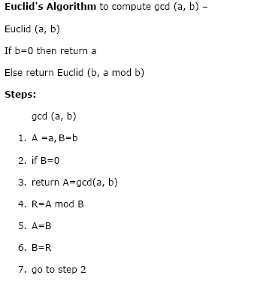
Modular Arithmetic & Euclid’s Algorithm:-
CNS_CSE_CSIT,Durg

Slide 15
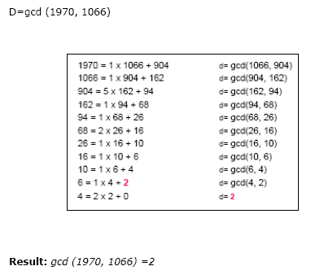
Example:-
CNS_CSE_CSIT,Durg

Slide 16
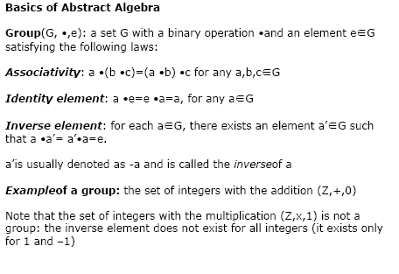
Polynomial Arithmetic, Finite Fields
CNS_CSE_CSIT,Durg

Slide 17
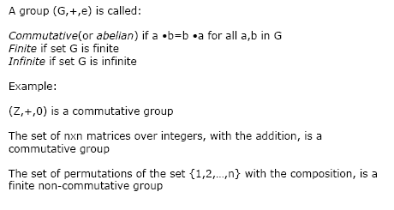
Contd……
CNS_CSE_CSIT,Durg

Slide 18
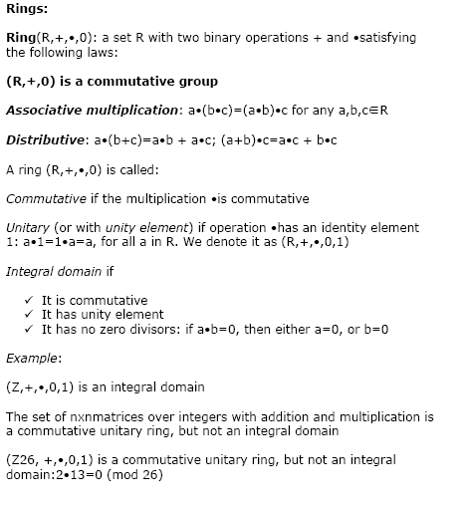
Contd…..
CNS_CSE_CSIT,Durg

Slide 19
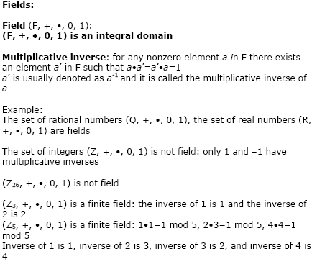
Contd….
CNS_CSE_CSIT,Durg

Slide 20
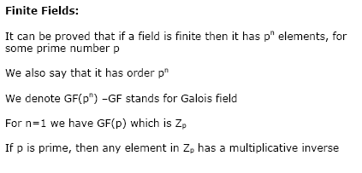
Contd…
CNS_CSE_CSIT,Durg

Slide 21
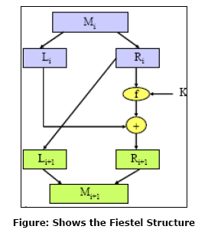
Feistal Cipher Network Structures:-
CNS_CSE_CSIT,Durg

Slide 22
Cryptographic Algorithm
Data Encryption Standared(DES)
IBM developed DES in early 1970’s
In Encryption DES first divides the original message in to blocks of 64 bits
CNS_CSE_CSIT,Durg

Slide 23
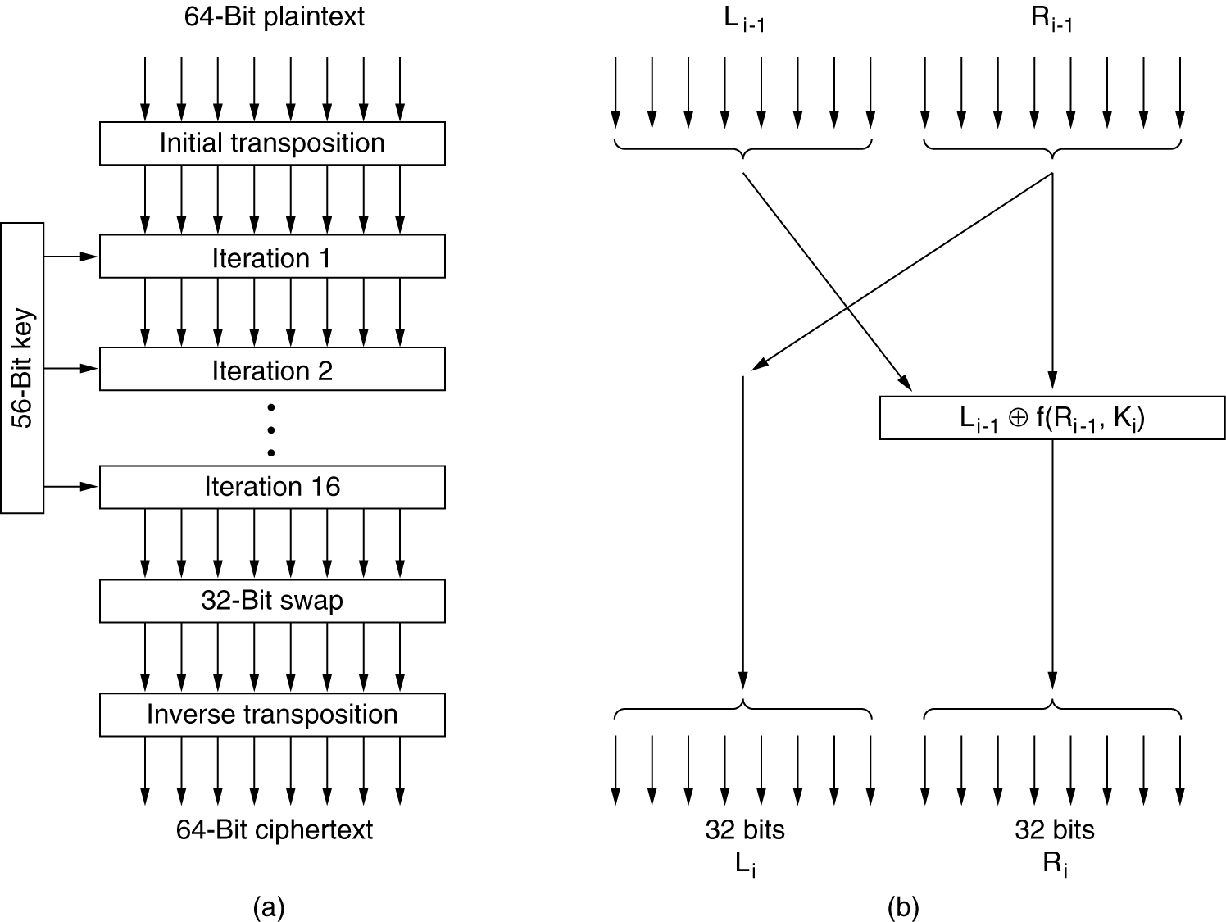
Data Encryption Standard
The data encryption standard. (a) General outline.
(b) Detail of one iteration. The circled + means exclusive OR.
CNS_CSE_CSIT,Durg

Slide 24
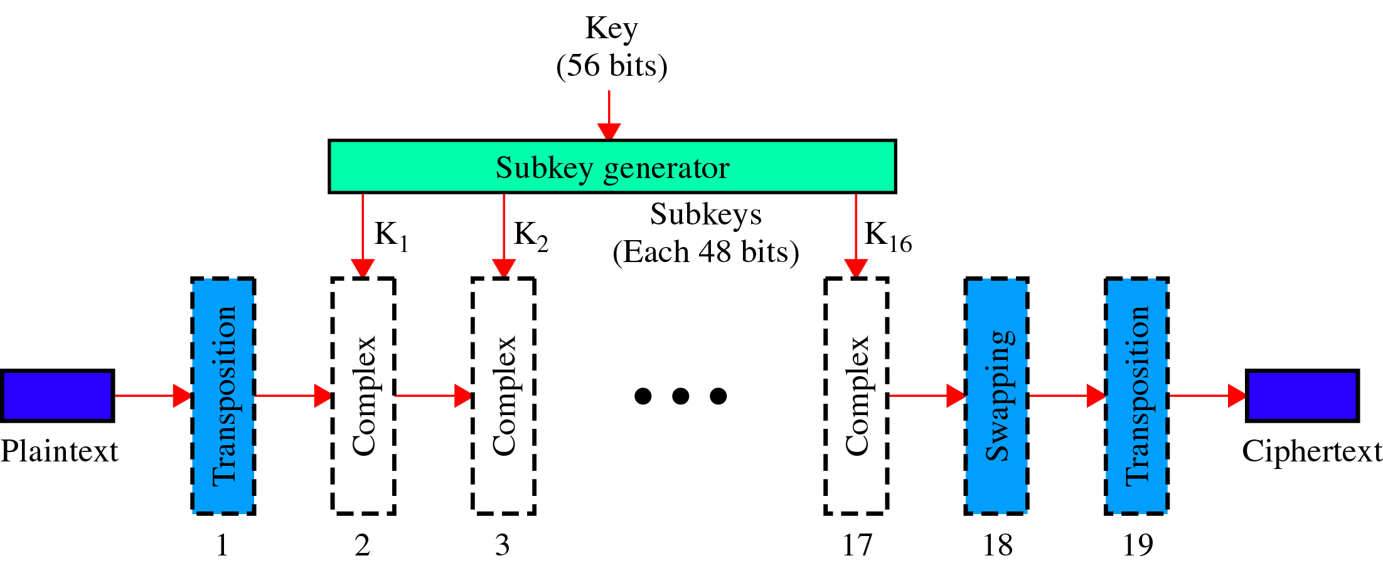
Figure 23-18
DES
CNS_CSE_CSIT,Durg

Slide 25
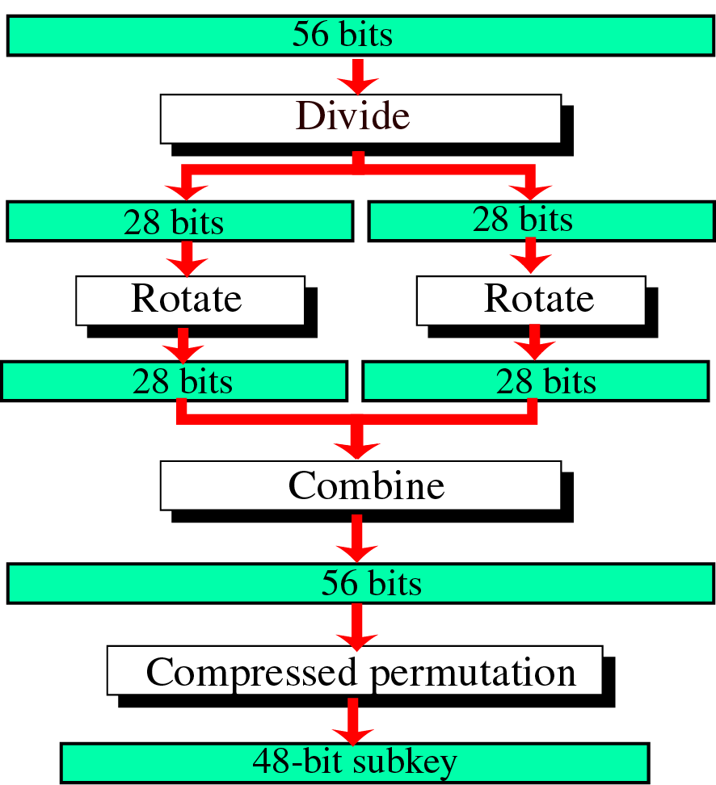
Figure 23-19
Subkey Generation in DES
CNS_CSE_CSIT,Durg

Slide 26
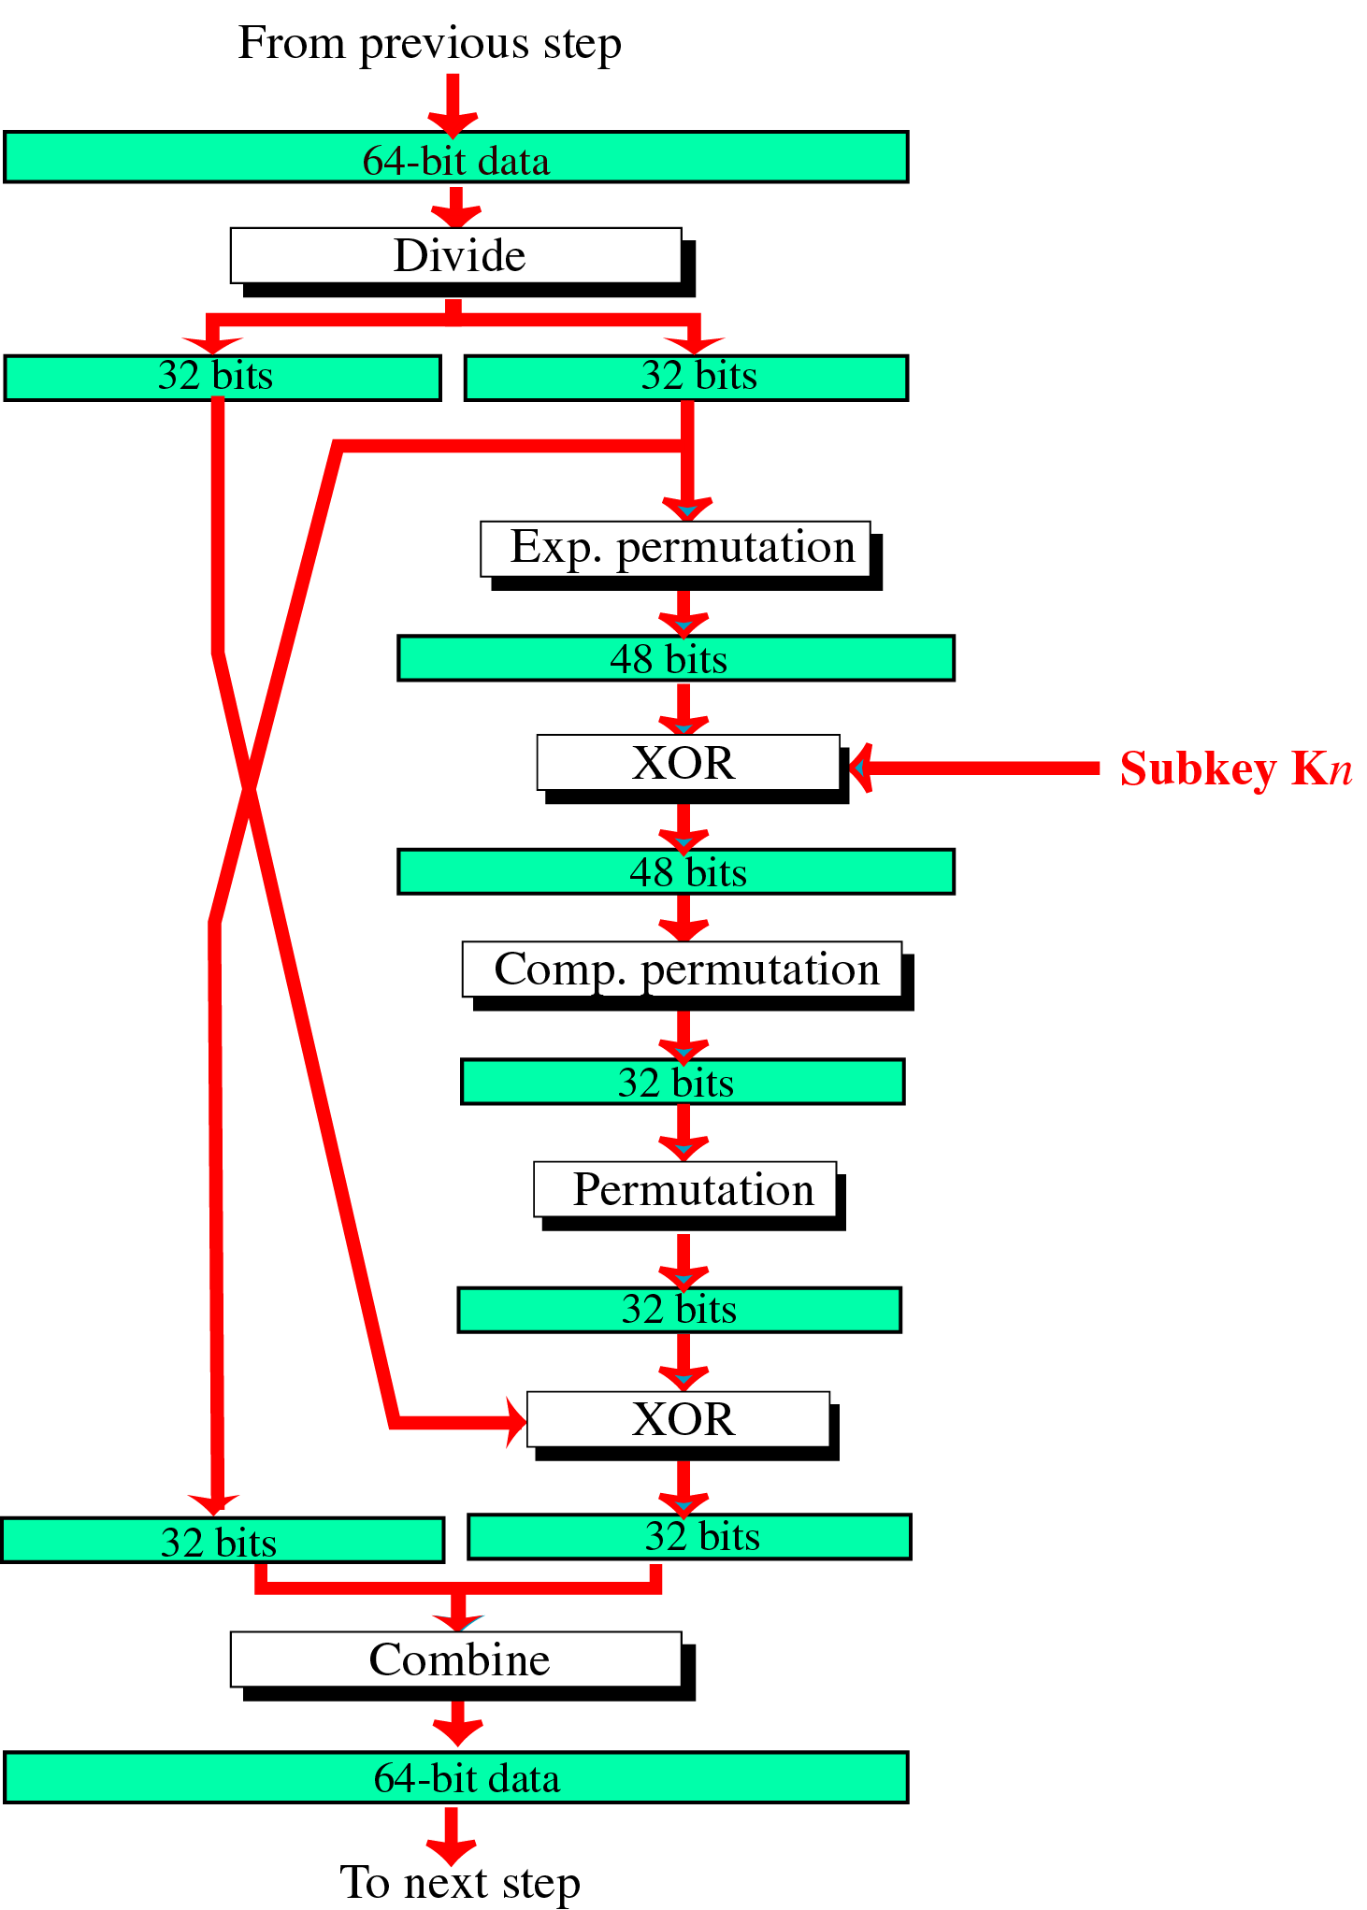
Figure 23-20
One of the 16
Steps in DES
CNS_CSE_CSIT,Durg

Slide 27
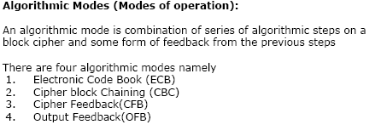
Modes of operation :-
CNS_CSE_CSIT,Durg

Slide 28
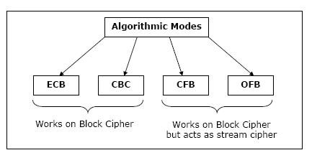
Modes of Operations:-
CNS_CSE_CSIT,Durg

Slide 29
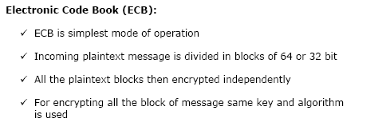
Contd…
CNS_CSE_CSIT,Durg

Slide 30
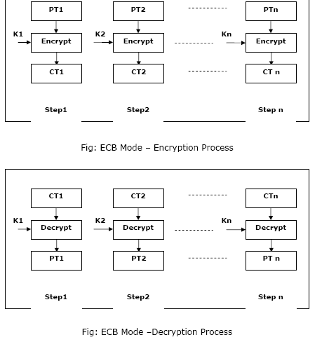
ECB
CNS_CSE_CSIT,Durg

Slide 31
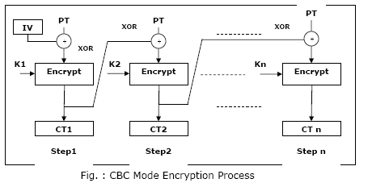
CBC
CNS_CSE_CSIT,Durg

Slide 32
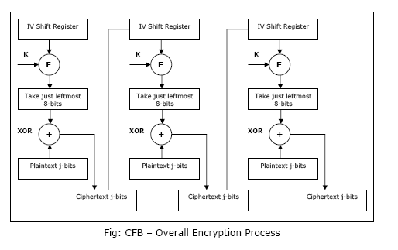
CFB
CNS_CSE_CSIT,Durg

Slide 33
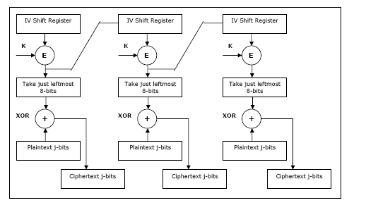
OFB
CNS_CSE_CSIT,Durg

Slide 34
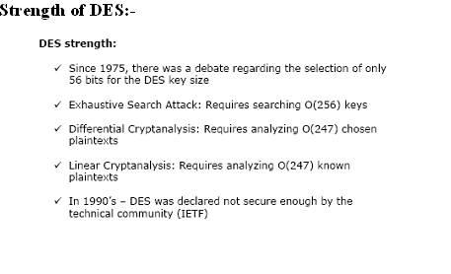
CNS_CSE_CSIT,Durg

Slide 35
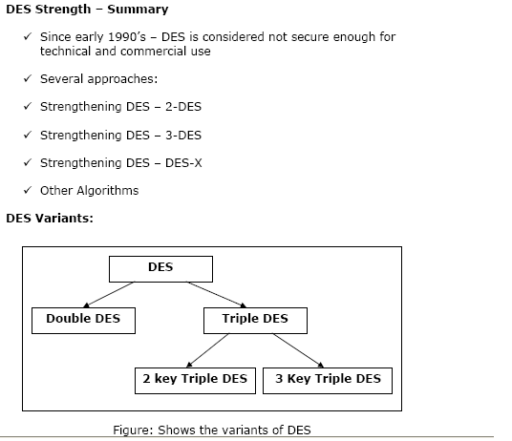
CNS_CSE_CSIT,Durg

