Slide 1


My Travel
Project for mobile applications and cloud computing
Francesco D’Abbraccio 1657674
Noura Boubou 1823776

Slide 2
Main features
The app is designed to easily manage your trips. No matter if you travel alone or with your friends: this is the right choice for you!
Give a name to your trip and add your destinations. In each destination page you’ll find useful information for you.
You can also manage your common payments. The app will dynamically calculate the balance for each participant.

Slide 3

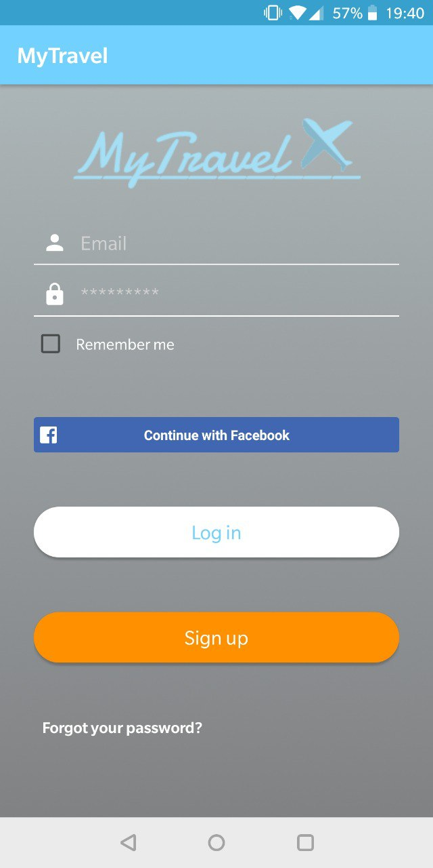
Home page
In the home page you’ll find all the links you need to start interacting with the app

Slide 4
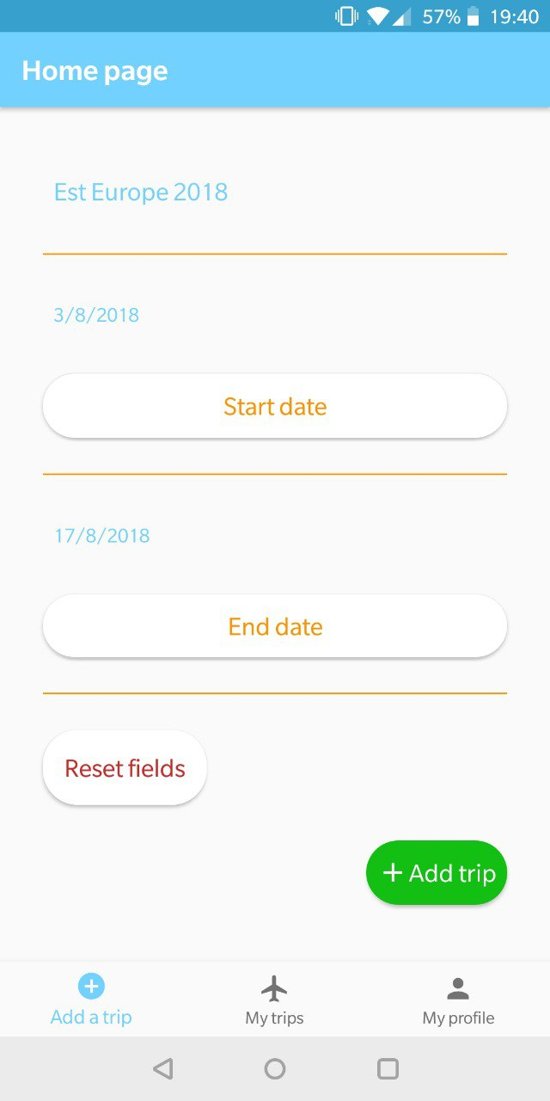
Add a trip
There are 3 pages. The default screen is where you can add a new trip to your list

Slide 5
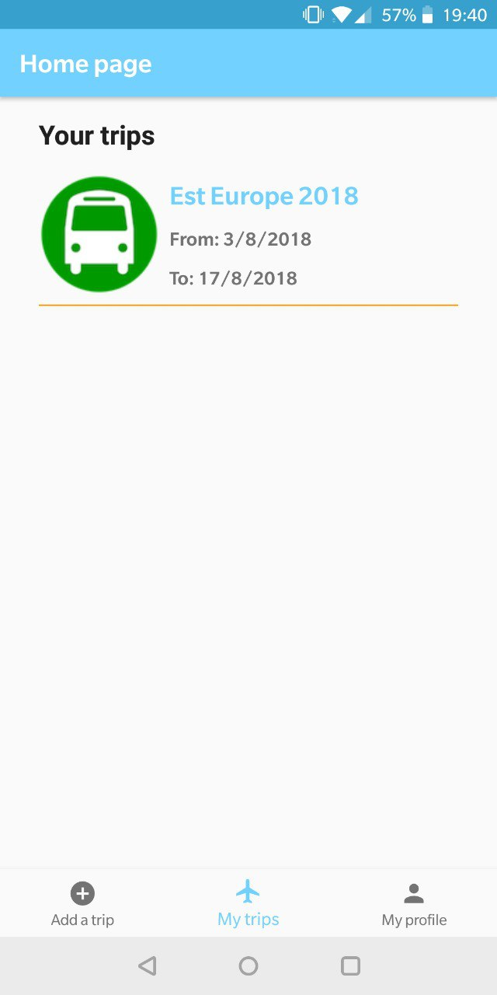
My trips
Here you can find the list of your trips, displayed by a Recycler View

Slide 6
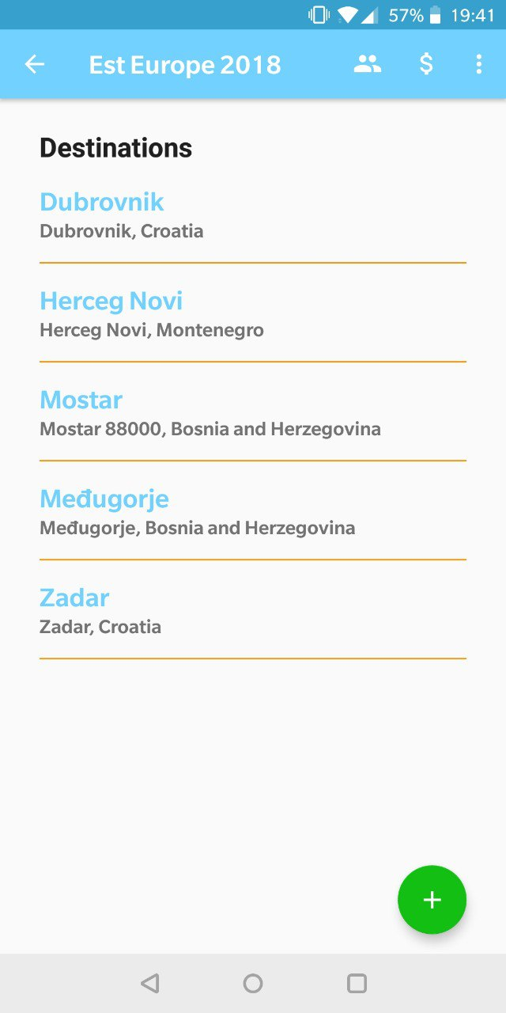
Trip page
In the trip page you’ll see the list of your destinations and three buttons on the app bar: these are for the participant page, payment page and a menu

Slide 7
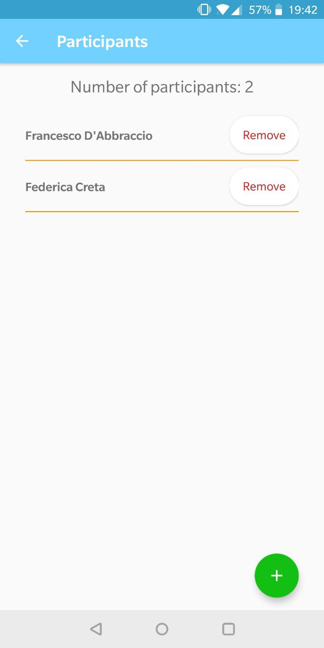
Participant page
This is the page where you can manage the participants to the trip

Slide 8
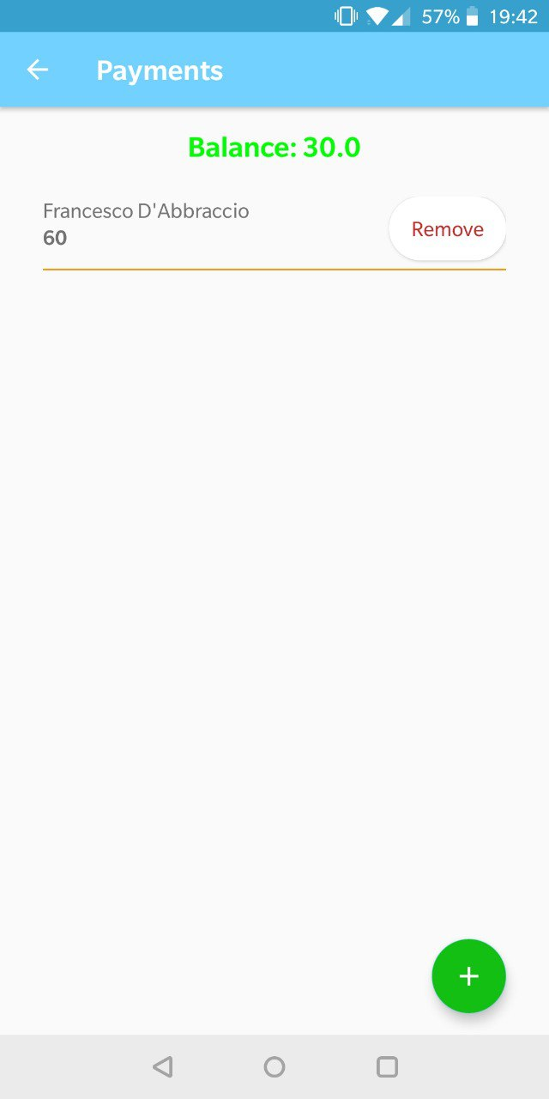
payments page
As well as the participants, you can manage all the payments

Slide 9
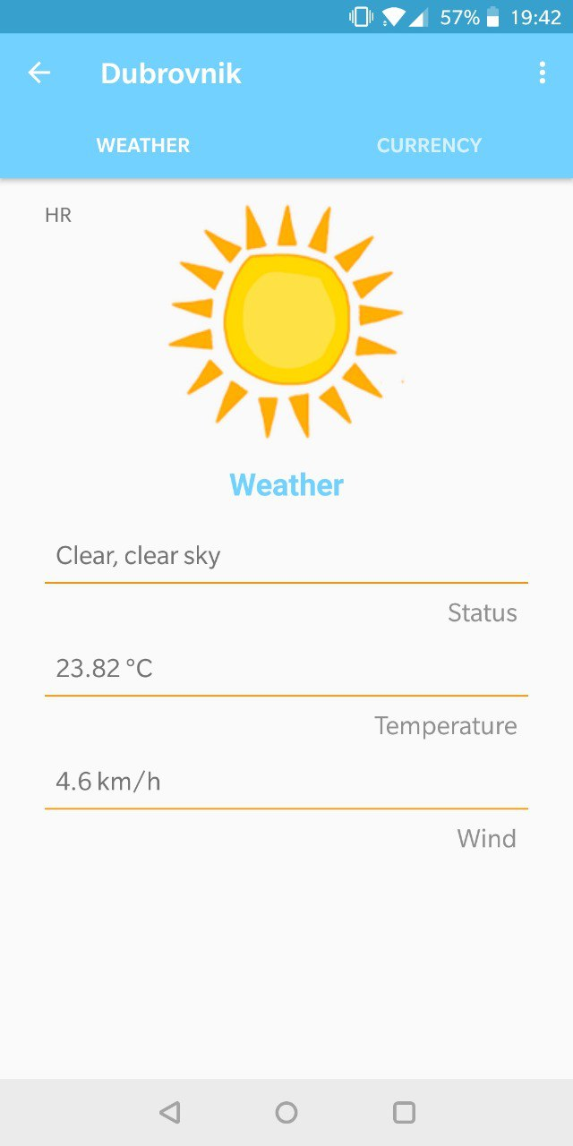
Destination page
In this page you can find information about destination’s weather

Slide 10
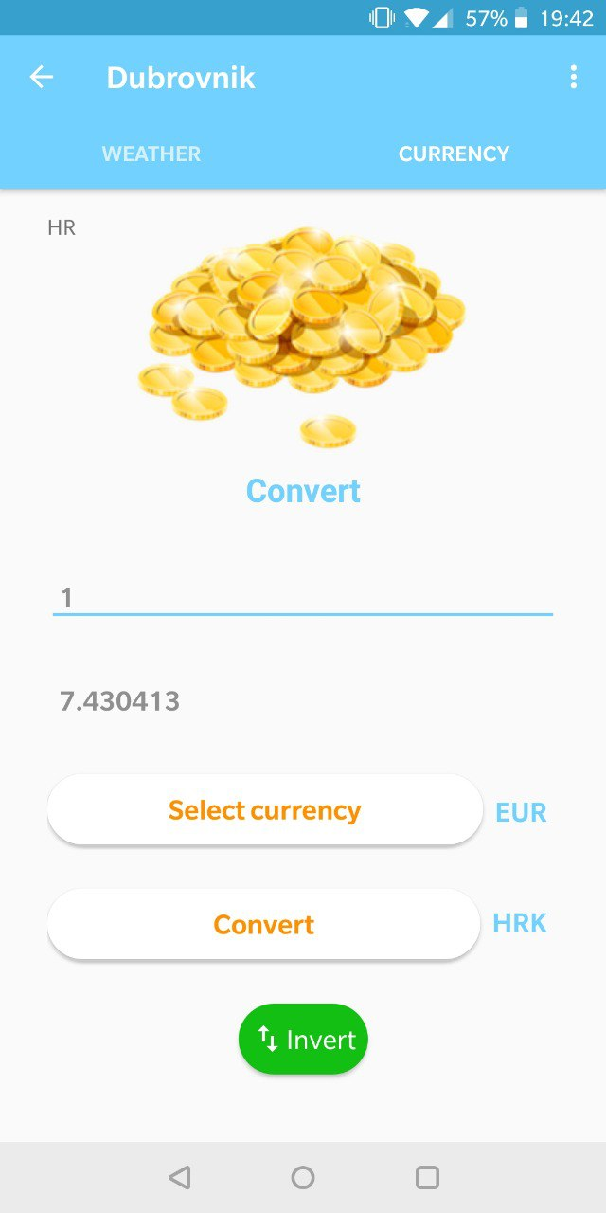
currency page
Here you can find information about the currency used in the city and also a conversion tool

Slide 11
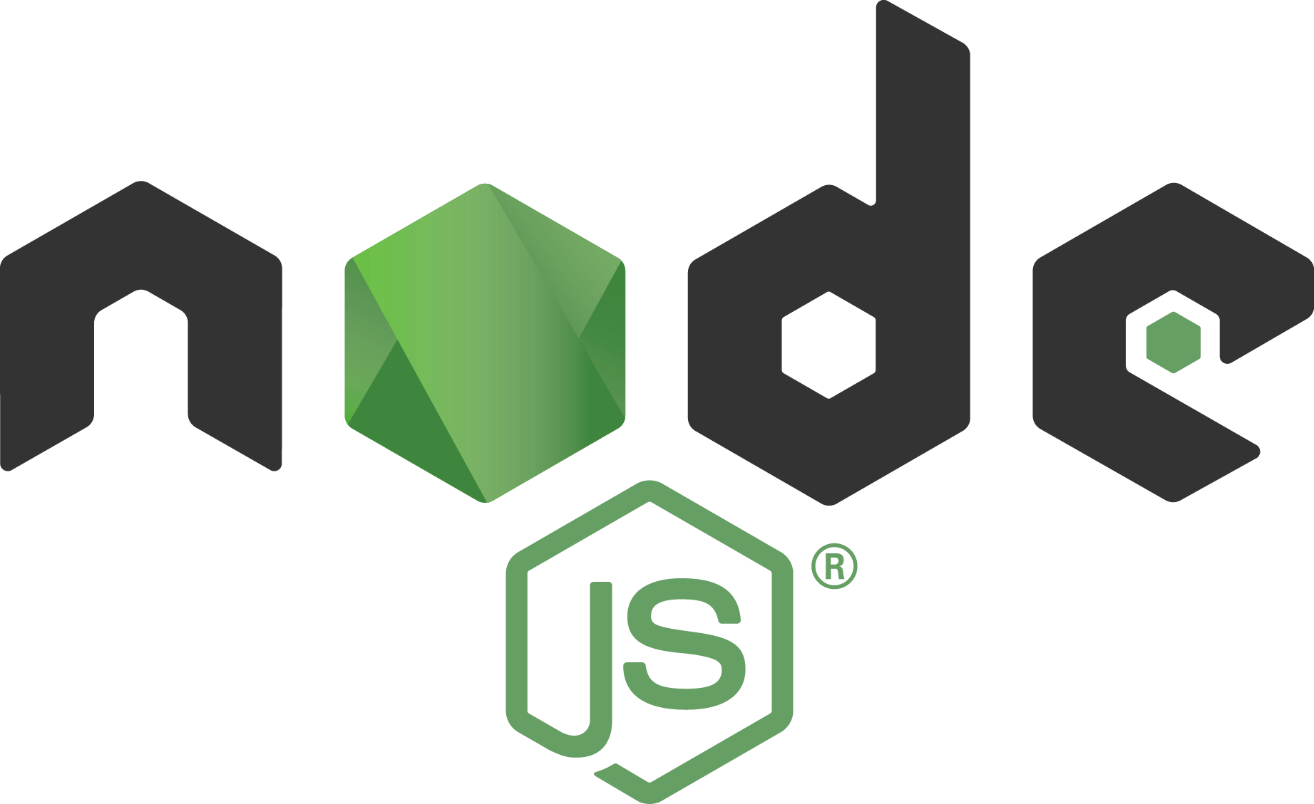
backend

Slide 12
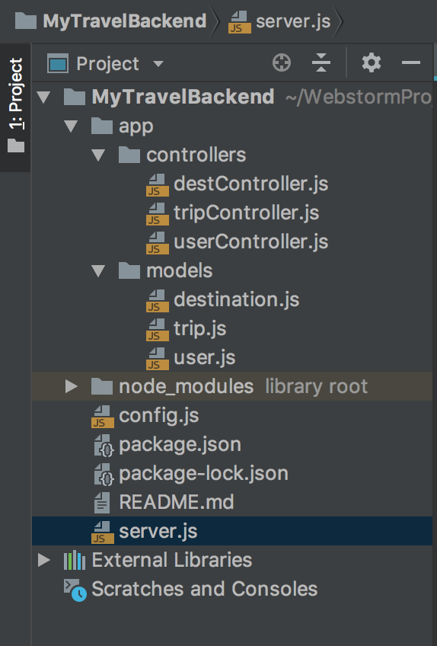
Main structure
This is the structure of the backend. Following the MVC pattern, here we have Models and Controllers, while the View is fully implemented on Android.

Slide 13
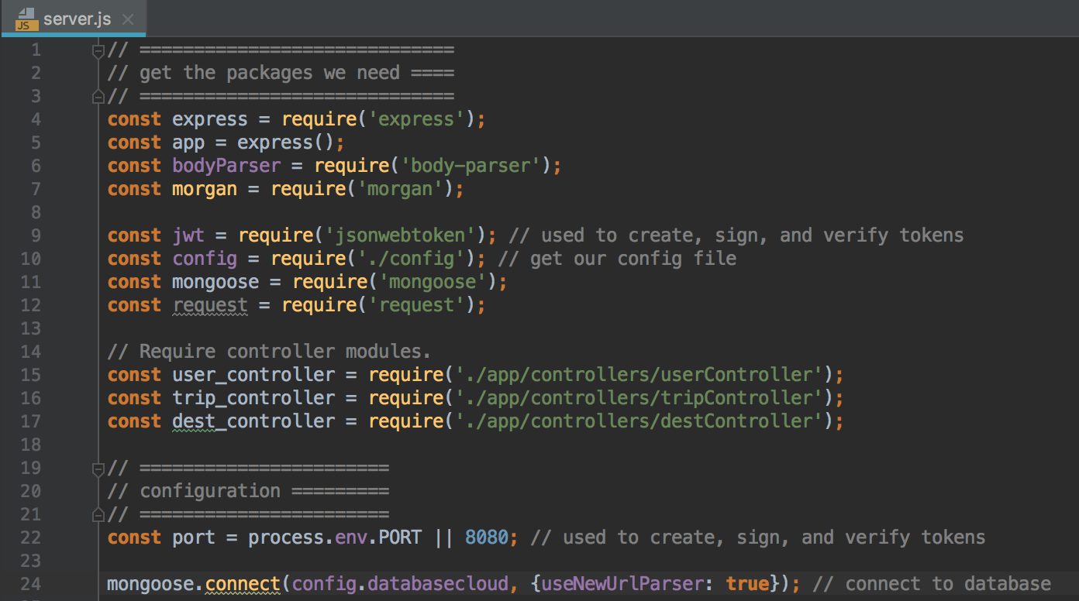
Additional plugins
In order to build a complete application, we need some external libraries, like Express and Mongoose.

Slide 14
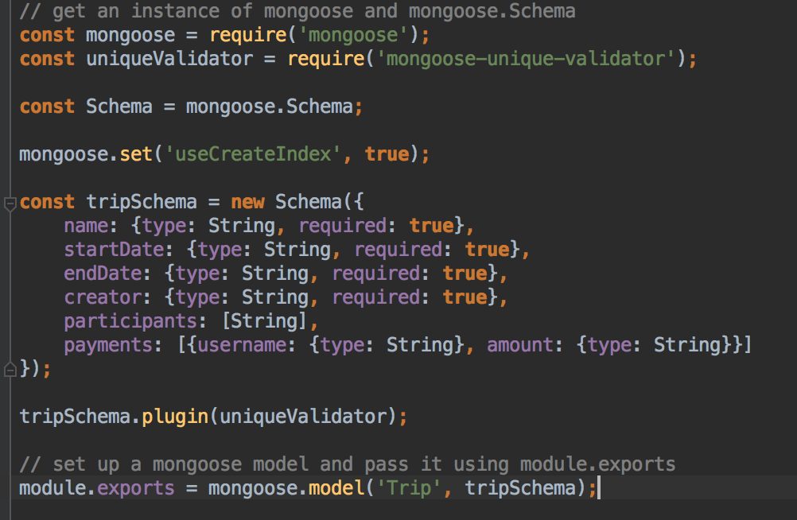
Model structure
The database used for the project is MongoDB, a NoSQL database. We don’t interact directly with it but through mongoose, a package for Node JS

Slide 15
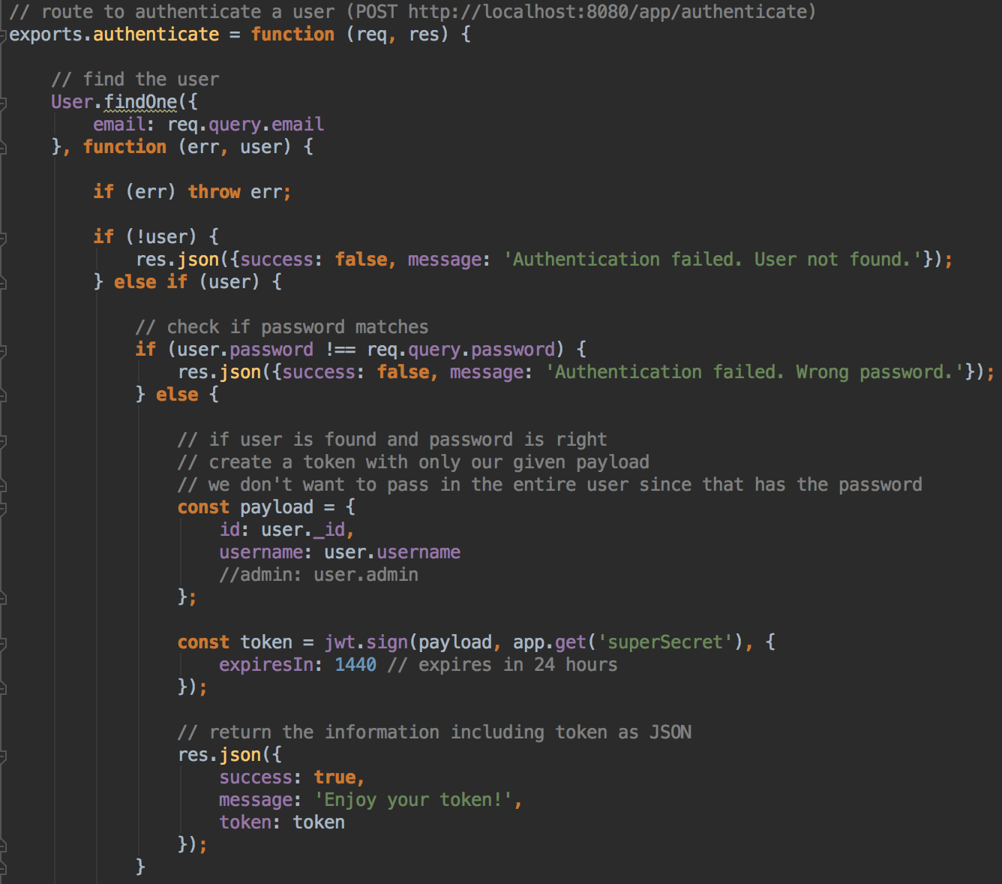
Token authentication
When we login in the app, we receive as response a token that expires in 24 hours. Every request must come with this token in order to check if we are able to access the content we want.

Slide 16
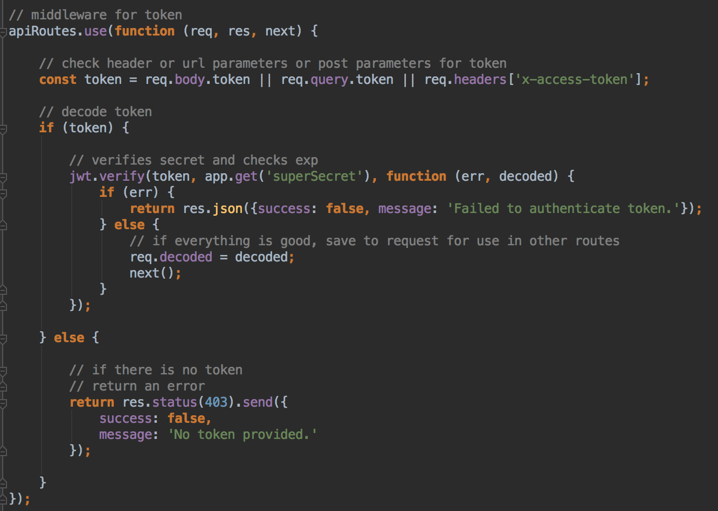
Middleware function
In order to authenticate the token, we define this function. Each route written after this middleware will execute this code first, for authentication

Slide 17
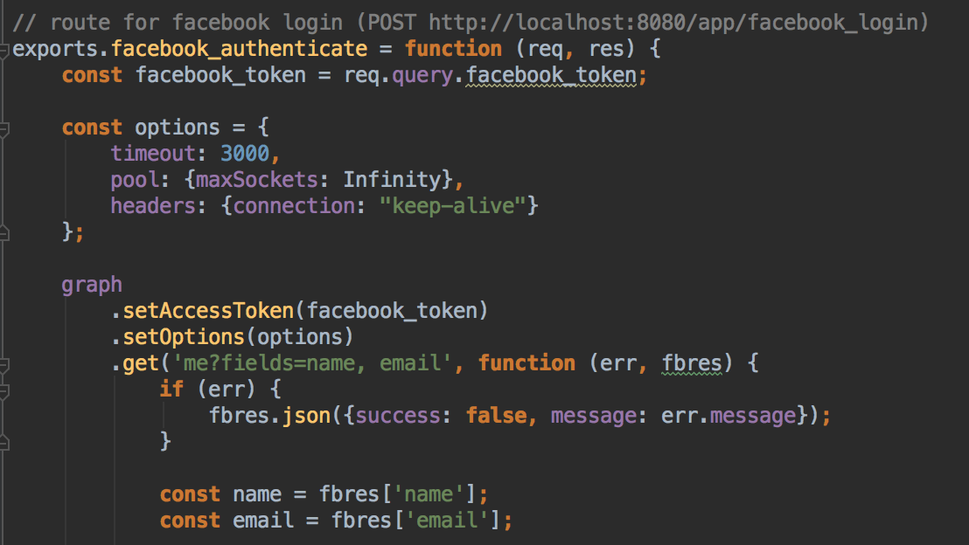
Facebook authentication
Using the Facebook authentication token we get from Android, we can access the Facebook API and get user’s name and email to create an account

Slide 18
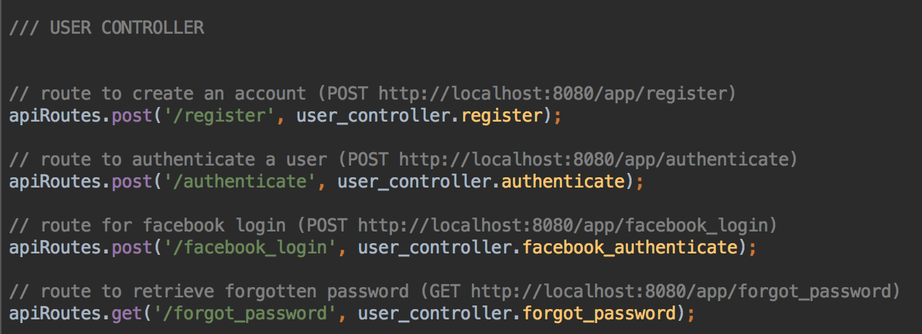
Defining routes
With Express, we are able to define the routes for our RESTful interface, using HTTP verbs

