Slide 1
Gen AI for Developers: Beginner Course
Different Roles Related to Gen AI:
  Generative AI Research Scientist or LLM Research Scientist/Engineer
  Fine-tuning / Adaptation Engineer (SFT, LoRA, PEFT)
  Generative AI Engineer or LLM Application Engineer
  AI Agent Engineer / Agentic AI Engineer and Agent Architect / Agent Orchestration Engineer
  RAG Engineer (Retrieval-Augmented Generation)
  Copilot / Assistant Engineer (enterprise copilots, internal assistants)
  LLMOps Engineer
  GenAI Platform Architect and GenAI Solution Architect
  Guardrails Engineer / Safety Mechanisms Engineer
  AI Incident Response / GenAI Trust & Safety Ops
  Responsible AI Specialist (GenAI) or AI Governance Architect / GenAI Governance Lead
  Model Risk Manager (GenAI)
  Generative AI Product Manager
https://lightcast.io/resources/blog/the-generative-ai-job-market-2025-data-insights?utm_source=chatgpt.com
https://www.ibm.com/think/topics/llmops?utm_source=chatgpt.com

Slide 2
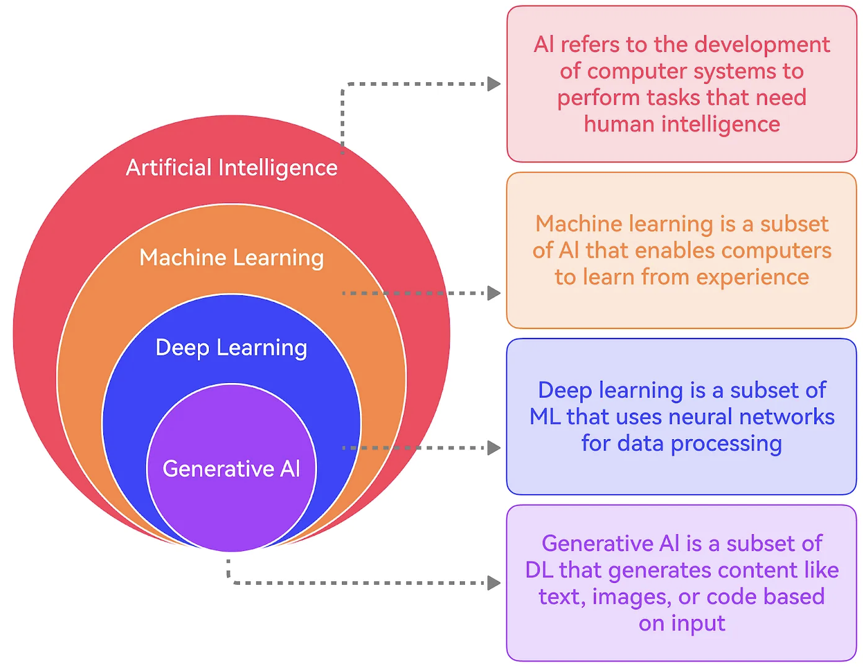
Gen AI for Developers: Beginner Course
https://blog.bytebytego.com/p/where-to-get-started-with-genai

Slide 3
What You’ll Learn in This Course:
What This Course Covers
This course is designed for beginners who want to get started with Generative AI application development.
This course focuses on getting you started with Generative AI development through hands-on practice and practical understanding..
Please note that this course does not cover advanced-level topics or deep theoretical details.
Requirements
Basic knowledge of Python programming
Familiarity with Python syntax, variables, and functions is sufficient
LLM Models: Open-source and Closed-source
Accessing LLMs: API keys, SDKs, first calls, unified runner
Open-Source LLMs: Hugging Face models
Key Concepts: Context window, tokenization, chunking, and other parameters
Prompt Engineering: Reliable prompts, constraints, examples
Structured Outputs & Tools: Safe routing and tool usage
Embeddings & Semantic Search
IDE: Coding with different IDEs
RAG: End-to-end document Q&A with citations
Agents & Workflows: Multi-step, tool-based applications – Different Agentic Frameworks
Evaluation & Testing: Golden datasets, regression checks
Observability & Tracing
CI/CD & Deployment: GitHub Actions
MCP Server: Introduction and use cases
Application Delivery: FastAPI / Streamlit apps

Slide 4
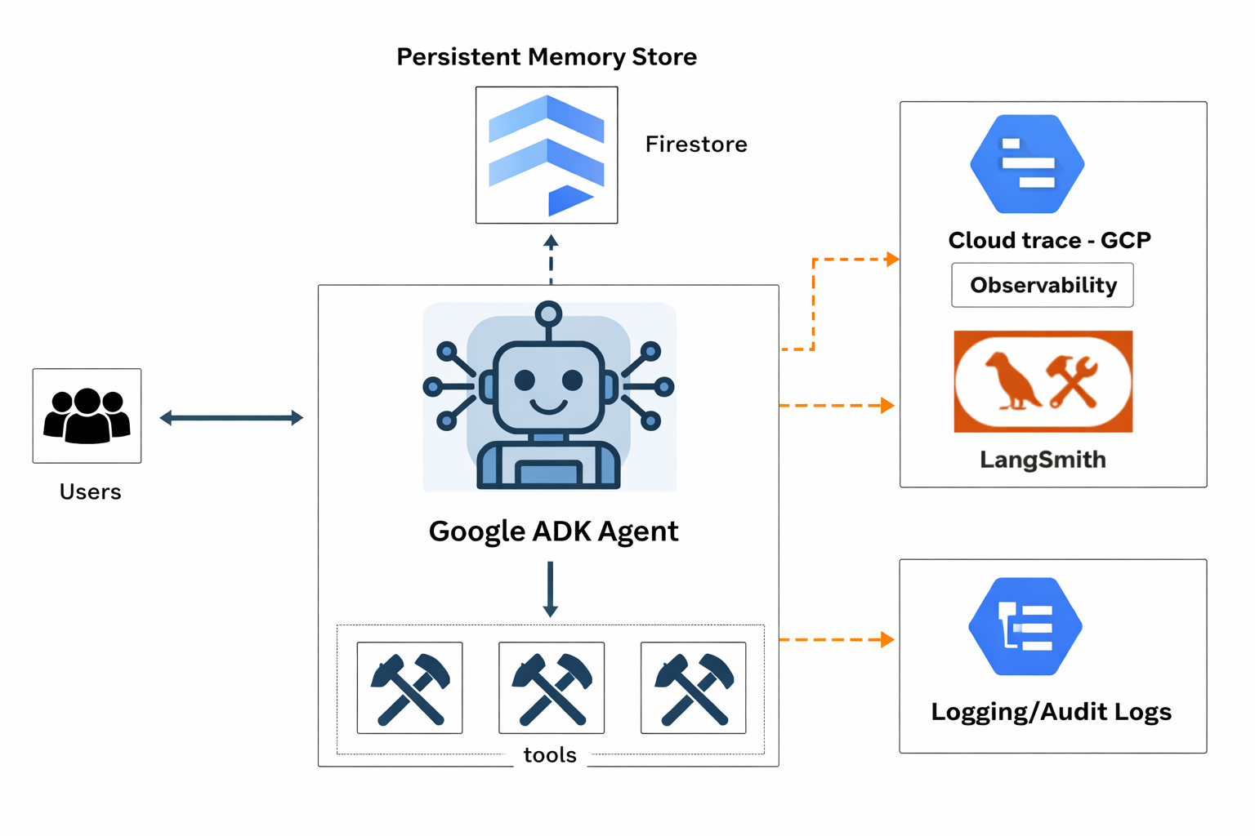
Implementing a Full Agentic Workflow

