Slide 1
Data Profiling and Cleaning
Handling Missing Values
UBCO Master of Data Science – DATA 542
Fatemeh Fard

Slide 2
Lecture 2 - review
DataFrames and Series objects in Pandas
Functions on DataFrames and Series to index and select data
Functions on DataFrames and Series to sub-set data (slicing)

Slide 3
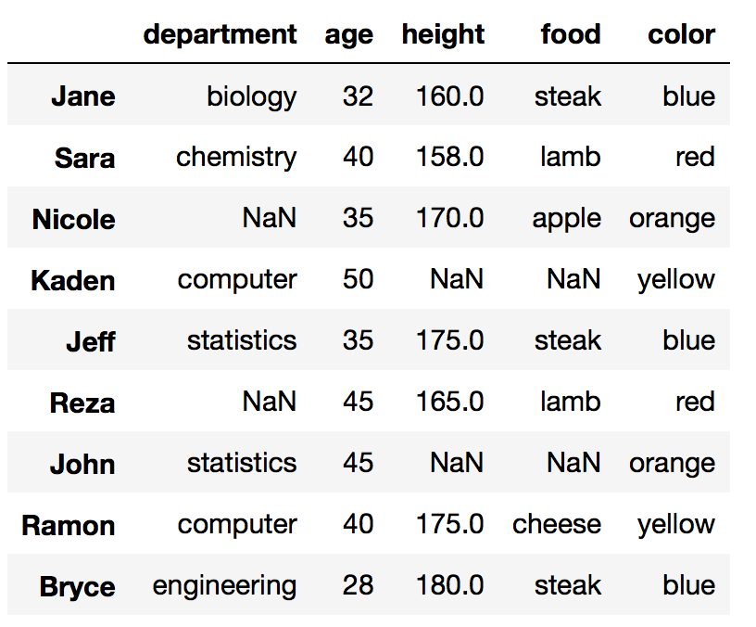
Example data

Slide 4
Discussion
What do you need to know about your data, before starting the analysis?

Slide 5
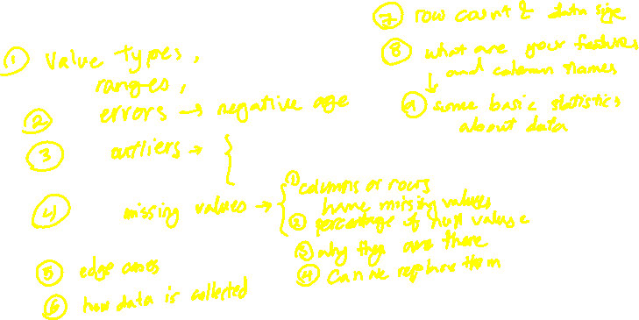
Discussion
What do you need to know about your data, before starting the analysis?

Slide 6
Data Profiling
Reviewing your data source, content, and identifying key quality assessments (e.g. outliers, null values)
1- Read your data
pd.read_csv() #Use header=None to include first row in the data
pd.read_sql()
pd.read_excel()

Slide 7
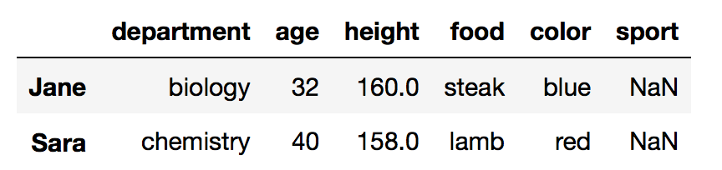
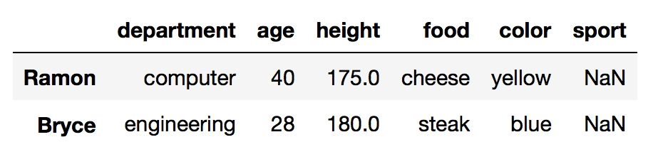
Data Profiling cont.
2- Take a look
df.head(integer)
df.tail(integer)
Optional number, indicating how many rows

Slide 8
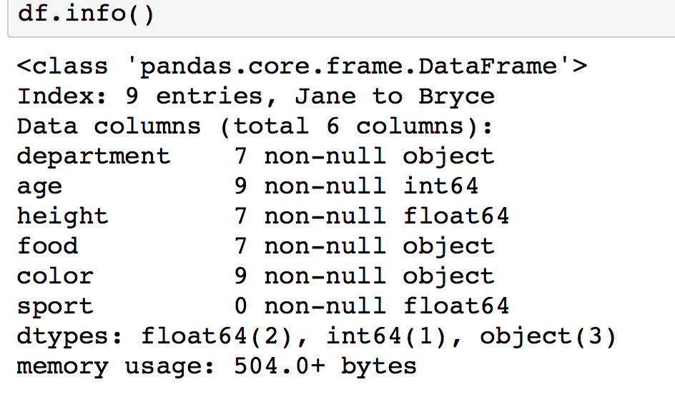
Data Profiling cont.
3- Gain some information about values
Null values
Data types
Number of entries
df.info()

Slide 9
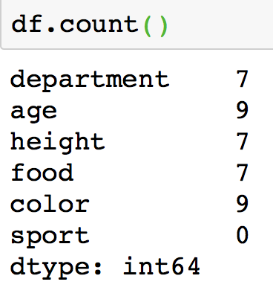
Data Profiling cont.
4- Explore your data using functions
Explore each column
df.age.sum() #count(), add(), agg
df.department.size()
Or explore the dataset
df.sample()
Each of the functions can be applied on a column or the dataset

Slide 10
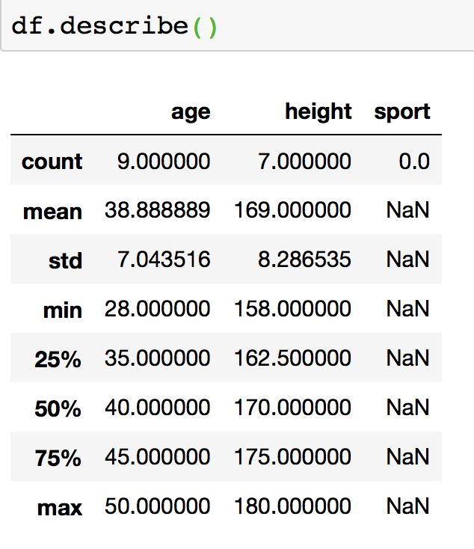
Data Profiling cont.
5- Examine statistics of your data
df.describe()

Slide 11
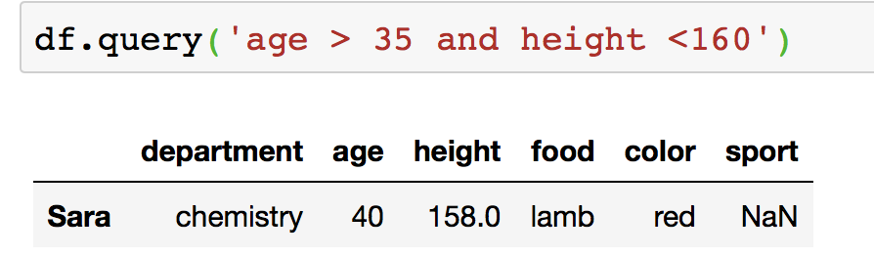
Data Profiling cont.
6- Run some query
df.query()
Note: df.query(‘age < 40’) is equivalent to
df[df.age < 40]

Slide 12
Try IT
Import the sample-data for lecture 3 and assess the data and column values

Slide 13
Exploring Missing Values

Slide 14
Discussion
1) Discuss some reasons for having null values in the data.
2) Why should we care about the null values, at all?!
Notes:
2)
Increasing the performance of the classifier
More precise results
Reliability of the analysis

Slide 15
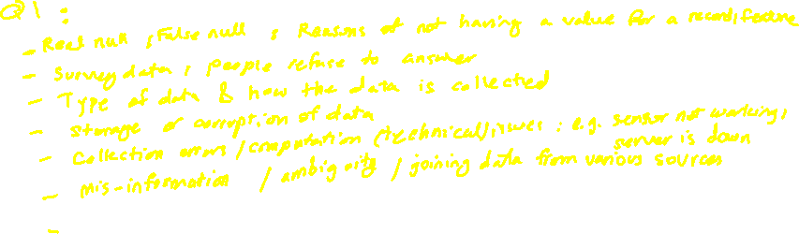
Discussion
1) Discuss some reasons for having null values in the data.
2) Why should we care about the null values, at all?!
Notes:
2)
Increasing the performance of the classifier
More precise results
Reliability of the analysis

Slide 16
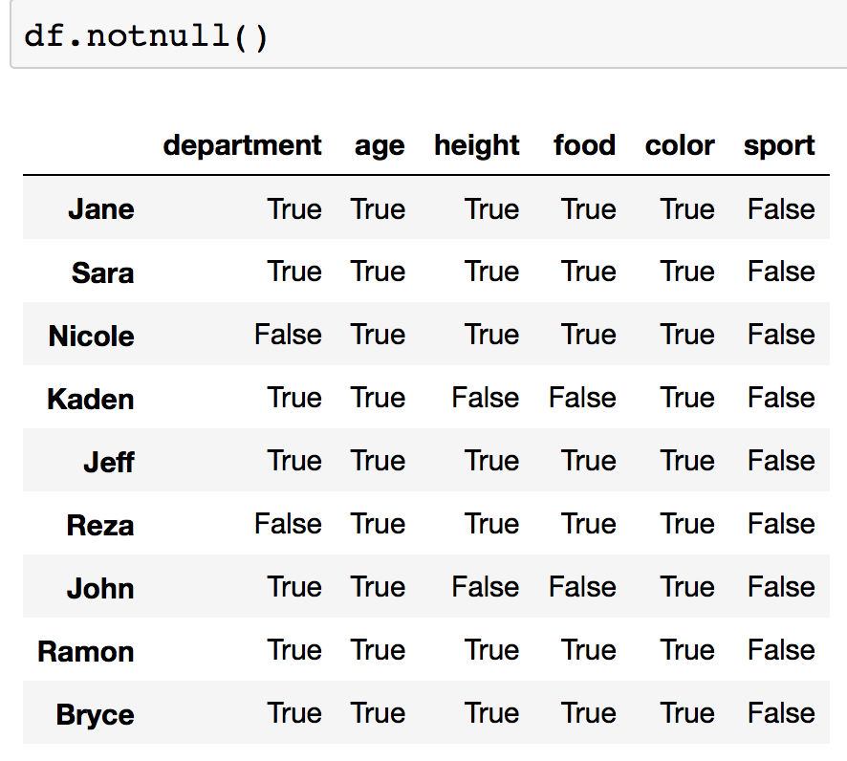
Data Profiling cont.
7- Examine null values
df.isnull()
df.notnull()
df.column_name.isnull()

Slide 17
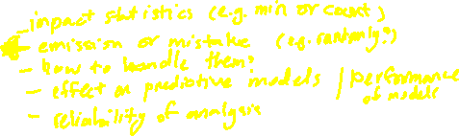
Data Profiling cont.
7- Examine null values
df.isnull()
df.notnull()
df.column_name.isnull()

Slide 18
Null values or missing values
Data can be missed because of:
No existing value for an observation
Child name for families with no children
Errors
Manual mistakes
Etc.

Slide 19
Missing values cont.
Missing Completely At Random (MCAR)
No systematic way that makes some data missing
Example: In a survey, some data are lost or ignored to be filled
Missing At Random (MAR)
There is a relationship between the observed data and the missing values
Example: men are more likely to reveal their weight, in a survey, specific professions are not willing to reveal their income
Missing Not At Random (MNAR)
There is a systematic mechanism of missing data
“propensity of a value to be missing and its values” or missing reason depends on the missing value itself
Example: In a survey, people with less than $500/month do not reveal their income, education filed is missing with the lowest educated ..
MNAR is Non-Ignorable
chi-square test, classification
https://www.theanalysisfactor.com/missing-data-mechanism/
Notes:
Review on the methods for handling missing values in datasets:
https://www.annualreviews.org/doi/pdf/10.1146/annurev.psych.58.110405.085530
Missing Completely at Random, MCAR, means there is no relationship between the missingness of the data and any values, observed or missing. Those missing data points are a random subset of the data. There is nothing systematic going on that makes some data more likely to be missing than others.
Missing at Random, MAR, means there is a systematic relationship between the propensity of missing values and the observed data, but not the missing data.
Whether an observation is missing has nothing to do with the missing values, but it does have to do with the values of an individual’s observed variables. So, for example, if men are more likely to tell you their weight than women, weight is MAR.
Missing Not at Random, MNAR, means there is a relationship between the propensity of a value to be missing and its values. This is a case where the people with the lowest education are missing on education or the sickest people are most likely to drop out of the study.
MNAR is called “non-ignorable” because the missing data mechanism itself has to be modeled as you deal with the missing data. You have to include some model for why the data are missing and what the likely values are.
“Missing Completely at Random” and “Missing at Random” are both considered ‘ignorable’ because we don’t have to include any information about the missing data itself when we deal with the missing data.

Slide 20
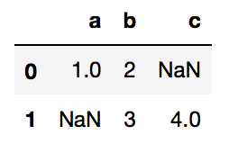
Missing values in Pandas
NAN(Not A Number) or Null
In Numpy: np.nan
pd.DataFrame([{'a': 1, 'b': 2},
{'b': 3, 'c': 4}])

Slide 21
Exploring the missing value patterns with visualizations
Visualization helps have an understanding of most missing values
Heatmaps help in understanding the correlation between variables (columns)
Notes:
https://dev.to/tomoyukiaota/visualizing-the-patterns-of-missing-value-occurrence-with-python-46dj

Slide 22
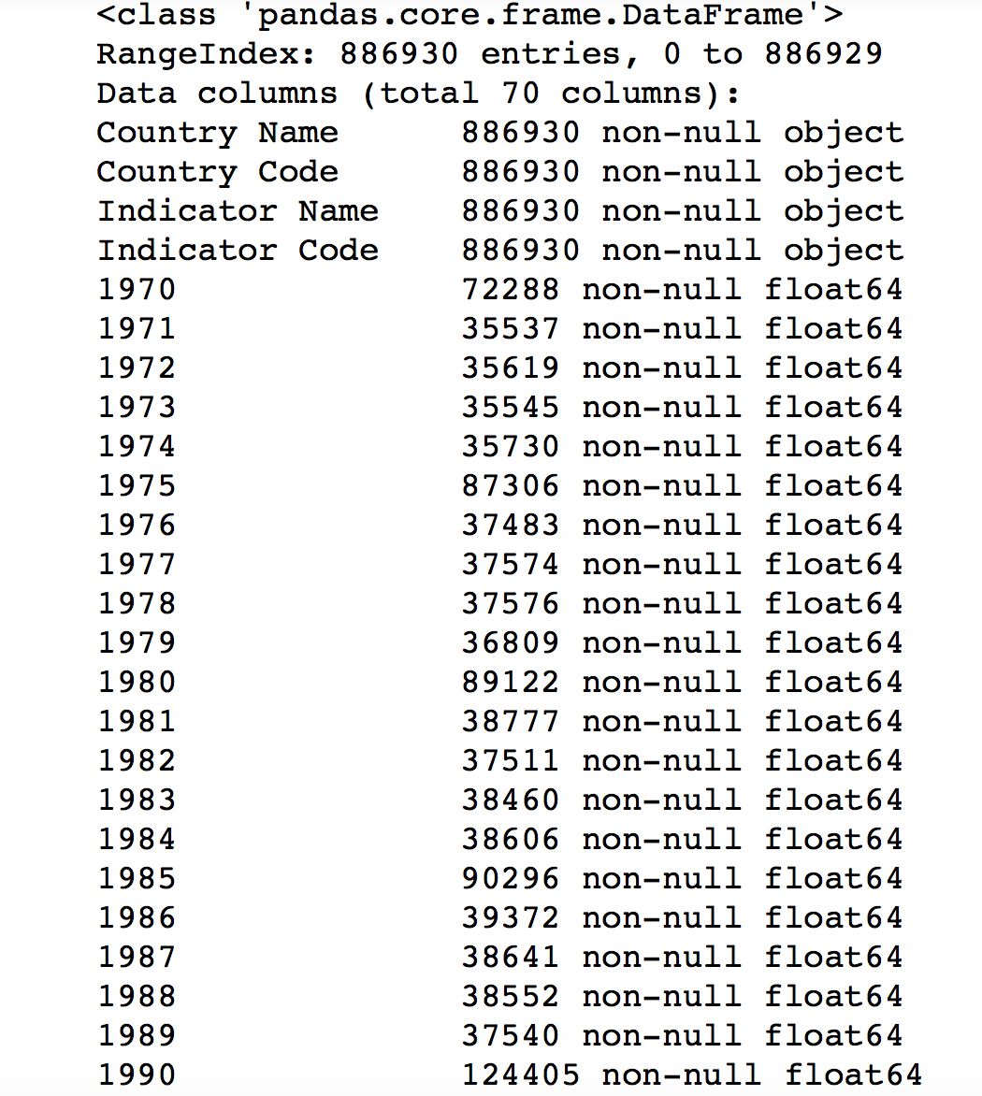
Useful in big datasets

Slide 23
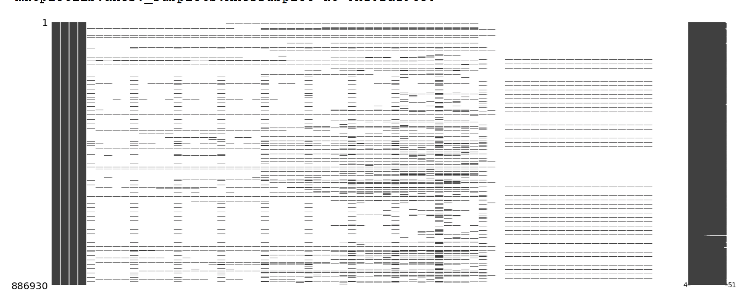
Check sparsity of data in matrix
msno.matrix(df)

Slide 24
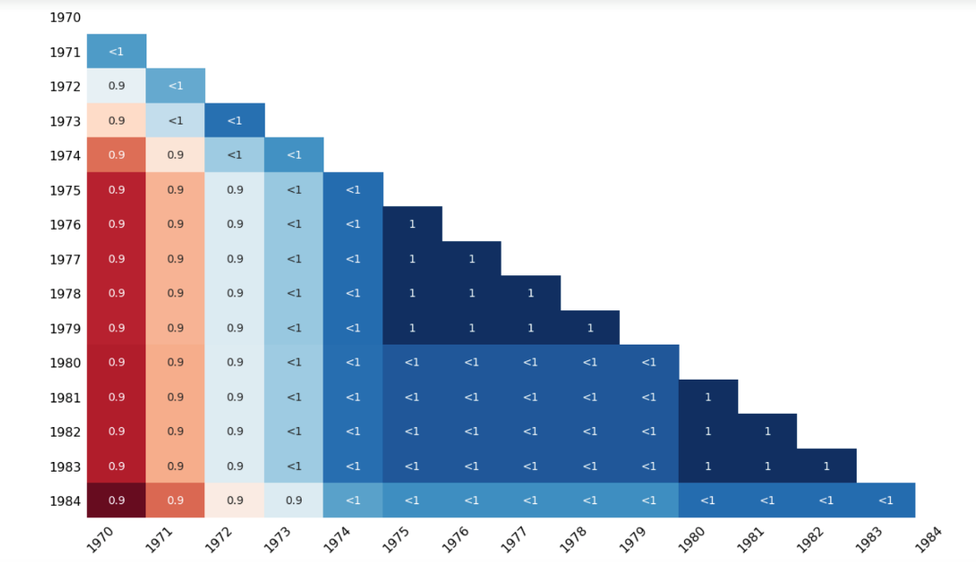
Heatmaps
“The missingno correlation heatmap measures nullity correlation: how strongly the presence or absence of one variable affects the presence of another”
https://github.com/ResidentMario/missingno
msno.heatmap(df)

Slide 25
Handling Missing Values

Slide 26
Handling missing values
Talk to the data collection source
1- Drop the missing value
Drop the whole variable (column)
Drop the data entry (suitable for less observations)
2- Replace missing values
Average value of the entire variable
Average value of the same group of data
Most frequency in categorical data (e.g. color)
Replace with the mode of the column in categorical data
Use expert domain knowledge
3- Predict missing values with machine learning algorithms
4- Leave it as it is
Notes:
https://towardsdatascience.com/the-tale-of-missing-values-in-python-c96beb0e8a9d
https://machinelearningmastery.com/handle-missing-data-python/
https://www.kaggle.com/dansbecker/handling-missing-values

Slide 27
Handling missing values in Pandas
isnull() # A boolean mask indicating missing values
notnull() # Opposite of isnull()
dropna() # Return a filtered version of the data
fillna() # Return a copy of the data with missing values filled or imputed

Slide 28
1- Drop missing values
Drop the values using dropna() to drop a row or a column containing NAN
data.dropna(column_list, axis, inplace)
data.dropna(axis = 0) #Drop entire row
data.dropna(axis = 1) #Drop entire column

Slide 29
2- Replace missing values using fillna()
Replace the missing values using
fillna(new_value)
fillna(method, axis)
Fills the NAN with the new_value
Fills the NAN with a forward_filling or backward_filling, along the specified axis
fillna() returns a copy of the array with the null values replaced.
Use isnull() as a mask to work with the array inplace.

Slide 30
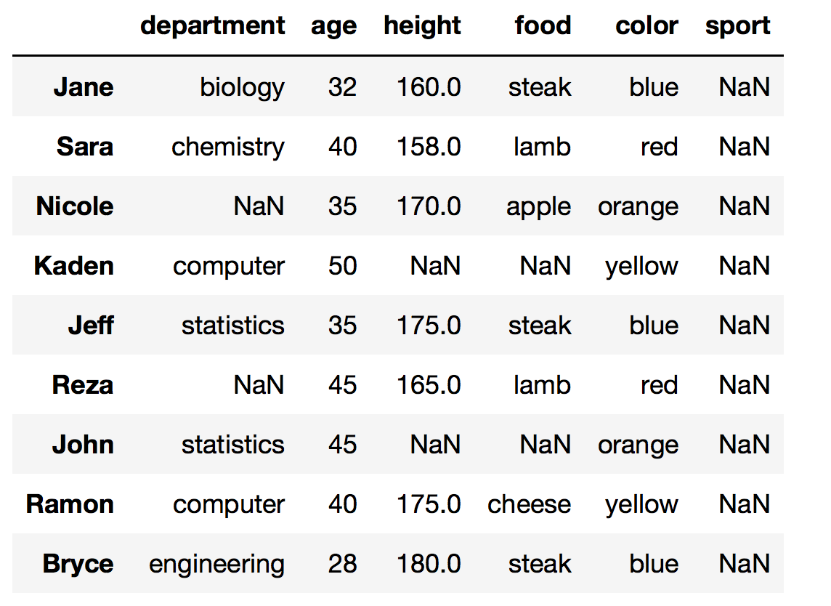
2- Replace missing values using fillna() cont.
Fill_forward, carries the previous value forward to fill the NAN
Fill_backward, carries the next value backward to fill the NAN
Fill Forward
Fill Backward

Slide 31
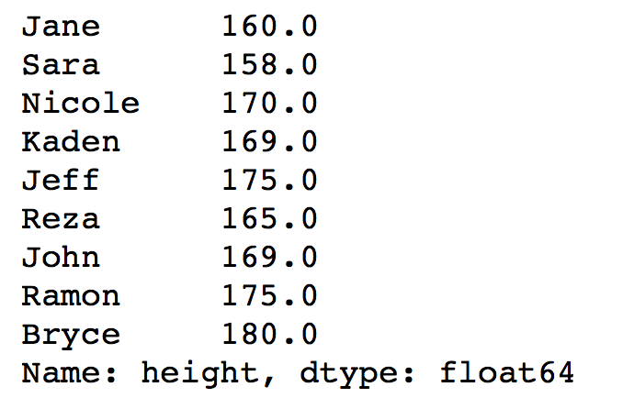
2- Replace missing values using replace()
Replace the missing values using
replace(missing_value, new_value)
mean = data.height.mean()
#alternation: data[‘height’].mean()
data[‘height’].replace(np.nan, mean)
Remember: The actual DataFrame does not change, until you assign the new column to it

Slide 32
2- Replace missing values cont.
Replace with Mean, Median, or Mode
More accurate values for replacement:
Average of the group (e.g. Male and Female, ethnicity, department, etc.)
Disadvantages:
Imputation with Mean reduces the variance in the data
Notes:
KNN
You fill in the cells with values of records that are most similar to the one that has missing values. You can use KNN or K-Nearest Neighbors in cases such as these.

Slide 33
3- Predict missing values with machine learning algorithms
Estimate missing values with:
Regression
ANOVA
Logistic regression
Notes:
https://www.datacamp.com/community/tutorials/exploratory-data-analysis-python

Slide 34
Rewrite SQL queries in Pandas
https://medium.com/jbennetcodes/how-to-rewrite-your-sql-queries-in-pandas-and-more-149d341fc53e

Slide 35
Try it
Download the dataset
https://www.kaggle.com/dansbecker/handling-missing-values
Explore the dataset (data profiling)
Explore the missing values
Visualize missing values
Use heatmaps and interpret the results, whether there is a correlation between various missing data features

Slide 36
Try it - Learn more
Try working with the experience from Kaggle:
https://www.kaggle.com/dansbecker/handling-missing-values/notebook

Slide 37
In Practice

Slide 38
Example data

Slide 39
Data Profiling
Reviewing your data source, content, and identifying key quality assessments (e.g. outliers, null values)
1- Read your data
pd.read_csv() #Use header=None to include first row in the data
pd.read_sql()
pd.read_excel()

Slide 40
Data Profiling cont.
2- Take a look
df.head(integer)
df.tail(integer)
Optional number, indicating how number of rows

Slide 41
Data Profiling cont.
3- Gain some information about values
Null values
Data types
Number of entries
df.info()

Slide 42
Data Profiling cont.
4- Explore your data using functions
Explore each column
df.age.sum() #count(), add(), agg
df.department.size()
Or explore the dataset
df.sample()
Each of the functions can be applied on a column or the dataset

Slide 43
Data Profiling cont.
5- Examine statistics of your data
df.describe()

Slide 44
Data Profiling cont.
6- Run some query
df.query()
Note: df.query(‘age < 40’) is equivalent to
df[df.age < 40]

Slide 45
Data Profiling cont.
7- Examine null values
df.isnull()
df.notnull()
df.column_name.isnull()

Slide 46
Null values or missing values
Data can be missed because of:
No existing value for an observation
Child name for families with no children
Errors
Manual mistakes
Etc.

Slide 47
Missing values cont.
Missing Completely At Random (MCAR)
No systematic way that makes some data missing
Example: In a survey, some data are lost or ignored to be filled
Missing At Random (MAR)
There is a relationship between the observed data and the missing values
Example: men are more likely to reveal their weight, in a survey, specific professions are not willing to reveal their income
Missing Not At Random (MNAR)
There is a systematic mechanism of missing data
“propensity of a value to be missing and its values” or missing reason depends on the missing value itself
Example: In a survey, people with less than $500/month do not reveal their income, education filed is missing with the lowest educated ..
MNAR is Non-Ignorable
chi-square test, classification
https://www.theanalysisfactor.com/missing-data-mechanism/
Notes:
Review on the methods for handling missing values in datasets:
https://www.annualreviews.org/doi/pdf/10.1146/annurev.psych.58.110405.085530
Missing Completely at Random, MCAR, means there is no relationship between the missingness of the data and any values, observed or missing. Those missing data points are a random subset of the data. There is nothing systematic going on that makes some data more likely to be missing than others.
Missing at Random, MAR, means there is a systematic relationship between the propensity of missing values and the observed data, but not the missing data.
Whether an observation is missing has nothing to do with the missing values, but it does have to do with the values of an individual’s observed variables. So, for example, if men are more likely to tell you their weight than women, weight is MAR.
Missing Not at Random, MNAR, means there is a relationship between the propensity of a value to be missing and its values. This is a case where the people with the lowest education are missing on education or the sickest people are most likely to drop out of the study.
MNAR is called “non-ignorable” because the missing data mechanism itself has to be modeled as you deal with the missing data. You have to include some model for why the data are missing and what the likely values are.
“Missing Completely at Random” and “Missing at Random” are both considered ‘ignorable’ because we don’t have to include any information about the missing data itself when we deal with the missing data.

Slide 48
Missing values in Pandas
NAN(Not A Number) or Null
In Numpy: np.nan
pd.DataFrame([{'a': 1, 'b': 2},
{'b': 3, 'c': 4}])

Slide 49
Exploring the missing value patterns with visualizations
Visualization helps have an understanding of most missing values
Heatmaps help in understanding the correlation between variables (columns)
Notes:
https://dev.to/tomoyukiaota/visualizing-the-patterns-of-missing-value-occurrence-with-python-46dj

Slide 50
Visualization packages in Python
seaborn
pip install seaborn
missingno
pip install missingno
https://seaborn.pydata.org
https://github.com/ResidentMario/missingno
import missingno as msno

Slide 51
Useful in big datasets

Slide 52
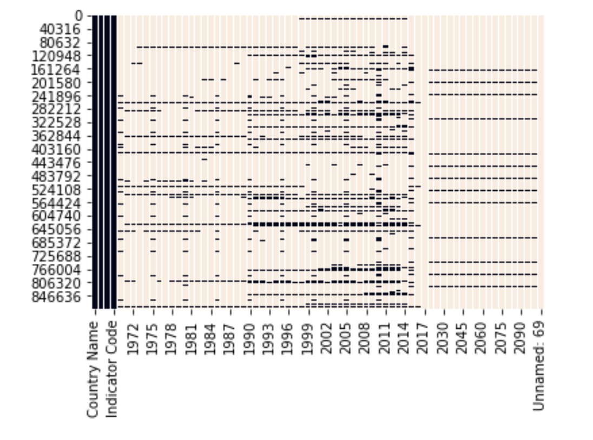
Check sparsity with matrix

Slide 53
Check sparsity of data in matrix
msno.matrix(df)

Slide 54
Heatmaps
“The missingno correlation heatmap measures nullity correlation: how strongly the presence or absence of one variable affects the presence of another”
https://github.com/ResidentMario/missingno
msno.heatmap(df)

Slide 55
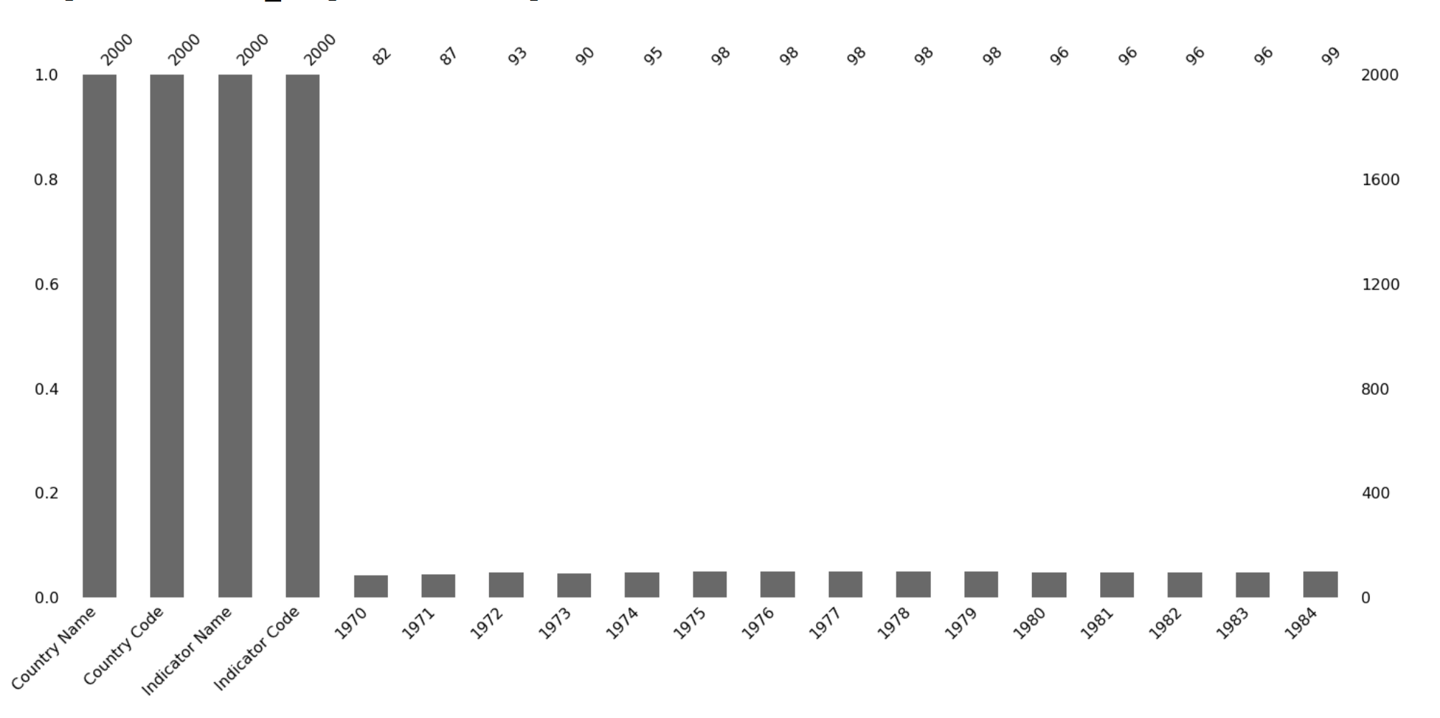
Barcharts

Slide 56
Other types of charts
Dendrogram
Geoplots

Slide 57
Usage of visualization functions in Python
import pandas as pd
import matplotlib.pyplot as plt
import seaborn as sns
import missingno as msno
msno.matrix(df)
msno.heatmap(df)
msno.bar(df)
sns.heatmap(df.isnull(), cbar=False)

Slide 58
Handling missing values
Talk to the data collection source
1- Drop the missing value
Drop the whole variable (column)
Drop the data entry (suitable for less observations)
2- Replace missing values
Average value of the entire variable
Average value of the same group of data
Most frequency in categorical data (e.g. color)
Replace with the mode of the column in categorical data
Use expert domain knowledge
3- Predict missing values with machine learning algorithms
4- Leave it as it is
Notes:
https://towardsdatascience.com/the-tale-of-missing-values-in-python-c96beb0e8a9d
https://machinelearningmastery.com/handle-missing-data-python/
https://www.kaggle.com/dansbecker/handling-missing-values

Slide 59
Handling missing values in Pandas
isnull() # A boolean mask indicating missing values
notnull() # Opposite of isnull()
dropna() # Return a filtered version of the data
fillna() # Return a copy of the data with missing values filled or imputed

Slide 60
1- Drop missing values
Drop the values using dropna() to drop a row or a column containing NAN
data.dropna(column_list, axis, inplace)
data.dropna(axis = 0) #Drop entire row
data.dropna(axis = 1) #Drop entire column

Slide 61
1- Drop missing values with dropna
data.dropna(axis = 0)
data.dropna(axis = ‘columns’)
data.dropna(subset=[‘height’], axis = 0)
Drops all rows that have a missing value
Drops all columns that have a missing value

Slide 62
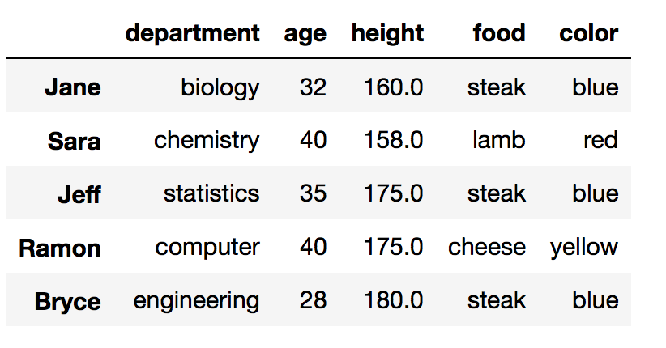
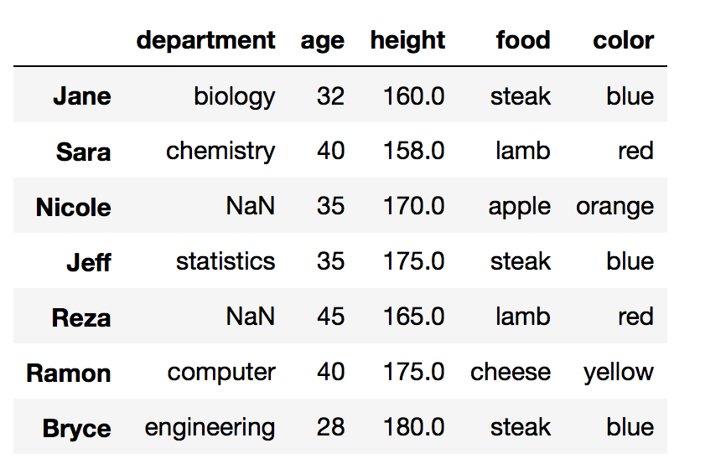
1- Drop missing values with dropna cont.
data.dropna(axis = 0)
data.dropna(subset=[‘height’], axis = 0)

Slide 63
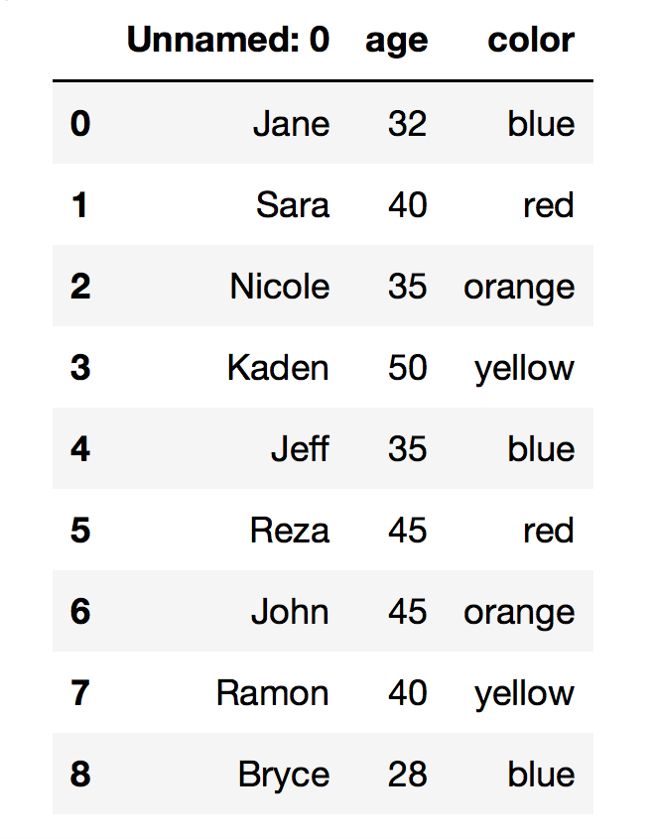
1- Drop missing values with dropna cont.
data.dropna(axis = ‘columns’)

Slide 64
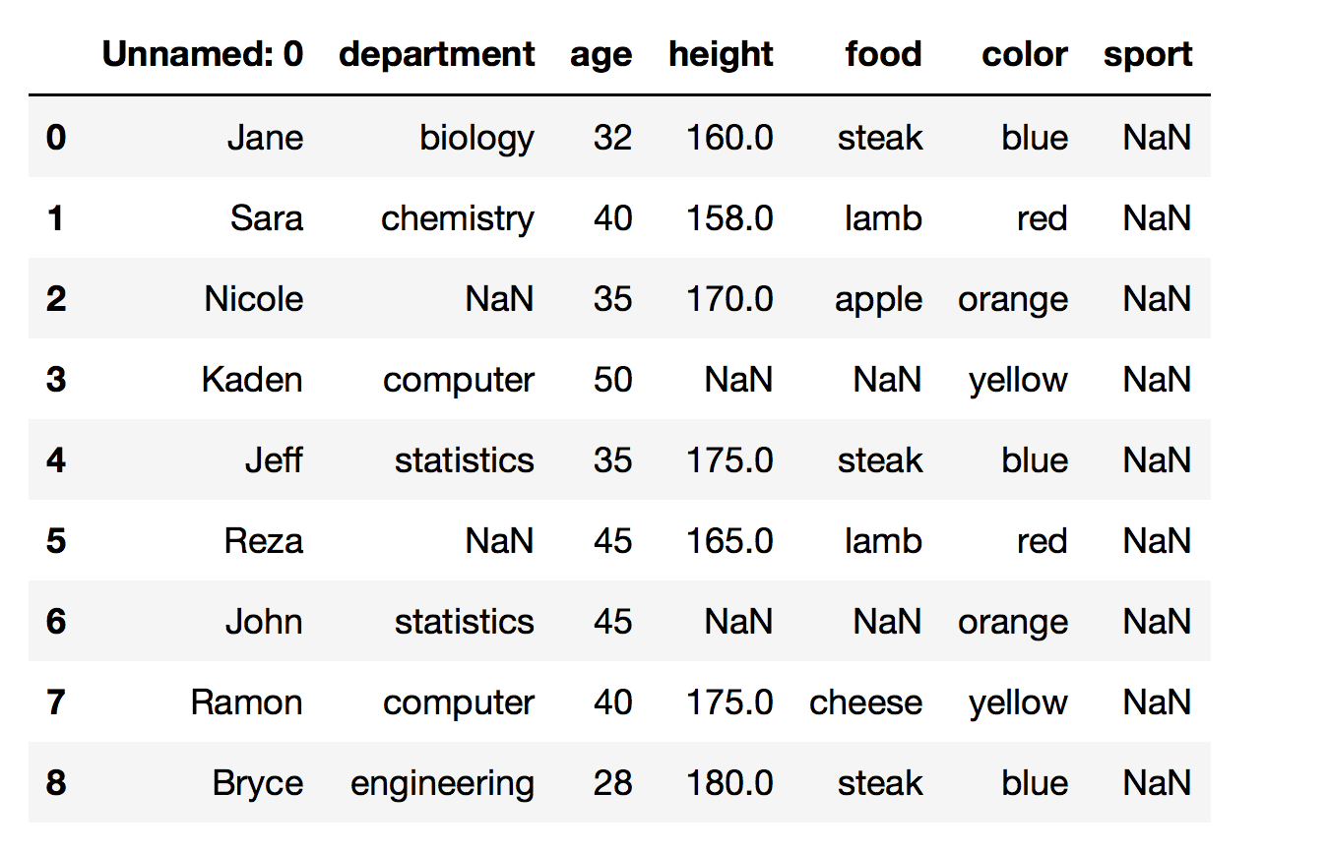
1- Drop missing values with dropna
Control the amount of drops by thresh and how
Default is: how = ‘any’
Alternate: how = ‘all’
Drops specified axis containing a null value
Drops specified axis that are ALL null values
Discuss the results
data.dropna(axis=1, how =‘all’)

Slide 65
1- Drop missing values with dropna
Control the amount of drops by thresh and how
thresh = integer
Requires that many non-NAN values
Discuss other alternations
data.dropna(axis=0, thresh = 4)

Slide 66
Important note
data.dropna(axis = 0)
data.dropna(subset=[‘height’], axis = 0)
data.dropna(subset=[‘height’], axis = 0, inplace = True)
Or
data = data.dropna(subset=[‘height’], axis = 0)
None of the above modifies the actual DataFrame.

Slide 67
2- Replace missing values using fillna()
Replace the missing values using
fillna(new_value)
fillna(method, axis)
Fills the NAN with the new_value
Fills the NAN with a forward_filling or backward_filling, along the specified axis
fillna() returns a copy of the array with the null values replaced.
Use isnull() as a mask to work with the array inplace.

Slide 68
2- Replace missing values using fillna() cont.
Fill_forward, carries the previous value forward to fill the NAN
Fill_backward, carries the next value backward to fill the NAN
Fill Forward
Fill Backward

Slide 69
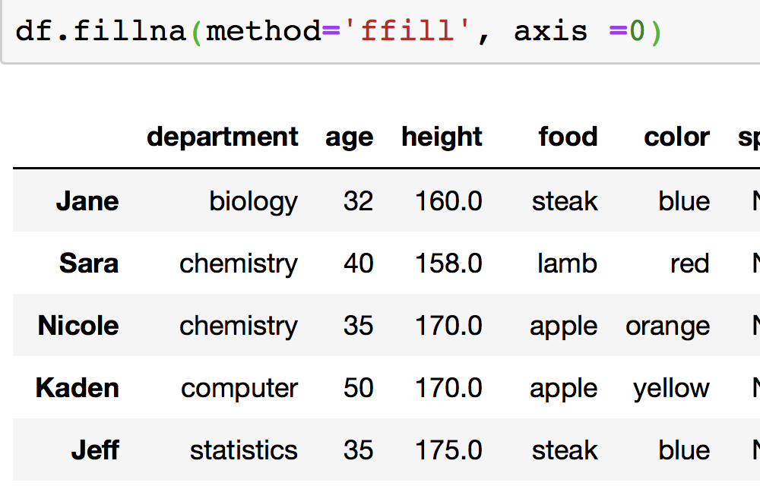
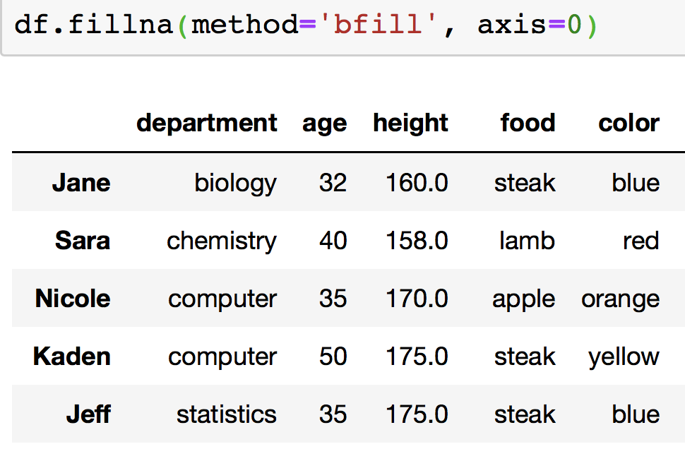
2- Replace missing values using fillna() cont.
Fill_forward, carries the previous value forward to fill the NAN
Fill_backward, carries the next value backward to fill the NAN

Slide 70
2- Replace missing values using replace()
Replace the missing values using
replace(missing_value, new_value)
mean = data.height.mean()
#alternation: data[‘height’].mean()
data[‘height’].replace(np.nan, mean)
Remember: The actual DataFrame does not change, until you assign the new column to it

Slide 71
Question
Question 1: Which of the following applies the modifications to the DataFrame data
mean = data.height.mean()
A) data[‘height’] = data[‘height’].replace(np.nan, mean)
B) data.height = data.height.replace(np.nan, mean)
C) A and B
D) None
Notes:
Answer: C
71

Slide 72
2- Replace missing values cont.
Replace with Mean, Median, or Mode
More accurate values for replacement:
Average of the group (e.g. Male and Female, ethnicity, department, etc.)
Disadvantages:
Imputation with Mean reduces the variance in the data
Discuss other alternations
Notes:
KNN
You fill in the cells with values of records that are most similar to the one that has missing values. You can use KNN or K-Nearest Neighbors in cases such as these.

Slide 73
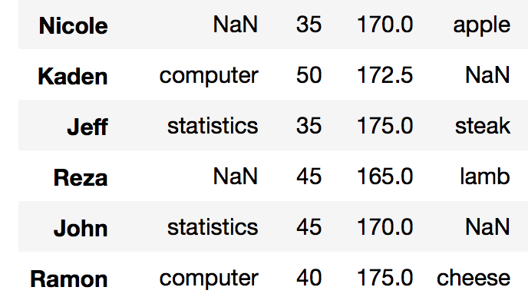
2- Replace missing values cont.
Interpolate the numerical values with Pandas Interpolate
Install SciPy
data.interpolate()
Arguments:
method: polynomial, cubic, etc.
limit: will determine how many values after a non-NaN value will be filled out
limit_direction: fill forward or backward. Default is forward
More information at: https://pandas-docs.github.io/pandas-docs-travis/missing_data.html

Slide 74
2- Replace missing values cont.
Imputation package from Scikit Learn
from sklearn.preprocessing import Imputer values = mydata.values imputer = Imputer(missing_values=’NaN’, strategy=’mean’) transformed_values = imputer.fit_transform(values)
# strategy can be changed to "median" and “most_frequent”

Slide 75
2- Replace missing values cont.
Imputation package from Scikit Learn
from sklearn.impute import SimpleImputer
my_imputer = SimpleImputer()
data_with_imputed_values = my_imputer.fit_transform(original_data)
Default value is Mean

Slide 76
3- Predict missing values with machine learning algorithms
Estimate missing values with:
Regression
ANOVA
Logistic regression
Notes:
https://www.datacamp.com/community/tutorials/exploratory-data-analysis-python

Slide 77
Rewrite SQL queries in Pandas
https://medium.com/jbennetcodes/how-to-rewrite-your-sql-queries-in-pandas-and-more-149d341fc53e

Slide 78
Try it
Download the flight_dalay_2017 dataset
https://www.kaggle.com/dansbecker/handling-missing-values
Explore the dataset (data profiling)
Explore the missing values
Visualize missing values
Use heatmaps and interpret the results, whether there is a correlation between various missing data features

Slide 79
Try it - Learn more
Try working with the experience from Kaggle:
https://www.kaggle.com/dansbecker/handling-missing-values/notebook

