Slide 1
Libraries, Documentation, and Help
Debugging
UBCO Master of Data Science – DATA 530

Slide 2
Objectives
Understand different resources and techniques for getting help in R and Python.
Read and apply standard documentation for R and Python.
Understand the importance of using libraries to improve code development efficiency and reliability.
Practice finding a library, reading its documentation, and applying its methods to solve a problem.
Define: debugging
List and explain the 4 key steps of debugging.
List and identify three types of program errors: syntax errors, logic errors, and exceptions.
Be able to debug Python and R code.

Slide 3
Getting Help
Getting help is important as remembering all details about a language and its packages is difficult.
The first source for help is the language's official documentation.
Python: https://docs.python.org/3/
R: https://cran.r-project.org/manuals.html
This documentation is often easily available in a development environment.
Online help is available on sites like Stack Overflow.

Slide 4
Python Documentation
The Python documentation provides reference material on the language and modules.
Make sure to be using Python 3 documentation.
To access information about a function use:
Jupyter Notebook shortcut: Shift+Tab
help(func)
Notes:
May also use ? Or ?? in a Python prompt.
len? – will show docstring
len?? – will show source code

Slide 5
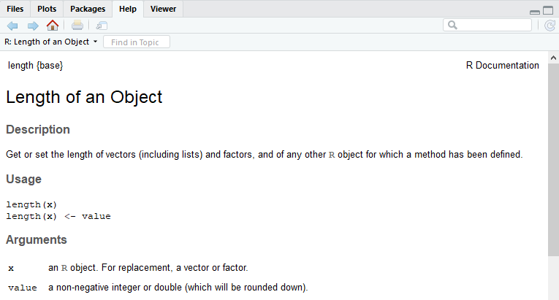
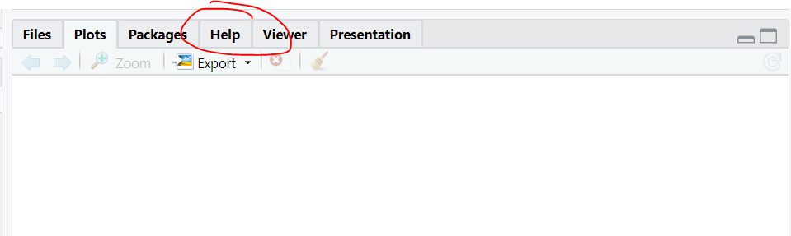
R Documentation
The R documentation is available in RStudio.
To access information about a function use:
help(func)
Or click on help tab

Slide 6
Python Libraries
Libraries are called modules in Python.
A module is Python code stored in a file (with .py) and loaded when imported.
Modules are imported using the import command:
A Python package is a collection of modules. Packages may have subpackages. Modules in a package are referenced by package.module.
Import module from package:
import modulename
import package.subpackage.modulename
Notes:
//: import imports the whole library. from import imports a specific member or members of the library.

Slide 7
Python Import Syntax Examples
Import module X:
Import module X in subpackage Y of package Z:
Import module X and rename as N:
Import function names F1, F2 from module Z.Y.X:
import X
import Z.Y.X
import X as N
from Z.Y.X import F1, F2
Notes:
//: import imports the whole library. from import imports a specific member or members of the library.
Import module X:
import X
Import module X in subpackage Y of package Z:
import Z.Y.X
Import module X and rename as N:
import X as N
Import function names F1, F2 from module Z.Y.X:
from Z.Y.X import F1, F2
Libraries are called modules in Python.
A module is Python code stored in a file (with .py) and loaded when imported.
Modules are imported using the import command: import modulename
A Python package is a collection of modules. Packages may have subpackages. Modules in a package are referenced by package.module.
Import module from package: import package.subpackage.modulename

Slide 8
Python Package Clicker Question
Question: Package random has a function called random. Given the following import, how would you call this function.
A) random.random()
B) random.rand()
C) rand.random()
D) rand()
E) rand.random()
from random import random as rand
Notes:
Answer: D
////: import imports the whole library. from import imports a specific member or members of the library.
Import module X:
import X
Import module X in subpackage Y of package Z:
import Z.Y.X
Import module X and rename as N:
import X as N
Import function names F1, F2 from module Z.Y.X:
from Z.Y.X import F1, F2
Libraries are called modules in Python.
A module is Python code stored in a file (with .py) and loaded when imported.
Modules are imported using the import command: import modulename
A Python package is a collection of modules. Packages may have subpackages. Modules in a package are referenced by package.module.
Import module from package: import package.subpackage.modulename
8

Slide 9
Python Import Package Clicker Question
Question: Package random has a function called random. The following code successfully calls the function, what was the import?
A) import random
B) from random import rand
C) from random import random as rand
D) import rand
E) import random as rand
rand.random()
Notes:
Answer: E
////: import imports the whole library. from import imports a specific member or members of the library.
Import module X:
import X
Import module X in subpackage Y of package Z:
import Z.Y.X
Import module X and rename as N:
import X as N
Import function names F1, F2 from module Z.Y.X:
from Z.Y.X import F1, F2
Libraries are called modules in Python.
A module is Python code stored in a file (with .py) and loaded when imported.
Modules are imported using the import command: import modulename
A Python package is a collection of modules. Packages may have subpackages. Modules in a package are referenced by package.module.
Import module from package: import package.subpackage.modulename
9

Slide 10
R Libraries
Libraries are called packages in R. There are thousands of packages.
https://cran.r-project.org/web/packages/available_packages_by_name.html
Two steps:
1) Install library into your environment using install.packages().
2) Add library into current R session using the library() command.
Example:
install.packages("ggplot2")
library(ggplot2)
Notes:
Libraries are called modules in Python.
A module is Python code stored in a file (with .py) and loaded when imported.
Modules are imported using the import command:
A Python package is a collection of modules. Packages may have subpackages. Modules in a package are referenced by package.module.
Import module from package:
=================
Import module X:
import X
Import module X in subpackage Y of package Z:
import Z.Y.X
Import module X and rename as N:
import X as N
Import function names F1, F2 from module Z.Y.X:
from Z.Y.X import F1, F2

Slide 11
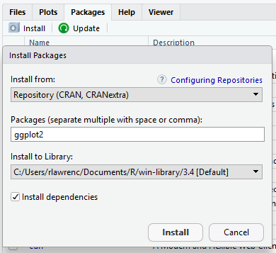
Adding Packages with RStudio
In RStudio, packages can be added by selecting Packages tab in Help section of editor and clicking on Install. Search by package name.

Slide 12
R Package Clicker Question
Question: How many of the following are TRUE?
1) An installed package is always available in a R session.
2) The library() command is used to install a package.
3) The install.packages() command makes a package available in the current R session.
4) There is no error if you use library() on the same package more than once in the current R session.
5) install.packages() handles package dependencies.
A) 1 B) 2 C) 3 D) 4 E) 5
Notes:
Answer: B) 2 #4, #5 are true
1) Install library into your environment using install.packages().
2) Add library into current R session using the library() command.
12

Slide 13
Try it: Libraries in R and Python
In either R or Python (or both):
Find a library for reading XML data.
Read the persondata.xml file using the library.
Output the number of people in the data set.
Output the average (mean) person height.
Output the max person weight.
Notes:
Note: Generated data at www.generatedata.com

Slide 14
Debugging

Slide 15
Debugging: What's the Problem?
Debugging is the process of determining why a system does not work properly.
We perform debugging all the time in daily life, usually to fix problems with other systems and tools we interact with (cars, lights, appliances, electronics, our own bodies, etc.).
Debugging is different with computers and information technology because usually it is not a component failure that is the source of the problem. More commonly, it is our interaction and limited understanding of how the computer works.
Notes:
the process of identifying and removing errors from computer hardware or software.
Debugging is the process of detecting and removing of existing and potential errors (also called as 'bugs') in a software code that can cause it to behave unexpectedly or crash.

Slide 16
Whose Problem Is It?
When we debug an information system, we are always part of the problem!
We give the commands and the input, so the only other possible cause is a broken system.
People do not knowingly make errors, but we frequently do if we do not understand how to use a system properly.
We must be precise and know what the computer expects. Computers are dumb… so we must be precise.
Debugging is challenging as a computer user because:
the computer cannot debug itself
we cannot debug it directly either because the error is internal to the computer
Debugging involves working with the computer to try and understand what is happening and why.

Slide 17
Entering Data into Forms
One way data is entered into a computer is using a form.
A programmer can restrict the types and number of symbols that can go into a form field.
e.g. only allow numbers in a phone number field
Many errors occur when users either enter data that does not follow these restrictions, or they enter incorrect data that is accepted by the computer because it is not properly checked.

Slide 18
Debugging: Solving a Mystery
Debugging is very similar to solving a mystery.
To discover and solve the problem we ask questions like:
Do I need more clues?
Are my clues reliable?
What is a theory to explain the problem?
How can I test if my theory is correct?
Like solving mysteries, the way to get good at debugging is practice and gaining experience about common problems and solutions.

Slide 19
The Four Key Steps in Debugging
1) Check that the error is reproducible.
Computers are deterministic. Make sure you know exactly how to reproduce the error.
2) Do not jump to conclusions.
The actual cause of the error may be many steps removed from the visible symptoms.
3) Check all the "obvious" sources of error.
You would be surprised how often a cable is not plugged in…
4) Isolate the problem
The goal is to make good assumptions and divisions of parts that you know are working and others that need investigation.
Be careful! It is often parts (including yourself) that you assume are working that really are not.
Make sure assumptions are backed up by tests.
Notes:
1. Check that the error is reproducible.
If not, there is no error. For example, typing google.ca and website can’t be found. Try yourself to see it actuall can’tbe found.
Maybe a debugging example here. Sit down at home with laptop. Open up browser. Try to get to google.ca but browser says the website cannot be found. Have students ask questions to see if they can track down the error.
Error I have in mind: The power is out at home (causes Internet router and cable modem) not to work.

Slide 20
Types of Python Errors
Syntax errors - are identified when the code is run and will cause an error due to incorrect commands
Logic errors - occur when code has correct syntax but does not function as expected
Exceptions - occur when a run-time event causing an error is not handled by the code (try-except)
Notes:
Syntax errors are similar to grammar or spelling errors in a Language. If there is such an error in your code, Python cannot start to execute your code. You get a clear error message stating what is wrong and what needs to be fixed. Therefore, it is the easiest error type you can fix.
For example print 20+20 in Python 3 won’t run
Missing symbols (such as comma, bracket, colon), misspelling a keyword, having incorrect indentation are common syntax errors in Python.
Logical errors are the most difficult errors to fix as they don’t crash your code and you don’t get any error message.
Logic error, Logic errors might not crash your program but will cause it to do the wrong thing. For example using if statement wrong in Excel. For example adding two numbers instead of subtracting.
If you have logical errors, your code does not run as you expected.
Using incorrect variable names, code that is not reflecting the algorithm logic properly, making mistakes on boolean operators will result in logical errors.
division by zero wrong placing of if statements
Exceptions: An exception is an event, which occurs during the execution of a program that disrupts the normal flow of the program's instructions.
In general, when a Python script encounters a situation that it cannot cope with, it raises an exception
Exceptions may occur in syntactically correct code blocks at run time. When Python cannot execute the requested action, it terminates the code and raises an error message.
Trying to read from a file which does not exist, performing operations with incompatible types of variables, dividing a number by zero are common exceptions that raise an error in Python.
We must eliminate the syntax errors to run our Python code, while exceptions can be handled at runtime.
Try/except; try == code to monitor, except ==code to handle the exception e.g. print message to someone to tell about division by zero
A runtime error in a program is an error that occurs while the program is running after being successfully compiled. Compiling is transformation from source code to machine code
Python is an interpreted language, which means the source code of a Python program is converted into bytecode that is then executed by the Python virtual machine
Python code is compiled to Bytecode is then interpreted or compiled to optimized machine code at runtime

Slide 21
Steps in Debugging Python Code
1) Reproduce errors – Run the program several times to understand where the error is occurring.
2) Do not jump to conclusions – The line of code where the error is detected is not necessarily where the error is located.
3) Obvious sources of errors – Fix syntax errors such as missing colons, improper indentation, etc. As you gain experience, more errors become obvious.
4) Isolate the problem – Use print statements and comment out code to isolate where the error occurs.

Slide 22
Python Debugging Question
Question: What type of error is this?
A) Exception B) Logic error C) Syntax error
Notes:
Answer: C
22

Slide 23
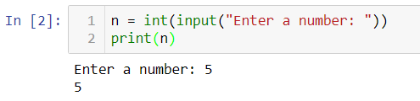
Python Debugging Question
Question: This code works many times but not always. Why?
A) Exception B) Logic error C) Syntax error
Notes:
Answer: A
If number entered is not a numbern = int
23

Slide 24
Aside: The Cost of Debugging
When developing a computer system or application, the process of testing and debugging is extremely costly.
Most software requires 40% of the total time, cost, and effort to debug and fix problems in the system.
Even so, many errors go unnoticed until the system is used.
To make software development more efficient and less costly, software engineering principles and techniques are followed.
Although building software is harder than building a bridge due to its complexity, software engineers continually strive to make software development better.

Slide 25
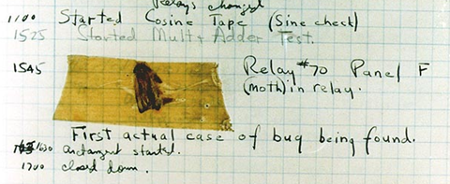
Aside: The First Bug
The first "bug" in a computer system was actually a moth found in the Harvard Mark II computer system in 1947 by Rear Admiral Grace Hopper.
Source: U.S. Naval Historical Center Online Library Photograph NH 96566-KN
Notes:
Bug was part of engineering jargon long before this incident. Thomas Edison referred to bugs in some of his letters as far back as 1878.
Rear Admiral Grace Murray Hopper was one of the first computer programmers. She created the term "bug" after a moth was found in a system relay (electro-mechanical switch) that caused the system to come down. She also was instrumental in the invention of compilers.
The First "Computer Bug" Moth found trapped between points at Relay # 70, Panel F, of the Mark II Aiken Relay Calculator while it was being tested at Harvard University, 9 September 1947. The operators affixed the moth to the computer log, with the entry: "First actual case of bug being found". They put out the word that they had "debugged" the machine, thus introducing the term "debugging a computer program". In 1988, the log, with the moth still taped by the entry, was in the Naval Surface Warfare Center Computer Museum at Dahlgren, Virginia, which erroneously dated it 9 September 1945. The Smithsonian Institute's National Museum of American History and other sources have the correct date of 9 September 1947 (Object ID: 1994.0191.01). The Harvard Mark II computer was not complete until the summer of 1947.
This image is part of the Wikimedia Commons.

Slide 26
Debugging Follows the Scientific Method
Determining what a program does and finding any errors follows the scientific method.
1) Model – create a hypothesis on what the program does
2) Predict - for inputs not yet tried / simulated
3) Experiment – run the program to check your prediction
4) Refine – modify your hypothesis based on experimental results and repeat.
Understanding software is in many ways similar to understanding how complex real-world processes work.

Slide 27
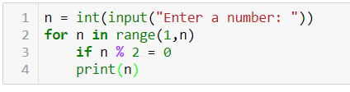
Try it: Debug Question
Fix all errors in this code intended to print only even numbers from 1 to N where N is the number entered by the user.
Notes:
try:
n = int(input("Enter a number: "))
for i in range(1,n+1):
if i % 2 == 0:
print(i)
except:
print("Invalid input")
Errors:
No try-except to handle exceptions on non-integer input
For loop should not use n as counter variable. Note: This actually works though!
Range to n+1 not n
Missing : at end of for loop
== not = for if - = is assignment operator for assigning value to a variable/// == is comparison operator for comparing 2 values. Returns 1 if both values are equal, 0 otherwise
Missing : at end of if statement
Did not indent print() correctly

Slide 28
Conclusion
Debugging is a systematic approach to discover and fix errors in a system.
Debugging a computer system requires working with the computer to diagnose the problem with the realization that we are often the cause of the problem.
The four key steps of debugging are:
1) Check that the error is reproducible.
2) Make sure you know what the problem is.
3) Check all the "obvious" sources of error.
4) Isolate the problem
Programming errors can be classified as syntax errors, logic errors, and exceptions.

