Slide 1
Competitivness of Classic Retail Stores
By: Dhun Sheth
Notes:
If you had the option to make a purchase online or in person how many would choose online?
As the availability of online sellers increases, competition for retail stores is not just limited to shops around them.
The goal is to help classic retail stores be more competitive.

Slide 2
Context
Notes:
This project focuses on a Retail chain selling phones and accessories
moving from North America to India

Slide 3
How to remain competitve?
1.
Optimize inventory purchasing
2.
Increase inventory turnover
Constraints:
$25,000 monthly store budget
Minimum purchase quantities
Notes:
How can the retail stores remain competitive against online sellers?
The goal of this project is to find a way to:
optimize inventory purchasing
Increase inventory turnover

Slide 4
How do we achieve this?
Analyze historical performance
Identify popular products for the store
Retail Shop Data
Analyze current market trends
Identify popular products for the market
Market Device Data

Slide 5
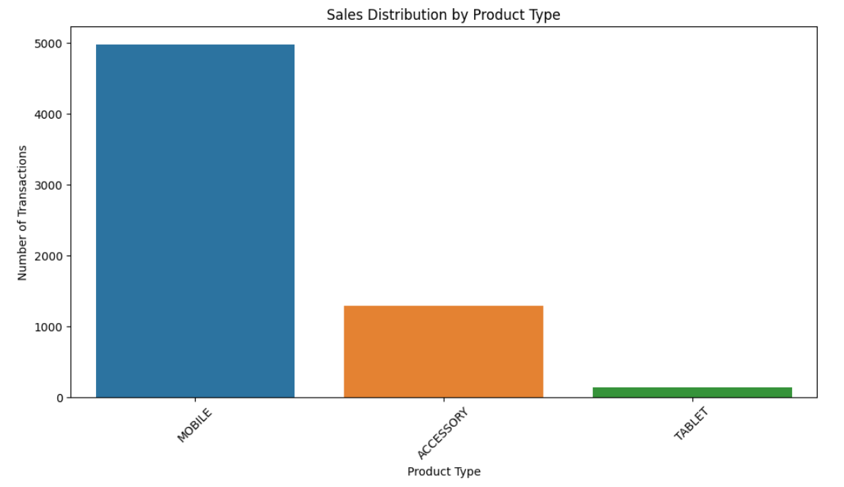
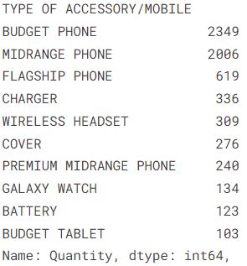
Historical Performance
2019 - 2022

Slide 6
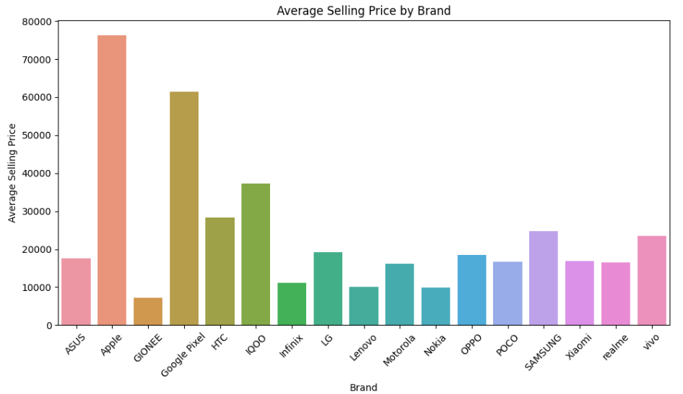
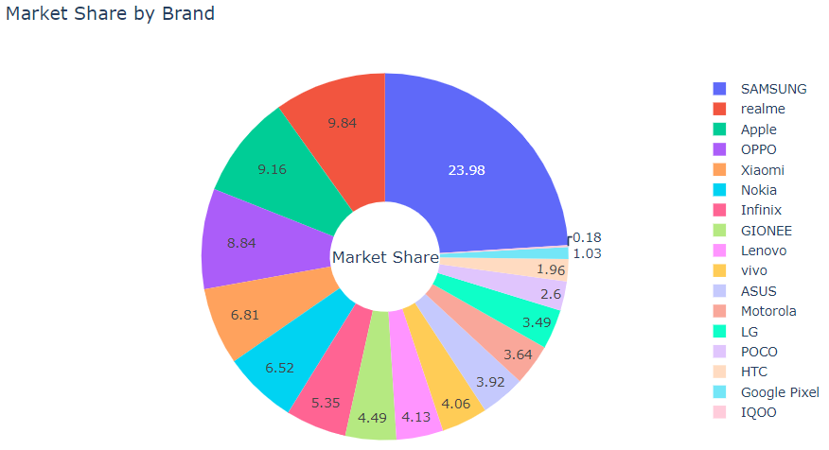
Current Market Trend
Notes:
Use average prices to segment brands into budget, midrange, flagship
Then use market share to order brands within categories.

Slide 7
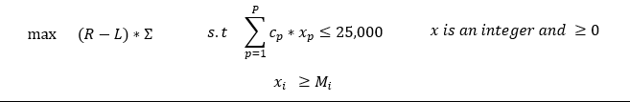
Optimization
Notes:
Previous results were used to come up with the sigma matrix of weights,
L punishes low turnover products
Solving the optimization would yield the optimal inventory quantities to order and of what.

Slide 8
Future Considerations
1.
Analyze local demographics and buying power
2.
Include more retail shop data
3.
Did not consider device launches and campaigns
Notes:
Future considerations

